Slide 1

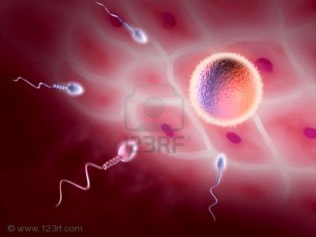

PHARMACOLOGY OF
CONTRACEPTION

Slide 2



CONTRACEPTION
PHARMACOLOGY
ILOs
By the end of this lecture you will be able to:
Perceive the different contraceptive utilities available
Classify them according to their site and mechanism of action
Justify the existing hormonal contraceptives present
Compare between the types of oral contraceptives pills with respect
to mechanism of action, formulations, indications, adverse effects,
contraindications and possible interactions
Hint on characteristics & efficacies of other hormonal modalities

Slide 3
IN CONCEPTION there is fusion of the sperm & ovum to produce a new organism.
?
IN CONTRACEPTION  we are preventing this fusion to occur
This achieved by interfering with
Normal process of ovulation
Prevents sperm from fertilizing the ovum
Implantation
IUD (copper T)
HORMONAL THERAPY
Killing the sperm
Interruption by a barrier
Oral Contraceptives
Contraceptive Patches
Injectable
Implants
Vaginal rings
IUD (with hormone)
Spermicidals
Jells
Foams
Ovules.....
Condoms
Cervical caps Diaphragms
Thin films

Slide 4
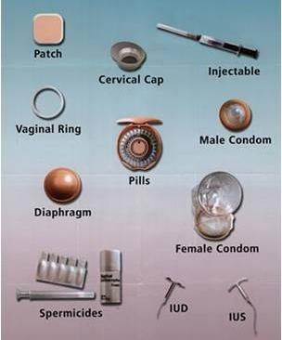
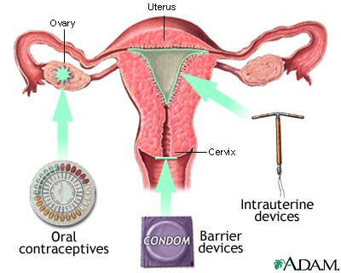


CONTRACEPTIVE UTILITIES AVAILABLE
SITE OF ACTION OF CONTRACEPTIVES

Slide 5
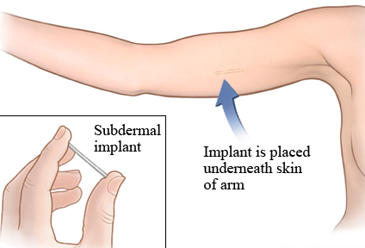
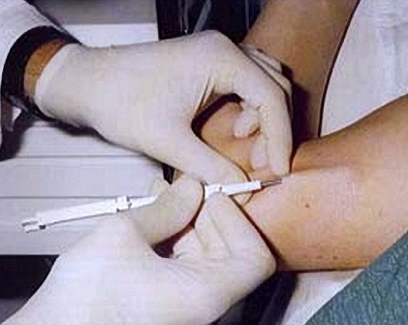
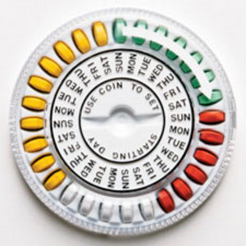
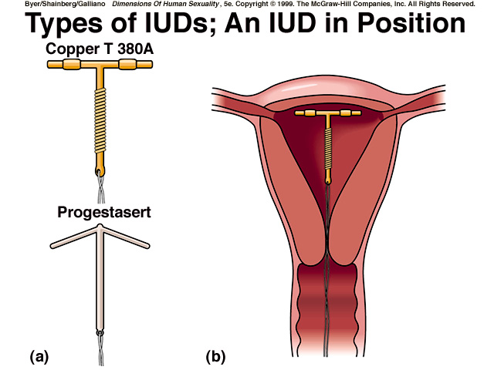
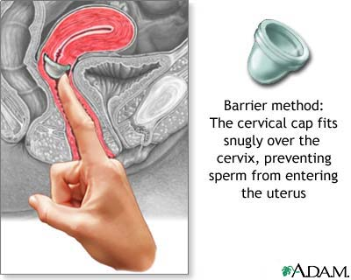
Interruption of normal process of ovulation
Interruption of Implantation by IUD
Interruption by a barrier
IUD

Slide 6

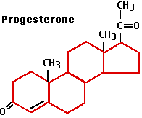
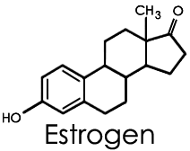

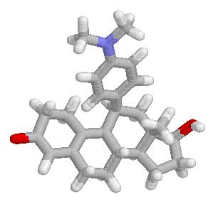
HORMONAL
CONTRACEPTION

Slide 7
Types
ORAL CONTRACEPTIVE Pills
According to composition & intent of use; OC are divided into three types
COMBINED Pills(COC)
MINI Pills(POP)
MORNING-AFTER Pills
Contain estrogens & progestin
Contain only a progestin
Contain both hormones or
Each one alone (high dose) or Mifepristone + Misoprostol
ESTROGENS
Ethinyl estradiol or mestranol [a “prodrug” converted to ethinyl estradiol]
Currently concentration used now is very low to minimize estrogen hazards
PROGESTINS
Norethindrone
Levonorgestrel (Norgestrel)
Medroxyprogesterone acetate
Show systemic androgenic effects; acne, hirsutism, weight gain, & deleterious effects on lipid & CHO metabolism.
Currently
Norgestimate
Desogestrel
Drospirenone
Has no systemic androgenic effects
○ Has also antimineralocorticoid activity

Slide 8
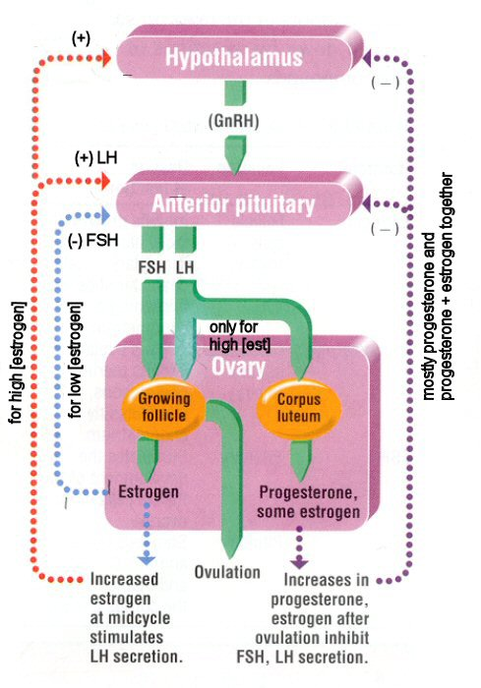
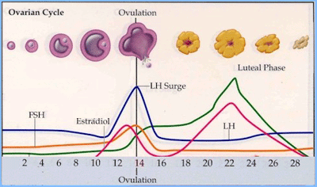
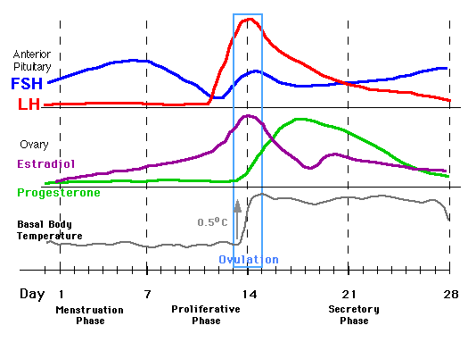
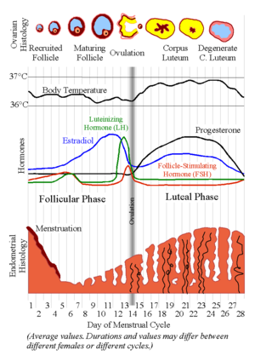
MECHANISM OF ACTION
Of COC
Follicular phase
Thus COC act mainly by Preventing OVULATION by SUPPRESSING THE RELEASE OF GONADOTROPHINS 
Yet, by doing so they also 
Inhibit IMPLANTATION by  endometrial proliferation  no ovum can be embedded + secretion & peristalsis in fallopian tubes hinder transport
Inhibit FERTILIZATION viscosity of cervical secretion  no sperm pass

Slide 9
Monthly Pills
COMBINED Pills [COC] Continued
They were essentially designed to mimic the menstrual cycle by
producing a monthly withdrawal bleeding.
Currently, their formulation were more improved to also mimic the
natural on going changes in hormonal profile  PHASE FORMULATIONS
Monophasic (fixed amount of estrogen & progestin)
Multiphasic (fixed amount of estrogen [ or variable] + amount of progestin  [ in second half or 3 successive phases of cycle)
Methods of administration
Pills are better taken same time of day
For 21 days; starting on day 5 / ending at day 26.
This is followed by a 7 day pill free period
TO IMPROVE COMPLIANCE; a formulation of 28 pills
* The first 21 pills are of multiphasic formulation
* Followed by the last 7 pills are actually placebo

Slide 10
Seasonal Pills
COMBINED Pills [COC] Continued
Are known as Continuous / Extended cycle  Cover 91 days schedule
Taken continuously for 84 days, break for 7 days
Has very low doses of both estrogens and progestins
Benefit; It lessens menstrual periods to 4 times a year useful in those who have pre-menestrual or menestrual disorders, and in perimenopausal women with vasomotor symptoms on pill free days.
Disadvantages; Higher incidence of breakthrough bleeding & spotting during early use.
Indications of COC
As a contraceptive; In women seeking; a reliable, reversible, coitally-independent method of contraception. Efficacy reach up to (99.9%) in preventing pregnancy if a woman is compliant.
Other indications;
  As a HRT
  Endometriosis; specially the extended cycle pills.

Slide 11
COMBINED Pills [COC] Continued
ADRs
1. Nausea and breast tenderness
2. Headache
3. Skin Pigmentation
4. Impair glucose tolerance
5.  incidence of breast, vaginal &
cervical cancer??
6. Cardiovascular - major problem
a. Thromboembolism
b. Hypertension
7.  frequency of gall bladder disease
A. Estrogen Related
B. Progestin Related
1. Nausea, vomiting
2. Headache
3. Fatigue, depression of mood
4. Menstrual irregularities
5. Weight gain
6. Hirsutism , masculinization
7. Ectopic pregnancy.

Slide 12
COMBINED Pills [COC] Continued
Contraindications
Thrombophlebitis / thromboembolic disorders
CHF or other causes of edema
Vaginal bleeding of undiagnosed etiology
Known or suspected pregnancy
Known or suspected breast cancer, or estrogen-dependent
neoplasms
Impaired hepatic functions
Fibroid tumors – use mini pill
Dyslipidemia, diabetes, hypertension, migraine…..
Lactating mothers – use mini pill
N.B. Females that are obese, smokers
Females > 35 years
better given the mini pills

Slide 13
COMBINED Pills [COC] Continued
Interactions
Medications that cause contraceptive failure
Medications that  COC toxicity
Medications that is altered in clearance by COC
Impairing absorption
CYT P450 Inhibitors
CYT P450 Inducers
Medications that cause contraceptive failure
Antibiotics that interfere with normal GI flora   absorption & 
enterohepatic recycling   its bioavailability
Microsomal Enzyme Inducers   catabolism of OC
Phenytoin , Phenobarbitone, Rifampin
Medications that  COC toxicity
Microsomal Enzyme Inhibitors;  metabolism of OC   toxicity Acetominophen, Erythromycin, SSRIs
Medications of altered clearance () by COC;   toxicity
WARFARIN, Cyclosporine, Theophyline

Slide 14
Types
ORAL CONTRACEPTIVE Pills
COMBINED Pills
MINI Pills
MORNING-AFTER Pills
Progestin-Only Pills (POP)
Contains only a progestin as norethindrone or desogestrel….
Mechanisms
The main mechanism of action ;  increase cervical mucous plug
○ no sperm penetration  inhibit FERTILIZATION .

Slide 15
MINI Pills Continued
Indications
Are alternative when oestrogen is contraindicated (specially in cardio-vascular, hepatobiliary, cancer and some metabolic disorders)
Are used with no age limits, in smokers & during lactation.
N.B. They became popular because no worry of estrogenic side effects & are better tolerated
Method of administration
Should be taken every day, the same time, better in evenings, all year round
ADRs & Contraindications
That related to progestins only
N.B. There is slightly higher contraception failure rates when used

Slide 16
Types
ORAL CONTRACEPTIVE Pills
COMBINED Pills
MINI Pills
MORNING-AFTER Pills
Contraception on instantaneous demand, 2^{ndry} to unprotected sexual intercourse
Post Coital Contraception
Emergency Hormonal Contraception [EHC]
Composition | Method of Administration | Timing of 1st dose After Intercourse | Reported Efficacy
Ethinyl estadiol + Levonorgestrel | 2 tablets twice with 12 hrs in between | Better within 12 hrs only up to 72hrs | 75%
High-dose only Ethinyl estadiol | Twice daily for 5 days | Better within 12 hrs only up to 72hrs | 75 - 85%
High dose only levonorgestrel | Twice daily for 5 days | Better within 12 hrs only up to 72hrs | 70 – 75%
Mifepristone ± Misoprostol | A single dose | Within l20 hrs | 85 - 100%

Slide 17
MORNING-AFTER Pills Continued
Mechanism
Exact mechanism(s) is questionable depending on the time it is taken in relevance to the menstrual cycle.
N.B. Mifepristone  is a competitive progestrone antagonist  luteolytic  abortificiant potentiated by addition of Misoprostol
Indications
When desirability for avoiding pregnancy is obvious
Inevitable  efficacy of other forms of contraception:
  Unsuccessful withdrawal before ejaculation
  Torn, leaking condom
  Missed pills
  Detached contraceptive patch......etc
Medico-legal insult: Rape
ADRs
Depending on formulations used.
If Mifepristone
○ uterine bleeding could be problematic
must be under medical supervision

Slide 18
OTHER HORMONAL CONTRACEPTIVE MODALITIES
Other Application MODALITIES | Hormonal Content Within | Dosing Frequency | Reported Efficacy
Patch (Transdermal System) | Like COC, having both hormones | On same day every week for three weeks, 1 week free | 99%
Injectable (given IM) | Depot medroxyprogesterone acetate | Every three month | 99.7%
Implant ( 6 rods) | Levonorgestrel | Every three –five years | 98-99%
Vaginal Ring | Releases a continuous low dose of hormones | Worn for 3 weeks, one week free to get the cycle | 85 - 100%
IUR | Levonorgestrel Levonorgestrel | Regular contraception Worn for 5 years For EHC Worn for a week / within 5 days | 97%

Slide 19



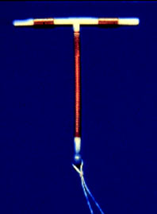
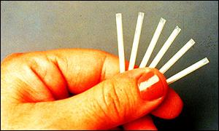
OTHER HORMONAL CONTRACEPTIVE MODALITIES

Slide 20
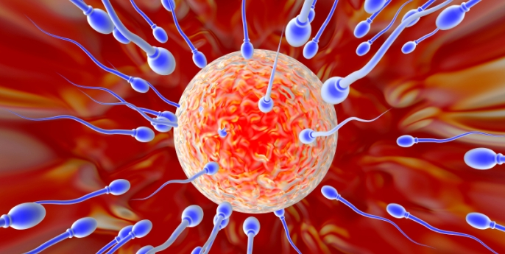
G
O
O
D
L
U
C
K
CONTRACEPTION
CONTRACEPTION

