Slide 1
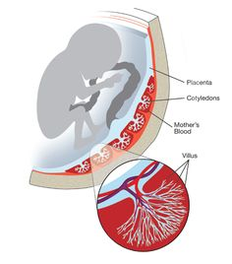
Dr. Saeed Vohra

Slide 2
PLACENTA
It is a Fetomaternal organ.
Formed by the beginning of the 4th month.
It is the primary site for exchange of gases and nutrients between the mother and the fetus.

Slide 3
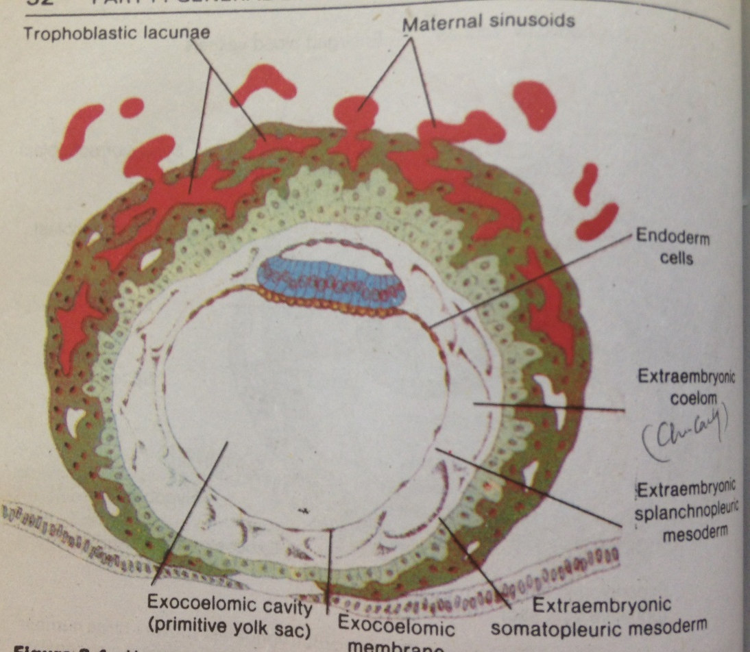
PLACENTA

Slide 4
PLACENTA

Slide 5
Full Term Placenta
Discoid in shape.
Weighs (500 – 600)g.
Has two surfaces:
A- Fetal
B-Maternal

Slide 6
Formation of Placenta
Fetal Part:
Villous Chorion
It is the bushy area at the embryonic pole
The villi are more in number, enlarged and branch profusely.

Slide 7
Formation of Placenta
Maternal Part:
Decidua Basalis part of the decidua deep to the conceptus
Decidua (Gravid Endometrium): it is the functional layer of the endometrium in pregnancy which is shed after parturition

Slide 8
Placental Membrane
It is a composite thin membrane of extra fetal tissues which separates the fetal and maternal bloods.
Up to (20) weeks, it is composed of (4) layers:
Syncytiotrophoblast.
Cytotrophoblast.
Connective tissue of the villus.
Endothelium of fetal capillaries.

Slide 9
Placental Membrane
At full term
It is composed of (3) layers only:
1. Syncytiotrohoblast.
2. Connective tissue.
3. Endothelium of the capillaries.
At some sites, the syncytio comes in direct contact with the endothelium of the capillaries and forms Vasculosyncytial placental membrane.

Slide 10
Fetal Surface
1. Smooth because it is covered with the amnion.
2. The umbilical cord is attached to its center.
3. The chorionic vessels are radiating from the umbilical cord.

Slide 11
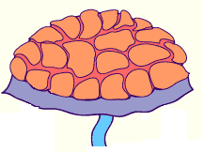
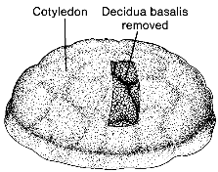
Maternal Surface
Is rough, formed of (15–20) irregular convex areas (Cotyledons)
The cotyledons are separated by grooves (placental septa).
Each cotyledon is covered by a thin layer of decidua basalis.

Slide 12
Structure of a Cotyledon
It consists of two or more stem villi with their many branched villi.
It receives (80-100) maternal spiral arteries that enter the intervillous spaces at regular intervals.

Slide 13
Intervillous Space
Large blood filled spaces which are freely communicating
They receive spiral arteries from the lacunae in the syncytiotrophoblast.
The spaces are drained through endometrial veins.
Both arteries and veins pass through pores in the cytotrophoblastic shell.

Slide 14
Fetal Placental Circulation
Two Umbilical Arteries:
Carry poorly oxygenated blood from the fetus to the placenta.
within the branch chorionic villi, they form:
Arterio-capillary venous network:
It brings the fetal blood extremely close to the maternal blood.
The well oxygenated fetal blood in the capillaries passes into veins accompanying the chorionic arteries.
At the umbilical cord, they form the one Umbilical Vein.

Slide 15
Maternal Placental Circulation
80 –100 spiral endometrial arteries discharge into the intervillous space.
The blood is propelled in jet like fountains by the maternal blood pressure.
The pressure of this entering blood is higher than that in the intervillous space.
It forms a roof of the space.
As the pressure dissipates, The blood flows slowly around the branch villi.

Slide 16
Maternal Placental Circulation
Exchange of metabolites and gases with the fetal blood.
As the pressure decreases, the blood flows back from the chorionic plate and enter the endometrial veins to the maternal circulation.

Slide 17
Functions of The Placenta
1. Metabolic:
Synthesis of glycogen, cholesterol and fatty acids.
They supply the fetus with nutrients and energy.
2. Transportation of:
A Gases:
Exchange of O2, CO2 and CO
The fetus extracts (20 – 30) ml of O2/minute from the maternal blood.

Slide 18
Functions of The Placenta
B. Nutrients and Electrolytes:
water, amino acids, carbohydrates, vitamins and free fatty acids are rapidly transferred to the fetus.
C. Maternal Antibodies:
Maternal immunoglobulin G gives the fetus passive immunity to some infectious diseases (measles, small box) and not to others (chicken box).

Slide 19
Functions of The Placenta
D. Drugs and Drug metabolites:
They cross the placenta by simple diffusion.
They can affect the fetus directly or indirectly by interfering with placental metabolism
E. Hormones:
Protein hormones do not reach the embryo in sufficient amounts.
some of these hormones (thyroxine & testosterone which may cause masculinization of a female fetus) can cross the placental membrane
F. Waste products:
Urea and uric acid pass through the placental membrane by simple diffusion

Slide 20
Functions of the Placenta
3. Endocrine Synthesis:
Progesterone
Maintains pregnancy if the corpus luteum is not functioning well.
Estrogen
Stimulates uterine growth and development of the mammary glands.
3 hCS or Hpl (Human chorionic somatomammotropin or Human Placental Lactogen)
A growth hormone that gives the fetus the priority on maternal blood glucose. Maintains the corpus luteum and used as indicator of pregnancy.
It promotes breast development for milk production.

Slide 21
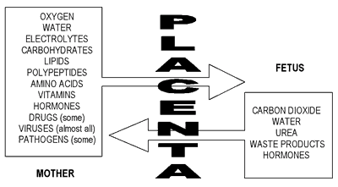
Functions of the Placenta

Slide 22
Fetal drug addiction can be due to some drugs as Heroin.
All sedatives and analgesics can affect the fetus to some degree.
Drugs used for management of labor can cause respiratory distress to the newborn.

Slide 23
Mechanism of Transportation
The transport through the placental membrane is by one of the following mechanisms
1. Simple (passive) diffusion
Depends on difference in pressure.
2. Active transport
Requires energy.
3. Facilitated transport
Through electrical discharge.
4. Pinocytosis
The material engulfed is a small sample of extracellular fluid.

Slide 24
Anomalies of Placenta
1. Placenta Accreta:
Abnormal absence of chorionic villi with partial or complete absence of the decidua basalis.
2. Placenta Percreta:
Chorionic villi penetrate the myometrium to the perimetrium.
The most common presenting sign of these two anomalies is trimester bleeding.
3. Placenta Previa:
The blastocyst is implanted close to or overlying the internal uterine os.
It is associated with late pregnancy bleeding.
Delivery is through Cesarean section.

Slide 25
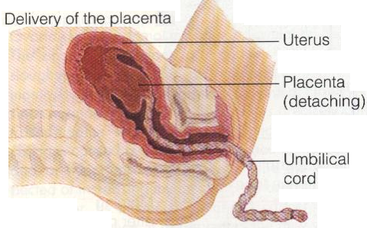
Fate of Placenta
Within 15 minutes after birth of the infant.
The strong uterine contractions that continue after birth compress uterine blood vessels to limit bleeding & cause the placenta to detach from the uterine wall.

Slide 26
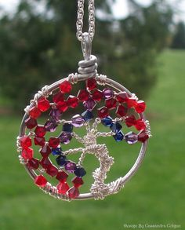
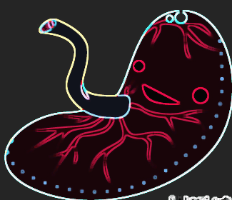
Thank you
Very Much

