Slide 1
Prostate Pathology
Emad Raddaoui, MD,FCAP, FASC

Slide 2
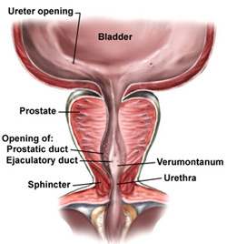
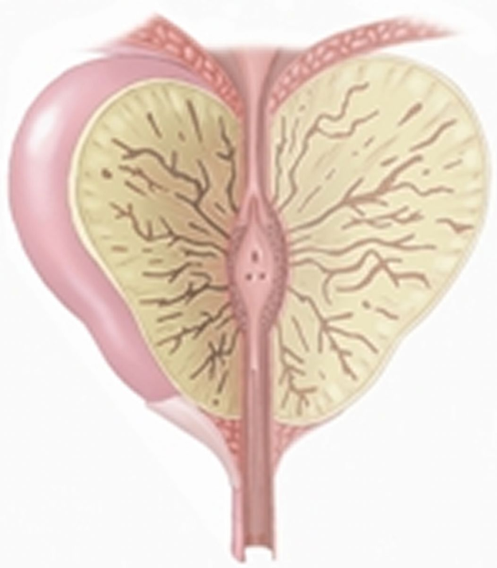
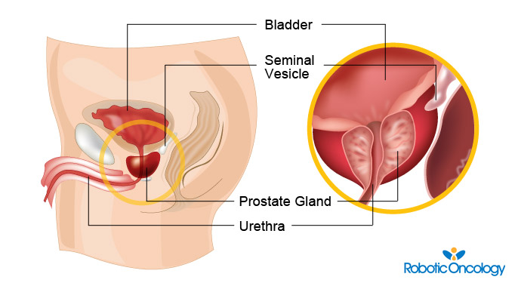
http://napaurology.com
http://www.yoursurgery.com

Slide 4
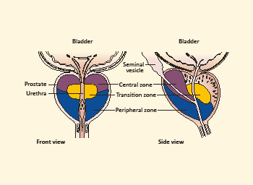
Prostate anatomy
Prostate weighs 20 grams in normal adult
Retroperitoneal organ, encircling the neck of bladder and urethra
Devoid of a distinct capsule
The prostate is divided into different zones. They are Central, Peripheral and Transitional zones. The transition zone is the middle area of the prostate, between the peripheral and central zones. It surrounds the urethra as it passes through the prostate
The majority of prostate cancers are found in the peripheral zone and benign nodular hyperplasia in the transitional zone.
Microscopically the prostate is a tubulo-alveolar organ. The prostate glands are lined by two layers of cells, basal cells and columnar secretory cells
http://www.theprostatecentre.com

Slide 5
Normal prostate
Picture Taken from Robbins and Cotran Pathologic basis of disease. 8th edition, Chapter 21, 2010 Sanders

Slide 6
Benign Prostatic Hyperplasia (BPH)
Also known as benign nodular hyperplasia
Extremely common lesion in men over age 50.
20% in men over age 40, up to 70% by age 60, and 90% by age 80.
Hyperplasia of glands and stroma results in large nodular enlargement in the periurethral region of the prostate.
One the nodules become large they compress the prostatic urethra causing either partial, or complete obstruction of the urethra.
Nodular hyperplasia is not a premalignant lesion

Slide 7
BPH: pathogenesis
The essential cause of BPH is unknown
The pathogenesis is related to the action of androgen. Dihydrotestesterone (DHT) is the ultimate mediator for prostatic growth. It increases the proliferation of stromal cells and inhibits epithelial cell death.
DHT is implicated in the pathogenesis of both benign prostatic hyperplasia (BPH) and prostate cancer.
Testosterone is converted to dihydrotestosterone (DHT) by 5-alpha reductase enzymes.
Drugs that act as inhibitors of 5-alpha reductase, therefore have an important role in the prevention and treatment of BPH and prostate cancer.
Prepubertal castration prevents BPH

Slide 8
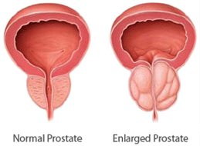
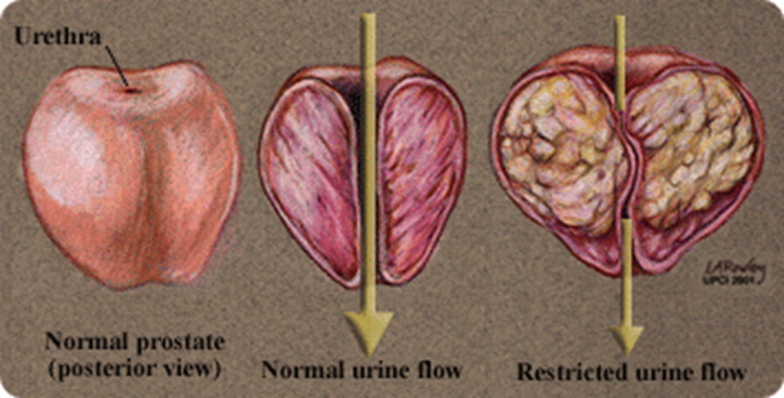
BPH: gross morphology
The prostate weighs between 60 and 100 grams
The hallmark of BPH is nodularity due to glandular and fibromuscular proliferation.
Nodular hyperplasia begins in the inner aspect of the prostate gland, the transition zone
Cut-section shows nodules which vary in size, color and consistency depending on which element is proliferating more (glandular or fibromuscular).
It compress the wall of the urethra resulting in a slit-like orifice.
http://www.drbriffa.com

Slide 9
BPH: microscopy
Microscopically, the main feature of BPH is nodularity
The nodules can be:
purely stromal nodules composed mainly of fibromuscular element
OR
fibroepithelial with both glandular and fibromuscular component. There is aggregation of small to large to cystically dilated glands, lined by two layers of epithelium surrounded by fibromuscular stroma.
Needle biopsy doesn’t sample the transitional zone where BPH begins and occurs, therefore the diagnosis of BPH cannot be made on needle biopsy

Slide 10
BPH: clinical feature and treatment
C/F:
The nodule compress the prostatic urethra and cause uretheral obstruction. This leads to retention of urine in the bladder with associated bladder hypertrophy.
The inability to empty the bladder completely leads to increase volume of residual urine and therefore infection
Increased urinary frequency
Nocturia
Difficulty in starting and stopping the stream of urine
Dysuria
Some patients present with acute urinary retention.
Treatment:
Mild cases of BPH may be treated with α-blockers and 5-α-reductase inhibitors
Moderate to severe require transurethral resection of the prostate (TURP)

Slide 11
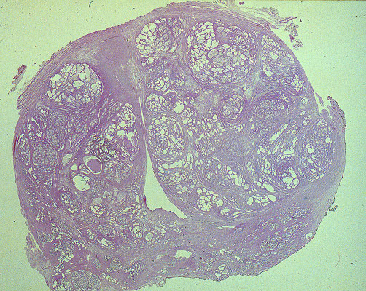
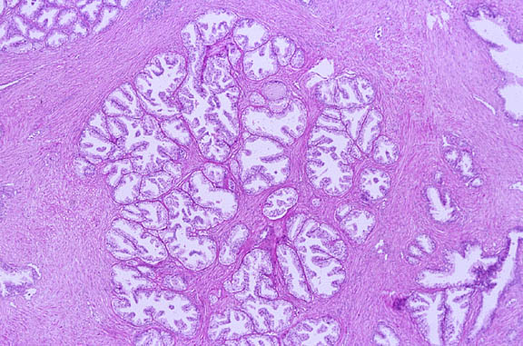
Nodular hyperplasia
http://pixgood.com/benign-prostatic-hyperplasia-histology.html

Slide 12
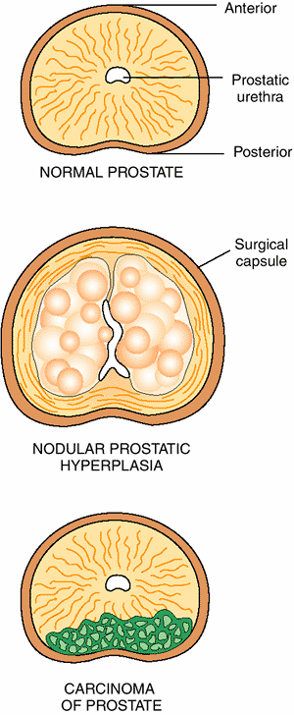
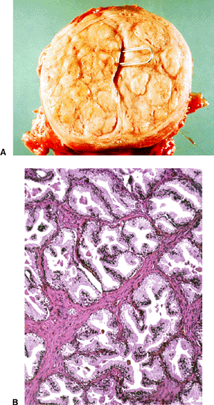
Rubin's Pathology : Clinicopathologic Foundations of Medicine, 5th Edition, 2008 Lippincott Williams & Wilkins

Slide 13
Prostatic Adenocarcinoma
The a common form of cancer in men
Second leading cause of cancer death
Disease of men over age 50
More prevalent among African Americans
These tumors show a wide range of clinical behaviors
Etiology: Several risk factors : Age, race, family history, hormone level (androgens) and environmental influences.
Androgen are believed to play a major role in the pathogenesis

Slide 14
Prostatic Adenocarcinoma: morphology
70% arises in the peripheral zone of the posterior part of the gland
Tumor is firm and gritty and is palpable on rectal exam
Spread by direct local invasion and through blood stream and lymph
Local extension most commonly involves the periprostatic tissue,seminal vesicles and the base of the urinary bladder (leading to ureteral obstruction)

Slide 15
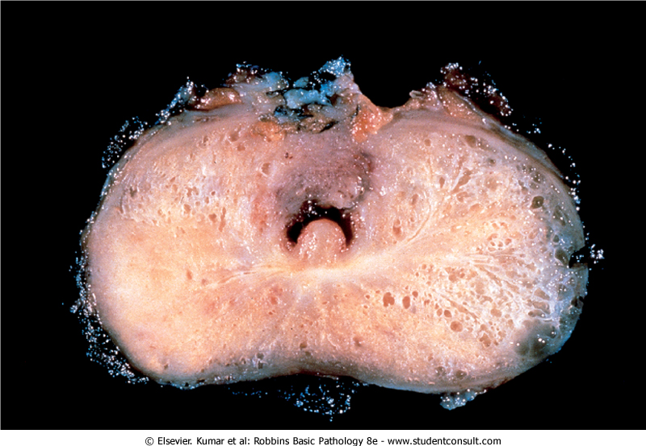

Slide 16
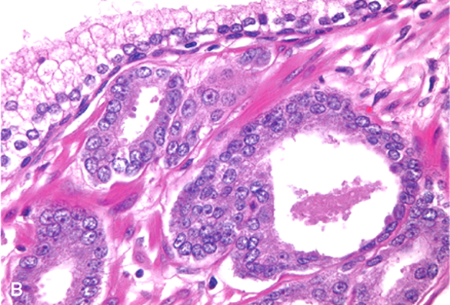
Prostatic Adenocarcinoma: microscopy
Histologically, most lesions are adenocarcinomas that produce well-defined gland patterns.
The malignant glands are lined by a single layer of cuboidal or low columnar epithelium with large nuclei and one or more large nucleoli. Nuclear pleomorphism is not marked. The outer basal cell layer typical of benign glands is absent
Commonly there is perineural invasion.

Slide 17
Adenocarcinoma
Metastases first spread via lymphatics: initially to the obturator nodes and eventually to the para-aortic nodes
Hematogenous extension occurs chiefly to the bones. The bony metastasis are typically osteoblastic .

Slide 18
Adenocarcinoma: Gleason Grading and Scoring
Gleason system is a histological grading and scoring system for prostatic adenocarcinoma done on the microscopic level.
There are five grades (1 to 5) depending on the degree and pattern of differentiation as seen microscopically (in which they range from, grade 1= well-differentiated and grade 5= very poorly differentiated).
The two most common types of grades seen in the biopsy for each cancer case are added to produce a combined Gleason score.
Gleason Grading and Scoring in prostate cancer is very useful in predicting prognosis of a patient.

Slide 19
Adenocarcinoma: Staging
Staging in prostate cancer depends on the TNM system. It is the most important indicator of prognosis.

Slide 20
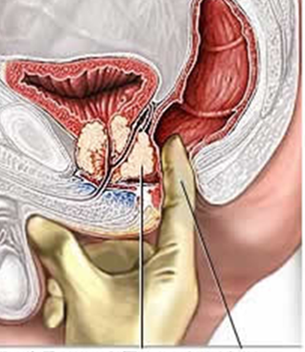
Adenocarcinoma: clinical features
Microscopic (very small size) cancers are asymptomatic and are discovered incidentally.
Most arise in the peripheral zone, away from urethra and therefore the urinary symptoms occur late.
Occasionally patients present with back pain caused by vertebral metastases
Careful digital rectal examination may detect some early cancers.
PSA (Prostate Specific Antigen) levels are important in the diagnosis and management of prostate cancer. However, 20% - 40% of prostate confined cancers have low PSA
PSA is organ specific but not cancer specific because it could be increased in BPH and prostatitis.
A transrectal needle biopsy is required to confirm the diagnosis
http://www.medicalhealthguide.com

Slide 21
Adenocarcinoma: treatment
Surgery, radiotherapy and hormonal therapy
90% of treated patients expected to live for 15 years
Currently the most acceptable treatment for clinically localized cancer is radical surgery
In locally advanced cancers can be treated by radiotherapy and hormonal therapy. Hormonal therapy (Anti-androgen therapy) can induce remission.
Advanced, metastatic carcinoma is treated by androgen removal trearment, either by orchiectomy or by hormonal anti-androgen therapy.
The prognosis depends on the Gleason score and stage of tumor.

Slide 22
Prostatic intraepithelial neoplasia (PIN)
PIN is the precursor lesion for invasive carcinoma. It can be low grade PIN or high grade PIN. (high grade PIN is like carcinoma in situ)
PIN like carcinoma occurs in the peripheral zone.

