Slide 1
The Uterine Corpus
Emad Raddaoui, MD, FCAP, FASC

Slide 2
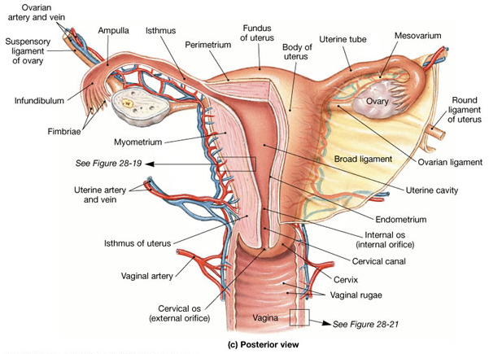
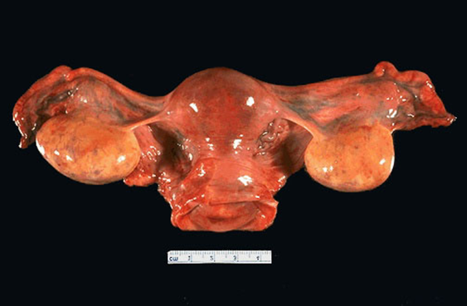
Uterus with bilateral tube and ovaries, posterior view
http://pixgood.com

Slide 3
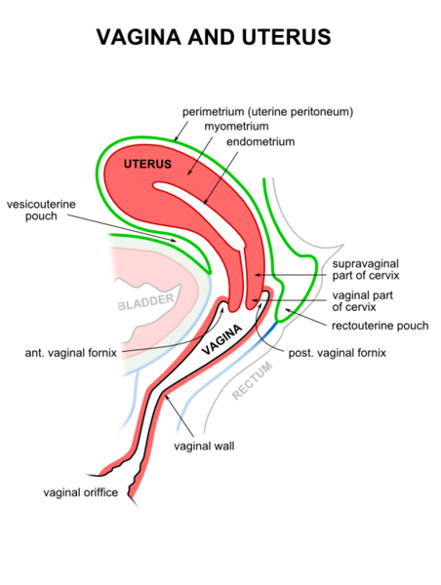
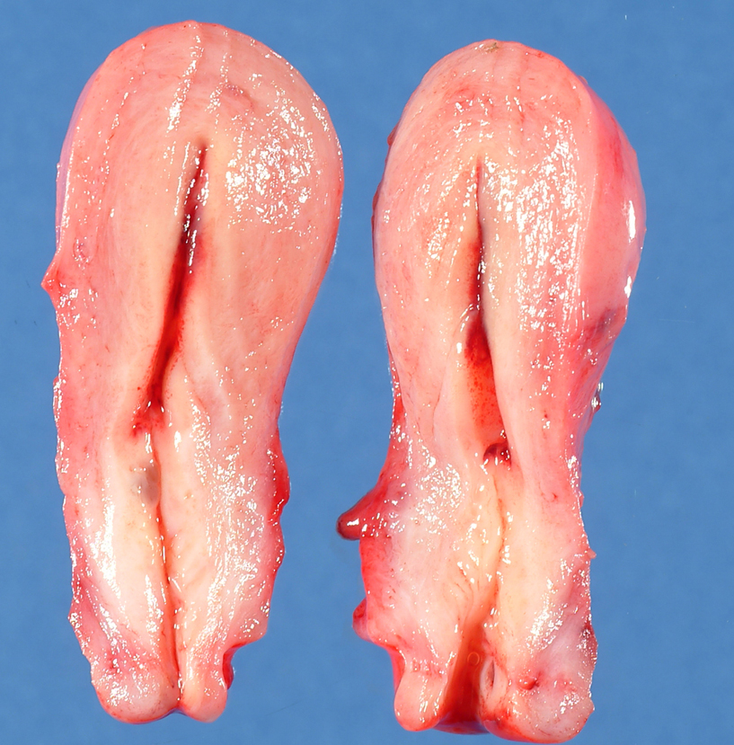
http://www.humpath.com/IMG/jpg/uterus_03_1.jpg
http://www.wikilectures.eu/images/thumb/8/82/Vagina_uterus.png/720px-Vagina_uterus.png

Slide 4
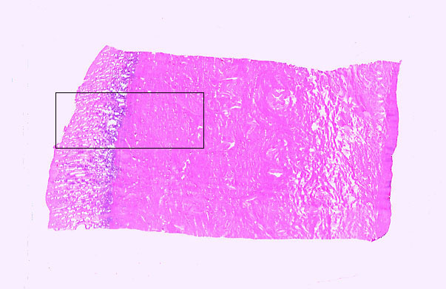
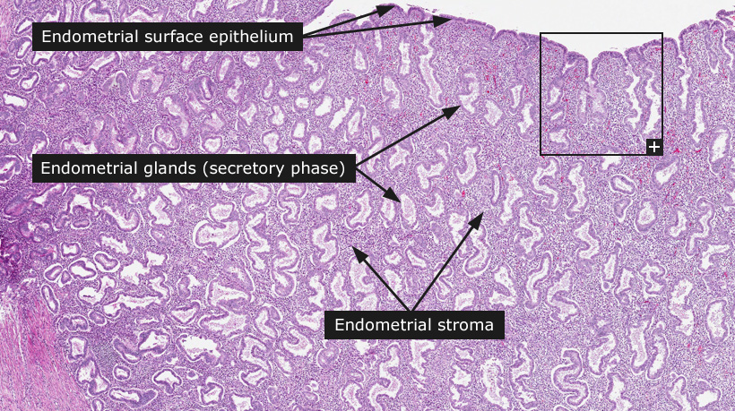
Lecture Outline
Lesions of endometrium of uterus:
Endometrial hyperplasia
Endometrial carcinoma
Lesions of myometrium of uterus:
Leiomyoma
Leiomyosarcoma
http://pixgood.com/uterus
http://pixgood.com/uterus-histology.html

Slide 5
Endometrial Hyperplasia

Slide 6
Endometrial Hyperplasia
Endometrial hyperplasia is a process in which there is a proliferation of endometrial glands resulting in an increase in gland/stroma ration compared to proliferative endometrium (i.e. there is more gland and less stroma when compared to normal).
It is induced by persistent, prolonged estrogenic stimulation of the endometrium.
The endometrial hyperplasia may progress to endometrial carcinoma.
The development of cancer is based on the level and duration of the estrogen excess.
The risk is depending on the severity of the hyperplastic changes and associated cellular atypia.

Slide 7
Endometrial Hyperplasia: causes
Causes of Endometrial Hyperplasia: any condition in which there is high estrogen level can lead to endometrial hyperplasia. Some of them are as follows:
Anovulatory menstrual cycles (failure of ovulation).
Excessive endogenous (by the body) production of estrogen e.g. in
-polycystic ovary syndrome (Stein-Leventhal syndrome),
-granulosa cell tumors of the ovary
-excessive ovarian cortical function (cortical stromal hyperplasia)
Exogenous administration of estrogenic steroids without counter balancing progestins, over a long period of time.

Slide 8
Endometrial Hyperplasia: clinical
Milder forms of hyperplasia tends to occur in younger patients
The great majority of mild hyperplasia regress, either spontaneously or after treatment.
The more severe forms, occur predominantly in peri- and postmenopausal women. This form has a significant premalignant potential.
Patients usually present with abnormal uterine bleeding.

Slide 9
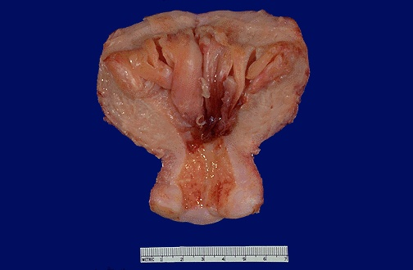
Endometrial hyperplasia
http://pixgood.com/endometrial-hyperplasia.html

Slide 10
Endometrial Hyperplasia: classification
There is proliferation of both glands and stroma but the glandular component is more. Therefore over crowding of glands occur. Endometrial hyperplasia is histologically classified according to:
Gland architecture: simple or complex depending on the degree of glandular complexity and crowding.
Cytologic features: with or without atypia. Atypia = pleomorphism (loss of polarity, vesicular nuclei, prominent nucleoli, rounded cells)
www.cram.com

Slide 11
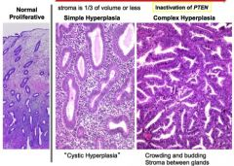
Therefore the classification is as follows:
I. Simple hyperplasia
Without atypia
With atypia
II. Complex hyperplasia
Without atypia
With atypia

Slide 12
No hyperplasia and no atypia
Hyperplasia with atypia
quizlet.com
http://www.indiacancersurgerysite.com/

Slide 13
Simple hyperplasia without atypia
Simple hyperplasia (cystic hyperplasia) : glands are varibly shaped and sized and cystically dilated with abundant cellular stroma and give a "Swiss Cheese" appearance.
There is a mild increase in the gland-to-stroma ratio
These lesions uncommonly progress to adenocarcinoma
Simple hyperplasia may progress to cystic atrophy

Slide 14
Simple hyperplasia with atypia
Uncommon
It has the Architecture of simple hyperplasia, but there is cytologic atypia within the glandular epithelial cells
10% of such lesions progress to carcinoma

Slide 15
Complex hyperplasia without atypia
Proliferation of endometrial glands resulting in complex crowded glands with papillary infoldings and irregular shapes. The crowded glands are back-to-back with very little intervening stroma.
The epithelial cells remain cytologically normal.
3% progression to carcinoma

Slide 16
Complex hyperplasia with atypia
Complex proliferation of endometrial glands (back-to-back irregular glands) with atypia.
The nuclei show loss of polarity and are enlarged and rounded and may have irregular nuclear membranes
23% to 48% of women with this diagnosis have carcinoma somewhere in the uterus when a hysterectomy is performed
30% progress to carcinoma

Slide 17
Endometrial Hyperplasia: Clinical behavior and premalignant potential
Some endometrial hyperplasias revert to normal spontaneously or with medical treatment, others persist as hyperplasia, and a few progresses to endometrial adenocarcinoma.
Generally, patients who have hyperplasia with atypia are more likely to develop carcinoma than those without atypia. The risks for developing adenocarcinoma in each are as follows:
Simple hyperplasia without atypia — 1%
Complex hyperplasia without atypia — 3%
Simple hyperplasia with atypia (simple atypical hyperplasia) — 10%
Complex hyperplasia with atypia (complex atypical hyperplasia) — 30%
Atypical hyperplasia in postmenopausal women appears to have a higher rate of progression to adenocarcinoma.

Slide 18
Endometrial Hyperplasia, Risk Factors
Obesity
Western diet
Nulliparity
Diabetes Mellitus
Hypertension
Hyperestrinism

Slide 19
Endometrial adenocarcinoma

Slide 20
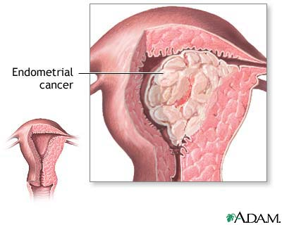
Endometrial adenocarcinoma
This is a common neoplasm in women. Worldwide, it is the fifth commonest cancer in women.
Endometrial cancers arise mainly in postmenopausal women
They cause postmenopausal bleeding
Early detection and cures are possible
These tumors are classified into two broad categories:
Type I carcinomas: Also known as endometrioid carcinoma. It is the most common type.
Type II carcinomas (the most common type II carcinoma is serous carcinoma )
www.healthtap.com

Slide 21
Type I endometrial carcinoma/ endometrioid carcinoma
Endometrioid carcinoma is associated with estrogen excess and endometrial hyperplasia. The majority are well differentiated.
Risk factors for type I are they same as that of endometrial hyperplasia and include:
Endometrial hyperplasia is a precursor to endometrioid carcinoma
obesity (women with upper body fat have 3 times the risk of women with lower body fat),
estrogen therapy,
nulliparity (as a result of infertility due to chronic anovulation),
chronic anovulation,
late menopause,
hypertension,
diabetes,
tamoxifen therapy,
and high socioeconomic status.
The disease may follow atypical hyperplasia but may occur independently of it especially in older patients.

Slide 22
Usual sequence of events in Type I endometrioid carcinoma
http://quizlet.com/22858165/srwk3
Notes:
Schematic diagram depicting the development of type I endometrial carcinoma arising in the setting of hyperplasia. The most
common molecular genetic alterations are shown at the time they are most likely to occur during the progression of the disease.
*MI, microsatellite instability.

Slide 23
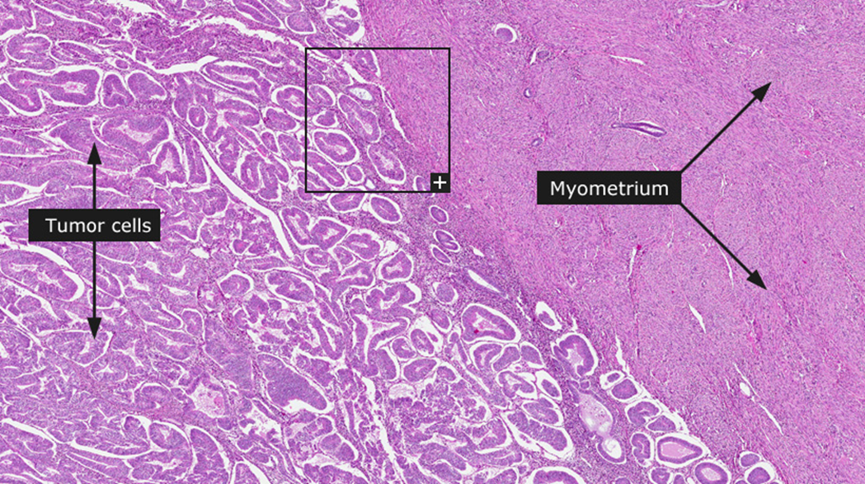
Type I endometrioid carcinoma: genetics
Mutations in the PTEN gene have been identified in 30% to 80% of endometrioid carcinomas
There maybe inactivation of DNA mismatch repair genes
In the more poorly differentiated endometrioid carcinomas, mutations in p53 can be found in up to 50% of cases
http://www.proteinatlas.org/images_dictionary/endometrial_cancer__1__figo_1__overview.jpg

Slide 24
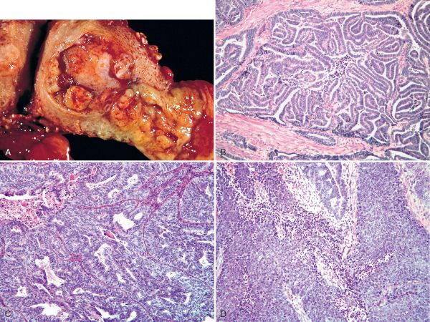
Endometrial carcinoma
Picture Taken from Robbins and Cotran Pathologic basis of disease. 8th edition, Chapter 21, 2010 Sanders

Slide 25
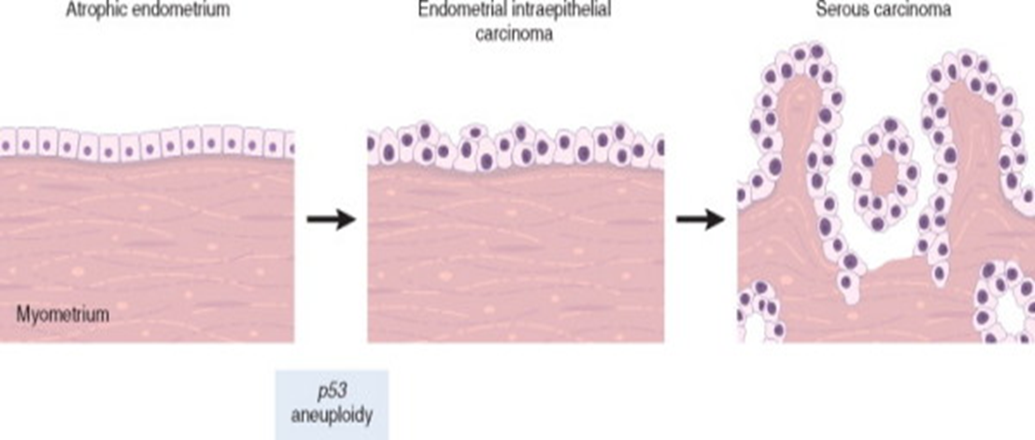
Type II carcinomas/ serous carcinoma
Serous carcinoma of the endometrium arises in older women, with endometrial atrophy (small atrophic uteri).
They occur in late in life, about one decade later than type I carcinoma
There is no association with hyperestrinism or preexisting hyperplasia
They represent 15% of cases of all endometrial carcinoma
Mutations in p53 are present in at least 90% of serous endometrial carcinoma
The precursor of serous carcinoma is endometrial intraepithelial carcinoma (like carcinoma in situ)
These tumors are large bulky poorly differentiated tumors which invaded early into the myometrium and have a poor prognosis. Extrauterine extension is common.
http://quizlet.com/22858165/srwk3

Slide 26
Endometrial carcinoma: basic morphology
Grossly:
May look close to normal or exophytic or infiltrative
Microscopy:
Both are adenocarcinomas.
In both cases tumors originate in the endometrium and can eventually infiltrate the underlying myometrium and enter vascular spaces, with metastases to regional lymph nodes.
Serous carcinoma has much greater cytologic atypia and are more poorly differentiated and therefore more aggressive
Tumor spreads by:
Direct myometrial invasion with extension to the periuterine structures
Through lymphatics to lymph nodes
In the late stages, metastasize to the lungs, liver, bones, others

Slide 27
Endometrial adenocarcinoma: clinical features
Most patients are between 50 and 59 years.
50% of the women who are under 40 years are nulliparous and more than 75% of them are obese.
Endometrial adenocarcinoma manifests as abnormal vaginal bleeding and excessive leucorrhea. In elderly women the bleeding is postmenopausal.
The diagnosis of endometrial cancer must be confirmed by biopsy or curettage and histologic examination of the tissue.
http://upload.wikimedia.org/wikipedia/commons/0/00/Endometrial_hyperplasia.jpg

Slide 28
Endometrial adenocarcinoma: prognosis
Clinical behavior of endometrial adenocarcinoma depends on the histologic type, the grade (degree of differentiation) and the stage (extent of spread).
Endometrioid carcinoma has a better prognosis than the other histologic types.
Stage is the major determinant of survival.
Serous carcinomas have poorer prognosis

Slide 29
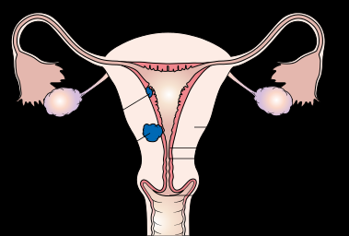
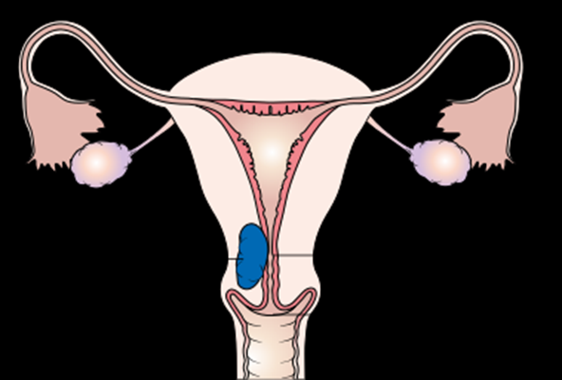
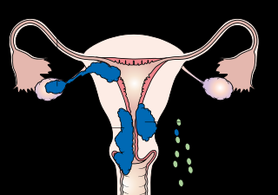
How endometrial carcinoma can spread (stages 1, 2 and 3 of endometrial carcinoma)
"Diagram showing stage 1A and 1B, 2 and 3A to 3C cancer of the womb CRUK 196, 206 and 224" by Cancer Research UK - Original email from CRUK. Licensed under CC BY-SA 4.0 via Wikimedia Commons - http://commons.wikimedia.org/wiki/File:Diagram_showing_stage_1A and 1B ,2_and3A_to_3C_cancer_of_the_womb_CRUK_206.svg#/media/File:Diagram_showing_stage_1A_and_1B,_2 and 3A_to_3C__cancer_of_the_womb_CRUK 196 and 206 and 224.svg

Slide 30
Leiomyoma (fibroid) of uterus
Leiomyoma is a benign tumor of smooth muscle origin.
It is the most common neoplasm of the female genital tract and probably the most common neoplasm in women.
The tumor is estrogen responsive and often increases in size during pregnancy and decreases in size during menopause.
Estrogens and possibly oral contraceptives stimulate their growth; they shrink postmenopausally.
About 40% of leiomyomas have an associated chromosomal abnormality
This is a benign tumor with no appreciable malignant potential (incidence of malignant transformation to sarcoma is 0.1-0.5%).

Slide 31
Leiomyoma (fibroid) of uterus
Clinical features
It can be single or multiple. Mostly it is multiple.
Patients may present with irregular abnormal bleeding, pelvic pain, pelvic mass, infertility.
It may cause anemia from heavy bleeding.
Urinary frequency if fibroid compressing urinary bladder.
It may interfere with implantation and therefore cause infertility.
In pregnant women it may cause abortion, obstructed labor, post partum hemorrhage etc
Alternatively it maybe entirely asymptomatic

Slide 32
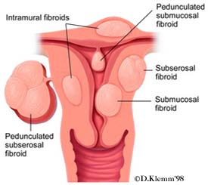
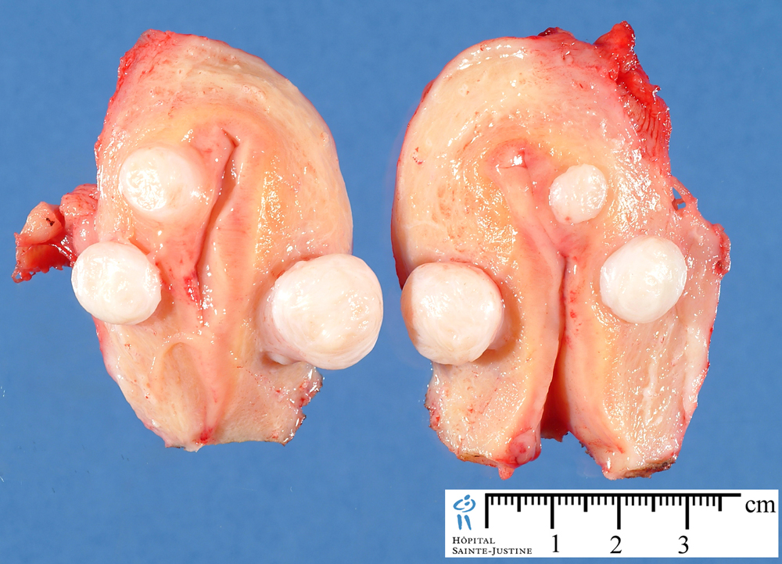
Uterine Leiomyoma/ Fibroid
Leiomyoma may be located anywhere in the myometrium.
Submucosal tumors are present immediately below the endometrium.
Intramural tumors, the most common, lie within the myometrium.
Subserosal fibroids lie beneath the serosal surface of the uterus or are pedunculated and attached to the serosa.
Pedunculated ones may loose their connection to the uterus forming a "parasitic leiomyoma".
http://www.fibroidoptions.com/images/fibroid1.jpg
http://www.humpath.com/IMG/jpg/uterine_leiomyoma_0412_3.jpg

Slide 33
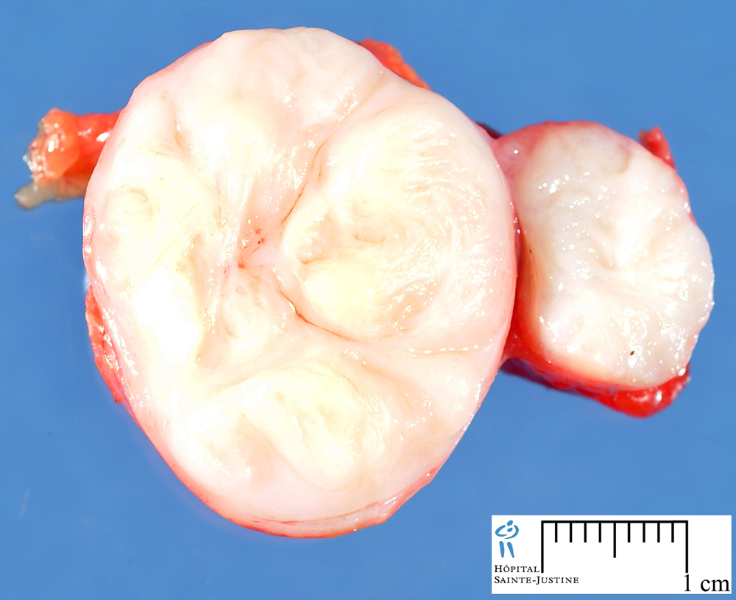
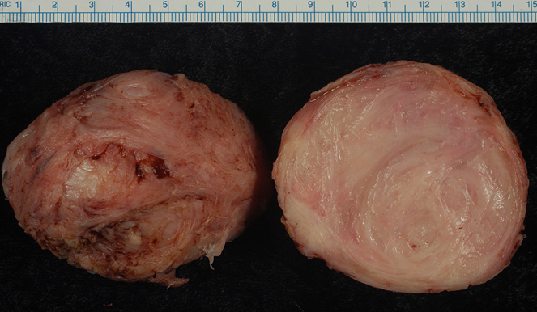
Leiomyoma gross:
Well circumscribed, spherical, dense and firm-to-hard masses.
Cut section shows whorled, tan-white cut surfaces.
"Leiomyoma" by Ed Uthman from Houston, TX, USA - Leiomyoma. Licensed under CC BY 2.0 via Wikimedia Commons - http://commons.wikimedia.org/wiki/File:Leiomyoma.jpg#/media/File:Leiomyoma.jpg

Slide 34
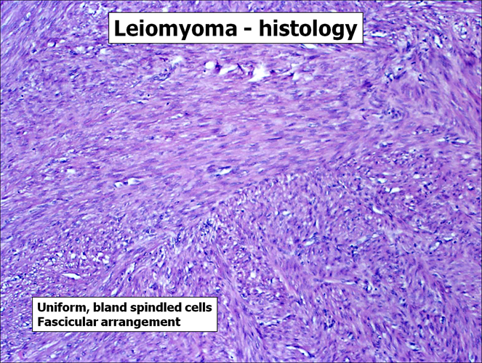
Leiomyoma: microscopy
Microscopically, there are interlacing bundles of smooth muscle cells with collagenous stroma between bundles. The individual muscle cells are uniform in size and shape. They have the characteristic oval to elongated nucleus. Mitotic figures are scarce.
http://pixgood.com/leiomyoma-histology.html
http://pixgood.com/myometrium.html

Slide 35
Leiomyosarcoma
It is the malignant tumor of the smooth muscle.
It is rare.
Sites include the uterus and soft tissue
Poor prognosis.

