Slide 1
Pathology of Uterine Cervix
Emad Raddaoui, MD, FCAP, FASC

Slide 2
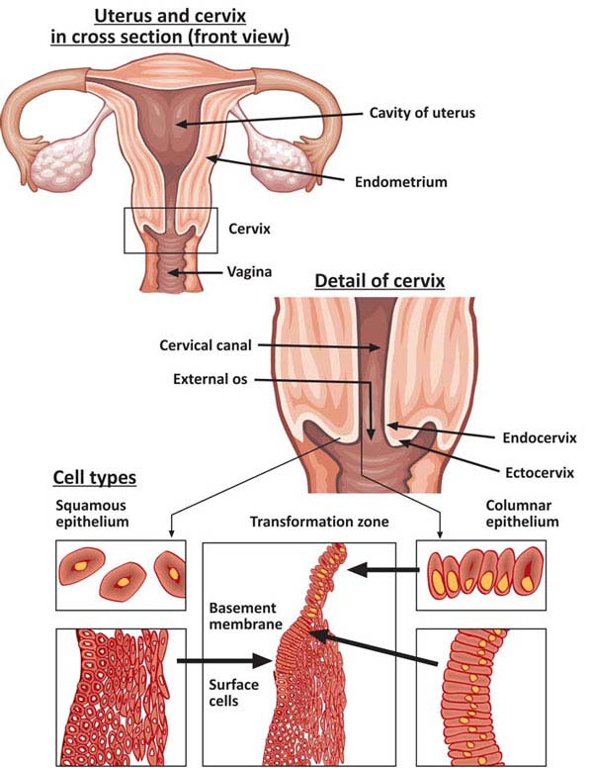
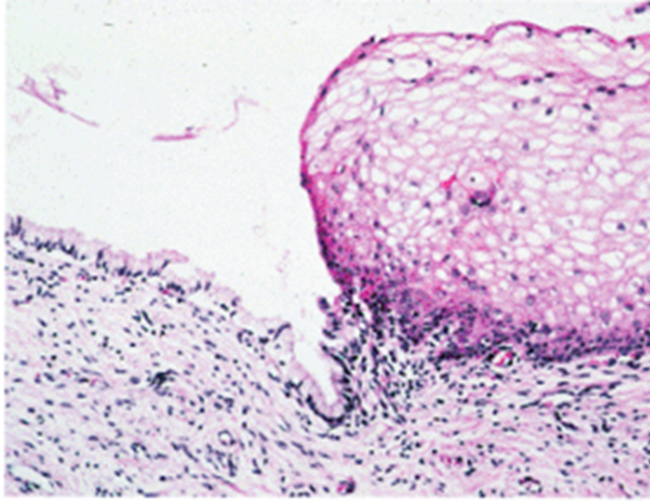

Slide 3
EROSION/ECTROPION
Characterized by columnar epithelium replacing squamous epithelium, grossly resulting in an erythematous area.
It is a typical response to a variety of stimuli including hormones, chronic irritation and inflammation (chronic cervicitis).
It is benign and has no malignant potential.
SQUAMOUS METAPLASIA
Columnar cells are replaced by squamous cells. It is seen in cervix at the squamocolumnar junction.
Squamous metaplastic epithelium is the area most affected by HPV infection and the area where dysplasia and malignant transformation starts.
(note: squamous metaplastic epithelium is benign and by itself not considered premalignant)

Slide 4
Cervical polyp
This is a small, pedunculated mass.
Most originate from the endocervix (endocervical polyps) with a few from the ectocervix (ectocervical polyps).
They are inflammatory proliferations of cervical mucosa and are not true neoplasms.
The lesion is characterized by overgrowth of benign stroma covered by epithelium.
Cervical polyps are covered by columnar epithelium or stratified squamous epithelium or partially by both.
The stroma contains thick-walled blood vessels and fibrous and some inflammatory cells.
http://images.wisegeek.com/diagram-of-vaginal-polyps.jpg

Slide 5
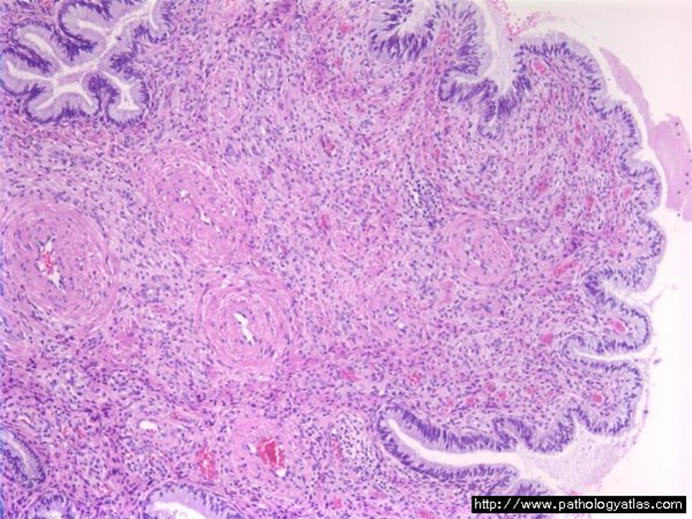
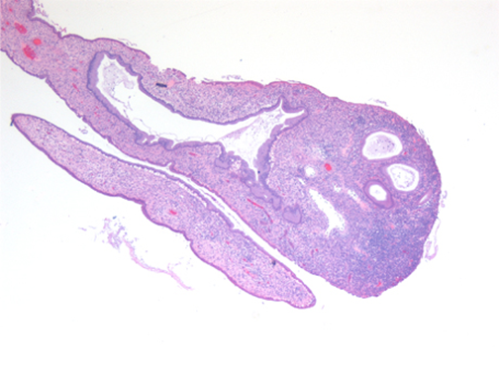
Cervical polyp
http://sunnybrook.ca/uploads/cx_polyp_vd_1.jpg

Slide 6
CERVICITIS
Inflammation of cervix.
Can be non-infectious or infectious.

Slide 7
Noninfectious (Nonspecific) Cervicitis
This is inflammation of the cervix caused by chemical (e.g. douche, deodorant) or mechanical (e.g. tampon, diaphragm) irritation. It is often acute but may be chronic.
Clinical appearances
often asymptomatic.
The cervix appears red and swollen
Histology
The inflammatory cells are seen(neutrophils, plasma cells and lymphocytes).
Squamous metaplasia of the endocervical glandular epithelium is common in chronic cervicitis.
Often some of the glands are dilate to form mucus-filled cysts called nabothian cysts.

Slide 8
Infectious cervicitis
Can be caused by various organisims e.g.staphylococci, enterococci, Gardnerella vaginalis, Trichomonas vaginalis, Candida albicans and Chlamydia trachomatis.
Most often involves the endocervix.
May be asymptomatic
May manifest as vaginal discharge or itching

Slide 9
Candidiasis (moniliasis)
Common
Involves cervix and vagina
Caused by Candida albicans, a normal component of the vaginal flora.
Associated with diabetes mellitus, pregnancy, antibiotic therapy, oral contraceptive use and immunosupression.
Characterized by white patchy mucosal lesions with thick curdy white discharge and vulvovaginal pruritis. Ulcers may develop.
Cytology smears show: Fungal colonies in the form of spores and branching pseudohyphae on the cervical epithelium. Chronic inflammatory cells are present.
"Candida pap 1" by Nephron - Own work. Licensed under CC BY-SA 3.0 via Wikimedia Commons - http://commons.wikimedia.org/wiki/File:Candida_pap_1.jpg#/media/File:Candida_pap_1.jpg

Slide 10
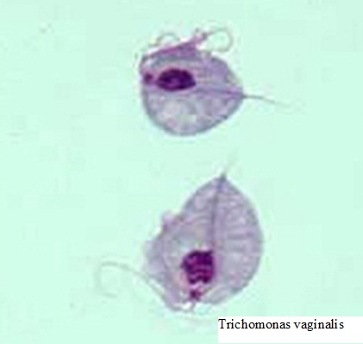
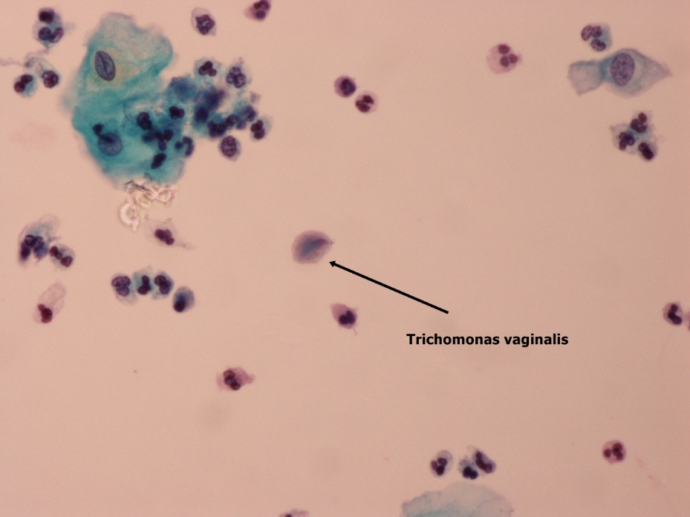
Trichomoniasis
It is caused by a unicellular flagellated protozoan, Trichomonas vaginalis.
It is sexually transmitted disease
Involves the vagina and cervix.
Clinical presentation
Greenish-yellow frothy and foul smelling vaginal dischargecommonly
Painful urination
vulvovaginal itching or irritation
dyspareunia
Cytology smears show:
The organism can be found in Pap-stained vaginal smears in a background of inflammatory cells. Diagnosis can also be made by examination of a saline wet preparation in which the motile trophozoites are seen.
http://www.medthical.com/trichomoniasis.html
http://137.189.150.85/cytopathology/Slide/31-7G3.jpg

Slide 11
Chlamydia trachomatis Cervicitis
Chlamydia trachomatis is an obligate, gram-negative intracellular pathogen.
Chlamydial cervicitis is the most common sexually transmitted disease in the developed countries. It may coexist with Neisseria gonorrhoeae infection.
It is a frequent cause of pelvic inflammatory disease.
Chlamdial infection may also cause a condition known as lymphogranuloma venereum
Clinical appearances
most often asymptomatic.
In symptomatic cases there is a mucopurulent cervical discharge with a reddened, congested and edematous cervix. It may be associated with urethritis.

Slide 12
Herpes simplex virus (HSV) Cervicitis
HSV Type 2 infection accounts for majority of genital herpes cases and is spread by sexual contact.
It produces vesicles and ulcers that can involve the cervix, vagina, vulva, urethra and perianal skin.
"Herpes simplex virus pap test" by Nephron - Own work. Licensed under CC BY-SA 3.0 via Wikimedia Commons - http://commons.wikimedia.org/wiki/File:Herpes_simplex_virus_pap_test.jpg#/media/File:Herpes_simplex_virus_pap_test.jpg

Slide 13
Human papilloma virus(HPV) infection
HPV infection of the cervix is common.
Over 20 serotypes infect the female genital areas. They cause a variety of different lesions with the different serotypes.
Clinical behavior
HPV infection is associated with increased risk of subsequent cervical cancer and so long-term follow-up with attention to the cervix, vagina and vulva is necessary.
HPV infection causes koilocytic atypia in the cervical squamous epithelium
HPV infection may cause any of the following depending on the serotype
1) Condyloma. This develops in the squamous epithelium of the cervix. The lesions may be flat or exophytic condylomma acuminatum. Usually caused by HPV serotypes 6 and 11.
2) Mild dysplasia is usually caused by "low risk" HPV serotypes, 6 and 11.
3) High- grade dysplasia is caused by "high risk” HPV (types 16 and 18) and moderate risk HPV( types 31, 33 and 35).

Slide 14
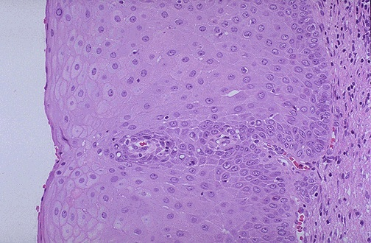
Normal
http://classconnection.s3.amazonaws.com/313/flashcards/1780313/jpg/11359563278872.jpg
KOILOCYTES: are squamous epithelial cells that has undergone structural change due to infection of the cell by HPV. They show koilocytosis or koilocytic atypia which is the following cellular changes:
Nuclear enlargement
Irregular nuclear membrane
Nuclear hyperchromasia
Perinuclear halo (clear area around the nucleus).
http://www.microcorre.com/GYN/FEM003.jpg

Slide 15
Cervix Carcinoma
Cervical carcinoma is one of the major causes of cancer-related death in women.
Most common cervical cancer is squamous cell carcinoma. Other types are adenocarcinoma, neuroendocrine carcinoma etc.
Nowadays there is dramatic improvement in management of this disease because of early diagnosis and treatment and therefore the deaths associated to cervical cancer are decreasing. This is dus to to the use of a screening method called PAP screening test.
The wide use of PAP screening has lowered the incidence of invasive cancer and deaths by it .

Slide 16
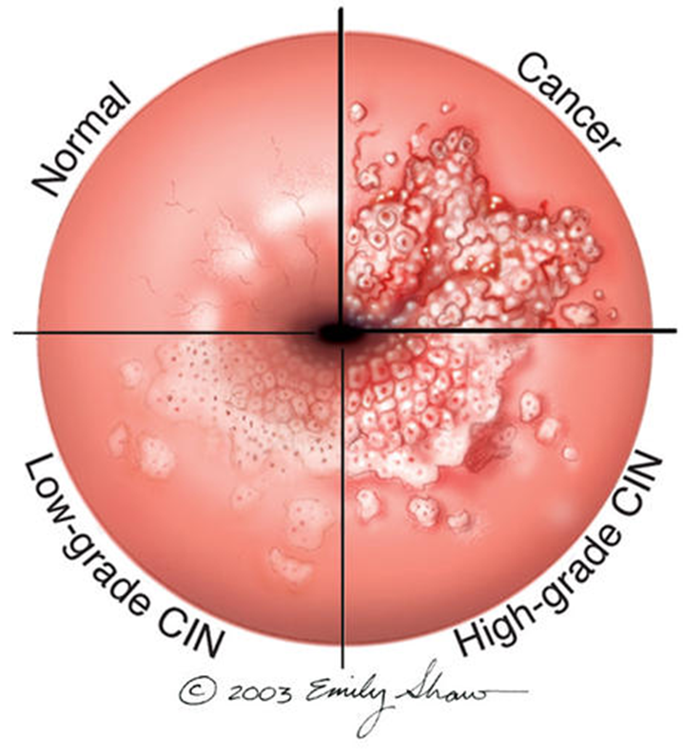
Precancerous lesion of cervical carcinoma: cervical intraepithelial neoplasia (CIN) or squamous intraepithelial lesions (SIL).
All invasive squamous cell carcinomas arise from non invasive pre-cancer epithelial lesions called cervical intraepithelial neoplasia (CIN) or squamous intraepithelial lesions (SIL).
SIL is the terminology used in cytology (pap smears) and CIN is the terminology used in histology (biopsies)
Timely detection and diagnosis of CIN/SIL is essential in preventing the development of carcinoma (invasive lesion) and therefore providing curative treatment possible.
Not all cases of CIN/SIL progress to invasive cancer and some cases of CIN/SIL may spontaneously regress.
The risk of progression to cancer is more in the high grade CIN/SIL and they are associated the high-risk HPV serotypes.

Slide 17
Cervical intraepithelial neoplasia (CIN)
CIN are precancerous lesions of the cervix.
Pre-cancer changes can precede the development of an overt cancer by many years.
CIN lesions may begin as Low Grade CIN and progress to High Grade CIN, or they might start straight off as High Grade CIN.
On the basis of histology, pre-cancer lesions are graded as follows:
-CIN I : Mild Dysplasia
-CIN II : Moderate Dysplasia
-CIN III : Severe Dysplasia and Carcinoma in situ.

Slide 18
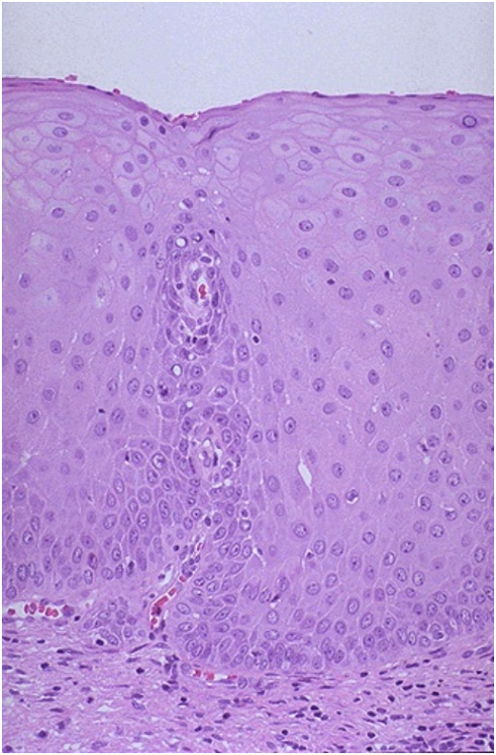
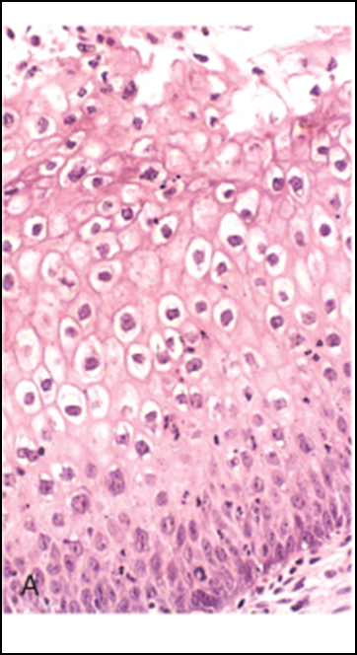
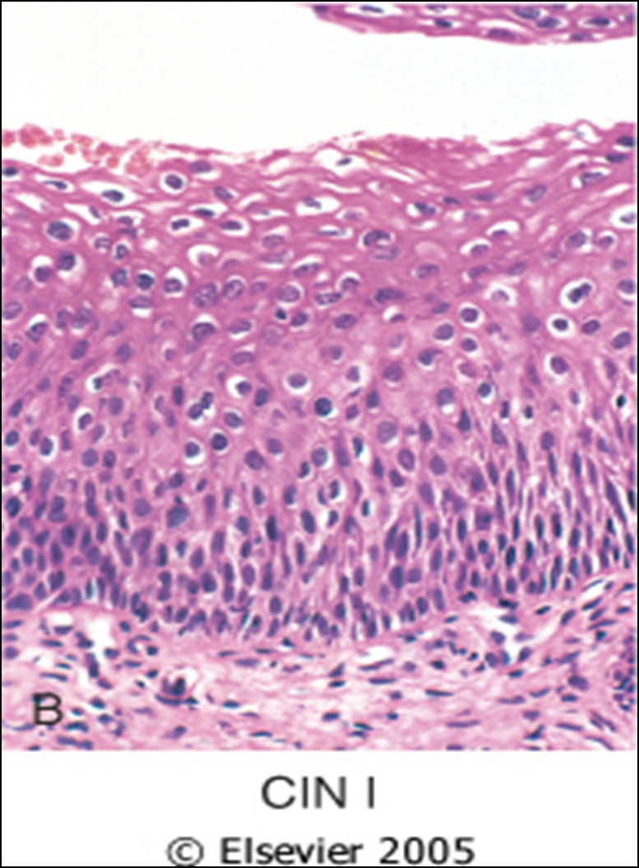
Cervical biopsy
Mild dysplasia = CIN I
with HPV associated koilocytotic atypia. Lower 1/3rd of the epithelium is replaced by pleomorphic cells
Normal
Koilocytotic atypia of HPV

Slide 19
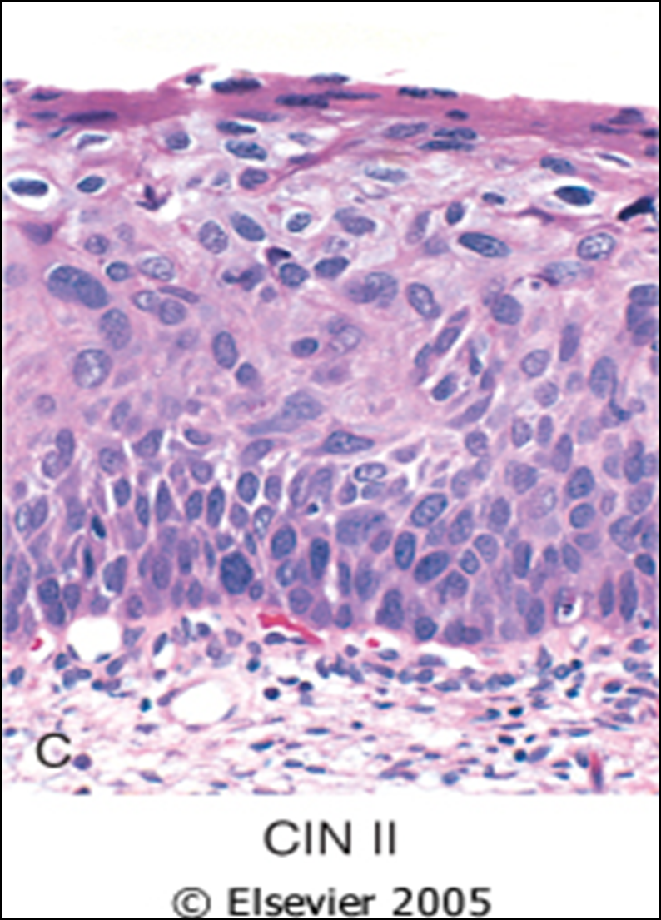
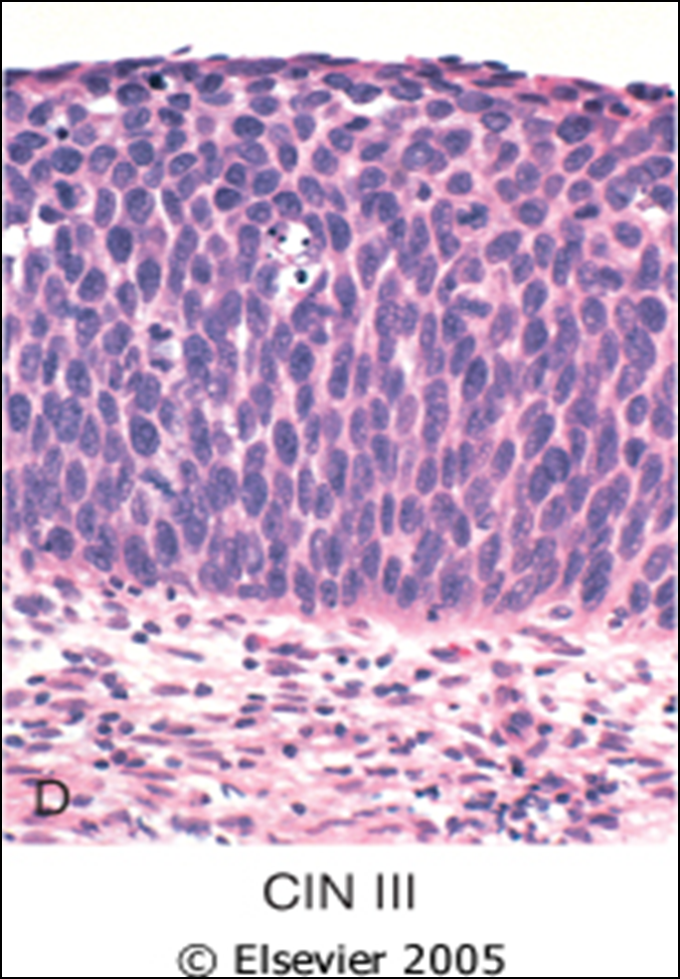
Cervical biopsy
Moderate dysplasia = CIN II. There is progressive atypia in the layers of the epithelium; lower 2/3rd of the epithelium is replaced by pleomorphic cells
Severe dysplasia = CIN III (carcinoma in situ). There is diffuse atypia and loss of maturation. All levels of the epithelium are replaced by pleomorphic cells, (full thickness)

Slide 20
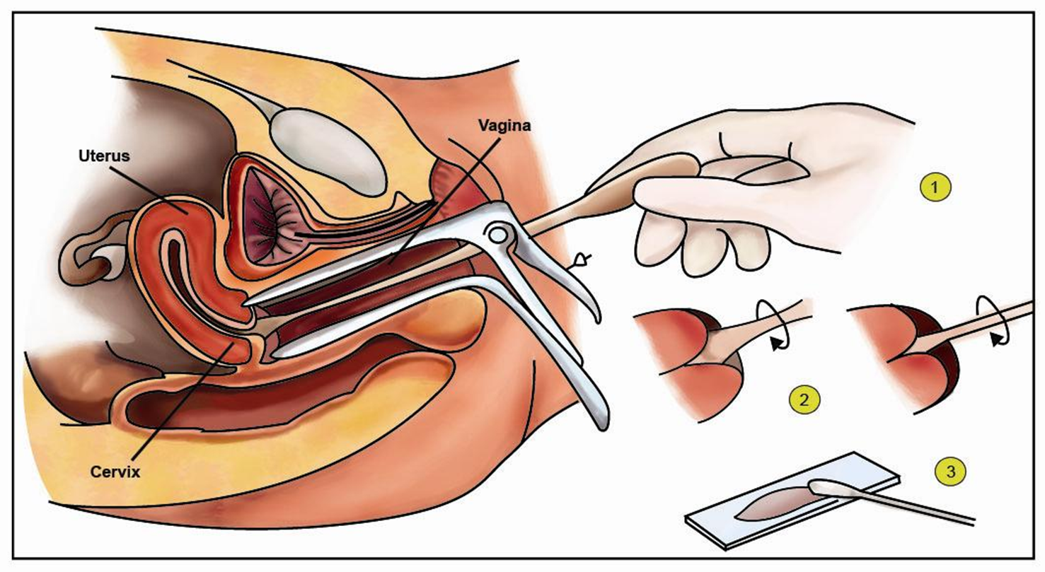
PAP SCREENING TEST: Cytology screening for precancerous lesions
Cytologic examination can detect precancerous squamous intraepithelial lesions long before any abnormality can be seen grossly, using the PAP test. PAP test is the cytologic examination of the cells of cervix. In it the cevix is examined and the cells lining the cervical wall at the transformation zone are scrapped/ sampled with a spatula and then transferred onto a slide, processed, stained (Papanicolaou stain) and examined under a light microscope to look for squamous intraepithelial lesions and a diagnosis is made.
This screening for precancer should be done on all young and old women (usually from age of 21 onwards).
http://www.ivf-clinic-india.com/pics/Pap-Smear.jpg

Slide 21
Cytology Pap Smear/Screening
SILs are divided into low grade and high grade SIL.
In cytology smear report these are few of the possible diagnoses:
Normal cells
Low Grade SIL (= CIN1/mild dysplasia)
High Grade SIL (= CIN2 and 3/moderate to severe dysplasia)
About 1 to 5% of low Grade SIL become invasive squamous cell carcinomas
About 6 to74% of high Grade SIL become invasive squamous cell carcinomas

Slide 22
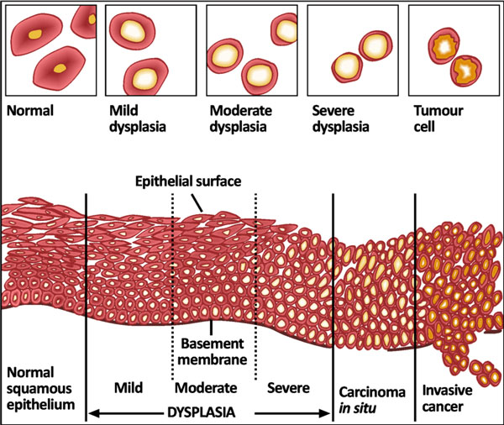
http://ab-histology.blogspot.com/

Slide 23
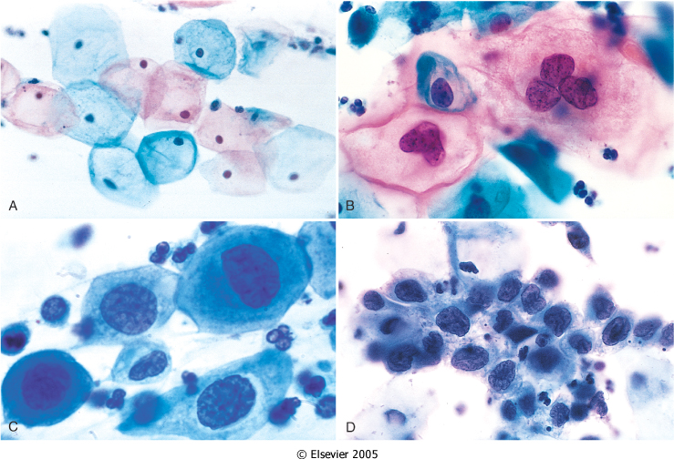
The cytology of cervical intraepithelial neoplasia as seen on the Papanicolaou smear. Cytoplasmic staining in superficial cells (A&B) may be either red or blue.
A, Normal exfoliated superficial squamous epithelial cells.
B, CIN I/ low grade SIL
C, CIN II/ high grade SIL.
D, CIN III/ high grade SIL.
Note the reduction in cytoplasm and the increase in the nucleus to cytoplasm ratio, which occurs as the grade of the lesion increases. This reflects the progressive loss of cellular differentiation on the surface of the lesions from which these cells are exfoliated.

Slide 24
Risk Factors and causes for CIN/ SIL and cervical carcinoma
Risk Factors
Early age at first intercourse
Multiple sexual partners
A male partner with multiple previous sexual partners
Persistent infection by high risk papillomaviruses
Other risk factors; low socioeconomic groups
rare among virgins and multiple pregnancies.
Causes
The cause is determined to be HPV virus .The HPV is the number one reason for abnormal cells of the cervix.
HPV is a skin virus, which results in warts, common warts ,flat warts, genital warts (condylomas), planter warts, and precancerous lesions.
HPV can be detected in 85 -90 % of pre-cancer lesions.
High risk types HPV : 16, 18, 31, 33, 35, 39, 45, 52, 56, 58, and 59.
Low risk types HPV :6, 11, 42, 44 . These types result in condylomas.
Treatment
laser or cone biopsy is the most effective method of managing patients with High grade SIL in cancer prevention

Slide 25
CIN/SIL & RULES OF PAP TEST
Signs of CIN/ SIL
There are no visible symptoms of dysplasia of the cervix, and it is difficult to diagnose without a Pap smear or Pap exam .
Therefore regular pap exams should be done to detect any abnormal cells.
General rules of Pap Screening for CIN/SIL and carcinoma cervix via pap smear are:
The common testing procedure for HPV infection is a cytology pap smear screening test/exam.
The Pap smear detects HPV infection early.
Should start at the age 21.
For women between age 21 to 29: cytological screening pap test should be done every 3 years
For women between age 30-64 : there are 2 possibilities
Either only cytology screening pap test is done every 3 years
Or there is co-testing in which cytology screening pap test is done along with DNA in-situ hybridization HPV testing, every 5 years.
NOTE: This HPV DNA in-situ hybridization (ISH) test, is called the Diegene Hybrid Capture test to identify the serotype of the viral strain. This test will determine whether you carry high or low risk strains of the virus. DNA screening test should not be used before age 30.

Slide 26
Cervical Carcinoma, Invasive
About 75 -90% of invasive cancers are Squamous cell carcinomas ,which generally evolve from pre-cancer CIN/SIL lesions.
The remainder are Adenocarcinoma.
Squamous cell cancers are appearing in increasingly younger women, now with a peak incidence at about 45 years, about 10-15 years after detection of their precursors.

Slide 27
http://home.ccr.cancer.gov/inthejournals/archives/images/guis_img.png Reference Gius D, Funk MC, Chuang EY, Feng S, Huettner PC, Nguyen L, Bradbury CM, Mishra M, Gao S, Buttin BM, Cohn DE, Powell MA, Horowitz NS, Whitcomb BP, Rader JS. Profiling microdissected epithelium and stroma to model genomic signatures for cervical carcinogenesis accommodating for covariates. Cancer Res 67: 7113–23, 2007

Slide 28
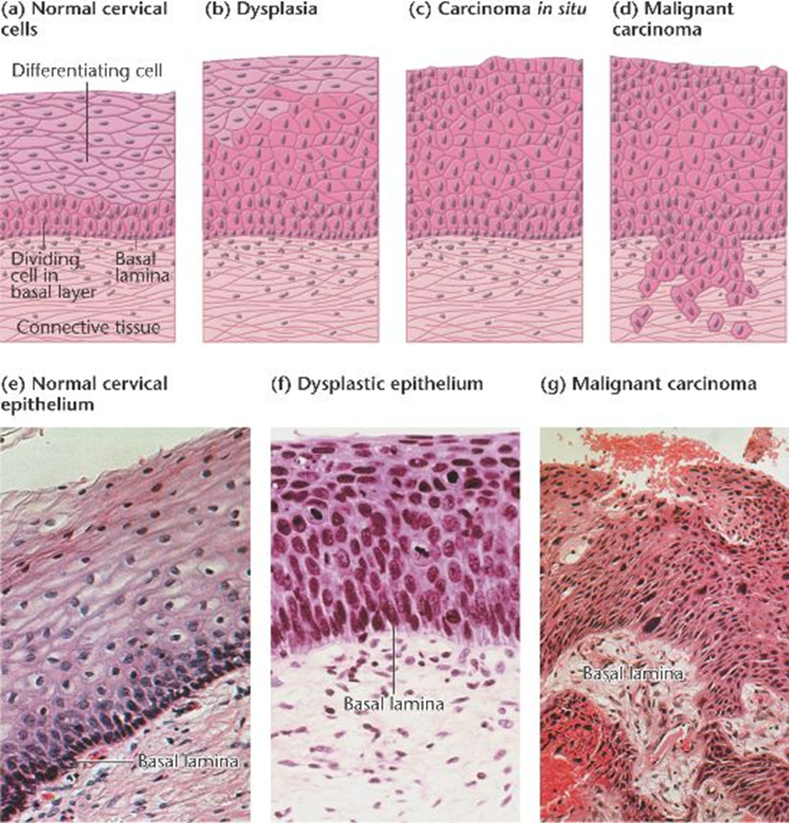

Slide 29
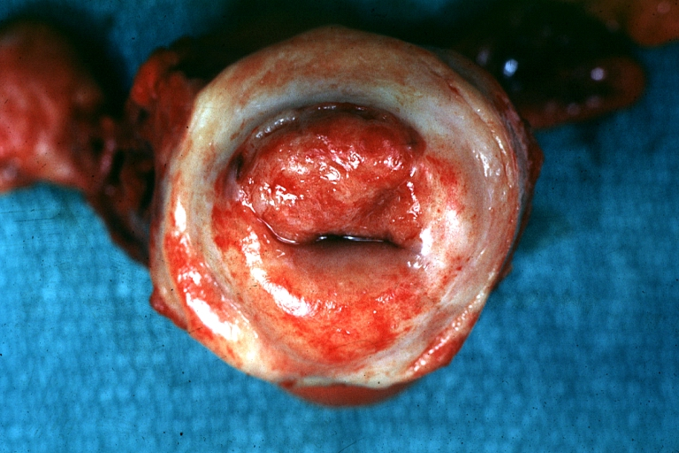
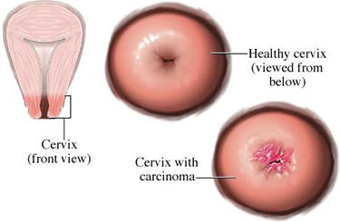
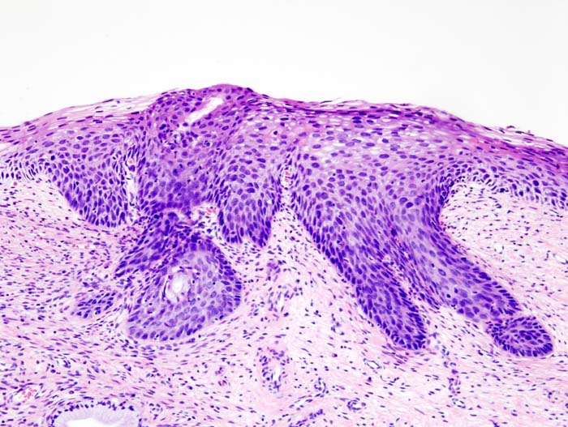
Cervical cancer
http://www.wikidoc.org/images/d/d6/Cervical_Carcinoma.jpg
http://ehealthmd.com/content/what-cervical-cancer
http://www.wikidoc.org/images/d/d6/Cervical_Carcinoma.jpg

Slide 30
Cervical Carcinoma (invasive carcinoma), Morphology
Mainly in the region of the transformation zone, and range from microscopic foci of early stromal invasion to grossly frank tumors encircling the cervical Os .
The tumors may be invisible or exophytic .
Cervical carcinomas are graded from 1 to 3( i.e. well, moderately and poorly differentiated) based on cellular differentiation and staged from 1 to 4 depending on clinical spread.

Slide 31
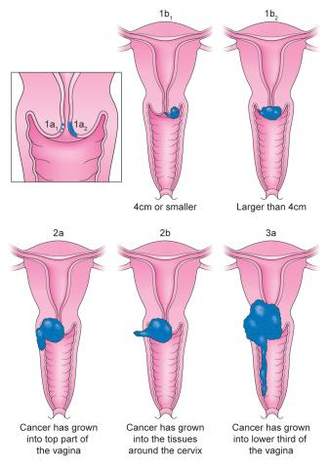
Cervical Carcinoma, Staging
0- Carcinoma in Situ
1- Confined to the cervix
2- Extension beyond the cervix without extension to the lower third of Vagina or Pelvic Wall
3- Extension to the pelvic wall and/or lower third of the vagina
4- Extends to adjacent organs
http://www.jostrust.org.uk/sites/default/files/styles/large/public/Cervical%20cancer%20stages.jpg?itok=KeOqGkCs

Slide 32
Cervical Carcinoma, Clinical Course
Many of cervical cancers are diagnosed in early stages, and the vast majority are diagnosed in the pre-invasive phase.
More advanced cases are seen in women who either have never had a Pap smear or have waited many years since the prior smear.
The early stages of cervical cancer may be completely asymptomatic.
Vaginal bleeding, contact bleeding, or cervical mass
Dyspareunia.
In advanced disease, metastases may be present in the abdomen, lungs or elsewhere.
Symptoms of advanced cervical cancer may include: loss of appetite, weight loss, fatigue, pelvic pain, back pain, leg pain, swollen legs, heavy bleeding from the vagina, bone fractures, and/or (rarely) leakage of urine or feces from the vagina

Slide 33
Cervical Carcinoma: Treatment
Depending on the stage the treatment options are:
If you still want to be able to have children, the cancer is removed with a cone biopsy (cervical conization), and then you are watched closely to see if the cancer comes back.
Simple hysterectomy (removal of the whole uterus including part of the vagina).
Radical hysterectomy (removal of the whole uterus including part of the vagina along with the removal of lymph nodes in the pelvis.
Adjunct chemotherapy and radiotherapy.

Slide 34
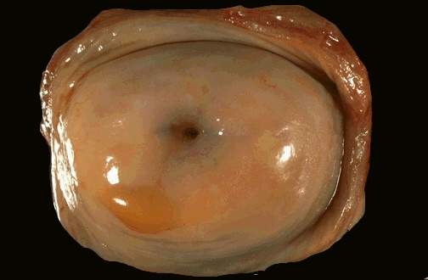
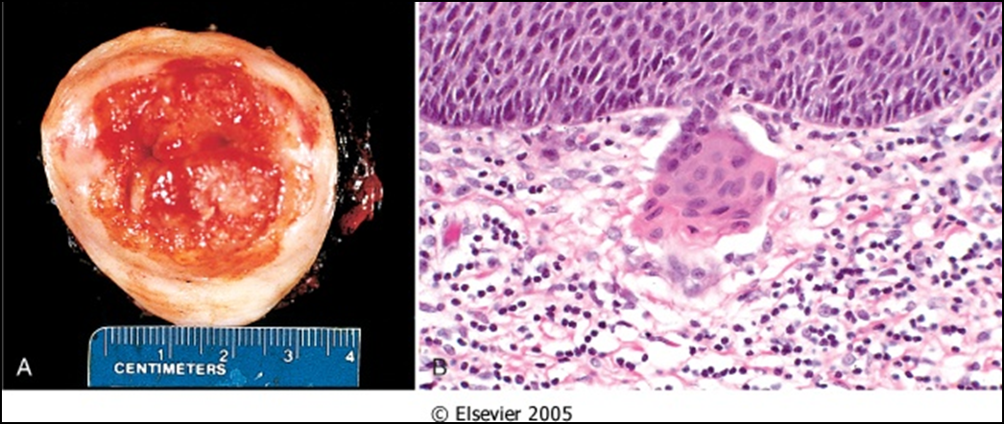
A, Carcinoma of the cervix, well advanced. B, Early stromal invasion occurring in a cervical intraepithelial neoplasm
http://homepage.smc.edu/wissmann_paul/anatomy2textbook/cervixNormalGross.jpg

Slide 35
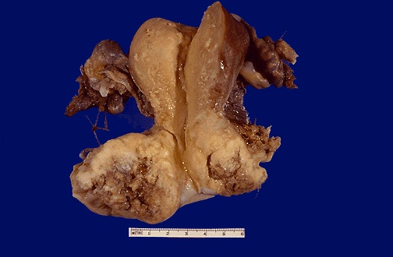

Slide 36
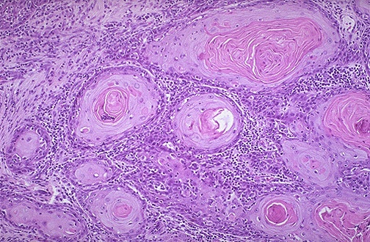
http://ab-histology.blogspot.com/

