Slide 1
Polycystic Ovarian Disease and Endometriosis
Emad Raddaoui, MD, FCAP, FASC

Slide 2
Polycystic Ovarian Disease (PCOD)
Polycystic ovaries are characterized by bilaterally enlargement of ovaries by multiple small cysts, chronic anovulation and clinical manifestations secondary to excessive production of estrogens and androgens, mainly androgens.
The initial abnormality resulting in the syndrome is not known but is believed to be related to hypothalamus-pituitary dysfunction leading to over secretion of luteinizing hormone (LH).
LH in turn stimulates the ovary to produce excess androgens. Secretion of follicle stimulating hormone (FSH) is inhibited resulting in suppression of ovulation with follicle cyst formation.
High level of LH and low FSH
Other names for this syndrome include polycystic ovarian syndrome and Stein-Leventhal syndrome
http://www.sustainhealth.com.au/wp-content/uploads/2015/02/polycystic-ovarian-syndrome.jpg

Slide 3
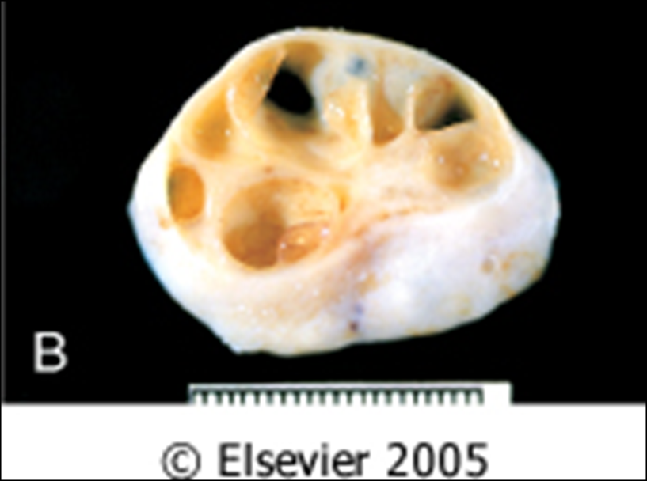
Polycystic Ovarian Disease
Clinical appearances.
The usual clinical presentation is a young woman (between 15 and 30 years) with
- secondary amenorrhea with anovulation
- oligomenorrhea or irregular menses
- infertility
- hirsutism
- virilism due to excessive amounts or effects of androgenic (masculinizing) hormones
- obesity
- acne

Slide 4
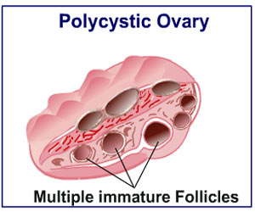
Polycystic ovarian disease. A, The ovarian cortex reveals numerous clear cysts. B, Sectioning of the cortex reveals several subcortical cystic follicles. C, Cystic follicles seen in a low-power microphotograph.
Picture Taken from Robbins and Cotran Pathologic basis of disease. 8th edition, Chapter 21, 2010 Sanders
http://cdns.medindia.net/images/patientinfo/300x250/polycystic-ovarian-syndrome.jpg

Slide 5
Polycystic Ovarian Disease
Histology
Ovaries:
Ovaries are 2 times the normal size with many subcortical cysts measuring 0.5 to 1.5 cm in diameter.
Microscopically, the outer portion of the cortex is thickened and fibrotic (cortical stromal fibrosis) with multiple cysts underneath. The follicular cysts usually have a prominent theca interna layer.
Corpora lutea are frequently absent due to the anovulation.
Endometrium:
The unopposed estrogenic due to chronic anovulation leads to a hyper estrogenic state. As a result endometrium may show a variety of appearances ranging from mild hyperplasia to complex hyperplasia to atypia to endometrial adenocarcinoma

Slide 6
Polycystic Ovarian Disease
Women with PCOS are at risk for the following:
Endometrial hyperplasia and endometrial cancer
Insulin resistance/Type II diabetes
High blood pressure
Depression/Anxiety
Dyslipidemia
Cardiovascular disease
Strokes
Weight gain
Miscarriage
Acanthosis nigricans (patches of darkened skin under the arms, in the groin area, on the back of the neck)
Autoimmune thyroiditis

Slide 7
Polycystic Ovarian Disease
Treatment
Treatment with drugs that either induce ovulation (clomiphene or hCG) or regulate the menstrual cycle restores fertility.
Reduction of ovarian volume by wedge resection of the ovaries is also successful in initiating ovulation and restoring fertility.
The endometrial changes usually regress once ovulation is achieved.

Slide 8
Endometriosis
Normally endometrial glands and endometrial stroma are found in the endometrium of the uterus.
Endometriosis is the presence of ectopic endometrial glands and stroma outside the uterus.
They are usually found on the peritoneal surfaces of the reproductive organs and adjacent pelvic organs.
The most frequent location is the ovary (approx. 50%) followed by the pouch of Douglas, uterine ligaments. Occasionally involve cervix, vagina, perineum, bladder, large bowel and the umbilicus. Rare lesions are seen as far as small bowel, kidneys, lungs, nose and brain.
It has been reported in men. The sites involved have been the bladder, scrotum and prostate
It is non-neoplastic.
Like the uterine endometrium it is responsive to the hormonal variations of the menstrual cycle, and bleeds during menstruation.
Therefore in endometriosis there is menstrual type bleeding at the site of the ectopic endometrium, resulting in blood filled areas (e.g. chocolate cysts).
http://upload.wikimedia.org/wikipedia/commons/d/d5/Blausen_0349_Endometriosis.png

Slide 9
Endometriosis :Clinical features
Clinical features depends on the site of endometriosis.
Dysmenorrhea, cyclic abdominal pain and dyspareunia are common symptoms. Usually there is severe menstrual-related pain.
Often results in infertility.
Endometriosis usually appears as multiple red or brown (due to hemosiderin) 1mm to 5mm nodules (some may form larger masses or cysts). Dense fibrous adhesions may surround the foci.
http://www.coastalivf.com.au/images/endometriosis.jpg

Slide 10
Endometriosis
Repeated hemorrhage into foci in the ovary with each menstrual cycle produces cysts, which contain inspissated, chocolate-brown material, called "chocolate cysts” in which the ovaries turn into large cystic masses filled with brown fluid
Clinical behavior
Benign with no malignant potential. May recur after surgical excision but the risk is low.
Chocolate cyst of ovary (endometriotic cyst)

Slide 11
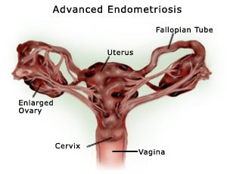
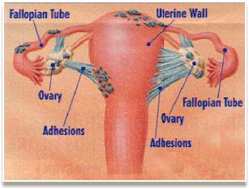
Endometriosis, complications
Infertility
Adhesions
http://longstoryshortgirl.com/wp-content/uploads/2014/08/causes-of-endometriosis-cyst.jpg
http://longstoryshortgirl.com/wp-content/uploads/2014/08/causes-of-endometriosis-cyst.jpg

Slide 12
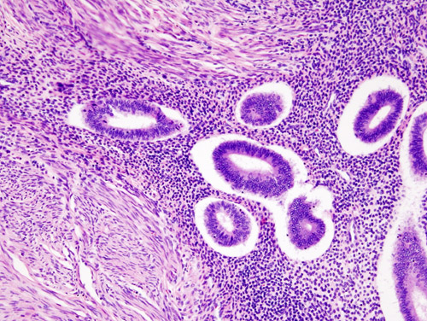
Endometriosis: histology
- Ectopic endometrial glands and endometrial stroma are present.
- Denatured blood from previous bleeding is present.
- Macrophages containing hemosiderin (siderophages) are present.
- When endometriosis develops in a muscular organ, the smooth muscle around it is often hyperplastic.
"Uterine adenomyosis (1)". Licensed under CC BY-SA 3.0 via Wikimedia Commons - http://commons.wikimedia.org/wiki/File:Uterine_adenomyosis_(1).JPG#/media/File:Uterine_adenomyosis_(1).JPG
Massive abdominal wall endometriosis masquerading as desmoid tumour Anand Mani, Deshmukh Sanjay D Year : 2011 | Volume: 4 | Issue Number: 2 | Page: 141-14 http://www.jcasonline.com/articles/2011/4/2/images/JCutanAesthetSurg_2011_4_2_141_85043_u4.jpg

Slide 13
Adenomyosis
- This is defined as the presence of endometrial glands and endometrial stroma in the myometrium of the uterus.
- The condition involves the posterior wall more often than the anterior wall but it may affect both walls in the same uterus.
- The disease is primarily a disorder of parous women and is uncommon in the nullipara. It is associated with menorrhagia and severe dysmenorrhea. In about a third of patients there are no symptoms and the lesions are discovered accidentally.
- When extensive the lesions produce myometrial thickening with small yellow or brown cystic spaces containing fluid or blood.
- Occasionally, proliferation of smooth muscle around a focus of adenomyosis produces a tumor called adenomyoma, which resembles uterine leiomyoma.
Clinical behavior.
This is a benign condition with no known malignant potential that regresses after the menopause

Slide 14
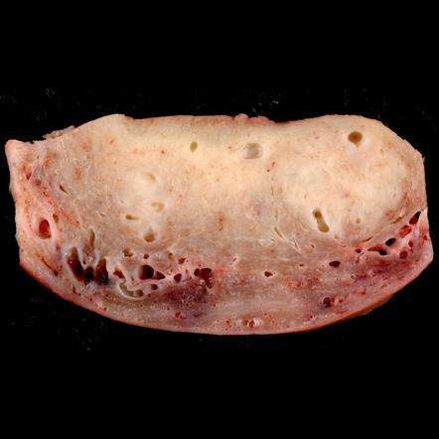
Adenomyosis
Cross section through the wall of a hysterectomy specimen of a 30-year-old woman who reported chronic pelvic pain and abnormal uterine bleeding. The endometrial surface is at the top of the image, and the serosa is at the bottom
http://www.paroleauxjeunes.fr/wp-content/uploads/2013/11/adenomyose.jpg
"Adenomyosis, Hysterectomy Specimen" by Ed Uthman, MD - http://www.flickr.com/photos/euthman/640264025/. Licensed under CC BY-SA 2.0 via Wikimedia Commons - http://commons.wikimedia.org/wiki/File:Adenomyosis,_Hysterectomy_Specimen.jpg#/media/File:Adenomyosis,_Hysterectomy_Specimen.jpg

