Slide 1
Drugs used for treatment of AIDS
Dr.Abdul latif Mahesar

Slide 2
How HIVpositive differs from AIDS
Does in every case HIV leads to AIDS ?

Slide 3
HIV causes AIDS: This is a progressive failure of immune system which allows life threatening infections and cancers to thrive.
Average life after HIV infection goes 9-11 years
But by the development of effective drugs ,person may live normal life by carrying a chronic infection for prolong time.

Slide 4
Drugs act on different viral targets
Viral load(quantity) is decreased
Immune system is maintained
Body is prevented from opportunistic infections

Slide 5
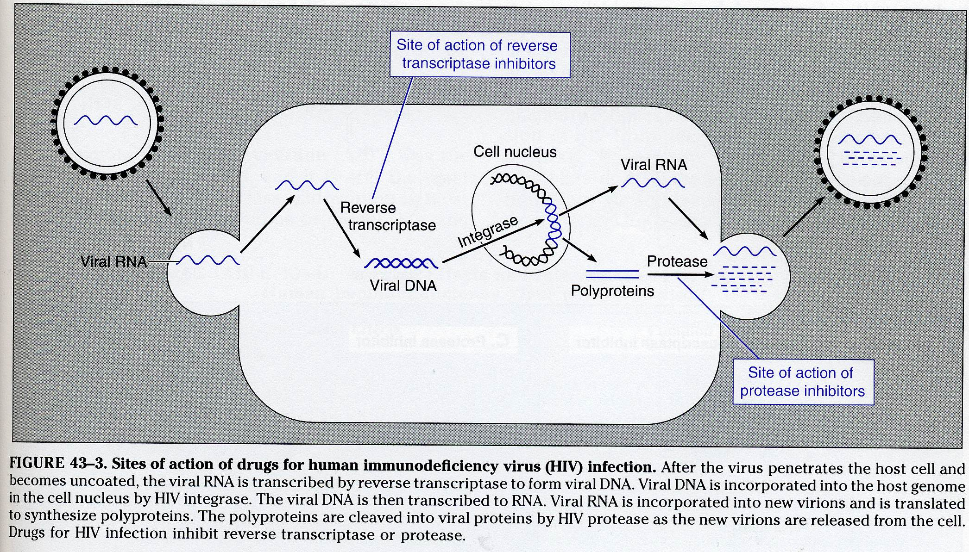
Targets for treatment of HIV (anti-retroviral drugs

Slide 6
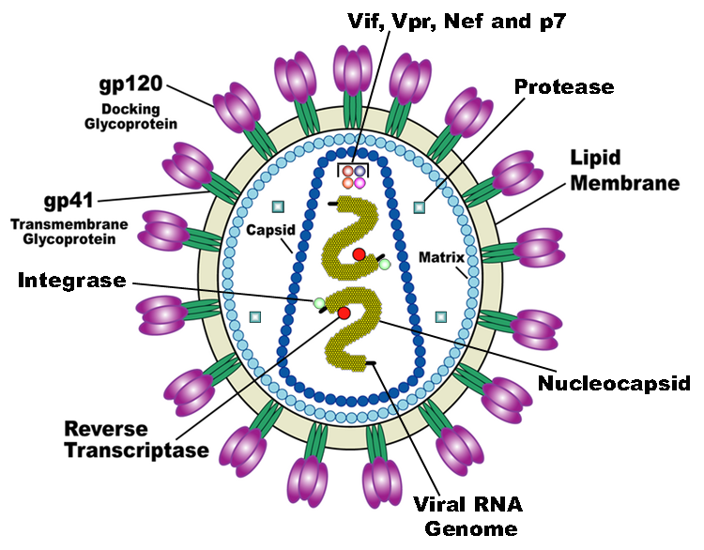

Slide 8
Drugs
Entry /fusion inibitors
Maraviroc , Enfuvertide
Nucleoside reverse transcriptase inhibitors
zidovudine ,Didanosine ,Emtricitabine
Non nucleoside reverse transcriptase inhibitors
Nevirapine ,Etraverine
Integrase Inhibitors
Raltigraver
Protease inhibitors
Ritonavir
Atazanavir

Slide 9
1st effective therapy for HIV was the nucleoside reverse transcriptase inhibitor zidovudine but this drugs or even in combination of drugs from this group were unable to suppress virus for long periods of time and patient eventually dies
Later on the development of other drugs, drug from other antiHIV class were used in combination as protease inhibitors indinavir.
Then concept of three drug therapy was quickly adapted in to clinical practice this rapidly showed impressive benefit with 60-80% decline in rates of AIDS, death and hospitalization this is called HAART
(highly active antiretroviral therapy).

Slide 10
by this way enhanced potency of the drugs is achieved with lesser chances of toxic effects
and
Emergence of the resistance by the virus is reduced or delayed when multiple drugs are used

Slide 11
When antiretroviral drugs are used improperly multi drug resistance can become dominant .
Now days fixed dose combination, three drug therapy is available in one pill which is to be taken as once daily dosing.
Antiretroviral drugs can also be use for prevention transmission of virus from one partner to other and from mother to child.

Slide 12
Nucleoside Reverse Transcriptase Inhibitors
Zidovudine
Are nucleoside & nucleotide analogue, inhibits the enzyme reverse transcriptase.
Hence leading to clinical and immunological improvements .can also be used to prevent viral transmission
It slow HIV replication but does not stop entirely.
Virus may become resistant over time ,usually used in combination.

Slide 13
CD4 count is increased
T cell immunity is restored
Weight gain by patients suffering from HIV
Safely prolong the life of patients with HIV

Slide 14
Mechanism of action
Selective reverse transcriptase inhibitors
acts as competitive substrate inhibitors
and can also be incorporated in to growing viral DNA chain and cause its termination

Slide 15
Zidovudine
Pharmacokinetics
Orally effective, well absorbed and distributed to most body fluids.
Penetrates CSF
eliminated by renal excretion, metabolized by hepatic gluccuronidation

Slide 16
It can safely be used in children in low dose
It is also used during pregnancy , labor and during delivery.
And then to neonates up to six weeks
it reduces the risk of development of AIDS to 8%

Slide 17
Side effects
Bone marrow depression (neutropenia)
Anemia
Hepatotoxity
Headache
Nausea , anorexia
Myopathy , fatigue
These are reversible either dose is reduced or drug is withdrawn.

Slide 18
Emtricitabine
It Highly absorbed orally, unaffected by food
Serum half life 10 hours ,bioavailability for 24 hrs
Oral formulation should not be used in a pregnant AIDs patient because it contains a propylene glycol which is a potentially toxic compound for the fetus. also contraindicated in children and patients with renal and hepatic impairment
Most common adverse effects headache GIT disturbance Hyper pigmentation of the palms & soles

Slide 19
Didanosine
Oral bioavilability is 40 %
Oral bioavailability is reduced by food it is given in buffer form to avoid acid destruction of the drug
Eliminated by the kidney
Causes acute pancreatitis there fore avoided to be co administered with other drugs with potential to cause pancreatitis and person with hypertriglycerdemia
Can also cause retinal damage and peripheral neuropathy

Slide 20
Non-Nucleoside Transcriptase Inhibitors
Nevirapine ( 1st generstion),
Etravirine ( 2nd generation )

Slide 21
Mechanism of action
Nevirapine
Bind near the active site of the viral reverse transcriptase to inhibit its activety. Binding site is distinct from the NRTIs
( Act as a non-competitive inhibitors of reverse transcriptase enzyme )

Slide 22
Pharmacokinetics
Orally effective
long serum half life
Metabolized in liver extensively
Excretion through kidney
Inducer of hepatic cytochrome P450
It is typically used as a component of combination therapy
Very effective for prevention of transmission as a single dose at time of labor and followed by oral dose to neonate with in three days

Slide 23
Side Effects
Hepatotoxicity
Skin reaction up to life threatening as Steven-Johnson Syndrome (with nevirapine)
Diarrhea
Headache
Etraverine is very effective against strains which have developed resistance to 1st genrations
Adverse effects most significant rash

Slide 24
Protease inhibitors
Ritonavir, Atazanvir
Block the viral protease enzyme necessary to produce mature virions
( prevent polyprotein cleavage, which is necessary for the maturation of viral cells )

Slide 25
Pharmacokinetics
Atazanavir
oral absorption requires an acid environment
Once daily dosing
Undergoes biliary elimination
Enzyme inhibitors P450

Slide 26
Pharmacokinetics
Ritonavir
it has high bioavailability when given with food
administered in slow dose escalation to limit side effects
Should be taken with meals
Clearance is mainly via the liver
Enzyme inhibitors P450

Slide 27
Side effects for protease inhibitors
Increased bleeding in hemophilic patients
It causes Hyperglycemia & insulin resistance
Changes in body fat distribution trunkal obesity, buffalo hump, gynecomastia

Slide 28
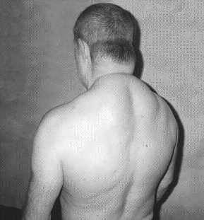
Dorsocervical fat pad (“buffalo hump’)

Slide 29
Entery /fusion inhibitors
Maraviroc
Binds selectively to CCR5 at CD4
Absorption rapid but variable
most of the drug is excreted in feces
Penetrates csf well
It is well tolerated with fewer adverse effects

