Slide 1
Reproductive Physiology Lecture 1 Hypothalamic-Pituitary-Gonadal axis
Dr.Mohammed Alotaibi
Assistant Professor of Physiology
College of Medicine
Department of Physiology
Email: mfalotaibi@ksu.edu.sa
Tel: 0114672629

Slide 2
OBJECTIVES
By the end of this lecture, you should be able to:
Describe the regulation of hypothalamic secretion of GnRH and its physiological role on LH & FSH secretion from the anterior pituitary gland.
Explain the mechanism by which LH & FSH regulate sexual function in males and females.
Describe the negative and positive feedback mechanisms in the hypothalamic-pituitary-gonadal axis (HPG axis) and their importance in the control of reproductive function

Slide 3
The anterior pituitary secretes six hormones:
1. Adrenocorticotropic hormone (ACTH)
2. Thyroid-stimulating hormone (TSH)
3. Growth hormone (GH)
4. Prolactin (PRL)
5. Follicle-stimulating hormone (FSH)
6. Luteinizing hormone (LH)
Secretion of AP hormone is controlled by “releasing hormones” formed in the hypothalamus and transported to the AP gland by the hypothalamic-hypophyseal portal system.

Slide 4
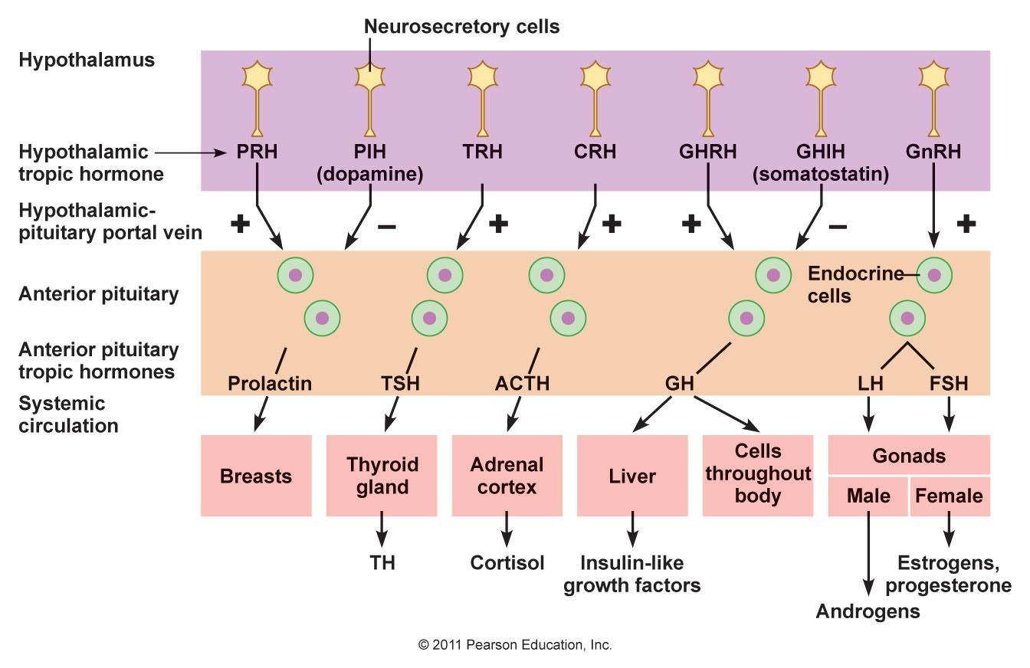
Hypothalamic → Pituitary→ Gonadal axis
lactotropes
Thyrotropes
Corticotropes
Somatotropes
Gonadotropes

Slide 5
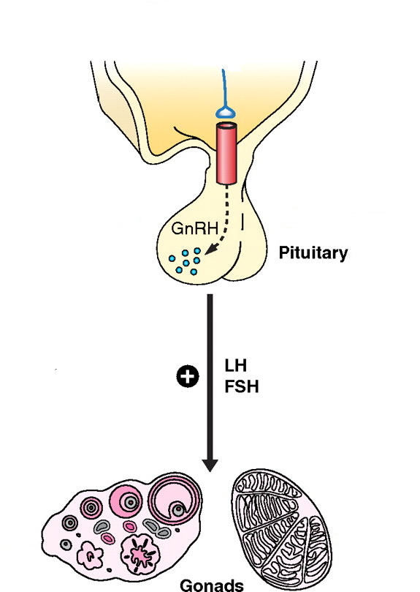
HPG axis
Hypothalamus

Slide 6
Control of male sexual functions by hormones from the hypothalamus and anterior pituitary gland
GnRH is secreted intermittently for few minutes every 1 to 3 hrs.
– The secretion of LH by the anterior pituitary is also cyclical following the pulsatile release of GnRH. Conversely, FSH secretion increases and decreases only slightly with each fluctuation of GnRH secretion
Testosterone
Spermatogenesis

Slide 7
Regulation of the female monthly rhythm, interplay between the ovarian and hypothalamic-pituitary hormones
Intermittent, pulsatile secretion of GnRH by the hypothalamus stimulates pulsatile release of LH & FSH from the AP.
GnRH is secreted in pulses lasting 5 to 25 minutes every 1 to 2 hrs

Slide 8
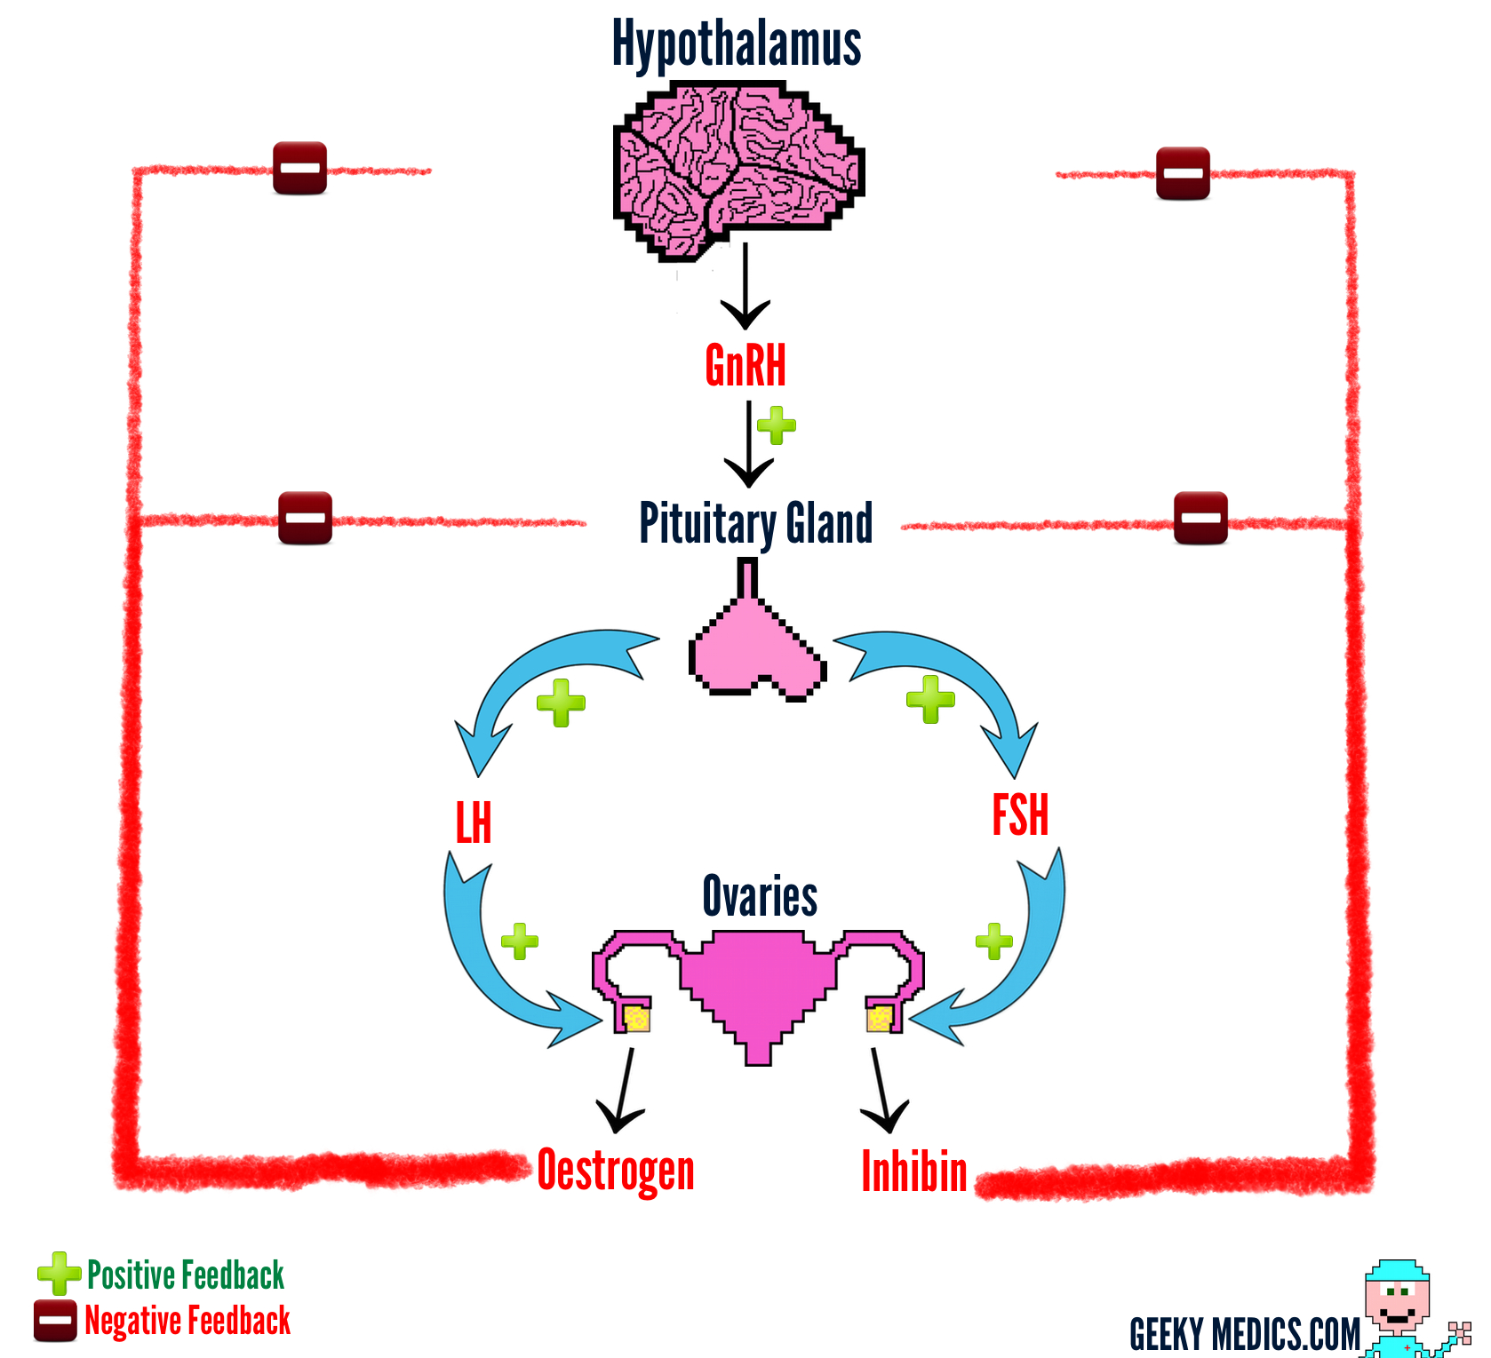
Negative feedback effects of estrogen and progesterone in decreasing both LH and FSH secretion

Slide 9
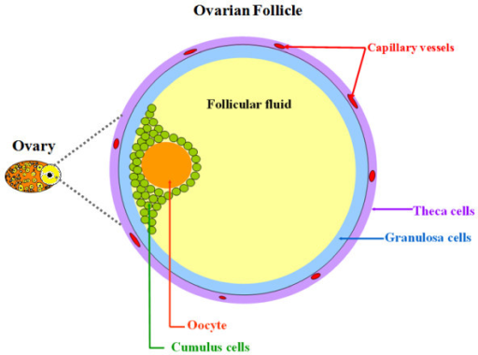
Female Ovarian Follicle

Slide 11
The End
Thank You

