Slide 1
Male Reproductive Physiology GUYTON & HALL, Chapter 80
Dr. Mohammed Alotaibi
Assist. Professor of Physiology
College of Medicine
King Saud University

Slide 2
Objectives
By the end of this lecture, you should be able to:
Explain how the hypothalamus and anterior pituitary gland regulate the male reproductive function
Explain the spermatogenesis and the functions of the male reproductive organs and glands
Describe the synthesis, secretion, metabolism and the effects of testosterone
Describe the abnormalities of male sexual function

Slide 3
Male Reproductive Organs
900 coiled seminiferous tubules
(6 m long)

Slide 5
Spermatogenesis
Formation of sperm from spermatogonia.
Occurs in seminiferous tubules during active sexual life by GnRH.
13 years >>>> ↓ older people
Sertoli cells: large with overflowing cytoplasmic envelopes that surround the developing spermatogonia around the central lumen of the seminiferous tubules.
Leydig cells: lie with interstitium between the seminiferous tubules.
- numerous in the newborn male infants for the first few months of life
- active at puberty & throughout adult life & secrete testosterone.

Slide 6
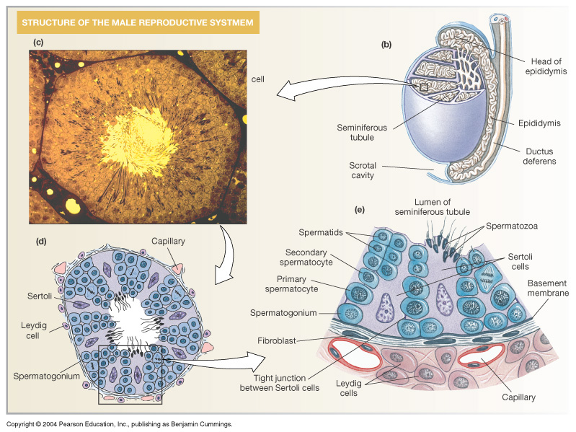
74 days
(sperm)

Slide 7
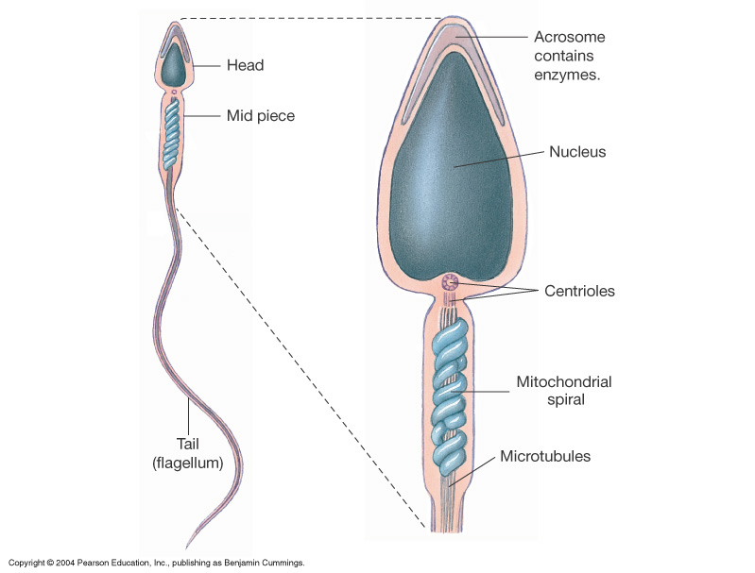
Physiology of mature sperm:
Mature sperm are motile & capable of fertilizing the ovum & their activity is enhanced in a neutral & slightly alkaline medium & depressed in mildly acidic medium. The life expectancy of ejaculated sperm in the female genital tract is only 1 to 2 days
The acrosome of the sperm stores large quantities of hyaluronidase (to digest proteoglycans) and proteolytic enzymes (to digest proteins).

Slide 8
Hormonal factors that stimulate spermatogenesis
1- Testosterone
2- Luteinizing hormone (LH)
3- Follicle stimulating hormone (FSH)
4- Estrogen
5- Growth hormone

Slide 9
Maturation of sperm in the epididymis
- After their formation in the seminiferous tubules, sperms require several days to pass through the epididymis (still non-motile).
- After 18 to 24 hrs >>> they develop the capability of motility
- (some inhibitory proteins in the epididymal fluid prevent final motility until after ejaculation).

Slide 10
Storage of sperms
The 2 testes of adult human form up to 120 million sperms each day.
– Small amount are stored in the epididymis
– The majority are stored in the vas deferens(month).
After ejaculation, the sperm becomes motile & capable of fertilizing the ovum “maturation”
– The sertoli cells and epithelium of the epididymis secrete nutrient fluid which contains (testosterone & estrogens), enzymes & nutrients essential for sperm maturation.

Slide 11
Secretion of Male glands

Slide 12
Function of the seminal vesicles
– Secrete mucoid material containing fructose, citric acid & nutrient substances & large quantities of prostaglandins & fibrinogen.
The prostaglandins help in fertilization in two ways:
1- by reacting with the female cervical mucus making it more receptive to sperm movement.
2- by causing backward reverse peristaltic contractions of the uterus & fallopian tubes to move the ejaculated sperm toward the ovaries.

Slide 13
Function of the prostate gland
The prostate gland secretes thin milky fluid contains Ca2+, citrate ion, phosphate ion, a clotting enzyme & profibrinolysin. The alkaline prostatic fluid is important for successful fertilization of the ovum.
Alkaline prostate fluid function:
1- helps to neutralize the slightly acidic fluid of the vas deferens (due to the presence of citric acid and metabolic product of the sperm which inhibits its fertility).
2- helps to neutralize the acidic vaginal secretions (pH 3.5-4.0) to optimize it for better sperm motility (pH 6.0-6.5)

Slide 14
Semen
Ejaculated semen during sexual act is composed of :
– the fluid & sperm from the vas deferens (~10%)
– fluid from the seminal vesicles (~60%)
– fluid from the prostate gland (~30%)
– small amounts from the mucous glands the bulbourethral glands.

Slide 15
Capacitation of the spermatozoa
Freshly ejaculated semen undergoes a process called “capacitation” within 1-10 hours.
1. inhibitory factors are washed out by uterine and fallopian fluids
2. the sperm swims away from cholesterol vesicles
3. the membrane of the sperms becomes more permeable to Ca⁺⁺

Slide 16
Stages of male sexual act:
1- Penile erection. by parasympathetic impulses.
2- Lubrication, Parasympathetic impulses cause the urethral glands & bulbourethral glands to secrete mucous.
3- Emission and ejaculation. Function of the sympathetic nerves. Contraction of the vas deferens & ampulla to cause expulsion of the sperm in the internal urethra. Contraction of the prostate & seminal vesicles to expel their fluid in the urethra. All these fluid mix in the internal urethra with the mucous secreted by the bulbourethral glands to form the semen. This process at this point is called emission
- Filling of the internal urethra with semen causes sensory impulses through pudendal nerves to the sacral region of the cord. Fullness of the internal urethra causes rhythmical contractions of the internal genital organs which increases their pressure to ejaculate the semen to the outside called ejaculation

Slide 17
Testosterone and other male sex hormones
The testis secretes several male sex hormones called androgens including testosterone, dihydrotestosterone and androstenedione.
Testosterone is the more abundant form while dihydrotestosterone is the more active form.
Secretion & chemistry of androgens in the body:
The term “androgen” means any steroid hormone that has masculinizing effects.
From the testes and adrenal glands. Synthesized either from cholesterol or directly from acetylcoenzyme A.

Slide 18
The basic intracellular mechanism of action of testosterone
It increases the rate of protein synthesis in target cells. Testosterone is converted by the intracellular enzyme 5 α reductase to dihydrotestosterone (DHT), then it binds to cytoplasmic “receptor protein”. This combination moves into the nucleus and initiates gene transcription and induces new protein formation.

Slide 19
It is responsible for the characteristic masculine body.
Functions of testosterone
hCG
10 weeks
Male climacteric

Slide 20
Functions of testosterone during fetal development
Testosterone secreted by the genital ridges & later by the fetal testes is responsible for development of the male body characteristics including the formation of penis & scrotum & suppression of the formation of female genital organs.
Effect of testosterone to cause descent of the testis:
The testes usually descend into the scrotum during the last 2 to 3 months of gestation when the testes begin secreting reasonable quantities of testosterone.

Slide 21
Effect of Testosterone on Development of Adult Primary and Secondary Sexual Characteristics

Slide 22
1- After puberty, the increasing amounts of testosterone cause enlargement of the penis, scrotum & testis & secondary sexual characteristics.
2- Effect on the distribution of body hair:
Testosterone causes growth of hair over the pubis and on the face
3- Baldness:
Testosterone decreases the growth of hair on the top of the head (two factors
1) genetic background; 2) large quantities of androgenic hormones.
4- Effect on voice:
It causes hypertrophy of the laryngeal mucosa, enlargement of the larynx (typical adult masculine voice)

Slide 23
5- Testosterone increases thickness of the skin and can contribute to development of acne
6- Testosterone increased protein formation and muscle development
7- Testosterone increases bone matrix and causes Ca2+ retention:
Bones grown thicker & deposit additional Ca2+. Thus it increases the total quantity of bone matrix & causes Ca2+ retention (anabolic effect).
8- Testosterone increases basal metabolism:
It increases the basal metabolic rate by about 15% (indirectly as a result of the anabolic effect).
9- Effect on red blood cells:
It increases red blood cells 15-20% (due to increase metabolic rate).
10- Effect on electrolyte and water balance:
It increase the reabosorption of Na+ in the distal tubules of the kidneys.

Slide 24
Abnormalities of spermatogenesis and male sexual function

Slide 25
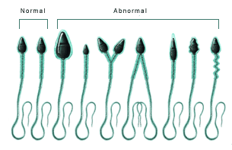
Effect of sperm count on fertility:
The quantity of ejaculated semen during coitus is about 3-5 ml
1ml >>>120 million sperm (normal sperm count 35 - 200 million sperm/ml).
Effect of sperm morphology and motility on fertility:
Sperm count is normal — infertile?-- abnormal shape.
Shape of the sperm is
normal but >> relatively
non-motile or entirely
non-motile which causes
infertility.

Slide 26
Prostate gland and its abnormalities
- Benign prostatic fibroadenoma in older age due to overgrowth of prostate tissue (not caused by testosterone). Cancer of the prostate gland caused by stimulation of cancerous cells by testosterone.
Hypogonadism in male:
- During fetal life when the testes are nonfunctional, none of the male sexual characteristics develop in the fetus. Instead female organs are formed.
- If the boy loses his testes before puberty → eunuchism (infantile sex organs & infantile sexual characteristics) is developed
- If a man is castrated after puberty, sexual organ regress in size and voice regress
Adiposogenital syndrome, Fröhlich syndrome, or hypothalamic eunuchism:
-Hypogonadism due to genetic inability of the hypothalamus to secrete normal amount of GnRH & abnormality of the feeding center of the hypothalamus resulting in obesity with eunuchism.

Slide 27
Cryptorchidism:
Failure of the testes to descend in the scrotum which normally occurs during fetal life.
Testicular tumors and hypergonadism in male:
Interstitial leydig cell tumors (rare), overproduction of testosterone. In children, causes rapid growth of the musculature and bones and early uniting of the epiphyses and causes excessive development of male sexual organs.

Slide 28
The End
Thank You

