Slide 1
Reproductive Physiology Lecture 6 Physiology of Pregnancy
GUYTON & HALL, Chapter 82
Dr.Mohammed Alotaibi
Assistant Professor of Physiology
College of Medicine
King Saud University

Slide 2
Objectives
By the end of this lecture, you should be able to:
Describe fertilization
Recognize the development and the function of the placenta
Recognize the placenta as an endocrine organ
Describe the physiological functions of placental hormones
Explain the mother’s physiological response to pregnancy

Slide 3
Fertilization

Slide 4
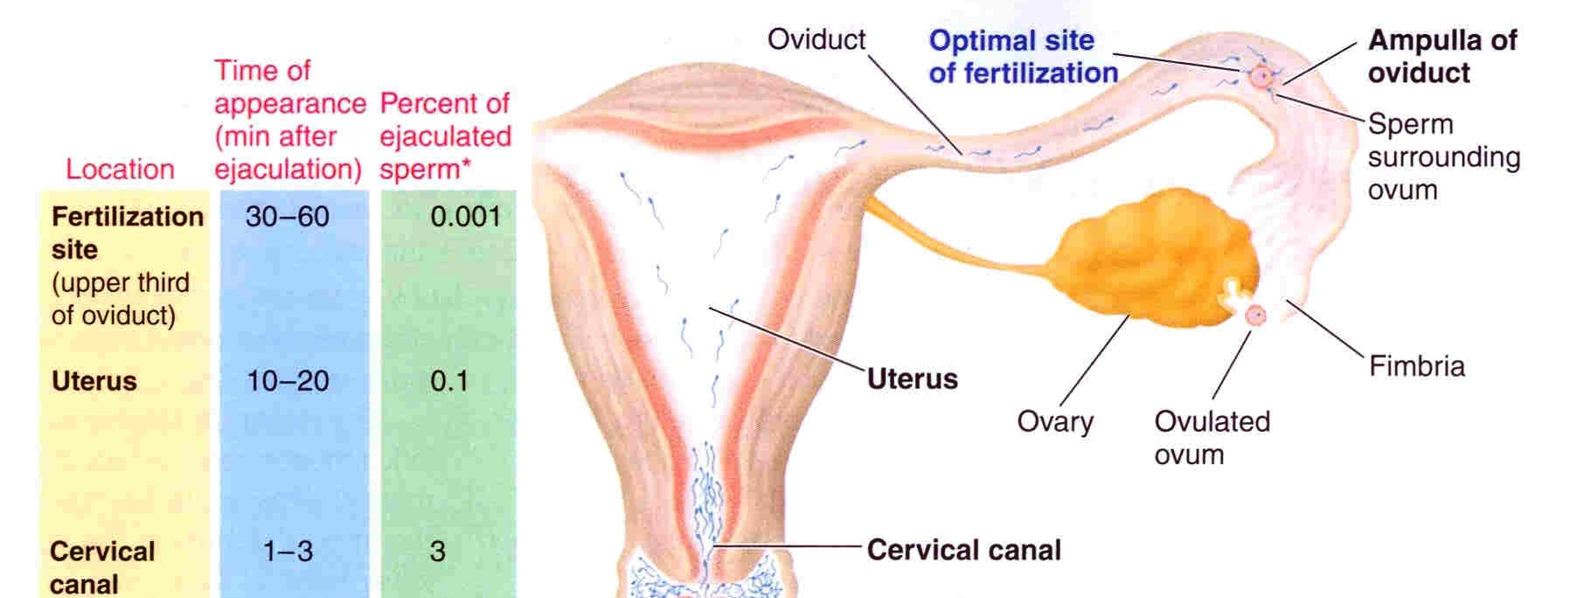
Fertilization
After ejaculation, sperms reach ampulla of fallopian tube within 30-60 min (PG and OT actions)

Slide 5
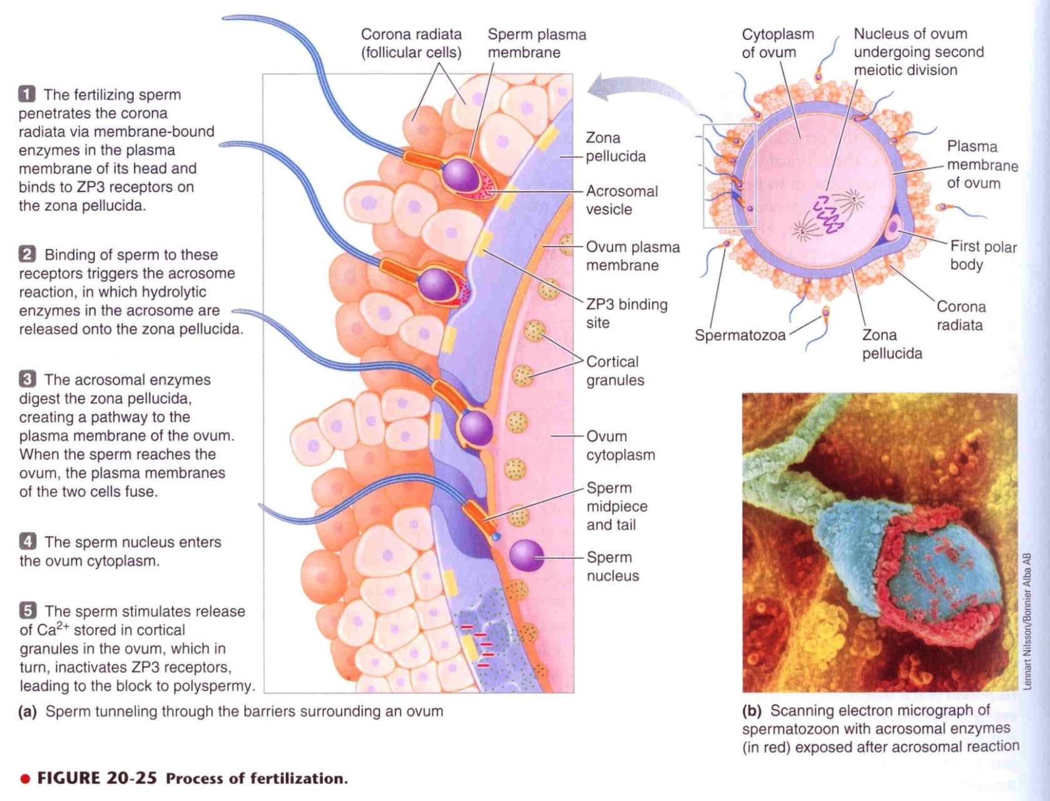
Fertilization

Slide 6
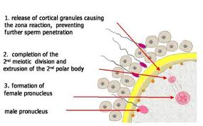
Fertilization
Sperm penetrates corona radiata and zona pellucida (hyaluronidase)
Oocyte divides to form mature ovum (female pronucleus 23 unpaired chr) + 2nd polar body
Head of sperm swells (male pronucleus 23 unpaired chr)
Fertilized ovum (zygote) contains 23 paired chr

Slide 7
Zygote

Slide 8
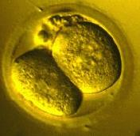
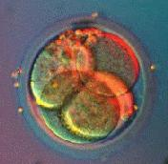
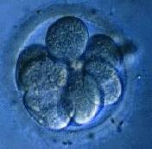
Cleavage
Following fertilization, the zygote undergoes several mitotic divisions inside the zona pellucida (overall size does not change).
1st cleavage yields a 2 celled embryo,
each cell is called a blastomere and is totipotent
Divisions continue rapidly until the 32 cell stage

Slide 9
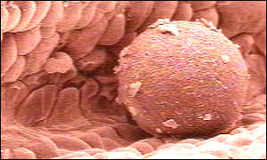
Traveling
Zygote begins to divide as it travels through oviduct
Implants into lining of uterus

Slide 10
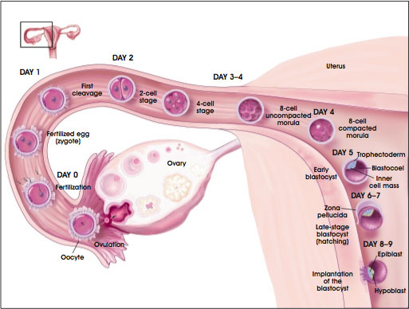
Transport of fertilized ovum

Slide 11
Transport of fertilized ovum
3-5 days after fertilization, the zygote reaches uterine cavity
Transport: fluid current + action of cilia + weak contractions of the fallopian tube
Isthmus (last 2cm) relaxes under effect of progesterone
Delayed transport allows cell division
Blastocyst (100 cells) enters the uterus

Slide 12
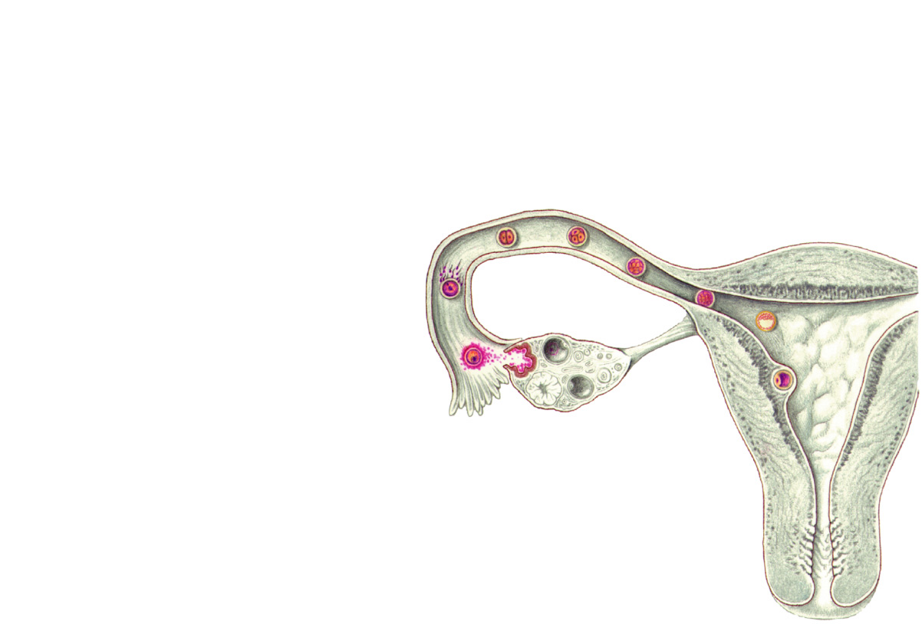
Cleavage
Ovary
Uterine tube
Secondary oocyte
Ovulation
Uterus
Endometrium

Slide 13
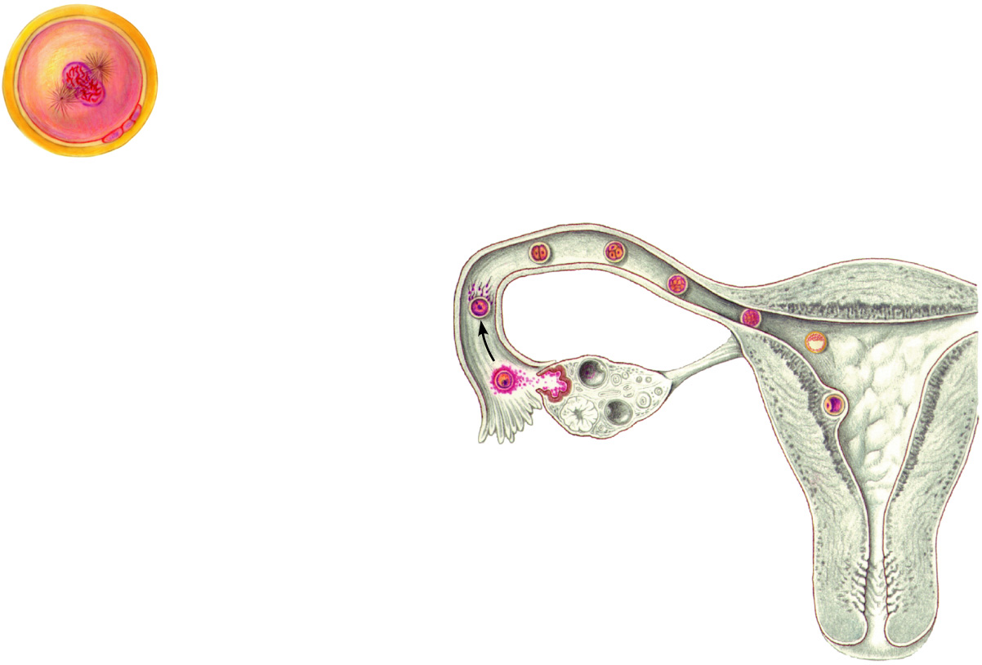
Cleavage
(a)
Zygote (fertilized egg)
Fertilization
(a)
Ovary
Uterine tube
Secondary oocyte
Ovulation
Uterus
Endometrium

Slide 14
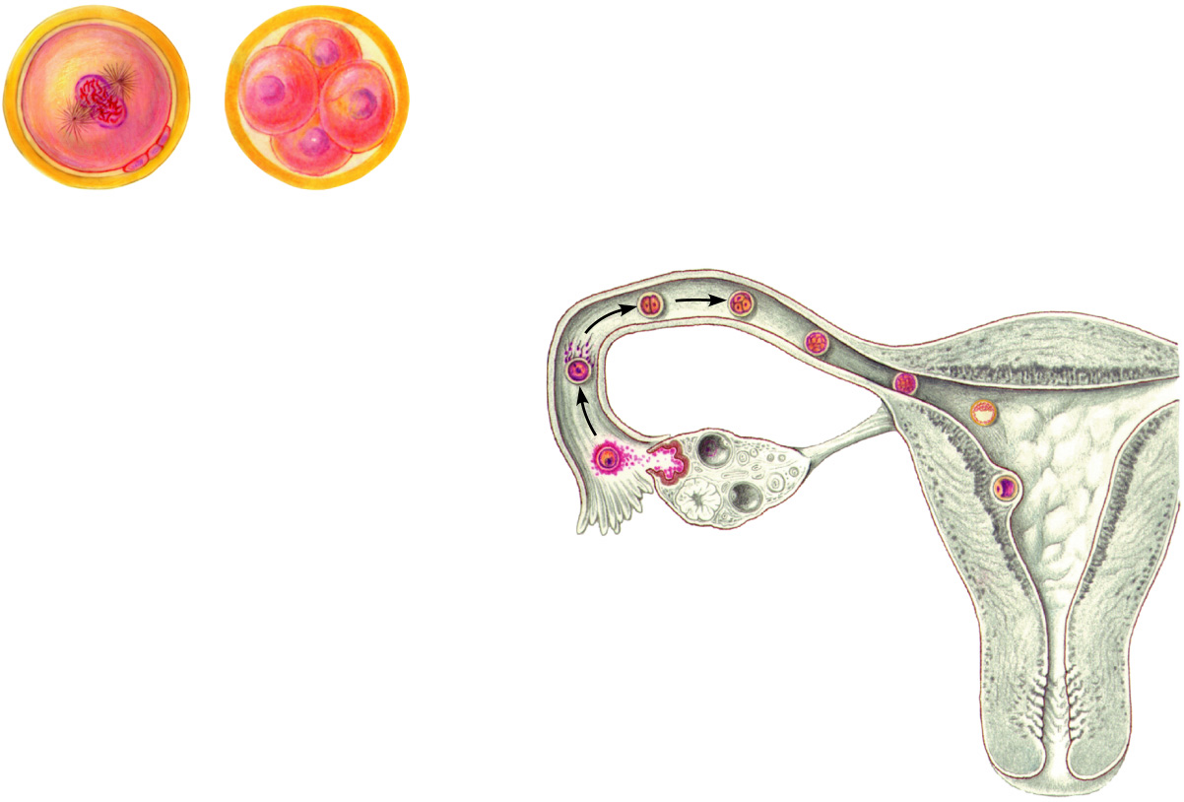
Cleavage
(a)
Zygote (fertilized egg)
(b)
Early cleavage 4-cell stage
(b)
Fertilization
(a)
Ovary
Uterine tube
Secondary oocyte
Ovulation
Uterus
Endometrium

Slide 15
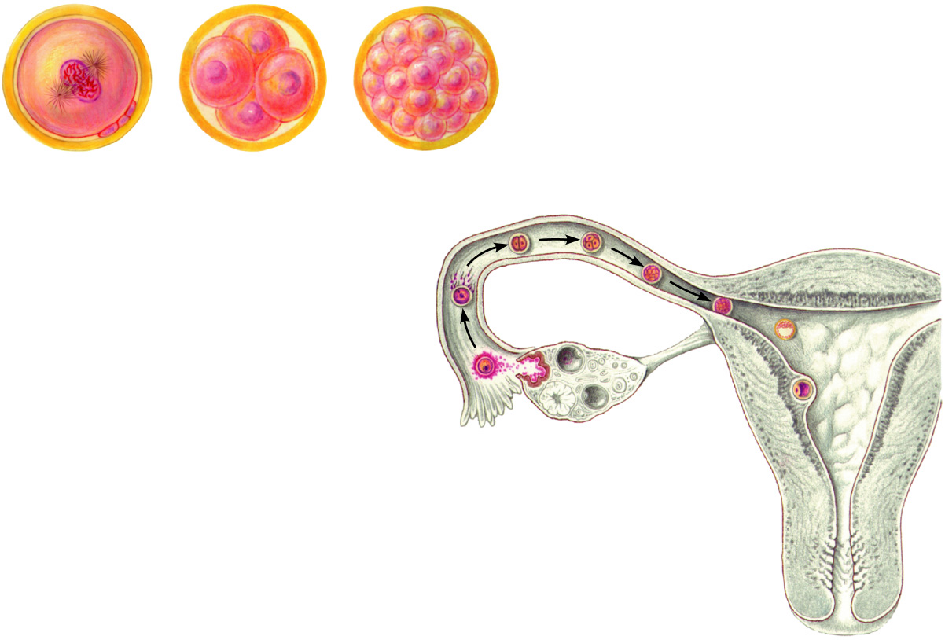
Cleavage
(a)
Zygote (fertilized egg)
(b)
Early cleavage 4-cell stage
(c)
Morula
(b)
(c)
Fertilization
(a)
Ovary
Uterine tube
Secondary oocyte
Ovulation
Uterus
Endometrium

Slide 16
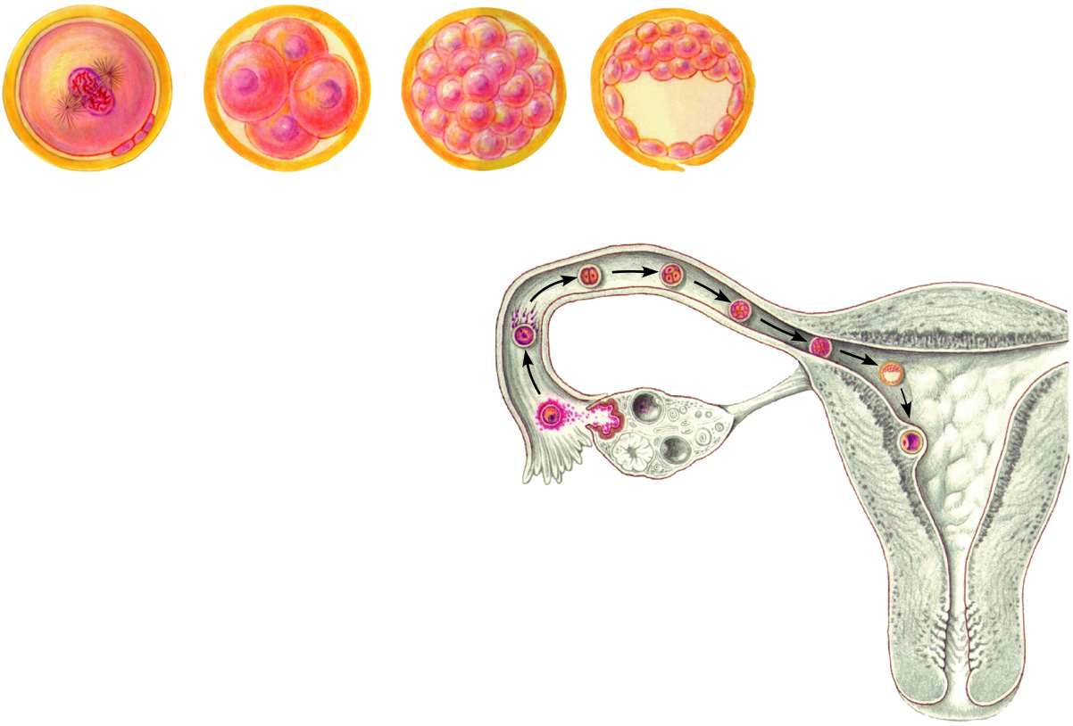
Cleavage
Blastocyst cavity
(a)
Zygote (fertilized egg)
(b)
Early cleavage 4-cell stage
(c)
Morula
(d)
Early blastocyst
(b)
(c)
Fertilization
(a)
Ovary
(d)
Uterine tube
Secondary oocyte
Ovulation
Uterus
Endometrium

Slide 17
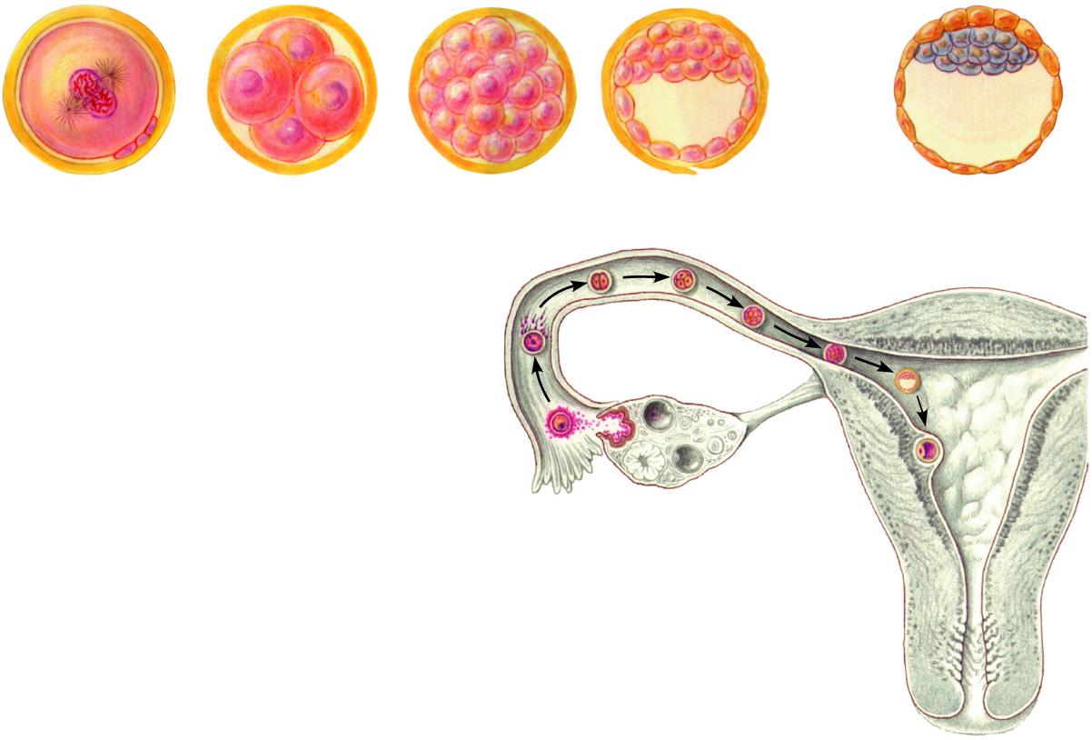
Cleavage
Blastocyst cavity
Inner cell mass
Trophoblast
(a)
Zygote (fertilized egg)
(b)
Early cleavage 4-cell stage
(c)
Morula
(d)
Early blastocyst
(e)
Late blastocyst (implanting)
(b)
(c)
Fertilization
(a)
Ovary
(d)
Uterine tube
Secondary oocyte
(e)
Ovulation
Uterus
Endometrium

Slide 18
Implantation
Trophoblastic cords from blastocyst
Blood capillaries grow in the cords
21 days after fertilization, blood starts to be pumped by fetal heart into the capillaries
Maternal blood sinuses develop around the trophoblastic cords
More and more trophoblast projections develop (placental villi)

Slide 19
Implantation

Slide 20
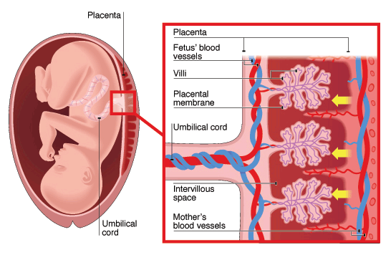
Placenta

Slide 21
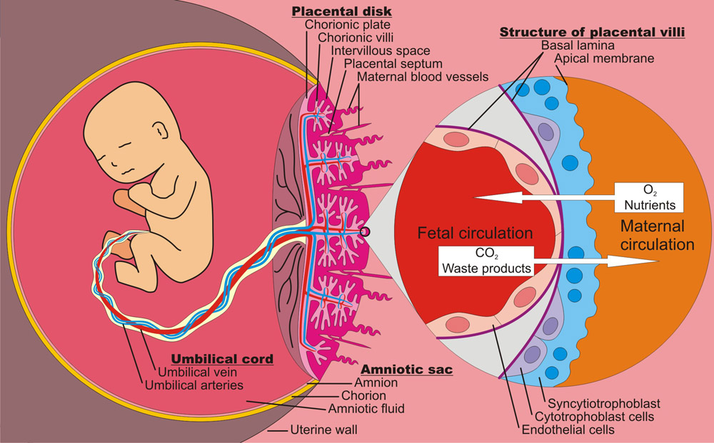
Function of the placenta
Major function:
Respiration
Nutrition
Excretion
Endocrine
Protection

Slide 22
Important factors facilitating delivery of oxygen to the fetal tissues
Difference in pO2 (concentration) between maternal and fetal blood (mother pO2 > fetus pO2)
High fetus haemoglobin (HbF)(16 - 17 g/dl) which has high affinity for O2 than mother’s haemoglobin (HbA)
At the low Po2 levels in fetal blood, the fetal hemoglobin can carry 20 to 50% more oxygen than maternal hemoglobin can

Slide 23
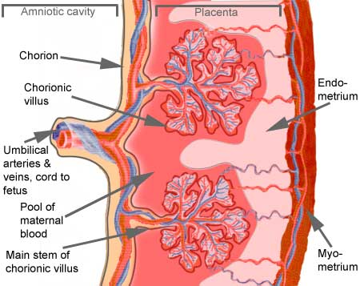
Important factors facilitating delivery of oxygen to the fetal tissues
High fetal cardiac output
Double Bohr Effect
High pH in fetal blood (alkaline)
Low pH in mother’s blood (acidic)
O2
CO2
PCO₂ 2-3 mm Hg higher in fetus

Slide 24
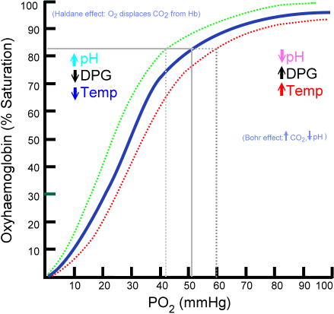
Respiration
Important shifts of the dissociation curves take place in the placenta:
The maternal blood gains CO₂, the pH falls and the curve shifts to the right releasing additional oxygen.
On the fetal side of the placenta CO₂ is lost, the pH rises and the curve shifts to the left allowing additional oxygen uptake.
Hemoglobin can carry more oxygen at a low Pco2 than it can at a high Pco2
↓ Pco2
↑ Pco2

Slide 25
Nutrition
Fetus uses mainly glucose for nutrition so the trophoblast cells in placental villi transport glucose by carrier molecules; GLUT (facilitated diffusion)
Fatty acids diffuse due to high solubility in cell membrane (more slowly than glucose)
The placenta actively transports all amino acids, with fetal concentrations exceeding maternal levels.
K+, Na+ and Cl- diffuse from maternal to fetal blood

Slide 26
Excretion
Excretory products of the fetus diffuse through the placental membrane to maternal blood to be excreted with the waste products of the mother
Urea, uric acid and creatinine
Higher conc. of excretory products in fetal blood ensures continuous diffusion of these substances to the maternal blood

Slide 27
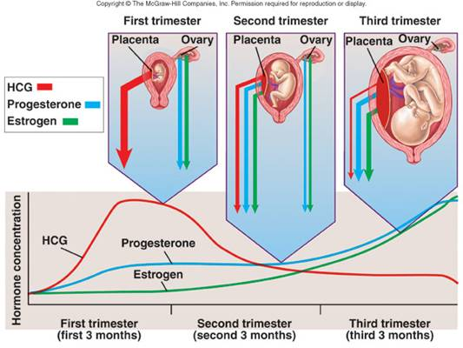
Endocrine

Slide 28
Placenta as Endocrine Organ
Human Chorionic Gonadotropin (hCG)
Glycoprotein
Secreted by syncytial trophoblast cells
Most important function is to maintain corpus luteum (↑estrogen & progesterone) till 13-17 weeks of gestation
Exerts interstitial (Leyding) cell-stimulating effect on testes of the male fetus (growth of male sex organs)

Slide 29
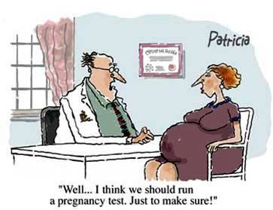
hCG level (pregnancy test)

Slide 30
Placenta as Endocrine Organ
Estrogen
Steroid hormone
Secreted by syncytial trophoblast cells
Towards the end of pregnancy it reaches 30×
Derived from weak androgen (DHEA) released from maternal & fetal adrenals cortex
Functions in the mother
Enlargement of uterus, breast & external genitalia
Relaxation of pelvic ligaments in preparation for labor
Activation of the uterus (gap junctions)

Slide 31
Placenta as Endocrine Organ
Progsterone
Steroid hormone
Secreted by syncytial trophoblast cells
Towards the end of pregnancy it reaches 10×
Derived from cholesterol
Functions in the mother
Provides nutrition to developing embryo (uterine secretory phase)
Development of decidual cells
Inhibits the contractility of the uterus

Slide 32
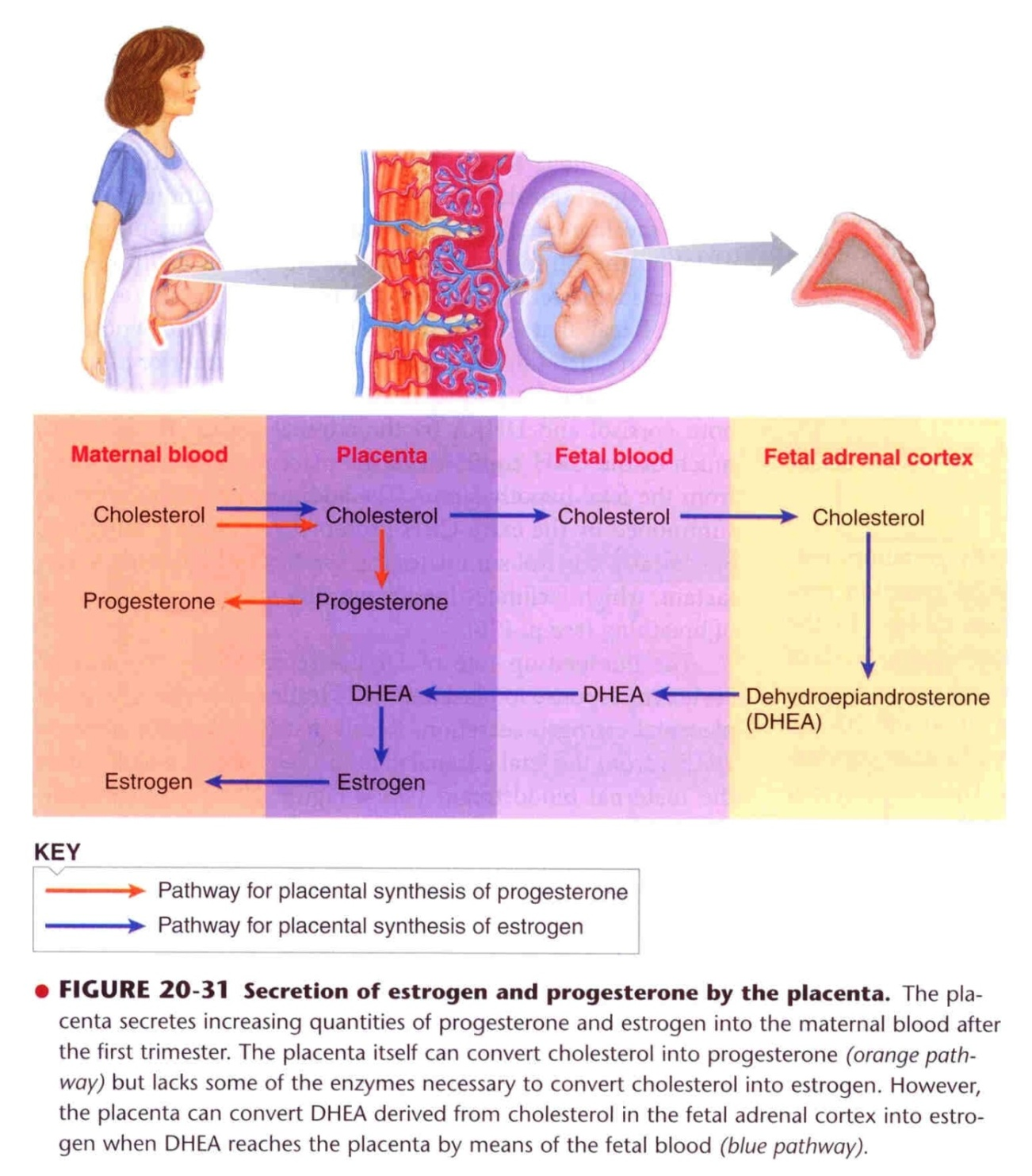

Slide 33
Placenta as Endocrine Organ
Human Chorionic Somatomamotropin or Human placental lactogen (hPL)
Protein hormone
Secreted by placenta around 5th gestational week
Functions in the mother
Breast development
Weak growth hormone’s action
Inhibits insulin sensitivity =↓ glucose utilization
Promotes release of fatty acids

Slide 34
Placenta as Endocrine Organ
Relaxin
Polypeptide
Secreted by corpus luteum and placenta
Functions in the mother
Relaxation of symphysis pubic ligament (weak)
Softens the cervix at delivery

Slide 35
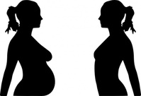
Physiological adaptation to pregnancy

Slide 36
Changes in maternal endocrine system
Anterior pituitary gland enlargement (50%)
Release of ACTH, TSH and PL
FSH and LH almost totally suppressed
Adrenal gland
Increase glucocorticoids secretion (mobilize AA)
Increase aldosterone (retain fluid)
Thyroid gland enlargement (50%)
Increase thyroxine production (hCG)
Parathyroid gland enlargement
Increase PTH secretion (maintain normal Ca⁺²)

Slide 37
Changes in different organs
Increase in uterine size (50 gm to 1100 gm)
The breasts double in size
The vagina enlarges
Development of edema and acne
Masculine or acromegalic features
Weight gain 10-12 kg (last 2 trimesters)
Increase appetite
Removal of food by fetus
Hormonal effect

Slide 38
Metabolism and kidney function during pregnancy
Increase basal metabolic rate (15%)
Increase in daily requirements for
Iron
Phosphates
Calcium
Vitamins - vitamin D (Ca⁺² absorption)
The renal tubules’ reabsorptive capacity for sodium, chloride, and water is increased as much as 50%
The renal blood flow and GFR increase up to 50%
Normal pregnant woman accumulates only about 5 pounds of extra water and salt.

Slide 39
Changes in circulatory system
Increase in COP (30-40%) by 27th weeks
Increase in blood flow through the placenta
Increase in maternal blood volume (30%) due to
Increase aldosterone and estrogen (↑ ECF)
Increase activity of the bone marrow (↑ RBCs)

Slide 40
Changes in respiration
Increase in O₂ consumption (20%)
Increase BMR
Increase in body size
Increase in respiratory rate (RR)
Progesterone ↑ sensitivity of RC to CO₂
Increase in minute ventilation by 50% and a decrease in arterial PCo2 to several millimeters

Slide 41
The End
Thank You

