Slide 1
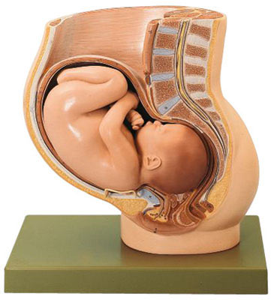
Physiology of Labor
Dr.Mohammed Alotaibi
AssisT.Professor of Physiology
College of Medicine
King Saud University

Slide 2
Objectives
By the end of this lecture, you should be able to:
Define parturition (labour, labor)
Recognize the factors triggering parturition
Describe the hormonal changes that occur before and during parturition
Describe the phases of parturition
Recognize the clinical stages of labour

Slide 3
Parturition
Interactions
Fetus
Mother
Placenta
Membranes
Normal Pregnancy
  Uterine quiescence
  Immature fetus
  Closed cervix
Parturition
  Coordinated uterine activity
  Maturation of the fetus
  Progressive cervical dilation

Slide 4
Parturition
Definition
  Uterine contractions that lead to expulsion of the fetus to the extrauterine environment
  Towards the end of pregnancy the uterus becomes progressively more excitable and develops strong rhythmic contractions that lead to expulsion of the fetus.

Slide 5
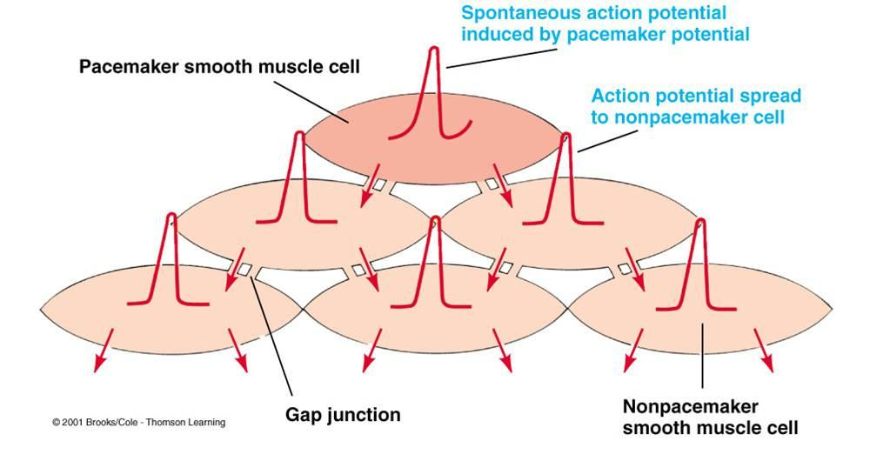
Parturition
Uterus is spontaneously active.
Spontaneous depolarization of pacemaker cells.
Gap junctions spread depolarization
Exact trigger is unknown
  Hormonal changes
  Mechanical changes

Slide 6
Hormonal changes
Oxytocin
  Dramatic ▲of oxytocin receptors (200 folds)
    gradual transition from passive relaxed to active excitatory muscle (↑responsiveness).
  Increase in Oxytocin secretion at labor
  Oxytocin increases uterine contractions by
    Directly on its receptors
    Indirectly by stimulating prostaglandin production

Slide 7
Hormonal changes
Prostaglandins
  Central role in initiation & progression of human labour
  Locally produced (intrauterine)
  Oxytocin and cytokines stimulate its production
  Prostaglandin stimulates uterine contractions by:
    Direct effect:
      Through their own receptors
      Upregulation of myometrial gap junctions
    Indirect effect:
      Upregulation of oxytocin receptors

Slide 8
Hormonal changes
Progesterone & Estrogen
  Progesterone inhibits uterine contractility
  Estrogen stimulates uterine contractility
From 7th month till term
  Progesterone secretion remains constant or decreases slightly
  Estrogen secretion increases continuously
  Increase estrogen/progesterone ratio

Slide 9
Hormonal changes
Progesterone
  ▼ GAP junctions
  ▼ Oxytocin receptors
  ▼prostaglandins
  ▲ resting mem. Potential
Estrogen
  ▲ GAP junctions with onset of labour.
  ▲ Oxytocin receptors.
  ▲ Prostaglandins
E
P

Slide 10
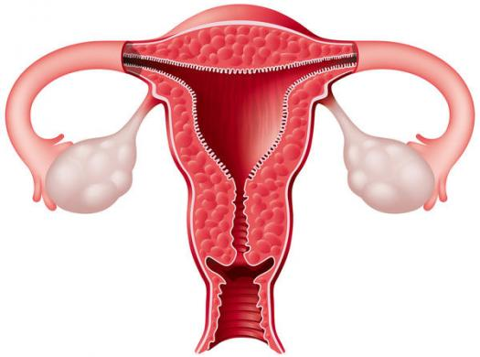
Mechanical changes
Stretch of the uterine muscle
  Increases contractility
    Fetal movements
    Multiple pregnancy
Stretch of the cervix
  Increases contractility (reflex)
  (Positive feedback mechanism)
  Membrane sweeping & rupture
  Fetal head

Slide 11
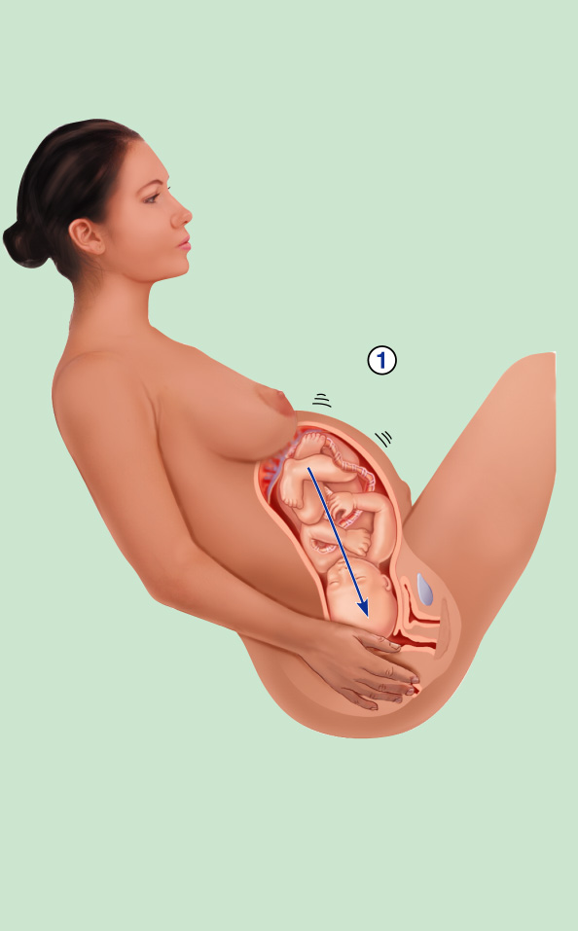


Initiation of Labor
Baby moves
deeper into
mother’s birth
canal
Baby moves
deeper into
mother’s birth
canal
Baby moves
deeper into
mother’s birth
canal
Afferent
impulses to
hypothalamus
Pressoreceptors
in cervix of
uterus excited
Pressoreceptors
in cervix of
uterus excited

Slide 12


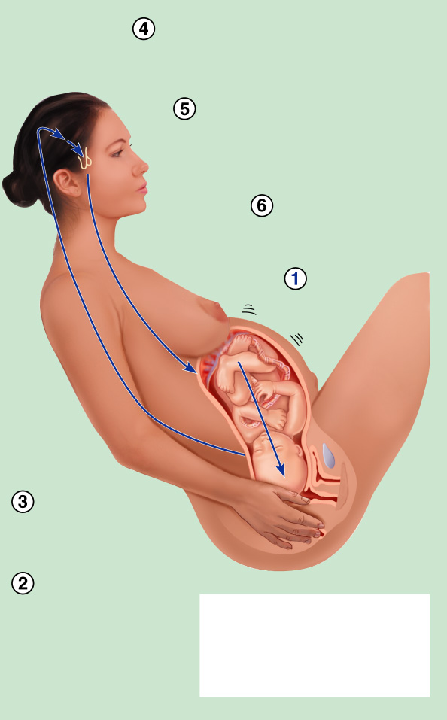
Initiation of Labor
Hypothalamus sends efferent impulses to posterior pituitary,
where oxytocin is stored
Hypothalamus sends efferent impulses to posterior pituitary,
where oxytocin is stored
Hypothalamus sends efferent impulses to posterior pituitary, where oxytocin is stored
Posterior pituitary releases oxytocin to blood; oxytocin
targets mother’s uterine muscle
Posterior pituitary releases oxytocin to blood; oxytocin targets mother’s uterine muscle
Uterus responds
by contracting
more vigorously
Baby moves
deeper into
mother’s birth canal
Baby moves
deeper into
mother’s birth canal
Baby moves
deeper into
mother’s birth canal
Afferent
impulses to
hypothalamus
Afferent
impulses to
hypothalamus
Afferent
impulses to
hypothalamus
Pressoreceptors
in cervix of
uterus excited
Pressoreceptors
in cervix of
uterus excited
Pressoreceptors
in cervix of
uterus excited
Positive feedback
mechanism continues
to cycle until interrupted by birth of baby

Slide 13
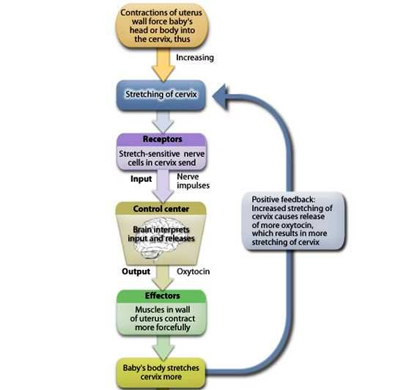
Positive feedback mechanism
Ferguson reflex

Slide 14
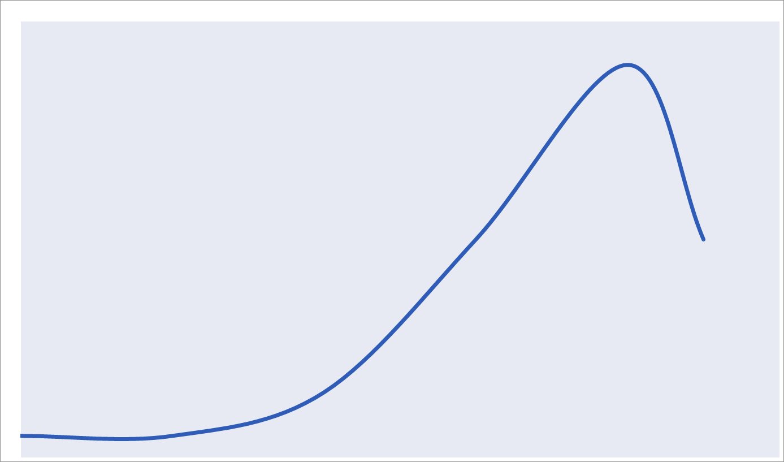
Phases of uterine activity
Inhibitors
- Progesterone
- Prostacycline
- Relaxin
- Nitric Oxide
- PHrP
- CRH
  - HPL
Quiescence
Phase 0
Uterotrophins
- Estrogen
- Progesterone
- Prostaglandins
- CRH
Activation
Phase 1
Uterotonins
- Prostaglandins
- Oxytocin
Stimulation
Phase 2
Involution
- Oxytocin
- Prostaglandins
- Thrombin
Involution
Phase 3

Slide 15
Phases of uterine activity
Phase 0 (quiescence)
  Occurs during early pregnancy
  Increase in cAMP level
  Increase in production of
    Prostacyclin (PGI₂) causes uterine relaxation
    Nitric oxide (NO) causes uterine relaxation
    CRH causes uterine relaxation

Slide 16
Phases of uterine activity
Phase 1 (activation)
  Occurs in third trimester
  Promotes a switch from quiescent to active uterus
  Increase excitability & responsiveness to stimulators by
    Increasing expression of gap junctions
    Increasing G protein-coupled receptors
      Oxytocin receptors
      PG receptors

Slide 17
Phases of uterine activity
Phase 2 (stimulation)
  Occurs in the last 2-3 gestational weeks
  Increase in synthesis of uterotonins
    Oxytocin
    Prostaglandins
    Cytokines

Slide 18
Phases of uterine activity
Phase 3 (uterine involution)
  Pulsatile release of oxytocin
  Delivery of the placenta
  Involution of the uterus
    Occurs in 4-5 weeks after delivery
    Lactation helps in complete involution

Slide 19
Phases of uterine activity (summary)
Phase 0 (quiescence)
Phase 1 (uterotrophins)
Phase 3 (involution)
Phase 2 (uterotonins)

Slide 20
Mechanism of parturition
Contractions start at the fundus and spread to the lower segment
The intensity of contractions is strong at the fundus but weak at the lower segment
In early stages: 1 contraction/ 30 minuets
As labour progresses: 1 contraction/ 1-3 minutes
Abdominal wall muscles contract
Rhythmical contractions allow blood flow

Slide 21
Onset of labor
During pregnancy
  Periodic episodes of weak and slow rhythmical uterine contractions (Braxton Hicks) 2nd trimester
Towards the end of pregnancy
  Uterine contractions become progressively stronger
  Suddenly uterine contractions become very strong leading to:
    Cervical effacement and dilatation

Slide 22
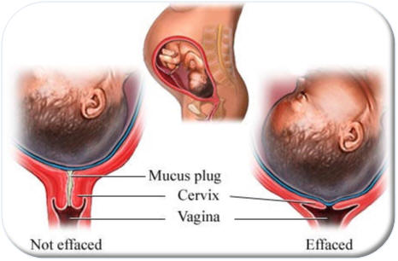
Clinical Stages of Labor

Slide 23
Clinical Stages of Labor
1) Dilation
  Cervix becomes dilated
  Full dilation is 10 cm
  Uterine contractions begin and increase
  Cervix softens and effaces (thins)
  The amnion ruptures (“breaking the water”)
  Longest stage at 6–12 hours

Slide 24
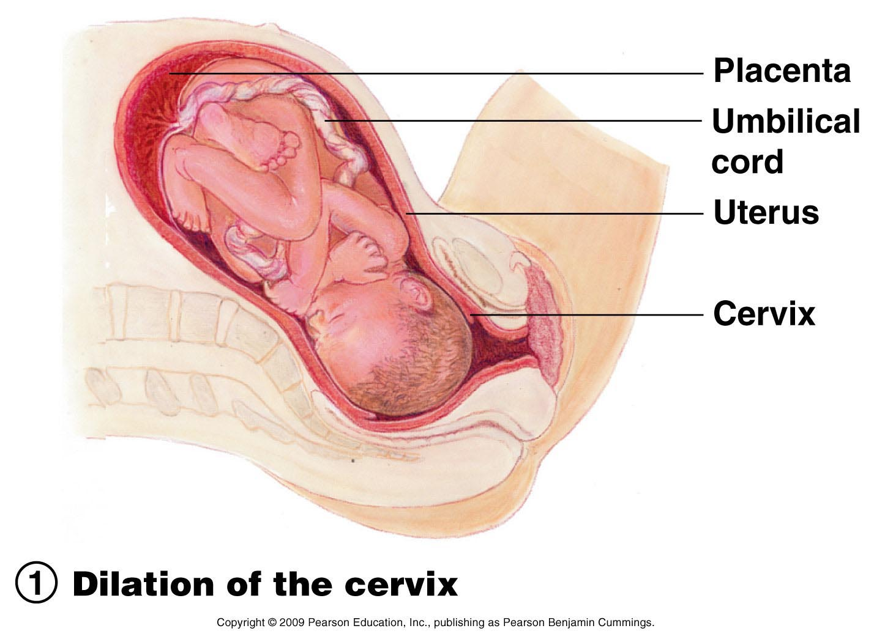
Clinical Stages of Labor

Slide 25
Stages of Labor
2) Expulsion
  Infant passes through the cervix and vagina
  Can lasts as long as 2 hours, but typically is 50 minutes in the first birth and 20 minutes in subsequent births
  Normal delivery is head first (vertex position)
  Breech presentation is buttocks-first

Slide 26
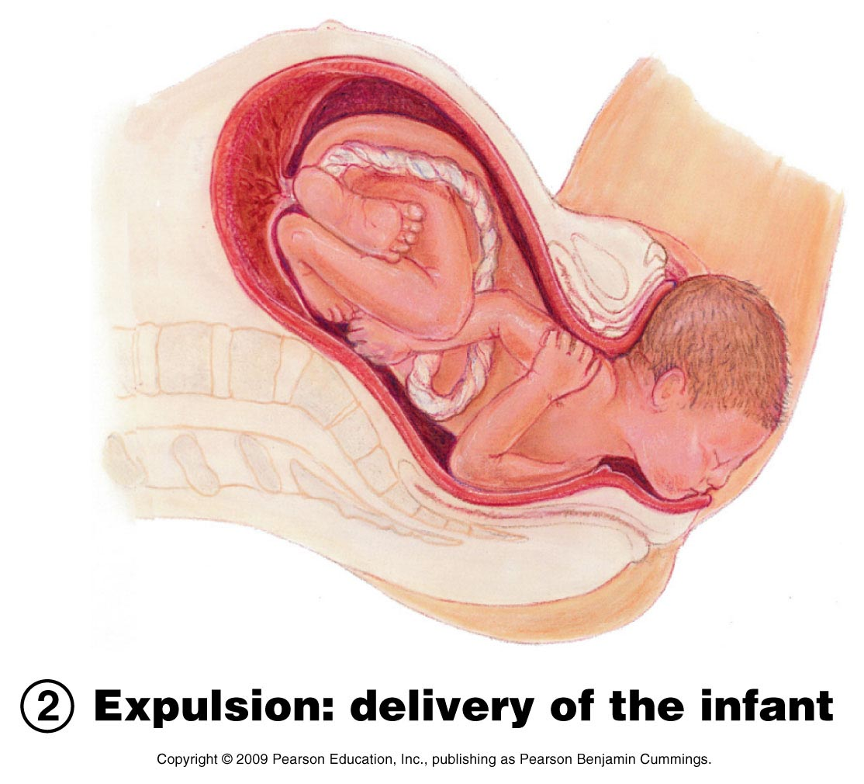
Clinical Stages of Labor

Slide 27
Clinical Stages of Labor
3) Placental stage
  Delivery of the placenta
  Usually accomplished within 15 minutes after birth of infant
  After birth—placenta and attached fetal membranes are delivered
  All placental fragments should be removed to avoid postpartum bleeding

Slide 28
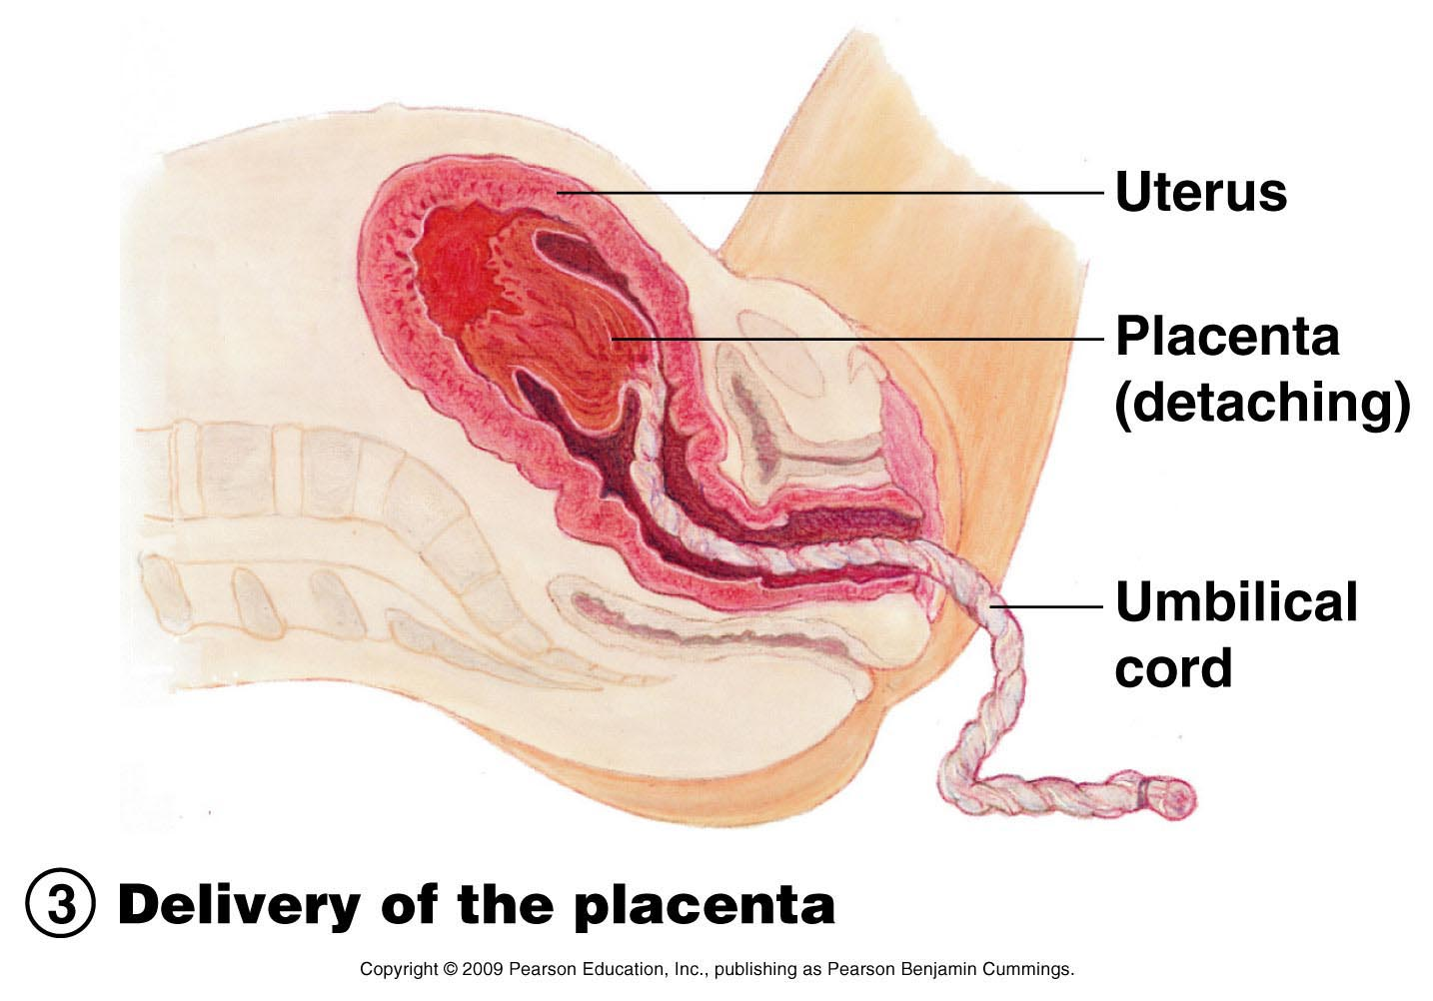
Clinical Stages of Labor

Slide 29
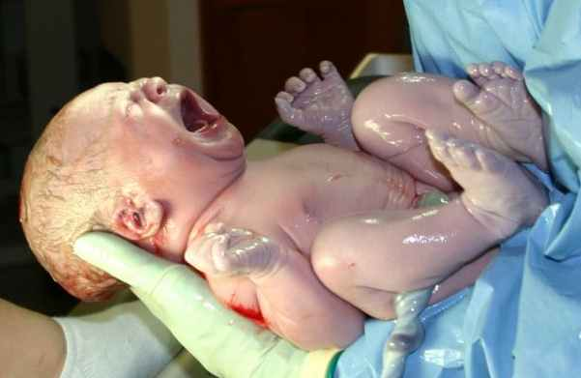
New arrival

Slide 30
The End
Thank You

