Slide 1
Reproductive Physiology Lecture 8 Hormones affecting female breast
Dr.Mohammed Alotaibi
Assistant Professor and CONSULTANT dEpartment of Physiology
College of Medicine
King Saud University

Slide 2
Objectives
By the end of this lecture, you should be able to:
Describe the hormones involved in the different phases of lactation:
Mammogenesis
Lactogenesis
Galactopoeisis
Explain the physiological basis of suckling reflex and its role in lactation.

Slide 3
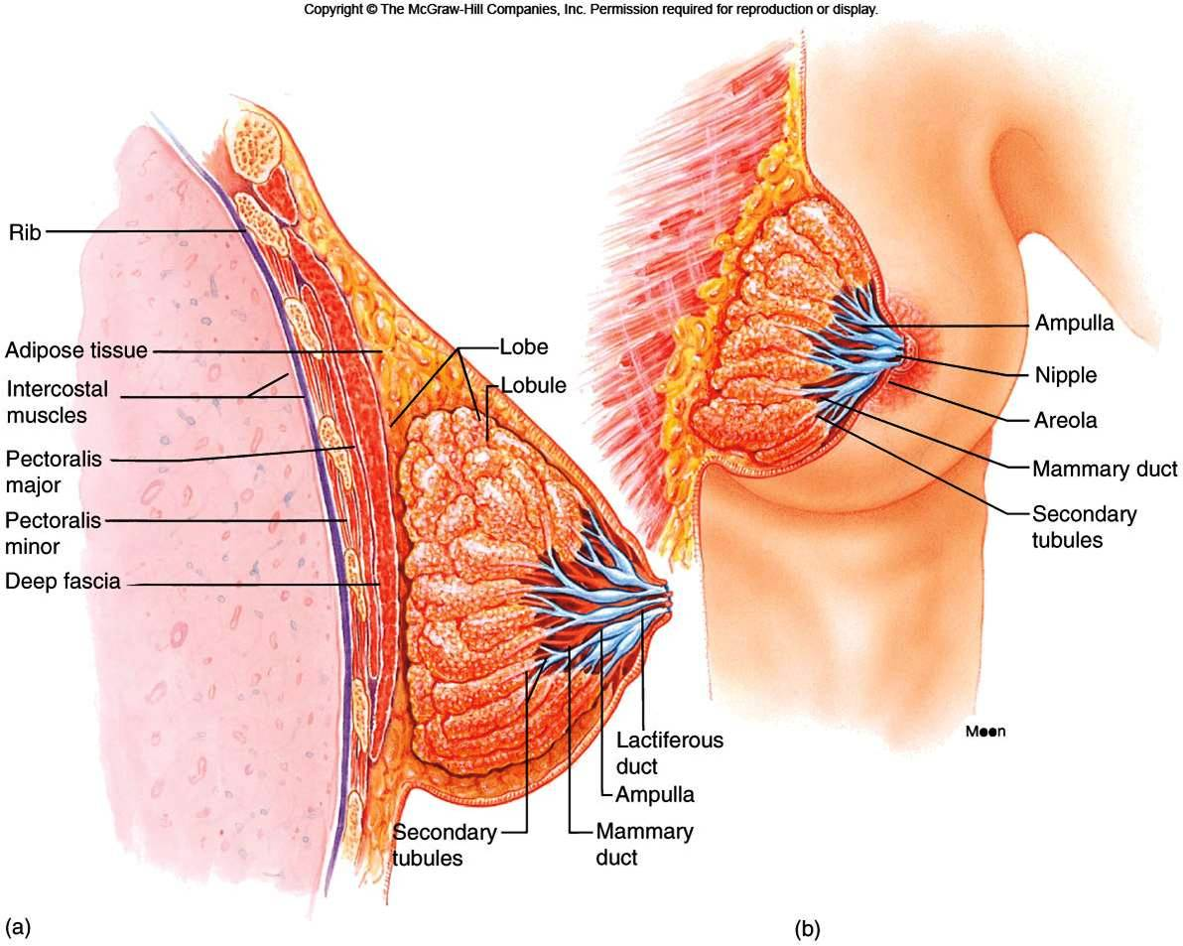
The structure of the breast and mammary glands

Slide 4
Structures of the Mammary Gland
Each breast consists of ~ 23 lobes of secretory tissue
a. Each lobe has one lactiferous duct
b. Lobes (and ducts) are arranged radially
c. Lobes are composed of lobules
d. Lobules are composed of alveoli

Slide 5
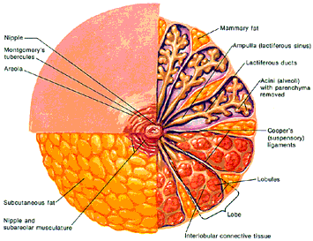
fat
nipple
Lactiferous sinus
Montgomery glands
Lactiferous duct
areola
Alveoli
(alveolar gland)
Suspensory
ligament
(Cooper)
lobules
fat
Lobe
nipple
Interlobular connective tissue

Slide 6
Ductal System
Alveolar tubule
Secondary tubule
Mammary duct
Ampulla (lactiferous sinus)
Lactiferous duct

Slide 7
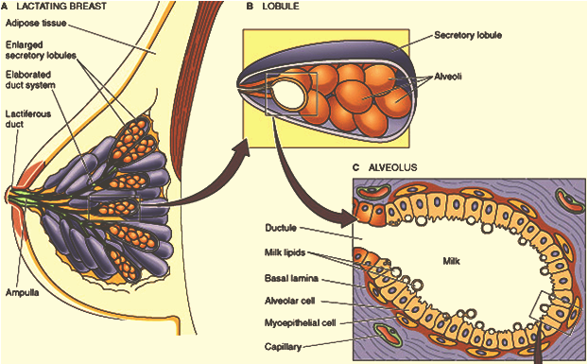
Lobule-Alveolar System

Slide 8
Physiology of Lactation- Endocrine control
Three main phases of lactation:
1) Mammogenesis (mammary growth).
2) Lactogenesis (initiation of milk secretion):
Stage 1
Stage 2
3) Stage 3 or Galactopoiesis (maintenance of milk secretion)

Slide 9
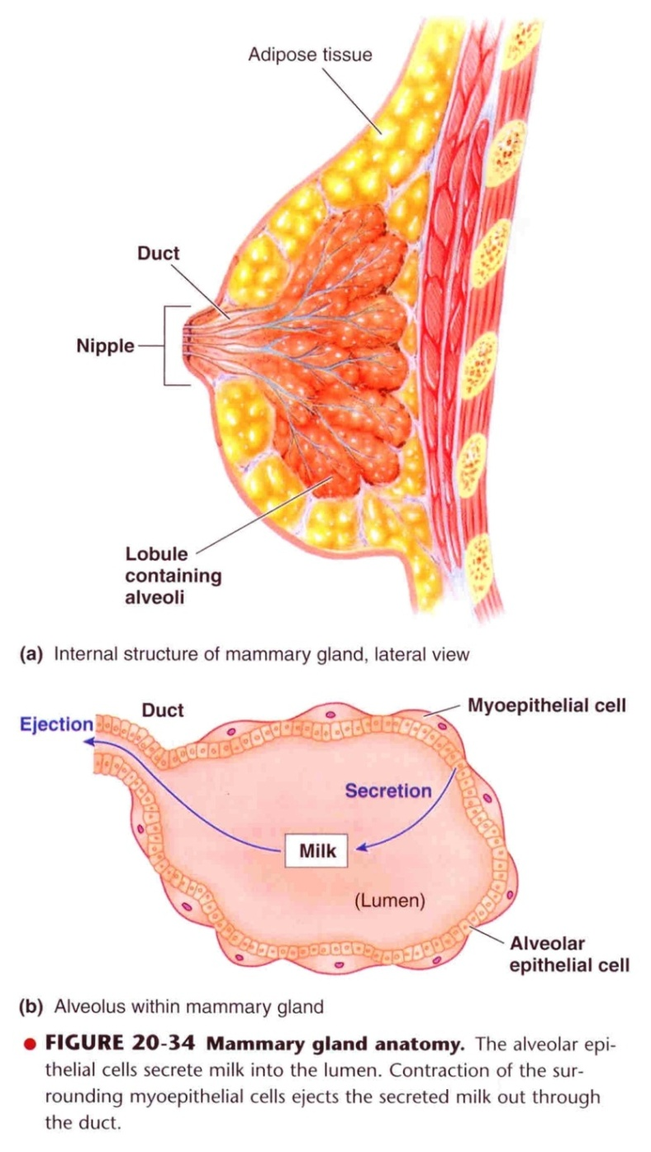
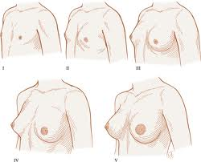
Mammogenesis- breast development
During puberty
Estrogen stimulates proliferation of ducts and deposition of fat.
Progesterone stimulates development of lobules.

Slide 10
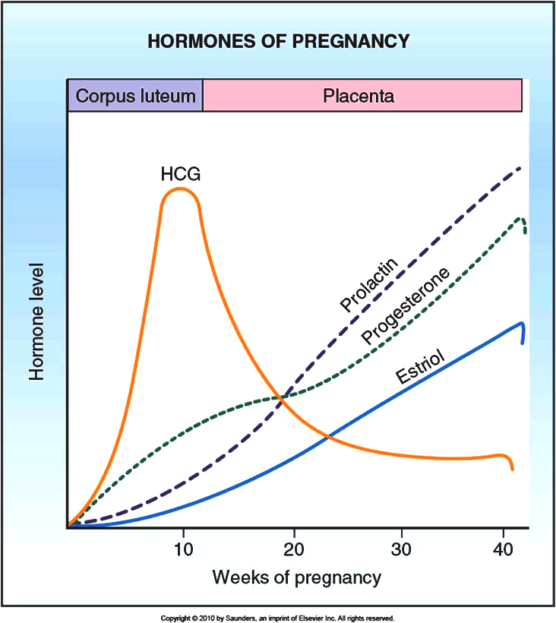
Mammogenesis- breast development
During pregnancy
Complete development of mammary glands

Slide 11
Mammogenesis- breast development
Hormones Involved in Mammary Growth
Estrogens Progesterone Growth hormone Human placental lactogens (hPL) Prolactin (PL) Glucocorticoids Insulin

Slide 12
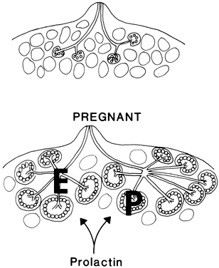
Mammogenesis- breast development
Estrogen (placenta)
Growth & branching of ductal system (with GH)
Fat deposition in the stroma
Progesterone (placenta)
Growth of lobule-alveolar system (budding of alveoli and secretory changes in epithelial cells )
Although estrogen and progesterone are essential for physical development of the breasts, they inhibit actual secretion of milk
During pregnancy

Slide 13
Mammogenesis- breast development
Prolactin (anterior pituitary)
Its level rises steadily from the fifth week of pregnancy until birth (10-20 times)
It stimulates mammary gland ductal growth and proliferation of alveolar epithelial cells which induce milk protein synthesis
Sudden drop in E & P after delivery allows milk production
It is controlled mainly by hypothalamic hormone
PIH (Dopamine)
Human placental lactogen (human chorionic somatomammotropin, hCS) (placenta)
Facilitates mammogenesis
supports the prolactin during pregnancy (lactogenic properties)
Delays milk production

Slide 14
Lactogenesis
Lactogenesis: Cellular changes by which mammary epithelial cell switches from a growing non secretory tissue to a secreting non-growing tissue (initiation of milk secretion)
Change is endocrine mediated
Involves 2 stages:
Lactogenesis 1
Lactogenesis 2

Slide 15
Lactogenesis
Lactogenesis 1: (Cytologic and enzymatic differentiation of alveolar epithelial cells).
Starts in mid-pregnancy and characterized by expression of many genes involved in the synthesis of milk components (increases in uptake transport systems for amino acids, glucose, and calcium required for milk synthesis).
ENDOCRINE REGULATION OF LACTOGENESIS :
1- Progesterone: promotes mammary growth, blocks epithelial secretion
2- Prolactin: Maturation of Golgi, Secretory vesicles, epithelial secretion
3- Growth hormone
4- Glucocorticoids (Cortisol): development of RER

Slide 16
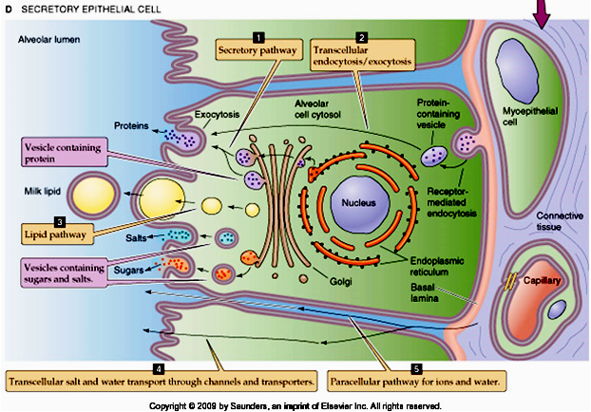

Slide 17
Lactogenesis
Lactogenesis 2: (Copious secretion of all milk components), starts 2-3 days postpartum
At parturition, withdrawal of progesterone + high level of prolactin leads to:
Further increase in expression of milk protein genes
Glands absorb large quantities of metabolic substrates from the blood
Movement of cytoplasmic lipid droplets and casein into alveolar lumen
Transfer of immunoglobulins
Secretion of colostrum followed by milk
Suckling stimulates further increase in expression of genes involved in milk secretion with expansion of alveolar epithelium
Lactation is maintained by removal of milk

Slide 18
Endocrine Control of Lactation
Milk Production Reflex:
Prolactin is a key lactogenic hormone, stimulating initial alveolar milk production
Milk Ejection Reflex:
Oxytocin contracts the myoepithelial cells, forcing milk from the alveoli into the ducts and sinuses where it is removed by the infant

Slide 19
Galactopoeisis
Definition: Galactopoeisis is defined as the maintenance of lactation once lactation has been established. starts 9-15 days postpartum
Galactopoeitic Hormones:
Prolactin: the most important galactopoeitic hormones involved in the maintenance of lactation.
Growth Hormone: supports increase in the synthesis of lactose, protein, and fat in the mammary gland
Glucocorticoids
Thyroid and parathyroid Hormones
Insulin

Slide 20
Autocrine Control of Lactation
Influence of Local Factors Acting on the Breasts
It is not just the level of maternal hormones, but the efficiency of milk removal that governs the volume product in each breast
A protein factor called feedback inhibitor of lactation (FIL) is secreted with other milk components into the alveolar lumen
FIL, insensitive to prolactin →  milk production

Slide 21
Autocrine Control of Lactation
FIL
FIL
FIL

Slide 22
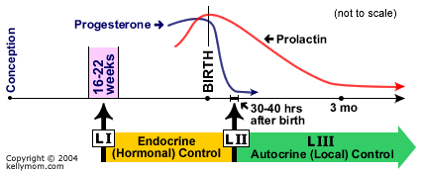
Stages of lactogenesis
Mammogenesis Lactogenesis Galactopoesis

Slide 23
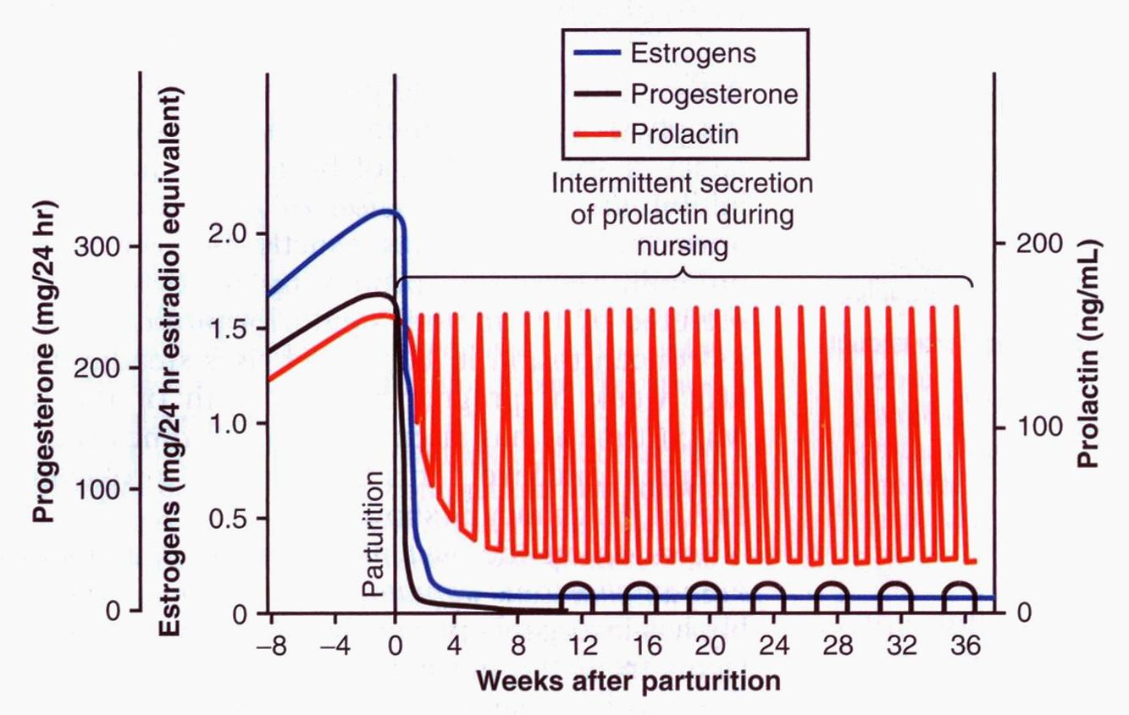

Slide 24
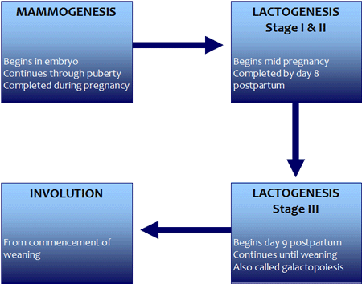

Slide 25
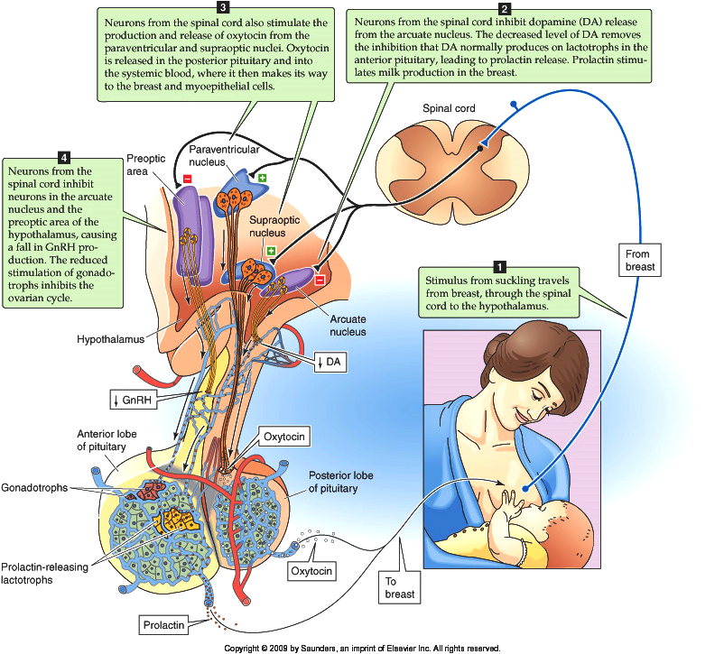
Suckling reflex

Slide 26
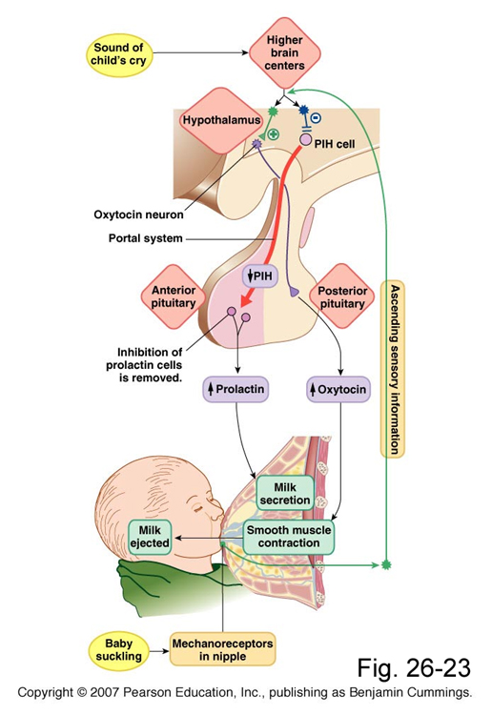
Neural reflex arc

Slide 27
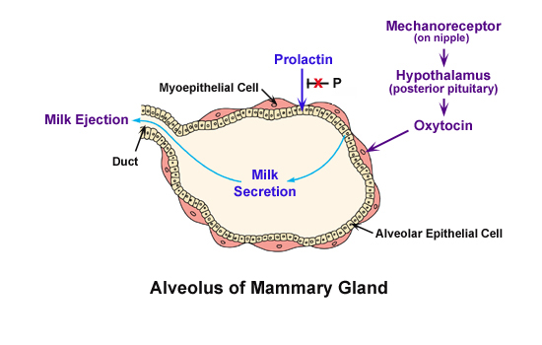

Slide 28
Milk production
Milk production is a "use it or lose it" process. The more often and effectively the baby nurses, the more milk will be produced.
Milk production <100 ml/day in day 1 postpartum.
Milk production by day 3 reaches 500 ml/day.
Involution: This is when the breasts stop producing milk completely after weaning

Slide 29
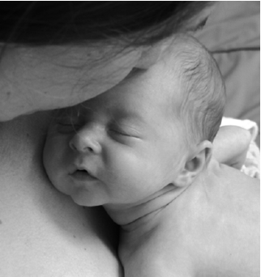
AAP Recommendations
Exclusive breastfeeding for the first six months of life
Continued breastfeeding for at least one year, ‘As long as is desired by mother and child’
يقول تعالى (والوالدات يرضعن أولادهن حولينِ كاملين لمن أراد أن يُتمَّ الرضاعة) [البقرة :233]
American Academy of Pediatrics (2005). "Breastfeeding and the Use of Human Milk." Pediatrics 115(2): 496-506.

Slide 30
The End
Thank You

