Slide 1
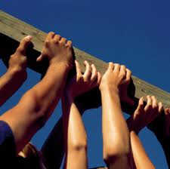
Community Services And Volunteer Work
Prof.Hanan Habib (Dr.Leena Kasem)
Dr. Kamran Sattar

Slide 2
OBJECTIVES students should be able to understand and describe;
The concept of community service.
The social, public and community responsibilities of the professionals.
The concept and types of volunteer work.

Slide 3
Definition of Community
The word "community" is derived from the old French communité which is derived from the Latin communitas (cum, "with/together" + munus, "gift"), a broad term for fellowship or organized society.
(Oxford University Press)

Slide 4
Definition of community (cont.)
Community is a group of interacting people, living in some proximity (i.e. in space, time, or relationship).
Community usually refers to a social unit larger than a household that shares common values and has social cohesion.

Slide 5
Community Service
Community service is defined as donated service or activity that is performed by someone or a group of people for the benefit of the public or its institutions.

Slide 6
Community Service
Some people associate community service with punishment, since it is often offered to small-time offenders as an alternative to fines or jail time.
However, community service can also be altruistic, and it is a vital part of many small communities.

Slide 7
Community Service
Basically anything which benefits the society in any way can be considered as a community service project or activity.

Slide 8
Community servise
In most cases, community service work is performed by volunteers who are not paid for their time.

Slide 9
Examples of Community Service
Community Services includes:
Visiting and spending time with lonely elderly .
Tutoring needy students in their studies for free.
Helping out at organizations such as libraries.

Slide 10
Why to carry out community service?
Benefits the community
The volunteers in the activities also gain
a sense of accomplishment
Better social communication skills
Exposure to new peoples and cultures
Overall improved mental health
When you cease to make a contribution, you begin to die. Anna Eleanor Roosevelt
(October 11, 1884 – November 7, 1962)

Slide 11
Physicians and the community
Physicians are members of the community.
Affect it and are affected by it.
Responsibilities of physicians are not limited to those within the hospital and clinical care.

Slide 12
Physicians and the community
Usually the focus is on the physician - patient relation.
The broader sense of responsibility of physicians is towards their community

Slide 13
Physicians and the community
Physicians role in the community extends to:
Public Health
Prevention of illnesses
Educational roles
Improving health care access
Setting policies
Assurance of competency
International Aid
Fund raising

Slide 14
Broad understanding of Health
Health depends not only on medical care but also on other factors including:
1. Individual behavior
2. Genetic makeup
3. Social and economic conditions

Slide 15
Individual health
Genetic
Social
Psychological
Environmental

Slide 16
A framework for improvement
Many entities in the community share the responsibility of maintaining and improving its health.

Slide 17
Who are health Stakeholders?
Health care providers
Public health agencies
Community organizations
Government agencies
Schools
Social services organizations

Slide 18
10 Essential services of stakholders
Monitor health status to identify community health problems.
Diagnose and investigate health problems and health hazards in the community.
Inform, educate, and empower people about health issues.
Mobilize community partnerships to identify and solve health problems.
Develop policies and plans that support individual and community health efforts.

Slide 19
10 Essential services of stakholders
Enforce laws and regulations that protect health and ensure safety.
Link people to needed personal health services and assure the provision of health care when otherwise unavailable.
Assure a competent public and personal health care workforce.
Evaluate effectiveness, accessibility and quality of personal and population-based health services.
Research for new insights and innovative solutions to health problems.

Slide 20
Public Health
-The science and practice of preventing diseases and promoting health in populations .
-It depends largely on epidemiology.
-Largely performed by governmental organizations.

Slide 21
Public Health
Traditional objective:
To control communicable diseases
Safety of water and food supply
Response to national disasters

Slide 22
Educational role of public health
Educating the public about:
Causes of illness
Preventive measures
Predisposing factors
Changes in lifestyle

Slide 23
Improving health access
Improve the level and ease of access of individuals to health care services by reducing inequalities.

Slide 24
International Aid
In some areas of the world, health care is very limited and almost non- existent
-Most people suffer from diseases such as Malaria, Tuberculosis, Typhoid, and AIDS.
-Many of the illnesses can be improved or eliminated by basic medical care and other measures .

Slide 25
International community services
Done through:
Organizations providing humanitarian needs
Medical Organizations
Governments

Slide 26
General Organizations
They provide:
Clean water supplies
Clothing
Education

Slide 27
Medical Organizations
Medical teams provide:
Medical care
Medications
Immunizations
Medical supplies
Teach communities about nutrition and preventive measures
Training of local health care providers

Slide 28
Governments
Aid to other countries during time of need.
May include sending:
Medical professionals
Medical equipments
Medications

Slide 29
Fund raising
May not apply locally since health care services are provided by the governments.
Funds may be raised to help those individuals who cannot afford to purchase medications or medical equipments.

Slide 30
The Concept Of Volunteering & Volunteer Work
Volunteering is generally considered an altruistic activity, intended to improve human quality of life.

Slide 31
Why some people volunteer ?
For their own skill development.
To solve problems when needed
To make contacts for possible employment.
To help others and earn respect and favor.
Get benefit of spare time.
A variety of other reasons.

Slide 32
Types of Volunteer Work
Skill –based volunteering : special skills required.
Micro & virtual- volunteering : off-site tasks done by internet . Completed in certain time .May need application process or training, eg. Tele-monitoring ,tele-tutoring.
Environmental volunteering: eg. Protecting animals, education about natural environment.
Emergency volunteering : during natural disasters.
School volunteering: additional teaching for students.

Slide 33
Types of Volunteer Work
Community volunteering: for orphanages, widows, mosques, blood donation, during Hajj and Ramadan,..etc.
International Work –Camps : environmental conservation, rural developments, etc.
Volunteering can be daily ,for hours ,weekly or when needed .
It can be done through: money, donations, work effort, or relations .

Slide 34
Volunteering in Islam
قال تعالى: ( يا أيها الناس اركعوا واسجدوا واعبدوا ربكم وافعلوا الخير لعلكم
تفلحون( ( الحج).
( فاستبقوا الخيرات إلى الله مرجعكم جميعاً فينبئكم بما كنتم فيه تختلفون )
(فمن تطوع خيراً فهو خير له)
قال الرسول عليه الصلاة والسلام: (مثل المؤمنين في توادهم وتراحمهم وتعاطفهم كمثل الجسد الواحد إذا اشتكى منه عضو تداعى له سائر الجسد
بالسهر والحمى)

Slide 35
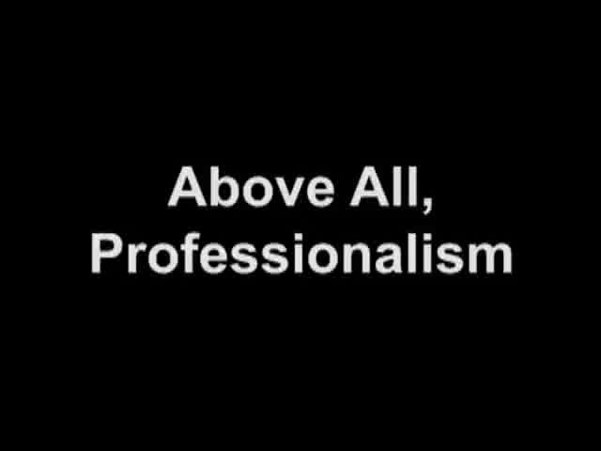

Slide 36
Doctors are to be committed to
1. Integrity 2. Compassion
3. Altruism
4. Continuous improvement
5. Excellence ,as well as ;
6. Working in partnership with members of the other health care teams.

Slide 37
In summary
The broader concept of physician role should be adopted to go past the individual and include the community as well.

Slide 38
Take home message
You have been given this life but once
in it,
do all the good that you can do
to all the people you can do
for as long as you can do .
Ceccere

Slide 39
FOR YOUR READING
1. An Introduction to Community Health
James F. McKenzie
2. Community Health and Wellness:
Primary Health Care in Practice Anne McMurray and Jill Clendon
3. Volunteers: a social profile
Indiana University Press, 2008 - Social Science
Marc A. Musick, John Wilson32 Reviewshttp://books.google.com.sa/books/about/Volunteers.html?id=u8Tabf5HcRcC Indiana University Press, 2008

