Slide 1
Ethics of Medical Research
Professor Ahmed A. Adeel
Dr. Maha Arafah
2015

Slide 2
Objectives
Identify the main principles of medical research ethics.
Discuss the balance of research and clinical care.
Describe requirements of ethics review committees, including definition of informed consent.
Identify the key international and national references for the rules and regulations of medical research

Slide 3
Main Functions of Medical Research
Monitoring and evaluation of drugs / treatments being used
The development of new treatments, especially drugs, medical devices and surgical interventions.
Understanding human physiology .
Causes of diseases and the best ways to prevent or cure them.
Factors in human health, including patterns of disease (epidemiology)
The organization, funding and delivery of healthcare (health systems research)
Social and cultural aspects of health (medical sociology and anthropology)

Slide 4
Why do practicing physicians need a good understanding of medical research methods ?
All physicians make use of the results of medical research in their clinical practice.
To maintain their competence, physicians must keep up with the current research , they must know how to interpret the results of research and apply them to their patients.

Slide 5
Two potential problems for practicing physicians :
    The physician’s primary responsibility is the health and well-being of the patient, whereas the researcher’s primary responsibility is the generation of knowledge, which may or may not contribute to the research subject’s health and wellbeing .
    Conflict of interest when the physician is influenced by financial gains from research or results of the research.

Slide 6
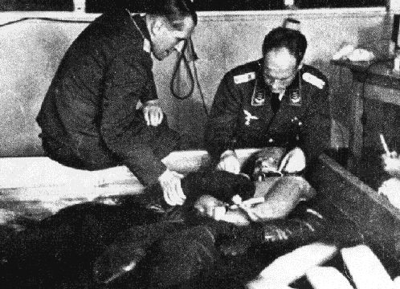
HISTORY : Development of codes of ethics for medical research , the Nuremberg Code
In During World War II , physicians in Nazi Germany and elsewhere performed research on subjects that clearly violated fundamental human rights.
The Nazis immersed their subjects into vats of ice water at sub-zero temperatures, or left them out to freeze in the winter cold. As the prisoners excreted mucus, fainted and slipped into unconsciousness, the Nazis meticulously recorded the changes in their body temperature, heart rate ,muscle response and urine.

Slide 7
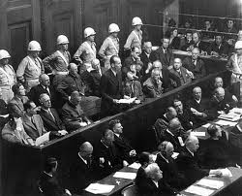
HISTORY : Development of codes of ethics for medical research , the Nuremberg Code
Following World War Two, some of these physicians were tried and convicted by a special tribunal at Nuremberg, Germany.
The basis of the judgment is known as the Nuremberg Code, which has served as one of the foundational documents of modern research ethics.
23 German doctors were charged with crimes against humanity for experiments .
The defendants committed the murders, brutalities الوحشية, cruelties القسوة, tortures تعذيب and other inhuman

Slide 8
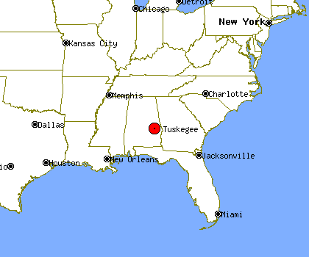
HISTORY : The Tuskegee Syphilis Study (1932-72)
“ the Tuskegee Study of Untreated Syphilis in the Negro Male ”
This clinical study that has become a symbol of unethical medical experimentation.

Slide 9
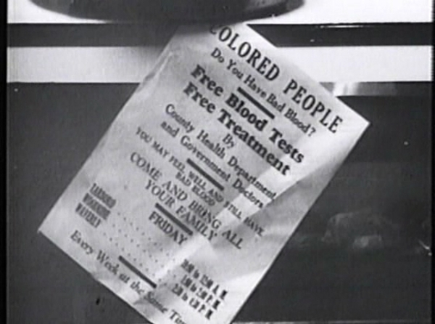
HISTORY : The Tuskegee Syphilis Study (1932-72)
Started in 1932 and involved nearly 400 poor and uneducated African-American men diagnosed with latent syphilis - meaning that they had the infection but showed no obvious symptoms at that stage.

Slide 10
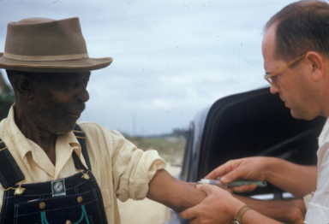
The Tuskegee Syphilis Study (1932-72)
For 40 years they were never told they had syphilis and were never treated for it, even when penicillin became a standard cure in 1947. They were simply told they had ‘bad blood’.
Among the aims of the study was to see whether syphilis affected black men differently from white men.

Slide 11
The Tuskegee Syphilis Study (1932-72)
For participating in the study, the men received free rides to and from the clinic at Tuskegee University, Alabama.
There they were given hot meals and free medical treatment for minor ailments. Any treatments they thought they were also getting for their ‘bad blood’ were actually placebos, aspirin or mineral supplements.
Medical staff allowed nothing to interfere with their work.
Even when 250 of the men were drafted for service in the Second World War, they remained part of the study.

Slide 12
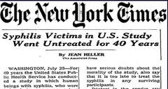
The Tuskegee Syphilis Study (1932-72)
When the study ended in 1972 following a public outcry, only 74 of the original participants were still alive.

Slide 13
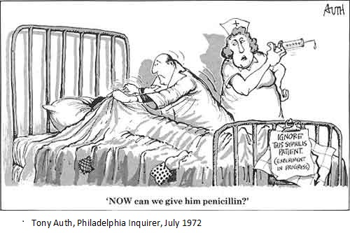
The Tuskegee Syphilis Study (1932-72)

Slide 14
The Tuskegee Syphilis Study
  Only 74 men were still alive.
  All rest had died of the disease or of related complications.
  40 wives had been infected
  19 children had been born with congenital syphilis.
  Survivors eventually received financial compensation

Slide 15
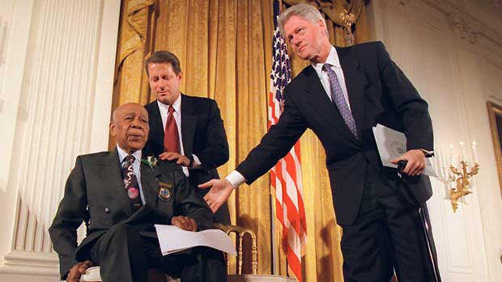
The Tuskegee Syphilis Study
1997 US President Bill Clinton was moved to declare that ‘on behalf of the American people, what the United States government did was shameful’

Slide 16
The syphilis experiments in Guatemala were United States-led human experiments conducted in Guatemala from 1946 to 1948, the cooperation of some Guatemalan health ministries and officials. Doctors infected soldiers, prostitutes, prisoners and mental patients with syphilis and other sexually transmitted diseases, without the informed consent of the subjects, and treated most subjects with antibiotics. This resulted in at least 83 deaths

Slide 17
The experiments were led by United States Public Health Service physician John Charles Cutler, who later took part in the late stages of the Tuskegee syphilis experiment

Slide 18
While the Tuskegee experiment followed the natural progression of syphilis in those already infected, in Guatemala doctors deliberately infected healthy people with the diseases some of which are fatal if untreated. The goal of the study seems to have been to determine the effect of penicillin in the prevention and treatment of venereal diseases. The researchers paid prostitutes infected with syphilis to have sex with prisoners and some subjects were infected by directly inoculating them with the bacterium.When the subjects contracted the disease they were given antibiotics, although adequate penicillin therapy was prescribed for 76% of subjects, completion of therapy was documented for only 26%. Francis Collins, the NIH director at the time of the revelations, called the experiments "a dark chapter in history of medicine" and commented that modern rules prohibit conducting human subject research without informed consent

Slide 19
The Belmont Report 1979
Principles of research with human subjects
Principles of Research with Human Subjects:
• Respect for Persons
• Beneficence
• Justice
معاملة الإنسان كشخصية مستقلة له رأيه الحر دون إكراه
الإحسان و منع الإساءة كما يجب أن لآ يصيب الضرر الإنسان نتيجةللبحث
العدل في العبء و الفائدة المرجوة من البحث
http://ohrp.osophs.dhhs.gov/humansubjects/guidance/belmont.htm

Slide 20
The Belmont Report 1979
Principles of research with human subjects
Principles of Research with Human Subjects
(1) Respect for Persons
معاملة الإنسان كشخصية مستقلة له رأيه الحر دون إكراه
– individuals have autonomy and choice
– people can not be used as a means to an end
– provide protection to the vulnerable
– provide informed consent and privacy
(2) Beneficence
(3) Justice

Slide 21
The Belmont Report 1979
Principles of research with human subjects
Principles of Research with Human Subjects
(1)Respect for Persons
(2) Beneficence
الإحسان و منع الإساءة كما يجب أن لآ يصيب الضرر الإنسان نتيجة للبحث
– kindness beyond duty
– obligation to do no harm
– obligation to prevent harm
– obligation to do good
– minimize risks, maximize benefits
(3) Justice

Slide 22
The Belmont Report 1979
Principles of research with human subjects
Principles of Research with Human Subjects
(1) Respect for Persons
(2) Beneficence
(3) Justice
العدل في العبء و الفائدة المرجوة من البحث
– treat all fairly
– share equitably burdens and benefits

Slide 23
Declaration of Helsinki (DoH)
Issued by World Medical Association (WMA) in 1964.
It was further revised in 1975, 1983, 1989, 1996, 2000 and 2008.
The DoH is a concise summary of research ethics. Other, much more detailed, documents have been produced in recent years on research ethics in general

Slide 24
Declaration of Helsinki (DoH)
Important points
(1) Ethics Review Committee Approval: Medical research on human subjects must be reviewed and approved by an independent ethics committee before it can proceed.
(2) Scientific Merit: Medical research involving human subjects must be justifiable on scientific grounds
( 3) Qualified Researchers : Medical research involving human subjects must be conducted by qualified researchers.
(4) Social Value: Medical research project should that it contribute to the wellbeing of society in general.
(5) Risks and Benefits: It is also necessary for the researcher to demonstrate that the risks to the research subjects are not unreasonable or disproportionate to the expected benefits of the research, which may not even go to the research subjects.
(6) Informed Consent :The first principle of the Nuremberg Code reads as follows: “The voluntary consent of the human subject is absolutely essential.

Slide 25
Declaration of Helsinki (DoH)
Important points
(7) Confidentiality
  Research subjects have a right to privacy with regard to their personal health information.
(8) Conflict of Roles
  The physician’s role in the physician-patient relationship is over the researcher’s role, even if the physician and the researcher are the same person.
(9) Honest Reporting of Results
  Research results be reported accurately, but unfortunately there have been numerous recent accounts of dishonest practices in the publication of research results.
(10) Whistle-blowing
  In order to prevent unethical research from occurring, or to expose it after the fact, anyone who has knowledge of such behavior has an obligation to disclose this information to the appropriate authorities.

Slide 26
Declaration of Helsinki (DoH)
Important points
(11) Justice
Equitable selection of participants, i.e., avoiding participant populations that may be unfairly coerced into participating, such as prisoners and institutionalized children. The principle of justice also requires equality in distribution of benefits and burdens among the population group(s) likely to benefit from the research.

Slide 27
Summary of main ethical research requirements
Voluntary consent
For good of society
Animal experiments 1st; human experiments 2nd
Avoid unnecessary suffering
Do not conduct if death & debility likely
Risk commensurate with benefits
Protect subjects against harm
Conducted only by qualified persons
Subjects should be at liberty to discontinue
Terminate if becomes apparent that death or debility will occur

Slide 28
What elements should be included in an informed consent?
Purpose of the research
Procedures involved in the research
Alternatives available should a subject decide not to participate in the research
All foreseeable risks and discomforts to the subject. *Note that these include not only physical injury but also possible psychological, social, or economic harm, discomfort, or inconvenience.
Benefits of the research to society and possibly to the individual human subject
Length of time the subject is expected to participate
Payment for participation (if applicable)
Person to contact for answers to questions or in the event of a research-related injury or emergency
Statement that participation is voluntary and that refusal to participate will not result in any consequences or any loss of benefits that the person is otherwise entitled to receive
Subjects' right to confidentiality and right to withdraw from the study at any time without any consequences

Slide 29
نظام أخلاقيات البحث على المخلوقات الحية
Code of Ethics for Research on Living Creatures, KSA
The National Committee of Medical & Bioethics was approved by the Royal Decree on 18/5/1422H, to be headquartered at KACST in Riyadh. It consists of the following sub-committees:
The legal sub-committee.
The human research sub-committee.
The flora & animal sub-committee.
The education & media sub-committee.

Slide 30


نظام أخلاقبات البحث على المخلوقات الحية
Code of Ethics for Research on Living Creatures, KSA

Slide 31
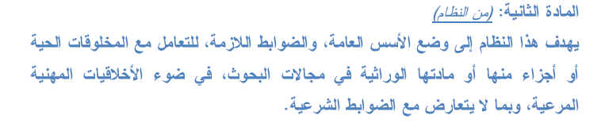
نظام أخلاقيات البحث على المخلوقات الحية
Code of Ethics for Research on Living Creatures, KSA

Slide 32
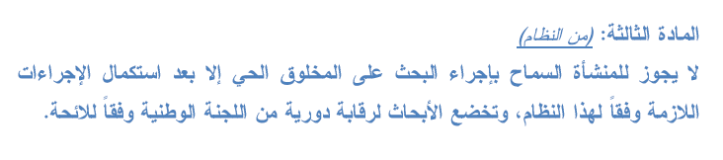
نظام أخلاقيات البحث على المخلوقات الحية
Code of Ethics for Research on Living Creatures, KSA

Slide 33
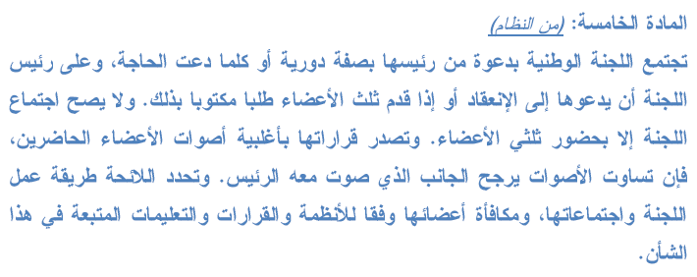
نظام أخلاقيات البحث على المخلوقات الحية
Code of Ethics for Research on Living Creatures, KSA

Slide 34

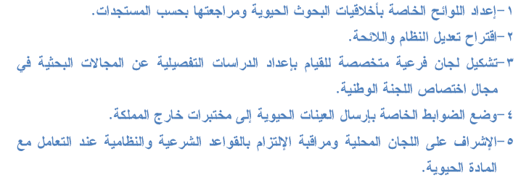
نظام أخلاقيات البحث على المخلوقات الحية
Code of Ethics for Research on Living Creatures, KSA

Slide 35
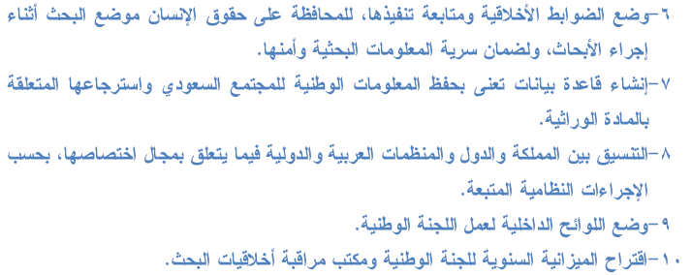
نظام أخلاقيات البحث على المخلوقات الحية
Code of Ethics for Research on Living Creatures, KSA

Slide 36
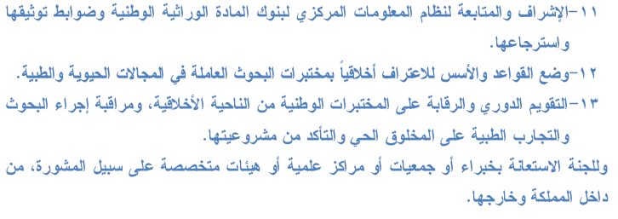
نظام أخلاقيات البحث على المخلوقات الحية
Code of Ethics for Research on Living Creatures, KSA

Slide 37
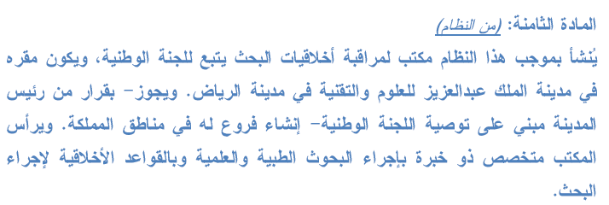
نظام أخلاقيات البحث على المخلوقات الحية
Code of Ethics for Research on Living Creatures, KSA

Slide 38
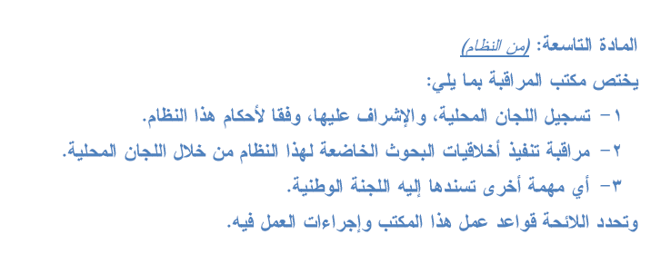
نظام أخلاقيات البحث على المخلوقات الحية
Code of Ethics for Research on Living Creatures, KSA

Slide 39
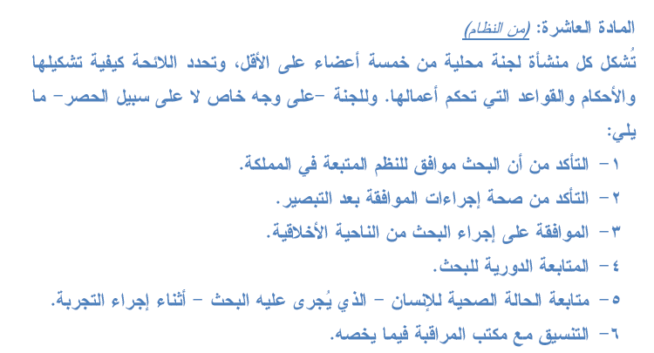
نظام أخلاقيات البحث على المخلوقات الحية
Code of Ethics for Research on Living Creatures, KSA

Slide 40

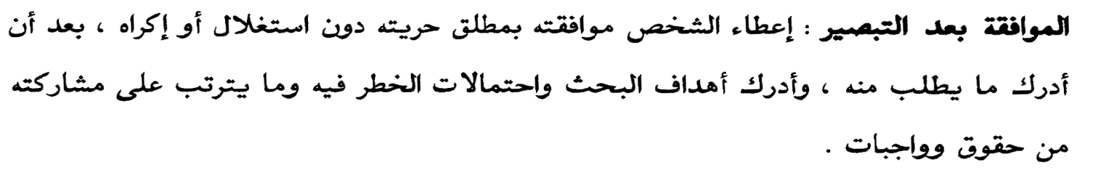
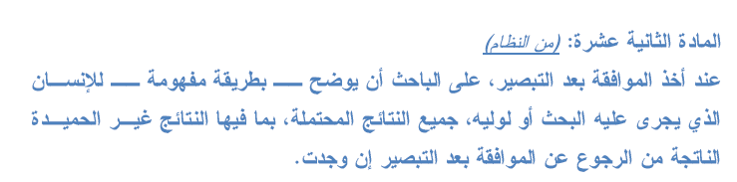

Informed Consent الموافقة بعد التبصير

Slide 41
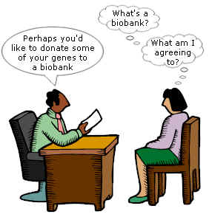
Informed Consent الموافقة بعد التبصير

Slide 42
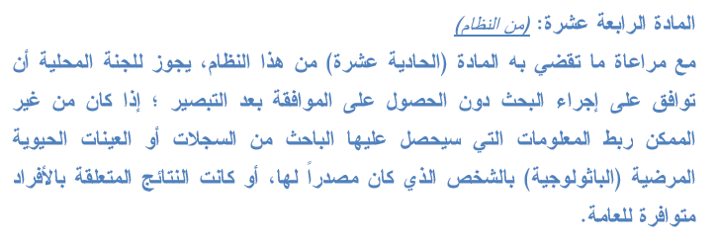
نظام أخلاقيات البحث على المخلوقات الحية
Code of Ethics for Research on Living Creatures, KSA

Slide 43

نظام أخلاقيات البحث على المخلوقات الحية
Code of Ethics for Research on Living Creatures, KSA

Slide 44

نظام أخلاقيات البحث على المخلوقات الحية
Code of Ethics for Research on Living Creatures, KSA

Slide 45


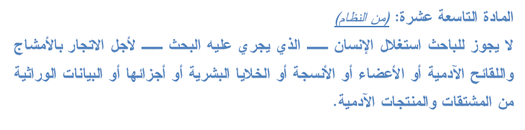
نظام أخلاقيات البحث على المخلوقات الحية
Code of Ethics for Research on Living Creatures, KSA

Slide 46



نظام أخلاقيات البحث على المخلوقات الحية
Code of Ethics for Research on Living Creatures, KSA

Slide 47
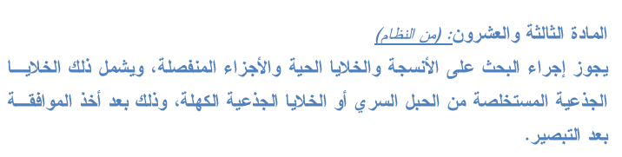

نظام أخلاقيات البحث على المخلوقات الحية
Code of Ethics for Research on Living Creatures, KSA

Slide 48


نظام أخلاقيات البحث على المخلوقات الحية
Code of Ethics for Research on Living Creatures, KSA

Slide 49

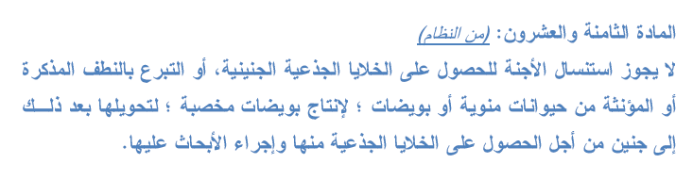
نظام أخلاقيات البحث على المخلوقات الحية
Code of Ethics for Research on Living Creatures, KSA

Slide 50

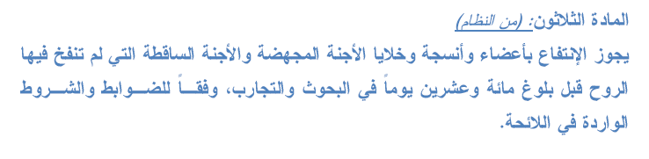
نظام أخلاقيات البحث على المخلوقات الحية
Code of Ethics for Research on Living Creatures, KSA

Slide 51
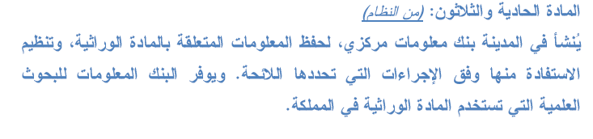

نظام أخلاقيات البحث على المخلوقات الحية
Code of Ethics for Research on Living Creatures, KSA

Slide 52
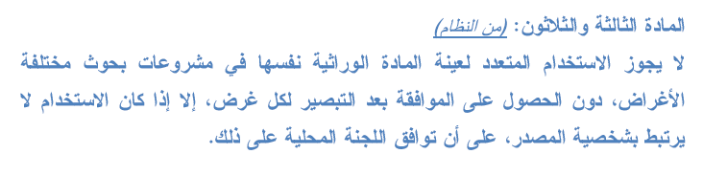

نظام أخلاقيات البحث على المخلوقات الحية
Code of Ethics for Research on Living Creatures, KSA

Slide 53
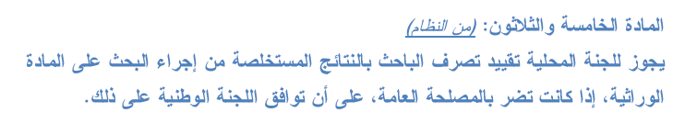


نظام أخلاقيات البحث على المخلوقات الحية
Code of Ethics for Research on Living Creatures, KSA

Slide 54
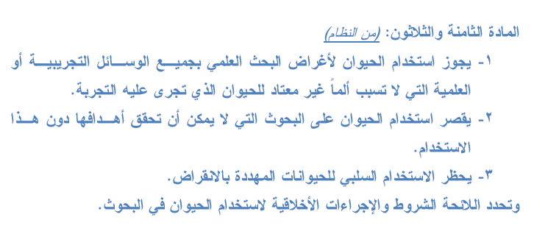
نظام أخلاقيات البحث على المخلوقات الحية
Code of Ethics for Research on Living Creatures, KSA

Slide 55
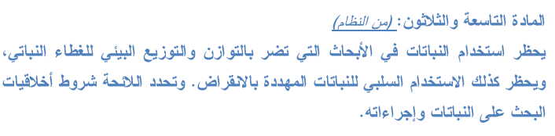
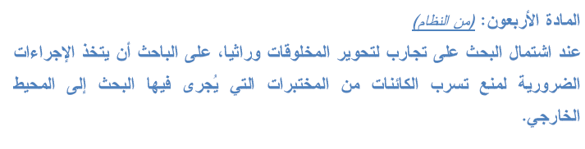
نظام أخلاقيات البحث على المخلوقات الحية
Code of Ethics for Research on Living Creatures, KSA

Slide 56
Case Studies in Medical Research Ethics
Case 1
Mrs X , an 81-year-old Alzheimer's patient hospitalized under your care has been asked to participate in a clinical trial testing a new drug designed to help improve memory. You were present when the clinical investigator obtained a signed informed consent from Mrs X a few days ago. However, when you visit Mrs. X today and ask her if she is ready to begin the study tomorrow, she looks at you blankly and seems to have no idea what you are talking about.
What should you do?

Slide 57
Case Studies in Medical Research Ethics
Case 1 Discussion
The ability of Mrs. X to give an ethically valid informed consent is in doubt. You should contact the primary investigator to discuss Mrs. X ‘s participation in the trial. There may be a relative who can give consent for her participation if it is deemed to be in her best interests. She should be considered a vulnerable research subject because of her mental status.

Slide 58
There are two types of consent that may be required:
Consent - An adult capable of giving permission to participate in a study can provide consent
Assent - In most states if the subject is under 18 years of age, assent must be obtained.

Slide 59
Case Studies in Medical Research Ethics
Case 2 Question
After having completed a study that involved the collection of tissue from the subjects, an investigator wishes to perform additional analysis of the archived tissue samples. This nature of this analysis was not explicitly (صراحةً)stated in the original consent form. Should the investigator be required to obtain explicit consent for the new research?

Slide 60
Case Studies in Medical Research Ethics
Case 2 Discussion
Institutional Review Boards ( IRB) or research committees have increasingly required that explicit consent be obtained, if practical, before archived tissue can be used for research. Archiving samples for an unspecified “future use” without explicit consent undermines the autonomy of the participants. Even if participants may be willing in general to have surplus tissue used for research purposes, they should still be asked for their consent.

Slide 61
Case Studies in Medical Research Ethics
Case 3 Question
University of British Columbia (UBC) medical genetics researcher Dr. Richard Ward
  883 subjects provided blood samples for arthritis study on a Canadian ethic group
  No conclusive results were obtained but the blood samples were used for other studies by the reseacher.
  Samples were used without consent for genetic analysis
  Results of genetic analysis suggested that the origin of the group was contrary to the group’s own understanding
What are the ethical issues in this case ?

Slide 62
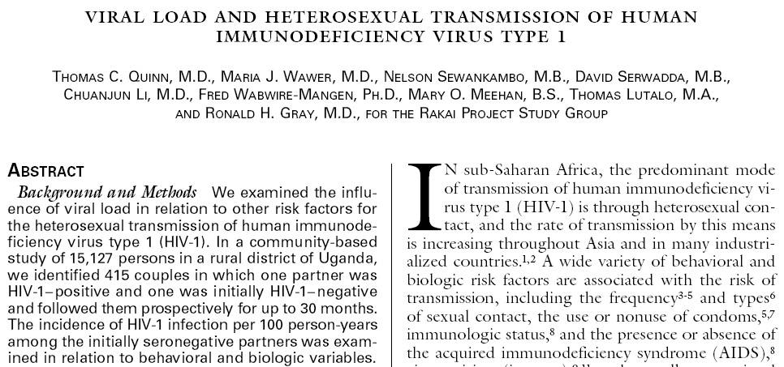


Case Studies in Medical Research Ethics
Case 4 story

Slide 63
Case Studies in Medical Research Ethics
Case 4 story
Goal of study to understand risk factors connected with heterosexual HIV transmission
    Identified 415 couples in which one partner was HIV+ and other not
    Followed up for 30 months
    90 of HIV- partners seroconverted
    No treatment offered for HIV+ participants
    It was left up to HIV+ partner to determine whether their status was disclosed to their partner
What ethical issues do you see in this case?

Slide 64
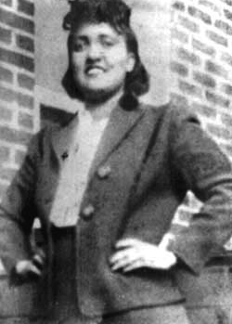
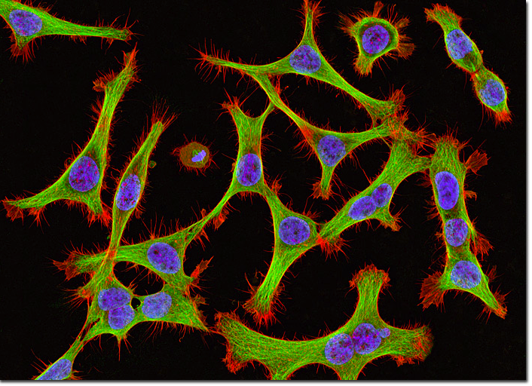
Case Studies in Medical Research Ethics
Case 5 Story
Diagnostic test for of Henrietta Lacks reveals cervical cancer (1951)
Cancer cells are removed for research purposes without consent
George Gey created the first immortal cell line “Hela Cells” , and they were widely shared
Creation of the cell line generated an increase in medical and biological research, including a vaccine for polio, cancer research, AIDS research, among others
The identity of Henrietta Lacks remained confidential until the 1970s
After her identity was known, the family found out for the first time that Henrietta Lack’s cells were still “alive.”

Slide 65
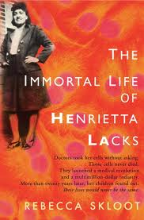
Case Studies in Medical Research Ethics
Case 5 story
by 2009, "more than 60,000 scientific articles had been published about research done on HeLa, and that number was increasing steadily at a rate of more than 300 papers each month

