Slide 1
Human Factors & Patient Safety

Slide 2
We will learn:
Human Factor and its relation to patient safety
To Err is Human : true or false
Medical Errors: types , causes and example
Actions to reduces medical errors as related to Humans

Slide 3
Human Factors
Understanding and advancement of the systematic consideration of people in relation to machines, systems, tools, and environments. (HFS) highlights fundamental human capabilities, limitations, and tendencies, as well as the basics of human performance.

Slide 4
TO ERR IS HUMAN
United States at least 44,000 people, and perhaps as many as 98,000 people die for preventable medical errors .
Cost of medical errors claims : between $17 billion and $29 billion per year in hospitals nationwide.
Institute of Medicine (IOM) in 1999 called for a national effort to make health care safer.
A total of 5514 articles on patient safety and medical errors were published during the 10 year study period
The rate of patient safety publications increased from 59 to 164 articles per 100,000 MEDLINE publications
Publications of original research increased from an average of 24 to 41 articles per 100 000 publications, while patient safety research awards increased from 5 to 141 awards.

Slide 5
Medical errors
Failure of a planned action to be completed as intended
or
the use of a wrong plan to achieve an aim.

Slide 6
Types of Medical Errors
Near Miss: incidence about to happen but by chance didn’t occur.
sentinel event: A sentinel event is an unexpected occurrence involving death or serious physical or psychological injury
Medication Error: is any preventable event that may cause or led to inappropriate medication use or patient harm.

Slide 7
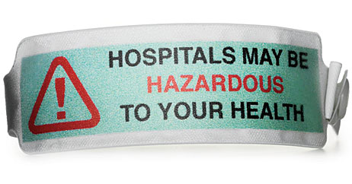

Slide 9
Factors Causing Errors
Large work loads
High patient acuity
Inexperienced staff
Constant interruption
Multiple hand offs
Lack of rewarding system

Slide 10
Causes of Medical Errors
1- Healthcare Complexity
Complicated technologies
Drugs interaction.
Intensive care
prolonged hospital stay.
Multidisciplinary approach
2- System and Process Design
Inadequate communication,
Unclear lines of authority

Slide 11
Cont:
3- Environmental factors.
Over crowded services
Unsafe care provision areas
areas poorly designed for safe monitoring.
4- Infrastructure failure.
Lack of documentation process
Lack of continuous improvement process

Slide 12
Cont:
5- Human Factors and Ergonomics
H Hungry
A Angry/ Emotions
L Late/ lazy
T Tired/fatigue/sleep less
lack of skilled workers.
Lack of training.

Slide 13
Examples of errors
Delay in response to emergency
Failure to diagnose or delay of a diagnosis.
Wrong drug or (wrong patient, wrong chemical, wrong dose, wrong time, wrong route)
Wrong-site surgery
Retained surgical instruments
Improper transfusions
Restraint -related injuries or death
Falls
Incorrect record-keeping

Slide 14
KKUH –Medical Errors
Expired medication dispensed
Un planned hysterectomy
Wrong Sponge counting
Self extubation
Wrong patient ID , went to wrong procedure
Wrong medication delivered
Wrong dose administered

Slide 15
Actions
Greater focus on the quality of healthcare ( performance measures / clinical audits/ quality in healthcare research )
Accreditation process mandatory
Patient safety standards/ goals
computerized drug ordering systems
Error reporting should be voluntary and confidential
malpractice insurance
National standards for on work hours for medical interns and residents
Patient education

Slide 16
Cont:
Verification, credentialing, privileging and evaluation process
Morbidity and mortality review process
OVR process
No Blame Culture
WHO / JCI/ AC and others standards and check list
Medical societies

