Slide 1
Understanding and learning from errors and managing clinical skills

Slide 2
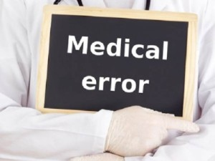
Medical error
Failure of planned action to be completed as intended
or
The use of wrong plan to achieve an aim

Slide 3
Types of errors
Sentinel events
Near miss
Major event
Adverse event
Medication errors

Slide 4
Near Miss:
incidence about to happen but by chance didn’t occur.
sentinel event:
A sentinel event is an unexpected occurrence involving death or serious physical or psychological injury
Medication Error:
is any preventable event that may cause or led to inappropriate medication use or patient harm.
Adverse event
defined as incidents in which harm resulted to a person receiving health care. They include infections, falls resulting in injuries,

Slide 5
How to capture error ?
Incident report
(OVR)
Patient complain
Morbidity Mortality review
Claim
Occurrence screening
Hazard mapping
observation

Slide 6
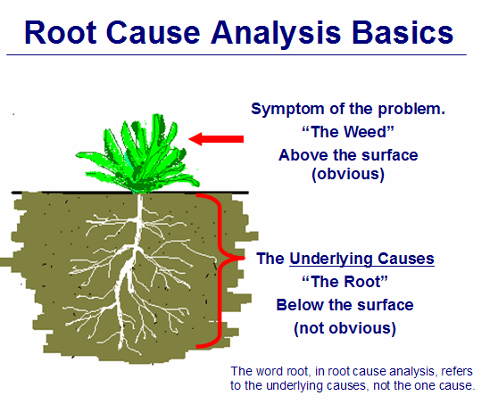
Root cause analysis (Fish bone analysis)
is an approach for identifying the underlying causes of why an incident occurred so that the most effective solutions can be identified and implemented

Slide 7
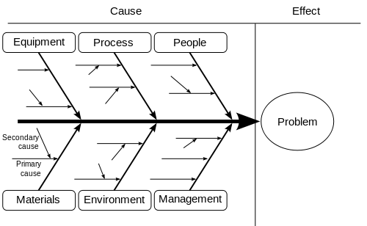
Fish bone analysis

Slide 8
Examine different solution
1. Engineering/ structural control
(Reconstruction, anti slippery floors, hood)
2. Administrative changes
(policies, protocols, job descriptions)
3. Personal measures
(PPEs, counseling)

Slide 9
Action plan and time frame
Objective (what) | Actions (how) | Responsible(who) | Timescale (when) | Progress (review regularly and sign off when completed)

Slide 10
Monitoring and evaluation
Reassessment through different method
1) Key performance indicators
2) tracer
3) compliance audit

Slide 11
Group exercise
The top management recognize tow major issues in the hospital
1- High volume of patient falls
2- medication error
Based on information you get from this lecture what is your plan to solve this problem ?

