Slide 1
What is patient safety ?

Slide 2
History of patient safety :
1955 when Codman who is also known as father of Patient safety looked at the outcome of patient care
1984 Anaesthesia patient safety foundation established
1992 first medical practice study across different specialties
1995 first conference on patient safety
1996 national patient safety foundation formed and JCI released the policy on Sentinel events,

Slide 3
1997 president Clinton created task force for quality in healthcare in America
1999 Institute of Medicine IOM published first report on medical errors
2000 AHRQ was established and JCI published patient safety standards
2002 six patient safety goals released by JCI , types of errors identified
2003 Bar coding on medication mandatory

Slide 4
Definition of patient safety
The IOM Institute of medicine defines patient safety as “the prevention of harm to patients
The Canadian Patient Safety defines patient safety as “the reduction and mitigation of unsafe acts within the healthcare system, as well as through the use of best practices shown to lead to optimal patient outcomes
The World Health Organization’s (WHO) defines patient safety as , “the reduction of risk of unnecessary harm associated with healthcare to an acceptable minimum.

Slide 5
Patient safety Dimension
safe
Effective
Patient-Centered
Efficient
Equitable
Timely

Slide 6
Safe : avoid injuries to patients from care that is intended to help them .
Timely : reduce waits and avoid harmful delays for both who receive and who give care .
Effective : provide care based on scientific knowledge to all who could benefit .
Efficient : avoid waste including waste of equipment , supplies , idea and energy .
Equitable : dealing fairly and equally with all patients ,care should not in quality because patient personal characteristic such as gender , ethnicity socioeconomic status .
Patient centered : should be respectful to patient need & values.

Slide 7
Culture of patient safety:
Definition from the Health and Safety Commission
The safety culture of an organization is the product of individual and group values, attitudes, perceptions,, and patterns of behavior that determine the commitment to, and the style and proficiency of, an organization’s health and safety management
an integrated pattern of individual and organizational behavior, based on a system of shared beliefs and values, that continuously seeks to minimize patient harm that may result from the process of care delivery.’ (Kizer 1999)

Slide 8
Patient safety culture survey
The first step in creating a culture of safety is to assess the readiness of an organization to implement healthcare safety practices .
The most Patient Safety Issues facing healthcare organization today are :
Maintain a culture of safety(Just Culture).
Identify organizational champions .
Develop and sustaining patient safety strategies.
Determine key drivers for patient safety programs.
Ensure the adoption of current safety-related technologies .

Slide 9
Just a culture
Is the concept used to reconcile the tension between “no blame “ and “blame “this concept is useful to create a culture of accountability while respecting the fundamental need to maintain a system focus and trusting workforce.

Slide 10
Safety culture divided into seven subcultures and defined as:
Leadership
Teamwork
Evidenced based
Communication
Learning
Just a culture
Patient centred

Slide 11
Seven steps for patient safety culture
1) Build a safety culture: Create a culture that is open and fair
2) Lead and support your staff: Establish a clear and be focus on patient safety throughout your organization
3) Integrate your risk management activity: Develop systems and processes to manage your risks and identify and assess things that could go wrong
4) Promote reporting: Ensure your staff can easily report incidents locally and nationally

Slide 12
5) Involve and communicate with patients and the public: Develop ways to communicate openly with and listen to patients
6) Learn and share safety lessons: Encourage staff to use root cause analysis to learn how and why incidents happen
7) Implement solutions to prevent harm: Embed lessons through changes to practice, processes or systems

Slide 13
Approaching patient safety within an Organization requires a review in six key areas:
Safe Structure : involves reviewing whether the facilities are designed to promote safety ,i.e. right supplies.
Safe Environment : include an assessment of lighting, temperature and noise level.
Safe Equipment/technologies : include an examination of labels, instruction and safety features when using various devices.
Safe Process : include an assessment of whether redesign would improve safety by looking at some factors i.e. complexity
The effect of people : (i.e. Staff) include attitude, motivation ,health education and training.
The leadership/culture : can drive safety issues when there is a willingness to allocate appropriate resources (i.e. equipment).

Slide 14
Patient Safety Goals – Required Organizational Practices (ROPs)
Communication
1-Verification
Client identification methods
At least 2 identifiers
2-Transfer of client information
Read back technique
SBAR
e-Medical Records
Transfer forms /Check list

Slide 15
Communication
3-Medication reconciliation
At admission, transfer and discharge
4- Safe surgical practice
Surgical safety check list
Pre-operative verification
Pre- operative marking
Time out prior to procedure
5-Dangerous abbreviations - New

Slide 16
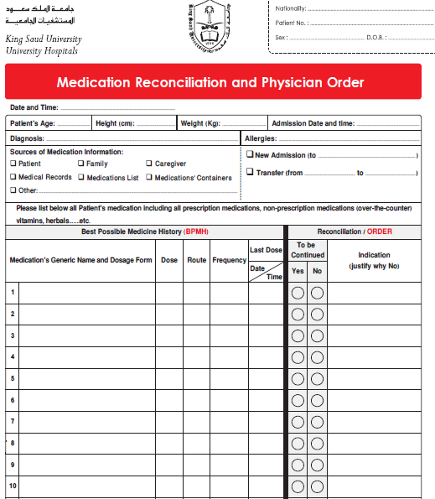

Slide 17
Medication Use
6-Control of Concentrated electrolytes
7-High alert medications (includes former drug concentrations)-New
8-Infusion pump training - New
Work life
9- Training on patient safety
10-Preventive maintenance program - New
Infection Control
11-Hand hygiene
12-Prophylactic antibiotics
13- Safe injection practices

Slide 18
Safety Culture
14-Adverse Event Reporting - New
Risk Assessment
15-Pressure ulcer prevention- New
16-Falls prevention - New
17-Venous thromboembolism prophylaxis- New

Slide 19
Clinical Patient Safety Performance Measures :
Number of Sentinel events
Number of repeated Sentinel events
Reported significant of Medication errors
Patient fall with injury rate
Number of serious injury/death associated with device
Devise associated bloodstream infection rate
Nosocomial respiratory infection rate

Slide 20
Health care Safety and Technology
Various technological solutions have been proposed to enhanced patient safety programs such as :
Electronic Medical Records
Computerized Provider Order Entry (CPOE)
Bar Code Medication Administration (BCMA)
Picture Archiving and Communication Systems (PACS)
Smart Intravenous Pumps

Slide 21
Tips of improvement patient safety
1) Constitution of patient safety committee
2) Develop clear policies and protocol for patient safety
3) Discuss regularly patient safety initiative within hospital staff
4) Orientation hospital staff on patient safety
5) Encourage transparency in the regular death review
6) Non punitive reporting by staff
7) Review , monitor and evaluate safety procedures regularly

Slide 22
Thank You

