Slide 1
Brainstem Slides

Slide 3
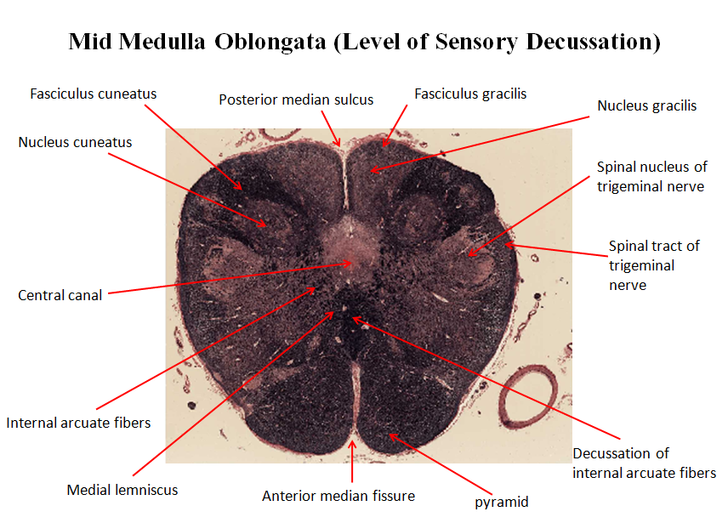

Slide 4
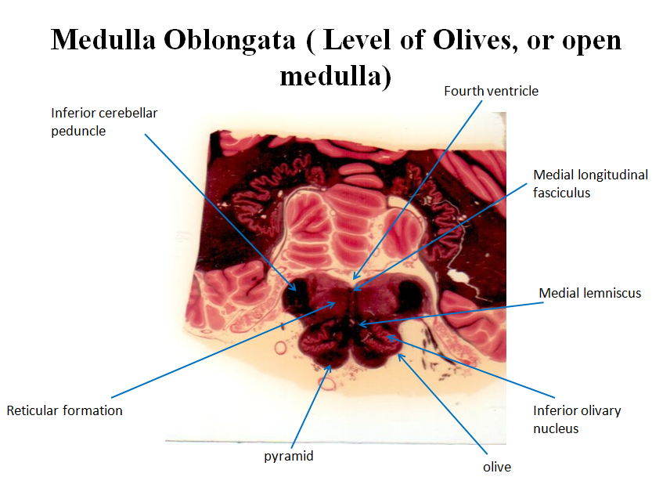

Slide 6
