Slide 1
Drugs Related to Balance System
The overall incidence of dizziness, vertigo, and imbalance is 5-10%
It reaches 40% in patients older than 40 years.
Accounts for 3% of total visits to emergency department
The incidence of falling is 25% in subjects older than 65 years.
1% of falls results in hip fracture
Roughly 50% of fractured hips will not function normally.

Slide 2
Drugs Related to Balance System
ILOS
To differentiate between classes of drugs used to control or to prevent vertigo
To identify drugs that can precipitate vertigo

Slide 3
Drugs Related to Balance System
Balance Disorders
Definition
Terms
Dizziness
Vertigo
Light headedness

Slide 4
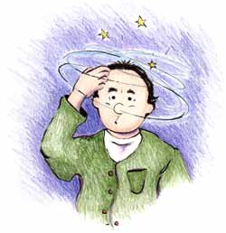
Symptoms
Spinning (vertigo)
Confusion or disorientation
Falling or feeling as if one is going to fall
Nausea or vomiting
Sweating
Abnormal eye movemet (nystagmus)

Slide 5
Pharmacologic approach
Involves targeting the underlying cause of the vertigo (e.g., ear infection).
Specific treatment
Symptomatic treatment
Involves controlling the acute symptoms and autonomic complaints (e.g., vertigo and vomiting)
Prophylactic treatment
Aims to reduce the recurrence of specific vertiginous conditions.
Diuretics (but not loop diuretics)
Corticosteroids
Ca Channel Blockers
Cinnarizine, Verapamil

Slide 6
Symptomatic control
Vestibular suppressants
Vestibular suppressants are drugs that reduce the intensity of vertigo and nystagmus evoked by a vestibular imbalance.
Antiemetics
1-Anticholinergics
2-Benzodiazepines
3-Betahistine

Slide 7
1-Anticholinergics
2-Benzodiazepines
Anticholinergics inhibit firing in vestibular nucleus neurons
In small dosages useful for the management of acute vertigo
Minimize anxiety and panic associated with vertigo
Reduce the velocity of vestibular nystagmus
Lorazepam, Clonzepam, Diazepam
e.g. hyoscine, also useful in motion sickness, sedation
ADRs:- Dependence, impaired memory, increased risk of falling.
ADRs:- dry mouth, blurred vision, sedation

Slide 8
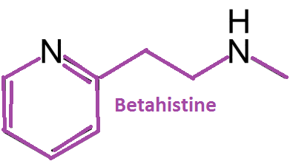
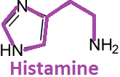
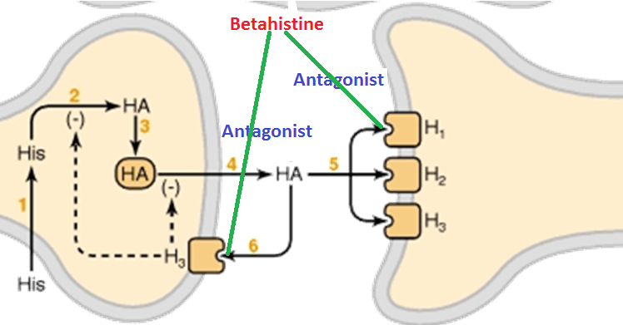
3-Betahistine
Mehanism of Action:-
Betahistine increases the level of serotonin in the brainstem →↓the activity of vestibular nuclei.
By stimulating H₁ receptors located on blood vessels in the inner ear→ local vasodilation and increased permeability, which helps to reverse the underlying problem of endolymphatic hydrops.
It is a structural analog of histamine with weak histamine H1 receptor agonist and more potent histamine H3 receptor antagonist properties
By bloking H3 receptors, Betahistine increases the local concentration of histamine in the inner ear.

Slide 9
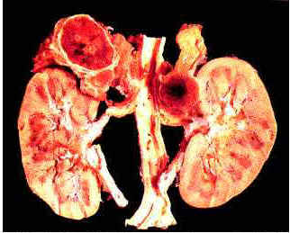
Pharmacokinetics
Contraindications
ADRs:-
Formulated as tablet or oral solution
Rapidly and completely absorbed.
Phaeochromocytoma
Headache
Nausea
t½= 3-4 hours excreted in urine within 24 hours
Bronchial asthma
Low protein binding
GIT side effects
History of peptic ulcer
Hypersensitivity reactions

Slide 10
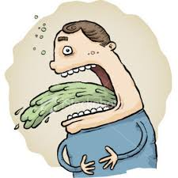
Antiemetics
Antiemetics are drugs used to control vomiting and nausea
Antihistamines e.g. diminhydrinate
Phenothiazines e.g. prochlorperazine
Dopamine antagonists e.g. metoclopramide and domperidone

Slide 11
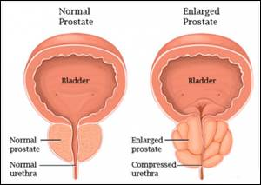
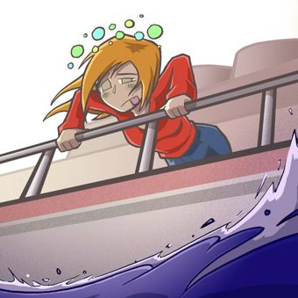
Diminhydrinate
ADRs:-
Sedation
Diziness
Anticholinergic side effects
Block H₁ receptors in CRTZ
Sedative effects
Weak anticholinergic effects
↓ Excitability in the labyrinth & blocking conduction in vestibular-cerebellar pathways
Contraindications:-
Glaucoma
Prostatic enlargement
Indications
In vertigo
Motion sickness

Slide 12
Prochlorperazine
Blocks dopamine receptors at CRTZ
Antipsychotic , some sedation + antiemetic
Indications
One of the best antiemetics in vertigo,
has some vestibular suppressant action

Slide 13
Metoclopramide
A potent central antiemetic acting on CRTZ
Has some sedative action
Has potent gastroprokinetic effect
ADRS:-
Restlessness or drowsiness
Extrapyramidal manifestations on prolonged use

Slide 14
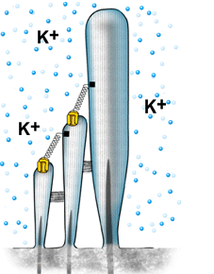
Cinnarizine
Mechanism of action
Selective calcium channel blocker, antihistamine, antiserotonin, antidopamine
Increased hydrostatic pressure on hair cells activates K+ currents
It promotes cerebral blood flow
Cinnarizine inhibits K+ currents
Inhibition of K+ currents lessen the vertigo and motion-induced nausea by dampening the over-reactivity of the vestibular hair cells.

Slide 15
Pharmacokinetics
Taken orally in tablet form
Contraindications
Clinical uses:-
ADRS:-
Rapidly absorbed
Sweating
Used to treat nausea and vomiting associated with motion sickness, vertigo, Meniere’s disease.
Parkinsonism
Headache
Low oral bioavailability due to hepatic first pass metabolism
Car drivers
Drowsiness
If administered IV in lipid emulsion, it has better bioavailability
Muscle rigidity and tremor

Slide 16
Drugs inducing vertigo
Drugs producing damaging effects on structure or function of labyrinthine hair cells &/ or their neuronal connections
Vesibular toxins
Mixed ototoxins
Drugs altering fluid & electrolyte balance
Diuretics
Drugs altering vestibular firing
Anticonvulsants
Antidepressants
Sedative hypnotics
Alcohol
Cocaine
Alter function

Slide 17
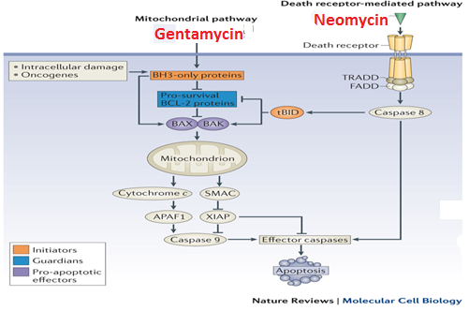
Mixed ototoxins
Quinine, chloroquine, quinidine
Nitrogen mustard
Loop diuretics
NSAIDs
Tobacco
Aminoglycoside antibiotics; gentamycin, kanamycin, neomycin, streptomycin
Gentamycin → Induce apoptosis by evoking free radicals → Mitochondrial Pathway
Neomycin →Induce apoptosis by activating caspases → Death Receptor Pathway
A lter function
↓Local blood flow → biochemical changes → ↓ electrochemical transduction → ↓firing of impulse
Alter structures

Slide 18
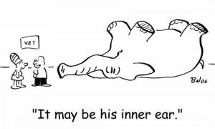
Synopsis
Drugs Affecting Balance
Drugs to treat vertigo
Specific
Symptomatic
Drugs inducing vertigo
Vestibular toxinss
Prophylactic
Duretics
Corticosteroids
Calcium antagonists
Vestibular suppressants
Antiemetics
Anticholinergics
Benzodiazepines
Betahistine
Antihistamines
Phenothiazines
Dopamine antagonist
Mixed ototoxins
eg Antibiotics

