Slide 1
http://www.bing.com/videos/search?q=parkinson+disease+vedeu&FORM=VIRE7#view=detail&mid=A4DB0D231B1637261F51A4DB0D231B1637261F51

Slide 2
The Autonomic Nervous System
BASAL GANGLIA
Fawzia Al-Rouq
Department of Physiology
College of Medicine
King Saud University

Slide 4
Objectives
Physiology of basal ganglia and regulatory mechanisms
At the end of this lectutre the student should be able to:-
1-appreciate different nuclei of basal ganglia
2-know different neurotransmitters that have a role in basal ganglia functions
3-appreciate general functions of basal ganglia
4-diagnose basal ganglia disorders

Slide 5
INTRODUCTION

Slide 6
BASAL GANGLIA
Basal ganglia are subcorticle nuclei of grey matter located in the interior part of cerebrum near about base

Slide 7
Movement Disorder | Features | Lesion
Chorea | Multiole quick, random movements, usually most prominent in the appendicular muscles | Atrophy of the striatum. Huntington Chorea
Athetosis | Slow writhing movements,which are usually more severe in the appendicular muscles | Diffuse hypermyelination of corpus striatum and thalamus
Hemiballismus | Wild flinging movements of half of the body | Hemorrhagic destruction of contralateral subthalamic n. Hypertensive patients
Parkinsonism | Pill rolling tremor of the fingers at rest, lead pipe rigidity and akinesia | Degenration of Substantia Nigra

Slide 8
OVERVIEW OF MOTOR ACTIVITY CONTROL

Slide 9
CEREBRAL CORTEX
Cerebral Cortex
Cerebral Cortex
BASAL GANGLIA
Corticospinal tracts
THALAMIUS
Corticobulbar tracts
BRAIN STEM
CEREBELLUM
Bulbospinal tracts
SENSORY INPUT
SPINAL CORD
FINAL COMMON PATH

Slide 10
BASAL GANGLIA
COMPONENTS
FUNCTIONAL ANATOMY

Slide 11
Basal
Nuclei
Caudate
Nucleus
Corpus
Striatum
Lenticular
Nucleus
Putamen
Globus Pallidus
Subthalamic Nucleus
Substantia Nigra

Slide 12
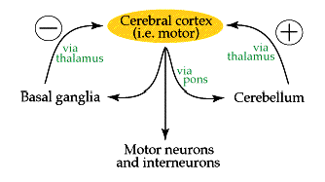
BASAL GANGLIA
CONNECTIONS

Slide 13
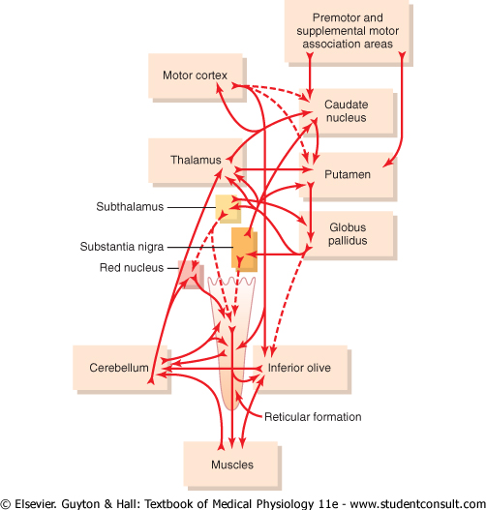
Connections for Motor Control

Slide 14
Connections to remember
Main input to the basal ganglia
Main output from the basal ganglia
Connections between parts of basal ganglia
Basal
Nuclei
Caudate
Nucleus
Corpus
Striatum
Lentiform
Putamen
Globus Pallidus
Subthalamic Nucleus
Substantia Nigra

Slide 15
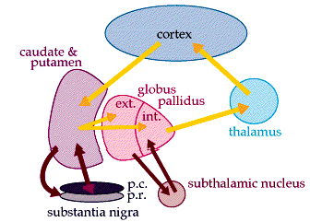
MAIN INPUT TO THE BASAL GANGLIA
The comes from the cerebral cortex (motor area) and projects to the NEOSTRIATUM
(a term for the caudate nucleus and putamen)
THE MAIN OUTPUT
Is via the thalamus to the cerebral cortex
(motor area)

Slide 16
BASIC CIRCUITS OF BASAL GANGLIA
Motor loop (putamen circuit) concerned with learned movment.
Cognitive loop (Caudate circuit) concerned with cognitive control of sequences of motor pattern. Basically it is concerned with motor intentions.
(Note: cognition means thinking process using sensory input with information already stored in memory.)
Limbic loop involved in giving motor expression to emotions like, smiling, aggressive or submissive posture.
Occulomotor loop concerned with voluntary eye movement [ saccadic movement]

Slide 17
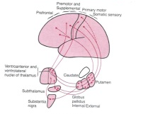
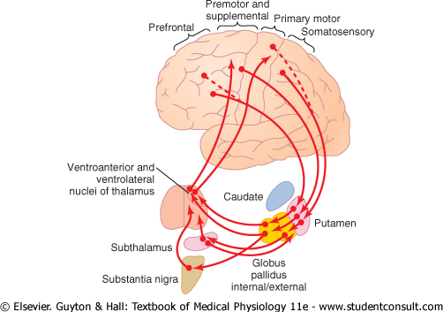
The Putamen Circuit
Prim Motor Cortex
Premotor
Suppl Motor Areas
Premotor
Suppl Motor
Somatosensory Cortex

Slide 18
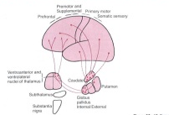
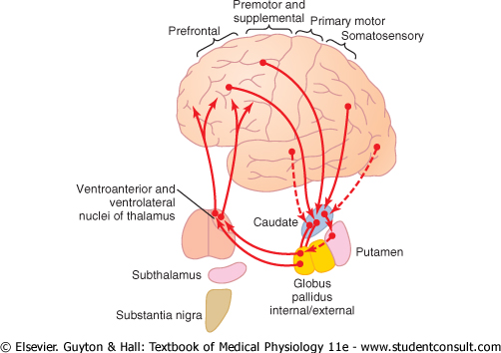
The Caudate Circuit
Prefrontal
Premotor
Suppl Motor
Association
Areas

Slide 19
Basal Ganglial Pathways Direct and Indirect

Slide 20
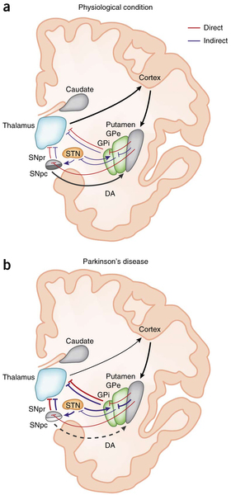
In the physiological condition, DA arising from the SNpc is thought to activate D1-expressing striatal MSNs of the direct pathway (red lines) and to inhibit D2-expressing striatal neurons of the indirect pathway (blue lines). The output nuclei GPi and SNpr project to the thalamus, which in turn sends efferents that complete the cortico-basal ganglia-thalamo-cortical loop. (b) In Parkinson's disease, degeneration of nigral neurons reduces DA receptor stimulation in striatal MSNs. The imbalance between direct and indirect pathways results into abnormal activation of output nuclei and over-inhibition of thalamic neurons projecting to the cortex

Slide 21
Direct Basal Ganglial Pathway
↑ MOTOR ACTIVITY
GLU
+
GLU
+
GPe
↓GABA
-
+
DA1+
GPi
St
-
Thalamus
↑ GABA
-
Thalamocortical Neurons
are disinhibited
DA2 -
SThN
SNPC

Slide 22
Indirect Basal Ganglial Pathway
↓ MOTOR ACTIVITY
GLU
+
+
GLU
GPe
↑GABA
-
St
GPi
↑ GABA
-
Thalamus
-
Subthalamic Neurons
are disinhibited
GLU
+
DA2 -
+
DA1+
-
↓GABA
SThN
SNPC

Slide 23
Both Direct & Indirect Basal Ganglial Pathway
↓ MOTOR ACTIVITY
↑ MOTOR ACTIVITY
Direct
Indirect
GPe
Striatum
GPi
Thalamus
SThN
SNPC

Slide 24
Both Direct & Indirect Basal Ganglial Pathway
↓ MOTOR ACTIVITY
↑ MOTOR ACTIVITY
+
+
GLU
GLU
GLU
+
-
GABA
GPe
↑GABA
-
+
GLU
GPi
St
GABA
-
Thalamus
-
-
GABA
GLU
+
DA1 +
DA2 -
-
GABA
SThN
SNPC

Slide 25
Metabolic characteristics
High Oxygen consumption .
High Copper content in Wilson’s disease (Copper intoxication):
Autosomal Recessive
Copper binding protein Ceruloplasmin is low
Lenticular degeneration occurs

Slide 26
BASAL GANGLIA
FUNCTIONS
Control of movements
Planning and programming of movements
Cognition

Slide 27
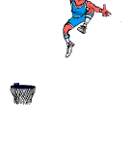
The Putamen Circuit
Executes Learned Patterns of Motor Activity
Basal ganglia function in association with the corticospinal system to control complex patterns of motor activity.
Examples are:
writing of letters of the alphabet.
cutting paper with scissors,
hammering nails,
shooting a basketball through a hoop,
passing a football,
throwing a baseball,
the movements of shoveling dirt,
most aspects of vocalization,
controlled movements of the eyes
virtually any other of our skilled movements, most of them performed subconsciously.

Slide 28
The Caudate Circuit
Cognitive Control of Sequences of Motor Patterns
Cognition means the thinking processes of the brain, using both sensory input to the brain plus information already stored in memory. Thoughts are generated in the mind by a process called cognitive control of motor activity.
Example:A person seeing a lion approach and then responding instantaneously and automatically by (1) turning away from the lion, (2) beginning to run, and (3) even attempting to climb a tree.
Thus, cognitive control of motor activity determines subconsciously, and within seconds, which patterns of movement will be used together to achieve a complex goal

Slide 30
The Caudate Circuit
Change the Timing and to Scale the Intensity of Movements
Two important capabilities of the brain in controlling movement are
(1) to determine how rapidly the movement is to be performed and
(2) to control how large the movement will be.
For instance, a person may write the letter "a" slowly or rapidly. Also, he or she may write a small "a" on a piece of paper or a large "a" on a chalkboard. Regardless of the choice, the proportional characteristics of the letter remain nearly the same

Slide 31
BASAL GANGLIA
DISORDERS
MOVEMENTS (ATAXIA Rate, Range, Force, Direction)
SPEECH
POSTURE
GAIT
MENTAL ACTIVITY
OTHERS

Slide 32
Movement Disorders
Hyperkinetic
Hemiballismus
Huntington’s Disease
Athetosis
Hypokinetic
Parkinson’s Disease
Drug Induced (Neuroleptics, MPTP)

Slide 33
Movement Disorder | Features | Lesion
Chorea | Multiole quick, random movements, usually most prominent in the appendicular muscles | Atrophy of the striatum. Huntington Chorea
Athetosis | Slow writhing movements,which are usually more severe in the appendicular muscles | Diffuse hypermyelination of corpus striatum and thalamus
Hemiballismus | Wild flinging movements of half of the body | Hemorrhagic destruction of contralateral subthalamic n. Hypertensive patients
Parkinsonism | Pill rolling tremor of the fingers at rest, lead pipe rigidity and akinesia | Degenration of Substantia Nigra

Slide 34
Parkinson’s Disease
Described by James Parkinson
Degeneration of dopaminergic nigrostriatal neurons (60-80 %).
Phenthiazines (tranquilizers drugs) .
Methyl-Phenyl-Tetrahydro-Pyridine (MPTP). The oxidant MPP+ is toxic to SN.
Five cardinal features
Tremor
Rigidity
Akinesia & Bradykinesia
Postural Changes
Speech Changes
Notes:
Loss of DA --. Lose excitatory effect on direct, lose inhibition of indirect
Overactive GPi and overactive STN → increased inhibition of motor thalamus

Slide 35
Huntingtons Disease
Hereditory , autosomal dominant .
Disease of caudate & putamen.
Jerky movement of hands toward end of reaching an object .
Chorea
Slurred speech and incomprehensive .
Progressive Dementia -

Slide 36
Cont. Huntingtons
Loss of GABA.
The loss of GABAergic neurons leads to chorea
Loss of Dopaminergic neurons leads to
Parkinson”s disease .

Slide 37
Summary of functions of basal ganglia
It play important motor function in starting and stopping motor functions and inhibiting unwanted movement.
It changes the timing and scales the intensity of movements.
Putamen circuit is inhibitory. Executes skilled motor activities for example cutting paper with a scissor, hammering on nail, shooting a basket ball & like throwing a base ball.
Putamen circuit has indirect connection to cortex via thalamus.while caudate has direct conection to the cortex from thalamus.

Slide 38
Cont…
Caudate circuit is excitatory, has instinctive function which works without thinking and need quick response. eg. response after seeing a lion.
[Note: effects of basal ganglia on motor activity are generally inhibitory.]
Lesions of the basal ganglia produce effects on contra lateral side of the body
Damage to basal ganglia does not cause paralysis. However it results in abnormal movements

Slide 39
