Slide 1
Brachial & Lumbosacral Plexuses

Slide 2
Objectives
By the end of this lecture, you should be able to :
Describe the stages of formation of brachial plexus.
List the main branches of brachial plexus.
Describe the formation of lumbosacral plexus (site, roots).
List the main branches of lumbosacral plexus.
Describe the important Applied Anatomy related to the brachial & lumbosacral plexuses.

Slide 3
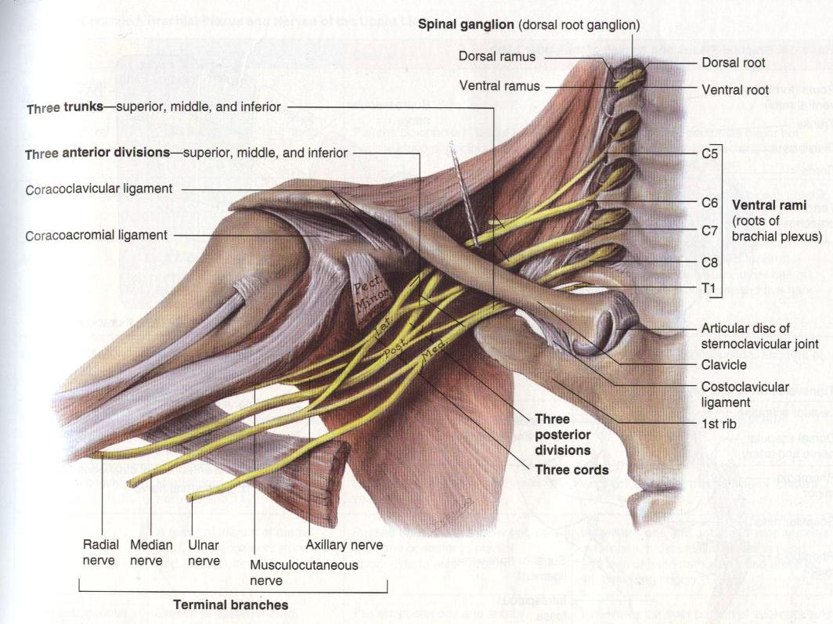
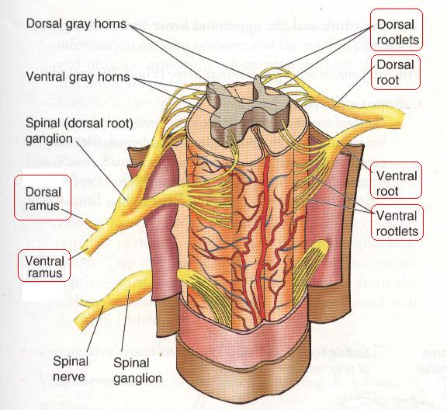
Formation of Brachial Plexuses
It is formed in the posterior triangle of the neck.
By the union of the anterior rami of the C 5th ,6th ,7th ,8th and the T1 spinal nerves.

Slide 4
Divisions
The plexus is divided into
Roots
Trunks
Divisions
Cords
Branches

Slide 5
Trunks
Upper trunk
Union of the roots of C5 & 6
Middle trunk
Continuation of the root of C7
Lower trunk
Union of the roots of C8 & T1

Slide 6
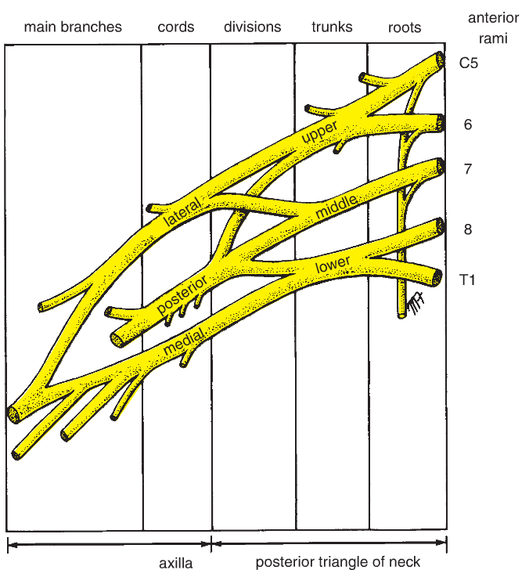
Divisions & Cords
Each trunk divides into anterior and posterior division
Posterior cord:
The three posterior divisions unite to form the posterior cord.
Lateral cord:
The anterior divisions of the upper and middle cords form the lateral cord.

Slide 7
CORDS & BRANCHES
Medial cord
It is the continuation of the anterior division of the lower trunk
Branches
All three cords give branches, to supply their respective regions

Slide 8
The Brachial Plexus
Long Thoracic (C5,6,7)
Dorsal Scapular(C5)
Nerve to Subclavius(C5,6)
upper
trunk
Suprascapular(C5,6)
roots
lateral Cord
(2LM)
C5
C6
middle
trunk
C7
lower
trunk
C8
posterior Cord
(ULTRA)
T1
medial Cord
(4MU)
Anterior divisions
Posterior divisions

Slide 9
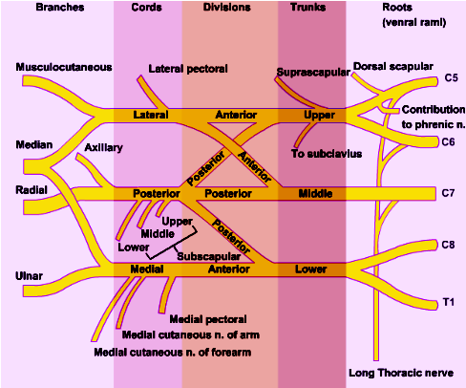
The Plexus can be divided into 5 stages:
Roots: in the posterior∆ of the neck
Trunks: in the posterior∆ of the neck
Divisions: behind the clavicle
Cords: in the axilla
Branches: in the axilla
The first 2 stages lie in the posterior triangle, while the last 2 sages lie in the axilla.

Slide 10
A. Branches from Roots
1. Nerve to rhomboids C5 (dorsal scapular nerve)
2. Long thoracic nerve C5, 6 & 7 nerve of Bell.
B. Branches from Trunk
The upper trunk is the only trunk which gives branches:
Nerve to subclavius
Suprascapular nerve (supplies supraspinatus & infraspinatus)

Slide 11
(C)Branches from Cords
Lateral Cord
(2LM)
.Lateral pectoral n
.Lateral root to median n
.Musculocutaneous n
C5
C6
C7
C8
T1
Medial cord
(4MU)
.Medial pectoral n.
.Medial root to median n.
.Medial cutaneous n of arm.
.Medial cutaneous n of forearm.
.Ulnar n.
Posterior Cord
(ULTRA)
.Upper subscapular n
.Lower subscapular n
.Thoracodorsal n
.Radial n
.Axillary n

Slide 12
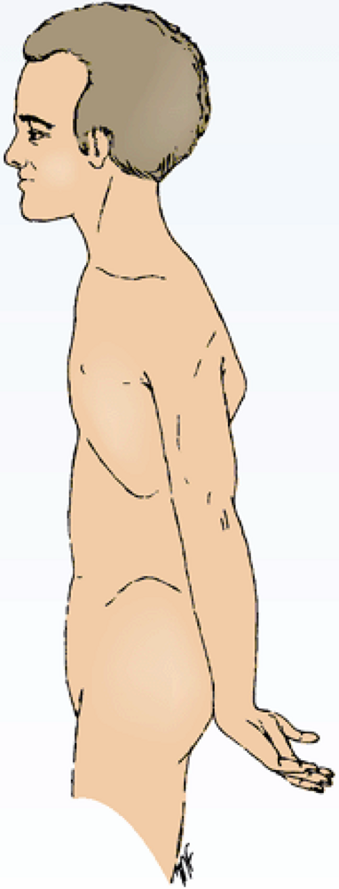
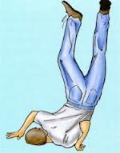
Brachial Plexus Injuries
Lesions of the Upper Trunk ( C5,6), (Erb-Duchenne Palsy ”waiter's tip position”.
Resulting from excessive displacement of the head to the opposite side and depression of the shoulder on the same side (a blow or fall on shoulder).
The position of the upper limb in this condition has been likened to that of a porter or waiter hinting for a tip or policeman’s tip hand.
The arm hangs by the side and is rotated medially. The forearm is extended and pronated
Erb-Duchenne’s paralysis due to injury of Upper Trunk of Brachial Plexus.

Slide 13
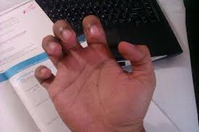
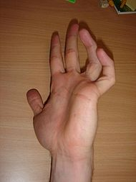
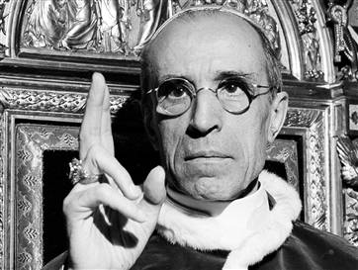
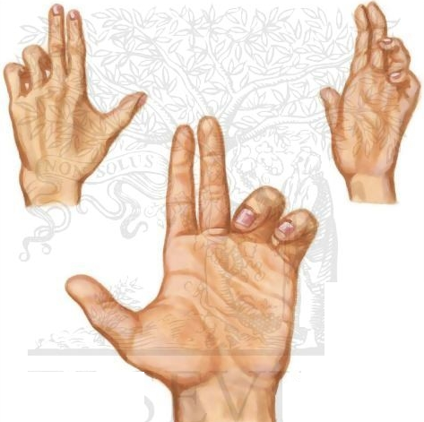
Brachial Plexus Injuries
Lesions of Lower Trunk of the Brachial Plexus, (Klumpke Palsy)/ (C8,T1):
Lower lesions of the brachial plexus are usually traction injuries caused by a person falling from a height clutching at an object to save himself. The first thoracic nerve is usually torn.
The nerve fibers from this segment run in the ulnar and median nerves to supply all the small muscles of the hand. The hand has a clawed appearance due to ulnar nerve injury
Claw Hand
Claw Hand
Hand of Benediction or Pop’s Blessings (APE HAND) will result from median nerve injury.

Slide 14
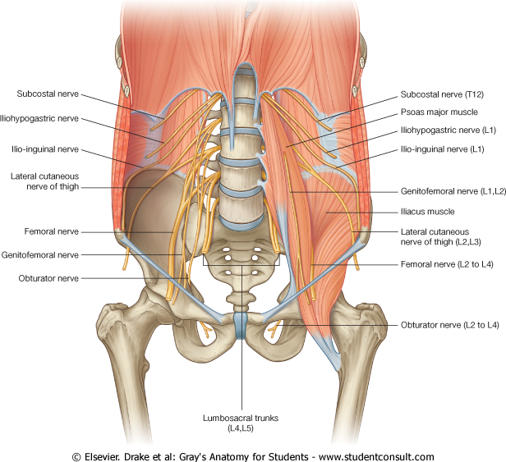
LUMBAR PLEXUS
Formation:
By ventral rami of L1, 2, 3 and most of L4.
Site:
Within the substance of psoas major muscle.
Main branches:
Iliohypogastric & ilioinguinal (L1).
To anterior abdominal wall
Obturator (L2 L3 & L4).
To medial compartment of thigh.
Femoral (L2 L3 & L4).
To anterior compartment
of thigh

Slide 15
FEMORAL NERVE
Origin:
From lumbar plexus (L2,3,4).
Course:
Descends lateral to psoas major & enters the thigh deep to the inguinal ligament lateral to the femoral sheath.
Passes lateral to femoral artery & divides into anterior & posterior divisions.

Slide 16
FEMORAL NERVE INJURY
Motor effect:
Wasting of quadriceps femoris.
Loss of extension of knee.
Weak flexion of hip (psoas major is intact).
Sensory effect:
Loss of sensation over the antero-medial aspect of thigh & medial side of leg & foot.

Slide 17
SACRAL PLEXUS
Formation:
By ventral rami of a part of L4 & whole L5 (lumbosacral trunk) + S1, 2, 3 and most of the S4.
Site:
In front of piriformis muscle.

Slide 18
SACRAL PLEXUS
Main branches:
Pelvic splanchnic nerve preganglionic parasympathetic to pelvic viscera & hindgut.
Pudendal nerve
To perineum.
Sciatic nerve
To lower limb.

Slide 19
LUMBOSACRAL PLEXUS

Slide 20
SCIATIC NERVE The largest nerve of the body
Origin:
From sacral plexus (L4, 5, S1, 2, & 3).
Course:
Leaves the pelvis through greater sciatic foramen, below piriformis & passes in the gluteal region (between ischial tuberosity & greater trochanter) then to posterior compartment of thigh.
Divides into tibial & common peroneal (fibular) nerves.
Ischial tuberosity

Slide 21
TIBIAL NERVE
Course:
Descends through popliteal fossa to posterior compartment of leg, accompanied with posterior tibial vessels
Passes deep to flexor retinaculum to reach the sole of foot where it divides into 2 terminal branches (medial and lateral planter nerves).

Slide 22
COMMON PERONEAL (FIBULAR) NERVE
Course:
Leaves popliteal fossa & through its lateral angle.
Turns around the lateral aspect of neck of fibula, (dangerous position).
Then divides into:
Superficial peroneal or Musculocutaneous: descends into lateral compartment of leg
Deep peroneal or anterior tibial:
into anterior compartment of leg

Slide 23
SUMMARY
The lumbar plexus is formed by ventral rami of the upper 4 lumbar nerves, ( L1,2,3 and most of L4).
It is formed within the substance of psoas major muscle.
The sacral plexus is formed by ventral rami of a part of L4 & whole L5 (lumbosacral trunk) plus the S1,2,3 and most of S4, in front of piriformis msucle.
The femoral nerve, a branch of lumbar plexus (L2,3,4).
Its injury will affect the flexion of hip & extension of knee as well as loss of sensation of skin of anteromedial aspects of the thigh, medial side of knee, leg and foot
The sciatic nerve is a branch of sacral plexus (L4,5, S1,2,3)
Its injury will affect the flexion of knee, extension of hip, all movements of leg & foot, as well as loss of sensation of skin of leg & foot (except areas supplied by saphenous branch of femoral nerve)

Slide 24
Thank you and Good Luck

Slide 25
1. Lesion of the upper trunk of the brachial plexus leads to :
Klumpke palsy.
Erb-Duchenne palsy
Drop wrist & hand.
Ape hand.
2. Which one of the following nerves is a branch of posterior cord of brachial plexus?
Ulnar
Radial
Median
Musclocutanous

Slide 26
QUESTION 1
The femoral nerve supplies:
Extensors of hip.
Skin of dorsum of foot.
Hamstrings.
Extensors of knee

Slide 27
QUESTION 2
Injury of common peroneal nerve leads to:
Loss of dorsiflexion of ankle
Loss of inversion of foot
Loss of extension of knee
Loss of flexion of toes

