Slide 1
Vision Lecture 1
Dr Taha Sadig Ahmed
MBBS , PhD ( Bristol , England )
AANEM ( USA )
Consultant , Clinical Neurophysiology , Saudi Council for Health Specialities .
Consultant , Clinical Neurophysiology , King Khalid Hospital and
King Abdulaziz University Hospital , Riyadh
Associate Professor , College of Medicicne , Riyadh

Slide 2
The eye consists of 3 layers :
1/ Outer fibrousv layer : consists of →
(a) Sclera , and
(b) Cornea القرنية
Cornea is transparent anterior portion
Conjunctiva lies anterior to the cornea . It is a transparent epithelium .
2/ Middle vascular layer: consists of →
(a) Iris ,الحجاب القزحي ونجد في وسطه البؤبؤ
Pupil
(b) Ciliary body,
(Ciliary body consists of Ciliary muscles and ciliary processes, which attach to suspensory ligaments of lens العدسة ) , and
(c) Choroid
3/ Inner Neural ( Nervous ) layer called →
Retina الشبكية It contains Photoreceptorsمستقبلات الضوء which are the Rods and Cones .

Slide 3
The Anterior & Posterior Cavities
The Ciliary Body (& its suspensory ligament ) and lens divide the eye into :
(1) Anterior cavity ( which contains a fluid called Aqueous Humor , and
(2) Posterior cavity
( which contains fluid calle Vitreous Humor .

Slide 4
The Anterior and Posterior Chambers
Posterior Chamber
Anterior Chamber
Furhermore , the Iris further divides the anterior cavity into :
Anterior Chamber ( in front of the iris ) , and
Posterior Chamber ( behind the iris ; between the iris and lens ) .

Slide 5
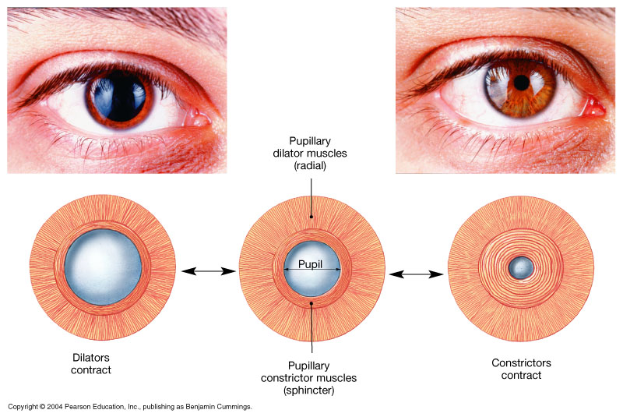
The Pupillary Muscles: consists of → Radial and Circular parts العضلة التي تتحكم في مدي ضيق أو إتساع البؤبؤ
Figure 17.5

Slide 6
The Retina الشبكية
The Retina consists of →
Outer pigmented portion ( part )
Inner neural part , containing Photoreceptors ( neurons that are receptors for light ) called called Rods and Cones .
Rods
(1) are best for vision in dim light الضوء الخافت
(2) are better than cones for detection of flicker ( sudden movements of objects ).
Cones are best for
(1) vision in daylight or bright light ( photopic vision)
(2) Color Vision ( color perception ) تمييز الألوان
(3) Perception of detail ( acuity of vision )
المقدرة علي تمييز التفاصيل ، أي بمعني آخر : حدة النظر

Slide 7
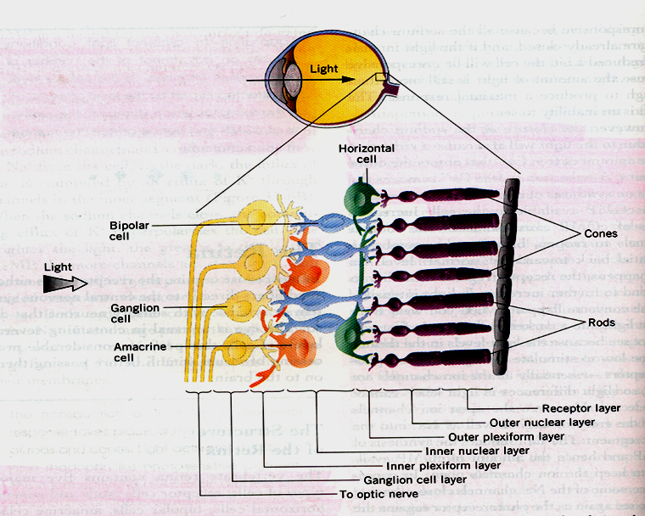

Slide 9
An important part of the retina is the Macula Lutea .
At the center of the Macula we find the Fovea Centralis .
In the Fovea we find the maximum concentration of cones →consequently و بالتالي → the Fovea is the point of maximal visual activity in the retina .لدقة الرؤيا و تبين التفاصيل الدقيقة للشيء الذي نتمعن فيه
Cones are densely packed at the Fovea .
When you turn your eye to look at an object → you tend to place its image صورته in the Fovea
عندما يسترعي شيء إنتباهك و تريد أن تركز نظرك عليه فأنت تجعل الشعاع الضوئي الراجع منها يقع علي هذه النقطة (الفوفيا)

Slide 10
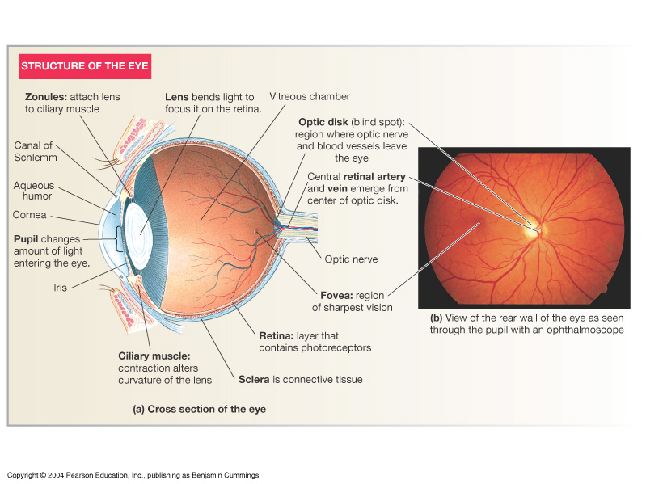

Slide 11
Optic Disc
( Blind Spot )
Fovea
( point of point of concentration of Cones )

Slide 12
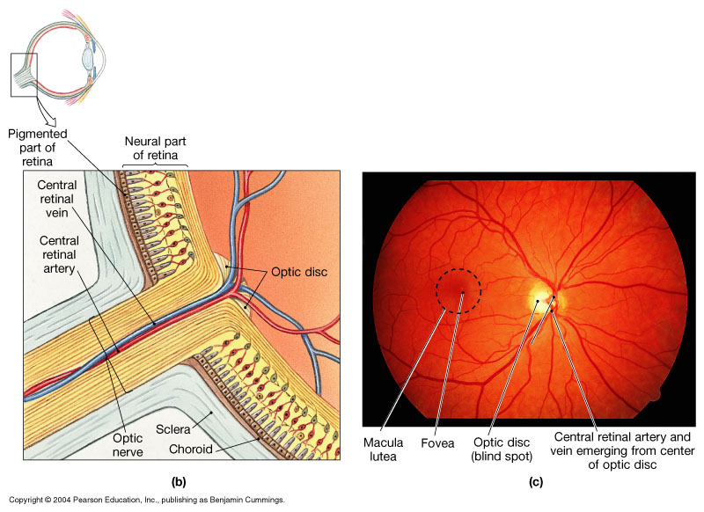
Organization of the Retina
Figure 17.6b, c

Slide 13
Optic Disc ( Papilla , Blind Spot ) : point of exit of optic nerve fibers , contains no photoreceptors
Fovea : contains cones only & therefore it is the area of maximum & best visual acuity

Slide 14
Visual Pathway ( Pathway from Retina to the Visual Centers in the Brain )
Photoreceptors مستقبلات الضوء Rods and Cones synapse on Bipolar Cells , which in turn , synapse on Ganglion Cells .
Axons of Ganglion Cells constitute the Optic Nerve . These axons converge at the Optic disc ,which is also called Blind Spot
( Why ? ) .
Passing through the Blind Spot → they leave the eye , constituting the Optic Nerve .

Slide 16
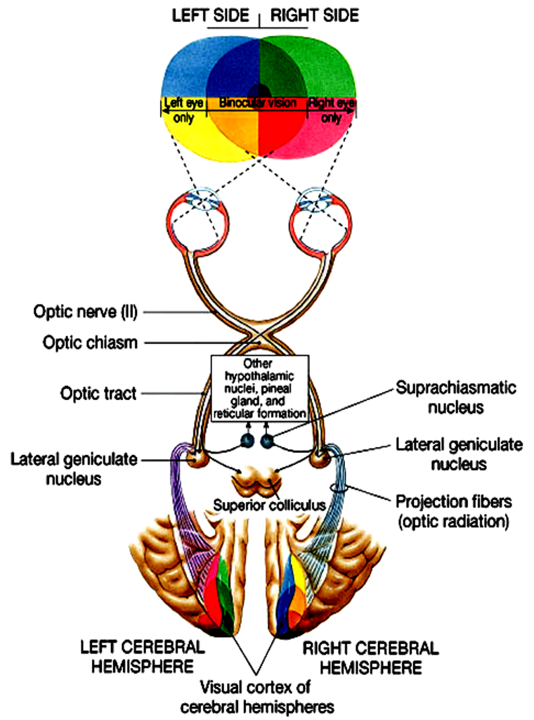
The Visual Pathway
Optic nerve fibers from the medial ( nasal ) side of retinae decussate in the Optic Chiasma .
Therefore an Optic Chiasma lesion ( e,g, Pituitary Tumor ) will cause vision loss from the both lateral halves of the Field of Vision مجال الرؤية
Optic nerve fibers from the lateral ( temporal ) parts of the retinae do not decussate .
Therefore , each optic tract carries fibers from the both the temporal side of the ipsilateral retina + nasal side of the contralateral retina.
Therefore , a lesion in optic tract will cause loss of vision from the ipsilateral nasal field of vision + contralateral temporal field of vision .
Figure 17.19

Slide 17
Then some optic tract fibers synapse in the Pretectal Area to mediate The Light Reflex ; but the majority of fibers synapse in the Lateral Geniculate Body .
From the Lateral Geniculate Body fibers ( called Optic Radiation ) go to the Cortical Center of Vision in area 17 of the Occipital Lobe .
Thus blindness can result from disease of the cornea , retina , optic nerve , optic tract , optic radiation or visual center in the occipital lobe .
Figure 17.19

Slide 18
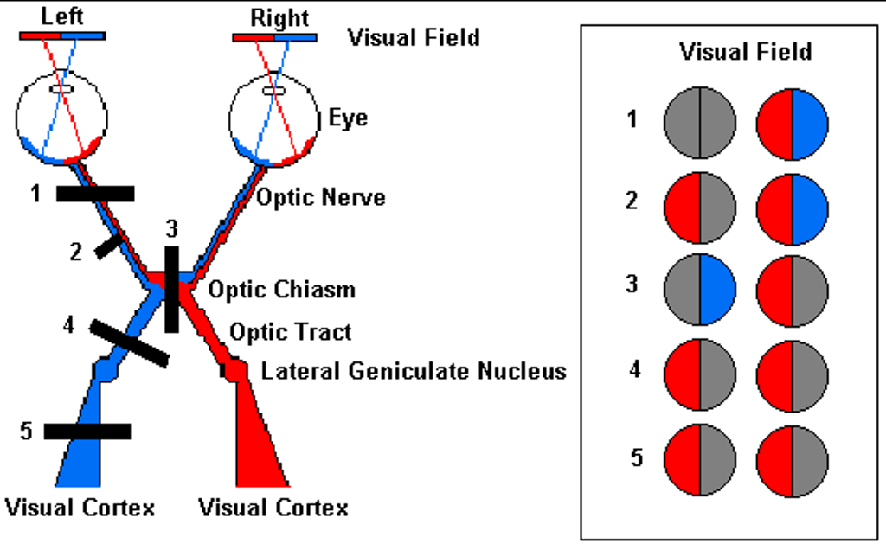

Slide 19
Image Formation
Figure 17.9

Slide 20
The Light Reflex
If you shine light into the healthy eye → the pupil constricts .
The afferent limb of this reflex is the Optic nerve and the efferent is the Oculomotor nerve .
The center of this Reflex is Edinger-Westphal nucleus in the midbrain ,
It can occur even if the cortical visual center in the Occipital Lobe is destroyed .

Slide 21
The Accomodation-Convergence Reflex
If you shift your sight from a distant object to a close object ( e.g., if you want to read some writing very close to you ) three things happen :
(1) Constriction of the pupils
(2) increased thickness of the lens ( because of contraqction of Ciliary muscle )
(3) Convergence of the visual axes
(1) + (2) together are called Accomdation
(3) is called Convegence.
This reflex ( unlike the light reflex ) needs intact Visual Cortex ( in Occipital Lobe ) .

Slide 22
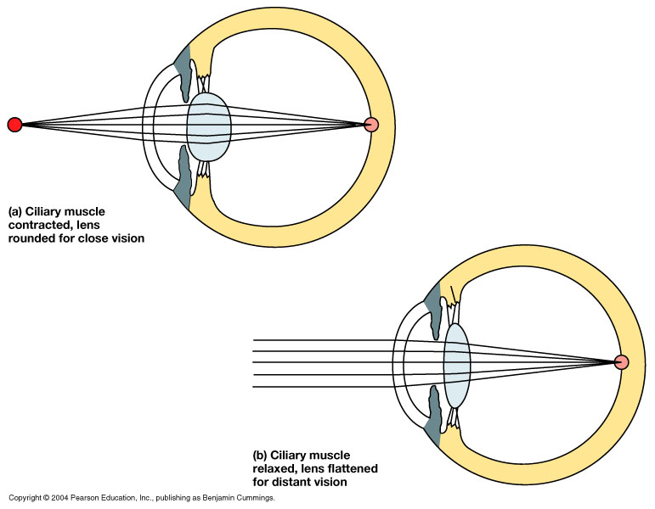
Accommodation
(2) Once you shift your gaze from the distant object to focus on a close object , the Ciliary muscle contrcts → relaxing the Suspensory ligament → allowing the lens to bulge and increase in thickness → thereby increasing its refractive power ( focusing on a close object ) .
(1) When you look at a distant object the ciliary muscle is relaxed and the suspensory ligament is taut , pulling on the lens and making it thinner → reducing its refractive power .
Figure 17.10

Slide 23
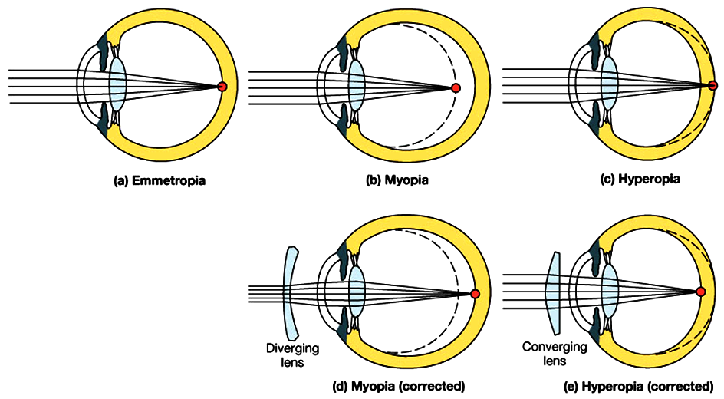
Visual Abnormalities
Long-shghted
Short-sighted
Long-shghted
Normal
Biconcave lens
Biconvex lens
Figure 17.11

