Slide 1
Accomodation

Slide 2
Errors of refraction:-
1-Hypermetropia (hyperopia = far-sightedness)
( small eyeball, focus behind retina,
headache&blurred vision
continuous accomodation—muscular effort--- cause headache, prolonged covergence by accomodation-----squint
correction by biconvex lens)
2-Myopia(nearsightedness)
( genetic,large eye ball, long anteroposterior diameter,or extensive close work as in studying-----cause focus in front of retina
correction by biconcave lens to diverge rays before strike lens)

Slide 3
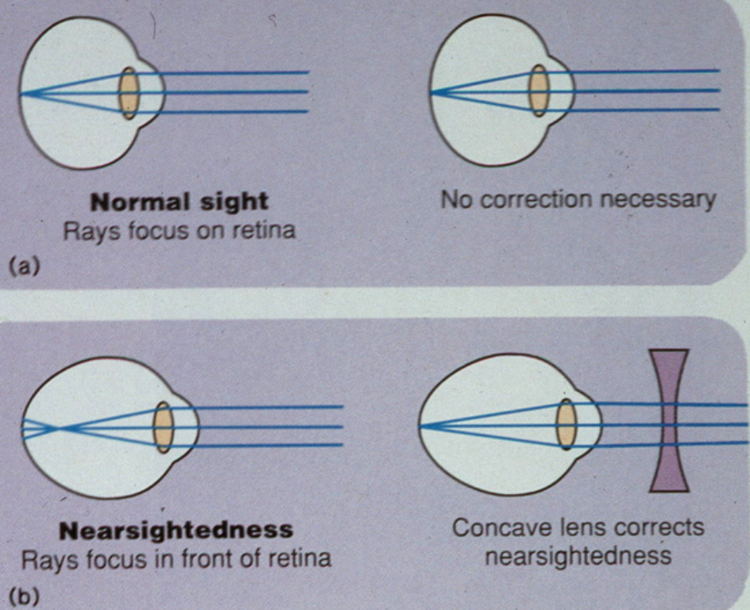

Slide 4
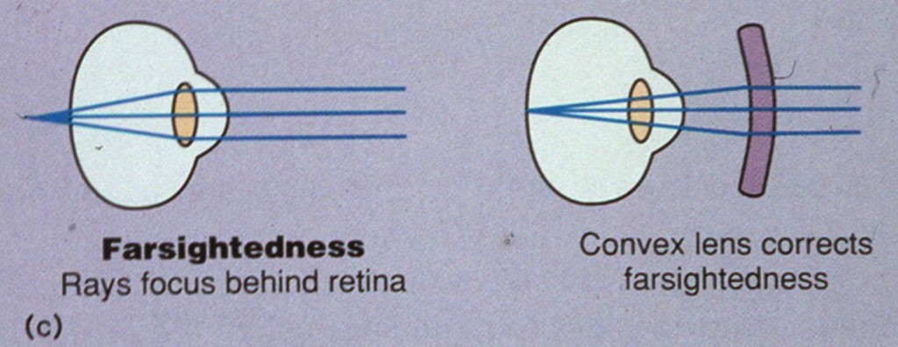

Slide 5
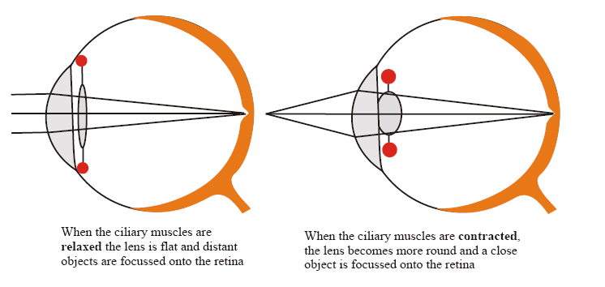

Slide 6
Image Formation
Figure 17.9

Slide 7
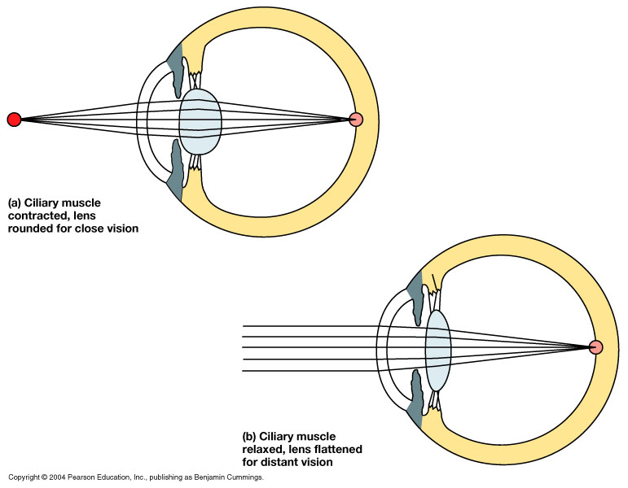
Accommodation
(2) Once you shift your gaze from the distant object to focus on a close object , the Ciliary muscle contrcts → relaxing the Suspensory ligament → allowing the lens to bulge and increase in thickness → thereby increasing its refractive power ( focusing on a close object ) .
(1) When you look at a distant object the ciliary muscle is relaxed and the suspensory ligament is taut , pulling on the lens and making it thinner → reducing its refractive power .
Figure 17.10

Slide 8
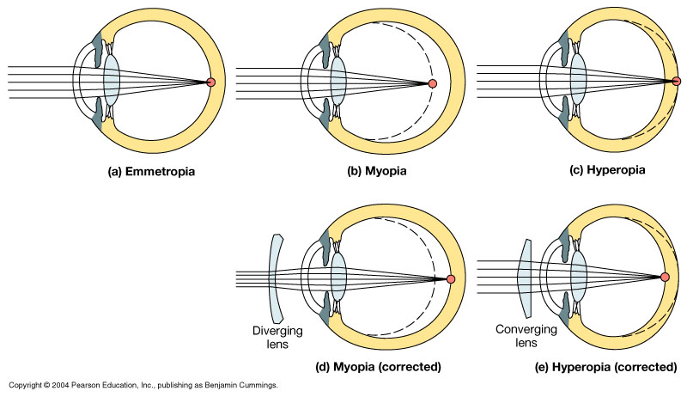
Figure 17.11 Visual Abnormalities
Long-shghted
Short-sighted
Normal
Biconcave lens
Biconvex lens
Figure 17.11

Slide 9
3-Presbyopia ( eye near point receeds by age due to loss of accomodation
- correction by biconvex lens
4-Astigmatism (uneven & ununiform corneal curvature,very rare ununiform lens curvature)
-rays refracted to diff focus---------blurred vision
-correction by cylindrical lens

Slide 10
3-Presbyopia ( eye near point receeds by age due to loss of accomodation
- correction by biconvex lens
4-Astigmatism (uneven & ununiform corneal curvature,very rare ununiform lens curvature)
-rays refracted to diff focus---------blurred vision
-correction by cylindrical lens

Slide 11
Priciples of optics:-
principle focus:-(parallel rays strike biconvex lens refracted in a point is PF.
principle axis:- PF lies on line pass through centers of lens curvatures
Principal focal distance:-distance between lens & PF.
Biconvex lens(converge) & biconcave lens(diverge)
Diopter (measure of refractive power) = 1 / Principal focal distance in meters
Exp/ if Principal focal distance of a lens is 25cm,so its R.P=1/ 0.25 meter = 4D
Emmetropic eye;-normal eye has image on retina,has diopteric power 60D
Lens-retina distance =15mm
The greater the curvature of the lens, the greater the refractive power of the eye.

Slide 12
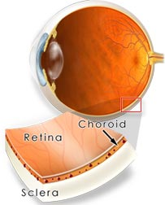

Slide 14
Refractive media of the eye:-
1-Cornea ( greatest refraction of light)
-diopteric power 40-45 D at ant surface
-(2/3 refractive power of eye)
2-Aquous humour
--( fluid produced by cilliary body ---to post chamber-----to pupil---to ant chamber----to canal of schlemm at angle of ant chamber---to veins
Function//
-nourishing retina
-causes intraocular pressure 10-20mm Hg

Slide 15
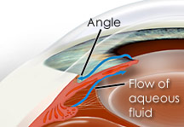
What is glucoma ? why it cause damage of optic nerve?(intraocular pressure more than 20mm Hg)

Slide 16
Accomodation:-
At rest (looking at far objects):-ciliary muscles relaxed, taut(tense) ligaments, flat lens
-
Accomodation reflex:-
focusing( increased anterior surface curvature of lens by ciliary muscles contraction, slack=relaxed ligaments, increased anterior surface curvature of lens .why?
-both circular & longitudinal cilliary muscles contract to pull cilliary muscle forwards&inwards----- cilliary muscles edges come close to each other.
Test-sanson purkinje image

Slide 17
looking at a close object (near response)
a- convergence. Why?
b- pupil constriction. Why?
c- Accomodation. Why?
Near point:-
Nearest point to eye at which object can brought into focus on retina by ACCOMODATION
-10 years-----9 cm
-At 60 years-----80-100 cm, due to hardness of lens & loss of accomodation.

Slide 19
Pathway of accomodation:-
Light on eye------ retina -----optic nerve -----optic chiasma------- optic tract------ lateral geniculate body in thalamus (away from pretectal N) to C.C---------- to sup. colliculus in midbrain for---EWN------ cilliary ganglion to oculomotor N---- cilliary body for contraction& miosis( accomodation. R)

Slide 20
Pupilary light reflex:-
Light on one eye-------constiction (miosis) of this pupil (direct)
& the other pupil (indirect)
Pathway of consensual Pupilary light reflex (indirect):-
Light on eye------ retina -----optic nerve -----optic chiasma------- optic tract------ pass to pretectal nucleus -----both oculomotor nerve nuclei (EWN)------ both ciliary ganglia----both eyes by oculomotor nerves -------miosis in both eyes.
-Atropine drops:- block parasympathetic supply------mydriasis
Q. Argyll Robertson pupil?
In syphilis tabes dorsalis which destroy pretectal nucleus
light .R is lost & accomodation .R remains

Slide 21
Accomodation
Q : What is accomodation ?
simply put : It is the process by which the eye forms sharp image of near and distant objects

Slide 22
Accomodation
Increased lens thickness (becomesthicker )
Pupils constrict
Visual axes concerge (Convergence)
The near response

Slide 23
Mechanism of accomodation for focusing near objects
Ciliary muscle ….Contraction:
Relaxation of the suspensory ligament
Lens more convex
Increase diopteric power of the eye
Near object focussed on the retina

Slide 24
Mechanism of accomodation for Focusing Far objects → involves ciliary muscle relaxation
Ciliary muscle ….Relaxation:
Stretching / contraction cof the suspensory ligament
o
Lens less convex ( more flat)
Decrease diopteric power of the eye
Far object focussed on the retina

Slide 25
The accomodation Reflex
Afferent:
Retina optic nerve optic chiasma optic tract lateral geniculate body visual cortex
Efferent: Occuluomotor nucleus (parasympathetic) ciliary ganglion
ciliary muscle circular pupillary muscle

Slide 26
The Accomodation-Convergence Reflex
If you shift your sight from a distant object to a close object ( e.g., if you want to read some writing very close to you ) three things happen :
(1) Constriction of the pupils
(2) increased thickness of the lens ( because of contraqction of Ciliary muscle )
(3) Convergence of the visual axes
(1) + (2) together are called Accomdation
(3) is called Convegence.
This reflex ( unlike the light reflex ) needs intact Visual Cortex ( in Occipital Lobe ) .

Slide 27
Accomodation:-
At rest (looking at far objects):-ciliary muscles relaxed, taut(tense) ligaments, flat lens
Accomodation reflex:-
focusing( increased anterior surface curvature of lens by ciliary muscles contraction, slack=relaxed ligaments, increased anterior surface curvature of lens .why?
-both circular & longitudinal cilliary muscles contract to pull cilliary muscle forwards&inwards-→ cilliary muscles edges come close to each other.
Test-sanson purkinje image

Slide 28
looking at a close object (near response)
a- convergence. Why?
b- pupil constriction. Why?
c- Accomodation. Why?
Near point:-
Nearest point to eye at which object can brought into focus on retina by ACCOMODATION
-10 years-----9 cm
-At 60 years-----80-100 cm, due to hardness of lens & loss of accomodation.

Slide 29
Pathway of accomodation:-
Light on eye------ retina -----optic nerve -----optic chiasma------- optic tract------ lateral geniculate body in thalamus (away from pretectal N) to C.C---------- to sup. colliculus in midbrain for---EWN------ cilliary ganglion to oculomotor N---- cilliary body for contraction& miosis( accomodation. R)

Slide 30
The light reflex
Retina optic tract superior colliculus occulomotor nucleus pupillary muscles

Slide 31
The Light Reflex
If you shine light into the healthy eye → the pupil constricts .
The afferent limb of this reflex is the Optic nerve and the efferent is the Oculomotor nerve .
The center of this Reflex is Edinger-Westphal nucleus in the midbrain ,
It can occur even if the cortical visual center in the Occipital Lobe is destroyed .

Slide 32
Pupilary light reflex:-
Light on one eye-------constiction (miosis) of this pupil (direct)
& the other pupil (indirect)
Pathway of consensual Pupilary light reflex (indirect):-
Light on eye------ retina -----optic nerve -----optic chiasma------- optic tract------ pass to pretectal nucleus -----both oculomotor nerve nuclei (EWN)------ both ciliary ganglia----both eyes by oculomotor nerves -------miosis in both eyes.
-Atropine drops:- block parasympathetic supply------mydriasis
Q. Argyll Robertson pupil?
In syphilis tabes dorsalis which destroy pretectal nucleus
light .R is lost & accomodation .R remains

Slide 33
VISUAL ACUITY :-
-Difinition :- DEGREE TO WHICH DETAILS OF OBJECTS ARE PERCIEVED
Visual threshold is minimal amount of light that elicit sensation of light
-Snellen s chart
Normal acuity =6/6
A person of 12/6 has better vision than normal vision (not hyperope)
A person of 6/12 has less vision than normal vision (d/D
Patient/normal)

Slide 34
Argyll Robertson pupils (Neurosyphilis)
Pupils constrict in response:
to accomodation reflex
but not
to the light reflex

Slide 36
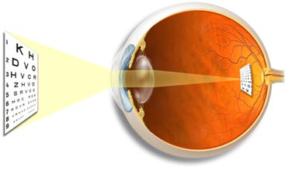
VISUAL ACUITY :-
-Difinition :- DEGREE TO WHICH DETAILS OF OBJECTS ARE PERCIEVED
Visual threshold is minimal amount of light that elicit sensation of light
-Snellen s chart
Normal acuity =6/6
A person of 12/6 has better vision than normal vision (not hyperope)
A person of 6/12 has less vision than normal vision (d/D
Patient/normal)

