Slide 1
Cerebellum 2015
Dr Taha Sadig Ahmed

Slide 2
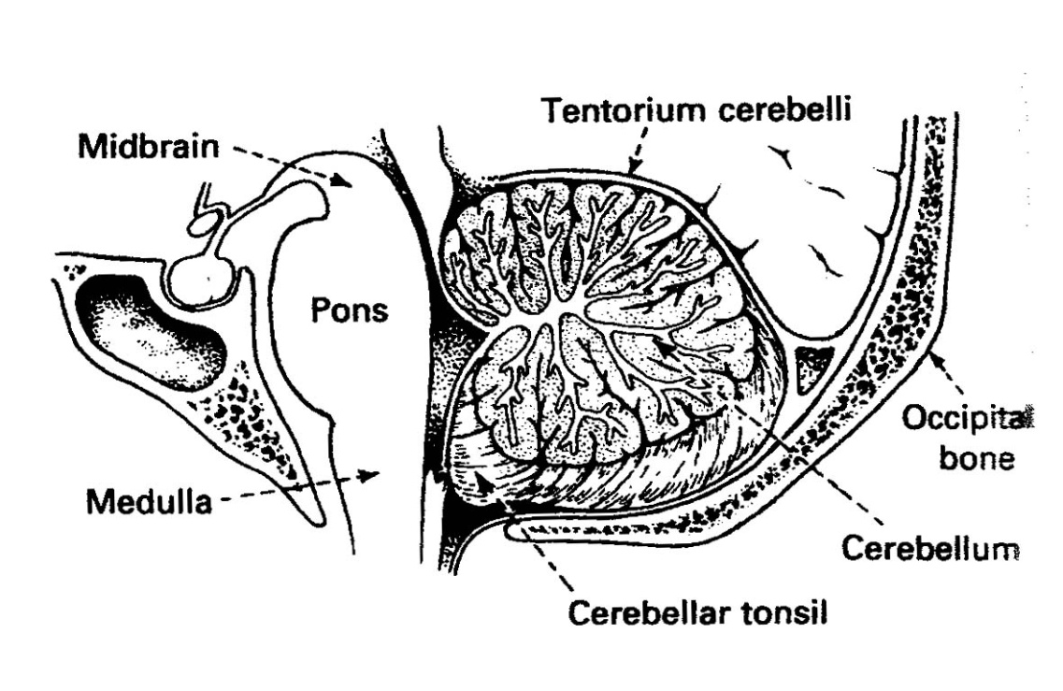
Cerebellum
Dr Taha Sadig Ahmed ,
4th Ventricle
The cerebellum is the largest part of the hindbrain
It is s located in the posterior cranial fossa

Slide 4
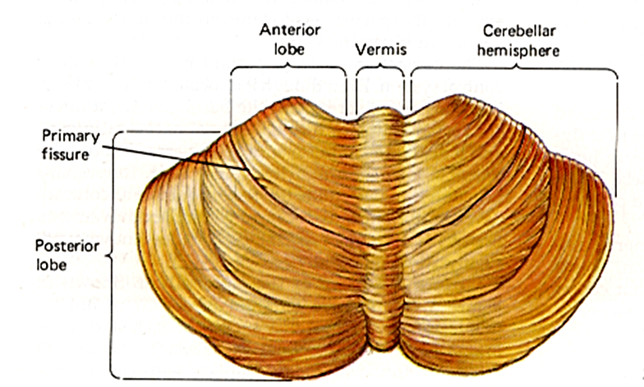
Anatomically-speaking , it consists of →
(1) middle Vermis ,
4

Slide 5
(2)two lateral Cerebellar Hemispheres , constituting the Neocererebellum and
5

Slide 6
(2)two lateral Cerebellar Hemispheres , constituting the Neocererebellum and
Posterolateral Fissure
Flocculonodular Lobe
6

Slide 7
(3) a posterior Flocculonodular Lobe
Posterolateral Fissure
7

Slide 8
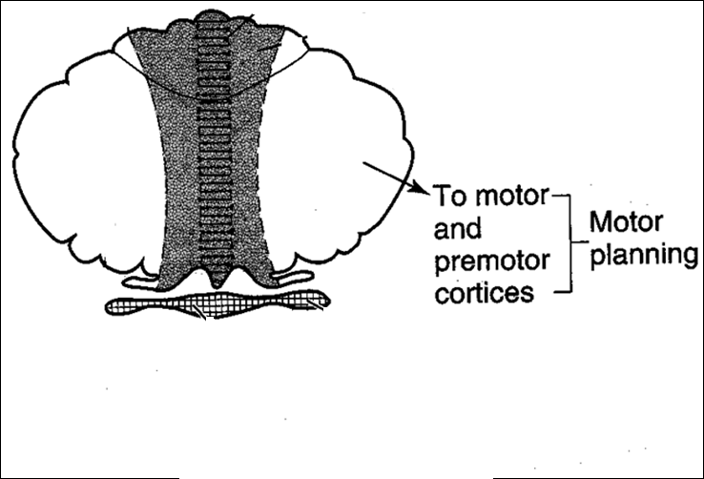
Functionally speaking , the Cerebellum is divided into 3 parts : Neocerebellum , Spinocerebellum , & Vestibulocerebellum
(A) Neocerebellum ( cerebrocerebellum)
Consists of the lateral parts of cerebellar hemispheres.
It receives inputs from the cortex via Pontine Nuclei ( Cortico-ponto-cerebellar fibers)
It interacts with motor and premotor cortex to →
(1) plan ,
(2) program &
(3) execute movements (particularly skilled movements )
تخطيط و برمجة الحركة ثم تنفي ها
e.g.→ distal limb muscles , such as hand manipulative , skilled movements .
Thus the Neocerebellum is involved in →
(1) planning and
(2) initiation of motor function

Slide 9
(A) Neocerebellum
Consists of the lateral parts of cerebellar hemispheres.
It interacts with motor cortex to plan , program & execute movements ; particularly skilled movements , e.g.→ distal limb muscles , such as hand manipilative , skilled movements .
Q : Which of the following is the function of the neocerebellum : a. Maintenance of equilibrium b. Servo-correction of voluntary movements c. Planning and programming of voluntary d. Maintenance of muscle tone
C is the answer : The lateral zone, which in humans is by far the largest part, constitutes the cerebrocerebellum, also known as neocerebellum. It receives input exclusively from the cerebral cortex (especially the parietal lobe) via the pontine nuclei (forming cortico-ponto-cerebellar pathways), and sends output mainly to the ventrolateral thalamus (in turn connected to motor areas of the premotor cortex and primary motor area of the cerebral cortex) and to the red nucleus. There is disagreement about the best way to describe the functions of the lateral cerebellum: It is thought to be involved in planning movement that is about to occur, in evaluating sensory information

Slide 10
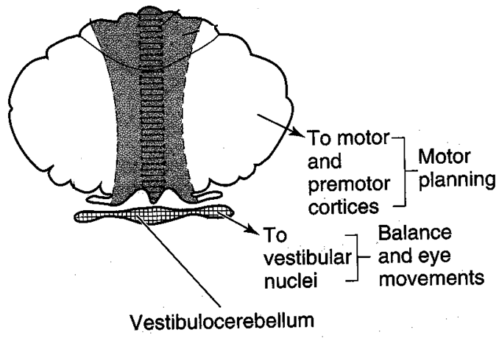
Functionally speaking , the Cerebellum is divided into 3 parts : Neocerebellum , Spinocerebellum , & Vestibulocerebellum
(A) Neocerebellum
Consists of the lateral parts of cerebellar hemispheres.
It interacts with motor cortex to plan , program & execute movements ; particularly skilled movements.
e.g., distal limb muscles , such as hand manipilative , skilled movements .

Slide 11
(B) Spinocerebellum
Consists of → Vermis +
Medial parts of the hemispheres
It receives inputs from muscle stretch receptors :
Afferents from muscle stretch receptors → spinal cord & brainstem → inferior olive → Spinocerebellum .
It receives inputs from muscle stretch receptors via the spinal cord & brainstem , & inferior olive
It is concerned with regulation of muscle tone .

Slide 12
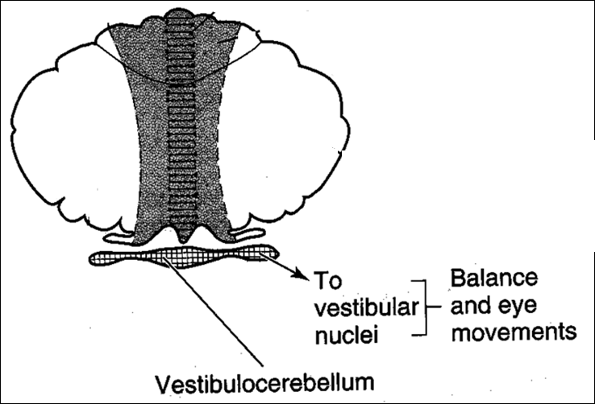
(C) Vestibulocerebellum
( Floculonodular Lobe):
It receives inputs from
vestibular nuclei ,
Consequently , it is concerned with balance & equilibrium

Slide 13
Functions of Cerebellum
The cerebrocerebellum ( Neocerebellum) is involved in (1) planning and (2) initiation of motor function
The spinocerebellum (1) oversees the actual execution and (2) the coordination of motor event
The vestibulocerebellum functions during the execution of the motor activity to maintain and adjust body posture.

Slide 14
Summary of Connections & Functions
Function | Outputs | Inputs | Cortex
Planning and executive of voluntary & skilledhand movements | to thalamus ( & therough its connections → to the cerebral cortex ). | Corticopontine/ pontocerebellar | Lateral portions of Cerebellar Hemisphere | Neo- cerebellum
Muscle tone , posture & coordination of movements | to Red Nucleus & to RF | Spinal and brainstem paths | Vermis & Medial portions of Cerebellar hemispheres | Spino- cerebellum
Balance ,&equilibrium | Vestibular nuclei & RF | Vestibular nuclei | Flocculonodular | Vestibulo- cerebellum

Slide 15
Summary of Connections & Functions
Function | Outputs | Inputs | Cortex
Planning and executive of voluntary & skilledhand movements | to thalamus ( & therough its connections → to the cerebral cortex ). | Corticopontine/ pontocerebellar | Lateral portions of Cerebellar Hemisphere | Neo- cerebellum
Muscle tone , posture & coordination of movements | to Red Nucleus & to RF | Spinal and brainstem paths | Vermis & Medial portions of Cerebellar hemispheres | Spino- cerebellum
Balance ,&equilibrium | Vestibular nuclei & RF | Vestibular nuclei | Flocculonodular | Vestibulo- cerebellum

Slide 16
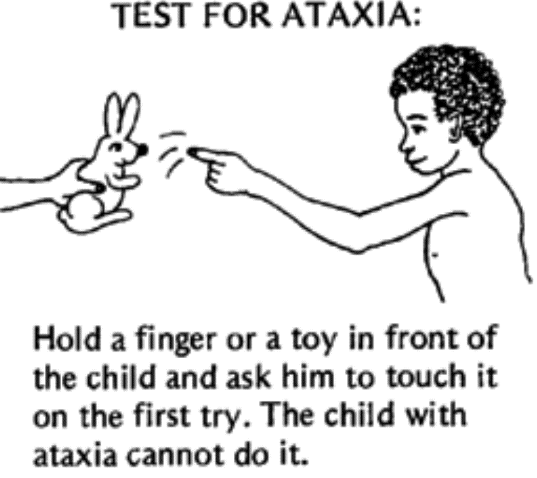
Cerebellar Hemispheric Lesions
Ataxia : Lack of muscle coordination , which is manifested by ( imbalance & unsteady gait ) is manifested by →
(1) Wide-based , unsteady “ drunken , or staggering “ gait .المريض يترنح و عديم التوازن و يكاد يطيح
(2) Scanning speech الكلام بطيء
(3) Dysmetria عدم القدرة علي تقدير المسافة بشكل صحيح
(4) “ Intention ( Kinetic) Tremor ارتجاف يظهر مع الحركة
(5) Adiadochkinesia ( Dysdiadochkinesia ) : فقدان المقدرة علي القيام بحركات سريعة متتالية
Inability to perform rapidly alternating opposite movements such as repeated pronation and supination of the hands .

Slide 17
Cerebellar Hemispheric Lesions
Ataxia ( imbalance ) is manifested by →
(1) Wide-based , unsteady “ drunken , or staggering “ gait .
(2) Scanning speech
(3) Dysmetria ( also called Past-Pointing ) : attempting to touch an object with a finger results in overstretching to one side or the other→ this promptly initiates a gross correction action ( corrective action ) , but the correction overshoots to the other side → Consequently , the finger oscillates back and forth .
This oscillation is the (4) “ Intention Tremor ” , which is characteristic of cerebellar disease .
This cerebellar tremor , unlike that of Parkinson’s disease , is absent at rest . II/ Inability to “ put on the brakes ” → i.e., inability to stop movement promptly . Normally , for example , flexion of the forearm against resistance is quickly checked when the resistance force is suddenly broken off . The patient with cerebellar disease can not break the movement of the limb , and the forearm flies back in a wide arc . This abnormal response is known as the “ Rebound Phenomenon ”.
III/ Adiadochkinesia ( Dysdiadochkinesia ) : Inability to perform rapidly alternating opposite movements such as repeated pronation and supination of the hands .
IV/ Difficulty in performing actions that involve simultaneous motions at more than one joint . The patient dissects such movements and carries them out one joint at a time , a phenomenon known as “ Decomposition of Movement ” .

Slide 18
Flocculonodular Lobe Lesions :
Midline cerebellar tumors in children involving the Flocculonodular Lobe makes the child to walk in an unsteady and staggering fashion
Such a child is afraid ( & reluctant ) to stand erect and move without support .
This is because if he tries to walk , he does so in a staggering fashion → staggering gait , (مشية متعثرة و مترنحة نبة لفقدان التوازن on a broad base يفرق مابين قدميه ليوسع القاعدة و يمنع السقوط, & tends to fall
Moreover , selective Flocculonodular lobe lesions may cause vertigo الشعور بأن الدنيا تدور

Slide 19
Flocculonodular Lobe Lesions :
Midline cerebellar tumors in children , arising from the “ Nodule ” , early in their course
(& before affecting the rest of the cerebellum) , damage first the Flocculonodular lobe .
Such a child is afraid ( & reluctant ) to stand erect and move without support .
This is because if he tries to walk , he does so in a staggering fashion → staggering gait , (مشية متعثرة و مترنحة نبة لفقدان التوازن on a broad base يفرق مابين قدميه ليوسع القاعدة و يمنع السقوط, & tends to fall
Moreover , selective Flocculonodular lobe lesions may cause vertigo

Slide 20
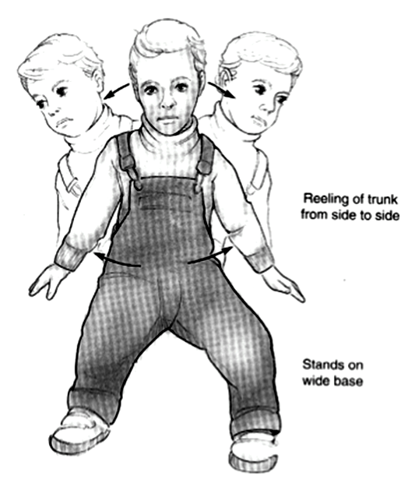
Flocculonodular Lobe Lesion
Midline cerebellar tumors in children , arising from the “ Nodule ” , early in their course
(& before affecting the rest of the cerebellum) , damage first the Flocculonodular lobe .
Such a child is afraid ( & reluctant ) to stand erect and move without support .
This is because if he tries to walk , he does so in a staggering fashion → staggering gait , (مشية متعثرة و مترنحة نبة لفقدان التوازن on a broad base يفرق مابين قدميه ليوسع القاعدة و يمنع السقوط, & tends to fall .
Moreover , selective Flocculonodular lobe lesions may cause vertigo

Slide 21
Flocculonodular Lobe Lesion
Midline cerebellar tumors in children involving the Flocculonodular Lobe makes the child to walk in an unsteady and staggering يتعثر أثناء المشي fashion
Such a child is afraid ( & reluctant يخاف بل و يمانع من الوقوف لحاله خوفا من السقوط بغير تثبيت) to stand erect and move without support .
This is because if he tries to walk , he does so in a staggering fashion → staggering gait , (مشية متعثرة و مترنحة نبة لفقدان التوازن on a broad base يفرق مابين قدميه ليوسع القاعدة و يمنع السقوط, & tends to fall .
Moreover , selective Flocculonodular lobe lesions may cause vertigo شعور بالدوران

Slide 22
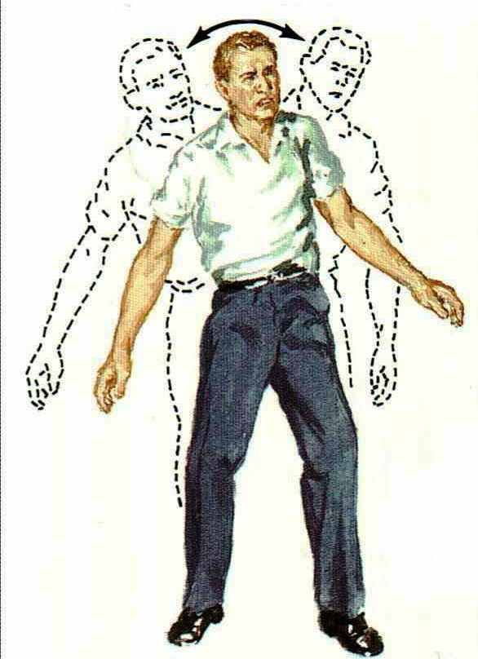
Cerebellar Ataxia
Ataxia is incoordination of muscle movememt leading to imbalanceعدم التوازن و الترنح

Slide 23
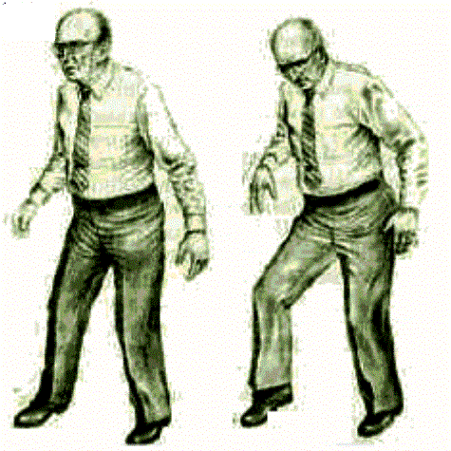
Cerebellar Ataxia

Slide 24
CEREBRAL CORTEX
Cerebral Cortex
Cerebral Cortex
BASAL GANGLIA
Upper Motor Neuron
( Corticospinal ,
Pyramidal Neuron /tract)
THALAMIUS
BRAIN STEM
CEREBELLUM
SPINAL CORD
Anterior Horn Cell ( Lower Motor Neuron )

Slide 25
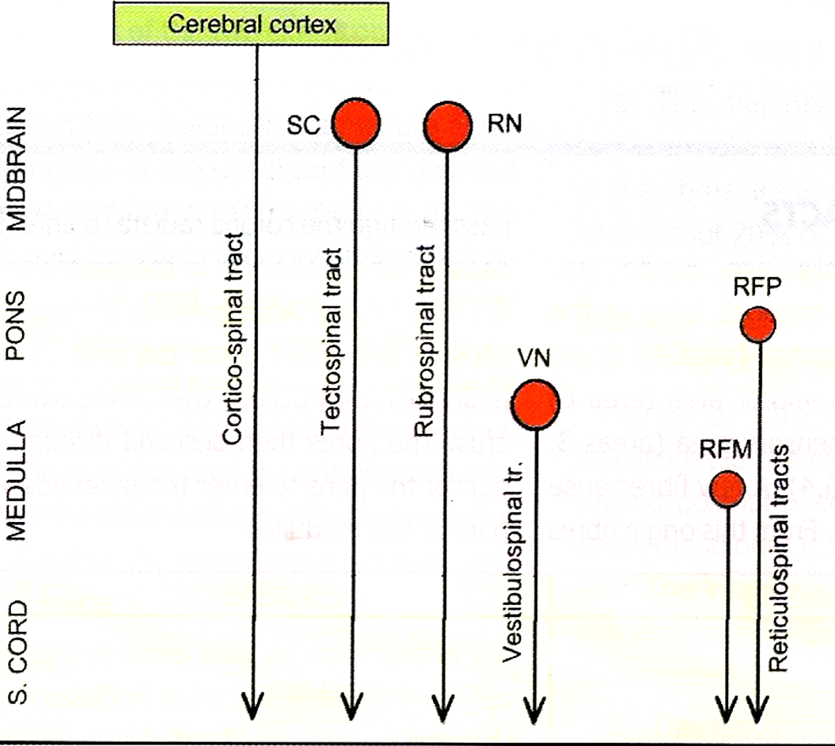
Pyramidal & Extrapyramidal Tracts

