Slide 1

Physiology of Pain
Neuro-Block: Lecture 6
By Laiche Djouhri, PhD
Associate Professor
Dept. of Physiology
Email: ldjouhri@ksu.edu.sa Ext:71044

Slide 2
Week1 Lecture 6
Chapter 48
(Guyton & Hall)
Somatic Sensations:II Pain, headache and Thermal Sensations

Slide 3
Objectives
By the end of this session students are expected to:
Differentiate between pain & nociception
Describe the types of nerve fibres and receptor types that mediate pain
Describe different types of pain and pain pathways
Describe the role of thalamus and cerebral cortex in pain perception

Slide 4
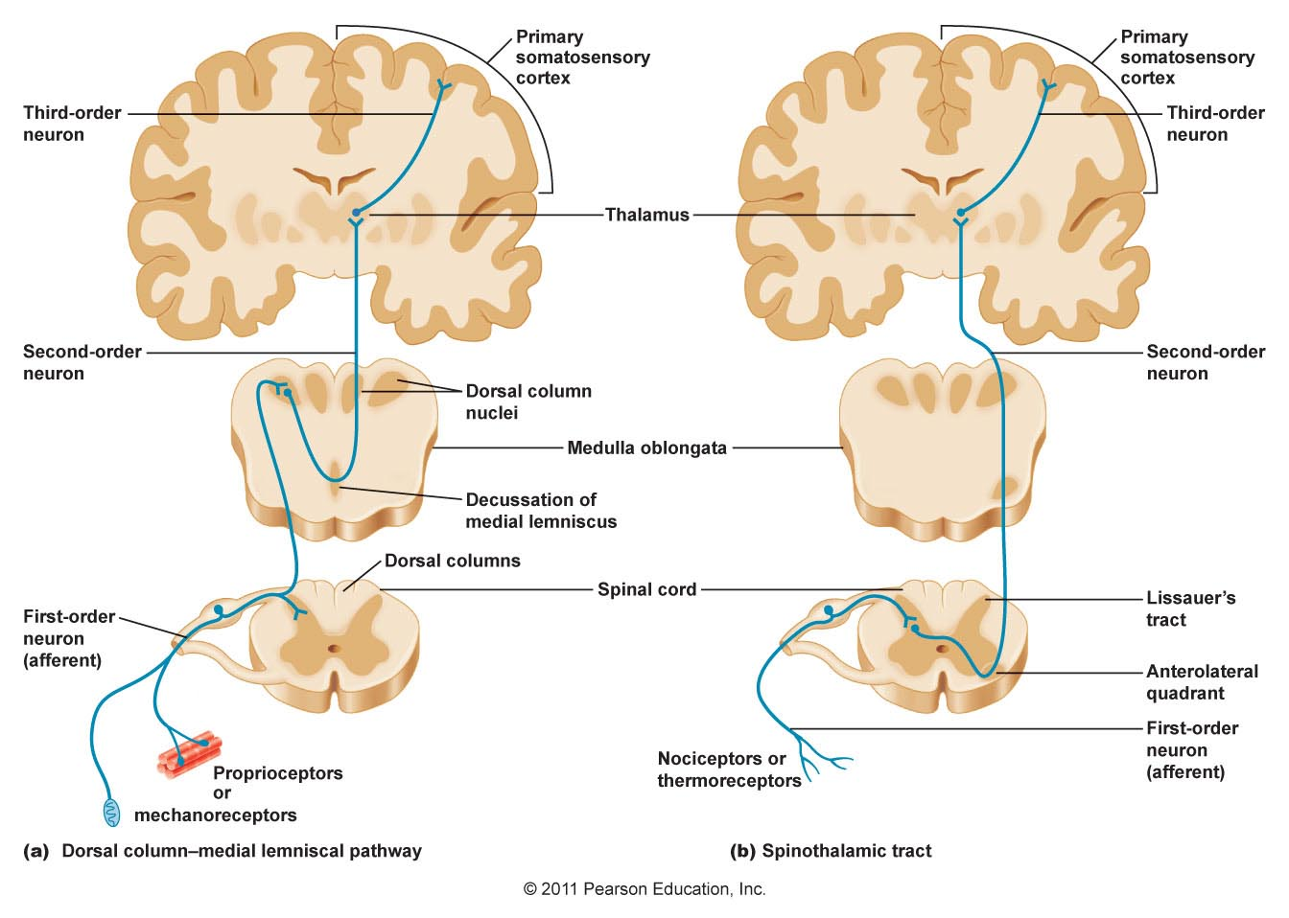
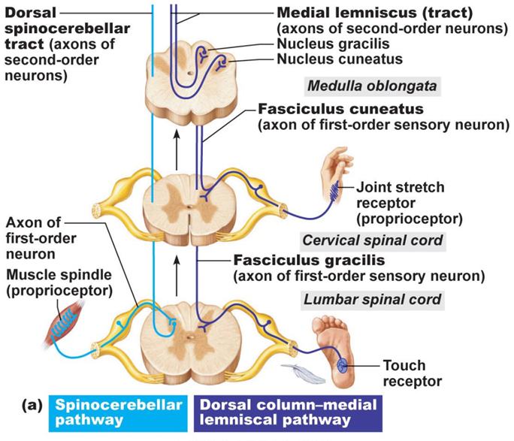
Definitions-1
Primary sensory (afferent) neurons: first-order neurons in the sensory system responsible for transmitting sensory information from the periphery to the CNS
Sensory receptors: are specialized peripheral endings of primary afferent neurons.
Noxious stimulus: any stimulus (mechanical, chemical or thermal) that produces tissue damage or threatens to do so (≠ innocuous).
Nociceptors (pain receptors): primary afferent receptors that respond selectively to noxious stimuli.
Polymodal nociceptors: respond to various noxious stimuli.
3
1
2
Notes:
Receptive field is an area in which stimulation leads to response of a particular sensory neuron"

Slide 5
Definitions-2
Adequate stimulus: the form of energy to which a specific receptor is most sensitive
Somatic pain – pain originating from skin, joints, muscles, and other deep tissues
Visceral pain – pain originating from the internal organs
Allodynia – pain caused by a stimulus that is not normally painful (e.g. touch)
Hyperalgesia – an increased sensitivity to a stimulus that is normally painful.
Spontaneous pain: stimulus independent pain (ongoing pain)

Slide 6
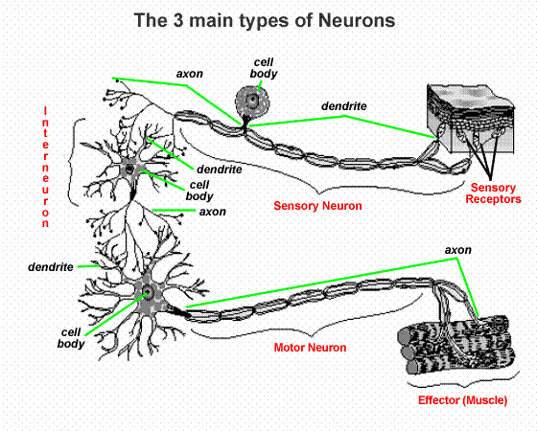
Afferent & Efferent Neurons
Sensory (afferent) neurons lie mainly in PNS
Motor (efferent) neurons lie mainly in CNS
Interneurons (~99% of all neurons) lie entirely in CNS
Skin
CNS
Periphery
Notes:
Sensory neurons: The neurons that conduct impulses from the receptors or sense organs to the central nervous system are called the sensory neurons. They evoke sensations of touch, pain, heat, cold, vision, hearing and tast
The neurons that conduct impulses from the central nervous system to the effectors (muscles or glands) are called the motor neurons. They cause movements of muscles and secretion of glands.
Interneurons or connecting neurons The neurons present in the brain that connect the sensory and the motor neurons.
Only very occasionally do motor neurons and sensory neurons connect directly.

Slide 7
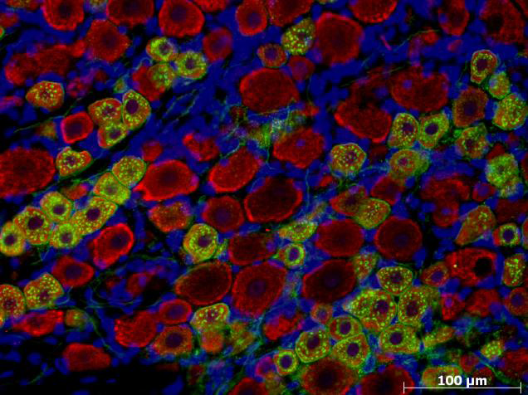
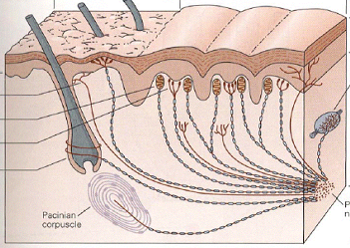
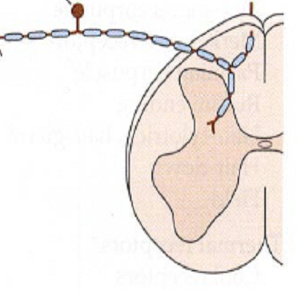
Afferent Neurons & Receptors
A-fibre
C-fibre
S
Small:<30µm
M
Medium: 31-40µm
L
Large:>40µm
S
M
Nociceptors (small/medium)
Non-nociceptors (large)
L
Modified: Martin and Jessel (1991) Principles of Neuroscience
Notes:
The endings of the peripheral branch are specialized in detecting and translating stimulus energy into a neuronal signal or nerve impulse. This signal or AP is then conducted along the axon into the CNS. These sensory receptors are usually divided into 2 main groups: nociceptors and non-nocicetors
DRG neurons are also divided according to to size of teheir biodie s into small medium and large neurons with most of the small and medium sized neurosn being nocicetros and most of the large neurons are non-nocicetors.
their CV into C, AD aand Ab neurons, and most of the nocicetors are slowly condunting neurons with C or Ad CV . conduct in the C and Ad. DRG neurons

Slide 8
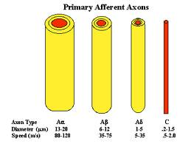
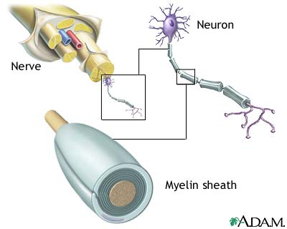
Classification of Nerve fibres
I
II
III
IV
Type
Aα
Aβ
Aδ
C
Type
10-20
5-10
2-5
0.5-2
Diameter (µm)
70-120
30-70
5-30
0.5-2
Conduction Velocity (m/s)

Slide 9
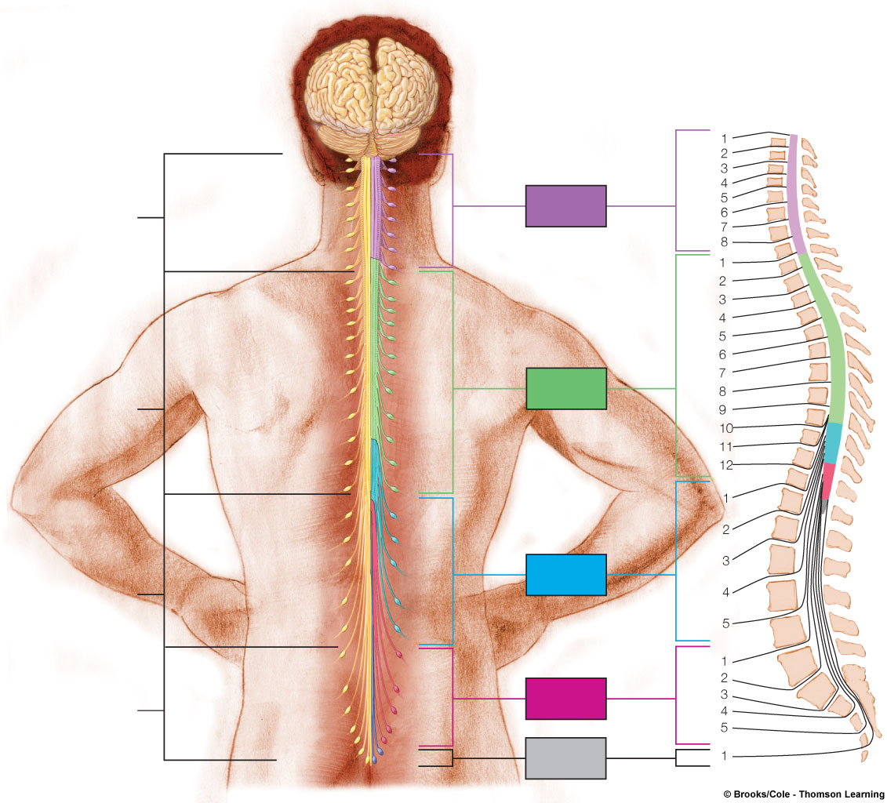
Figure 5.28
Page 173
Primary Afferent Neurons: Where are They?
Cervical
cord
Cervical
nerves
Vertebrae
31 pairs of spinal nerves
Thoracic
nerves
Thoracic
cord
Lumbar
nerves
Lumbar
cord
Sacral
nerves
Sacral
cord
Coccygeal
nerve

Slide 10
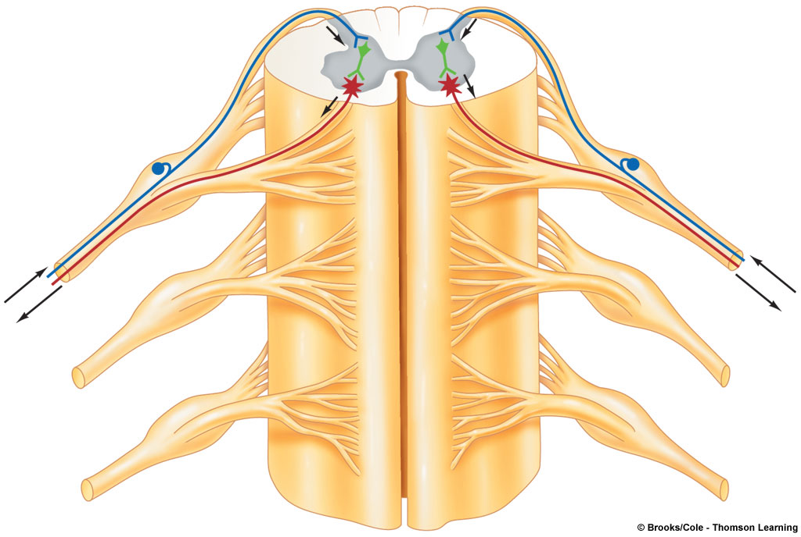
What is a Spinal Nerve?
Gray matter
Cell body of
efferent neuron
White matter
Gray matter
Interneuron
Dorsal root
Cell body (soma) of
Afferent neuron
Dorsal root
Ganglion (DRG)
From receptors
Efferent fiber
To effectors
Ventral root
Spinal nerve

Slide 11
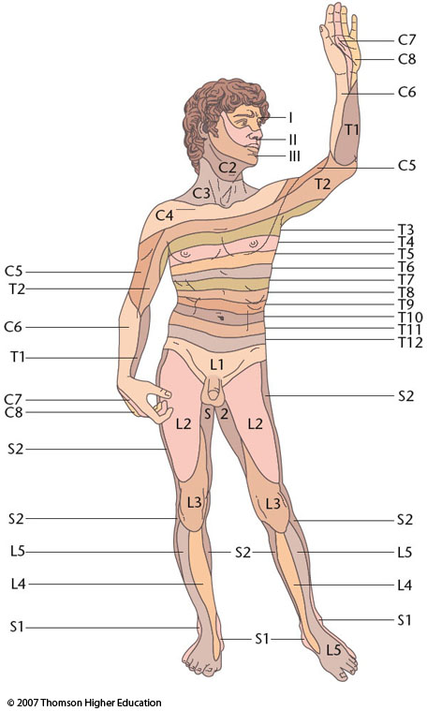
What is a Dermatome?
Dermatome (derma, “skin”, tome, “cut up”)
Dermatome: skin area innervated by a single spinal nerve
Dermatomal map: is an important diagnostic tool for determining site of spinal cord injury
Notes:
Figure 7.14: Dermatomes innervated by the 31 sensory spinal nerves.
Areas I, II, and III of the face are not innervated by the spinal nerves but instead by three branches of the fifth cranial nerve. Although this figure shows distinct borders, the dermatomes actually overlap one another by about one-third to one-half of their width.

Slide 12
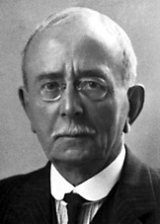
Pain Receptors `Nociceptors`?
‘‘ are special receptors that respond only to noxious stimuli and generate nerve impulses which the brain interprets as "pain". Sherrington 1906
They are specific (have adequate stimulus) in that pain is not produced by overstimulation of other receptors.
Heat pain threshold > 43 °C
Do not adapt (or very little) to repetitive stimulation (can be sensitized by various agents, eg. prostaglandins)
Sir Charles Scott Sherrington (1857-1952)

Slide 13
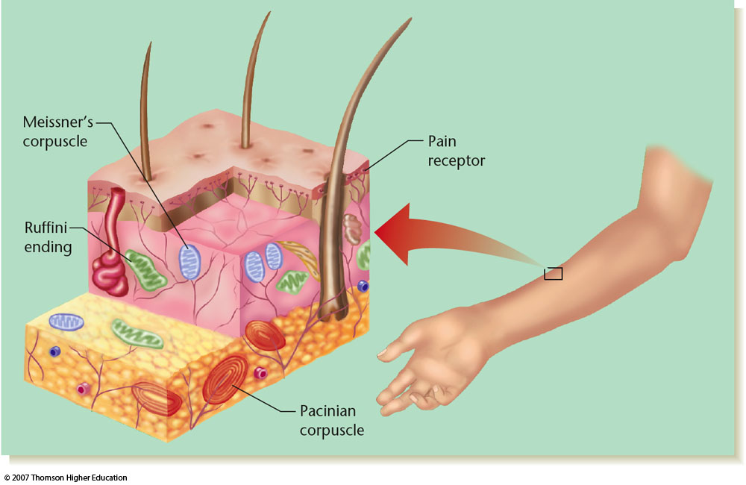
Distribution of Pain Receptors (Nociceptors)
﴿إِنَّ الَّذِينَ كَفَرُواْ بِآيَاتِنَا سَوْفَ نُصْلِيهِمْ نَاراً كُلَّمَا نَضِجَتْ جُلُودُهُمْ بَدَّلْنَاهُمْ جُلُوداً غَيْرَهَا لِيَذُوقُواْ الْعَذَابَ إِنَّ اللّهَ كَانَ عَزِيزاً حَكِيماً﴾[النساء: 56
Are free nerve endings
Widespread in superficial layers of skin
Fewer in deep tissue and absent in brain tissue
Nociceptors

Slide 14
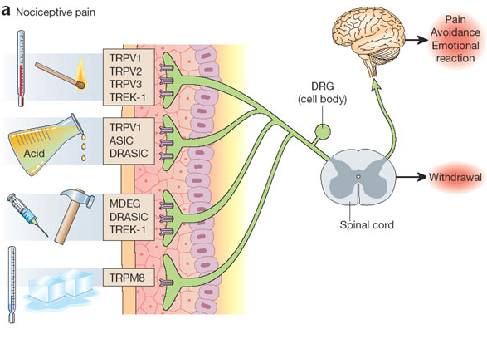
Types of Nociceptors
Mechanosensitive
Thermosensitive
Chemosensitive
Polymodal nociceptors
Scholz & Woolf Nat. Neurosci. 2002

Slide 15
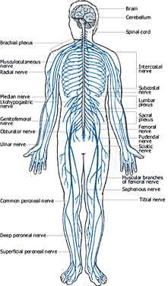
Pain & Nociception
What is nociception?
      Refers to the transmission of signals evoked by activation of nociceptors from periphery to the CNS.
What is pain?
Is perception of unpleasant sensation that originates from a specific body region.
  Is an unpleasant sensory and emotional experience associated with actual or potential tissue damage, or described in terms of such damage (IASP)
http://www.salsassociates.com/structural.html

Slide 16
Significance of Pain: Why do we feel pain?
It is a protective mechanism meant to make us aware that tissue damage is occurring or is about to occur
  Avoid noxious stimuli
  Remove body parts from danger
  Promote healing by preventing further damage
Storage of painful experiences in memory helps us to avoid potentially harmful event in the future
The sensation of pain may be accompanied by behavioural responses (withdrawal, defense) as well as emotional responses (crying or fear).

Slide 17
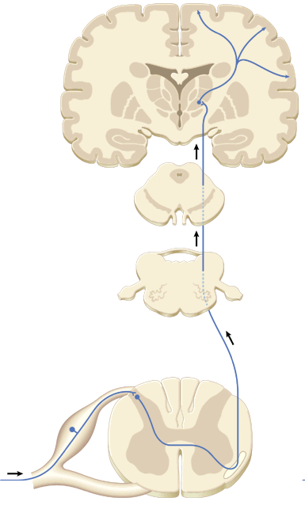
Role of Thalamus and Cortex in Pain Perception
  Pain perception occurs at the level of RF, the thalamus and basal regions.
  The somatosensory cerebral cortex is important for topognosis i.e. location and quality of pain
  Stimulus intensity is encoded by the rate of action potentials
Spino-thalamic tract
primary afferent
Aδ or C fibers
http://www.salsassociates.com/structural.html

Slide 18
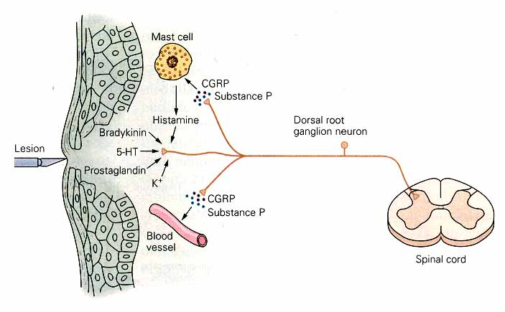
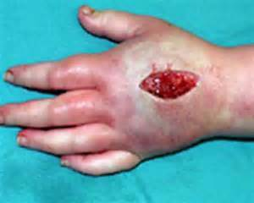
Pain Mediators After Tissue damage
Nociceptive neurons release peptides e.g. substance P, and CGRP which stimulate mast cells and blood vessels
Vasodilation
Extravasation
Efferent Function of Nociceptors

Slide 19
Axon Reflex
Noxious stimulus
Nociceptive
afferent
Nociceptor terminal
4. Plasma extravasation
Many nociceptors have Afferent as well as Efferent actions
1. Nerve impulse
3. Vasodilation and increased blood flow
2. SP release
Reproduced from Berne & Levy, 1993
Notes:
It is a reflex that occurs when an AP in one branch of nociceptor conducts centrally through the main axon, but in addition it spreads antidromically into other branches of the axon in the skin leading to SP and CGRP (Calcitonin gene related peptide) release from the peripheral branches of the nociceptor.
The released SP has several effects including:-Vasodilation: resulting in reddening (erythema) and warming of the skin.
plasma extravasation which is flow of water and electrolytes out of the capillaries into the extracellular space.
Many nociceptors thus have efferent as well as afferent actions

Slide 20
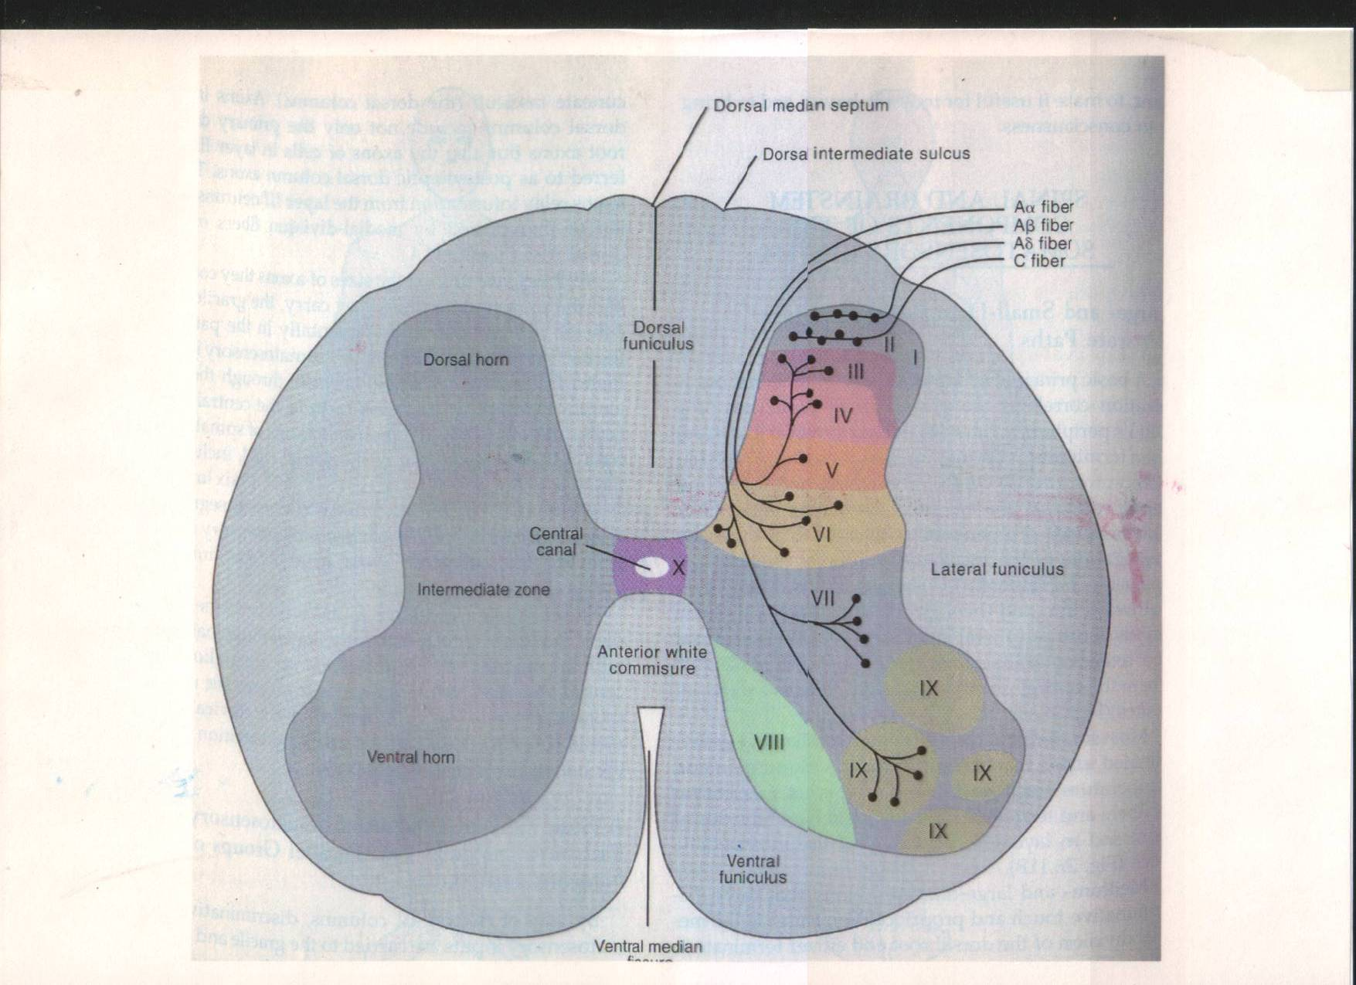
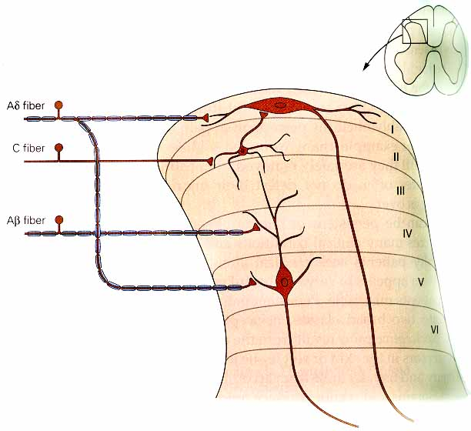
Nociceptive Input to the Spinal Cord
C-fibers in laminae II-III (subtantia gelatinosa)
Aδ-fibers in lamina marginalis
SP = substance P
G= Glutamate
G
G & SP
G
Projection/relay neurons
Notes:
On entering the spinal cord from the dorsal spinal roots the pain fibers terminate on relay neurons in the dorsal horn.

Slide 21
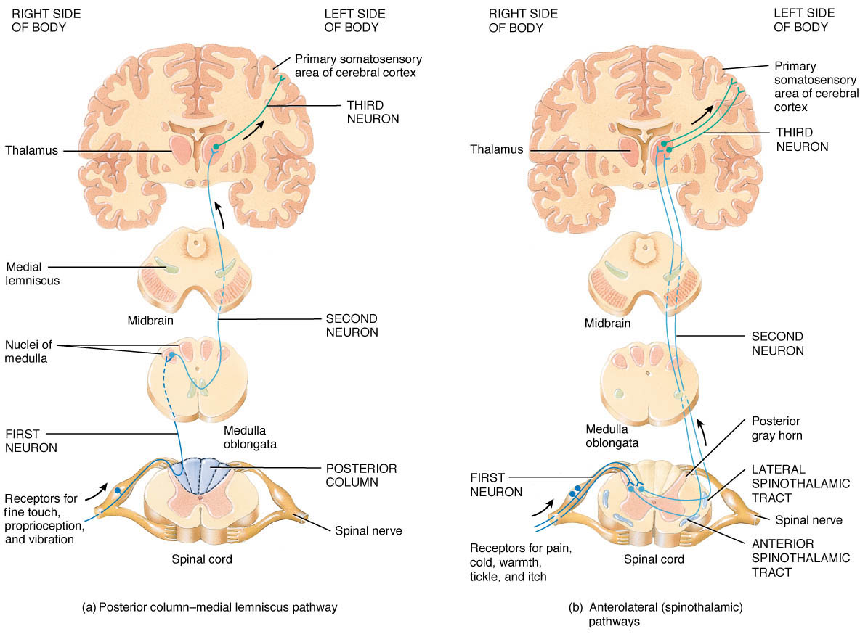
Dual Pain Pathways
Pain signals take 2 pathways to the brain:
Neospinothalamic (lateral STT):
  Fast pain (Aδ-type)
  Thermal pain (acute type)
Paleospinothalamic (ventral STT):
  Slow pain (C-type) plus some Aδ
  Crude touch & pressure
  Itch & tickle
  Sexual sensations
Separation between the 2 pathways is no longer so clearly identified!!
Notes:
In the spinal cord there are two systems for processing the pain signals on their way to the brain.
On entering the spinal cord, the pain signals take 2 pathways:

Slide 22
Nociceptive `Pain` Pathways
Pain
Temperature
Crude touch
Tickle
Itch
Sexual sensation
A α/β-fibres
Fine Touch
Pressure
Vibration
Position
Movement
C- & Aδ-fibres

Slide 23
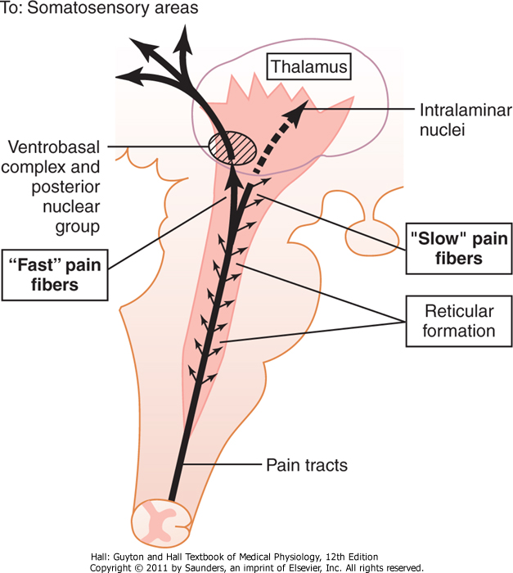
Where Do Fibers of L-STT and V-STT terminate?
Most pain fibers of L-STT pass all the way to thalamus:
  VBC
  Posterior NG
Only few pain fibers of V-STT pass all the way to thalamus:
  Brain stem reticular formation (RF)
  Hypothalamus & adjacent region of
  Impulses reaching these regions have strong arousal effects
Fig.48-3

Slide 24
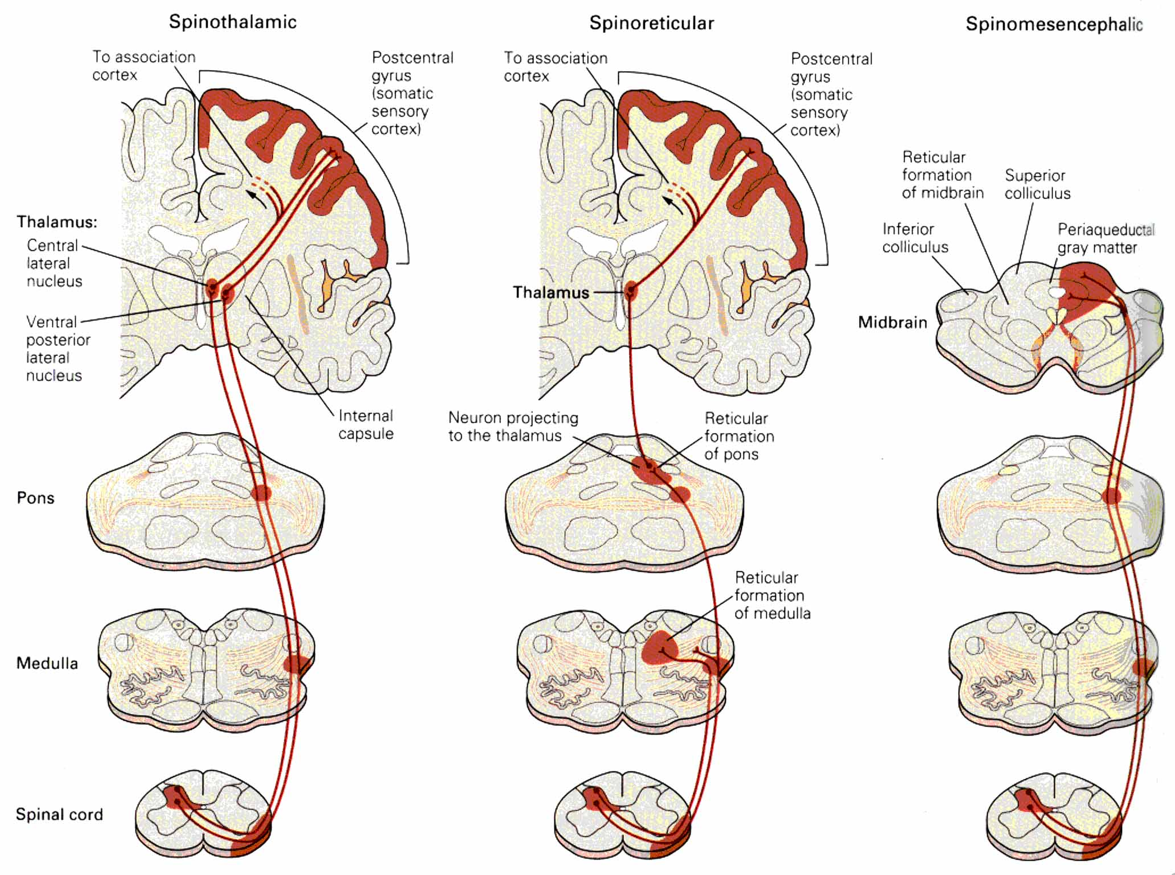
Ascending Pain Pathways
Spinothalamic
Spinoreticular
Spinomesencephalic
  Pain pathways that provide different brain regions with information for processing different aspects of pain

Slide 25

Types and Qualities of Pain
Question
What are the qualities/types of pain you feel when you injure “cut” yourself ?

Slide 26
Types and Qualities of Pain
Fast/Sharp (1st) pain vs slow diffuse (2nd) pain
Phenomenon of double-pain
Fast pain
Sharp, intense, pricking, begins without delay (felt within 0.1 sec)
Associated with reflex withdrawal
Usually somatic not
visceral
Easily localized and is mediated by Aδ-fiber nociceptors
Slow pain
Burning, aching, throbbing “unbearable” after 1 sec or more
Associated with destruction of tissue
Can occur in skin or any internal organ/tissue
Poorly localized and is mediated by C-fiber nociceptors: → misery (responsible for emotional aspect
of pain)

Slide 27
Acute “Physiologic” & Chronic “Pathologic” Pain
Normal acute pain ‘good’: protective role
  Cause is known and pain resolves spontaneously
  Somatic pain (bones, joints, muscles)
  Visceral pain (internal organs, e.g. stomach).
  Activation of nociceptors
  Responsive to common analgesics
Chronic pain ‘bad’: no useful function
  Cause often unknown
  Duration >6 months, can last for years or life time
  Affects ~ 20% of population world wide
  Inflammatory (tissue injury) pain & neuropathic (nerve injury) pain
  Abnormal impulse generation in afferent axons.
  Often refractory to common analgesics

Slide 28
Pain Modulation
Question
Why does it feel better to rub a bumped skin?

Slide 29
Afferent Inhibition: Gate Control Theory
C-fibre
-
+
-
Inhibitory interneuron:
Projection neuron
The gate
+
+
Aβ fibre (touch)
Melzack and Wall, 1965
Notes:
This can be explained by a theory known as the gate control theory proposed by Melzak and Wall in 1965.
According to this theory, rubbing a bumped skin reduces pain by activating touch-sensitive Ab fiber neurons which via activating an inhibitory interneuron can suppress the projection neuron that transmit pain signal to the brain.
Dorsal horn considered the gate through which pain impulses reach the spinothalamic system.
Inhibition of pain transmission (closure of gate) is possible by collaterals from dorsal column fibers or by descending fibers from pain control circuits in brain

Slide 30
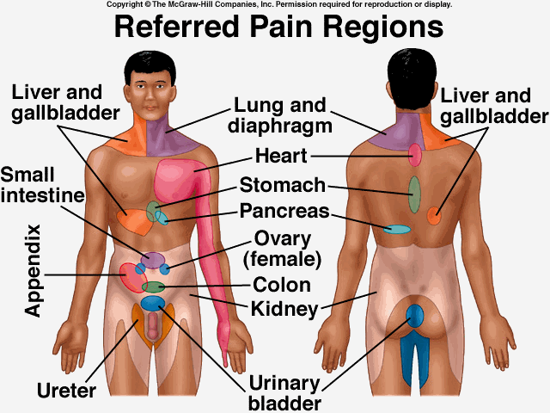
Referred Pain
Visceral pain that is felt at a somatic structure that can be far away from the origin site
Poorly localized and is not identical in all people:
  Heart pain can be referred to right arm or neck (in some people)

Slide 31
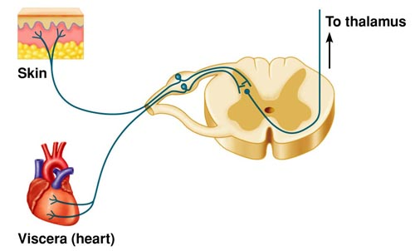
Basis of Referred Pain
Convergence theory:
Referred pain is presumed to be due to converge of cutaneous and visceral nociceptors onto the same spinothalamic tract (STT) neurons
Facilitation theory:
Pain fibers from a visceral organ decrease the threshold of STT neurons, increasing their excitability.
The brain interprets the information coming from visceral nociceptors as having arisen from cutaneous nociceptors, because this is where nociceptive stimuli originate more frequently

Slide 32



