Slide 1
THE PHYSIOLOGY OF SLEEP
PRESENTED BY COLIN GREENGRASS, PH.D.

Slide 2
AT THE END OF THIS LECTURE THE STUDENT SHOULD BE ABLE TO :
(1) EXPLAIN THE DIFFERENCE BETWEEN SLEEP AND COMA
(2) DEFINE WHAT IS MEANT BY NREM (NON-RAPID EYE MOVEMENT, SWS) AND REM (RAPID EYE MOVEMENT) SLEEP
(3) DESCRIBE HOW NREM AND REM SLEEP ARE DISTRIBUTED DURING A NORMAL NIGHT SLEEP IN THE AVERAGE ADULT HUMAN
(4) DESCRIBE THE BEHAVIOURAL AND AUTONOMIC FEATURES ASSOCIATED WITH NREM AND REM SLEEP .
(5) DESCRIBE HOW THE EEG , AS A PHYSIOLOGICAL TOOL , IS BEING USED TO DELINEATE IN WHICH STAGE OF SLEEP ( OR WAKEFULNESS ) A PERSON IS .
(6) APPRECIATE HOW THE TOTAL SLEEP DURATION AND DIFFERENT SLEEP STAGES VARY WITH DIFFERENT AGES IN NORMAL HUMANS .
(7) DESCRIBE THE CURRENT THEORIES ABOUT THE NEURAL BASIS OF SLEEP .

Slide 3
THE DIFFERENCE BETWEEN SLEEP AND COMA
SLEEP IS DEFINED AS UNCONSCIOUSNESS FROM WHICH A PERSON CAN BE AROUSED BY SENSORY OR OTHER STIMULI.
IT IS TO BE DISTINGUISHED FROM COMA, WHICH IS UNCONSCIOUSNESS FROM WHICH A PERSON CANNOT BE AROUSED.

Slide 4
THE CIRCADIAN RHYTHM

Slide 5
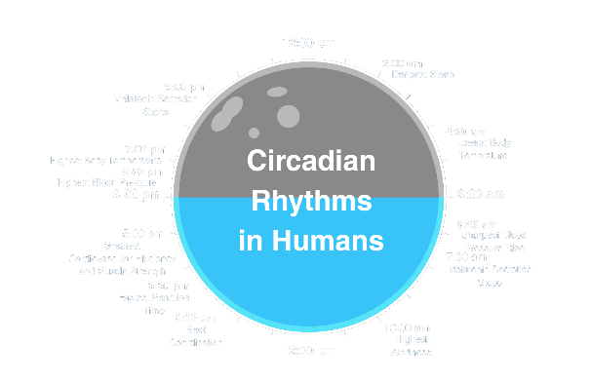
THE CIRCADIAN RHYTHM
ANIMALS GENERATE ENDOGENOUS 24 HOUR CYCLES OF WAKEFULNESS AND SLEEP.
THIS CYCLE IS CALLED THE CIRCADIAN RHYTHM
THE CIRCADIAN RHYTHM IS PRODUCED BY INTERNAL MECHANISMS THAT OPERATE ON AN APPROXIMATELY 24 HOUR CYCLE
IN HUMANS THIS ENDOGENOUS CYCLE HAS A DURATION OF 24.2 HOURS
THE PURPOSE OF THE CIRCADIAN RHYTHM IS TO KEEP OUR INTERNAL WORKINGS IN PHASE WITH THE OUTSIDE WORLD.

Slide 6
THE CIRCADIAN RHYTHM
THE CIRCADIAN RHYTHM ALSO REGULATES:
THE FREQUENCY OF EATING AND DRINKING
BODY TEMPERATURE
SECRETION OF HORMONES
VOLUME OF URINATION
SENSITIVITY TO DRUGS

Slide 7
CHARACTERISTICS OF THE CIRCADIAN RHYTHM
CIRCADIAN RHYTHMS REMAIN RELATIVELY CONSISTENT DESPITE LACK OF ENVIRONMENTAL CUES INDICATING THE TIME OF DAY
CIRCADIAN RHYTHMS CAN DIFFER BETWEEN PEOPLE AND LEAD TO DIFFERENT PATTERNS OF WAKEFULNESS AND ALERTNESS.
CIRCADIAN RHYTHMS CHANGE AS A FUNCTION OF AGE WITH DIFFERENT SLEEP PATTERNS FROM CHILDHOOD TO LATE ADULTHOOD

Slide 8
MANIPULATION OF THE CIRCADIAN RHYTHM
EXPERIMENT TO DETERMINE VARIATION OF THE CIRCADIAN RHYTHM:
SUBJECTS PLACED IN CLOSED ENVIRONMENTS WITH NO CUES TO THE TIME OF DAY.
RESULTS DEPEND UPON THE AMOUNT OF LIGHT TO WHICH SUBJECTS ARE ARTIFICIALLY EXPOSED.
IN BRIGHT LIGHT, RHYTHMS RUN FASTER AND SUBJECTS HAVE TROUBLE SLEEPING.
IN COMPLETE DARKNESS, RHYTHMS RUN SLOWER AND SUBJECTS HAVE TROUBLE WAKING.
HUMAN CIRCADIAN CLOCK GENERATES A RHYTHM SLIGHTLY LONGER THAN 24 HOURS WHEN IT HAS NO EXTERNAL CUE TO SET IT.
MOST PEOPLE CAN ADJUST TO:
23- OR 25- HOUR DAY
BUT NOT TO A 22- OR 28- HOUR DAY.
BRIGHT LIGHT LATE IN THE DAY CAN LENGTHEN THE CIRCADIAN RHYTHM.

Slide 9
ZEITGEBER
LIGHT IS CRITICAL FOR PERIODICALLY RESETTING OUR CIRCADIAN RHYTHMS.
A ZEITGEBER IS A TERM USED TO DESCRIBE ANY STIMULUS THAT RESETS THE CIRCADIAN RHYTHMS.
EXERCISE, NOISE, MEALS, AND TEMPERATURE ARE OTHER ZEITGEBERS.

Slide 10
JET LAG REFERS TO THE DISRUPTION OF THE CIRCADIAN RHYTHMS DUE TO CROSSING TIME ZONES.
STEMS FROM A MISMATCH OF THE INTERNAL CIRCADIAN CLOCK AND EXTERNAL TIME.
CHARACTERIZED BY SLEEPINESS DURING THE DAY, SLEEPLESSNESS AT NIGHT, AND IMPAIRED CONCENTRATION.
TRAVELING WEST “PHASE-DELAYS” OUR CIRCADIAN RHYTHMS.
TRAVELING EAST “PHASE-ADVANCES” OUR CIRCADIAN RHYTHMS.

Slide 11
WHY DO WE NEED SLEEP?

Slide 12
SLEEP HAS IMPORTANT PHYSIOLOGICAL FUNCTIONS
THERE IS LITTLE DOUBT THAT SLEEP HAS IMPORTANT FUNCTIONS.
IT EXISTS IN ALL MAMMALS, AND AFTER TOTAL DEPRIVATION THERE IS USUALLY A PERIOD OF “CATCH-UP” OR “REBOUND” SLEEP
AFTER SELECTIVE DEPRIVATION OF REM OR SLOW-WAVE SLEEP, THERE IS ALSO A SELECTIVE REBOUND OF THESE SPECIFIC STAGES OF SLEEP
THE ESSENTIAL ROLE OF SLEEP IN HOMEOSTASIS IS DEMONSTRATED WHERE RATS DEPRIVED OF SLEEP FOR 2 TO 3 WEEKS OFTEN WILL DIE
Notes:
THERE IS LITTLE DOUBT THAT SLEEP HAS IMPORTANT FUNCTIONS.
IT EXISTS IN ALL MAMMALS, AND AFTER TOTAL DEPRIVATION THERE IS USUALLY A PERIOD OF “CATCH-UP” OR “REBOUND” SLEEP
AFTER SELECTIVE DEPRIVATION OF REM OR SLOW-WAVE SLEEP, THERE IS ALSO A SELECTIVE REBOUND OF THESE SPECIFIC STAGES OF SLEEP
THE ESSENTIAL ROLE OF SLEEP IN HOMEOSTASIS IS DEMONSTRATED WHERE RATS DEPRIVED OF SLEEP FOR 2 TO 3 WEEKS OFTEN WILL DIE

Slide 13
WHY DO WE NEED SLEEP?
SLEEP IS A SPECIALIZED STATE THAT SERVES A VARIETY OF IMPORTANT FUNCTIONS INCLUDING:
CONSERVATION OF METABOLIC ENERGY
REPAIR AND RESTORATION
PROTEINS ARE REBUILT
ENERGY SUPPLIES ARE REPLENISHED

Slide 14
SLEEP AND THE BRAIN
SLEEP IS A SPECIALIZED STATE THAT SERVES THE BRAIN IN
AIDING LEARNING AND MEMORY CONSOLIDATION
NEURAL MATURATION
CLEARANCE OF METABOLIC WASTE PRODUCTS GENERATED BY NEURAL ACTIVITY IN THE AWAKE BRAIN

Slide 15
SLEEP AND MEMORY
SLEEP ALSO PLAYS AN IMPORTANT ROLE IN ENHANCING LEARNING AND STRENGTHENING MEMORY.
PERFORMANCE ON A NEWLY LEARNED TASK IS BETTER THE IF ADEQUATE SLEEP IS ACHIEVED DURING THAT NIGHT.
INCREASED BRAIN ACTIVITY OCCURS IN THE AREA OF THE BRAIN ACTIVATED BY A NEWLY LEARNED TASK WHILE ONE IS ASLEEP.
ACTIVITY ALSO CORRELATES WITH IMPROVEMENT IN ACTIVITY SEEN THE FOLLOWING DAY.

Slide 16
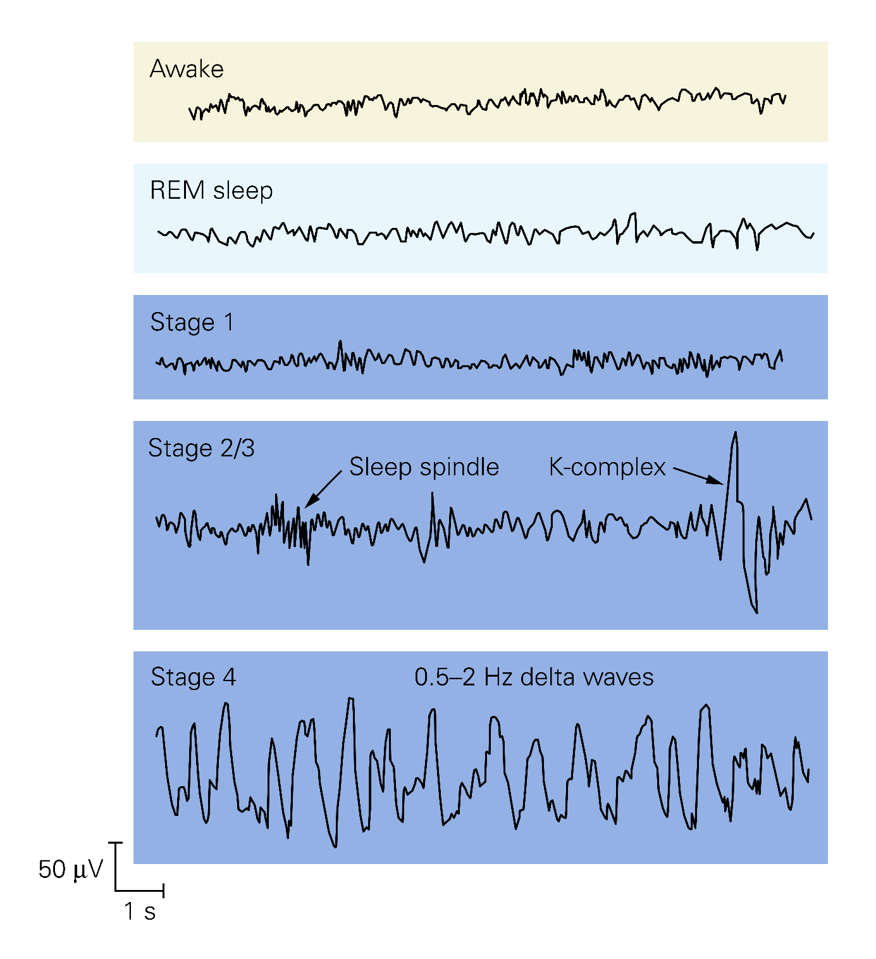
STAGES OF SLEEP

Slide 17
(3) DESCRIBE HOW NREM AND REM SLEEP ARE DISTRIBUTED DURING A NORMAL NIGHT SLEEP IN THE AVERAGE ADULT HUMAN
(5) DESCRIBE HOW THE EEG , AS A PHYSIOLOGICAL TOOL , IS BEING USED TO DELINEATE THE STAGE OF SLEEP ( OR WAKEFULNESS )

Slide 18
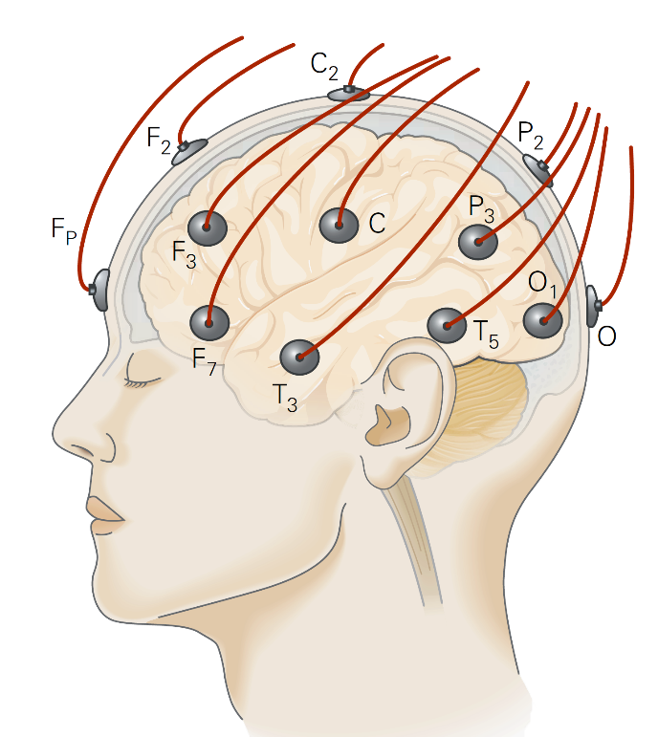
STAGES OF SLEEP
THE EEG (ELECTROENCEPHALOGRAPH) HAS ALLOWED RESEARCHERS TO DISCOVER THAT THERE ARE SEVERAL STAGES OF SLEEP.

Slide 19
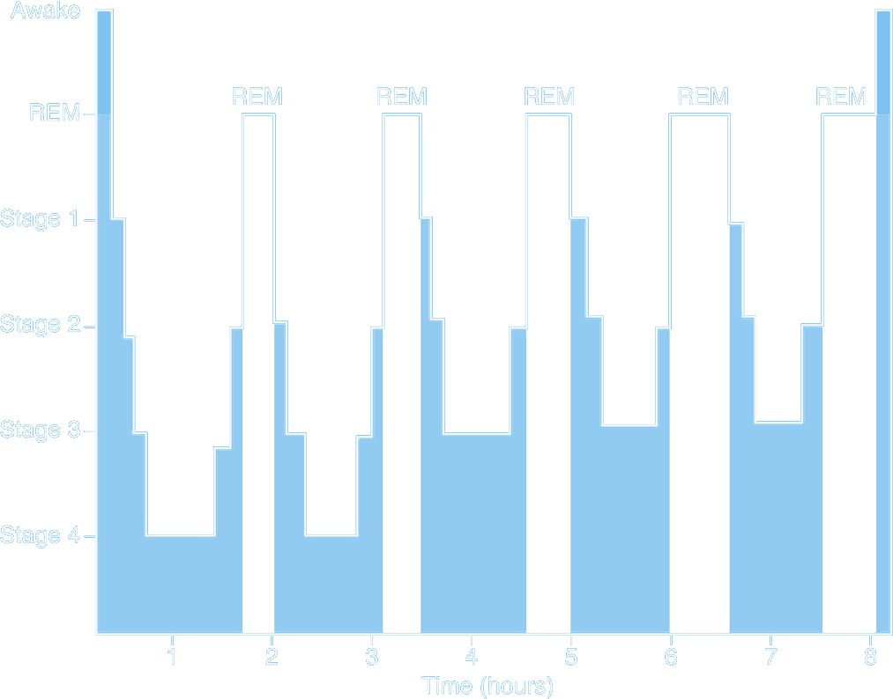
TWO TYPES OF SLEEP—SLOW-WAVE SLEEP
AND RAPID EYE MOVEMENT SLEEP
EACH NIGHT, A PERSON GOES THROUGH STAGES OF TWO MAJOR TYPES OF SLEEP THAT ALTERNATE WITH EACH OTHER THESE TYPES ARE CALLED
RAPID EYE MOVEMENT SLEEP (REM SLEEP)
SLOW-WAVE SLEEP OR NON-REM (NREM) SLEEP
IN WHICH THE EYES UNDERGO RAPID MOVEMENTS EVEN THOUGH THE PERSON IS STILL ASLEEP
IN WHICH THE BRAIN WAVES ARE STRONG AND OF LOW FREQUENCY, AS WE DISCUSS LATER.

Slide 20
NON REM SLEEP HAS FOUR STAGES.
STAGE 1 IS CHARACTERIZED BY A SLIGHT SLOWING OF THE EEG
STAGE 2 HAS HIGH-AMPLITUDE K COMPLEXES AND SPINDLES
STAGES 3 AND 4 HAVE SLOW, HIGH-AMPLITUDE DELTA WAVES

Slide 21
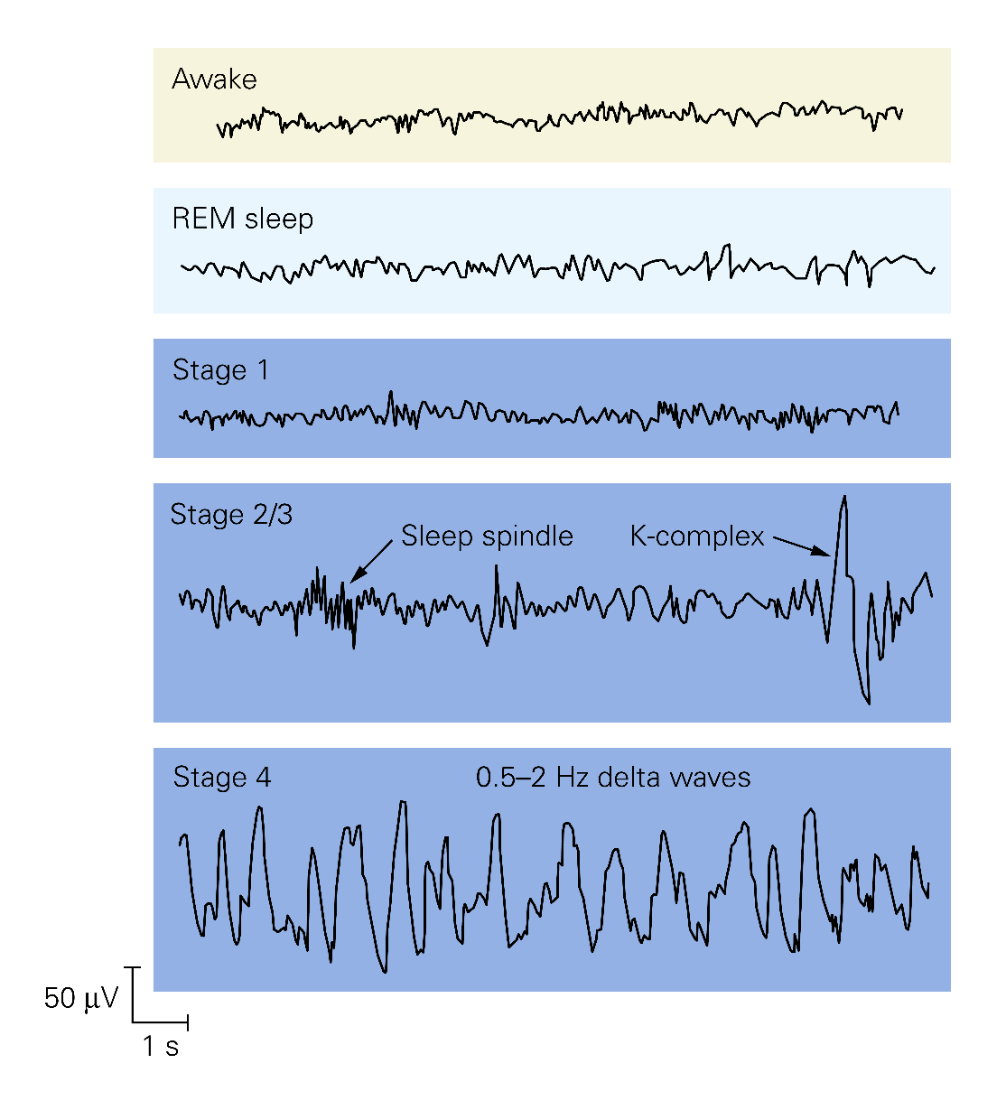
THE ELECTRICAL ACTIVITY OF THE BRAIN IS DISTINCTIVE DURING WAKEFULNESS AND EACH OF THE FIVE STAGES OF SLEEP
ELECTRODES ARE PLACED SYSTEMATICALLY ON THE SCALP FOR RECORDING THE ELECTROENCEPHALOGRAM
WHEN THE SUBJECT IS AWAKE WITH EYES OPEN, THE EEG EXHIBITS LOW-VOLTAGE, HIGHER-FREQUENCY ACTIVITIES.
STAGE 1 SLEEP IS CHARACTERIZED BY A SLIGHT SLOWING OF FREQUENCIES
STAGES 2 SLEEP IS CHARACTERIZED BY SPINDLE WAVES AND K-COMPLEXES AS WELL AS INCREASES IN OTHER SLOW RHYTHMS.
STAGE 4 SLEEP SLOW RHYTHMS BECOME VERY PROMINENT.
DURING RAPID EYE MOVEMENT (REM) SLEEP IS SIMILAR TO THAT DURING WAKING
Notes:
ELECTRODES ARE PLACED SYSTEMATICALLY ON THE SCALP FOR RECORDING THE ELECTROENCEPHALOGRAM
WHEN THE SUBJECT IS AWAKE WITH EYES OPEN, THE EEG EXHIBITS LOW-VOLTAGE, HIGHER-FREQUENCY ACTIVITIES.
STAGE 1 SLEEP IS CHARACTERIZED BY A SLIGHT SLOWING OF FREQUENCIES
STAGES 2 SLEEP IS CHARACTERIZED BY SPINDLE WAVES AND K-COMPLEXES AS WELL AS INCREASES IN OTHER SLOW RHYTHMS.
STAGE 4 SLEEP SLOW RHYTHMS BECOME VERY PROMINENT.
DURING RAPID EYE MOVEMENT (REM) SLEEP IS SIMILAR TO THAT DURING WAKING

Slide 22
ALPHA WAVES
ALPHA WAVES ARE PRESENT WHEN ONE BEGINS A STATE OF RELAXATION.
THIS IS A RELAXED WAKING STATE

Slide 23
STAGES OF SLEEP – STAGE 1
STAGE 1 SLEEP IS WHEN SLEEP HAS JUST BEGUN
BRAIN ACTIVITY BEGINS TO DECLINE.
EXPERIENCE
THIS IS EXPERIENCED AS FALLING ASLEEP AND IS A TRANSITION STAGE BETWEEN WAKING AND SLEEP.
DURATION
BETWEEN 1 AND 5 MINUTES
OCCUPIES APPROXIMATELY 2-5 % OF A NORMAL NIGHT OF SLEEP.
SIGNS
EYES BEGIN TO ROLL SLIGHTLY.
WAVEFORM
THE EEG IS DOMINATED BY IRREGULAR, JAGGED, LOW VOLTAGE WAVES

Slide 24
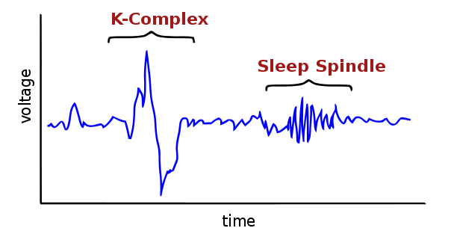
STAGES OF SLEEP – STAGE 2
EXPERIENCE
THE "BASELINE" OF SLEEP.
DURATION
THIS STAGE IS PART OF THE 90 MINUTE CYCLE AND OCCUPIES APPROXIMATELY 45-60% OF SLEEP.
WAVEFORM IS CHARACTERIZED BY THE PRESENCE OF:
SLEEP SPINDLES - 12- TO 14-HZ WAVES DURING A BURST THAT LASTS AT LEAST HALF A SECOND.
K-COMPLEXES - A SHARP HIGH-AMPLITUDE NEGATIVE WAVE FOLLOWED BY A SMALLER, SLOWER POSITIVE WAVE.

Slide 25
STAGES OF SLEEP – STAGES 3 & 4
EXPERIENCE
DEEP SLEEP
DELTA SLEEP IS THE "DEEPEST" STAGE OF SLEEP AND THE MOST RESTORATIVE.
IT IS DELTA SLEEP THAT A SLEEP-DEPRIVED SUBJECT'S BRAIN CRAVES
GENERALLY CHILDREN UNAWAKE ABLE OR "DEAD ASLEEP"
DURATION
15-30 MINUTES
CAN OCCUPY UP TO 40% OF ALL SLEEP TIME
SIGNS
SLOWING OF HEART RATE, BREATHING RATE, AND BRAIN ACTIVITY.

Slide 26
STAGES OF SLEEP – STAGES 3 & 4
WAVEFORM
STAGE 3 AND STAGE 4 TOGETHER CONSTITUTE SLOW WAVE SLEEP (SWS) AND IS CHARACTERIZED BY:
EEG RECORDING OF SLOW, LARGE AMPLITUDE WAVE.
HIGHLY SYNCHRONIZED NEURONAL ACTIVITY.
BRAIN ACTIVITY SLOWS DOWN FROM THE "THETA" RHYTHM OF STAGE 2 TO A MUCH SLOWER RHYTHM CALLED "DELTA" AND THE HEIGHT OR AMPLITUDE OF THE WAVES INCREASES DRAMATICALLY.

Slide 27
STAGES OF SLEEP – RAPID EYE MOVEMENT
EXPERIENCE
VERY ACTIVE STAGE OF SLEEP.
VIVID DREAMS CAN OCCUR.
DURATION
COMPOSES 20-25 % OF A NORMAL NIGHTS SLEEP.
WAVEFORM
EEG WAVES ARE IRREGULAR, LOW-VOLTAGE AND FAST.

Slide 28
OVER THE COURSE OF ABOUT 90 MINUTES A SLEEPER GOES THROUGH SLEEP STAGES 1, 2, 3, AND 4
THEN RETURNS THROUGH THE STAGES 3 AND 2 TO A STAGE CALLED REM.

Slide 29
SLOW WAVE PREDOMINANCE
MOST SLEEP DURING EACH NIGHT IS OF THE SLOW-WAVE (NREM) VARIETY,
WHICH IS THE DEEP, RESTFUL SLEEP THAT THE PERSON EXPERIENCES DURING THE FIRST HOUR OF SLEEP AFTER HAVING BEEN AWAKE FOR MANY HOURS
STAGE 3 AND 4 SLEEP PREDOMINATE EARLY IN THE NIGHT.
THE LENGTH OF STAGES 3 AND 4 DECREASE AS THE NIGHT PROGRESSES.

Slide 30
SLEEP CYCLES
REM SLEEP IS PREDOMINANT LATER IN THE NIGHT.
LENGTH OF THE REM STAGES INCREASES AS THE NIGHT PROGRESSES.
FOUR OR FIVE SLEEP CYCLES OCCUR IN A TYPICAL NIGHT’S SLEEP - LESS TIME IS SPENT IN SLOW-WAVE, MORE IS SPENT IN REM

Slide 31
(6) APPRECIATE HOW THE TOTAL SLEEP DURATION AND DIFFERENT SLEEP STAGES VARY WITH DIFFERENT AGES IN NORMAL HUMANS

Slide 32
NORMAL SLEEP CYCLES AT DIFFERENT AGES – YOUNG ADULT
REM SLEEP IS INDICATED IN RED.
IN A TYPICAL NIGHT OF SLEEP, A YOUNG ADULT FIRST ENTERS NREM SLEEP, PASSES THROUGH STAGES 1 AND 2, AND SPENDS 70–100 MIN IN STAGES 3 AND 4.
SLEEP THEN LIGHTENS, AND A REM PERIOD FOLLOWS.
THIS CYCLE IS REPEATED AT INTERVALS OF ABOUT 90 MIN THROUGHOUT THE NIGHT.

Slide 33
NORMAL SLEEP CYCLES AT DIFFERENT AGES
REM SLEEP OCCUPIES
80% OF TOTAL SLEEP TIME IN PREMATURE INFANTS
50% IN FULLTERM NEONATES.
THEREAFTER, THE PROPORTION OF REM SLEEP FALLS RAPIDLY AND PLATEAUS AT ABOUT 25% UNTIL
REM SLEEP FALLS TO ABOUT 20% IN THE ELDERLY.
(Reproduced from Kales AM, Kales JD: Sleep disorders. N Engl J Med 1974;290:487.)

Slide 34
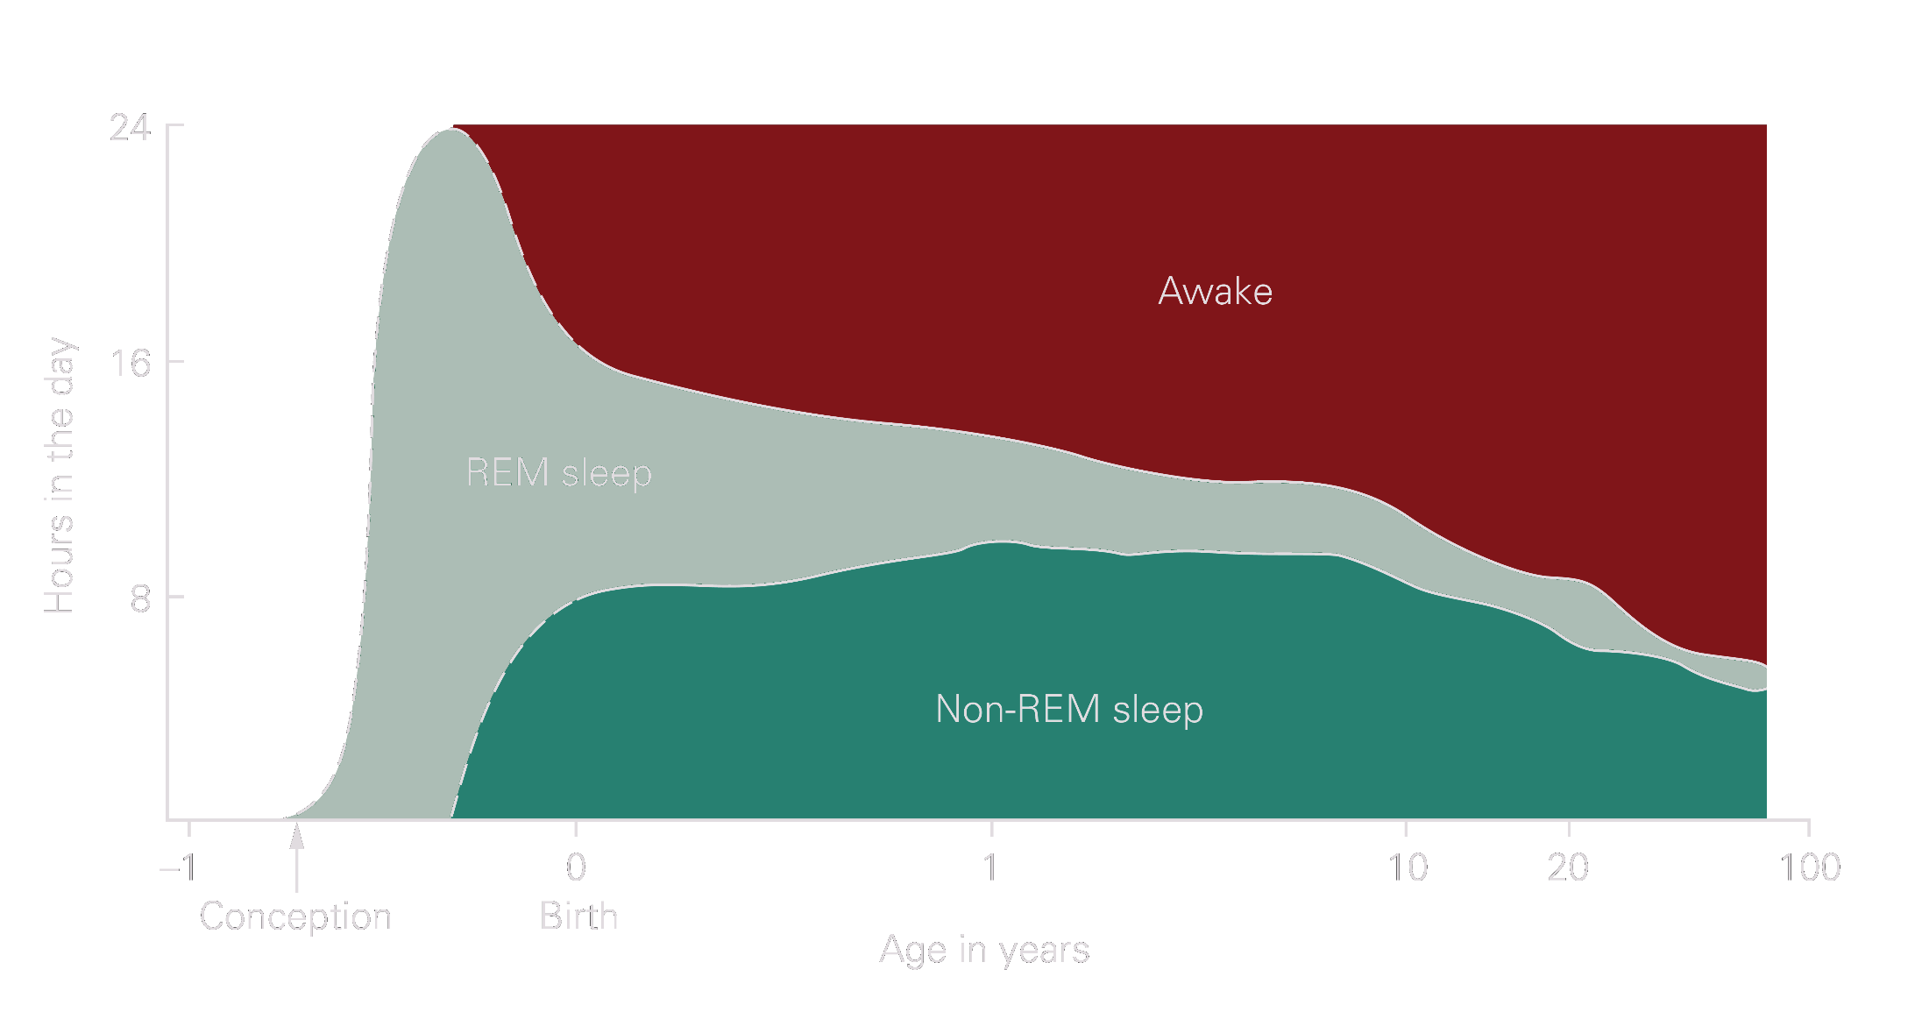
Children have more total sleep time (8–10 h) compared to most adults (about 6 h).

Slide 35
RAPID EYE MOVEMENT (rem) SLEEP

Slide 36
REM SLEEP HAS SEVERAL IMPORTANT CHARACTERISTICS:
IT IS AN ACTIVE FORM OF SLEEP USUALLY ASSOCIATED WITH DREAMING AND ACTIVE BODILY MUSCLE MOVEMENTS.
THE PERSON IS EVEN MORE DIFFICULT TO AROUSE BY SENSORY STIMULI THAN DURING DEEP SLOW-WAVE SLEEP, AND YET PEOPLE USUALLY AWAKEN SPONTANEOUSLY IN THE MORNING DURING AN EPISODE OF REM SLEEP.
MUSCLE TONE THROUGHOUT THE BODY IS EXCEEDINGLY DEPRESSED, INDICATING STRONG INHIBITION OF THE SPINAL MUSCLE CONTROL AREAS.

Slide 37
REM SLEEP HAS SEVERAL IMPORTANT CHARACTERISTICS:
HEART RATE AND RESPIRATORY RATE USUALLY BECOME IRREGULAR, WHICH IS CHARACTERISTIC OF THE DREAM STATE.
DESPITE THE EXTREME INHIBITION OF THE PERIPH­ERAL MUSCLES, IRREGULAR MUSCLE MOVEMENTS DO OCCUR IN ADDITION TO THE RAPID MOVEMENTS OF THE EYES.
THE BRAIN IS HIGHLY ACTIVE IN REM SLEEP, AND OVERALL BRAIN METABOLISM MAY BE INCREASED AS MUCH AS 20 PERCENT.
THIS TYPE OF SLEEP IS NOT SO RESTFUL, AND IT IS OFTEN ASSOCIATED WITH VIVID DREAMING.

Slide 38
EEG AND MUSCLE ACTIVITY DURING VARIOUS STAGES OF THE SLEEP–WAKE CYCLE
REM SLEEP IS CHARACTERIZED BY EYE MOVEMENTS, LOSS OF MUSCLE TONE, AND A LOW-AMPLITUDE, HIGH-FREQUENCY ACTIVITY PATTERN.

Slide 39
STAGES OF SLEEP – RAPID EYE MOVEMENT
SIGNS
RAPID EYE MOVEMENT SLEEP (REM) ARE PERIODS CHARACTERIZED BY RAPID EYE MOVEMENTS DURING SLEEP.
ALSO KNOWN AS “PARADOXICAL SLEEP” BECAUSE IT IS DEEP SLEEP IN SOME WAYS, BUT LIGHT SLEEP IN OTHER WAYS.
POSTURAL MUSCLES OF THE BODY ARE MORE RELAXED THAN OTHER STAGES
BODY IS ESSENTIALLY PARALYZED DURING REM.
BREATHING, HEART RATE AND BRAIN WAVE ACTIVITY QUICKEN.
AFTER REM, RETURNS BACK TO STAGE 2
EOG, ELECTROOCULOGRAM REGISTERS EYE MOVEMENTS;
EMG, ELECTROMYOGRAM REGISTERING SKELETAL MUSCLE ACTIVITY.

Slide 40
AN ELECTROENCEPHALOGRAM (EEG) SHOWS A PATTERN OF BRAIN WAVES SIMILAR TO THOSE THAT OCCUR DURING WAKEFULNESS.
THIS TYPE OF SLEEP IS ALSO CALLED PARADOXICAL SLEEP BECAUSE IT IS A PARADOX THAT A PERSON CAN STILL BE ASLEEP DESPITE THE PRESENCE OF MARKED ACTIVITY IN THE BRAIN

Slide 41
ALTHOUGH REM IS STRONGLY ASSOCIATED WITH DREAMING, DREAMING ALSO OCCURS IN OTHER STAGES OF SLEEP.
DURING REM SLEEP:
ACTIVITY INCREASES IN THE PONS (TRIGGERS THE ONSET OF REM SLEEP), LIMBIC SYSTEM, PARIETAL CORTEX AND TEMPORAL CORTEX.
ACTIVITY DECREASES IN THE PRIMARY VISUAL CORTEX, THE MOTOR CORTEX, AND THE DORSOLATERAL PREFRONTAL CORTEX.

Slide 42
CELLS IN THE PONS SEND MESSAGES TO THE SPINAL CORD WHICH INHIBIT MOTOR NEURONS THAT CONTROL THE BODY’S LARGE MUSCLES.
PREVENTS MOTOR MOVEMENT DURING REM SLEEP.

Slide 43
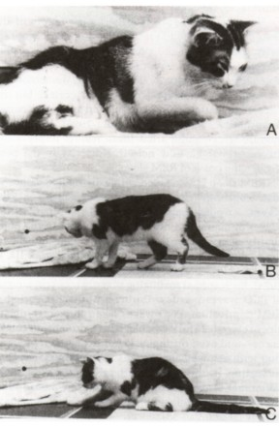
REM AND DREAMING
RESEARCH IS INCONCLUSIVE REGARDING THE EXACT FUNCTIONS OF REM.
DURING REM:
THE BRAIN MAY DISCARD USELESS CONNECTIONS
LEARNED MOTOR SKILLS MAY BE CONSOLIDATED.
SINCE THE BRAIN IS GETTING LITTLE INFORMATION FROM THE SENSE ORGANS, IMAGES ARE GENERATED WITHOUT CONSTRAINTS OR INTERFERENCE.
AROUSAL CAN NOT LEAD TO ACTION AS THE PRIMARY MOTOR CORTEX AND THE MOTOR NEURONS OF THE SPINAL CORD ARE SUPPRESSED.
ACTIVITY IN THE PREFRONTAL CORTEX IS SUPPRESSED WHICH IMPAIRS WORKING MEMORY DURING DREAMING.

Slide 44
YOU DON’T HAVE TO REVISE THIS AS A PART OF THIS LECTURE – HOWEVER THIS INFORMATION is interesting AND USEFUL
“FURTHER INFORMATION” MEANS

Slide 45
TYPES OF DREAM | FURTHER INFORMATION
DREAMS OCCUR SEVERAL TIMES A NIGHT
TRUE DREAM - VIVID, DETAILED DREAMS CONSISTING OF SENSORY AND MOTOR SENSATIONS EXPERIENCED DURING REM
SLEEP THOUGHT - LACKS VIVID SENSORY AND MOTOR SENSATIONS, IS MORE SIMILAR TO DAYTIME THINKING, AND OCCURS DURING SLOW-WAVE SLEEP
Notes:
Keywords: true dream, sleep thought

Slide 46
THE NEUROSCIENCE OF DREAMS | FURTHER INFORMATION
ACTIVITY IS HIGH IN THE INFERIOR PART OF THE PARIETAL CORTEX, AN AREA IMPORTANT FOR VISUAL-SPATIAL PERCEPTION.
ACTIVITY IS HIGH IN THE HYPOTHALAMUS AND AMYGDALA WHICH ACCOUNTS FOR THE EMOTIONAL AND MOTIVATIONAL CONTENT OF DREAMS.
EITHER INTERNAL OR EXTERNAL STIMULATION ACTIVATES PARTS OF THE PARIETAL, OCCIPITAL, AND TEMPORAL CORTEX.
LACK OF SENSORY INPUT FROM THE PRIMARY VISUAL CORTEX AND NO INHIBITION FROM THE PREFRONTAL CORTEX CREATES THE HALLUCINATORY PERCEPTIONS.

Slide 47
WHY DREAM? | FURTHER INFORMATION
WHAT ARE TRUE DREAMS FOR?
ALTHOUGH RESEARCH HAS YET TO ANSWER THIS QUESTION, “A PREVALENT VIEW IS THAT DREAMS DON’T SERVE ANY PURPOSE AT ALL, BUT ARE SIDE EFFECTS OF REM” – IS THIS TRUE?
TO EXERCISE GROUPS OF NEURONS DURING SLEEP
SOME ARE IN PERCEPTUAL AND MOTOR AREAS
REM OCCURS IN OTHER MAMMALS AND TO A MUCH GREATER EXTENT IN FETUSES AND INFANTS THAN ADULTS
REM SLEEP MAY HELP CONSOLIDATE MEMORIES
Notes:
Keywords: side effect view of dreaming

Slide 48
THE REALITY OF DREAMS AND THEIR USE | FURTHER INFORMATION
Bukhari :: Book 9 :: Volume 87 :: Hadith 124
Narrated Abu Qatada:
The Prophet said, "A good dream is from Allah, and a bad dream is from Satan. So whoever has seen (in a dream) something he dislike, then he should spit without saliva, thrice on his left and seek refuge with Allah from Satan, for it will not harm him, and Satan cannot appear in my shape."
Bukhari :: Book 9 :: Volume 87 :: Hadith 119
Narrated Abu Huraira:
I heard Allah's Apostle saying, "Nothing is left of the prophetism except Al-Mubashshirat." They asked, "What are Al-Mubashshirat?" He replied, "The true good dreams (that conveys glad tidings)."
Muslim :: Book 29 : Hadith 5621
Abu Huraira reported Allah's Messenger (may peace be upon him) as saying: When the time draws near (when the Resurrection is near) a believer's dream can hardly be false. And the truest vision will be of one who is himself the most truthful in speech, for the vision of a Muslim is the forty-fifth part of Prophecy, and dreams are of three types: one good dream which is a sort of good tidings from Allah; the evil dream which causes pain is from the Satan; and the third one is a suggestion of one's own mind; so if any one of you sees a dream which he does not like he should stand tip and offer prayer and he should not relate it to people.

Slide 49
SLOW-WAVE SLEEP AND DREAMS
ALTHOUGH SLOW-WAVE SLEEP IS FREQUENTLY CALLED “DREAMLESS SLEEP,” DREAMS AND SOMETIMES EVEN NIGHTMARES DO OCCUR DURING SLOW-WAVE SLEEP.
THE DIFFERENCE BETWEEN THE DREAMS THAT OCCUR IN SLOW-WAVE SLEEP AND THOSE THAT OCCUR IN REM SLEEP IS THAT THOSE OF REM SLEEP ARE ASSOCIATED WITH MORE BODILY MUSCLE ACTIVITY.
ALSO, THE DREAMS OF SLOW-WAVE SLEEP ARE USUALLY NOT REMEMBERED BECAUSE CONSOLIDATION OF THE DREAMS IN MEMORY DOES NOT OCCUR.

Slide 50
EFFECTS OF SLEEP DEPRIVATION

Slide 51
INDIVIDUAL DIFFERENCES IN SLEEP DRIVE
SOME INDIVIDUALS NEED MORE AND SOME LESS THAN THE TYPICAL 8 HOURS PER NIGHT
NONSOMNIACS - SLEEP FAR LESS THAN MOST, BUT DO NOT FEEL TIRED DURING THE DAY
INSOMNIAC - HAS A NORMAL DESIRE FOR SLEEP, BUT IS UNABLE TO AND FEELS TIRED DURING THE DAY
Notes:
Keywords: nonsomniacs, insomniacs

Slide 52
INSOMNIA
INSOMNIA CAN MANIFEST AS
DIFFICULTY FALLING ASLEEP
DIFFICULTY STAYING ASLEEP THROUGH THE NIGHT
EARLY MORNING AWAKENING BEFORE SUFFICIENT SLEEP IS OBTAINED
INSOMNIA MAY RESULT FROM
PHYSICAL OR EMOTIONAL COMPLICATIONS
CONSUMPTION OF EXCESSIVE CAFFEINE
EXERCISING VIGOROUSLY BEFORE SLEEP
INSOMNIA, THE MOST COMMON FORM OF SLEEP DISRUPTION, CAN BE PROLONGED AND SEVERE OR TEMPORARY AND MILD, AS IN RESPONSE TO SHORT-TERM STRESS.
THE INCIDENCE OF INSOMNIA INCREASES WITH AGE AND IS MORE COMMON IN WOMEN.
INSOMNIA IS OFTEN ASSOCIATED WITH DEPRESSION WHERE EARLY MORNING AWAKENING IS COMMON

Slide 53
INSOMNIA - CAUSES
INSOMNIA IS A SLEEP DISORDER ASSOCIATED WITH INABILITY TO FALL ASLEEP OR STAY ASLEEP.
RESULTS IN INADEQUATE SLEEP.
CAUSED BY A NUMBER OF FACTORS INCLUDING NOISE, STRESS, PAIN MEDICATION.
CAN ALSO BE THE RESULT OF DISORDERS SUCH AS EPILEPSY, PARKINSON’S DISEASE, DEPRESSION, ANXIETY OR OTHER PSYCHIATRIC CONDITIONS.
DEPENDENCE ON SLEEPING PILLS AND SHIFTS IN THE CIRCADIAN RHYTHMS CAN ALSO RESULT IN INSOMNIA.

Slide 54
TREATMENT OF INSOMNIA | FURTHER INFORMATION
BENZODIAZEPINES, COMMONLY USED AS ANXIOLYTICS ARE ALSO COMMONLY USED FOR SHORT-TERM TREATMENT OF INSOMNIA.
BENZODIAZEPINES FACILITATE THE OPENING OF GABA_{A} (γ-AMINOBUTYRIC ACID TYPE A) RECEPTOR-CHANNELS
THESE DRUGS FACILITATE SLEEP, THEY ALSO SUPPRESS STAGE 4 SLEEP.
CHRONIC USE MAY BE HABIT-FORMING AND LEAD TO A LIGHTENING AND FRAGMENTATION OF SLEEP
ANTIHISTAMINES (H1 HISTAMINE RECEPTOR ANTAGONISTS) ARE USED AS OVER-THE-COUNTER SLEEP AIDS
ANTIHISTAMINES ARE SEDATIVE IN SOME INDIVIDUALS BECAUSE THEY ANTAGONIZE THE ACTIVATION OF H1 RECEPTORS, WHICH NORMALLY EXCITE THALAMIC AND OTHER CENTRAL NEURONS

Slide 55
EFFECTS OF INSOMNIA ON BEHAVIOUR | FURTHER INFORMATION
HAS LITTLE EFFECT ON PERFORMANCE OF TASKS REQUIRING PHYSICAL SKILL OR INTELLECTUAL JUDGMENT
HURTS PERFORMANCE ON SIMPLE, BORING TASKS MORE THAN CHALLENGING ONES
MOST RELIABLE EFFECT IS SLEEPINESS ITSELF

Slide 56
SLEEP DEPRIVATION | FURTHER INFORMATION
MODERATE SLEEP DEPRIVATION RESULTS IN
IMPAIRED CONCENTRATION,
IRRITABILITY,
HALLUCINATIONS,
TREMORS,
DYSPHORIC MOOD,
INHIBITED RESPONSE OF THE IMMUNE SYSTEM.

Slide 57
SLEEP DEPRIVATION | FURTHER INFORMATION
THE AMOUNT OF SLEEP REQUIRED BY INDIVIDUALS IS VARIED.
MOST SLEEP ABOUT 8 HOURS.
PROLONGED SLEEP DEPRIVATION IN LABORATORY ANIMALS RESULTS IN:
INCREASED METABOLIC RATE, APPETITE AND BODY TEMPERATURE
IMMUNE SYSTEM FAILURE AND DECREASE IN BRAIN ACTIVITY

Slide 58
INTERNAL MECHANISMS CONTROLLING SLEEP
(7) DESCRIBE THE CURRENT THEORIES ABOUT THE NEURAL BASIS OF SLEEP

Slide 59
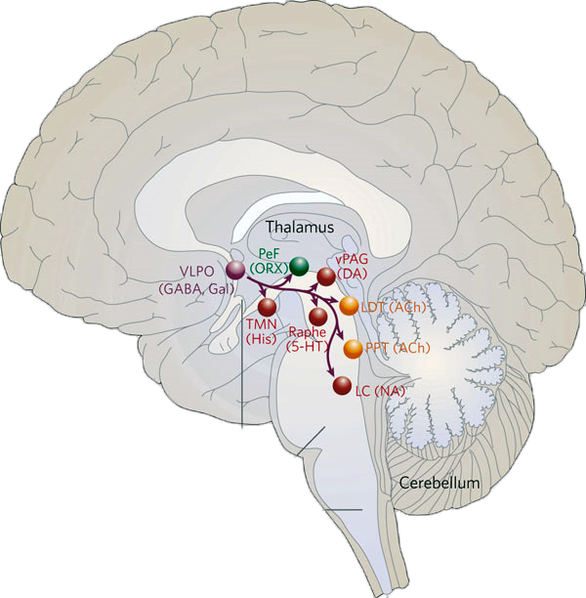
THE NEURAL BASIS OF SLEEP
BRAIN REGIONS INVOLVED
NEUROTRANSMITTERS INVOLVED
SUPRACHIASMATIC NUCLEUS
PINEAL GLAND
VENTROLATERAL PREOPTIC NUCLEUS
THE RAPHE NUCLEI
TUBEROMAMMILLARY NUCLEUS
MELATONIN
SEROTONIN
ADENOSINE
HISTAMINE
OREXIN
MURAMYL

Slide 60
SLEEP AND THE CIRCADIAN RHYTHM
HOW DO SLEEP AND OTHER CIRCADIAN RHYTHMS BECOME SYNCHRONIZED TO THE DAY-NIGHT CYCLE?
A SMALL NUMBER OF RETINAL GANGLION CELLS RESPOND DIRECTLY TO LIGHT
THESE PROJECT TO THE SUPRACHIASMATIC NUCLEUS IN THE HYPOTHALAMUS

Slide 61
THE SUPRACHIASMATIC NUCLEUS
THE SUPRACHIASMATIC NUCLEUS (SCN) IS PART OF THE HYPOTHALAMUS AND THE MAIN CONTROL CENTRE OF THE CIRCADIAN RHYTHMS OF SLEEP AND TEMPERATURE.
IT CONTAINS A BIOLOGICAL CLOCK RESPONSIBLE FOR ORGANIZING MANY OF THE BODY’S CIRCADIAN RHYTHMS
DAMAGE TO THE SCN RESULTS IN LESS CONSISTENT BODY RHYTHMS THAT ARE NO LONGER SYNCHRONIZED TO ENVIRONMENTAL PATTERNS OF LIGHT AND DARK.
Notes:
THE SUPRACHIASMATIC NUCLEUS (SCN) IS PART OF THE HYPOTHALAMUS AND THE MAIN CONTROL CENTRE OF THE CIRCADIAN RHYTHMS OF SLEEP AND TEMPERATURE.
IT CONTAINS A BIOLOGICAL CLOCK RESPONSIBLE FOR ORGANIZING MANY OF THE BODY’S CIRCADIAN RHYTHMS
DAMAGE TO THE SCN RESULTS IN LESS CONSISTENT BODY RHYTHMS THAT ARE NO LONGER SYNCHRONIZED TO ENVIRONMENTAL PATTERNS OF LIGHT AND DARK.

Slide 62
THE RETINOHYPOTHALAMIC PATHWAY
LIGHT RESETS THE SCN VIA A SMALL BRANCH OF THE OPTIC NERVE KNOWN AS THE RETINOHYPOTHALAMIC PATHWAY
TRAVELS DIRECTLY FROM THE RETINA TO THE SCN.
THE RETINOHYPOTHALAMIC PATH COMES FROM A SPECIAL POPULATION OF GANGLION CELLS THAT HAVE THEIR OWN PHOTOPIGMENT CALLED MELANOPSIN
MELANOPSIN IS A PHOTOPIGMENT PRESENT IN GANGLION CELLS IN THE RETINA WHOSE AXONS TRANSMIT INFORMATION TO THE SCN
THE CELLS RESPOND DIRECTLY TO LIGHT AND DO NOT REQUIRE ANY INPUT FROM THE RODS OR CONES
Notes:
LIGHT RESETS THE SCN VIA A SMALL BRANCH OF THE OPTIC NERVE KNOWN AS THE RETINOHYPOTHALAMIC PATHWAY
TRAVELS DIRECTLY FROM THE RETINA TO THE SCN.
THE RETINOHYPOTHALAMIC PATH COMES FROM A SPECIAL POPULATION OF GANGLION CELLS THAT HAVE THEIR OWN PHOTOPIGMENT CALLED MELANOPSIN
MELANOPSIN IS A PHOTOPIGMENT PRESENT IN GANGLION CELLS IN THE RETINA WHOSE AXONS TRANSMIT INFORMATION TO THE SCN
THE CELLS RESPOND DIRECTLY TO LIGHT AND DO NOT REQUIRE ANY INPUT FROM THE RODS OR CONES

Slide 63
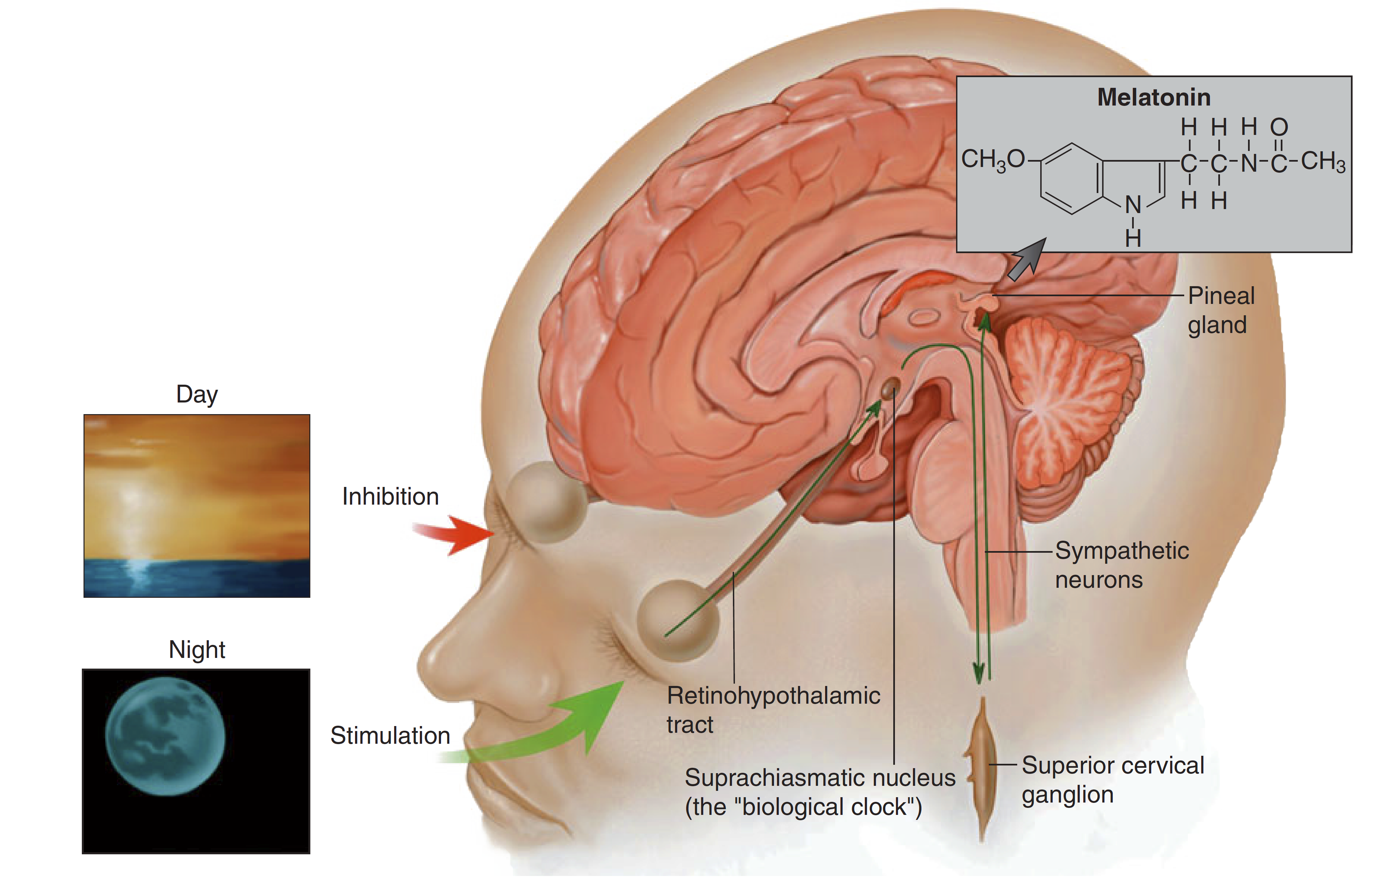
SUPRACHIASMATIC NUCLEUS AND THE PINEAL GLAND
THE SCN REGULATES WAKING AND SLEEPING BY CONTROLLING ACTIVITY LEVELS IN OTHER AREAS OF THE BRAIN.
THE SCN REGULATES THE PINEAL GLAND, AN ENDOCRINE GLAND LOCATED POSTERIOR TO THE THALAMUS.
THE PINEAL GLAND SECRETES MELATONIN, A HORMONE THAT INCREASES SLEEPINESS.

Slide 64
SUPRACHIASMATIC NUCLEUS AND THE PINEAL GLAND
THE LIGHT-DARK CYCLE IS THE MAIN TIME CUE OF THE REGULATING SYSTEM OF MELATONIN SECRETION.
PHOTIC (LIGHT) INFORMATION IS TRANSMITTED TO THE SCN VIA RETINOHYPOTHALAMIC FIBRES.
THE SUBSEQUENT SIGNAL FROM THE SCN TRAVELS ONWARDS THROUGH THE CERVICAL SYMPATHETIC GANGLIA AND ULTIMATELY INFLUENCES MELATONIN PRODUCTION IN THE PINEAL GLAND
DURING THE DAY, THE PRESENCE OF LIGHT INHIBITS MELATONIN SECRETION BY THE PINEAL GLAND

Slide 65
THE VENTROLATERAL PREOPTIC NUCLEUS (VLPO)
THE VLPO IS A SMALL CLUSTER OF NEURONS SITUATED IN THE ANTERIOR HYPOTHALAMUS
THE VLPO, PROJECTS TO MANY OF THE BRAIN REGIONS ASSOCIATED WITH AROUSAL
THE VLPO IS PRIMARILY ACTIVE DURING NON-RAPID EYE MOVEMENT SLEEP
IN THESE PROJECTIONS THE VLPO UTILISES NEUROTRANSMITTERS ALSO ASSOCIATED WITH SLEEP

Slide 66
THE VENTROLATERAL PREOPTIC AREA AND SLEEP
VENTROLATERAL PREOPTIC AREA NEURONS
RELEASE THE INHIBITORY NEUROTRANSMITTERS GALANIN AND GABA
THESE INHIBIT THE MONOAMINERGIC CELL GROUPS IN AREAS RESPONSIBLE FOR AROUSAL
LOCUS COERULEUS
THE RAPHE NUCLEUS
TUBEROMAMMILLARY NUCLEUS

Slide 67
SOMNOGENS AND THE VENTROLATERAL PREOPTIC AREA
VLPO IS ACTIVATED BY SOMNOGENS WHICH ACCUMULATE DURING WAKING
SEROTONIN
ADENOSINE
PROSTAGLANDIN D2
THESE ACCUMULATE IN THE BODY THROUGHOUT THE DAY AND INDUCE SLEEP
VLPO IS INHIBITED BY AROUSAL TRANSMITTERS
NORADRENALINE
ACETYLCHOLINE.

Slide 68
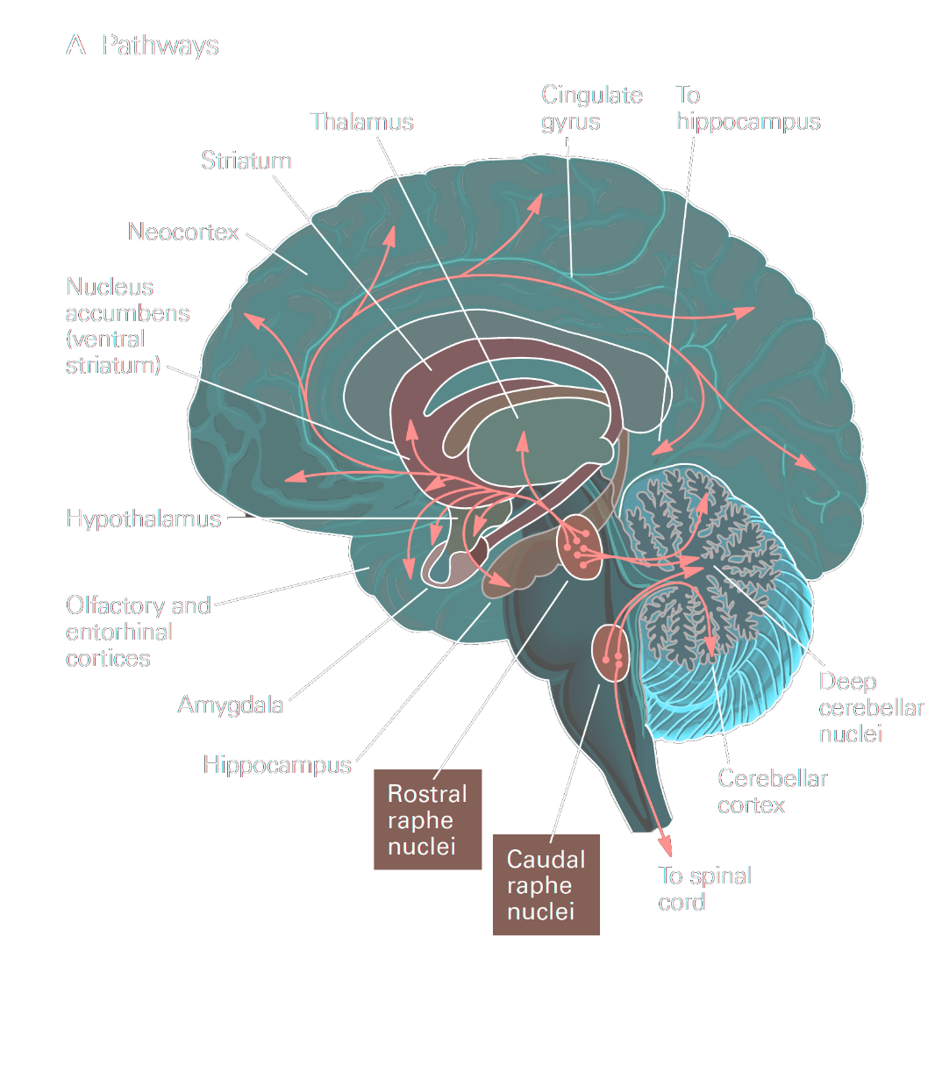
THE RAPHE NUCLEI
DISCRETE LESIONS IN THE RAPHE NUCLEI LEAD TO A HIGH STATE OF WAKEFULNESS.
NERVE FIBRES FROM THESE NUCLEI SPREAD LOCALLY IN THE BRAIN STEM RETICULAR FORMATION
IN ADDITION, FIBRES EXTEND DOWNWARD INTO THE SPINAL CORD, TERMINATING IN THE POSTERIOR HORNS, WHERE THEY CAN INHIBIT INCOMING SENSORY SIGNALS, INCLUDING PAIN
NERVE FIBRES FROM THESE NUCLEI SPREAD UPWARD INTO THE THALAMUS, HYPOTHALAMUS, MOST AREAS OF THE LIMBIC SYSTEM, AND EVEN THE NEOCORTEX OF THE CEREBRUM.

Slide 69
THE RAPHE NUCLEUS
RAPHE NUCLEUS:
A GROUP OF NUCLEI LOCATED IN THE RETICULAR FORMATION OF THE MEDULLA, PONS, AND MIDBRAIN, SITUATED ALONG THE MIDLINE; CONTAIN SEROTONERGIC NEURONS.
SEROTONIN (5-HT)
APPEARS TO PLAY A ROLE IN ACTIVATING BEHAVIOR;
ALMOST ALL OF THE BRAIN’S SEROTONERGIC NEURONS ARE FOUND IN THE RAPHE NUCLEUS

Slide 70
MELATONIN
SECRETED FROM THE PINEAL GLAND
INCREASED LEVELS OF MELATONIN PRODUCE SOMNOLENCE (SLEEPINESS)
MELATONIN SECRETION USUALLY BEGINS 2 TO 3 HOURS BEFORE BEDTIME.
MELATONIN FEEDS BACK TO RESET THE BIOLOGICAL CLOCK THROUGH ITS EFFECTS ON RECEPTORS IN THE SCN.
EXOGENOUS MELATONIN TAKEN IN THE AFTERNOON CAN PHASE-ADVANCE THE INTERNAL CLOCK AND CAN BE USED AS A SLEEP AID.

Slide 71
ADENOSINE
INHIBITORY NEUROMODULATOR
INCREASES DURING PROLONGED PERIODS OF WAKEFULNESS, DECREASES AFTER SLEEP
INHIBITED BY CAFFEINE
INHIBITS ACH NEURONS IN FOREBRAIN
RELEASES INHIBITION (DISINHIBITION) OF HISTAMINE NEURONS IN TUBEROMAMMILARY NUCLEUS, THUS PROMOTES SLEEP.

Slide 72
SUBSTANCES THAT CAN CAUSE SLEEP—A POSSIBLE SPECIFIC ROLE FOR SEROTONIN
MANY NERVE ENDINGS OF FIBRES FROM THE RAPHE NEURONS SECRETE SEROTONIN.
WHEN A DRUG THAT BLOCKS THE FORMATION OF SEROTONIN IS ADMINISTERED TO AN ANIMAL, THE ANIMAL OFTEN CANNOT SLEEP FOR THE NEXT SEVERAL DAYS.
THEREFORE, IT HAS BEEN ASSUMED THAT SEROTONIN IS A TRANSMITTER SUBSTANCE ASSOCIATED WITH THE PRODUCTION OF SLEEP.

Slide 73
POSSIBLE TRANSMITTER SUBSTANCES RELATED TO SLEEP - MURAMYL PEPTIDE
MURAMYL PEPTIDE
WHEN ONLY MICROGRAMS OF THIS SLEEP-PRODUCING SUBSTANCE ARE INJECTED INTO THE THIRD VENTRICLE
A LOW-MOLECULAR-WEIGHT SUBSTANCE THAT ACCUMULATES IN THE CEREBROSPINAL FLUID AND URINE IN ANIMALS KEPT AWAKE FOR SEVERAL DAYS.
ALMOST NATURAL SLEEP OCCURS WITHIN A FEW MINUTES,
THE ANIMAL MAY STAY ASLEEP FOR SEVERAL HOURS.

Slide 74
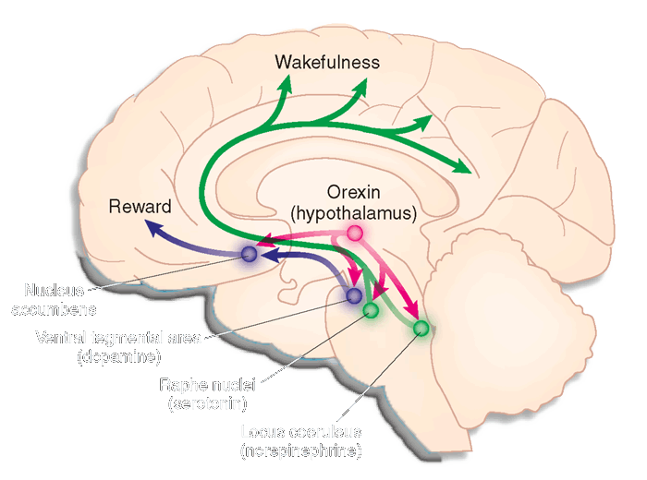
OREXIN AND THE HYPOTHALAMUS
OREXIN IS A PEPTIDE NEUROTRANSMITTER RELEASED IN A PATHWAY FROM THE LATERAL NUCLEUS OF THE HYPOTHALAMUS HIGHLY RESPONSIBLE FOR THE ABILITY TO STAY AWAKE.
STIMULATES ACETYLCHOLINE-RELEASING CELLS IN THE FOREBRAIN AND BRAIN STEM TO INCREASE WAKEFULNESS AND AROUSAL.

Slide 75
OREXIN NEURONS ARE IMPORTANT IN AROUSAL AND WAKE­FULNESS
OREXIN (ALSO CALLED HYPOCRETIN) IS PRODUCED BY NEURONS IN THE HYPOTHALAMUS THAT PROVIDE EXCITATORY INPUT TO MANY OTHER AREAS OF THE BRAIN WHERE THERE ARE OREXIN RECEPTORS.
OREXIN NEURONS ARE MOST ACTIVE DURING WAKING AND ALMOST STOP FIRING DURING SLOW WAVE AND REM SLEEP.
OREXIN PRODUCTION IS PROBABLY INHIBITED BY THE VLPO (VENTROLATERAL PREOPTIC NUCLEUS) NEURONS WHICH SEND GABAERGIC INHIBITORY PROJECTIONS TO OREXIN NEURONS.

Slide 76
OREXIN NEURONS ARE IMPORTANT IN AROUSAL AND WAKE­FULNESS
LOSS OF OREXIN SIGNALLING AS A RESULT OF DEFECTIVE OREXIN RECEPTORS OR DESTRUCTION OF OREXIN-PRODUCING NEURONS CAUSES NARCOLEPSY
NARCOLEPSY IS A SLEEP DISORDER CHARACTERIZED BY OVERWHELMING DAYTIME DROWSINESS AND SUDDEN ATTACKS OF SLEEP THAT CAN OCCUR EVEN WHEN A PERSON IS TALKING OR WORKING.

Slide 77
HISTAMINE AND THE HYPOTHALAMUS
THE HYPOTHALAMUS CONTAINS NEURONS THAT RELEASE “HISTAMINE” TO PRODUCE WIDESPREAD EXCITATORY EFFECTS THROUGHOUT THE BRAIN.
ANTI-HISTAMINES PRODUCE SLEEPINESS.
TUBEROMAMMILLARY NUCLEUS:
A NUCLEUS IN THE VENTRAL POSTERIOR HYPOTHALAMUS
CONTAINS HISTAMINERGIC NEURONS INVOLVED IN CORTICAL ACTIVATION AND BEHAVIORAL AROUSAL.

Slide 78
BIBLIOGRAPHY

