Slide 1
Applied Nerve & Muscle Physiology 31.8.2015 Nerve Conduction Study ( NCS) )and Electromyography ( EMG)
Dr Taha Sadig Ahmed
Physiology Department , College of Medicine , King Saud University

Slide 2
Objectives
Define what is nerve conduction study (NCS) and electromyography ( emg) .
Explain the procedure of NCS using Abductor Pollicicis Brevis muscle .
Define the normal conduction velocity in upper limb and lower limb nerves .
Define the motor unit potentials ( MUPs) and how they are changed in muscles .

Slide 3
In the patients of muscular weakness, muscle atrophy, traumatic or metabolic neuropathy, these tests are considered as an extension of the physical examination rather than a simple laboratory procedure.

Slide 4
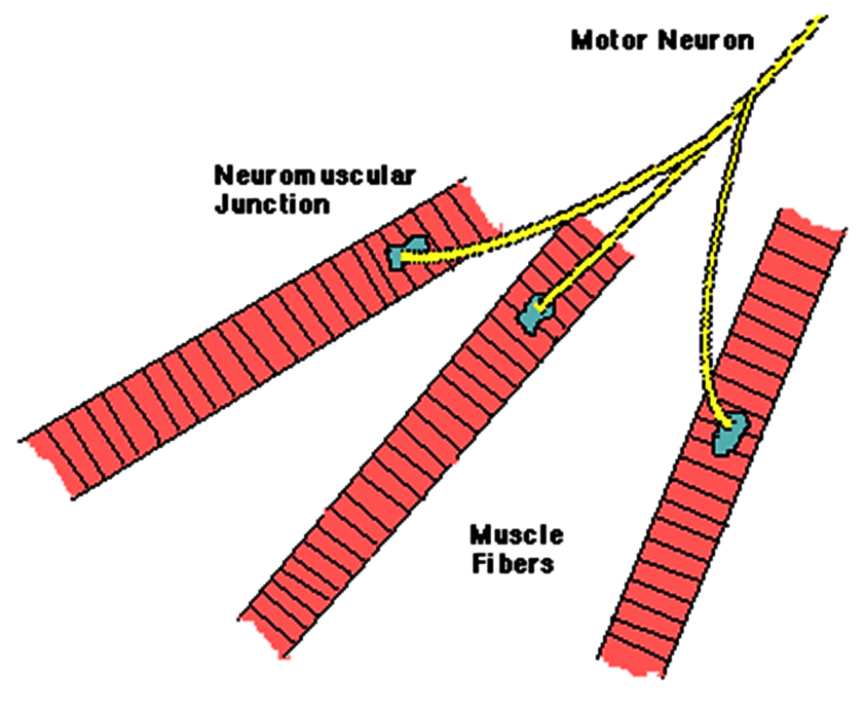
A motor unit is defined as one motor neuron and all of the muscle fibers it innervates.
Notes:
A motor unit is defined as one motor neuron and all of the muscle fibers it innervates. When a motor unit fires, the impulse (called an action potential) is carried down the motor neuron to the muscle. The area where the nerve contacts the muscle is called the neuromuscular junction, or the motor end plate. After the action potential is transmitted across the neuromuscular junction, an action potential is elicited in all of the innervated muscle fibres of that particular motor unit. The sum of all this electrical activity is known as a motor unit action potential (MUAP). This electrophysiologic activity from multiple motor units is typically evaluated during an EMG. The composition of the motor unit, the number of muscle fibres per motor unit, the metabolic type of muscle fibres and many other factors affect the shape of the motor unit potentials in the myogram.

Slide 5
Motor nerve conduction velocity
Motor nerve conduction velocity of peripheral nerves may be closely correlated to their functional integrity or to their structural abnormalities.
Based on the nature of conduction abnormalities two principal types of peripheral nerve lesions can be identified: Axonal Degeneration and Segmental Demyelination.

Slide 6
OBJECTIVES
At the end of the session the students should be able to:
Acquire a skill to perform the test by themselves.
Analyze the motor unit potentials and states their uses in health and diseases.
Determine and calculate motor conduction velocities of the peripheral nerves.

Slide 7
Requirements
Machine.
Electrodes.
Electrode jelly
Adhesive tape
Saline & antiseptic (70 % alcohol)

Slide 8
Instrument set up
EMG
Sweep time 10msec / cm
Amplitude 1µV / cm
Audioamplifier on

Slide 9
Instrument set up
Nerve conduction velocity
Sweep time 2msec / cm
Amplitude 1µV / cm
Stimulator set up
Frequency 1 / sec.
Duration 0.2 msec.
Intensity gradually increasing (MAM)

Slide 10
Procedure EMG
Select a volunteer and explain him the procedure.
Put the ground electrode over the forearm after soaking with saline.
Clean the skin over the selected muscle.
Apply the surface electrodes with the electrode jelly and reference electrode over bony point at least 3 cm apart.

Slide 11
Cont…
Ask the subject to relax to evaluate any resting activity.
Ask the subject to exert mild voluntary effort then moderate effort while continue recording.
Change the sweep speed to 100msec/cm and then ask the subject to exert maximum effort to determine interference pattern. Put the sweep run (continuous).

Slide 12
Analysis
EMG
Spontaneous activity
The normal skeletal muscle is silent at rest, hence spontaneous activity is absent.

Slide 13
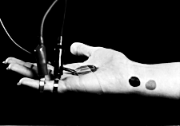
Types of nerve conduction studies
Sensory: typically antidromic
Typical nerves examined: Sural, ulnar, median, occasionally radial or superficial peroneal
Recording
Stimulation

Slide 14
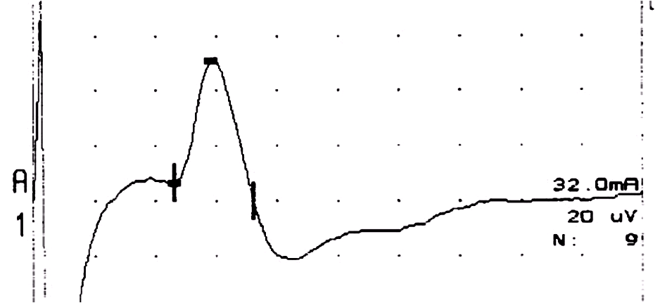
Normal Median Sensory Study
1 msec/div
Latency CV Amp
(msec) (m/s) (uV)
Wrist-D2 2.2 58 44.1

Slide 15
Sensory NCS Parameters
Onset and peak latencies
Conduction velocity
determined by velocity of a very few fast fibers
Amplitude
determined by the number of large sensory fibers activated

Slide 16
Motor NCS Parameters
Distal Latency
determined by conduction velocity of the nerve, neuromuscular junction & muscle
Amplitude
determined by number of muscle fibers activated
Proximal conduction velocity
determined by conduction velocity of the fastest fibers

Slide 17
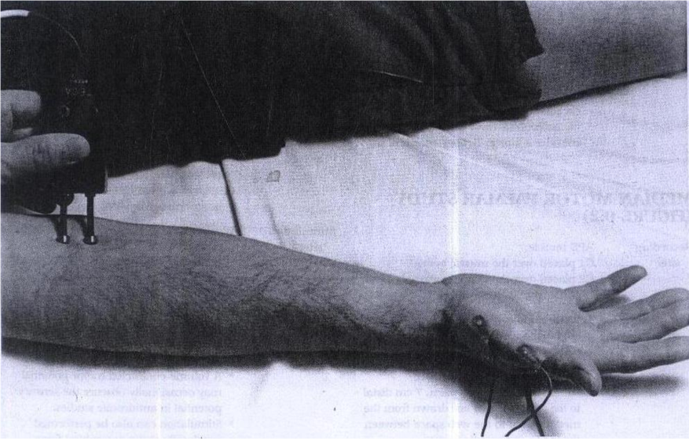
The stimulus duration is adjusted to 0.2 ms and stimulus frequency to 1 / sec.
Apply the stimulus and record the response from stimulation at the wrist .
Store the CMAP ( compound muscle action potential ) in the first channel of the oscilloscope .
Change the stimulating site from wrist to antecubital fossa ( elbow ) .
Stimulate the nerve & record the CMAP for median nerve stimulation at the elbow .

Slide 18
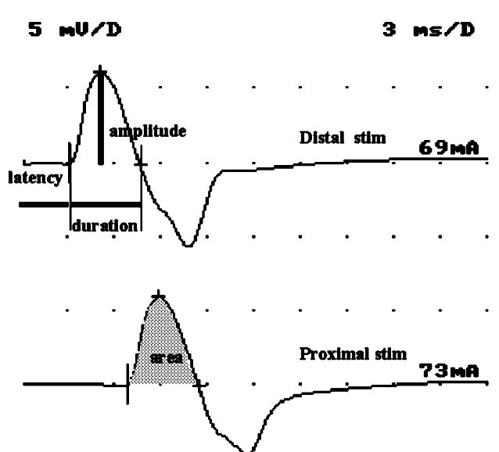
Motor Nerve Conductions
Vital part of EDX as
this important for
identifying
demyelination, and axonal
degeneration .
Need to do proximal
and distal stimulation
studies to evaluate for
conduction velocity,
conduction block,
temporal dispersion
Typical nerves: are
ulnar, median, peroneal, tibial.
Less common: radial, femoral, phrenic, spinal accessory, facial

Slide 19
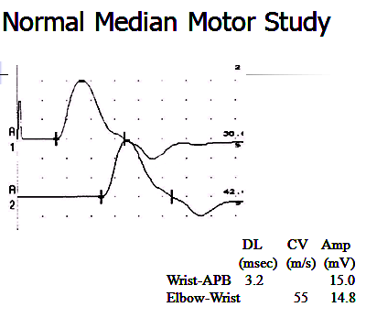

Slide 20
Nerve Conduction Study ( NCS)
(2) sensory nerve conduction study ( for SNAP , sensory nerve action potential ) or
(3) mixed nerve conduction study .
Because of the time constraints, in this lecture , only motor nerve conduction study will be discussed
In the motor test the recorded response is the muscle CMAP ( compound muscle action potential )

Slide 21
Nerve Conduction Study ( NCS)
Nerve conduction study (NCS) is an electrophysiology test test commonly used to evaluate the function of peripheral nerves .
It could be →
(1) motor conduction study ( stimulating a nerve and recording the response ( CMAP) of the muscle innervated by that nerve e.g.stimulating the median nerve and recording the CMAP from Abductor Pollicis Brevis muscle( APB ) .or stimulating the ulnar nerve and recording the response of Abducor Digiti Minimi muscle ( ADM) .

Slide 22
’Motor Nerve Conduction Velocity
An electrical stimulus is applied over the median nerve
and a recording electrode is place over APB muscle ( which is
one of the muscles supplied suppllied by the median nerve ).
The stimulus is applied at two sites → (1) a distal site
( wrist ) and a (2) proximal one ( antecubital fossa , elbow) .
The muscle usually chosen in this routine test in the upper
limb is the Abductor Pollicis Brevis
The active recording electrode (G1) is place over the
thenar eminence which overlies the muscle .
And the reference recording electrode (G2) about 3
cm away .
The oscilloscope ( CRO) sweep speed is adjusted to 2 ms /
cm.

Slide 23
The stimulus duration used is 0.2 ms and stimulus frequency to 1 / sec.
Apply the stimulus and record the response from stimulation at the wrist .
Store the CMAP ( compound muscle action potential ) in the first channel of the oscilloscope .
Change the stimulating site from wrist to antecubital fossa ( elbow ) .
Stimulate the nerve & record the CMAP for median nerve stimulation at the elbow .

Slide 24
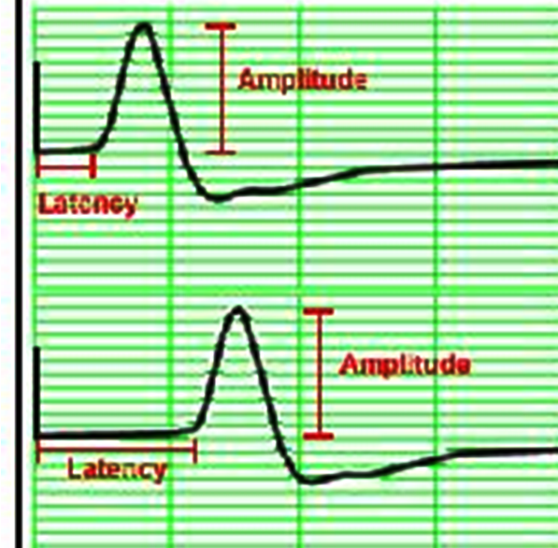
(1) Measure the latency ( time الفترة الزمنية ) of the first CMAP الأستجابة الأولي
( wrist) and 2nd CMAP (الأستجابة الثانية elbow)
(2) قس المسافة الفعلية بين مكاني التحفييز ( بين الكوع و الرسغ )
with a measuringtape.
(3) Enter the distance between the elbow and wrist in the machine
computer ادخل البيانات في الجهاز.

Slide 25
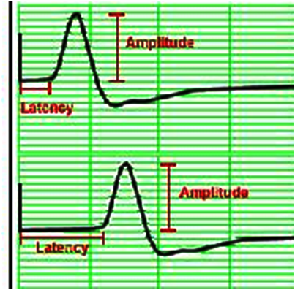
(1) Measure the latency ( time الفترة الزمنية ) of the first CMAP الأستجابة الأولي
( wrist) and 2nd CMAP (الأستجابة الثانية elbow)
(2) قس المسافة الفعلية بين مكاني التحفييز ( بين الكوع و الرسغ )
with a measuringtape.
(3) Enter the distance between the elbow and wrist in the machine
computer ادخل البيانات في الجهاز.

Slide 26
(1) Measure the latency ( time الفترة الزمنية ) of the first CMAP الأستجابة الأولي
( wrist) and 2nd CMAP (الأستجابة الثانية elbow)
(2) قس المسافة الفعلية بين مكاني التحفييز ( بين الكوع و الرسغ )
with a measuringtape.
(3) Enter the distance between the elbow and wrist in the machine
computer ادخل البيانات في الجهاز.

Slide 27
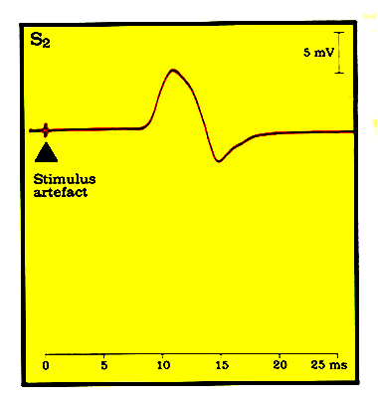
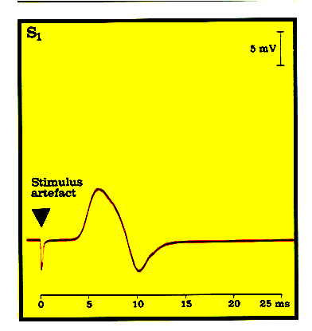
Latency differencee= 8.5-3.5 = 5.5 ms
Distance
d = 284 mm
]هDistance ( 284 mm ) divided by latency difference ( 5.5 ms) gives CV = 51 m/per second
L2 Latency At الزمن في الكوع elbow
= 8.5 ms
L1 Latency At الزمن في الرسغ wrist
= 3.5 ms

Slide 28
MNCV
MNCV will appear.
It can also be calculated by formula
MNCV (m/sec)=
L1 = latency at wrist
L2 = latency at elbow
8.5-3.5 =5.5
Distance (mm)
--------------------------
L2-L1 (ms)

Slide 29
Normal values for conduction velocity
In arm
50 – 70 m / sec.
In leg
40 – 60 m / sec.

Slide 30
The stimulus duration is adjusted to 0.2 ms and stimulus frequency to 1 / sec.
Apply the stimulus and record the response from stimulation at the wrist .
Store the CMAP ( compound muscle action potential ) in the first channel of the oscilloscope .
Change the stimulating site from wrist to antecubital fossa ( elbow ) .
Stimulate the nerve & record the CMAP for median nerve stimulation at the elbow .

Slide 31
Measure the distance from elbow to wrist with a measuring tape.
Measure the latency in first CMAP & in the next CAMP.
Enter the distance between the elbow and wrist .
284mm /5 ms = 56.8 m/s

Slide 32
MNCV
MNCV will appear.
It can also be calculated by formula
MNCV (m/sec)=
L1 = latency at wrist
L2 = latency at elbow
Distance (mm)
--------------------------
L2-L1 (ms)

Slide 33
Normal values for conduction velocity
In arm
50 – 70 m / sec.
In leg
40 – 60 m / sec.

Slide 34
Common Mononeuropathies
Median at the Wrist (CTS)
Ulnar at the Elbow
Peroneal Palsy at the Fibular Head

Slide 35
Case 1
63 year old woman
Numbness, tingling, pain of entire right hand X 4 months
Awakens her at night.
Drops objects from right hand
Works as sander in furniture factory.
Borderline diabetic
Examination: Decreased cold entire right hand, normal strength, positive Tinel’s right wrist, normal reflexes in the RUE

Slide 36
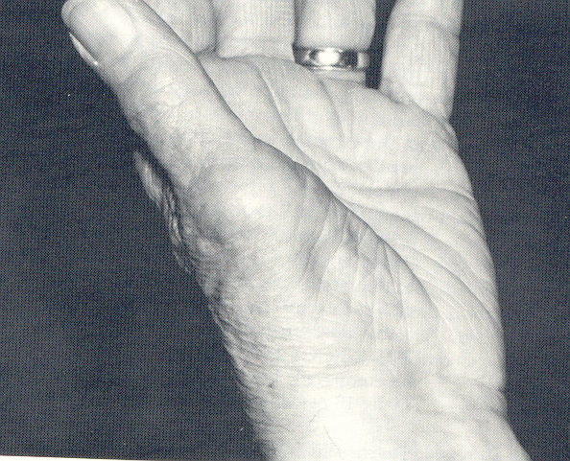
Carpal Tunnel Syndrome Atrophy of APB Muscle

Slide 37
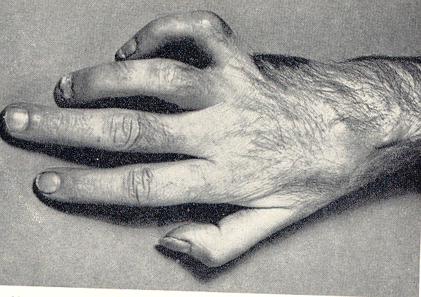
Ulnar Neuropathy Claw Hand

Slide 38
Guillain-Barre Syndrome Conduction Block

Slide 39
What to Expect From an EMG Report
A clinically and physiologically relevant interpretation/diagnosis
An outline of the localization, severity, and acuity of the process
Notation of other diagnoses that are detected/excluded
Explanation of any technical problems

Slide 40
Summary: Utility of EMG/NCS
Highly sensitive indicator of early nerve injury
Detects dynamic and functional injury missed by MRI
Provides information regarding chronicity of nerve injury
Provides prognostic data
Highly localizing
Clarifies clinical scenarios when one disorder mimics another
Identifies combined multi-site injury, avoiding missed diagnoses
Identifies more global neuromuscular injury with focal onset
Provides longitudinal data for charting course, response to therapy
** All dependent on a reliable laboratory with full repertoire of techniques

Slide 41
EMG “Pearls”
Electrodiagnostic studies are a supplement to, and not a replacement, for the history and physical examination
Electrodiagnostic results are often time-dependent
Electrodiagnostic studies are not “standardized” investigations and may be modified by the practitioner to answer the diagnostic question

Slide 42
Electromyography ( EMG)

Slide 43
Needle Electromyography: Techniques
Needle electrode is inserted into the muscle
Needle is disposable, single use
Multiple muscles are accessible for examination
Combination of muscles tested
Dependent upon clinical question
Level of discomfort is mild

Slide 44
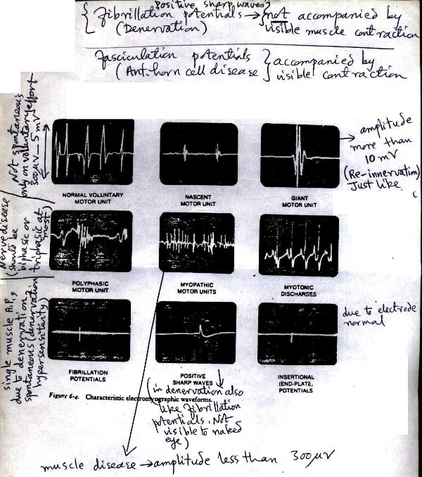

Slide 45
A motor unit is defined as one motor neuron and all of the muscle fibers it innervates.
Notes:
A motor unit is defined as one motor neuron and all of the muscle fibers it innervates. When a motor unit fires, the impulse (called an action potential) is carried down the motor neuron to the muscle. The area where the nerve contacts the muscle is called the neuromuscular junction, or the motor end plate. After the action potential is transmitted across the neuromuscular junction, an action potential is elicited in all of the innervated muscle fibres of that particular motor unit. The sum of all this electrical activity is known as a motor unit action potential (MUAP). This electrophysiologic activity from multiple motor units is typically evaluated during an EMG. The composition of the motor unit, the number of muscle fibres per motor unit, the metabolic type of muscle fibres and many other factors affect the shape of the motor unit potentials in the myogram.

Slide 46
Normal MUPs
Bi – Triphasic
Duration 3 – 15 mSec.
Amplitude 300μV – 5 mV

Slide 47
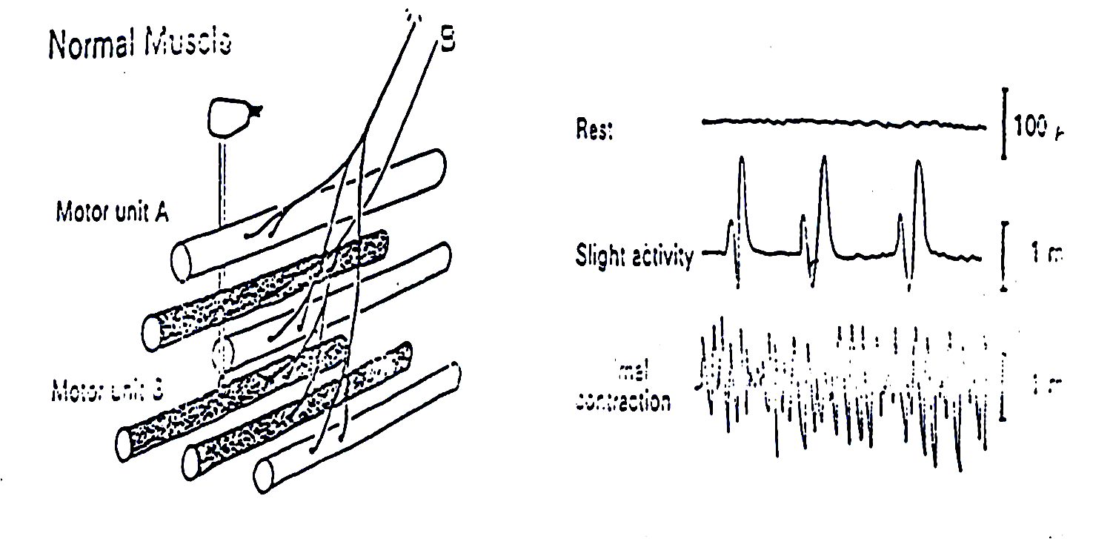
Normal MUPs

Slide 48
Abnormal MUPs
In neurogenic lesion ( nerve disease )
spontaneous activity نشاط تلقائي من غير أي محفز خارجي
are noted →
Types of spontaneous activity are →
(1) PSW ( positive Sharp Waves ) →A small potential of 50 to 100 µV, 5 to 10 msec duration with abrupt onset and slow outset.

Slide 49
Fibrillation Potential
these are randomly occurring small amplitude potentials or may appear in runs.
The audioamplifier gives sounds, as if somebody listen sounds of rains in a tin shade house.
These potentials are generated from the single denervated muscle fiber → they are due to denervation hypersensitivity to acetyl choline

Slide 50
Fasciculation potentials:
These are high voltage, polyphasic, long duration potentials appear spontaneously associated with visible contraction of the muscle.
They originate from a large motor unit which is formed due to reinnervation of another motor unit from the neighboring motor unit.

Slide 51
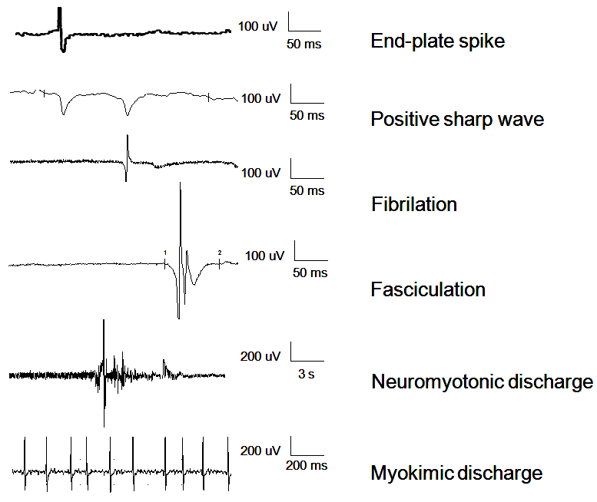
Types of Spontaneous Activity

Slide 52
Myopathic MUPs

Slide 54
Electromyography (EMG) is a technique for evaluating and recording physiologic properties of muscles at rest and while contracting.
It’s a recording of electrical activity of the muscle by inserting needle electrode in the belly of the muscles ( needle emg ) or by applying the surface electrodes ( surface emg )
The potentials recorded are derived from motor units of the muscle, hence known as motor unit potentials (MUPs).
Q: Define what is a “ motor unit ”?

Slide 55
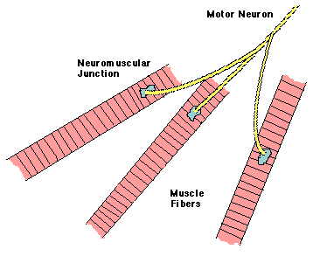
A motor unit is defined as one motor neuron and all of the muscle fibers it innervates.
Notes:
A motor unit is defined as one motor neuron and all of the muscle fibers it innervates. When a motor unit fires, the impulse (called an action potential) is carried down the motor neuron to the muscle. The area where the nerve contacts the muscle is called the neuromuscular junction, or the motor end plate. After the action potential is transmitted across the neuromuscular junction, an action potential is elicited in all of the innervated muscle fibres of that particular motor unit. The sum of all this electrical activity is known as a motor unit action potential (MUAP). This electrophysiologic activity from multiple motor units is typically evaluated during an EMG. The composition of the motor unit, the number of muscle fibres per motor unit, the metabolic type of muscle fibres and many other factors affect the shape of the motor unit potentials in the myogram.

Slide 56
Contraindications for Needle EMG
(1) Pregnant women,
(2) severe cardiac patients, and
(3) haemophilia & coagulopathy patients,
(4) lymphedema,
(5) soft tissue infections

Slide 57
Abnormal Spontaneous Activity

Slide 58
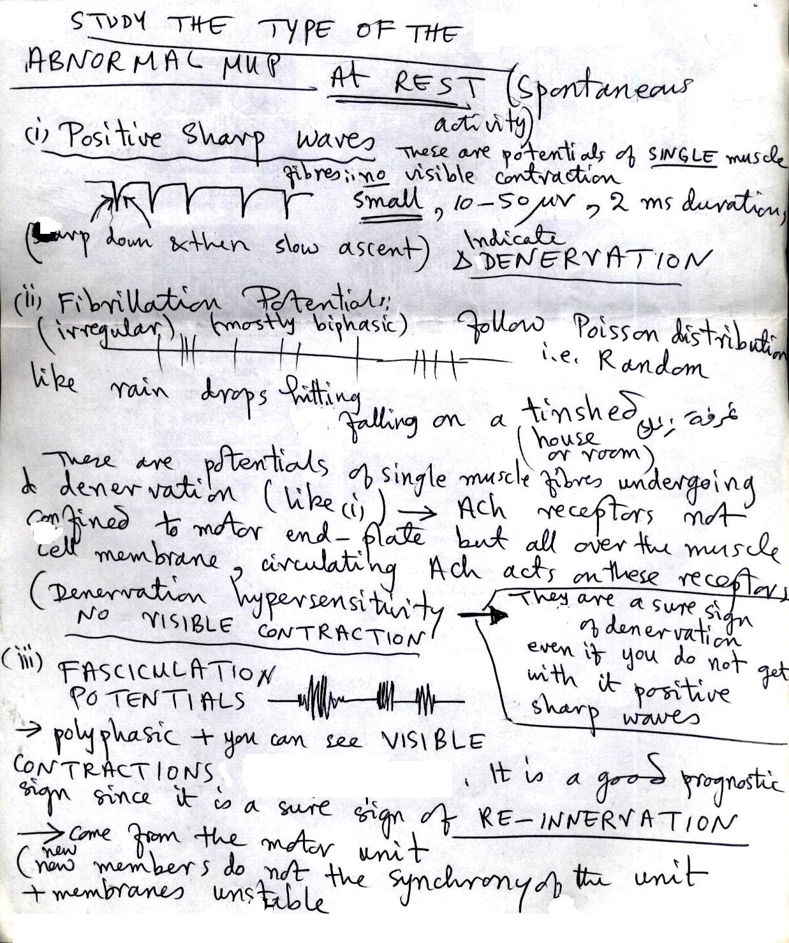
(4) While the pt is completely relaxed and the muscle at rest → look for abnormal spontaneous activity →
NB : a normal muscle should be silent at rest .
If there is spontaneous activity , determine its type →

Slide 59
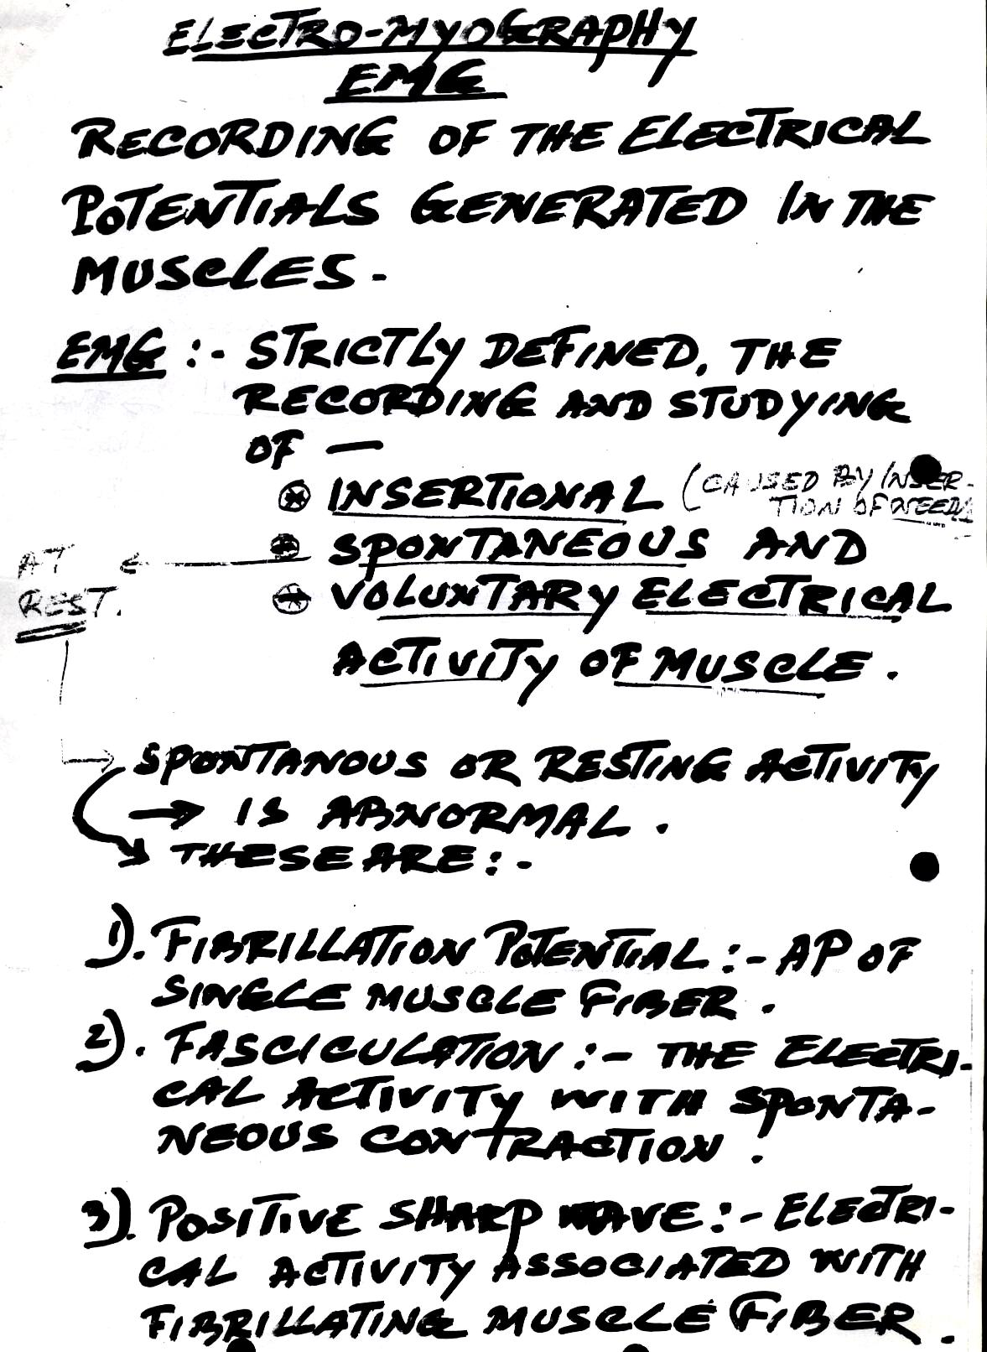

Slide 60
Abnormal Spon taneous Activity
Occur in neurogenic lesion or in active myositis, the following spontaneous activity is noted
Positive Sharp Waves (PSWs) :
A small potential of 50 to 100 µV, 5 to 10 ms duration with abrupt onset and slow outset
Fibrillation Potentials :
these are randomly occurring small amplitude potentials or may appear in runs. The audioamplifier gives sounds, as if somebody listen sounds of rains in a tin shade house. These potentials are generated from the single muscle fiber of a denervated muscle, possibly due to denervation hypersensitivity to acetyl choline.

Slide 61
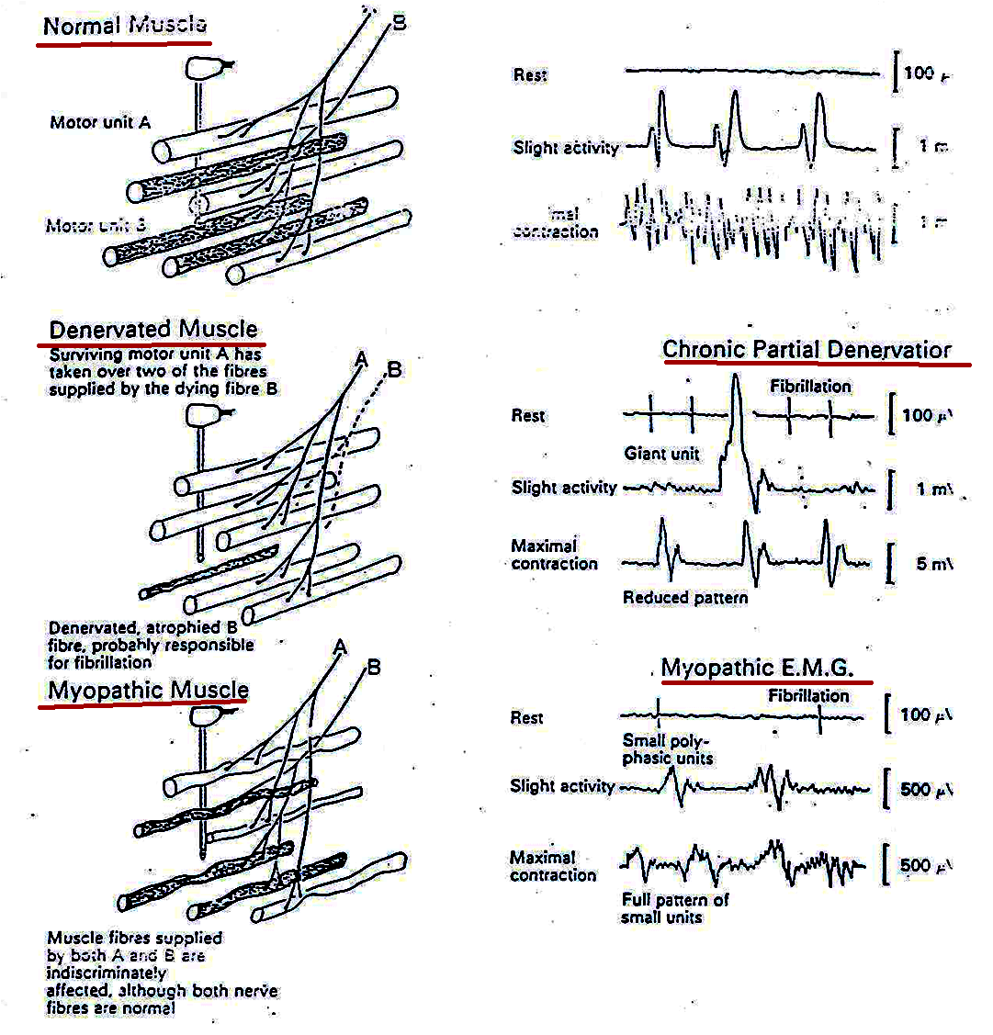

Slide 62
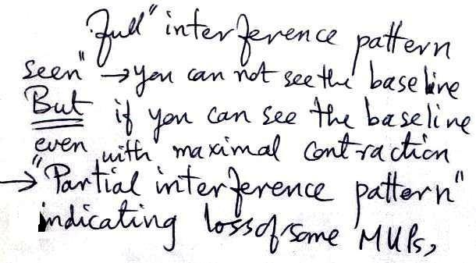
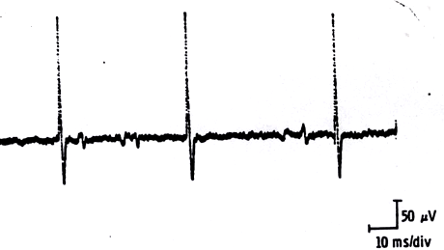
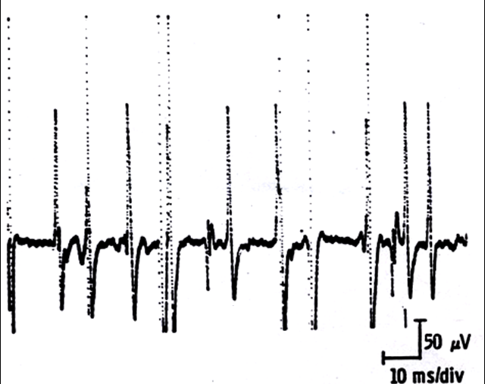
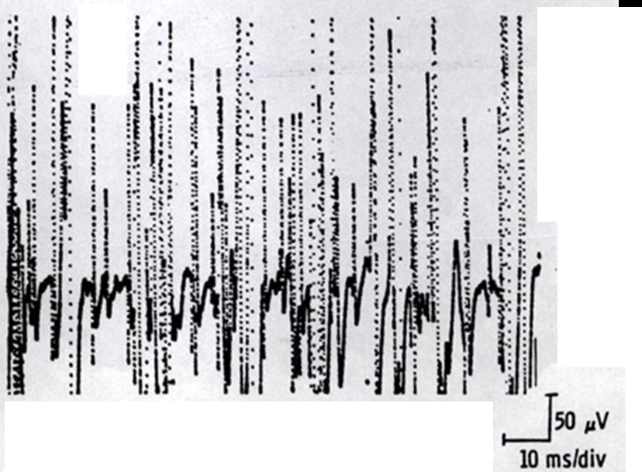
MUPs (2)
During Mild Effort
During Full Voluntary Effort . There is full recruitment ( you can not see the baseline )
During Moderate Effort → note recruitment of additional motoneurons

Slide 63
Abnormal MUPs
In neurogenic lesion or in active myositis, the following spontaneous activity is noted
Positive sharp wave:
A small potential of 50 to 100 µV, 5 to 10 msec duration with abrupt onset and slow outset.

Slide 64
Fibrillation Potentials :
These are randomly occurring small amplitude potentials or may appear in runs.
The audioamplifier gives sounds, as if somebody listen sounds of rains in a tin shade house.
These potentials are generated from the single muscle fiber of a denervated muscle, possibly due to denervation hypersensitivity to acetyl choline.

Slide 65
Fasciculation potentials:
These are high voltage, polyphasic, long duration potentials appear spontaneously associated with visible contraction of the muscle.
They originate from a large motor unit which is formed due to reinnervation of another motor unit from the neighboring motor unit.

Slide 66
Analysis of a motor unit potential (MUP)
MUP | NORMAL | NEUROGENIC | MYOPATHIC
Duration msec. | 3 – 15 msec | longer | Shorter
Amplitude | 300 µV – 5 mV | Larger | Smaller
Phases | Biphasic or triphasic | Polyphasic | May be polyphasic
Resting Activity | Absent | Present | Present
Interference pattern | full | Partial | Full

Slide 67
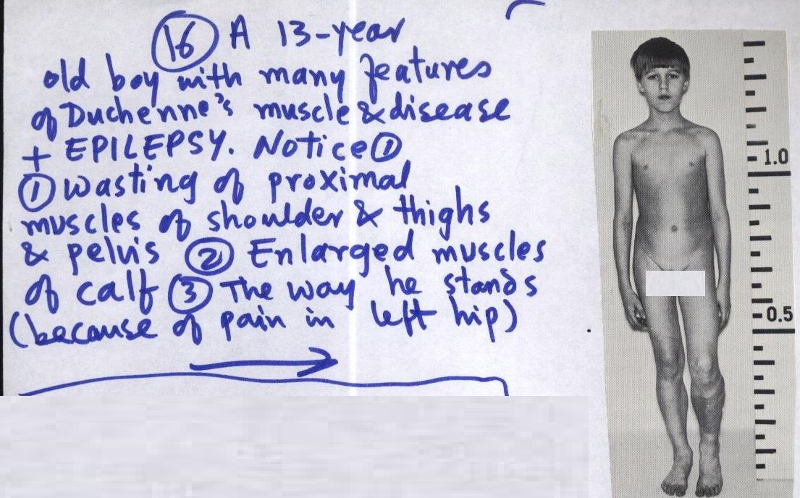

Slide 68
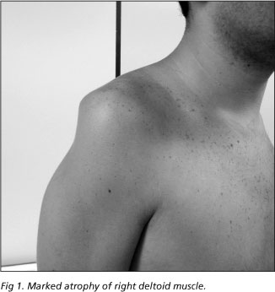
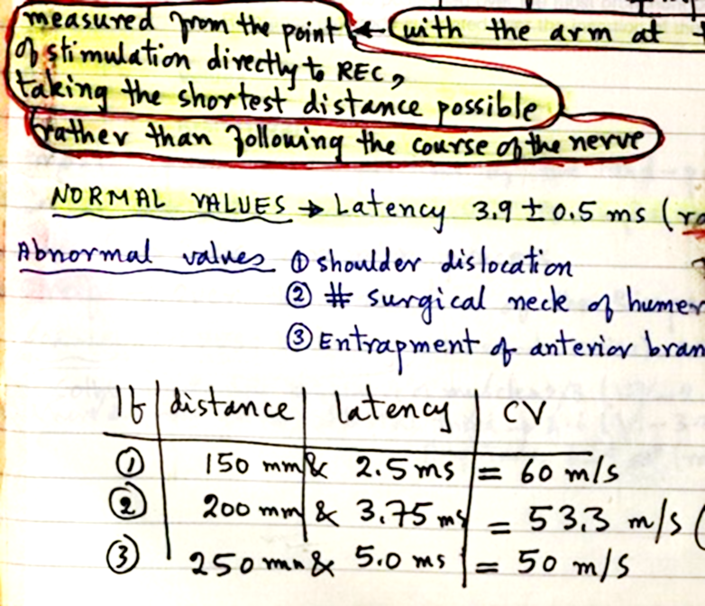
Testing Deltoid ( Axillary , Circumflex nerve
Notes:
Injured in shoulder dislocation ,wrong im injection , gunshot wound , etc .

Slide 69
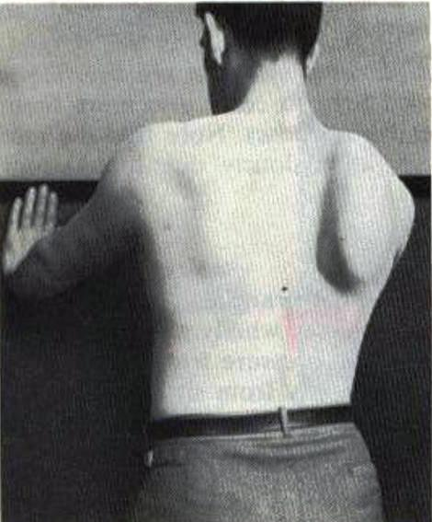
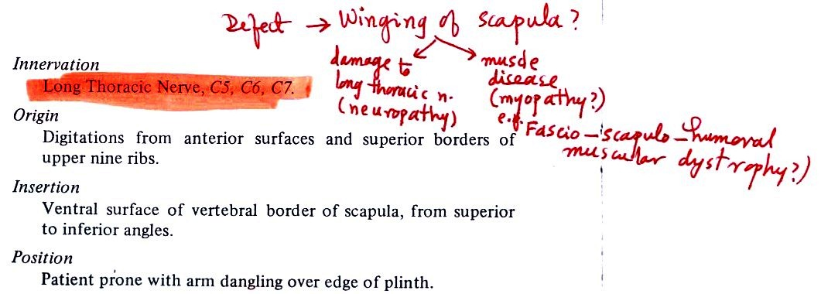
) Testing Serratus Anterior Long Thoracic Nerve ( C5,C6,C7), Winging of Scapula

Slide 70
Notes:
Erb’s Palsy

Slide 71
Surgical scar
Erb’s Palsy: injury to the upper group of the arm main nerves, specifically the upper trunk ( C5-C6) nerves . These form part of the Brachial Plexus, compring the ventral rami of C5-C8 and T1 nerves.
s,.
Notes:
Erb’s Palsy

Slide 72
Thanks
v

Slide 73
Needle Electromyography: Data
Insertional Activity
Spontaneous Activity
Motor Unit Configuration
Motor Unit Recruitment
Interference Pattern

Slide 74
Needle Electromyography: Data
Motor Unit Configuration
Single motor unit: A motor axon and all its muscle fibers
Motor Unit Configuration: Amplitude, Duration, Morphology
Muscle is volitionally activated at different force levels
Needle recording properties enable assessment of single MUs
Motor Unit Recruitment
Pattern of motor unit activation with increasing volitional activation
Interference Patterns
Motor unit pattern with full voluntary activation

Slide 75
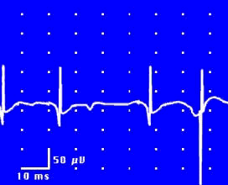
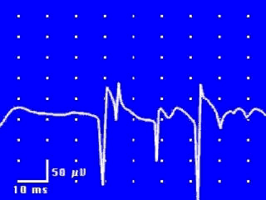
EMG: Spontaneous Activity
Fibrillation Potentials
Positive Sharp Waves

Slide 76
EMG: Spontaneous Activity
Fasciculation Potential

Slide 77
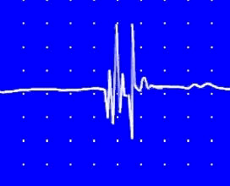
EMG: Neurogenic Motor Unit
10 msec/div, timebase
2MV/vertical segment

Slide 79
Electromyography (EMG) is a technique for evaluating and recording physiologic properties of muscles at rest and while contracting.
It’s a recording of electrical activity of the muscle by inserting needle electrode in the belly muscles .
The potentials recorded in needle emg are derived from motor units of the muscle, hence known as motor unit potentials (MUPs).
Q: Define what is a “ motor unit ”?

Slide 80
Electromyography (EMG) is a technique for evaluating and recording physiologic properties of muscles at rest and while contracting.
It’s a recording of electrical activity of the muscle by inserting needle electrode in the belly of the muscles ( needle emg ) or by applying the surface electrodes ( surface emg )
The potentials recorded in needle emg are derived from motor units of the muscle, hence known as motor unit potentials (MUPs).
Q: Define what is a “ motor unit ”?

Slide 81
Normal MUPs
Amplitude : 300 μV ( microvolt) – 5 mV ( millivolts)
Duration : 3 – 15 ms(milliseconds )

Slide 82
MUPs (2)
During Mild Effort
During Full Voluntary Effort . There is full recruitment ( you can not see the baseline )
During Moderate Effort → note recruitment of additional motoneurons

Slide 83
Examples of Abnormalities of MUPs
In nerve diseases : Giant MUPs due to reinnervation > 5 mV
In muscle disease : Small MUPs < 300μV

Slide 84
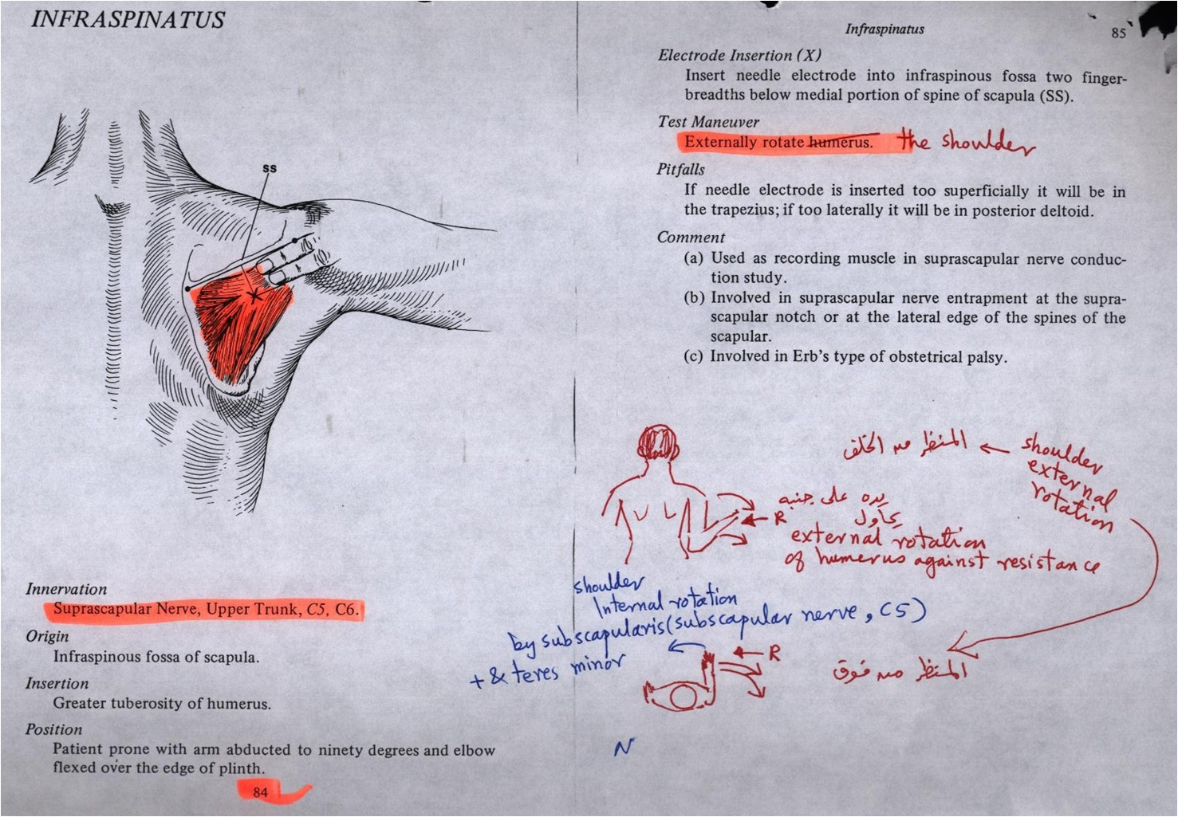

Slide 85
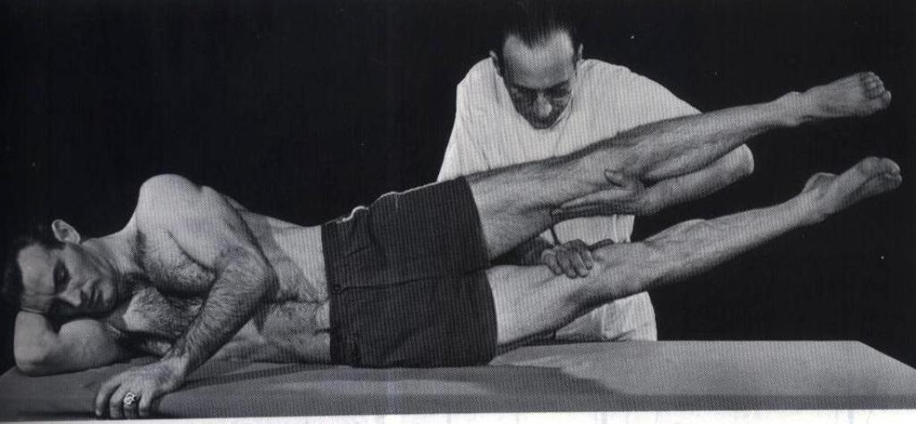
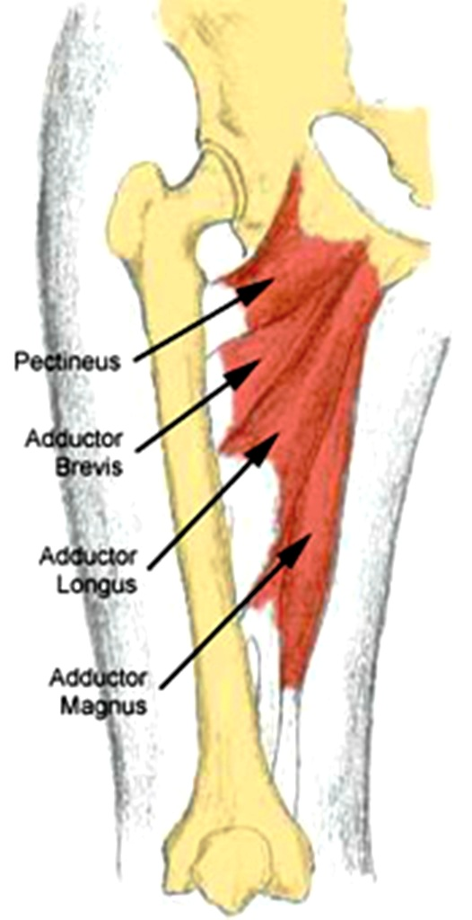
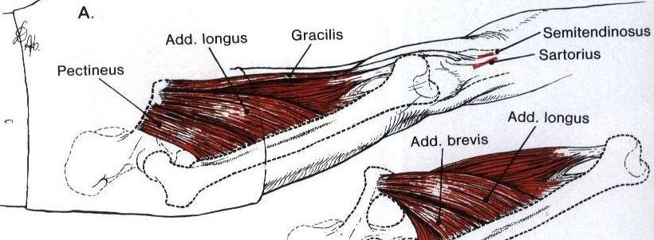
Notes:
Hip Adductorsobyturator nerve L2,L3,L4

Slide 86
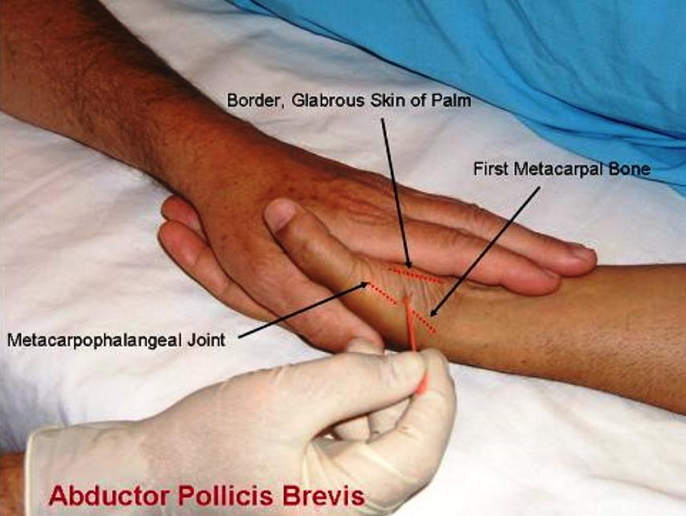

Slide 87
Tibialis Anterior

Slide 88
Thanks

