Slide 1
Dr. Taj
Tests of Hearing And Pure Tone Audiometry

Slide 2
* The usual primary purpose of pure- tone tests is to determine the type, degree, and configuration of hearing loss. * To plot the frequency intensity recording and construct the audiograms * To interpret the audiograms
Objective

Slide 3
IN THIS PRACTICAL WE WILL DO:
TUNNING FORK TESTS
AUDIOMETRY

Slide 4
AIR CONDUCTION: this test assesses sensitivity when the signal is transmitted through the outer, middle, and inner ear and then through the brain to the cortex. Testing may be performed using headphones, insert earphones.
TERMINALOGY

Slide 5
This technique assesses sensitivity when the signal is transmitted through the bones of the skull to the cochlea and then through the auditory pathways of the brain. This type of testing bypasses the outer and middle ear.
BONE CONDUCTION

Slide 6
Masking presents a constant noise to the non-test ear to prevent crossover from the test ear. The purpose of masking is to prevent the non-test ear from detecting the signal (line busy), so only the test ear can respond.
MASKING

Slide 7
A pure tone is a single frequency tone with no harmonic content (no overtones). This corresponds to a sine wave.
PURE TONE

Slide 8
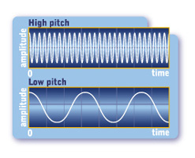
PURE TONE

Slide 9
The audiogram is a chart of hearing sensitivity with frequency charted on the X- axis and intensity on the y-axis. Intensity is the level of sound power measured in decibels; loudness is the perceptual correlate of intensity.
AUDIOGRAM

Slide 10
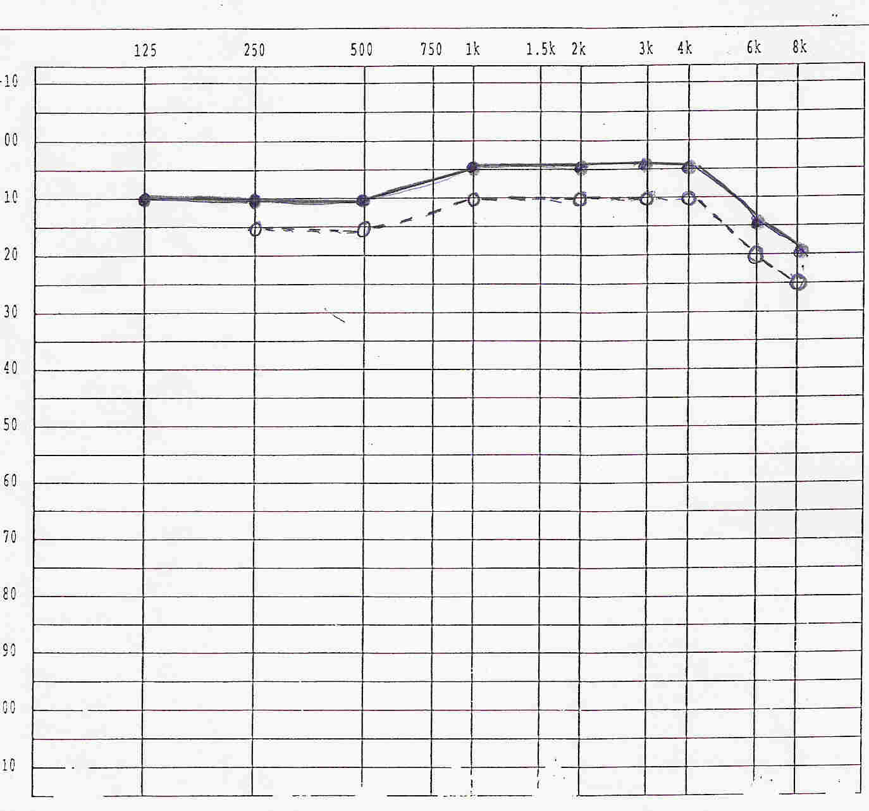
AUDIOGRAM

Slide 11
TUNING FORK TESTS

Slide 12
Technique
First: Bone Conduction
Vibrating Tuning Fork held on Mastoid process
Patient covers opposite ear with hand
Patient signals when sound ceases
Move the vibrating tuning fork over the ear canal
(Near, but not touching the ear)
Next: Air Conduction
Patient indicates when the sound ceases
Normal: Air Conduction is better than Bone Conduction
Air conduction usually persists twice as long as bone
Referred to as "positive test"
Abnormal: Bone conduction better than air conduction
Suggests Conductive Hearing Loss.
Referred to as "negative test"
RINNE’S TEST

Slide 13
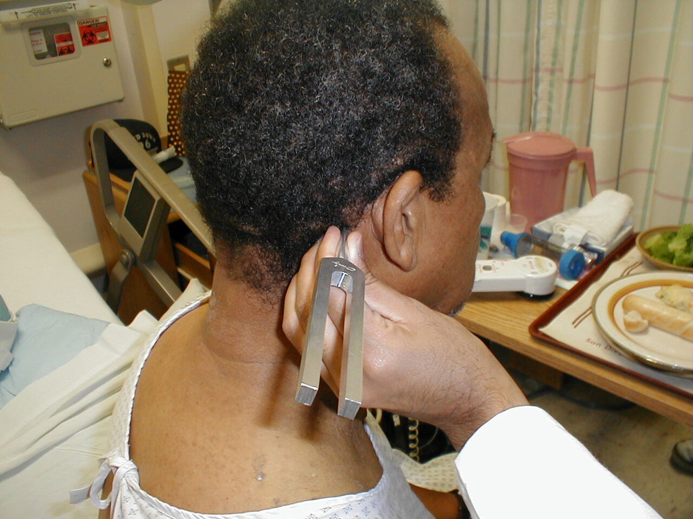

Slide 14
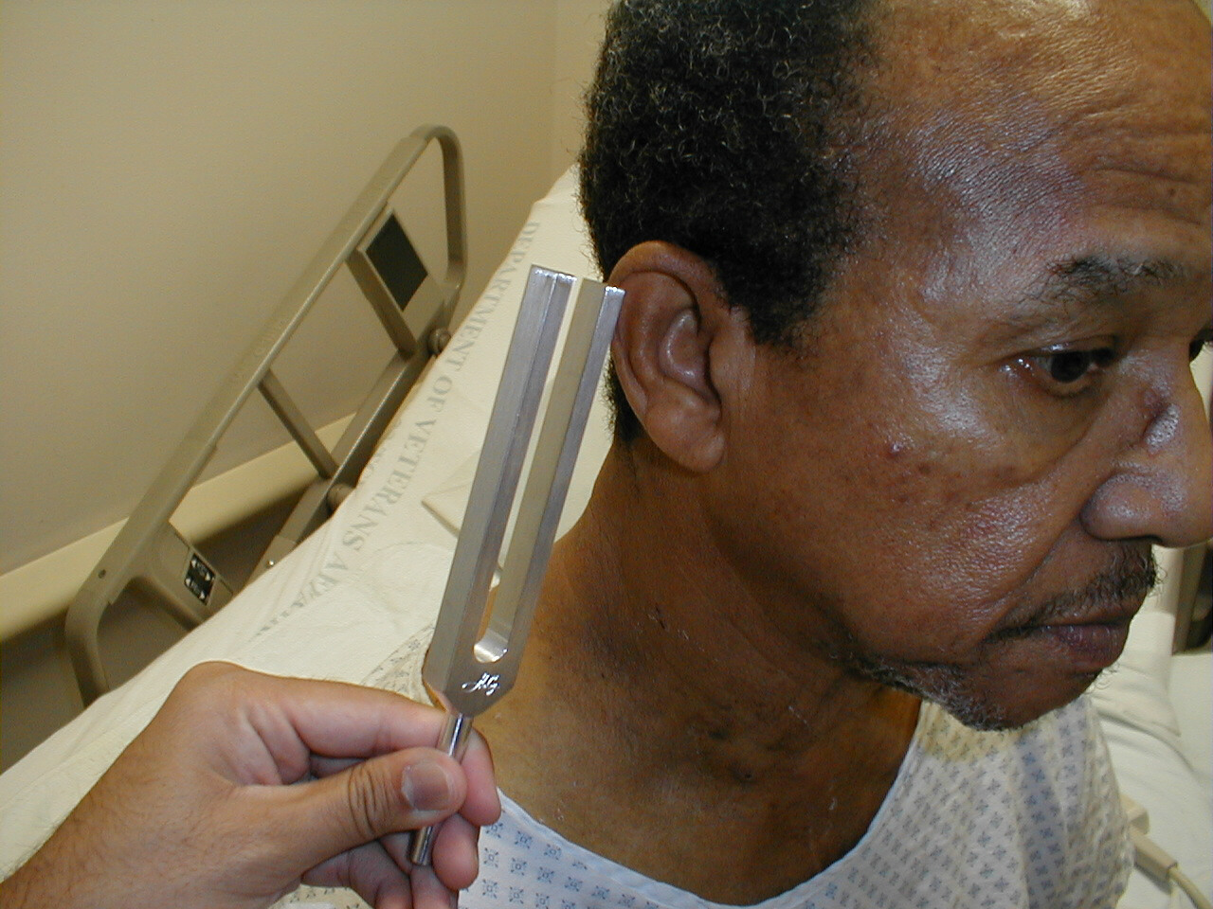

Slide 15
Technique:
Tuning Fork placed at midline forehead
Normal: Sound radiates to both ears equally
Abnormal: Sound lateralizes to one ear
Ipsilateral Conductive Hearing Loss OR
Contralateral Sensorineural Hearing Loss.
WEBER TEST

Slide 16
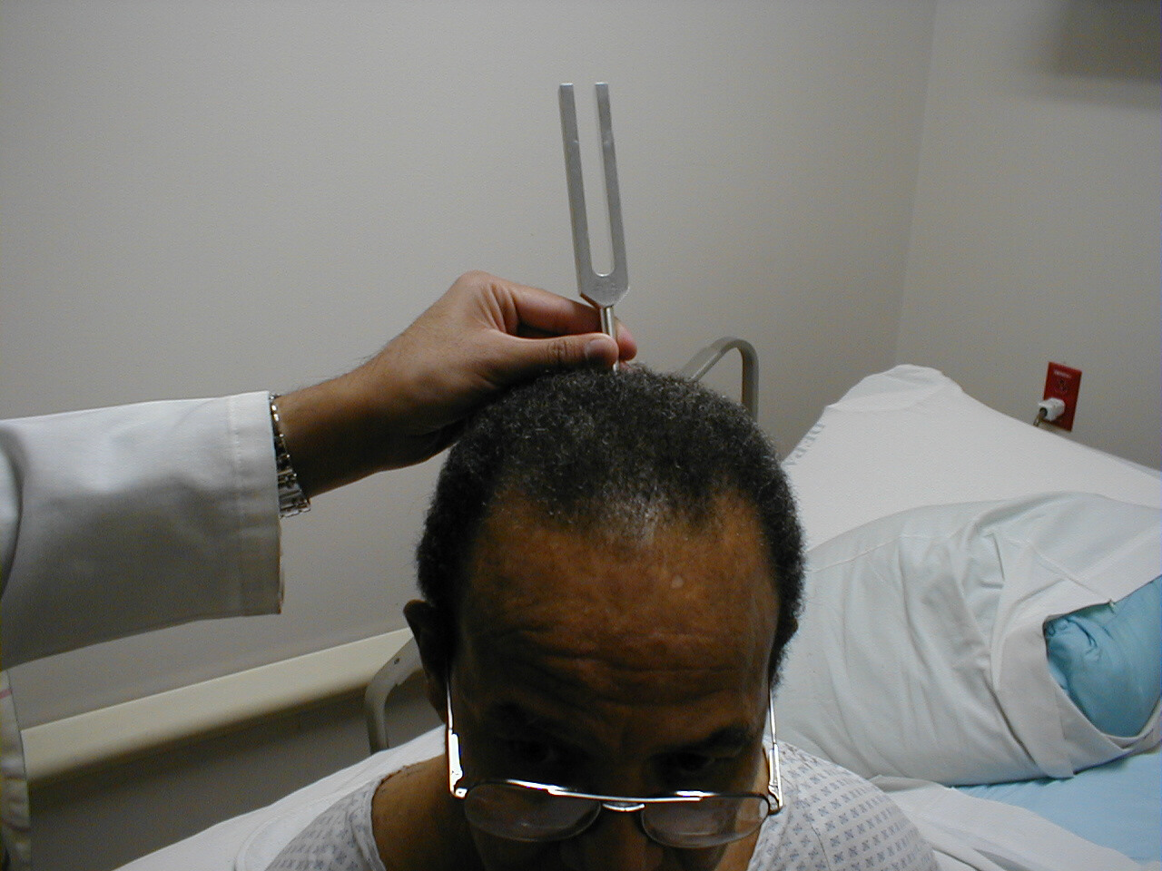

Slide 17
In a sound proof room person is seated comfortably. Ear phones are applied which are color coded. (Red for right ear, blue for left ear.) Masking sound is delivered to the non-test ear. Start with a frequency of 125hz. & 0 db. Gradually increase the db. Till person hears the sound & respond. Mark the threshold intensity on the audiogram paper.
PURE TONE AUDIOMETRY

Slide 18
Find the threshold of hearing from 125 hz. To 8000hz. & Mark on the audiogram paper. Join the points to make air conduction audiogram. Place the bone vibrator over the mastoid process. Deliver the sound through the vibrator & find out the threshold of hearing for different frequencies of sound.
Cont…

Slide 19
Use different sign to mark the bone conduction audiogram. Select the other ear and repeat the whole procedure.
Cont…

Slide 20
Conductive hearing loss Sensorineural hearing loss Mixed hearing loss
TYPES OF HEARING LOSS

Slide 21
The abnormality reduces the effective intensity of the air-conducted signal reaching the cochlea, but it does not affect the bone-conducted signal that does not pass through the outer or middle ear. Examples of abnormalities include perforated tympanic membranes, fluid in the middle ear system, or scarring of the tympanic membrane. Pure-tone air-conduction thresholds are poorer than bone-conduction thresholds by more than 10 db
Conductive Hearing loss (deafness)

Slide 22
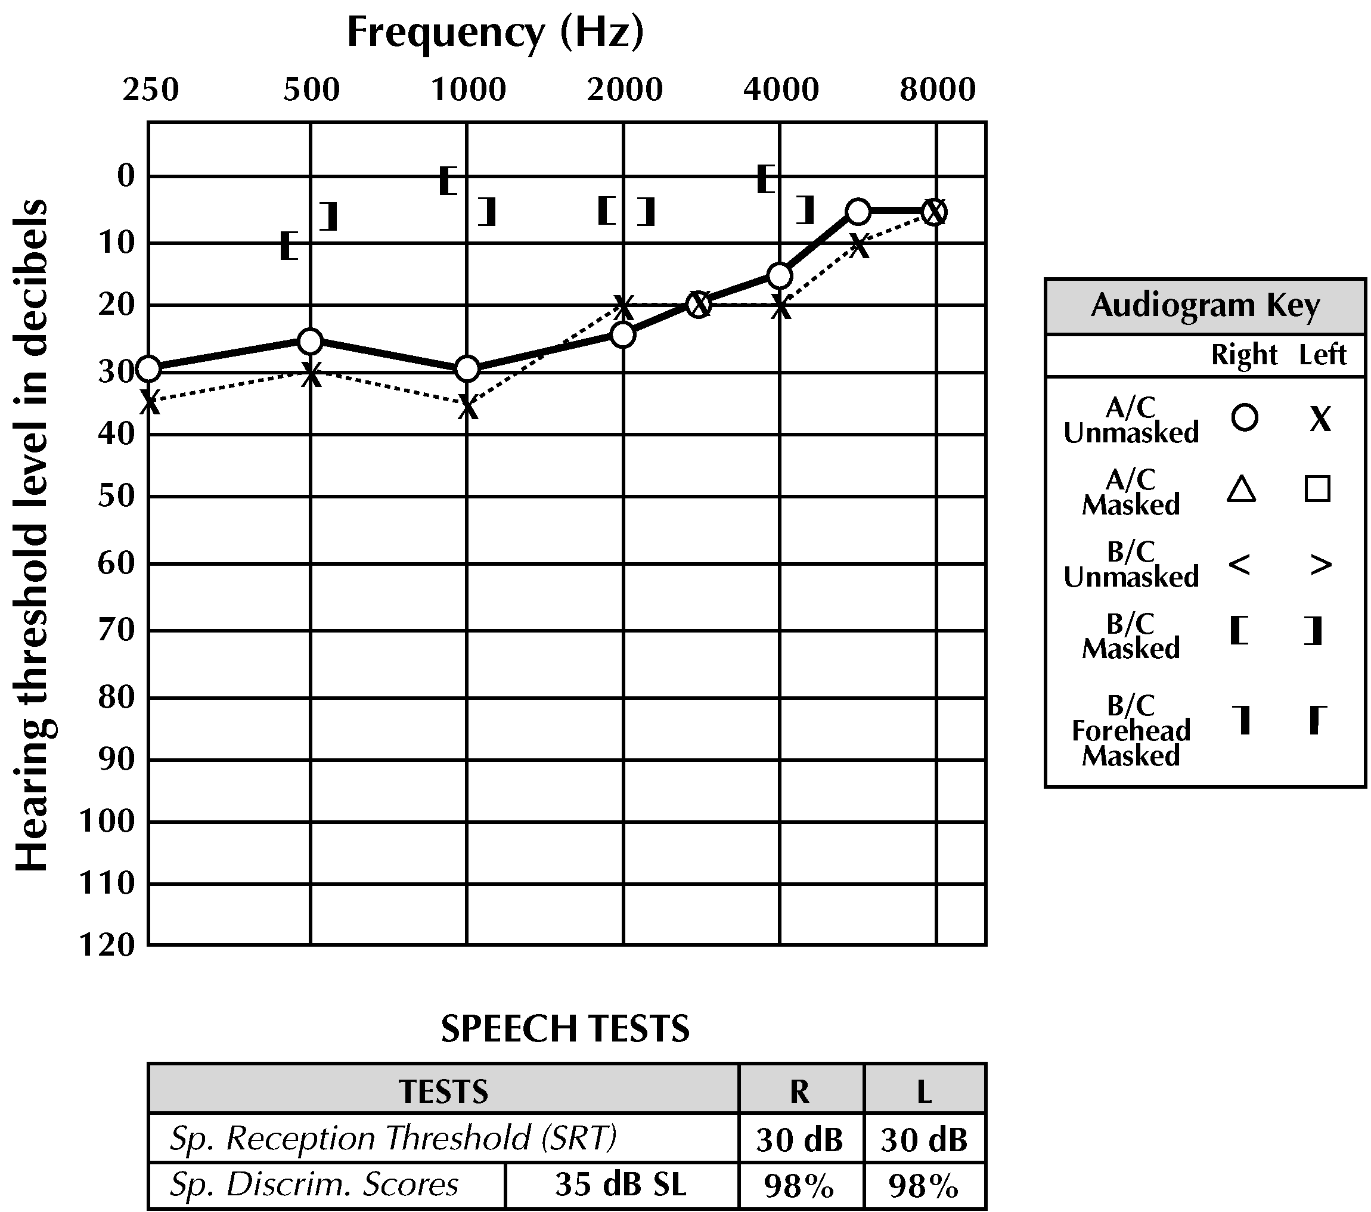
Conductive deafness

Slide 23
This type of hearing loss is secondary to cochlear abnormality and/or abnormality of the auditory nerve or central auditory pathways. Because the outer ear and middle ear do not reduce the signal intensity of the air-conducted signal, both air- and bone-conducted signals are effective in stimulating the cochlea. Pure-tone air- and bone-conduction thresholds are within 10 db
Sensorineural Hearing loss (deafness)

Slide 24
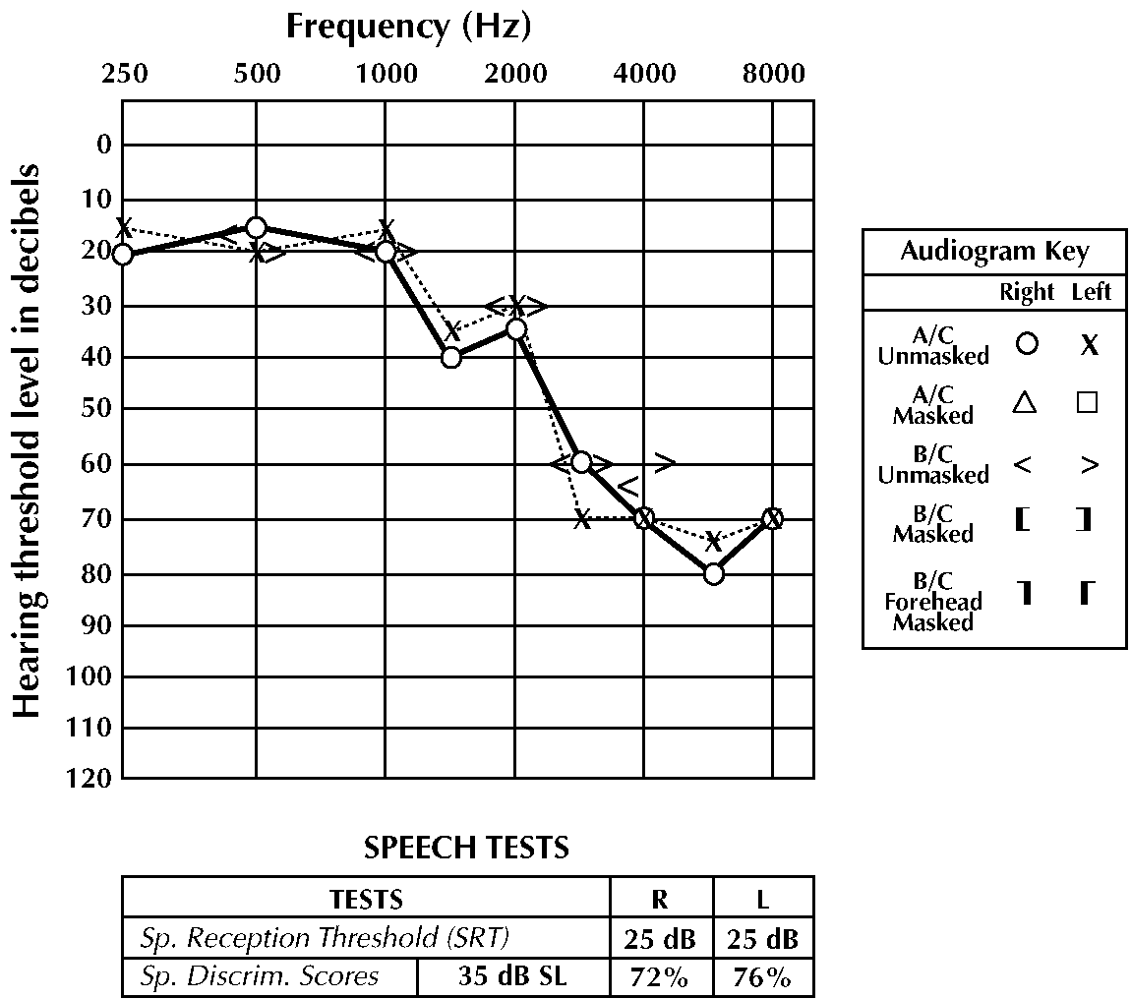
Sensorineural

Slide 25
This type of hearing loss has sensorineural and conductive components. Pure-tone air-conduction thresholds are poorer than bone-conduction thresholds by more than 10 db, and bone-conduction thresholds are less than 25 db
Mixed Hearing loss

Slide 26
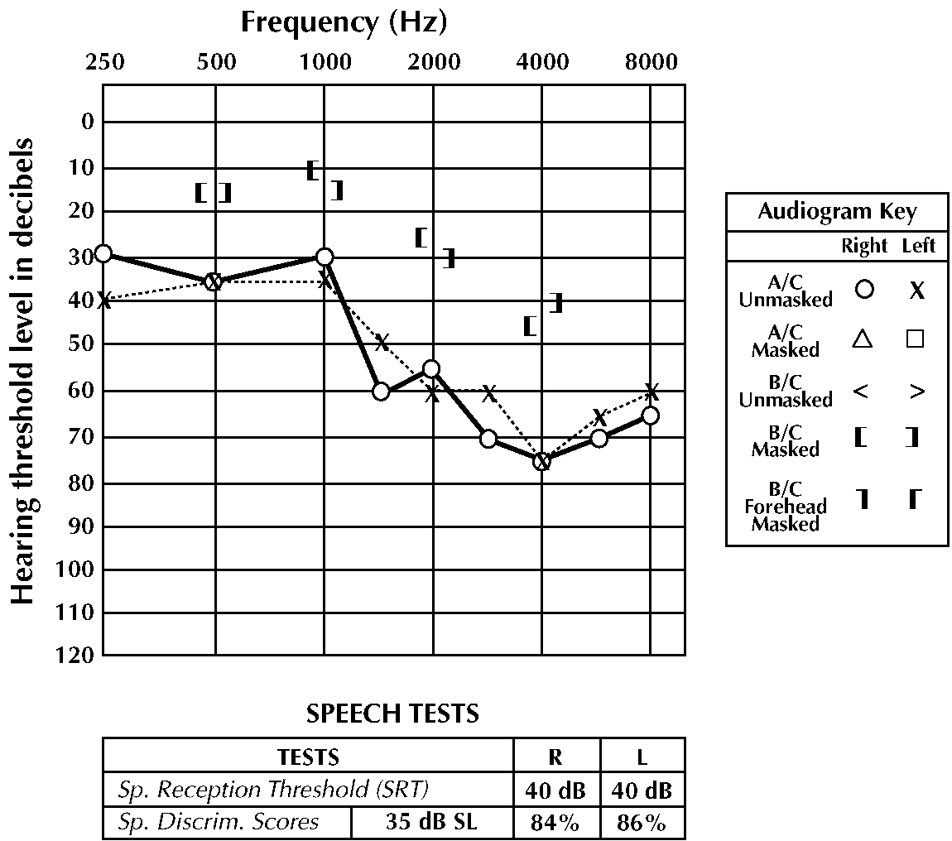
Mixed Hearing Loss

Slide 27
DEGREES OF HEARING LOSS
Normal hearing (0-25 dB)
Mild hearing loss (26-40 dB)
Moderate hearing loss (41-55 dB)
Moderate-severe hearing loss (56-70 dB)
Severe hearing loss (71-90 dB)
Profound hearing loss (>90 dB)

Slide 28
COMMON AUDITORY DISORDERS
Presbyacusis (age related hearing loss)
Otitis media: This condition is marked by fluid in the middle ear space usually secondary to an infection.
Noise-induced hearing loss.
Otosclerosis: The condition is caused by stapedial fixation in the oval window, stiffening the middle ear system.
Ménière disease

Slide 29
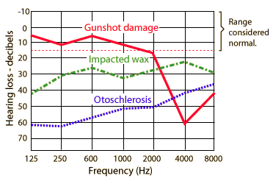

Slide 30
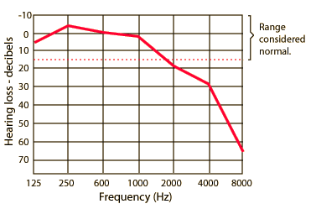
Presbyacusis

Slide 33
Glossary
Pure tone
Deafness
Conductive
Contralateral
Frequency

Slide 34
THANK YOU

