Slide 1
Brainstem Slides
Practical session
Note:
Please keep in mind that the labelling in the slides is not complete, this is just a selection.

Slide 3
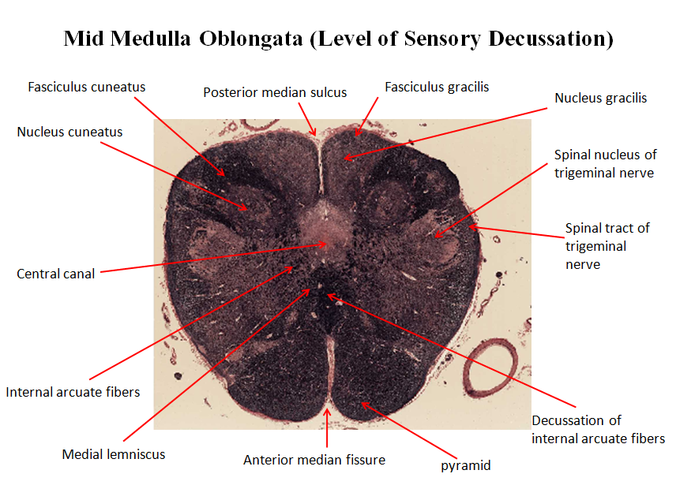

Slide 4
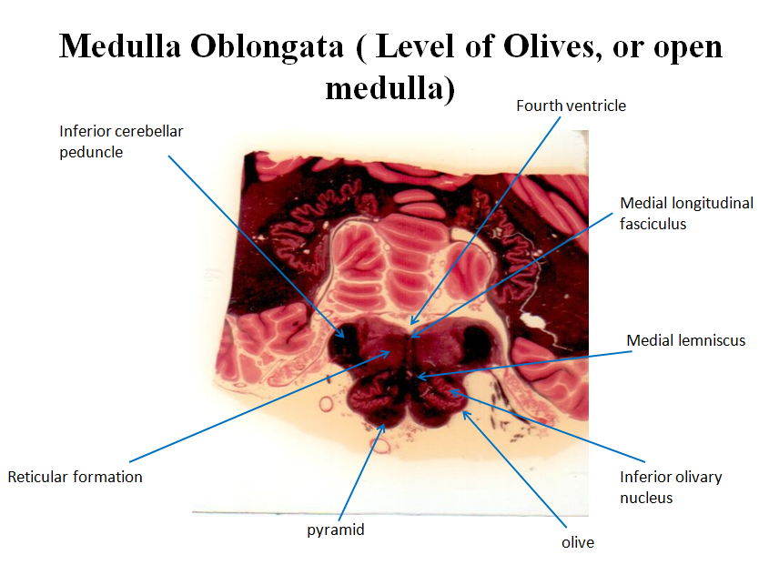

Slide 6
