Slide 1
BLEEDING DISORDERS BY:
DR. FATMA AL-QAHTANI
CONSULTANT HAEMATOLOGIST
DEPARTMENT OF PATHOLOGY
COLLEGE OF MEDICINE
KING SAUD UNIVERSITY

Slide 2
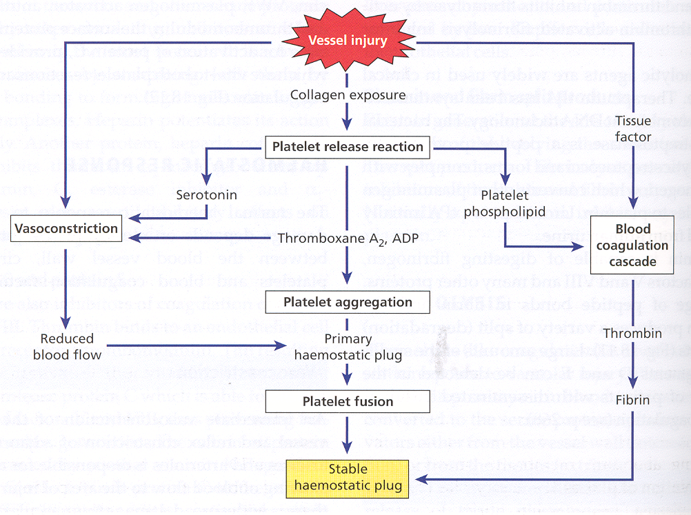

Slide 3
THE BLEEDING DISORDERS INCLUDE
Inherited and acquired blood vessel disorders
Inherited and acquired platelets disorders
Inherited and acquired coagulation disorders

Slide 6
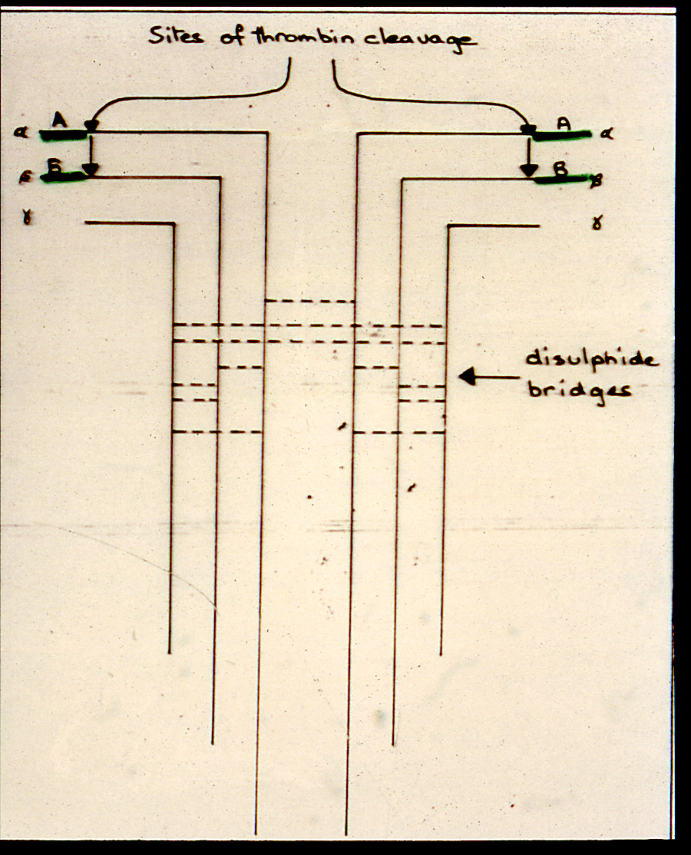

Slide 8
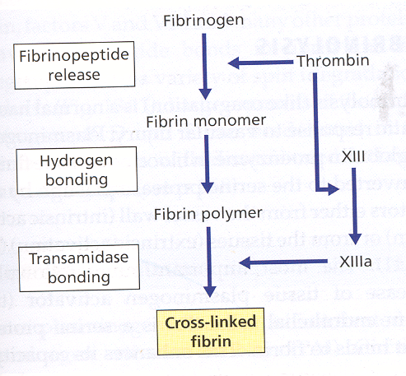

Slide 9
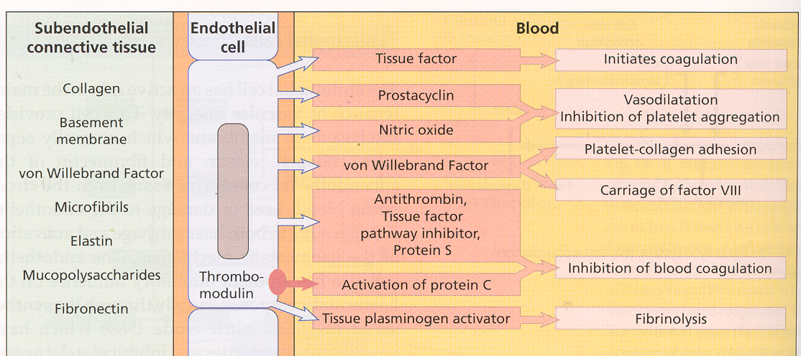

Slide 10
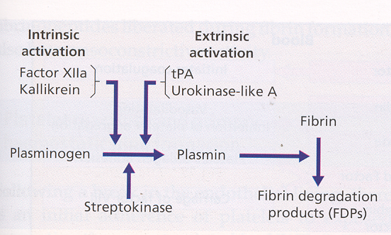

Slide 11
INHERITED COAGULATION DISORDERS HAEMOPHILIA * A Factor VIII Deficiency * B Factor IX Deficiency (Christmas Disease) * C Factor XI Deficiency * Von Willebrand Disease * Other Factors Deficiency

Slide 12
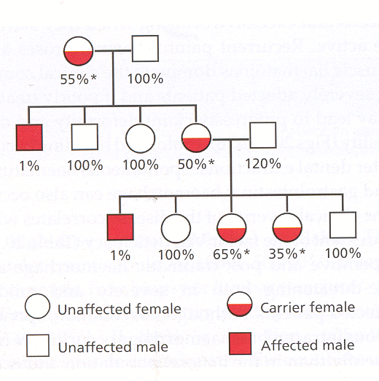

Slide 13
CLINICAL FEATURES OF HAEMOPHILIA

Slide 14
Correlation of coagulation factor activity and disease severity in haemophilia A or hemophilia B
---------------------------------------------------------------------------------------------------------------------------------------------------------------------------------------------------------------------------------------------------------------
Coagulation factor activity Clinical manifestations
(percentage of normal)
---------------------------------------------------------------------------------------------------------------------------------------------------------------------------------------------------------------------------------------------------------------
<1 Severe disease
Frequent spontaneous bleeding episodes
from early life
Joint deformity and crippling if not
adequately teated
1 – 5 Moderate disease
Post-traumatic bleeding
occasional spontaneous episodes
5 – 20 Mild diesease
Post-traumatic bleeding
---------------------------------------------------------------------------------------------------------------------------------------------------------------------------------------------------------------------------------------------------------------

Slide 15
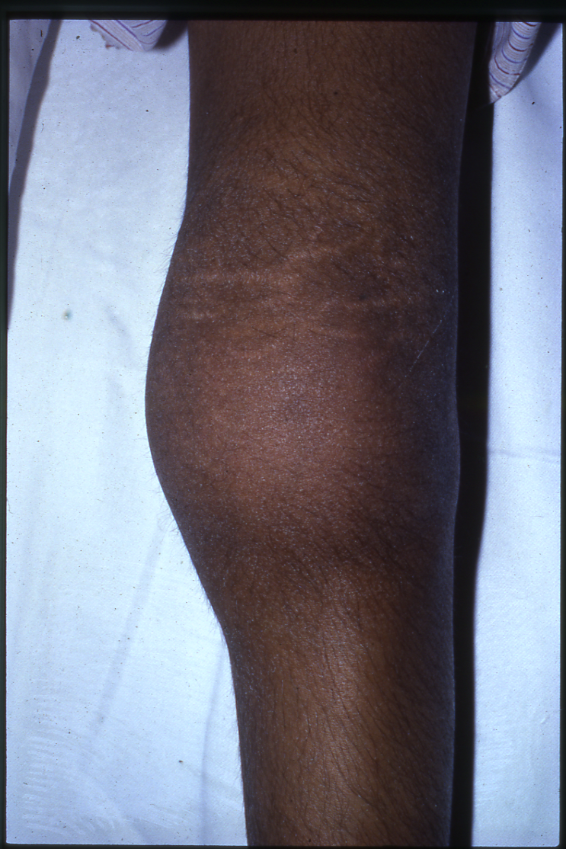

Slide 16
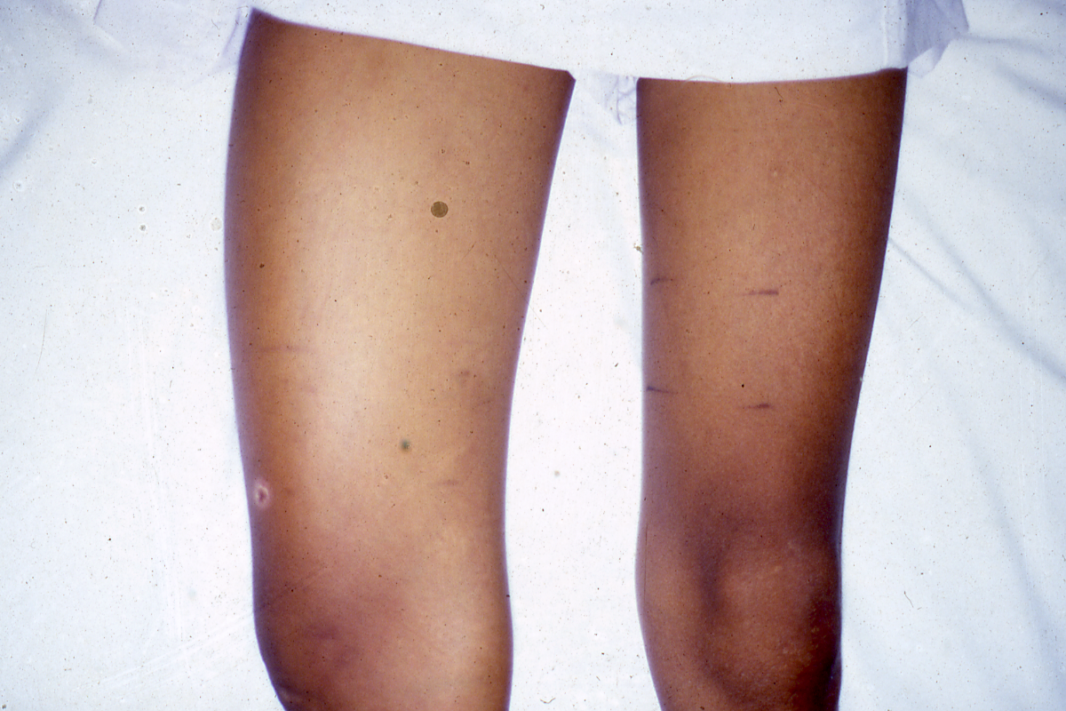

Slide 21
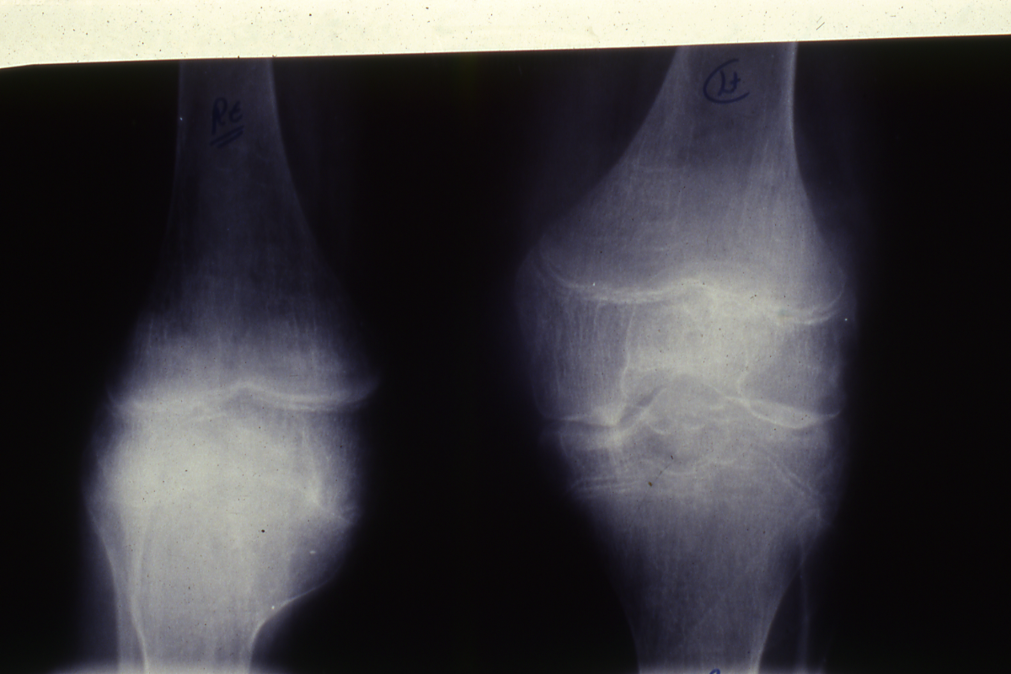

Slide 22
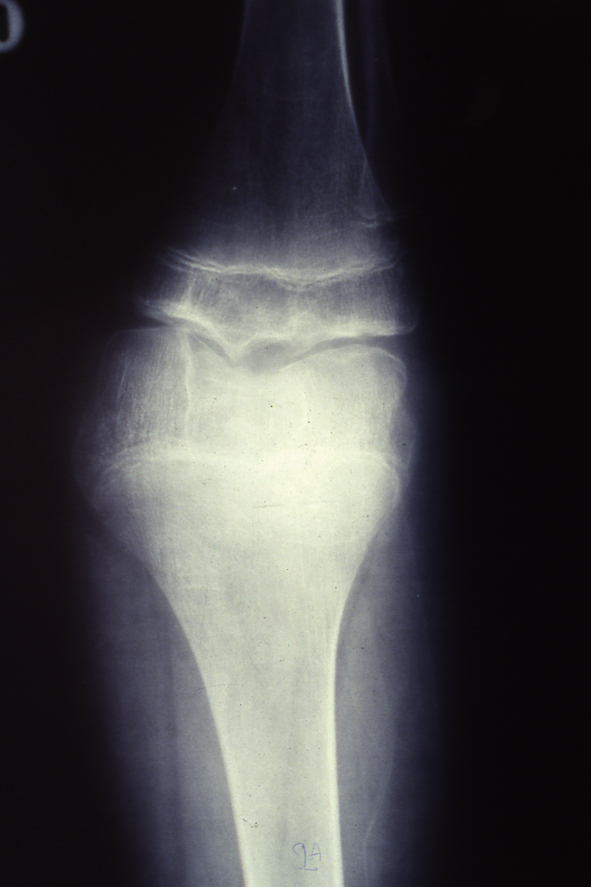

Slide 23
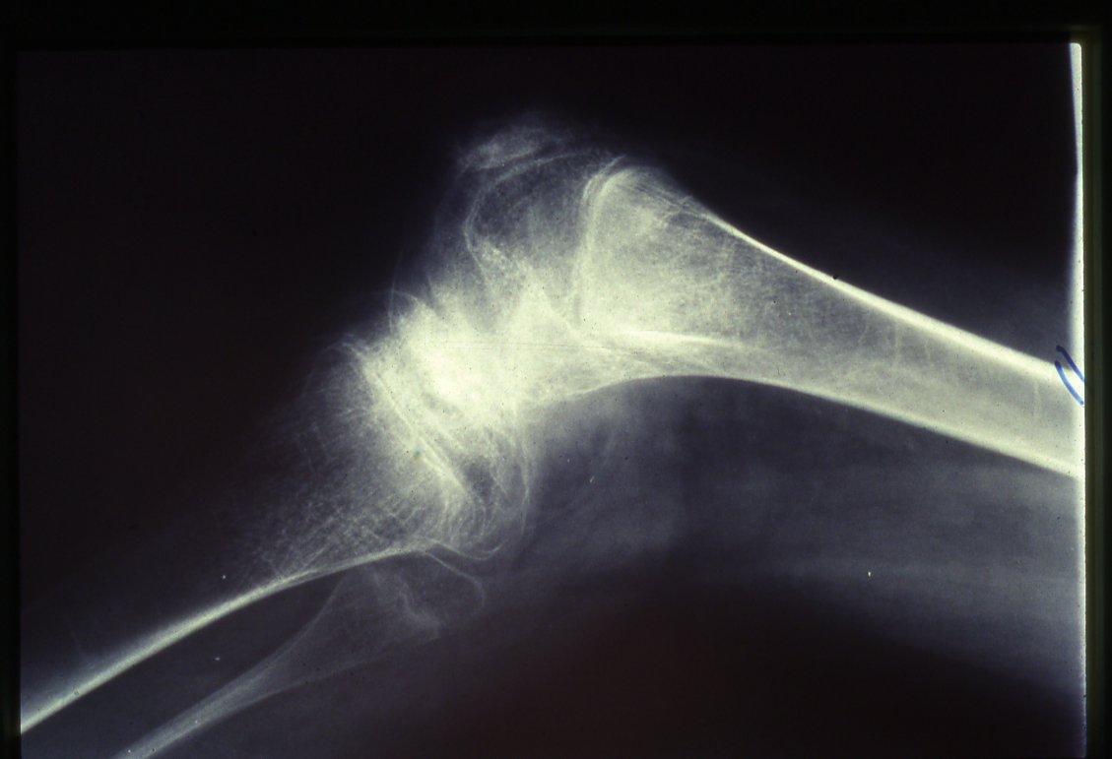

Slide 25
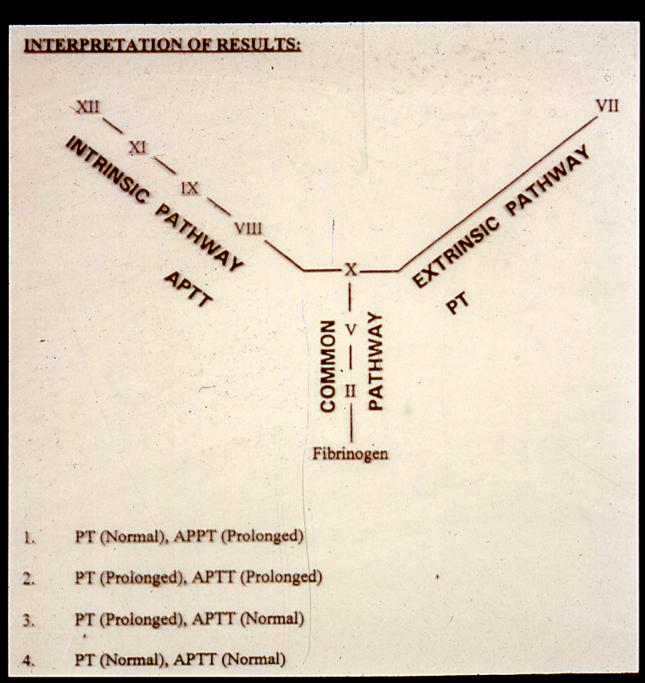

Slide 26
The Abnormalities in Von Willebrand Disease
Abnormal bleeding time
Prolonged APTT & normal PT
Deficiency of Factor VIII Clotting activity
Deficiency of Von Willebrand Factor
(Ristocetin Co-factors)
Low Von Willebrand Antigen
Abnormal Platelet Aggregations

Slide 27
vWF

Slide 30
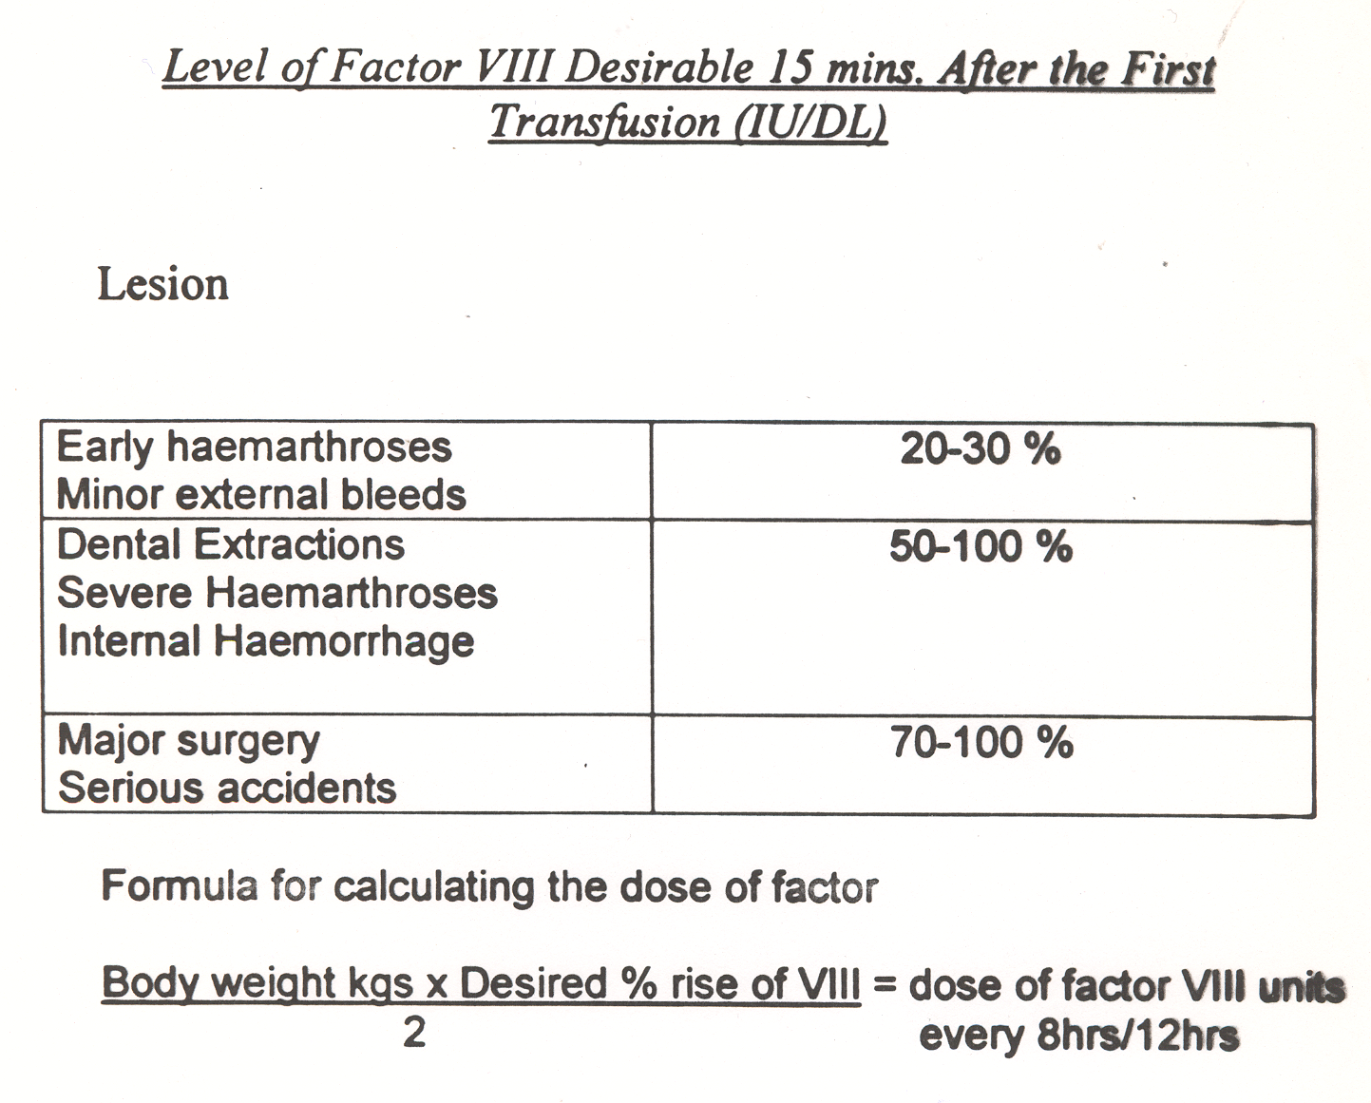

Slide 33
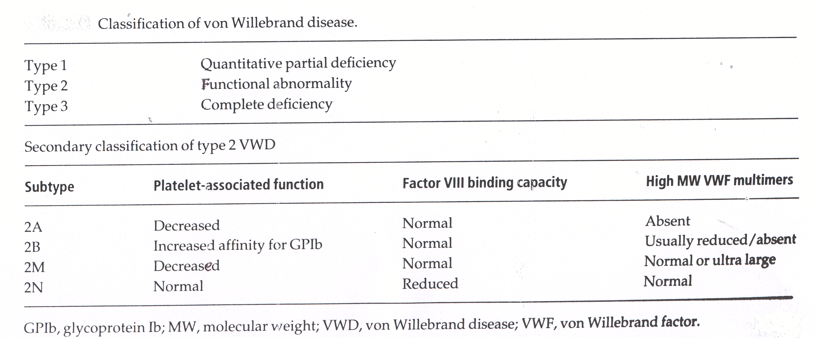

Slide 37
FACTOR XIII DEFICIENCY
Bruising with minor injury
Hematoma after trauma
Bleeding (secondary bleeding)
Abnormal healing of wounds with excessive scar formation (keloid formation)

Slide 38
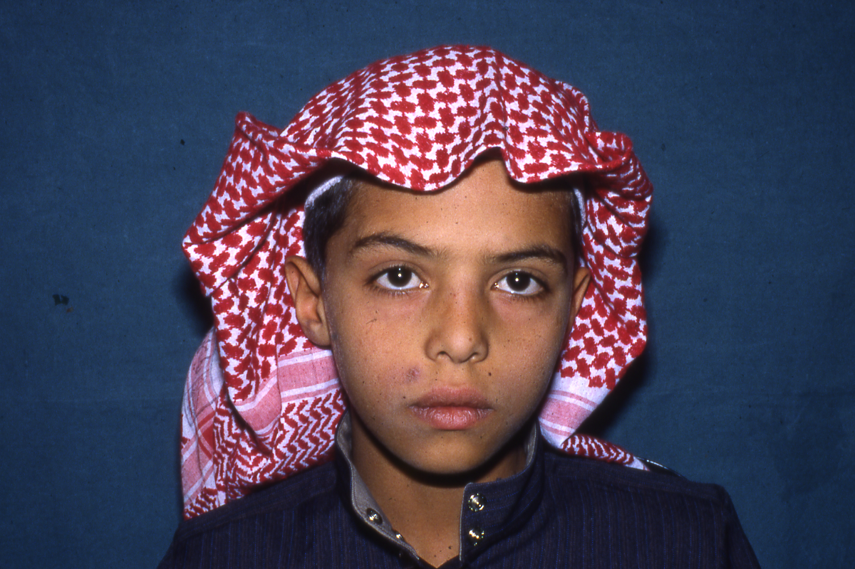

Slide 39
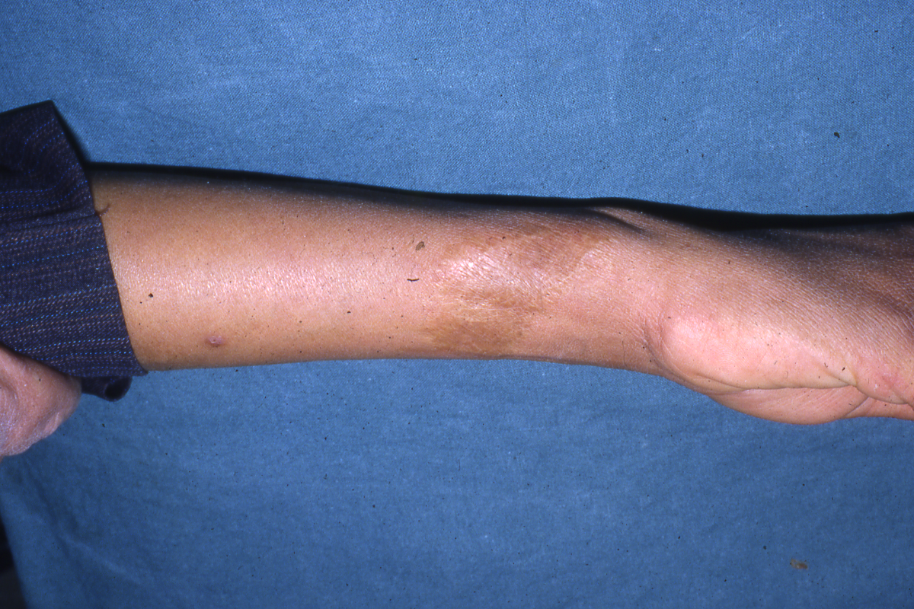

Slide 40
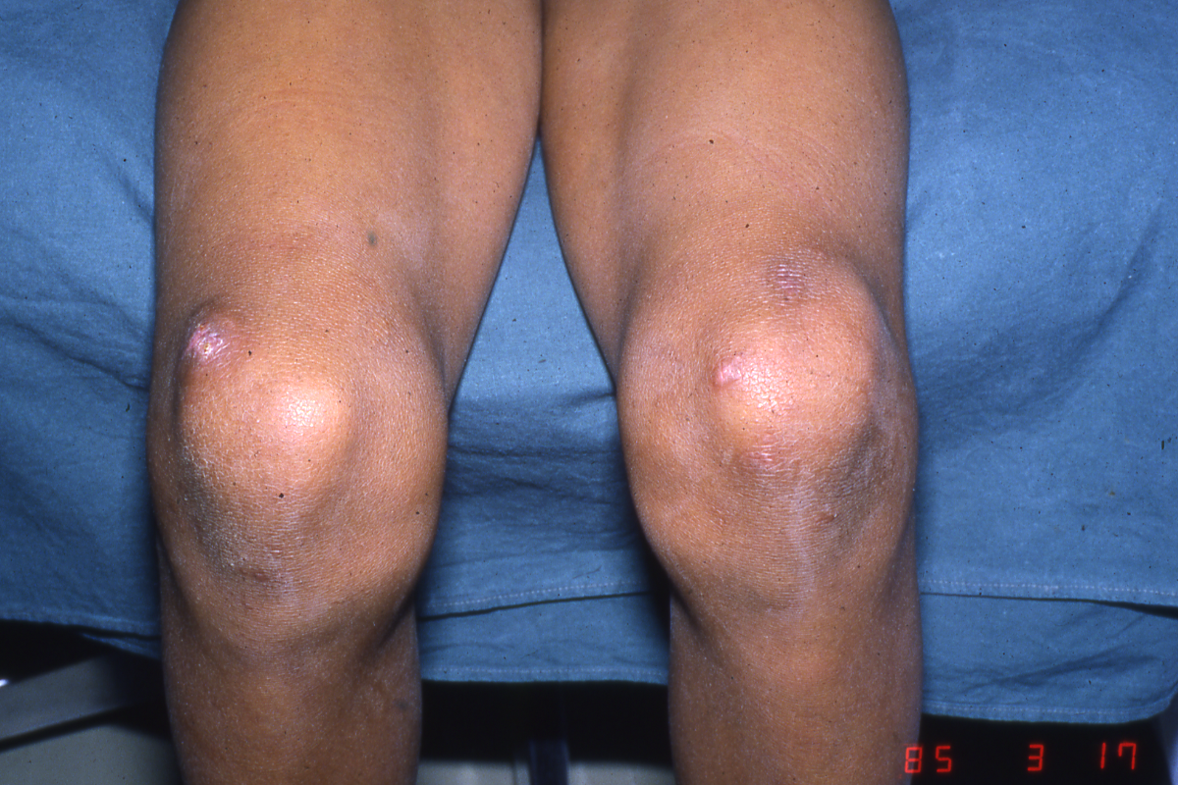

Slide 41
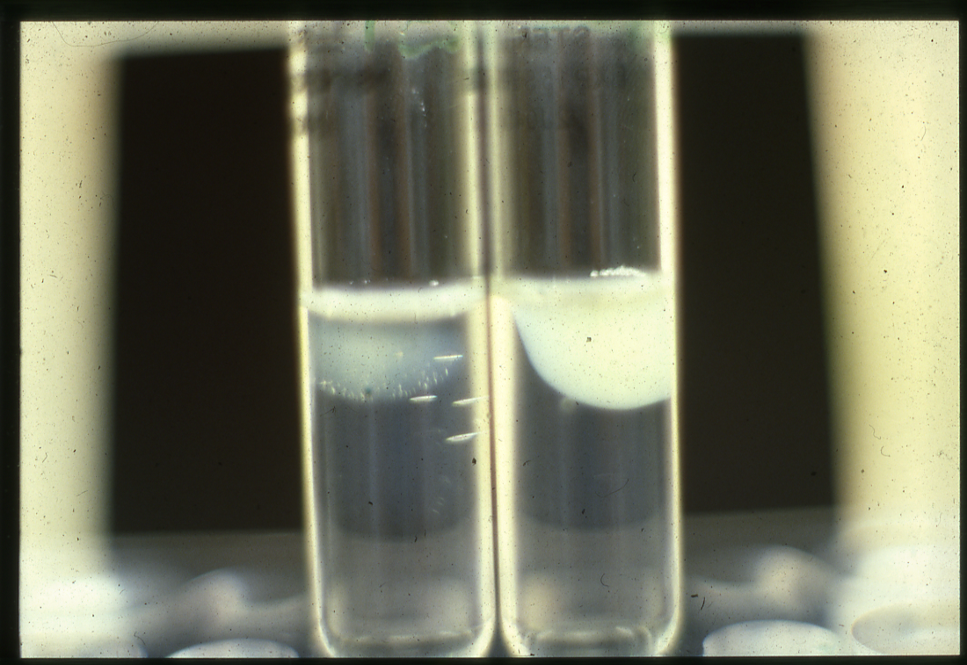

Slide 42
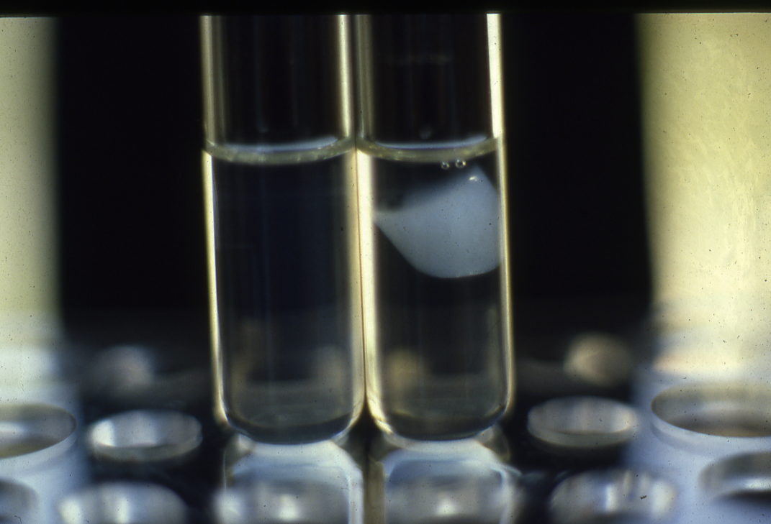

Slide 43
LABORATORY DIAGNOSIS OF FACTOR XIII DEFICIENCY
Normal PT & Normal APTT
Normal Bleeding time & Normal Platelet aggregation
Normal fibrinogen level
Abnormal clot stability with five molar urea
Low Factor XIII level

Slide 44
ACQUIRED BLEEDING DISORDERS

Slide 45
DIC
DISSEMINATED INTRAVASCULAR COAGULATION
‘CONSUMPTION COAGULATIONPATHY’
‘DEFIBRINATION SYNDROME’

Slide 46
Causes of disseminated intravascular coagulation
--------------------------------------------------------------------------------------------------------------------------------------------------------------------------------------------------------------------------------------------------------------
Infections
Gram-negative and meningococcal septicaemia
Clostridium welchii septicaemia
Severe Falciparum malaria
Viral infection – varicella, HIV, hepatitis, cytomegalovirus
Malignancy
Widespread mucin-secreting adenocarcinoma
Acute promyelocytic leukaemia
Obstetric complications
Amniotic fluid embolism
Premature separation of placenta
Septic abortion

Slide 47
Causes of disseminated intravascular coagulation (continued)
----------------------------------------------------------------------------------------------------------------------------------------------------------------------------------------------------------------------------------------------------------------------------------
*Hypersensitivity reactions
Anaphylaxix
Incompatible blood transfusion
*Widespread tissue damage
Following surgery or trauma
After severe burns
*Vascular abnormalities
Kasabach-Merritt syndrome
Leaking prosthetic valves
Cardiac bypass surgery
*Miscellaneous
Liver failure
Snake and invertebrate venoms
Hypothermia
Heat stroke
Acute hypoxia

Slide 51
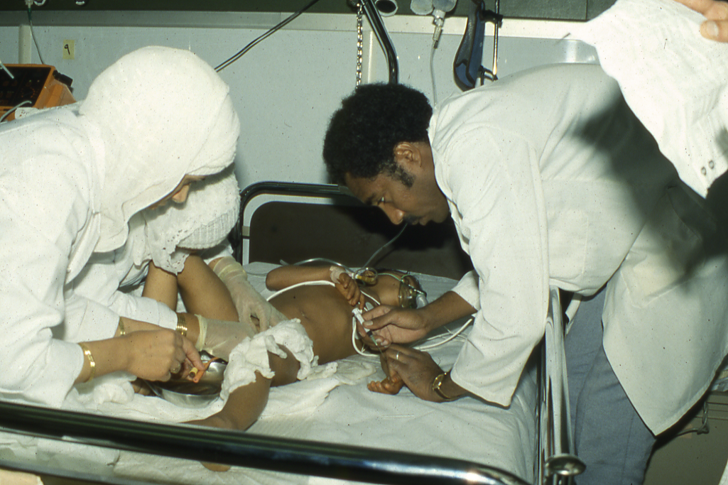

Slide 52
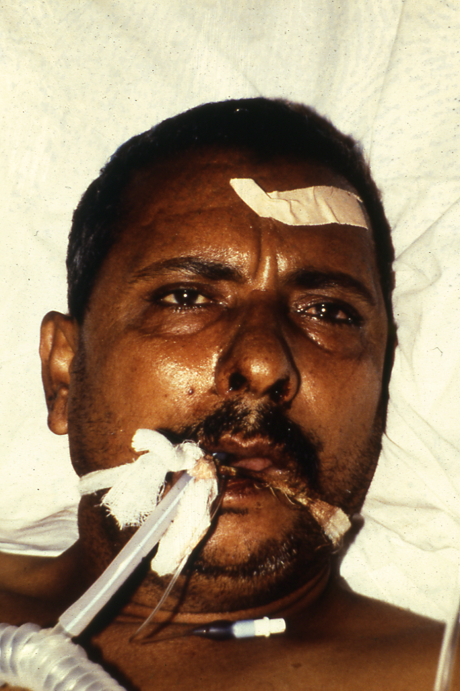

Slide 53
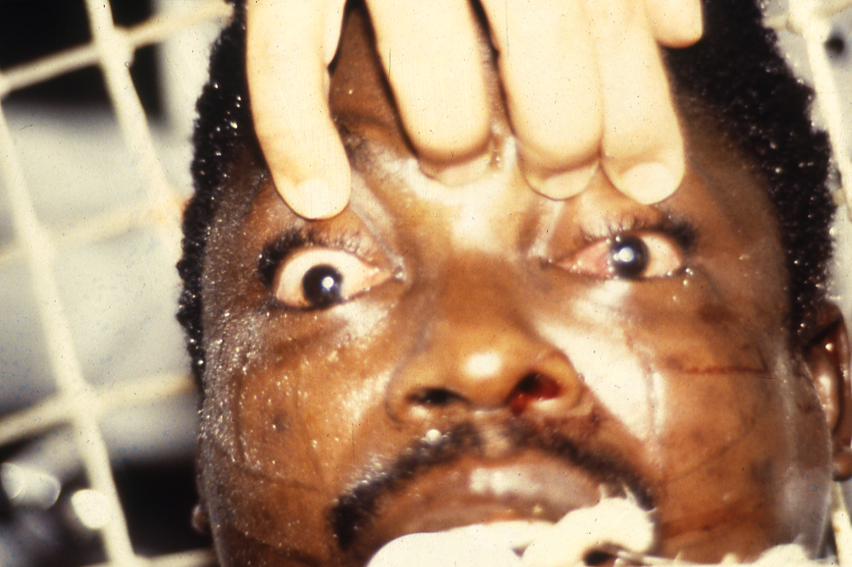

Slide 54
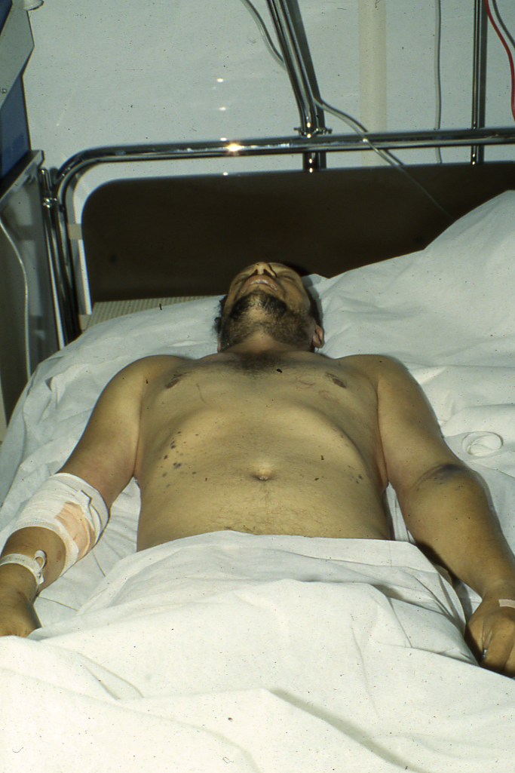

Slide 55
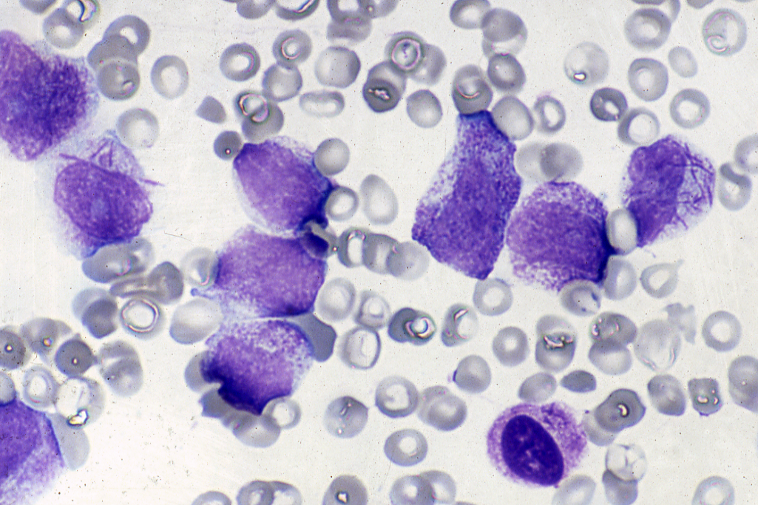

Slide 56
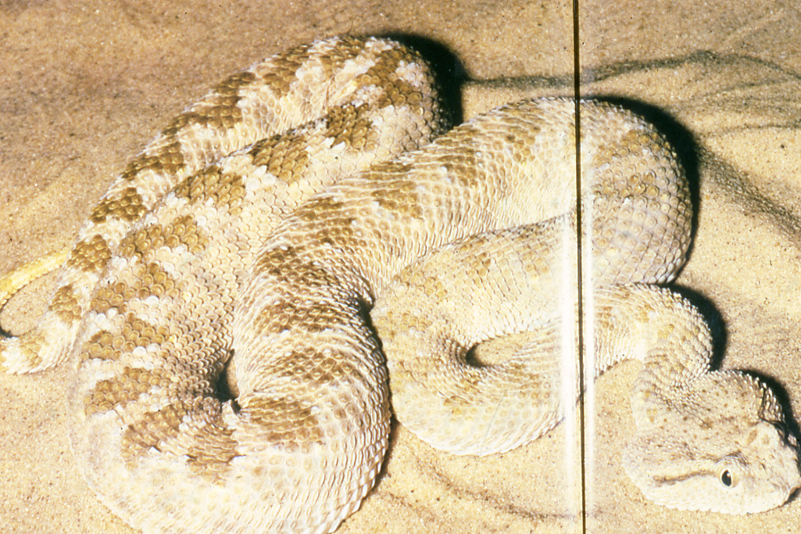

Slide 57
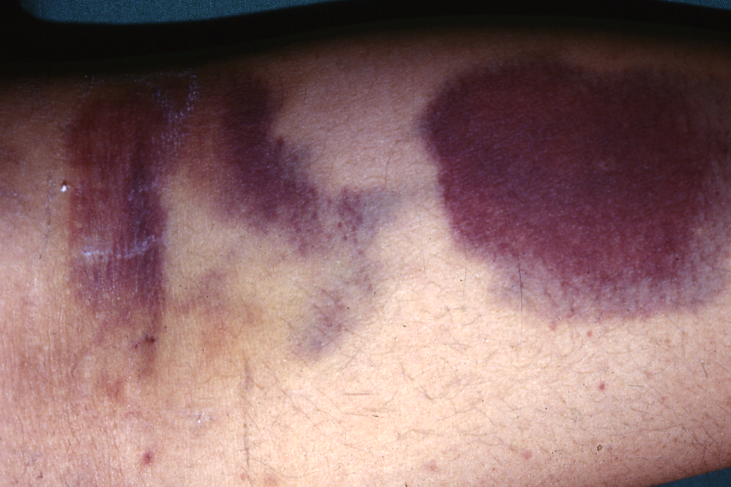

Slide 60
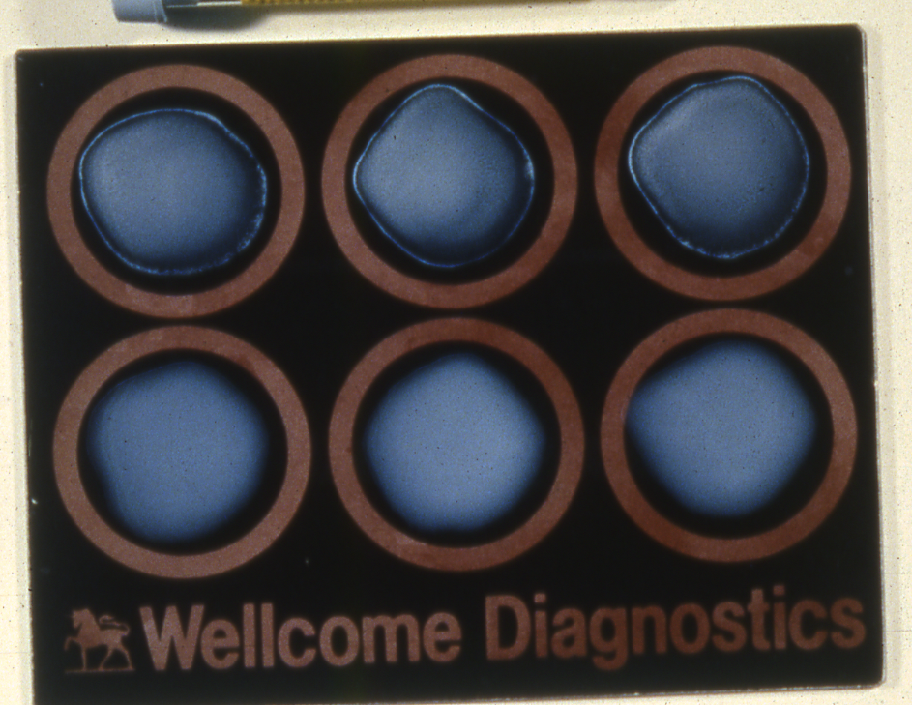

Slide 61
Haemostasis tests: typical results in acquired bleeding disorders
 | Platelet count | Prothrombin time | Activated partial thromboplastin time | Thrombin time
Liver disease | Low | Prolonged | Prolonged | Normal (rarely prolonged)
Disseminated intravascular coagulation | Low | Prolonged | Prolonged | Grossly prolonged
Massive transfusion | Low | Prolonged | Prolonged | Normal
Oral anticoagulants | Normal | Grossly prolonged | Prolonged | Normal
Heparin | Normal (rarely low) | Mildly prolonged | Prolonged | Prolonged
Circulating anticoagulant | Normal | Normal or prolonged | Prolonged

Slide 62
Screening Tests of Hemostasis
Screening tests | Defects
B.T. Prolonged | Platelets (↓ or dysfunction) + Von Willebrand’s disease
APTT prolonged | Factors: XII, XI, VIII, IX, X, V, II, I
P.T. Prolonged | Factors: VII, X, V, II, I
T.T. Prolonged | Fibrinogen (Factor I) high FDPS
Reptilase time prolonged | Fibrinogen (factor I) high FDPS. Not effected by Heparin therapy
FDPS high | ▪ D.I.C. ▪ Snake Bite ▪ Thrombolytic therapy ▪ Dysfibrinogenemia
Platelet Count Low | Thrombocytopenia
Platelet Count Normal | Platelet dysfunction

Slide 63
Indications for the use of fresh frozen plasma
Coagulation factor deficiency (where specific or
combined factor concentrate is not available)
Reversal of warfarin effect.
Multiple coagulation defects, e.g. in patients with liver disease, DIC
Massive blood transfusion with coagulopathy and
clinical bleeding
Thrombotic thrombocytopenic purpura
Deficiencies of antithrombin, protein C or protein S
Some patients with immunedeficiency syndromes

Slide 64
Oral Anticoagulants Indications
* Venous thrombosis and pulmonary embolism.
* Atrial fibrillation.
* Heart valve prostheses.
* Myocardial infarction (Selected cases)

Slide 65
Antithrombotic Therapy
2- Oral anticoagulants
* Antiplatelet drugs
* Warfarin
* New oral anticoagulant (Ximelagatran)

Slide 67
Oral Anticoagulants (Warfarin)
Doses and Preparations Available
Warfarin Preparations
Tablets 1 mg (Pink), 2 mg (Gray-Blue) 5 mg (Orange). 7.5 mg (Yellow) 10 mg (white)
Dosage: Large loading doses are no longer recommended. Depending on clinical circumstances, start with a daily dose of about 5 mg for 3 days. Check LFTs before starting treatment and do INR daily (the APTT as well) if the patient is receiving heparin, aiming to get the INR in the range between 2.0-4.5.
The usual daily dose for most patients lies between 3 mg and 6 mg but maintenance doses may vary widely and regular control, by means of an INR performed at no longer than 8 weekly intervals, is mandatory.

Slide 69
A lower dose of Warfarin may be required in any
of the following:
a. Elderly
b. Poor nutrition
c. Liver disease
d. Potentiating drugs (especially antibiotics)
e. Heart failure
f. Following surgery

Slide 70
Oral Anticoagulants (Warfarin)
INR : International Normalized Ratio
ISI : International Sensitivity Index
for the thromboplastin reagent used.
Patient’s PT ISI
INR = ---------------------
Mean normal PT

Slide 71
Oral anticoagulant control tests. Target INR levels.
-----------------------------------------------------------------------------------------
Target INR Clinical State
-------------------------------------------------------------------------------------------
2.5 Treatment of DVT, pulmonary embolism, atrial
(2.0 – 3.0) fibrillation, recurrent DVT of warfarin; symptomatic inherited thrombophilia, cardiomyopathy, mural thrombus, cardioversion
3.5 Recurrent DVT while on warfarin, mechanical
(3.0 – 4.0) prosthetic heart valves, antiphospholipid syndrome
(some cases)
-------------------------------------------------------------------------------------------

Slide 72
Recommendations on the management of bleeding and excessive anticoagulation.
__________________________________________________________________
INR 3.0 – 6.0 (target INR 2.5) Reduce warfarin dose or stop
INR 4.0 – 6.0 (target INR 3.5) Stop Warfarin,
Restart warfarin when INR < 5.0
INR 6.0 – 8.0
No bleeding or minor bleeding Stop warfarin,
Restart when INR <5.0
INR>8.0 Stop warfarin
No bleeding or minor bleeding Restart warfarin when INR<5.0
If other risk factors for bleeding
give 0.5 – 2.5 mg of vitamin K orally
Major bleeding Stop warfarin - Give prothrombin complex
concentrate 50 units/kg or FFP 15 ml/kg
Give 5 mg vitamin K (oral or i.v.)
_________________________________________________________________

Slide 73
Drugs and other factors which interfere with the control of anticoagulant therapy
---------------------------------------------------------------------------------------------------
Potentiation of oral anticoagulants Inhibition of oral anticoagulants
--------------------------------------------------------------------------------------------------
Drugs which increased the effect of coumarins Drugs which depress the action of coumarins
Reduced coumarin binding to serum albumin Acceleration of hepatic microsomal degradation of coumarin
sulphonamides barbiturates
Inhibition of hepatic microsomal degradation of coumarin rifampicin
cimetidine Enhanced synthesis of clotting factors
allopurinol Oral contraceptives
Tricyclic antidepressants
metronidazole Hereditary resistance to oral anticoagulants
Sulphonamides
Alteration of hepatic receptor site for drug Pregnancy
thyroxine
quinidine
Decreased synthesis of vitamin K factors
high doses of salicylates
some cephalosporins
Liver disease
Decreased synthesis of vitamin K factors
Decreased absoorption of vitamin K
e.g. malabsorption, anitibiotic therapy, laxatives

Slide 76
Fibrinolytic agents – plasminogen activators
Streptokinase (SK)
Tissue plasminogen activator (tPA)
Single – chain urokinase-type plasminogen activator (SCU – PA)
Acylated plasminogen – streptokinase activator complex (APSAC)

Slide 77
Contraindications to thrombolytic therapy
__________________________________________________________________
Absolute contraindications Relative contraindications
__________________________________________________________________
Active gastrointestinal bleeding Traumatic cardiopulmonary
Aortic dissection resuscitation
Head injury or cerebrovascular Major surgery in the past 10 days
accident in the past 2 months Past history of gastrointestinal
Neurosurgery in the past bleeding
2 months Recent obstetric delivery
Intracranial aneurysm or Prior arterial puncture
neoplasm Prior organ biopsy
Proliferative diabetic Serious trauma
retinopathy Severe arterial hypertension
(systolic pressure >200 mmHg, diastolic
pressure >110 mmHg)
Bleeding diathesis
__________________________________________________________________

Slide 78
Thank you
Notes:
78

