Slide 1
HAEMOGLOBINOPATHIES
DR. FATMA AL-QAHTANI
Consultant Haematologist
Department of Pathology

Slide 2
HAEMOGLOBINOPATHIES
A - THALASSAEMIAS
B - ABNORMAL HAEMOGLOBINS

Slide 4
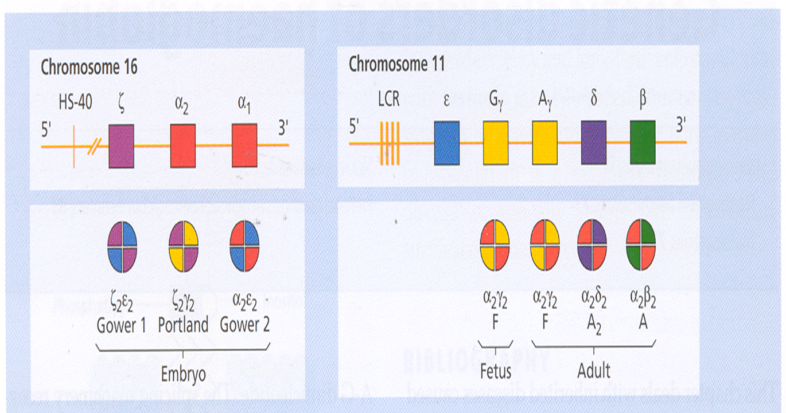

Slide 7
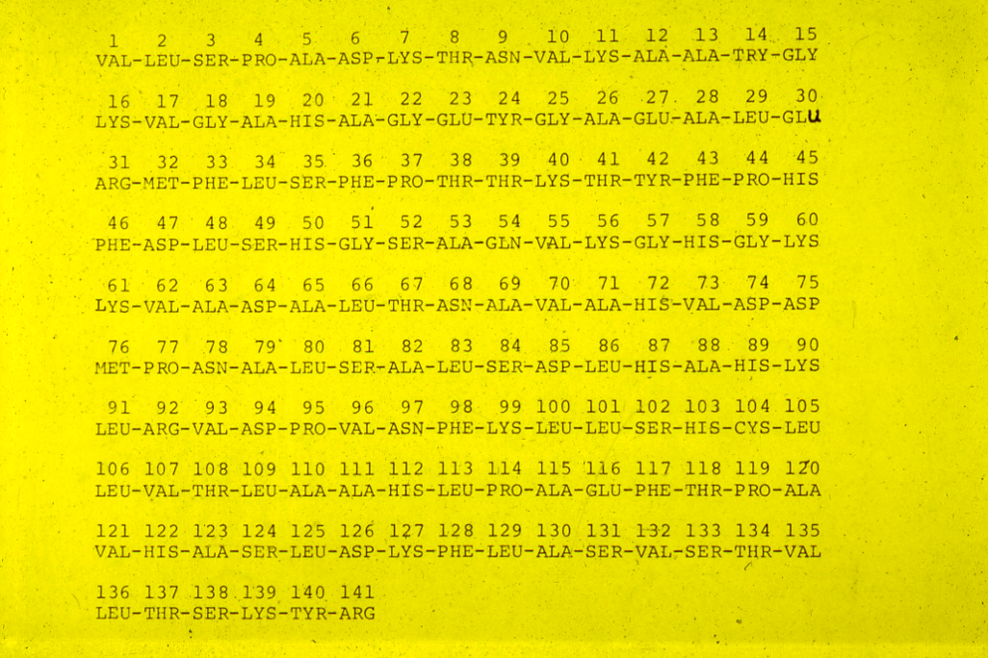

Slide 8
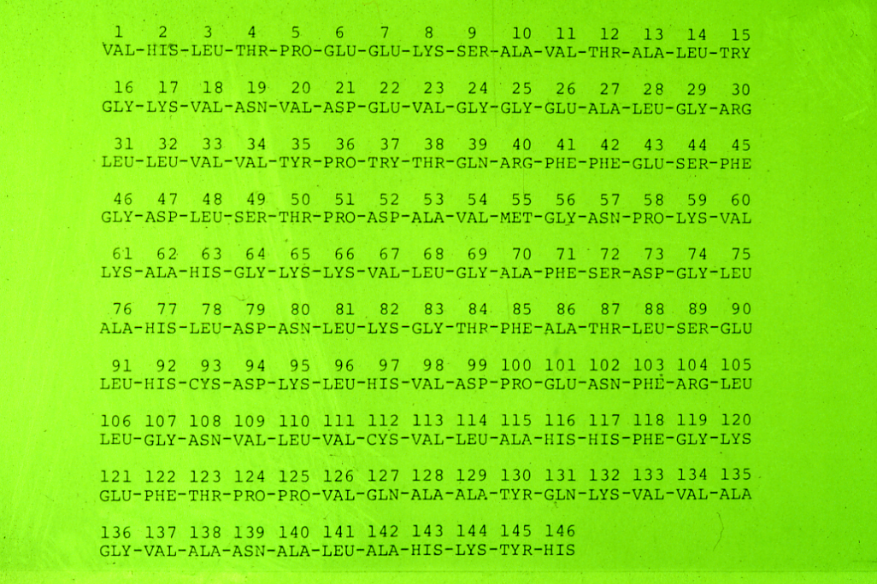

Slide 9
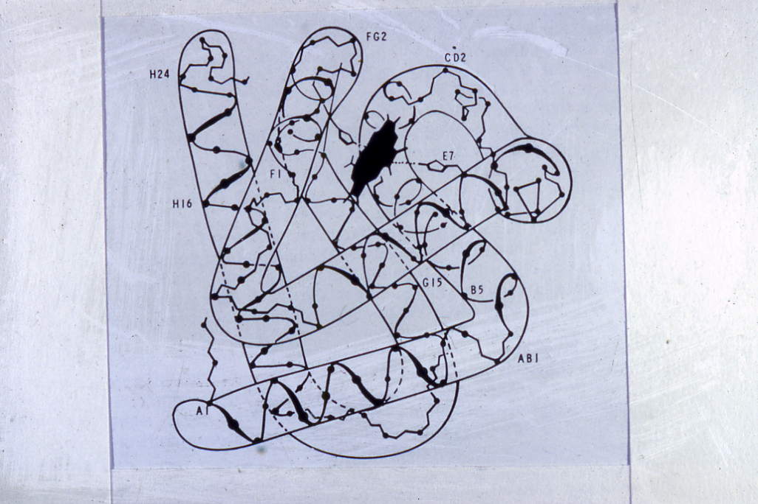

Slide 10
NAME | Chains
Haemoglobin A | α2 | β2
Haemoglobin A2 | α2 | δ2
Haemoglobin F | α2 | γ2
Haemoglobin H | - | β4
Haemoglobin Bart’s | - | γ4
Haemoglobin Gower I | ζ2 | Є2
Haemoglobin Gower II | α2 | Є2
Haemoglobin portland | ζ2 | γ2
Haemoglobin Lepore | α2 | (δβ)2

Slide 11
THE HAEMOGLOBINS PRESENT AT BIRTH IN NORMAL NEW BORN
NAME %
HbA 15 – 40
HbA₂ < 0.3
HbF 60 – 85
Hb Bart’s < 0.5

Slide 12
THE NORMAL HUMAN HAEMOGLOBINS
EMBRYONIC
(Upto 8 Weeks gestation) ζ₂ Є ₂ Hb Gower I
ζ ₂ γ₂ Hb Portland
α₂ Є ₂ Hb Gower II
FETAL α₂ γ₂ HbF 60 - 85%
α₂β₂ HbA 15 – 40 %
Caucasian Saudi
ADULT α₂ β₂ HbA 97.0% 95.0%
α₂δ₂ HbA₂ 2.5% 3.5%
α₂ γ₂ HbF 0.5% 1.5%

Slide 13
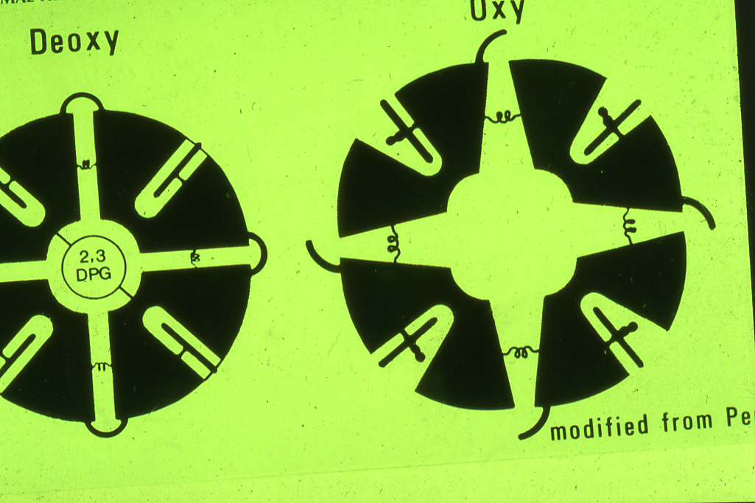

Slide 14
THALASSAEMIA – α or β
HETEROZYGOUS
HOMOZYGOUS

Slide 20
LABORATORY DIAGNOSIS OF ALPHA THALASSEMIA SYNDROME
High red cell count in the trait
Hypochromic microcytic red cells & target cells
Normal serum iron or low in children
Normal total iron binding capacity or high in children
Positive Hb H inclusion bodies in the blood film preparation & positive Heinz bodies with vital stains
Hemoglobin electrophoresis show presence of hemoglobin H (Hb H disease)
Hemoglobin electrophoresis show low Hb A2 level
Genetic study to confirm the diagnosis

Slide 21
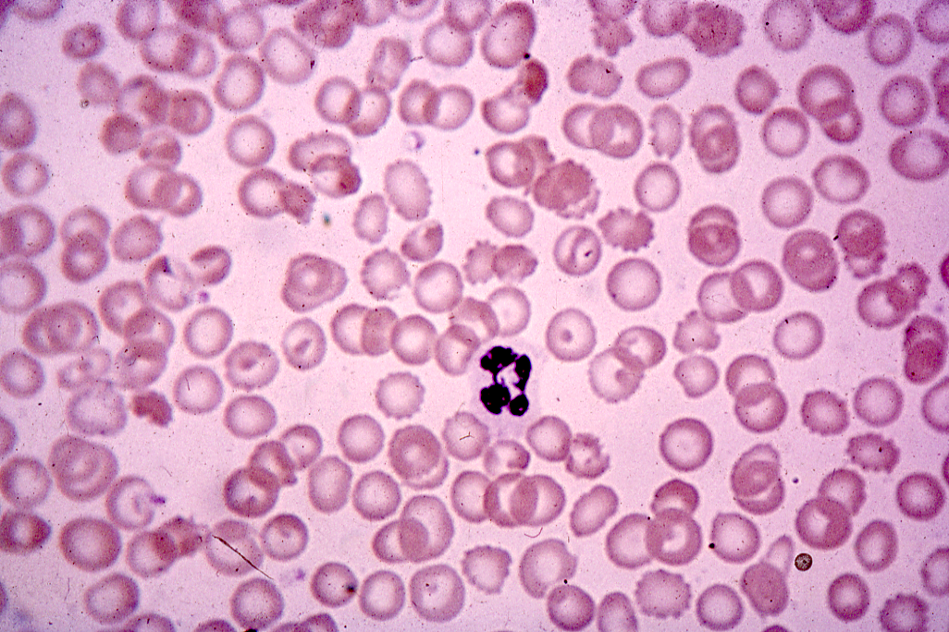

Slide 22
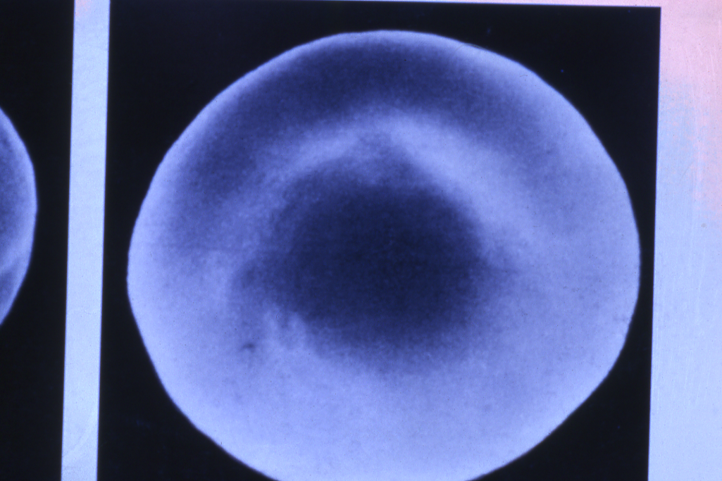

Slide 23
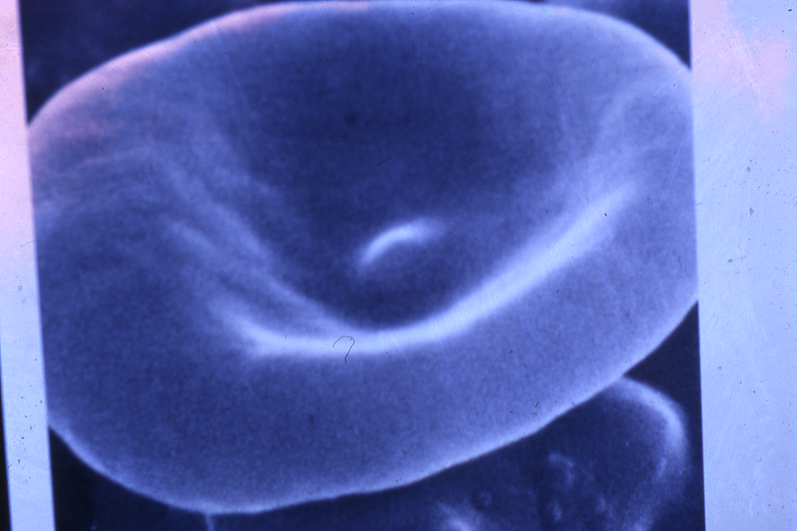

Slide 25
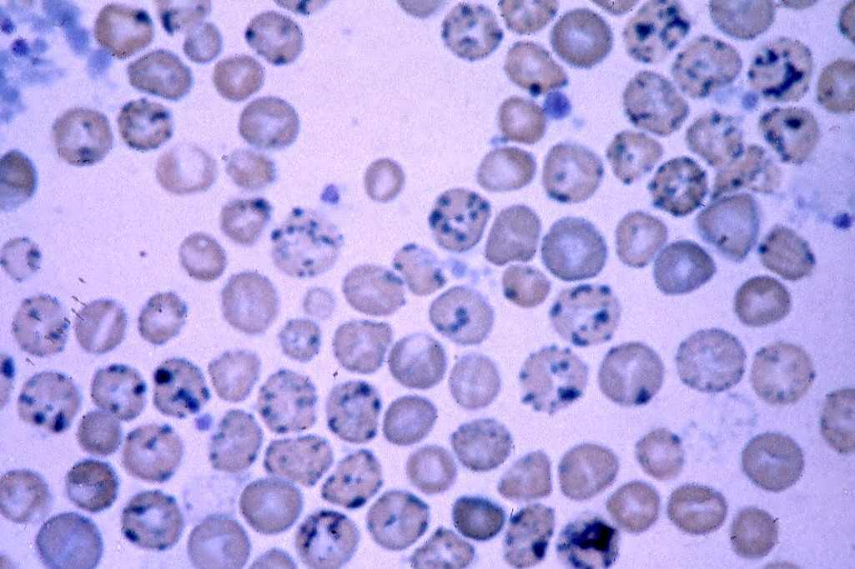

Slide 26
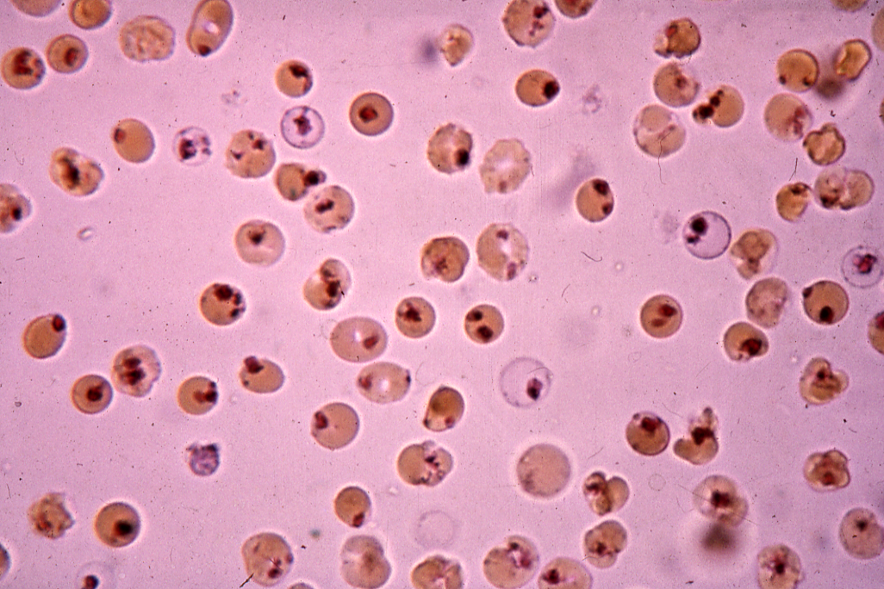

Slide 27
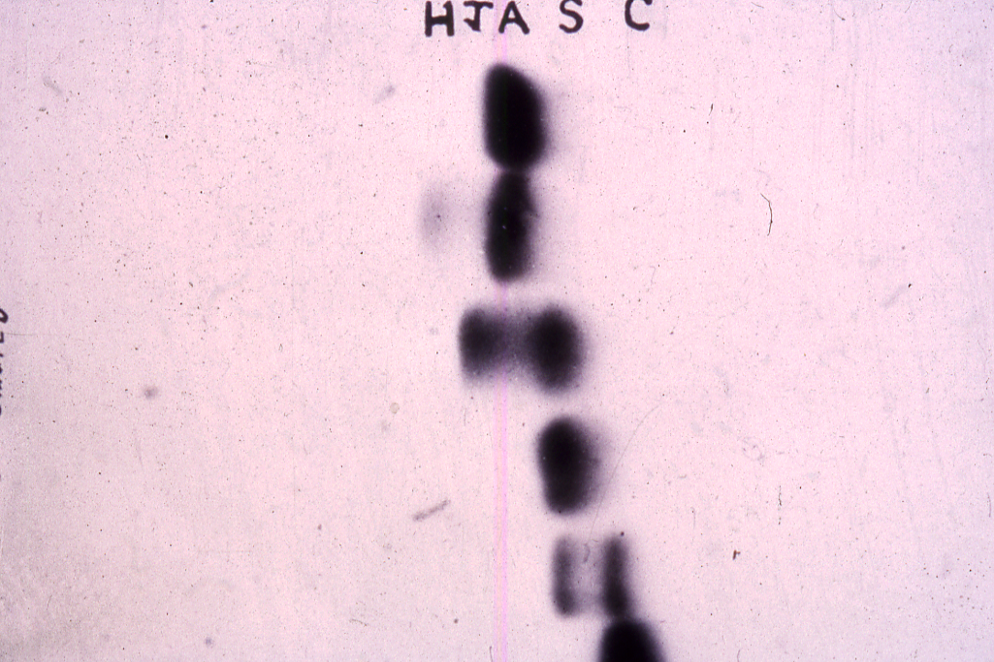

Slide 28
β-THALASSAEMIA

Slide 29
5’ ε Gγ Aγ uη δ β 3
Hc Hd Hd Hc A B
The –globin gene cluster showing the position of various common restriction endonuclease polymorphic sites. (Hc, Hinc II; Hd, Hind III; A, Ava II; B, Bam H1).

Slide 30
Molecular Defects in the β-Thalassaemia Syndrome
 | β-Globin synthesis | β⁻mRNA | β-Globin Gene | δ-Globin Synthesis | γ-Globin Synthesis
1. β⁺-Thalassemia 2. β⁰-Thalassemia | Decreased Absent | Decreased Absent | Present Present | Present Present | Present Present
Ferrara Variant Indian Variant | Absent Absent | Inactive Absent | Present Partially Deleted | Present Present | Present Present
3. δβ-Thalassaemia 4. HPFH | Absent Absent | Absent Absent | Deleted Deleted | Absent Absent | Increased increased

Slide 31
Hemoglobin Fractions in the Genotypic Variants
of the β-Thalassaemia Syndromes
Genotype | HbA | HbA₂ | HbF (%) | Other Hemoglobins
Normal β/β | 97 | 2.5 – 3.2 | <1 | None
Thalassaemia major β⁰/β⁰ β+/β⁺ Mediterranean β⁰/β⁺ (δβ) Lepore/ (δβ) Lepore | 0 Present Present 0 | 1.0 – 5.9 2.4 – 8.7 0.6 – 3.4 0 | >94 20 – 90 >75 70 – 92 | Free α-chains Free α-chains None Hb Lepore (8-30%)
Thalassaemia intermedia β+/β⁺, black β⁰/ (δβ)⁰ β⁺/ (δβ)⁰ β⁰/ (δβ)⁰ Lapore β⁺/ (δβ)⁰ Lepore β⁰/β (δβ)⁰ / (δβ)⁰ (δβ)⁰/ (δβ)Lepore α/β | Present 0 20 – 30 0 Present Present 0 0 Present | 5.4 – 10.0 0.3 – 2.4 Decreased Decreased Decreased >3.2 0 0 Increased | 30 – 73 60 – 99 Increased Increased Increased 1.5 – 12 100 92 Normal or increased | None None None Hb Lepore (10%) Hb Lepore (10%) None None Hb Lepore (8%) ± Hb H

Slide 32
Hemoglobin Fractions in the Genotypic Variants
of the β-Thalassaemia Syndromes (Continued)
Genotype | HbA | HbA₂ | HbF (%) | Other Hemoglobins
Thalassaemia minor β ⁺/β β⁰/β (δβ)⁰/β (δβ) Lepore/ β (γδβ)⁰/β | >90 >90 >90 Present Present | 3.5 – 8.0 3.5 – 8.0 2.5 – 8.0 1.2 – 2.6 2.5 – 3.2 | 1 – 2 1 – 2 5 – 20 1 – 3 < 1 – 2 | None None None Hb Lepore ( 5 – 15%) None
Thalassaemia minima β^{silent}/β | 97 | <3.2 | <1 | None

Slide 33
Clinical Manifestations in Thalassaemias
Pallor
Jaundice
Apathy and Anorexia
Failure to Thrive
Hepato-splenomegaly
Skeletal Deformity
Iron Overload mainfestations

Slide 34
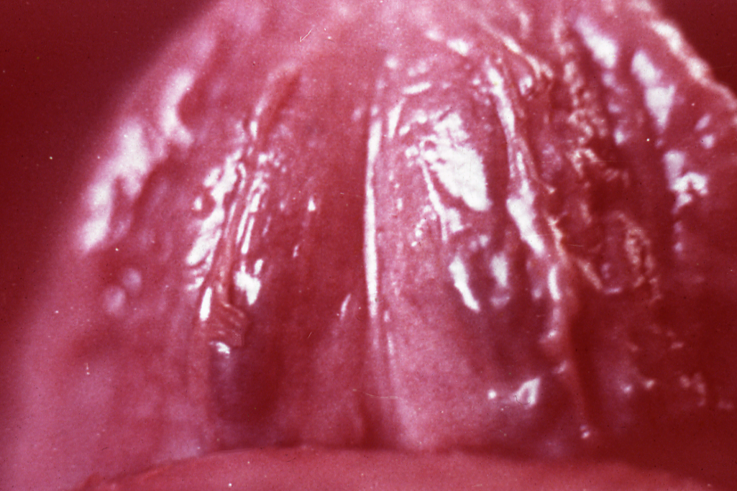
.

Slide 35
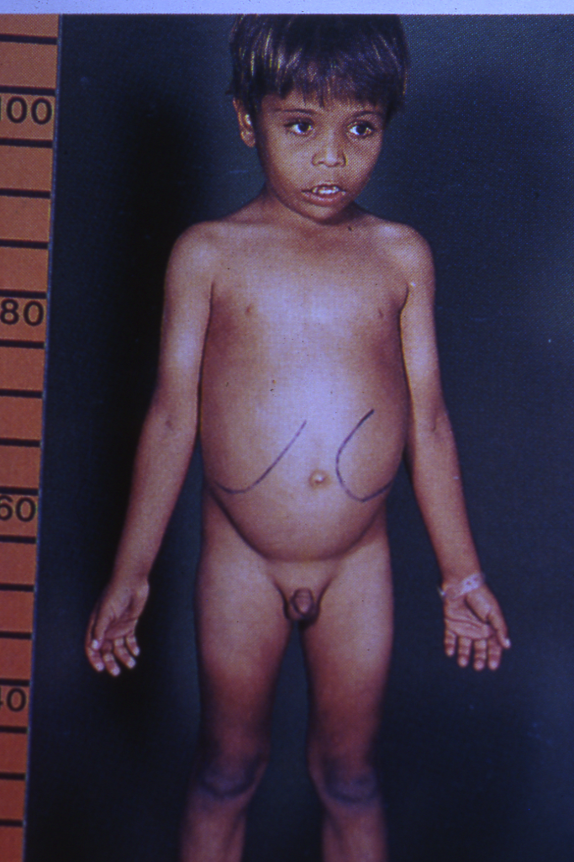
.

Slide 36
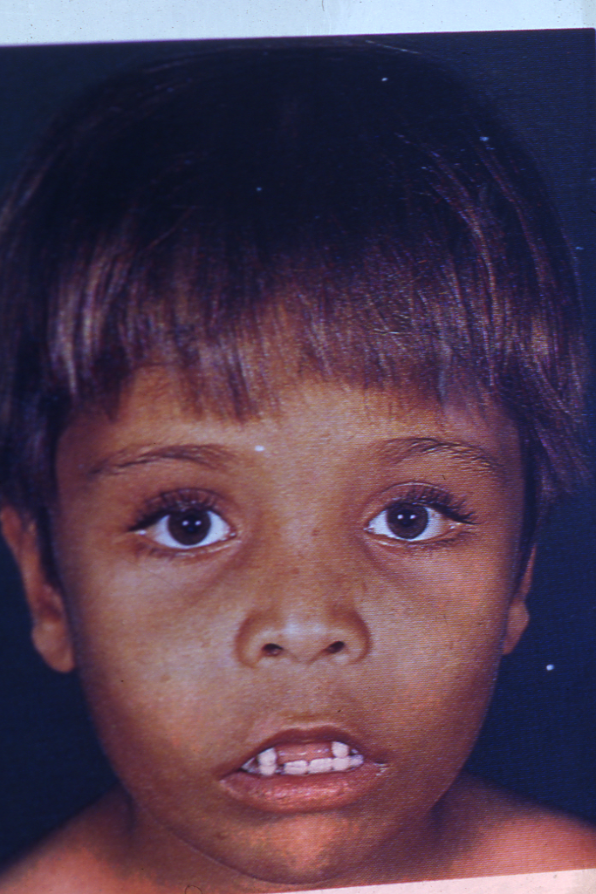
.

Slide 37
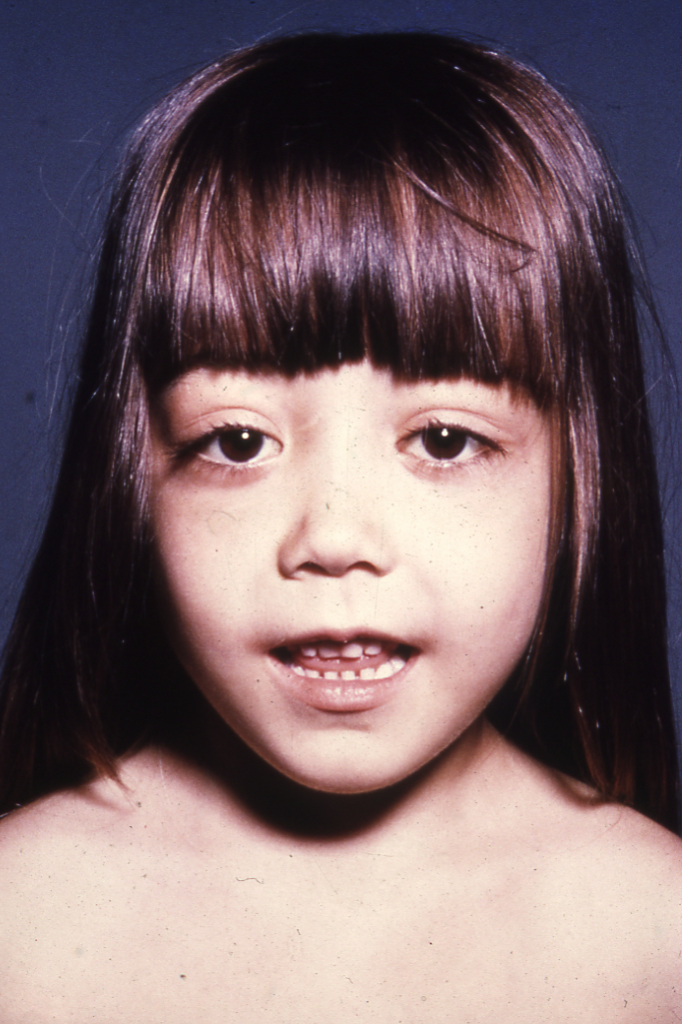
.

Slide 40
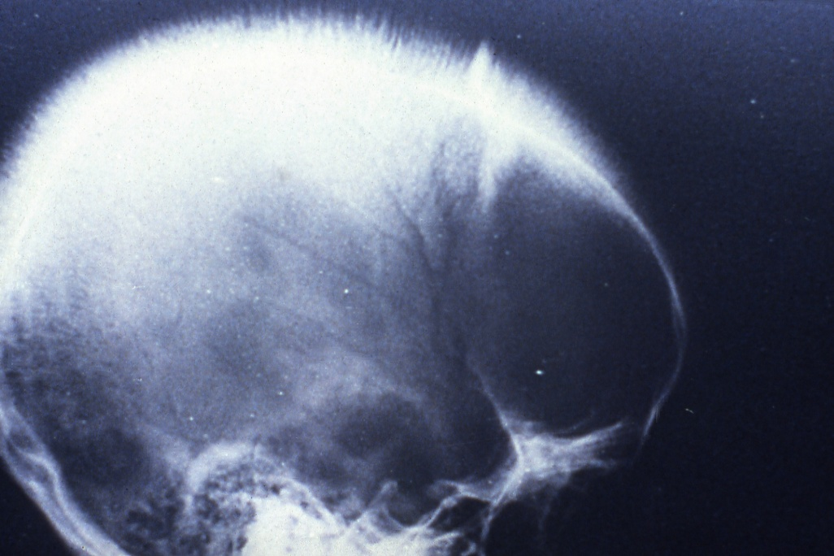
.

Slide 41
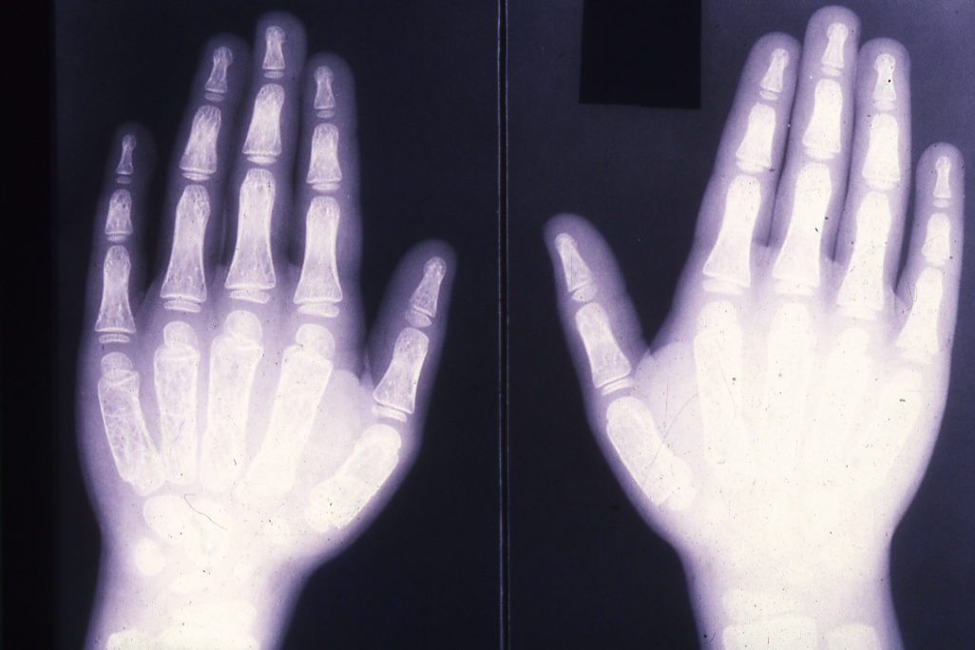
.

Slide 42
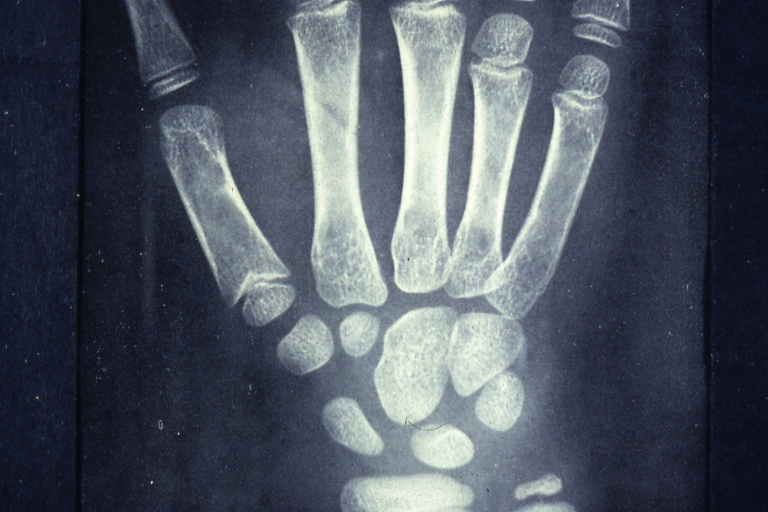
.

Slide 43
Clinical and Hematological Features
of the β-Thalassemia Syndrome
 | Major | Intermedia | Minor | Minima
Severity of mainfestations | ++++ | ++ | +, ± | ±, 0
Genetics | Homozygotes, double heterozygotes | Homozygotes, double heterozygotes, rarely heterozygotes | Heterozygotes | Heterozygotes
Splenomegaly | ++++ | ++,+++ | +,0 | 0
Jaundice | +++ | ++,+ | 0 | 0
Skeletal changes | ++++,++ | +,0 | +,0 | 0
Anemia (Hb, g/dl) | <7 | 7 – 10 | >10 | Normal
±, little or no abnormality; +, mild abnormality; ++++, prominent abnormality

Slide 44
Clinical and Hematologic Features
of the β-Thalassemia Syndrome (Continued)
 | Major | Intermedia | Minor | Minima
Hypochromia | ++++ | +++ | ++ | +
Microcytosis | +++ | ++ | + | 0
Target cells | 10 – 35% | ++ | + | ±
Basophilic stippling | ++ | + | + | 0, +
Reticulocytes (%) | 5 – 15 | 3 – 10 | 2 – 5 | 1 – 2
Nucleated red cells | +++ | +, 0 | 0 | 0
±, little or no abnormality; +, mild abnormality; ++++, prominent abnormality

Slide 46
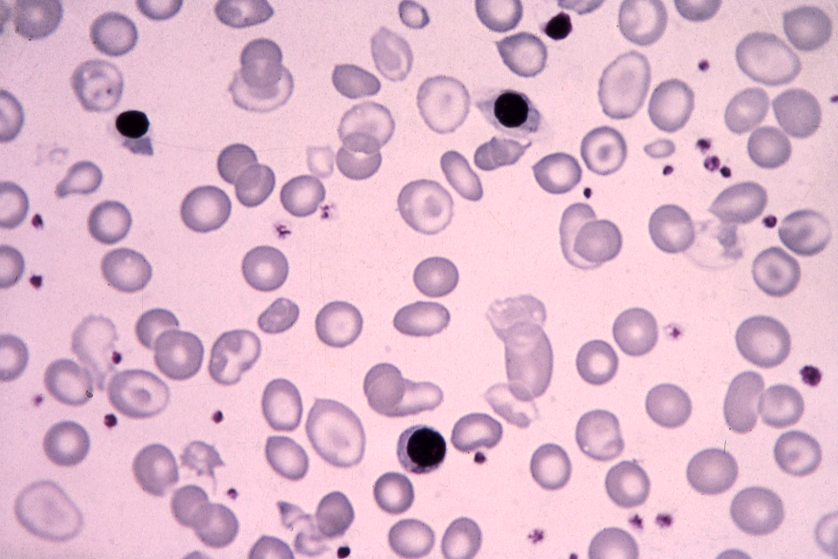
.

Slide 47
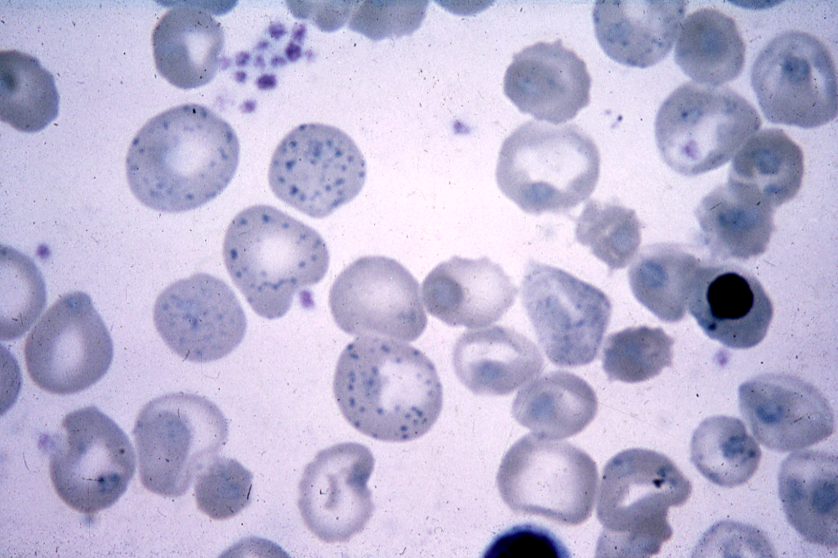
.

Slide 48
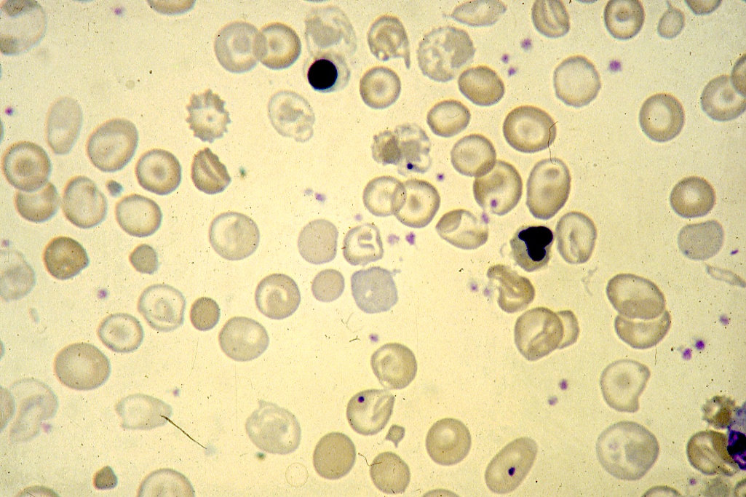
.

Slide 56
Prenatal diagnosis of the haemoglobinopathies (Including thalassaemia)
DNA Analysis
Chorionic villus sampling
Transcervical approach (9 – 11 weeks of pregnancy)
Transabdominal approach (up to 15 weeks of pregnancy)
Amniotic fluid cell analysis (16 – 20 weeks gestation)
Fetal blood sampling (> 20 weeks gestation)
DNA analysis
Haematological parameters
Biochemical analysis
Globin chain synthesis
α/β Ratio
α/ɣ Ratio
α/δ Ratio

Slide 58
DNA ANALYSIS
Gene mapping
2. RFLPs linkage analysis
(Restriction fragment length polymorphisms)
Oligonucleotide probes
(Using short gene probes 17 – 19 Nucleotide)
Gene amplification
(Enzymatic amplification of DNA sequences)
DNA polymerase chain reaction technique.

Slide 59
MANAGEMENT OF THE THALASSEMIAS
Blood Transfusion
Iron chelation therapy
Splenectomy
Hormone replacement
Bone marrow transplantation
Gene therapy

Slide 60
SUMMARY OF RECOMMENDATIONS FOR THE
TREATMENT OF THALASSEMIA MAJOR
TRANSFUSION
Transfusion, in the absence of cardiopathy:
Blood-type the patient completely;
Vaccinate hepatitis B negative patients against hepatitis;
Transfuse when the Hb remains consistently below 8 g/dL, or earlier if there are other indications;
Keep the pretransfusion Hb between 10.5 and 11 g/dL;
Give 10-15 mL/kg of blood preparation in 2 h;
Do not raise the posttransfusion Hb above 16 g/dL;
Choose a 3-4 week transfusion interval.

Slide 61
SUMMARY OF RECOMMENDATIONS FOR THE TREATMENT OF THALASSEMIA MAJOR (Continued)
TRANSFUSION
Transfusion in the presence of cardiopathy, or when the Hb is less than 5 g/dL:
Inject furosemide 1-2 mg/kg;
Preferably use fresh blood;
Do not transfuse more than 5 mL/kg of blood;
Do not transfuse faster than 2 mL/kg, or for more than 4 h;
If necessary, divide the blood among 2 or more bags;
Use very short intertransfusion intervals.

Slide 62
IRON CHELATION THERAPY
Desferrioxamine S.C. 20-60 mg/kg/day in 8 h (average 40 mg/kg/day, or 280 mg/kg/ week).
In selected subjects, give desferrioxamine i.v. in high dose, maximum 100 mg/kg over 8 h, only on the days of transfusion.
SPLENECTOMY
Is indicated when the blood consumption is more than 1.5 times normal.
Give anti-pneumococcal vaccine to children more than 2 years old prior to splenectomy.
Inform the patients and their family doctors of increased risk of serious infections.
Give prophylactic penicillin, and a platelet anti-aggregant when there is thrombocytosis.

Slide 63
INVESTIGATIONS
Prior to treatment: | Study the case, and do complete red cell typing.
Before each transfusion: | Hb, cross-match and red cell antibody detection, serum transminases (in areas with a high incidence of hepatitis). Record the date of transfusion, net weight and mean hematocrit of the blood preparation, and the Hb of the patient
After each transfusion: | Measure the posttansfusion Hb.
Every 3 months: | Measure height and weight
Every 6 months: | Ferritin estimation.
Every year: | Evaluate growth and development. Calculate the transfusion indices. Evaluate iron balance. Complete evaluation of the case.
Variable intervals: | Cardiac and endocrinological investigations according to the clinical state of the patient.

Slide 64
Diagnosis of Haemoglobinopathies including Thalassaemias
Personal & Family History
Physical Examination
Laboratory Investigation
1. Haematological Tests – CBC, Red cell indices, blood film Morphology, reticulocyte count.
2. Sickling Tests – Sickle cell test, Sickle cell solubility test.
3. Hb Electrophoresis at alkaline/acidic pH and quantitation.
4. Quantitation of HbA2 and HbF
5. Osmotic fragility test
6. Serum iron total iron binding capacity and ferritin level
7. Biochemical tests:
Liver functions tests, renal function tests, blood gases and acid-base status, bone profile and urine analysis.
8. Special Tests
A. Family studies (Laboratory Investigations)
B. Measurement of Alpha/Non-Alpha chain ratio
C. Gene Studies

Slide 68
ORAL IRON CHELATION THERAPY
-----------------------------------------------------------------------------------------
Deferiprone [ Ferriprox ]
Oral Tablet or Syrup 5 to 10 mg /kg /day divided in 3 doses.
More effective than desferoxamine in chelating cardiac iron.
Total iron excretion with deferiprone is less than with desferoxamine.
Major adverse effect especially in children include - Gastrointestinal symptoms, joint pain, liver disfunction, neuropenia in 27% of patients.

Slide 69
ORAL IRON CHELATION THERAPY (CONTINUE)
-----------------------------------------------------------------------------------------
Deferasirox (EXJADE, NOVARTIS)
The dose is 20-30 mg/kg/day once daily.
Approved by FDA.
Reduction of liver iron to 50%, reduction of serum ferritin to 70% after 1 year treatment.
Side effects:
Nausea, vomiting, diarrhea, abdominal pain, skin rash.
Mid increase in serum cratinine in 30% of patients as with
Desferoxamine ocular and auditory disturbance have been reported.
Increase in serum transaminases in 10% of patients.
Reduction of the dose in steps 5-10mg/kg/day every 3-6 months depending on serum ferritin level.

Slide 70
Assessment of Iron Stores
Serum ferritin
Serum iron and percentage saturation of transferrin (iron-binding capacity)
Bone marrow biopsy (Perl’s stain) for reticuloendothelial stores
DNA test for mutation resulting in Cys282 Tyr in the HFE gene
Liver biopsy (parenchymal and reticuloendothelial stores)
Liver CT scan or MRI
Cardiac MRI
Desferrioxamine iron excretion test (chelatable iron)
Repeated phelobotomy until iron deficiency occurs

Slide 71
Assessment of tissue damage caused by
iron overload
Cardiac Clinical; chest X-ray; ECG; 24-h monitor;
echocardiography; radionuclide (MUGA scan to check left ventricular ejection fraction at rest and with stress
Liver Liver function tests; liver biopsy; CT scan
Endocrine Clinical examination (growth and sexual development) glucose tolerance test; pituitary gonadotrophin release tests; thyroid, parathyroid, gonadal, adrenal function, growth hormone assays; radiology for bone age; isotopic bone density study
-----------------------------------------------------------------------------------------
CT, computed tomography; ECG, electrocardiography; MRI, magnetic resonance imaging; MUGA, multiple gated acquisition.

Slide 72
Thank you !!!

