Slide 1
PATHOLOGY AND PATHOGENESIS OF CHOLECYSTITIS

Slide 2
Pathology and pathogegenesis of cholecystitis
Compare the various types of gallstones, how they are formed, what the risk factors for their development are, and what complications they can cause.
Recognize the predisposing factors of cholecystitis and the different types of cholecystitis.
Understand the pathogenesis of acute and chronic cholecystitis

Slide 3
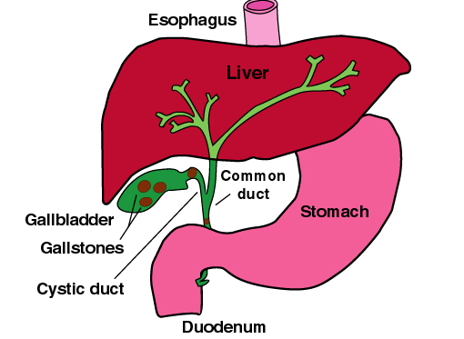
Components of bile
A. Bile salts/acids (~67%)
Hepatic product of CH metabolism
Water soluble
Detergent action renders CH soluble in bile.
B. Phospholipid (22%)
Mainly lecithin, Hydrophobic, Solubilizes CH in bile
C. Protein (4.5%), free CH (4%), conjugated bilirubin (0.3%)
In extravascular hemolytic anemia (EHA; e.g., hereditary spherocytosis, sickle cell disease), there is an increase in UCB (macrophage destruction of spherocytes/sickle cells) and a corresponding increase in the uptake and conjugation of UCB to conjugated bilirubin (CB) in the liver. In the gallbladder, some of the CB is converted back to UCB, which combines with calcium to form calcium bilirubinate stones.
D. Water, electrolytes, bicarbonate

Slide 4
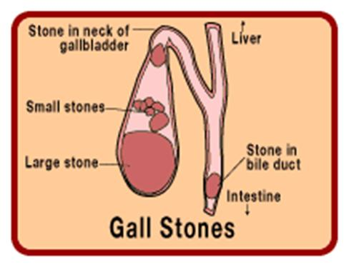
Disorders of the Gallbladder CHOLELITHIASIS (GALLSTONES)
Majority of gallstones (>80%) are "silent," and most individuals remain free of biliary pain or stone complications for decades.

Slide 5
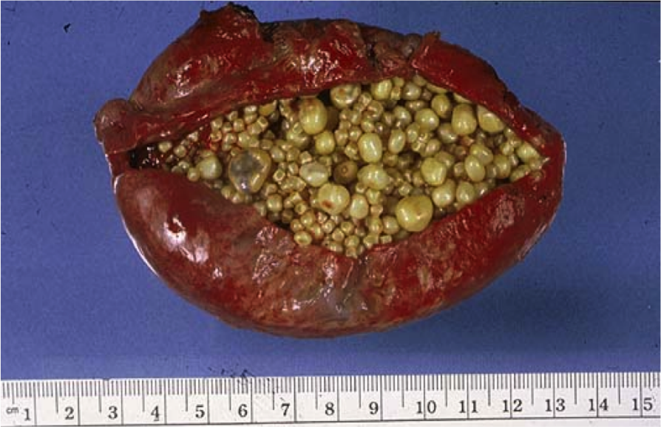
Disorders of the Gallbladder CHOLELITHIASIS (GALLSTONES)
There are two main types of gallstones
Cholesterol stones
Pigment stones
About 80%, containing more than 50% of crystalline cholesterol monohydrate.
20%, containing bilirubin calcium salts.

Slide 6
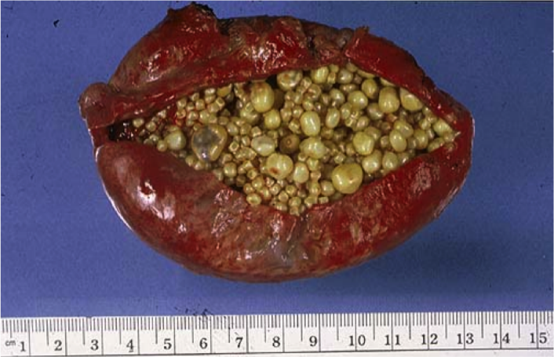
Prevalence and Risk Factors:
The major risk factors for cholesterol stone are:
Demography: northern Europeans, North and South Americans, Native Americans, Mexican Americans
Advancing age
Female sex hormones
Female gender
Oral contraceptives
Pregnancy
Obesity and metabolic syndrome
Rapid weight reduction
Gallbladder stasis
Inborn disorders of bile acid metabolism
Hyperlipidemia syndromes

Slide 7
Prevalence and Risk Factors:
The major risk factors for pigment stone are:
Demography: Asians more than Westerners, rural more than urban
Chronic hemolytic syndromes
Biliary infection
Gastrointestinal disorders: ileal disease (e.g., Crohn disease), ileal resection or bypass, cystic fibrosis with pancreatic insufficiency

Slide 8
Pathogenesis of Cholesterol Stones
Cholesterol is rendered soluble in bile by aggregation with water-soluble bile salts and water-insoluble lecithins, both of which act as detergents.
When cholesterol concentrations exceed the solubilizing capacity of bile (supersaturation), cholesterol can no longer remain dispersed and nucleates into solid cholesterol monohydrate crystals.
Cholesterol gallstone formation involves four simultaneous defects:

Slide 9
Pathogenesis of Cholesterol Stones
Supersaturation of bile with cholesterol is the result of hepatocellular hypersecretion of cholesterol.
Gallbladder hypomotility ensues. It promotes nucleation typically arround a calcium salt crystal nidus.
Cholesterol nucleation in bile is accelerated.
Mucus hypersecretion in the gallbladder traps the crystals, permitting their aggregation into stones.

Slide 10
Pathogenesis of Cholesterol Stones
prolonged fasting, pregnancy, rapid weight loss, total parenteral nutrition, and spinal cord injury also promote stone formation.

Slide 11
Pathogenesis of Pigment Stones
Pathogenesis of pigment stones is based on the presence in the biliary tract of unconjugated bilirubin (which is poorly soluble in water) and precipitation of calcium bilirubin salts.
Thus, infection of the biliary tract, as with Escherichia coli or Ascaris lumbricoides or by the liver fluke Opisthorchis sinensis, increases the likelihood of pigment stone formation.
Chronic hemolytic conditions also promote formation of unconjugated bilirubin in the biliary tree.

Slide 12
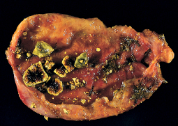
Morphology
Cholesterol stones arise exclusively in the gallbladder and are composed of cholesterol ranging from 100% pure (which is rare) down to around 50%.
pale yellow, round to ovoid to faceted, and have a finely granular, hard external surface.
Stones composed largely of cholesterol are radiolucent; only 10% to 20% of cholesterol stones are radio-opaque.

Slide 13
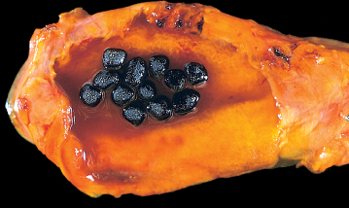
Morphology
Pigment gallstones are black and brown.
"Black" pigment stones are found in sterile gallbladder.
"Brown" pigment stones are found in infected intrahepatic or extrahepatic bile ducts.
Both are soft and usually multiple.
Brown stone are greasy.
Because of calcium carbonates and phosphates, approximately 50% to 75% of black stones are radio-opaque.

Slide 14
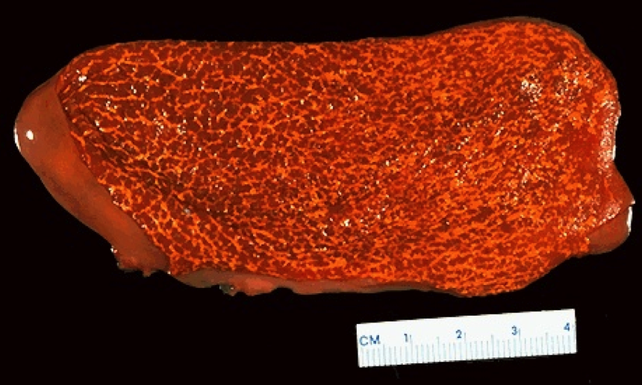
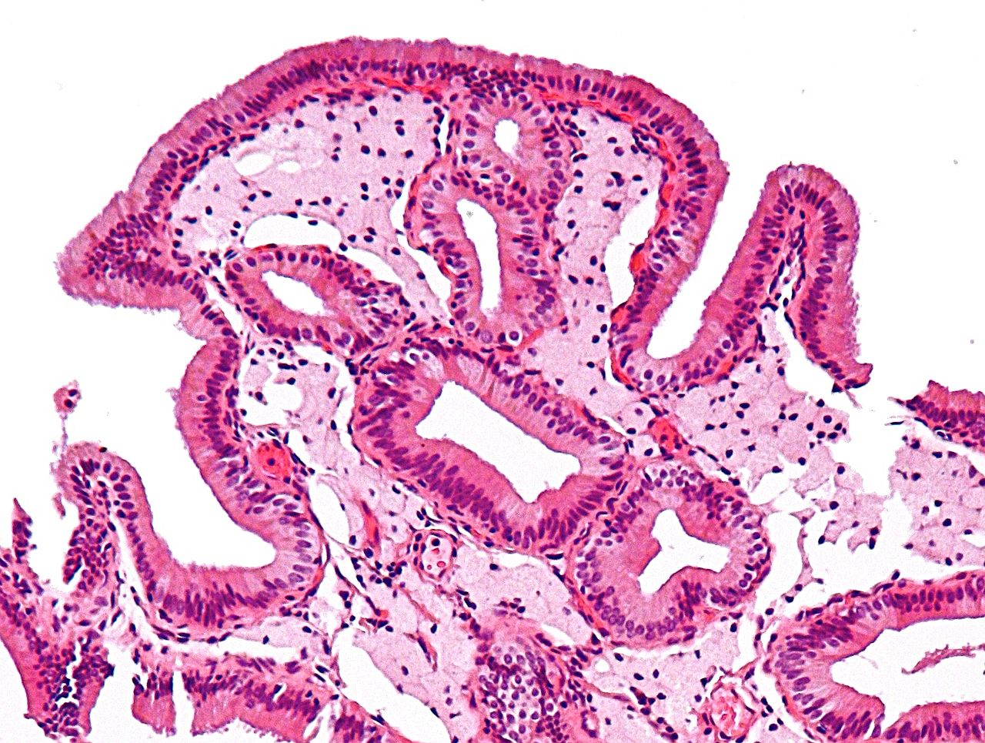
Cholesterolosis
An incidental finding, is cholesterolosis. Cholesterol hypersecretion by the liver promotes excessive accumulation of cholesterol esters within the lamina propria of the gallbladder. The mucosal surface is studded with minute yellow flecks, producing the "strawberry gallbladder

Slide 15
Clinical Features
70% to 80% of patients remain asymptomatic throughout their lives.
Symptoms: spasmodic or "colicky" upper quadrant pain, which tends to be excruciating .
It usually follows a fatty meal which forces a stone against the gall bladder outlet leading to increased pressure in the gall bladder causing pain. Pain is localized to right upper quadrant or epigastrium that may radiate to the right shoulder or the back
It is usually due to obstruction of bile ducts by passing stones.

Slide 16
Complications
Empyema, perforation, fistulas, inflammation of the biliary tree (cholangitis), obstructive cholestasis and pancreatitis.
The larger the calculi, the less likely they are to enter the cystic or common ducts to produce obstruction; it is the very small stones, or “gravel,” that are more dangerous.
Occasionally a large stone may erode directly into an adjacent loop of small bowel, generating intestinal obstruction (“gallstone ileus” or Bouveret syndrome).
Gallstones are associated with an increased risk of gallbladder carcinoma

Slide 17
CHOLECYSTITIS
Inflammation of the gallbladder may be acute, chronic, or acute superimposed on chronic. It almost always occurs in association with gallstones.

Slide 18
Acute Cholecystitis
Acute calculous cholecystitis is an acute inflammation of the gallbladder, precipitated 90% of the time by obstruction of the neck or cystic duct.
It is the primary complication of gallstones and the most common reason for emergency cholecystectomy.
Acute acalculous cholecystitis occurs in the absence of gallstones, generally in severely ill patient. Most cases of occur in the following circumstances:
(1) the postoperative state after major, nonbiliary surgery (2) severe trauma (motor vehicle accidents, war injuries) (3) severe burns
(4) multisystem organ failure
(5) sepsis
(6) prolonged intravenous hyperalimentation
(7) the postpartum state.

Slide 19
Acute Cholecystitis :Pathogenesis.
Acute calculous cholecystitis results from chemical irritation and inflammation of the obstructed gallbladder. These events occur in the absence of bacterial infection; only later in the course may bacterial contamination develop.

Slide 20
Acute Cholecystitis: Morphology
In acute cholecystitis, the gallbladder is usually enlarged and tense, and bright red to green-black . The serosal covering is frequently layered by fibrin and, in severe cases, by exudate.
There are no morphologic differences between acute acalculous and calculous cholecystitis, except for the absence of macroscopic stones in the former.
In calculous cholecystitis, an obstructing stone is usually present in the neck of the gallbladder or the cystic duct.

Slide 21
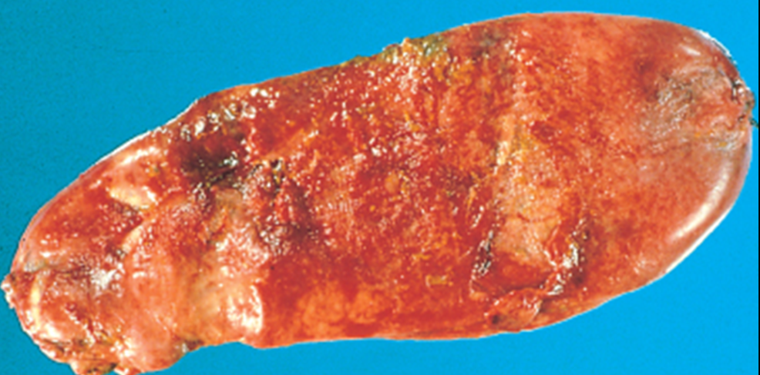
Acute Cholecystitis: Morphology.
The gallbladder lumen is filled with a cloudy or turbid bile that may contain fibrin and frank pus, as well as hemorrhage. When the contained exudate is virtually pure pus, the condition is referred to as empyema of the gallbladder.
In mild cases, the gallbladder wall is thickened, edematous, and hyperemic.
In more severe cases, it is transformed into a green-black necrotic organ, termed gangrenous cholecystitis, with small-to-large perforations.

Slide 22
Acute Cholecystitis: Clinical Features
Progressive right upper quadrant or epigastric pain, frequently associated with mild fever, anorexia, tachycardia, sweating, and nausea and vomiting. The upper abdomen is tender. Most patients are free of jaundice
Acute calculous cholecystitis may appear with remarkable suddenness and constitute an acute surgical emergency or may present with mild symptoms that resolve without medical intervention.

Slide 23
Acute Cholecystitis: Clinical Features
Clinical symptoms of acute acalculous cholecystitis tend to be more insidious, since symptoms are obscured by the underlying conditions precipitating the attacks.
A higher proportion of patients have no symptoms referable to the gallbladder.
The incidence of gangrene and perforation is much higher than in calculous cholecystitis.

Slide 25
Chronic cholecystitis
Chronic cholecystitis may be a sequel to repeated bouts of mild to severe acute cholecystitis, but in many instances, it develops in the apparent absence of antecedent attacks.
It is associated with cholelithiasis in over 90% of cases.

Slide 26
Chronic cholecystitis
The symptoms of calculous chronic cholecystitis are similar to those of the acute form and range from biliary colic to indolent right upper quadrant pain and epigastric distress.
Patients often have intolerance to fatty food, belching and postprandial epigastric distress, sometimes include nausea and vomiting.

Slide 27
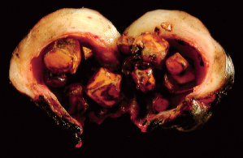
Morphology
The morphologic changes in chronic cholecystitis are extremely variable and sometimes minimal. Gall bladder may be contracted (fibrosis), normal in size or enlarged (from obstruction). The wall is variably thickened. Stones are frequent.

Slide 28
Morphology
On histology, the degree of inflammation is variable. Outpouchings of the mucosal epithelium through the wall (Rokitansky-Aschoff sinuses) may be quite prominent.
Rarely, extensive dystrophic calcification within the gallbladder wall may yield a porcelain gallbladder, notable for a markedly increased incidence of associated cancer.
Xanthogranulomatous cholecystitis is also a rare condition in which the gallbladder is shrunken, nodular, fibrosed and chronically inflamed with abundant lipid filled macrophages.
Finally, an atrophic, chronically obstructed gallbladder may contain only clear secretions, a condition known as hydrops of the gallbladder.

Slide 29
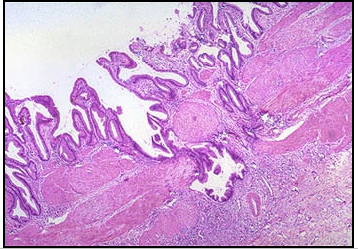
Rokitansky-Aschoff sinuses (outpouchings of the mucosal epithelium through the muscular wall of the gallbladder) may be seen in chronic cholecystis

Slide 30
Complications: acute and chronic cholecystitis
Bacterial superinfection with cholangitis or sepsis
GB perforation & local abscess formation
GB rupture with diffuse peritonitis
Biliary enteric (cholecystenteric) fistula with drainage of bile into adjacent organs, and potentially gallstone-induced intestinal obstruction (ileus)
Aggravation of pre-existing medical illness, with cardiac, pulmonary, renal, or liver decompensation

Slide 31
Cholecystitis
Take home message
Question: Causes of acute cholecystitis?

Slide 32
Under what conditions do cholesterol gallstones form, and what are the steps in the formation of gallstones?
Cholesterol is rendered soluble in bile via aggregation with water-soluble bile salts and water-insoluble lecithins. When cholesterol concentrations increase, supersaturation of bile and nucleation of cholesterol crystals occur. Gallbladder stasis, increased mucin content of the bile, and biliary sludge all act to promote nucleation of cholesterol crystals, which grow by accretion into stones.
Risk factors for cholesterol and mixed gallstones include ethnic and geographic factors (Native American populations and industrialized societies), increasing age, female sex, environmental factors (oral contraceptive use and multiparity), acquired disorders (diabetes, obesity, rapid weight loss, diseases of the distal small intestine such as Crohn disease), and hereditary disorders (hyperlipidemias).

Slide 33
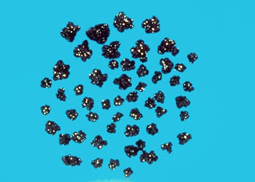
What are risk factors for the development of pigment gallstones?
Cirrhosis, chronic hemolytic anemias (such as patients with sickle cell anemia), bacterial contamination of the biliary tree, and chronic parasitic biliary infections are recognized risk factors for the development of pigment stones.

Slide 34
What are the pathobiologic mechanisms leading to the development of acute calculous cholecystitis?
Acute calculous cholecystitis is due to irritation and inflammation of the gallbladder wall when there is obstruction of bile outflow. Lysolecithin, a hydrolytic product of biliary lecithin produced with bile stasis, is toxic to the gallbladder mucosa. Bile salts are also toxic. Prostaglandins contribute to further damage. Furthermore, inflammation and distention of the gallbladder lead to increased luminal pressure, which compromises blood flow to the wall.

Slide 35
In addition to cholecystitis what are the complications arising from cholelithiasis?
Seventy to eighty percent of patients with gallstones remain asymptomatic throughout their lives. However, stones can cause colicky pain, acute and chronic cholecystitis, empyema of the gallbladder, gallbladder perforation or fistulae, gallstone ileus, choledocholithiasis with ascending cholangitis and possible liver abscesses, obstructive cholestasis, and pancreatitis.

Slide 36
What do the laboratory tests of marked elevation of serum amylase and lipase indicate?
The marked elevation of serum amylase and lipase is consistent with a diagnosis of acute pancreatitis.
What do the laboratory tests of elevated alkaline phosphatase with a conjugated hyperbilirubinemia indicate?
An elevated alkaline phosphatase with a conjugated hyperbilirubinemia is suggestive of obstructive jaundice due to choledocholithiasis.

Slide 37
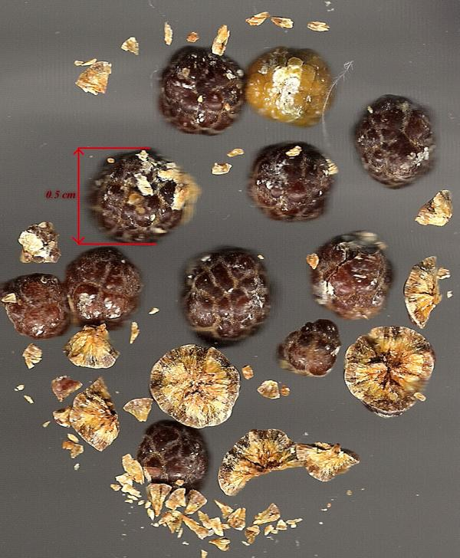

Slide 38
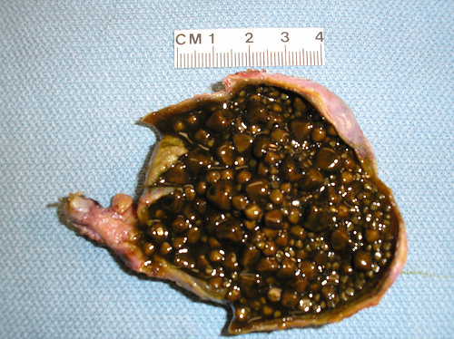
Brown stones

Slide 39
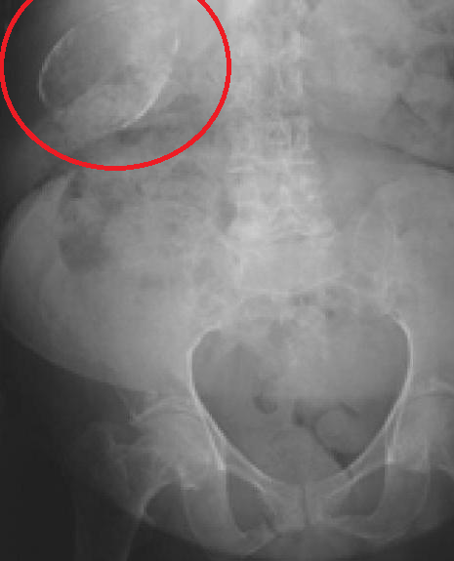
Porcelain gallbladder

Slide 40
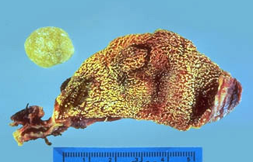
Cholesterol stone and cholesterolosis of the gallbladder –
Gross, mucosal surface
This image shows a round, yellow, pure cholesterol gallstone next to an opened gallbladder, which shows a geographic yellow mucosal surface caused by cholesterolosis of the gallbladder. Cholesterolosis is not a risk factor for gallstone formation. Microscopically, gallbladders affected by cholesterolosis contain numerous triglyceride- and cholesterol-laden macrophages in the lamina propria of the tips of the villi in the mucosal layer

