Slide 1
Peptic Ulcer Disease
Dr Maha Arafah

Slide 2
Objectives
Upon completion of this lecture the students will :
A] Understand the Pathophysiology of acute and chronic peptic ulcer
B] Know the possible causes of gastric and duodenal ulcers with emphasis on most common causes (H pylori and drugs)
C] Recognize the gross and microscopic features of peptic ulcer
D] Recognize the clinical features and consequences of acute and chronic peptic ulcer

Slide 3
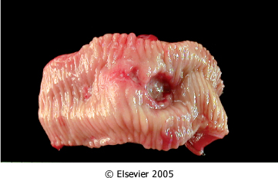
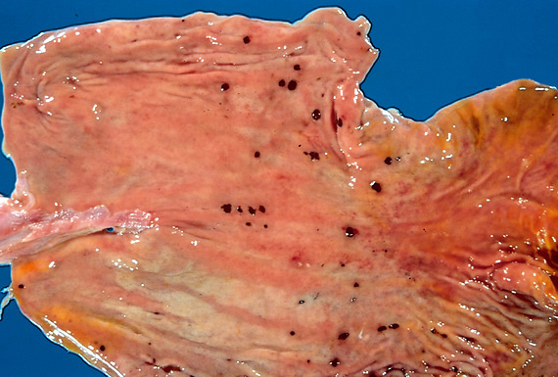
Ulcer
Ulcer: a breach in the mucosa of the alimentary tract tha may extend through muscularis mucosa into submucosa or deeper.
Peptic ulcer
Stress ulcers (acute gastric ulcers)

Slide 4
Peptic ulcer is ulcer in the lining of the stomach or first part of the small intestine, the duodenum. It can be acute or chronic.

Slide 5
Pathophysiology
Defensive Factors
Aggressive Factors

Slide 6
Pathophysiology
Defensive Factors
Mucus
bicarbonate
Blood flow,
cell renewal
Prostaglandins
Phospholipid

Slide 7
Pathophysiology
Aggressive Factors
H. pylori
Drugs (NSAIDs)
Acid
pepsin
Bile salts

Slide 8
Pathophysiology
imbalance
Defensive Factors
Mucus
bicarbonate
Blood flow,
cell renewal
Prostaglandins
Phospholipid
Aggressive Factors
H. pylori
Drugs (NSAIDs)
Acid
pepsin
Bile salts
Defensive Factors
Aggressive Factors

Slide 9
Pathophysiology
imbalance
Defensive Factors
Mucus
bicarbonate
Blood flow,
cell renewal
Prostaglandins
Phospholipid
Aggressive Factors
H. pylori
Drugs (NSAIDs)
Acid
pepsin
Bile salts
Defensive Factors
Aggressive Factors

Slide 10
Acute peptic ulcers Pathophysiology
As part of an acute gastritis
As a complication of a severe stress response
As a result of extreme hyperacidity.

Slide 11
Acute peptic ulcers
Pathophysiology
As part of an acute gastritis (acute response to an irritant 'chemical' injury by drugs or alcohol
As a complication of a severe stress response (severe burns (Curling's ulcer), major trauma or cerebrovascular accidents( c )
As a result of extreme hyperacidity (Zollinger-Ellison syndrome).

Slide 12
Chronic peptic ulcer Peptic Ulcer Disease Locations
May occur in any portion of the GI tract exposed to acidic gastric juices
98% located in first portion of duodenum or stomach, ratio = 4:1
Esophagus……. as a result of GERD or acid secretion by ectopic gastric mucosa.
Gastric mucosa within a Meckel diverticulum can result in peptic ulceration of adjacent mucosa.

Slide 13
Peptic Ulcer Disease Gastric ulcers
Pathophysiology
The mucosal defences against acid attack consist of:
Mucus-bicarbonate barrier
The surface epithelium.

Slide 14
Peptic Ulcer Disease Gastric ulcers
Pathophysiology
The mucosal defences against acid attack consist of:
Mucus-bicarbonate barrier
2. The surface epithelium.
Duodeno-gastric reflux ( bile )
NSAIDs (blocking the synthesis of the prostaglandins)
H. pylori infection, ( cytotoxins and ammonia)
Thus peptic ulcers in the stomach, breakdown of mucosal defence is much more important than excessive acid production.

Slide 15
Peptic Ulcer Disease Duodenal ulcers
Pathophysiology
Increased production of acid assumes more importance in the pathogenesis of duodenal ulceration
H. pylori-infected individuals secrete 2-6 times as much acid as non-infected persons
Helicobacter Pylori does not colonise normal duodenal epithelium. Helicobacter colonises areas of gastric metaplasia in duodenal ulceration because there is gastric metaplasia in response to excess acid. Gastric metaplasia paves the way for colonisation by Helicobacter
+
=
Increased production of acid
Helicobacter P
Duodenal ulcers

Slide 16
Peptic Ulcer Disease Pathophysiology
Duodeno-gastric reflux ( bile )
Hyperacidity
Gastric
ulcers
H. pylori
Duodenal
ulcers
NSAIDs
H pylori infection of the pyloric antrum is present in nearly all patients with chronic duodenal ulcer and approximately 75% of patients with chronic gastric ulcer.
Although more than 70% of individuals with PUD are infected by H. pylori, fewer than 20% of H. pylori–infected individuals develop peptic ulcer.

Slide 17
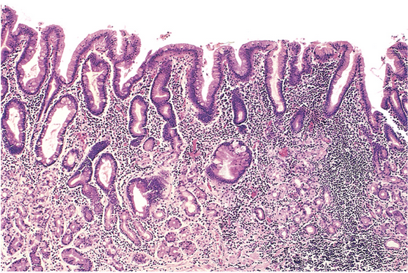
H. pylori
chronic active
gastritis

Slide 18
Morphology
Gross
usually less than 20 mm in diameter but they may > 100 mm in diameter.
The classic peptic ulcer is a round to oval, sharply punched-out defect
In contrast, heaped-up margins are more characteristic of cancers
Microscopy
the base consists of necrotic tissue and polymorph exudate overlying inflamed granulation tissue which merges with mature fibrous (scar) tissue.

Slide 19
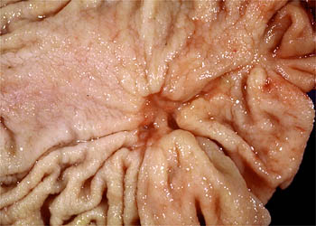
Differential Diagnosis:Malignant gastric ulcer

Slide 20
Clinical features
Epigastric pain (the most common symptom)
Gnawing or burning sensation
Occurs 2-3 hours after meals
Relieved by food or antacids
Patient awakens with pain at night.
Some present with complications such as iron deficiency anemia, frank hemorrhage, or perforation.

Slide 21
Complications
Hemorrhage.
Penetration. The ulcer penetrates the full thickness of the stomach or duodenal wall, progressing into adherent underlying tissue, particularly the pancreas or liver. Penetration of the pancreas often manifests clinically as severe back pain.
Perforation. This leads to peritonitis.
Fibrous stricture. This is seen in peptic ulcer of the esophagus and the stomach (pyloric stenosis)
Malignant change. This is extremely uncommon.

Slide 23
Therapy
Current therapies for PUD are aimed at
H. pylori eradication
Neutralization of gastric acid and acid suppression
primarily with proton pump inhibitors and H2 blockers

