Slide 1
Gastrointestinal Block
Pathology lecture
2015
Malabsorption
Dr. Maha Arafah
Dr. Ahmed Al Humaidi

Slide 2
Malabsorption
Define Malabsorption
Know the major malabsorption syndromes and its causes
2. Know the many organ systems affected by the consequences of malabsorption
3. Know the following aspects of celiac disease:
    a. definition
    b. pathogenesis
    c. clinical features
    d. pathology (gross and microscopic features)
    e. complications (T-cell lymphoma and GI tract carcinoma)
4. Know the cause and types of Lactose intolerance.

Slide 3
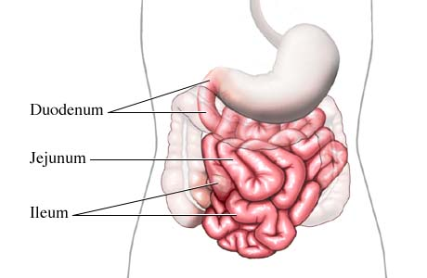
Absorption of Nutrient

Slide 4
Physiology
  The main purpose of the gastrointestinal tract is to digests and absorbs nutrients (fat, carbohydrate, and protein), micronutrients (vitamins and trace minerals), water, and electrolytes.

Slide 5
Malabsorption is characterized by defective absorption of fats, fat- and water-soluble vitamins, proteins, carbohydrates, electrolytes and minerals, and water.
presents most commonly as chronic diarrhea

Slide 6
Malabsorption Syndrome
Inability of the intestine to absorb nutrients adequately into the bloodstream
Impairment can be of single or multiple nutrients depending on the abnormality

Slide 7
Mechanisms and Causes of Malabsorption Syndrome
1. Inadequate digestion
2. Deficient bile salt
3. Primary mucosal abnormalities
4. Inadequate small intestine
5. Lymphatic obstruction

Slide 8
Mechanisms and Causes of Malabsorption Syndrome
Inadequate digestion
Postgastrectomy
Deficiency of pancreatic lipase
Chronic pancreatitis
Cystic fibrosis
Pancreatic resection
Zollinger-Ellison syndrome
Deficient bile salt
Obstructive jaundice
Bacterial overgrowth
Stasis in blind loops, diverticula
Fistulas
Hypomotility states (diabetes)
Terminal ileal resection
Crohns' disease
Precipitation of bile salts (neomycin)
Primary mucosal abnormalities
Celiac disease
Tropical sprue
Whipple's disease
Amyloidosis
Radiation enteritis
Abetalipoproteinemia
Giardiasis
Inadequate small intestine
Intestinal resection
Crohn's disease
Mesenteric vascular disease with infarction
Jejunoileal bypass
Lymphatic obstruction
Intestinal lymphangiectasia
Malignant lymphoma
Macroglobulinemia
Many causes

Slide 9
Pathophysiology
Inadequate digestion
Or
Small intestine abnormalities
=
Malabsorption

Slide 10
Pathophysiology
Inadequate digestion
Postgastrectomy
Stomach
Deficiency of pancreatic lipase
Chronic pancreatitis
Cystic fibrosis
Pancreatic resection
Pancreas
Bile
Small intestine abnormalities
Obstructive jaundice
Terminal ileal resection
mucosa
Inadequate small intestine
Lymphatic obstruction

Slide 11
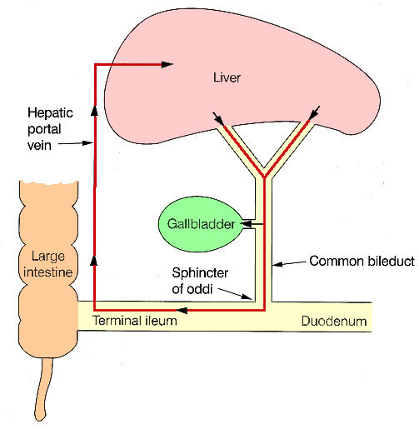
Enterohepatic circulation
Bile secretion and absorption

Slide 12
Pathophysiology
Inadequate digestion
Celiac disease
Tropical sprue
Whipple's disease, (caused by Tropheryma whipplei)
Giardiasis
Stomach
Pancreas
Bile
Small intestine abnormalities
mucosa
Intestinal resection
Crohn's disease
Inadequate small intestine
Lymphatic obstruction
Intestinal lymphangiectasia
Malignant lymphoma

Slide 13
Pathophysiology
Pancreas
Bile
mucosa

Slide 14
Malabsorption Syndrome
Clinical features
There is increased fecal excretion of fat (steatorrhea)
Abnormal stools
Failure to thrive or poor growth in most but not all cases (Weight loss despite increased oral intake of nutrients).
Specific nutrient deficiencies, either singly or in combination.
Stools become soft, yellow, malodorous, greasy and floated at the top of the water in the toilet
Quantitative stool for fat
  (1) Best screening test
  (2) 72-hour collection of stool
  (3) Positive test > 7 g of fat/24 hours.

Slide 15
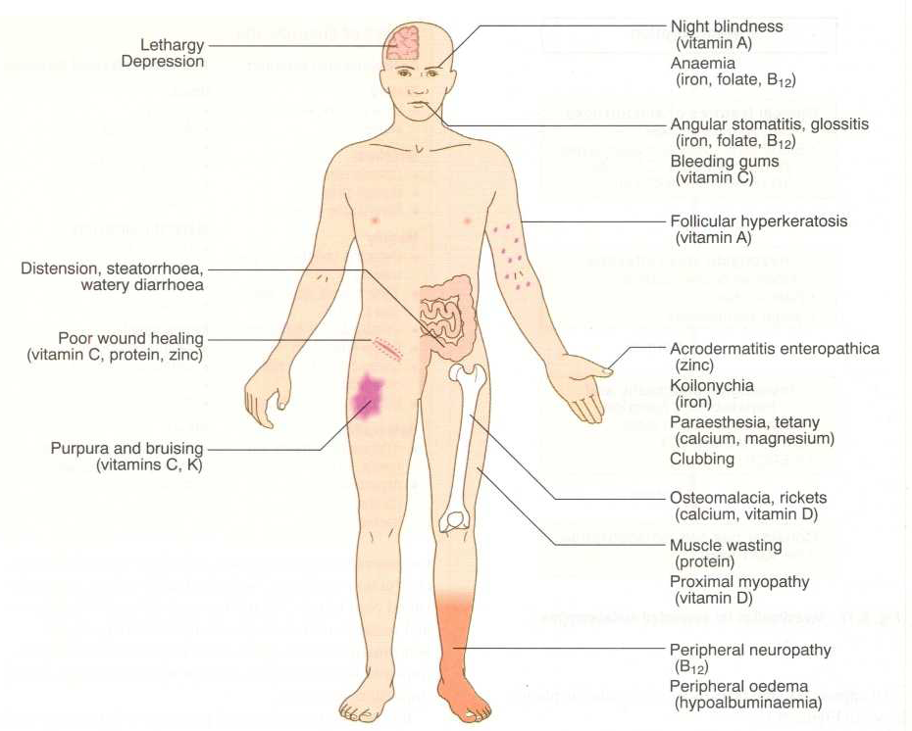
Clinical features

Slide 16
Malabsorption Syndrome
Clinical features
Depend on the deficient nutrient
Swelling or edema
Muscle wasting
Protein
Anemia
B12, folic acid and iron deficiency
(fatigue and weakness
Muscle cramp
vitamin D, calcium
Osteomalacia and osteoporosis
vitamin K and other coagulation factor
Bleeding tendencies

Slide 17
Diagnosis
There is no specific test for malabsorption.
Investigation is guided by symptoms and signs.
Fecal fat study to diagnose steatorrhoea
Blood tests
Stool studies
4. Endoscopy
Biopsy of small bowel

Slide 18
Malabsorption Syndrome
Celiac disease
  An immune reaction to gliadin fraction of the wheat protein gluten in genetically predisposed persons more in European white
  Usually diagnosed in childhood – mid adult.
  Patients have raised antibodies to gluten autoantibodies
  Highly specific association with class II HLA DQ2 (95% of cases) and, to a lesser extent, DQ8 ((5% of cases).

Slide 19
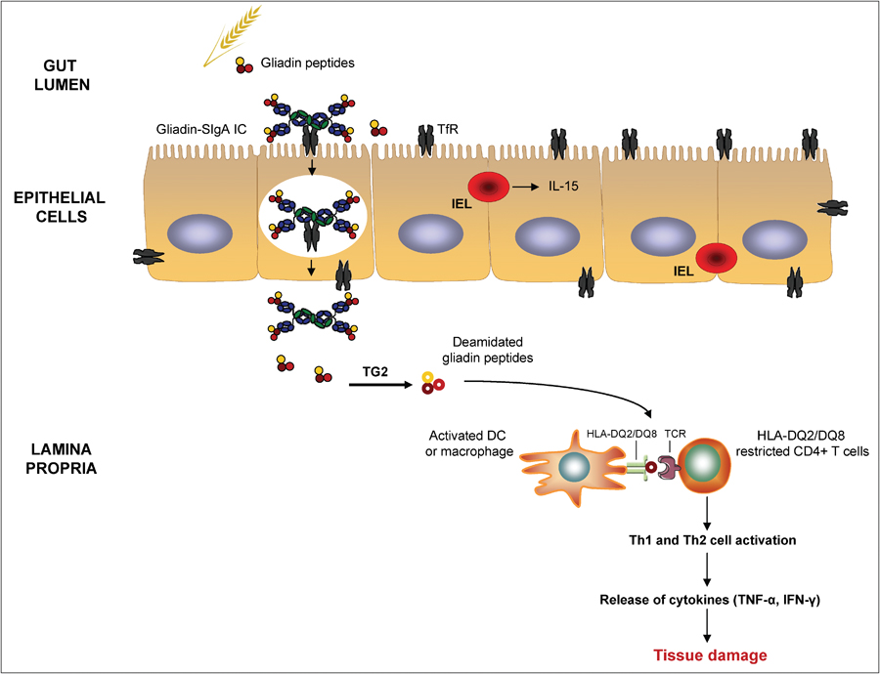
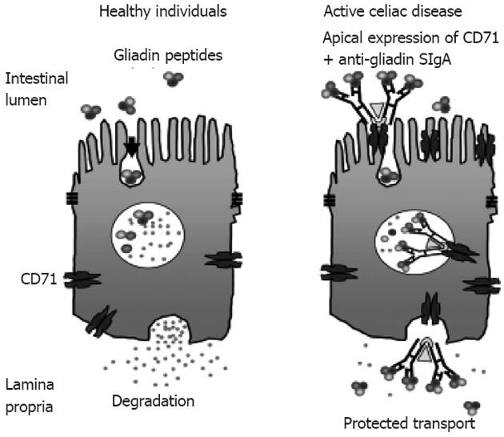
a 33-amino acid gliadin peptide that is resistant to degradation by gastric, pancreatic, and small intestinal proteases
Gliadin is deamidated by tissue transglutaminase
deamidated gliadin peptides induce epithelial cells to produce the cytokine IL-15, which in turn triggers activation and proliferation of CD8+ intraepithelial lymphocytes

Slide 20
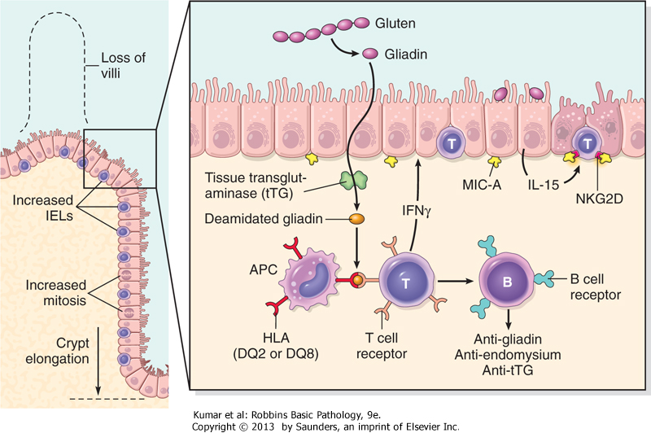
a 33-amino acid peptide

Slide 21
Celiac disease
CD4 T cells produce cytokines that release matrix proteases causing cell death and degradation in the epithelial cells, resulting in the loss of the villous surface in the small intestine
This results in impaired mucosal function and inability for absorption

Slide 22
Clinical features
Celiac disease
Typical presentation
GI symptoms that characteristically appear at age 9-24 months.
Symptoms begin at various times after the introduction of foods that contain gluten.
A relationship between the age of onset and the type of presentation;
Infants and toddlers….GI symptoms and failure to thrive
Childhood…………………minor GI symptoms, inadequate rate of weight gain,
Young adults……………anemia is the most common form of presentation.
Adults and elderly…...GI symptoms are more prevalent

Slide 23
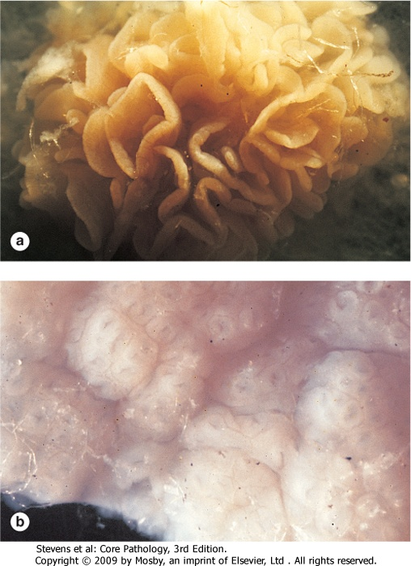
Endoscopy
Normal
Celiac disease

Slide 24
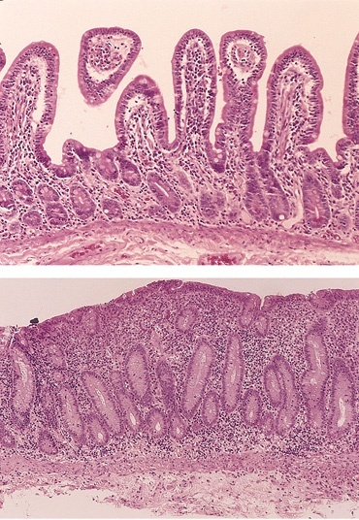
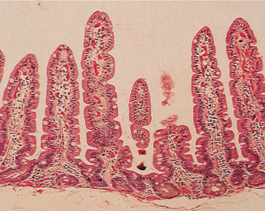
Celiac Disease
Histology
Mucosa is flattened with marked villous atrophy.
Increased intraepithelial lymphocytosis
Crypt elongation
Subtotal villous atrophy
Normal
Total villous atrophy

Slide 25

Celiac Disease
Diagnosis
Clinical documentations of malabsorption.
Stool ………. Fat
Serology is +ve for IgA to tissue transglutaminase or IgG to deamidated gliadin or anti-endomysial antibodies
Small intestine biopsy demonstrate villous atrophy.
Improvement of symptom and mucosal histology on gluten withdrawal from diet.
wheat, barley, flour
Other grains, such as rice and corn flour, do not have such an effect.

Slide 26
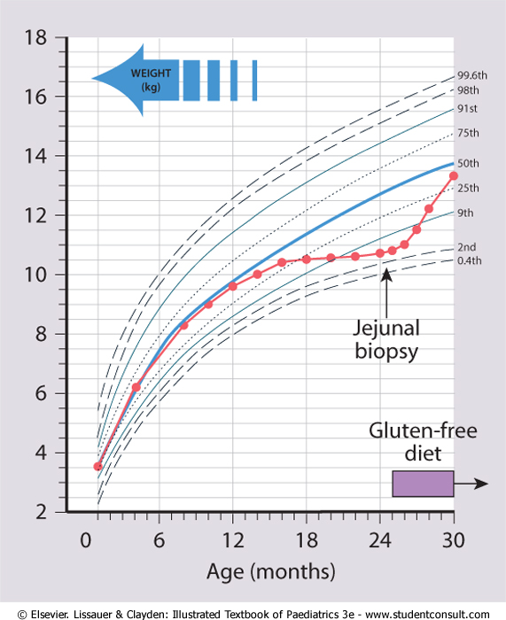
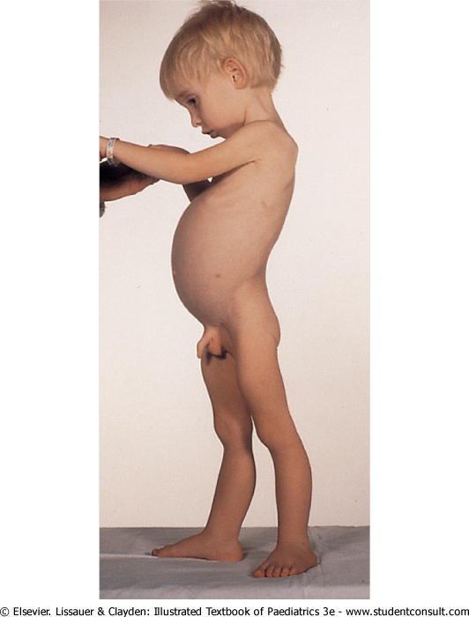

Slide 27
Celiac Disease
Complications
Osteopenia , osteoporosis
Infertility in women
Short stature, delayed puberty, anemia,
Malignancies[intestinal T-cell lymphoma],
10 to 15% risk of developing GI lymphoma.
DDX Tropical sprue

Slide 28
Lactose Intolerance

Slide 29
Lactose Intolerance
Pathophysiology
lactase
Lactose
glucose + galactose
At the brush border of enterocytes
Lactose Intolerance
Low or absent activity of the enzyme lactase

Slide 30
Lactose Intolerance causes
Inherited lactase deficiency
Congenital lactase deficiency
Childhood-onset and adult-onset lactase deficiency
extremely rare
common
Genetically programmed progressive loss of the activity of the small intestinal enzyme lactase.
Acquired lactase deficiency
Transient
Secondary lactase deficiency due to intestinal mucosal injury by an infectious, allergic, or inflammatory process

Slide 31
Clinical
Bloating, abdominal discomfort, and flatulence
……………1 hour to a few hours after ingestion of milk products

Slide 32
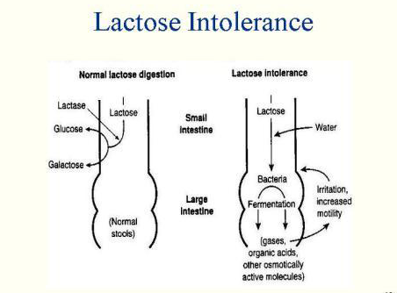

Slide 33
Lactose Intolerance
Diagnosis
Empirical treatment with a lactose-free diet, which results in resolution of symptoms;
Hydrogen breath test

Slide 34
Hydrogen breath test
An oral dose of lactose is administered
The sole source of H₂ is bacterial fermentation;
Unabsorbed lactose makes its way to colonic bacteria, resulting in excess breath H₂.
Increased exhaled H₂ after lactose ingestion suggests lactose malabsorption.

Slide 35
A 3-week trial of a diet that is free of milk and milk products is a satisfactory trial to diagnose lactose intolerance

Slide 36
Lactose Intolerance summary
Deficiency/absence of the enzyme lactase in the brush border of the intestinal mucosa → maldigestion and malabsorption of lactose
Unabsorbed lactose draws water in the intestinal lumen
In the colon, lactose is metabolized by bacteria to organic acid, CO2 and H2; acid is an irritant and exerts an osmotic effect
Causes diarrhea, gaseousness, bloating and abdominal cramps

Slide 37
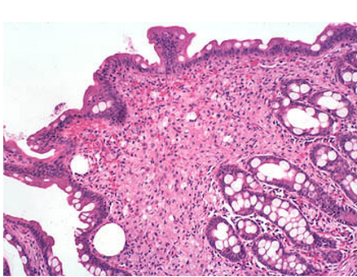
Small bowel, Whipple disease
(Mucosal disease)
Numerous macrophages are seen throughout the lamina propria.

Slide 38
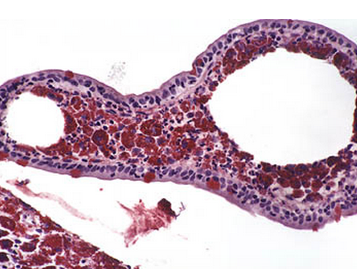
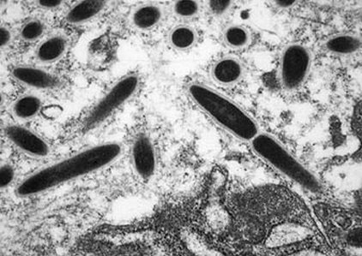
Small bowel, Whipple disease
(Mucosal disease)
A PAS stain highlights the cytoplasmic inclusions (staining them a deep red)
An electron micrograph reveals that these inclusions are rod-shaped bacilli
(caused by a gram-positive bacterium, Tropheryma whippelii)

Slide 39
Summary
Malabsorption results from disturbance in at least one of the four phases of nutrient absorption:
  Intraluminal digestion, in which proteins, carbohydrates, and fats are broken down into forms suitable for absorption;
  Terminal digestion, which involves the hydrolysis of carbohydrates and peptides by disaccharidases and peptidases in the brush border of the small intestinal mucosa;
  Transepithelial transport, in which nutrients, fluid, and electrolytes are transported across and processed within the small intestinal epithelium; and
  Lymphatic transport of absorbed lipids.

Slide 41
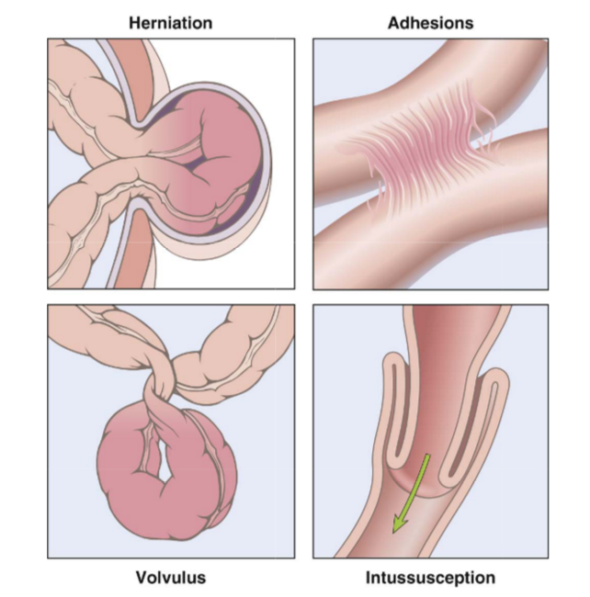
Intestinal Obstruction
The clinical manifestations include abdominal pain and distention, vomiting, and constipation.
Treatment: Surgical intervention

Slide 42
Case scenario
A 44-year-old white male presented with a seven-month history of increasing diarrhea. The frequency of his bowel movements had increased to 5-7 per day, and his stools were yellow and malodorous and floated at the top of the water in the toilet.
He had occasional abdominal cramping, but no tenesmus, melena, or bleeding. His appetite was good, but he had experienced gradual weight loss.
His bowel movement frequency would decrease upon fasting and would increase with food intake.
A family history of a brother with chronic diarrhea was elicited.

Slide 43
Case scenario
Stool tests revealed a stool output of 4128 g/d (nl 100-200 g/d) with fat excretion of 17 g/d (nl <5 g/d). Microscopic examination for ova and parasites and cultures for bacterial pathogens and acid-fast bacilli were negative.
Blood testing showed mild anemia (Hct 36), hypoproteinemia (4.9 mg/dL), and hypoalbuminemia (3.4 mg/dL).
Colonoscopy showed normal mucosa.
Esophagogastroduodenoscopy (EGD) showed flat-appearing mucosa in the duodenum.
Biopsies were performed.

Slide 44
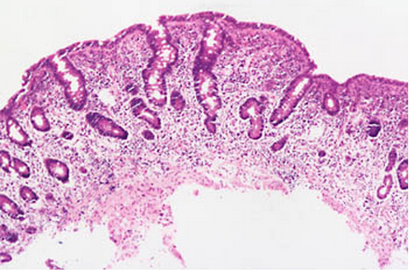
Duodenal Biopsy
What effect does this process have on the surface area available for absorption?
Flattening of the villi greatly decreases the surface area available for absorption.

Slide 45
Exposure to what dietary antigen is thought to be the cause of these changes?
What food components contain this antigen?
Will these histologic changes resolve with dietary modification?
Gluten (specifically, the gliaden constituent of this protein).
Wheat, barley and rye
Yes.

Slide 46
Case scenario
Serum tests for anti-endomysial and antigliadin antibodies were positive.
The patient was discharged with appropriate dietary instructions. His diarrhea resolved, and his weight began to increase.

