Slide 1
Organization and General Principles of Gastrointestinal Physiology
Dr. Hana Alzamil

Slide 2
Objectives
Physiologic anatomy of gastrointestinal wall
The general characteristics of smooth muscle
The specific characteristics of smooth muscle
Control of gastrointestinal function (ENS)
Types of neurotransmitters secreted by enteric neurons
Functional types of movements in the gastrointestinal tract
Gastrointestinal blood flow (Splanchnic circulation)
Effects of gut activity and metabolic factors on GI blood flow

Slide 3
Group activity Brain storming What are the GIT parts?

Slide 4
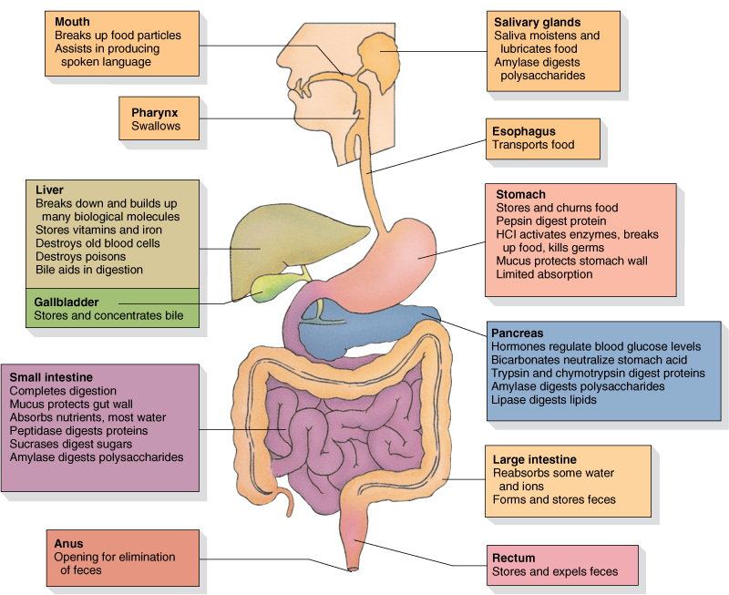
Gastrointestinal Tract

Slide 5
Parts and functions of gastrointestinal tract (GIT)
GIT provides the body with continuous supply of water, electrolytes, vitamins and nutrients
To achieve its function:
Movement of food
Secretion of digestive juice
Digestion
Absorption
Circulation of blood
Control of all these functions

Slide 6
https://youtu.be/yzQAgfivX74

Slide 7
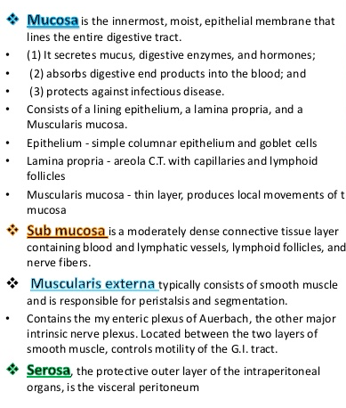
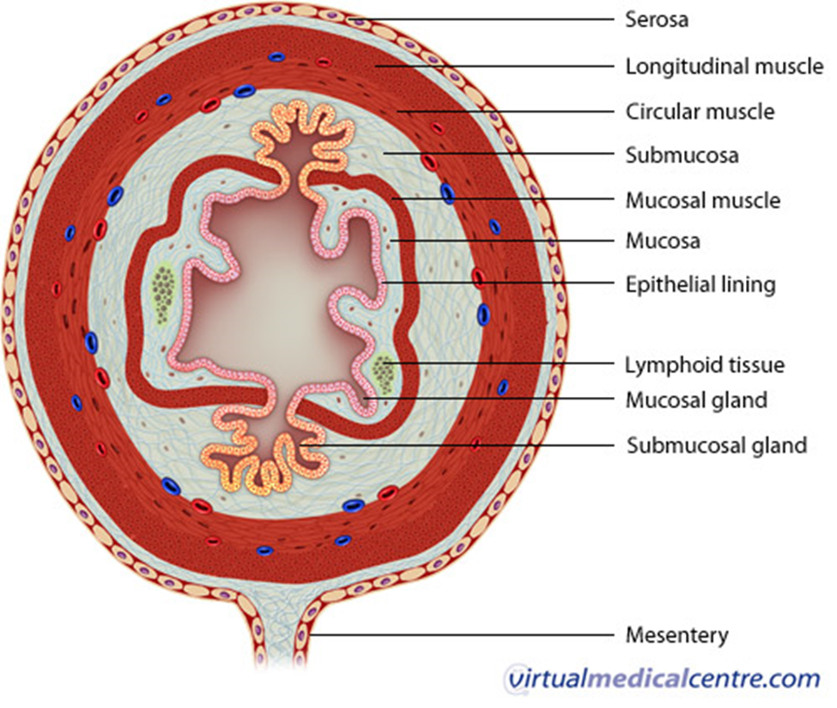

Slide 8
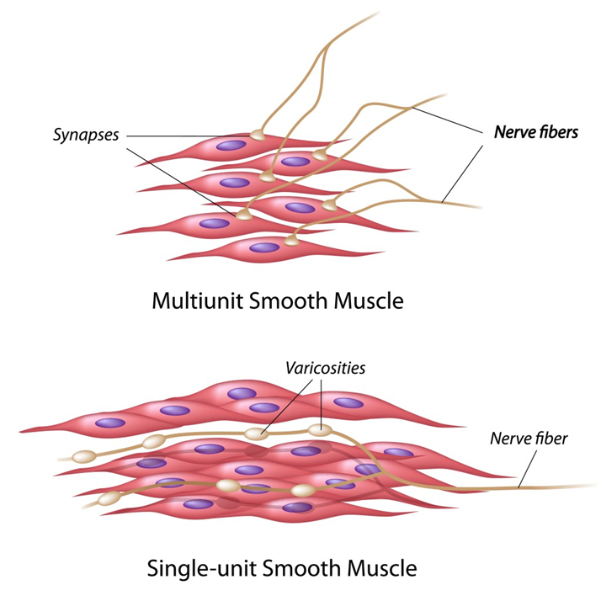
The general characteristics of smooth muscle
Types of smooth muscle
Multi-unit.
Single-unit (unitary).
Multi-unit
Each fiber can contract independently
Controlled mainly by nerve signals
Examples: ciliary & iris muscles in the eye
and piloerector muscles of the hair
Unitary (syncytial or visceral smooth muscle)
Mass of 100-1000 smooth muscle fibers
Contract as a single unit
Arranged in sheets or bundles
Cell membranes are adherent at multiple points
Many gap junctions that allow ion movements
When action potential is generated it travel in all directions
Examples: GIT, bile ducts, ureters, uterus, blood vessels.

Slide 9
Difference between skeletal and smooth muscles
Nervous control
Neuromuscular junctions
Smooth muscle

Slide 10
Types of smooth muscles

Slide 11
The specific characteristics of smooth muscle

Slide 12
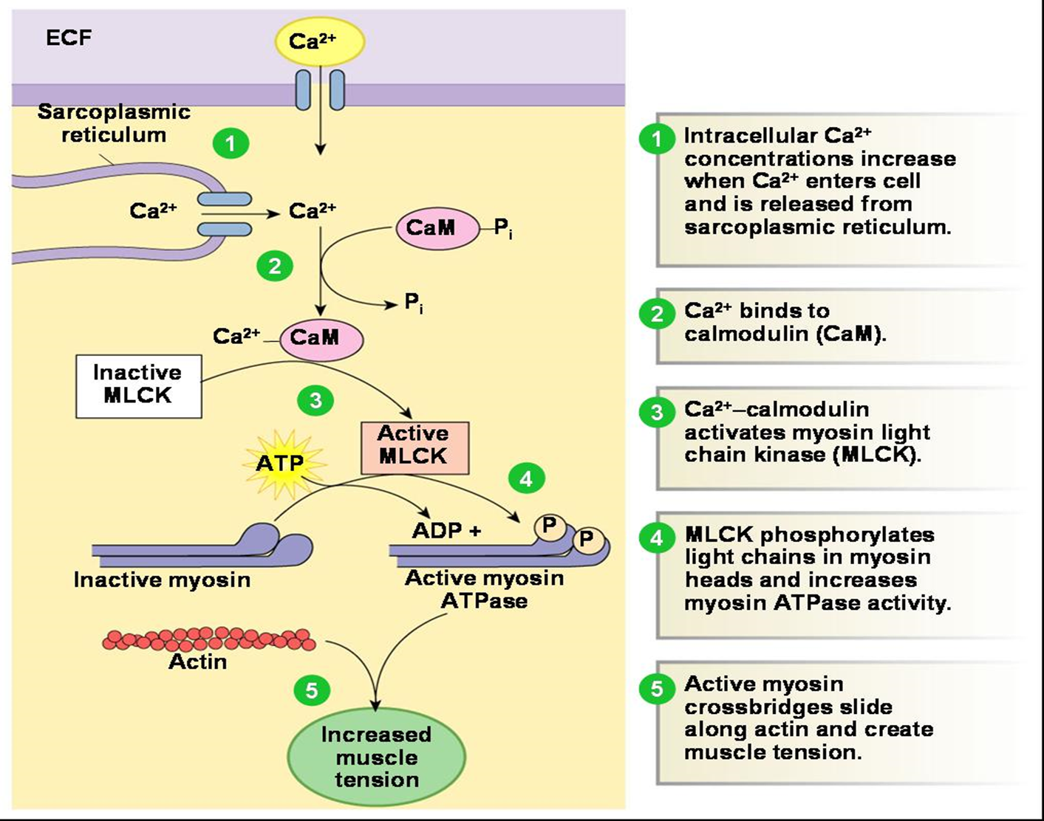
Mechanism of smooth muscle contraction

Slide 13
Electrical activity of GI smooth muscle
There is continuous slow intrinsic electrical activity
Two basic types of electrical waves:
Slow waves
Spikes
Most GI contractions occur rhythmically
Rhythm is determined by the frequency of slow waves

Slide 14
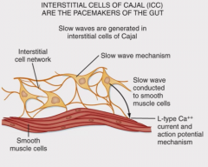
Electrical activity of GI smooth muscle
Slow waves:
Are changes in resting membrane potential
Are not action potentials
Their intensity 5-15 mv
Frequency: 3-12 /min
Stomach 3, duodenum 12 and ileum 8-9/min
Caused by interaction between smooth muscle cells & interstitial cells of Cajal
Do not by themselves cause muscle contractions
Do not cause calcium ions to enter (only sodium ions)
Mainly excite the appearance of intermittent spike potentials

Slide 15
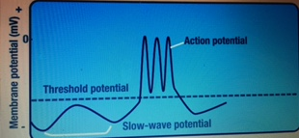
Electrical activity of GI smooth muscle
Spike potential:
Are true action potentials
Occurs when resting membrane potential become more positive than -40 (normal range -50mv to -60mv) appear on the peaks
The higher the slow wave potential the greater the frequency(1-10spikes/sec)
Channels responsible for action potential are calcium-sodium channels
These channels are much slower to open and close
They allow large number of Calcium ions to enter + smaller number of sodium ions
They cause muscle contractions

Slide 16
The specific characteristics of smooth muscle
Slow cycling of the myosin cross-bridges
Low energy requirement
Slowness of onset of contraction and relaxation
Greater max. force of contraction
Latch mechanism
Stress-Relaxation
Revers stress-relaxation

Slide 18
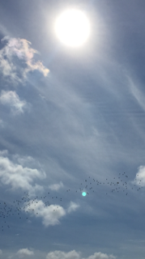
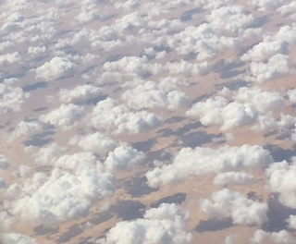

Slide 19
Control of gastrointestinal function
Nervous control
Enteric nervous system (ENS)
Autonomic nervous system
Hormonal control
Stretch of the muscle

Slide 20
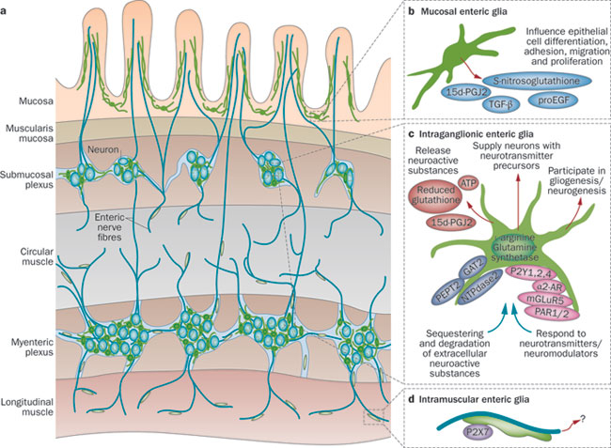
Nervous control Enteric Nervous System (little brain)
Lies in the wall of the gut, beginning in the esophagus and extending all the way to the anus and contain 100 million neurons
Connected to CNS by sympathetic &
parasympathetic fibers
Can function autonomously
Controls gastrointestinal movements and secretion.
Myenteric or Auerbach’s plexus
Submucosal or Meissner’s plexus

Slide 21
Nervous control Enteric Nervous System (little brain) Differences between myenteric & messiner’s plexuses
Myenteric or Auerbach’s plexus
Submucosal or Meissner’s plexus
An outer plexus between the longitudinal and circular muscle
A linear chain of interconnecting neurons
Controls mainly the GI movements
Increase tone, rate, intensity and velocity of rhythmic contraction
Some neurons are inhibitory
(eg. pyloric &ileocecal valves)
An inner plexus, that lies in the submucosa.
Control the function within inner wall of each minute segment
Controls mainly GI secretion and local blood flow

Slide 22
Nervous control Enteric Nervous System (little brain)
Types of neurotransmitters secreted by enteric neurons:
Acetylcholine
Norepinephrine
Substance P
Vasoactive intestinal peptide (VIP)
Somatostatin
Serotonin
Dopamine
Cholecystokinin (CCK)
Gama aminobutyrate (GABA).
The gases nitric oxide (NO) & carbon monoxide (CO)

Slide 23
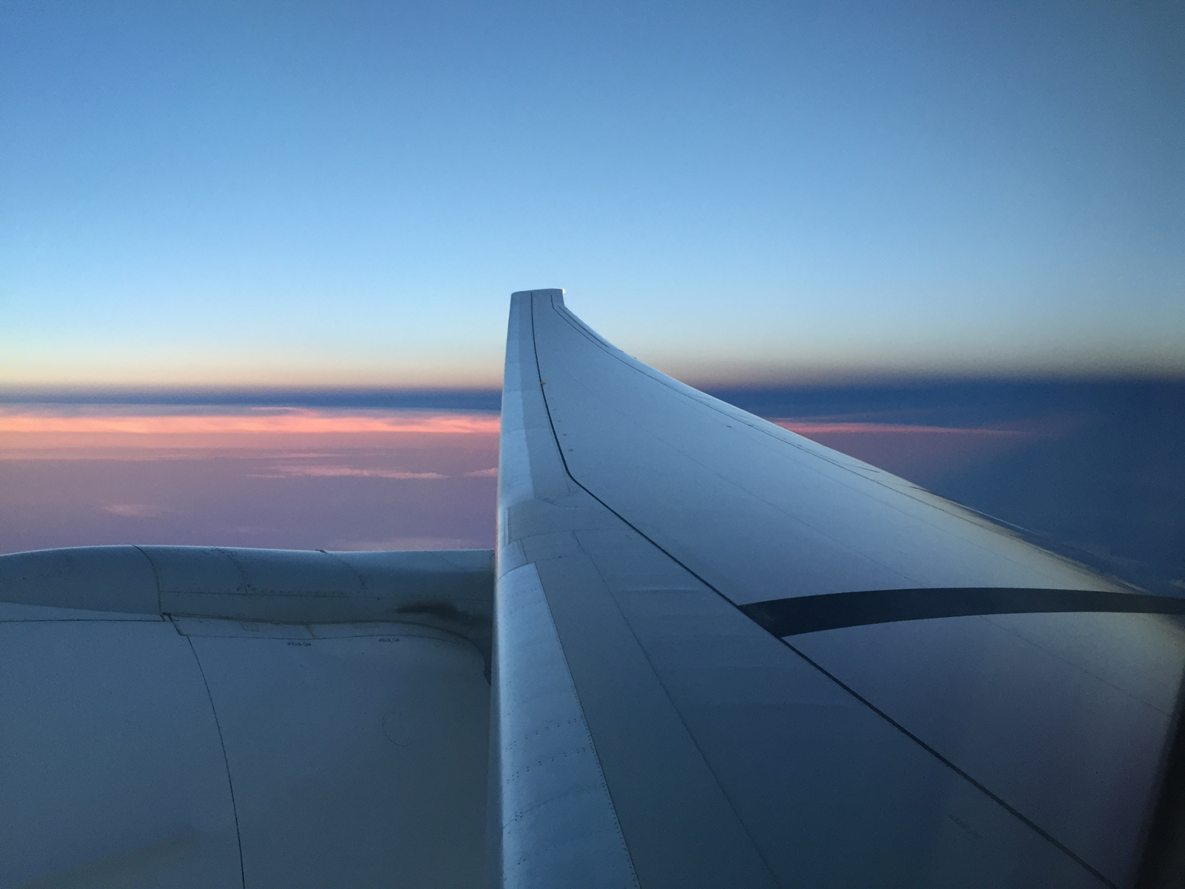
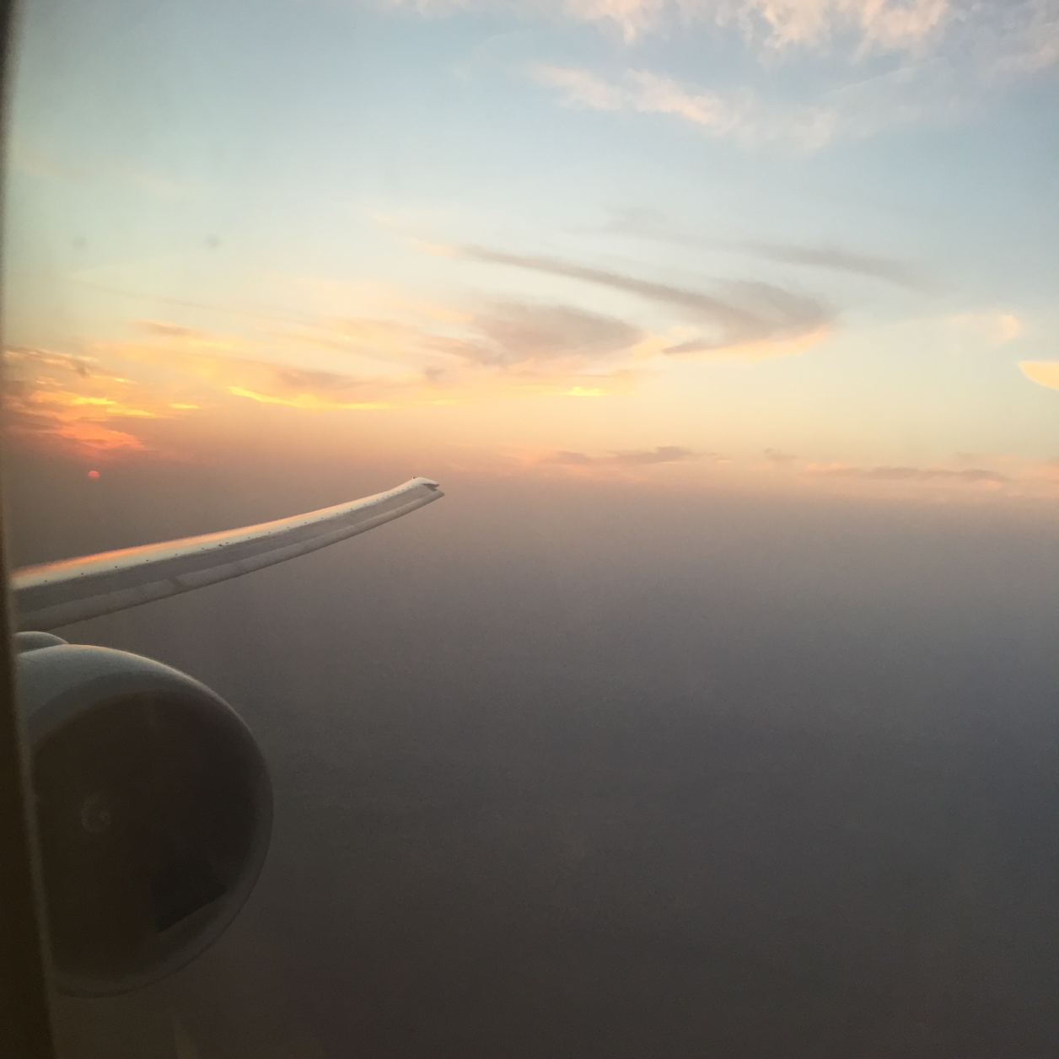

Slide 24
Nervous control Autonomic Nervous System
Parasympathetic
Cranial
Almost entirely in the vagus nerve (except mouth and pharynx)
Innervate esophagus, stomach, pancreas, small intestine and first half of large intestine
Sacral
Originate in 2nd, 3rd and 4th sacral segments of spinal cord
Innervate distal half of large intestine, and anus through pelvic nerves
Postganglionic neurons are located in myenteric and submucosal plexuses
More extensive near the oral cavity and anus
Stimulation causes general increase in activity of the entire enteric nervous system

Slide 25
Neural control Autonomic Nervous System
Sympathetic
Originate in the spinal cord between segment T5 and L2 of spinal cord
Enter sympathetic chain then pass to ganglia:
Celiac ganglia
Superior mesenteric ganglia
Inferior mesenteric ganglia
Postganglionic fibers spread to all parts of the gut
Stimulation inhibit intestinal tract smooth muscle (except mucosal muscle)
Secretes mainly norepinephrine

Slide 26
Neural control Autonomic Nervous System

Slide 27
Neural control Sensory nerves
Sensory nerve fiber cell bodies are either in
The enteric nervous system
Dorsal root ganglia
Sensory nerves can be stimulated by:
Irritation of the gut mucosa
Excessive distention of the gut
Presence of specific chemicals
Signals transmitted through the fibers can cause :
Excitation
Inhibition
80% of fibers in vagus nerves are afferent
Sensory signals transmitted by sensory nerve fibers initiate GI reflexes

Slide 28
Neural control Integrated control

Slide 29
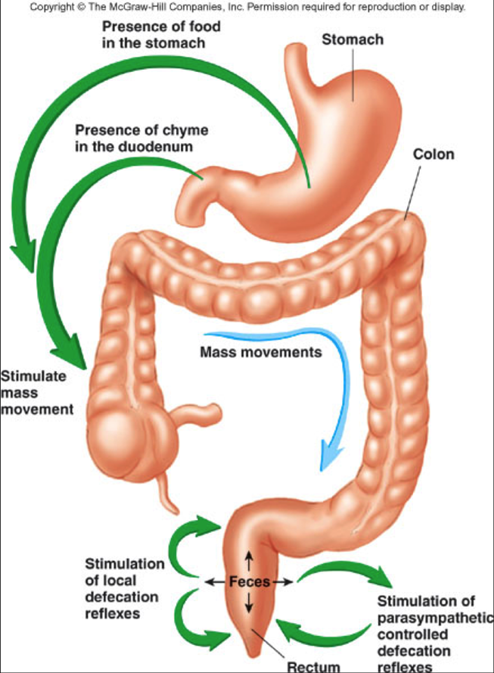
Neural control Gastrointestinal reflexes:
Reflexes integrated within gut wall
Reflexes that controls secretion, peristalsis, mixing contractions and local inhibition
Reflexes from the gut to sympathetic ganglia back to the gut
Gastrocolic reflex: stimulate evacuation of the colon
Enterogastric reflex: inhibit stomach motility and secretion
Colonoileal reflex: inhibit empting of ileal contents
Reflexes from the gut to the spinal cord or brain stem then back to GIT
From stomach and duodenum to the brain stem and back to stomach to control gastric motor and secretory activity
Pain reflexes that cause general inhibition of GIT
Defecation reflexes from colon and rectum to spinal cord and back to cause powerful colonic, rectal and abdominal contractions.

Slide 30
Neural Control of gastrointestinal function

Slide 32
Hormonal control

Slide 34
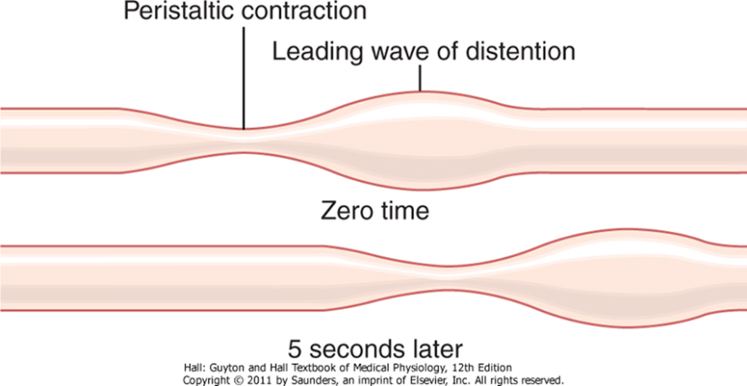
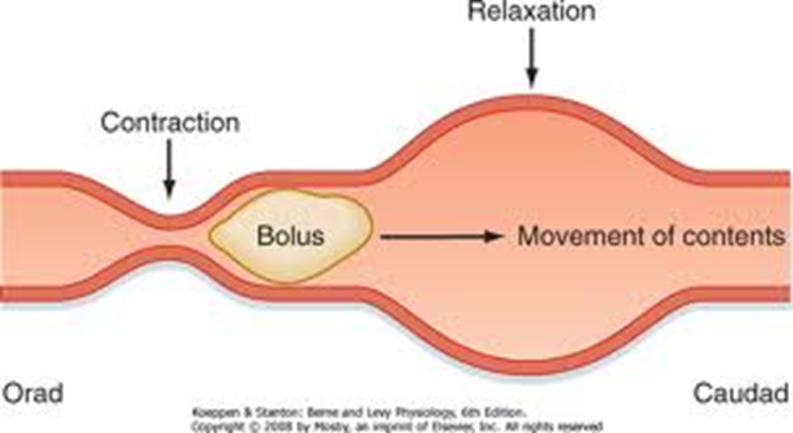
Functional types of movements in the GIT
Two types of movements:
Propulsive movements
Mixing movements
Propulsive movements:
Peristalsis which is inherent property of syncytial smooth muscle tube
Stimulus is distention of the gut
Stimulation of enteric nervous system
Contractile ring 2-3 Cm behind stimulus
Contractile ring moves forward
Can not occur in absence of Myenteric plexus
Peristaltic (myenteric) reflex and the low of gut

Slide 35
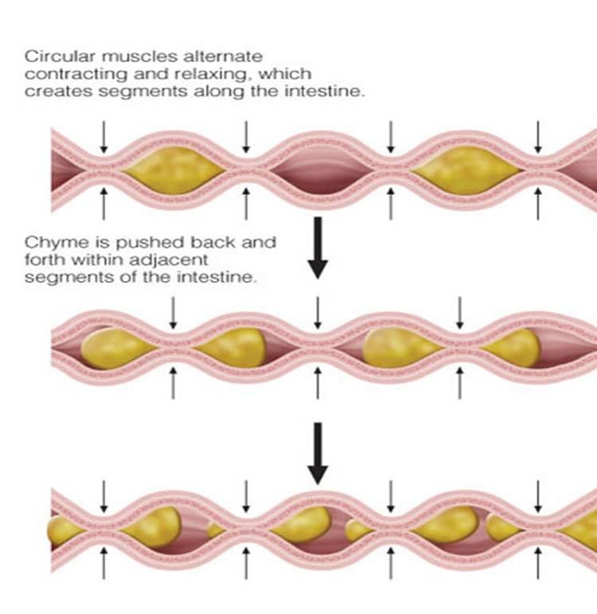
Functional types of movements in the GIT
Segmentation & Mixing movements:
Provides mixing of intestinal contents (know as chyme) with digestive juices.
Segment of bowel contracts at both ends
A second contraction occurs in the center of the segment
Chyme is forced forward and backward
Can occur independent of central input

Slide 36
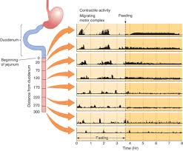
Functional types of movements in the GIT
Migrating motor complex (MMC):
Cycles of motor activity migrate from the stomach to the distal ileum
Have 3 phases
Phase1 quiescence
Phase2 irregular electrical & mechanical activity
Phase3 burst of regular activity
Occurs during fasting.
Initiated by motilin
Migrate at a rate of 5cm/min
Occurs at intervals of ~ 90 min
Accompanied by increase gastric, bile and pancreatic secretion
Serve to clear the stomach and small intestine of luminal contents

Slide 37
Gastrointestinal blood flow (Splanchnic circulation)

Slide 38
Gastrointestinal blood flow (Splanchnic circulation)

Slide 39
Effects of gut activity & metabolic factors on GI blood flow
Blood flow in GIT is directly related to local activity
Blood flow in villi during active absorption increased up to 8 folds
After a meal blood flow increases greatly then return to resting level over 2-4 hrs
Causes of increase blood flow:
Vasodilators such as peptide hormons
Kinins secreted by GI glands (kallidin & bradykinin)
Decreased oxygen concentration increase blood flow 50-100%
Four folds increase in adenosine (vasodilator) secretion due to decrease oxygen

