Slide 1
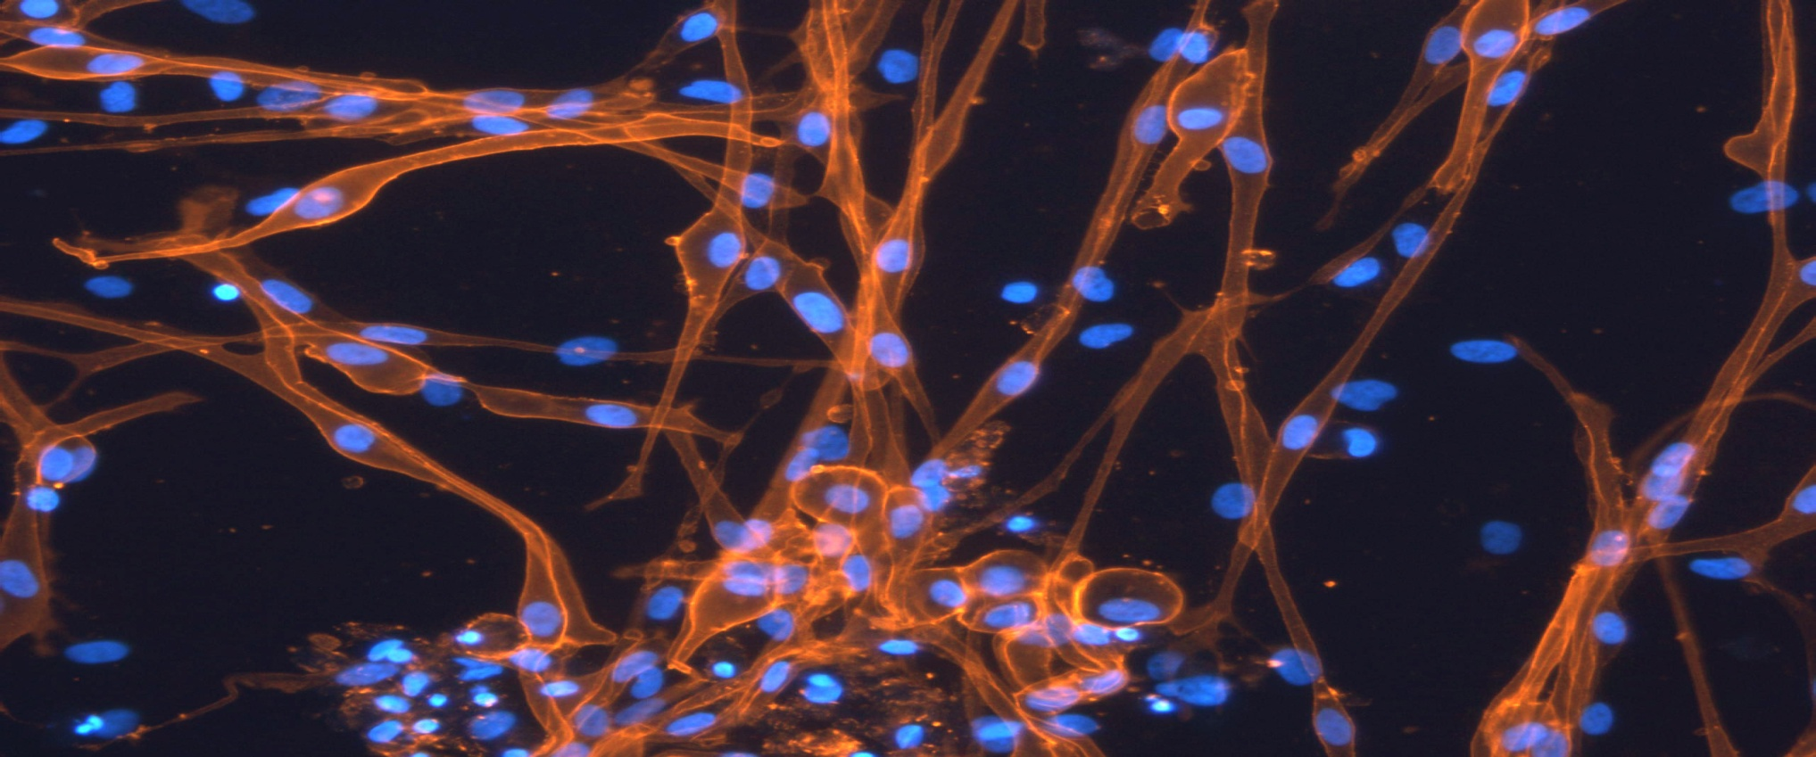

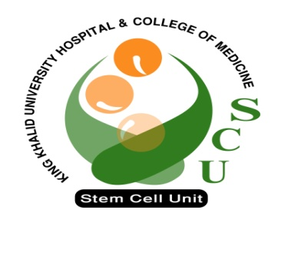
Introuduction to Stem Cell
Research
BY : Saeed Vohra
Mona Elsafadi

Slide 2
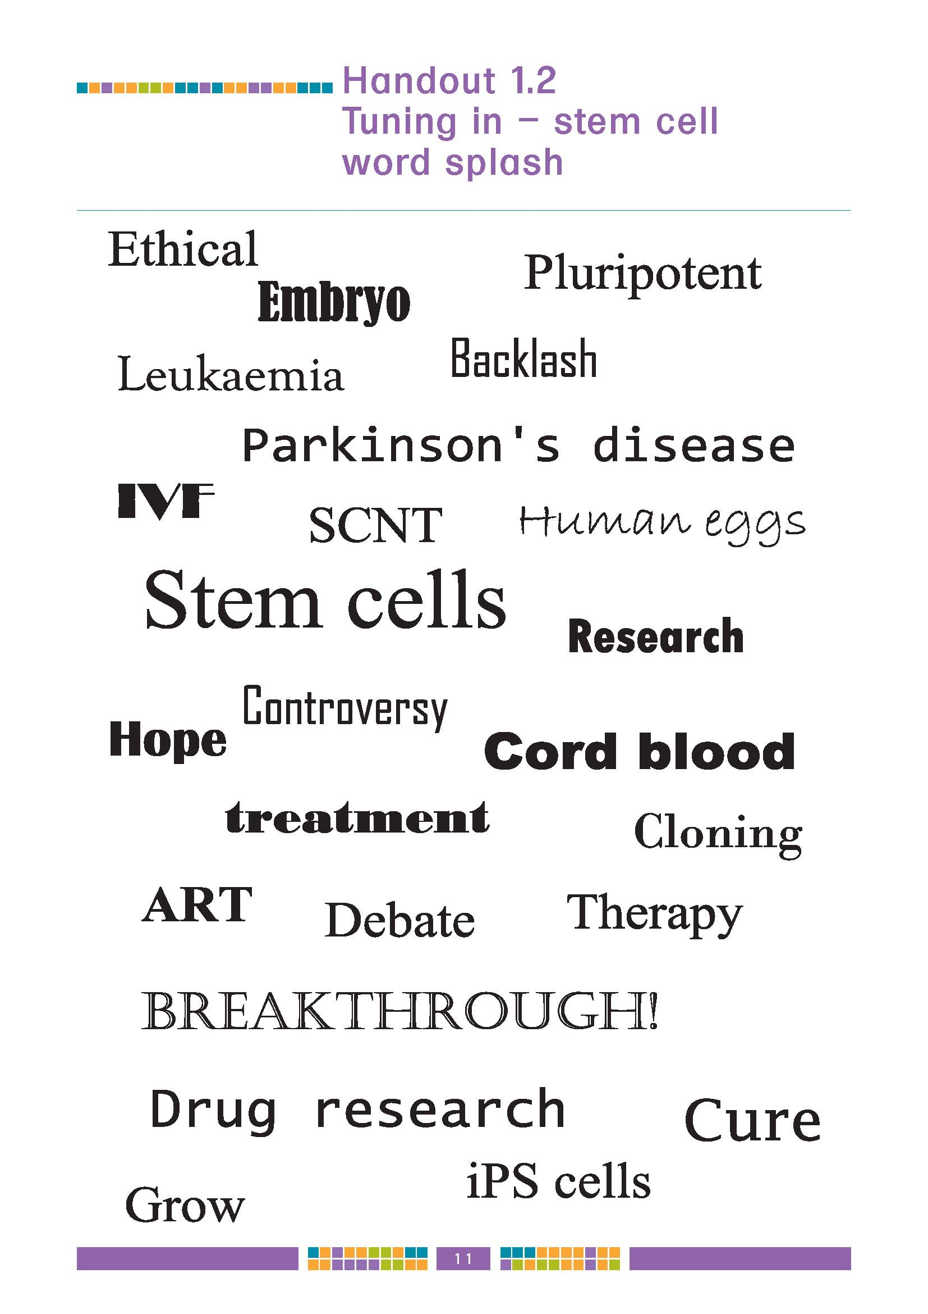
Introducing….stem cells!
Notes:
2
This slide is designed to be interactive.
Start with a question like “What do you think of when someone mentions stem cells?” and allow the students to suggest key words.
At the click of a mouse in will come key words associated with stem cell research.

Slide 3
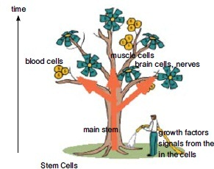

Stem Cells

Slide 4
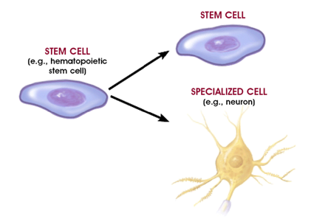
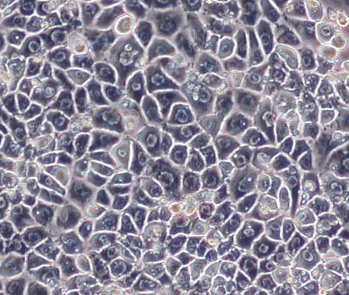
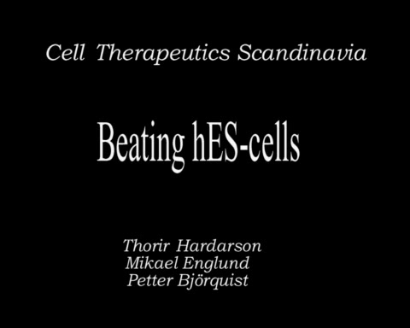
Unique Characteristics of Stem Cells
Endoderm
(hepatocytes)
Mesoderm
(cardiac
myotubes)
Unlimited self renewal (Regeneration)
Differentiation (eg. beating cells of the heart muscles):
    Internal signals (specific genes)
    External signals (GF, cytokines)
Ectoderm
(Neurons)
Notes:
A cell with the ability to divide (= self-replicate) for long periods of time. That’s why scientists can make “cell lines” out of them, taking one stem cell and stimulating it to reproduce itself over and over again.

Slide 5
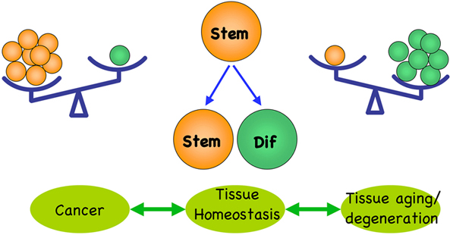

Slide 6
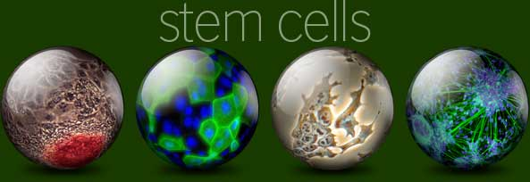

What are Stem Cells?
A cell that has the ability:
to continuously divide and give rise to new copy of itself (self-renew)
and other specialized ( differentiated ) cells/tissues.
Stem cells divide to new cell that has the potential to either remain a stem cell or become another type of cell with a more specialized function as cells of the blood, heart, bones, skin, muscles, brain etc, serving as a sort of repair system for the body.

Slide 7
The History of Stem Cells

Slide 8
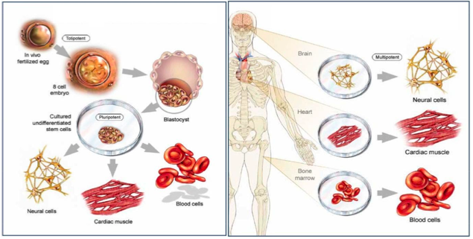
Embryonic Stem Cells
Adult Stem Cells

Slide 9
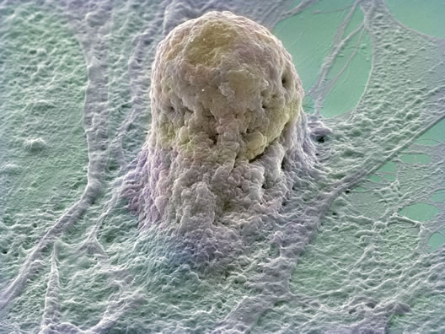
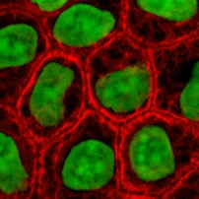
ESC
ASC
Multipotent
Limited numbers and more difficult to isolate
No immune rejection
No Ethical concerns
Pluripotent
large number can be harvested
May cause immune rejection
Ethical concerns

Slide 10
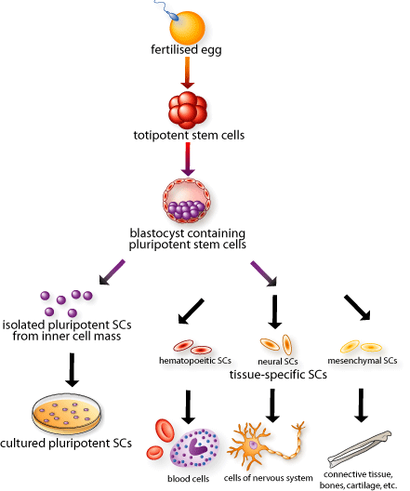
Totipotent
This cell
Can form the
Embryo and placenta
Pluripotent
This cell
Can just form the
embryo
Multi-
potent
Fully mature
Notes:
10
CLICK! This diagram will eventually show the entire range of development, from fertilized egg to mature cell types in the body.
Each cell in the 8-cell embryo, here in red, can generate every cell in the embryo as well as the placenta and extra-embryonic tissues. These cells are called CLICK! TOTIPOTENT stem cells. Why are they called totipotent? (wait for answers) Because one red cell can potentially make all necessary tissues for development. CLICK!
During In Vitro Fertilization, can parents choose whether their baby is going to be a boy or a girl? (wait) Yes, there is a widely-practiced procedure called pre-implantation genetic diagnosis, where one cell is removed from the 8-cell embryo and its DNA is examined. What might you look for when trying to identify the embryo’s sex? (wait) If there’s an X and Y chromosome it’s a boy and if there are two X’s it’s a girl. The parents can decide whether to implant it. Also parents with a genetic disease might want to see if their baby has any identifiable genetic disorders and decide whether to implant based on this information. Pre-implantation genetic diagnosis doesn’t destroy the embryo. Scientists are attempting to adapt this pre-implantation genetic diagnosis procedure and use it to create a stem cell line from one single TOTIPOTENT cell, without destroying the embryo.
The embryonic stem cells inside the blastocyst, here in purple, can generate every cell in the body except placenta and extra-embryonic tissues. These are called CLICK! PLURIPOTENT stem cells…why? (wait for answers) Because they can differentiate into all the 200+ cell types in the body, but they do not form the placenta. CLICK! Pluripotent stem cells can be isolated and grown in culture, or left to develop into more specialized cells in the body.
CLICK! Adult stem cells or tissue-specific stem cells have restricted lineages. Adult stem cells show up when the three distinct layers form in the 14-day-old embryo, and are present in the fetus, baby, child, and so forth. Adult just means they’ve gone further down their lineage pathway than the initial stem cells in the embryo. They are called CLICK! MULTIPOTENT stem cells because they will only become mature cells from the tissue in which they reside. Adult stem cells are present throughout your life and replace fully mature CLICK!, yet damaged and dying cells.
So to review (if time): TOTIPOTENT stem cells come from embryos that are less than 3 days old. These cells can make the TOTAL human being because they can form the placenta and all other tissues. PLURIPOTENT stem cells come from embryos that are 5-14 days old. Embryos and fetuses that are older than 14 days DO NOT contain pluripotent cells. These cells can form every cell type in the body but not the placenta. MULTIPOTENT stem cells are also called adult stem cells and these appear in the 14 day old embryo and beyond. At this point these stem cells will continue down certain lineages and CANNOT naturally turn back into pluripotent cells or switch lineages.

Slide 11
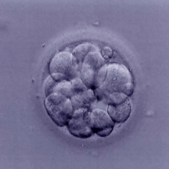
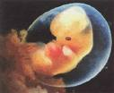
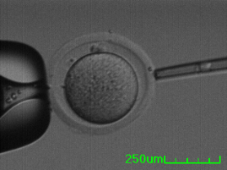

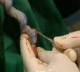
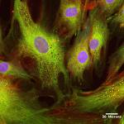


Types of Stem Cells
Embryonic Stem Cells (ESC)
    IVF embryos
    Aborted embryos
    cloned embryos
Adult Stem Cells (ASC):
    Bone Marrow
    Placental Cord
    Mesenchymal Stem cells

Slide 12
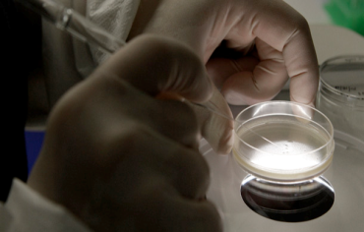
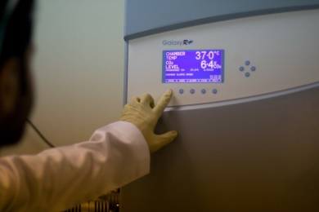
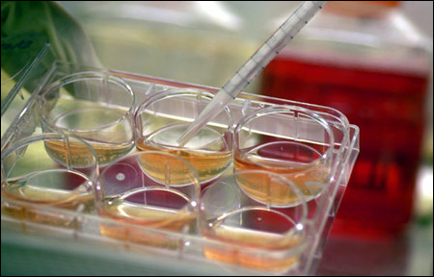
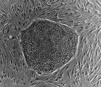
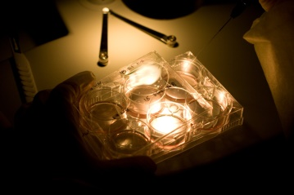
Generation of embryonic stem cells
Isolate and transfer of cell into culture dish in culture media
Culture at 37c and 5% CO₂
Cells divide and spread over the dish
Inner surface of culture dish is coated with inactivated mouse embryonic fibroblasts (MEFs) as a feeder layer:
    provides sticky surface for attachment
    release nutrients
ESCs are removed gently and plated into several different culture plates.

Slide 13
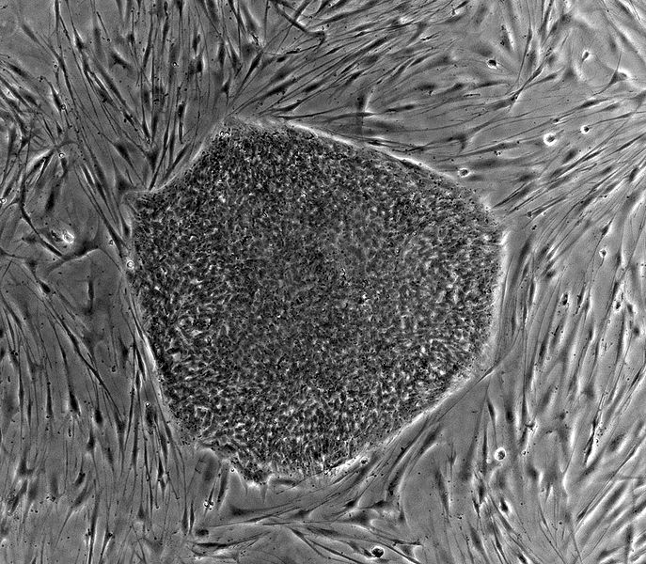
Embryonic stem cells in the dish
What do cultured ES cells look like?
Notes:
There are THOUSANDS of HUMAN embryonic stem cells growing in this circular colony. The HUMAN embryonic stem cells are grown on top of MOUSE feeder cells—the elongated cells—which provide essential nutrients.
When we culture embryonic stem cells, we are trying to stop the majority of the colony from differentiating so that we can maintain a pure population of self-renewing embryonic stem cells. Why do you think this would be important? (wait) We want them proliferating not differentiating so we have a continuing supply for research purposes.

Slide 14
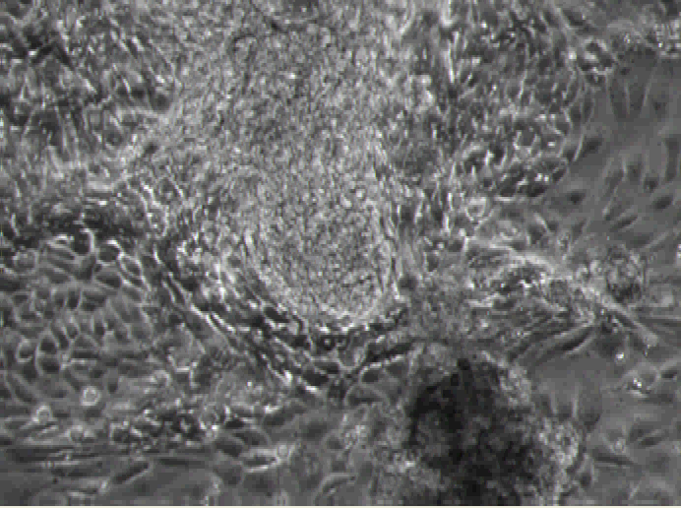
Beating cardiomyocytes derived from hESCs

Slide 15
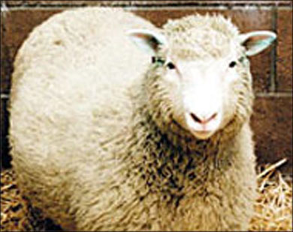

CLONING
Somatic Cell Nuclear Transfer
SCNT
Reproductive Cloning
Notes:
To overcome the possibility of rejection of stem cell transplants as foreign tissues a new technology has been developed

Slide 16
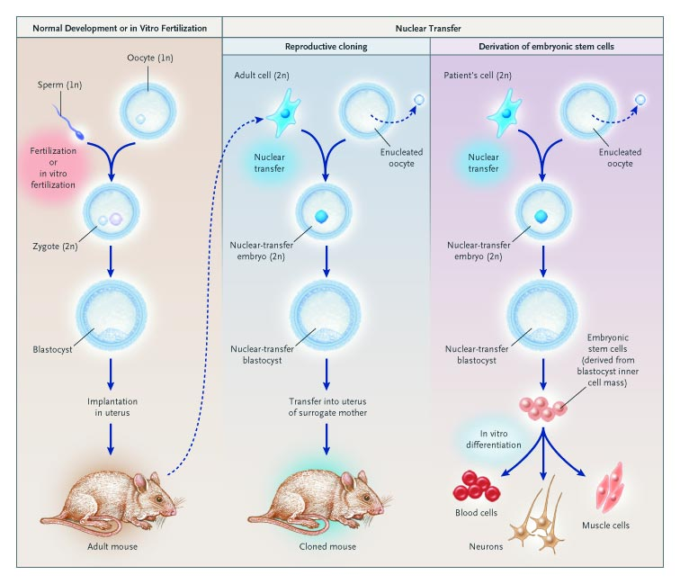

Slide 17
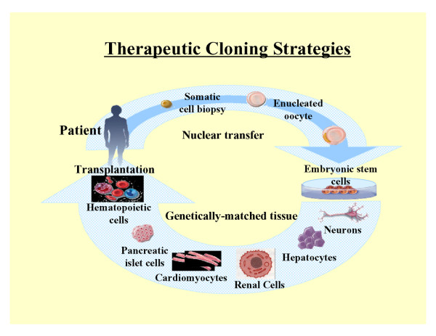
Therapeutic Cloning
Therapeutic cloning uses stem cells to correct diseases and other health problems that someone may encounter.
Therapeutic cloning does not cloned to make full humans but rather is used for the stem cells of embryo

Slide 18
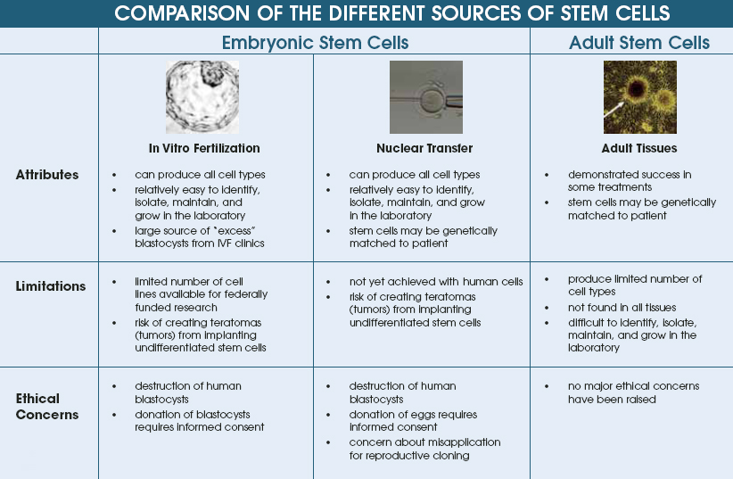

Slide 19
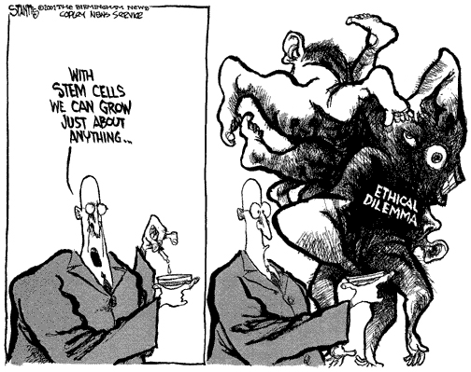
Notes:
The reason I am testifying before you today is that this cartoon tells the truth: it’s not possible to discuss stem cells without creating an ethical dilemma or bogging down in an ethical quagmire. I hope to show you a way out of the swamp without getting our feet too muddy.

Slide 20
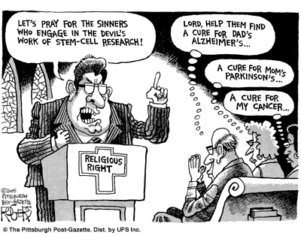

Slide 21
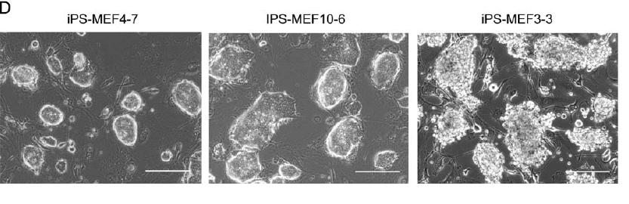
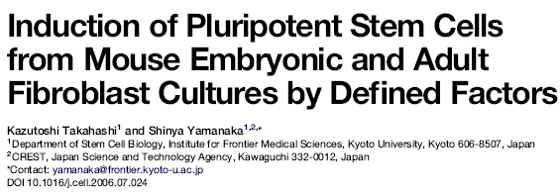

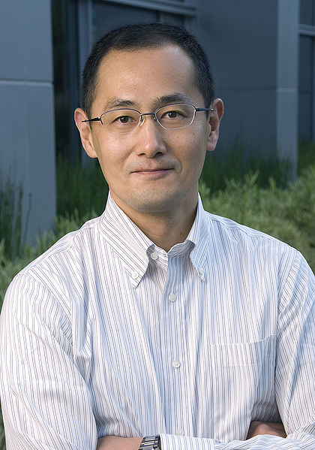
The first iPSCs
In late 2006 the group of Takahashi and Yamanaka reported the stimulation of cells of adult and embryonic origin to pluripotent stem cells called induced pluripotent stem (iPS) cells.

Slide 22
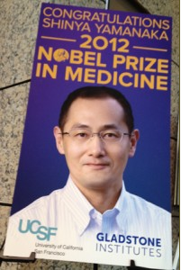

Slide 23
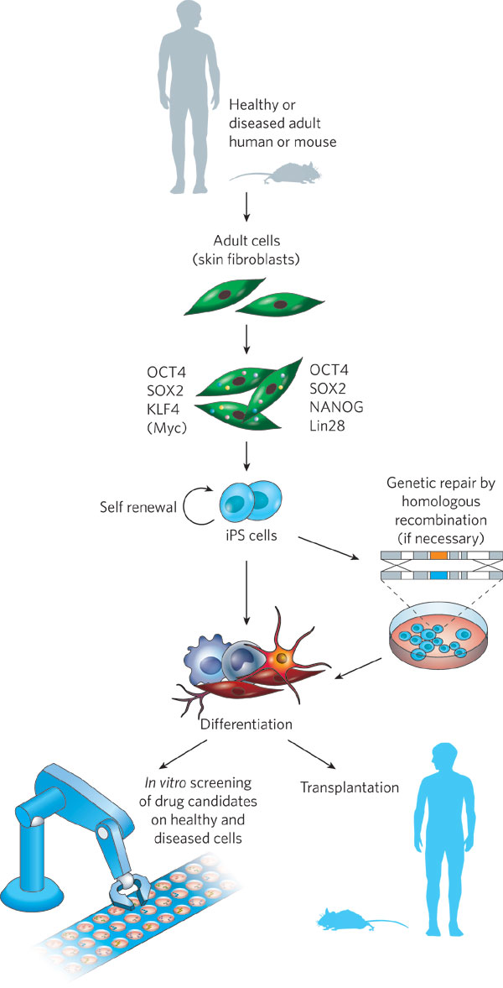
iPS Cells
Notes:
Thomson: Oct4, Sox2, Nanog, Lin28

Slide 24
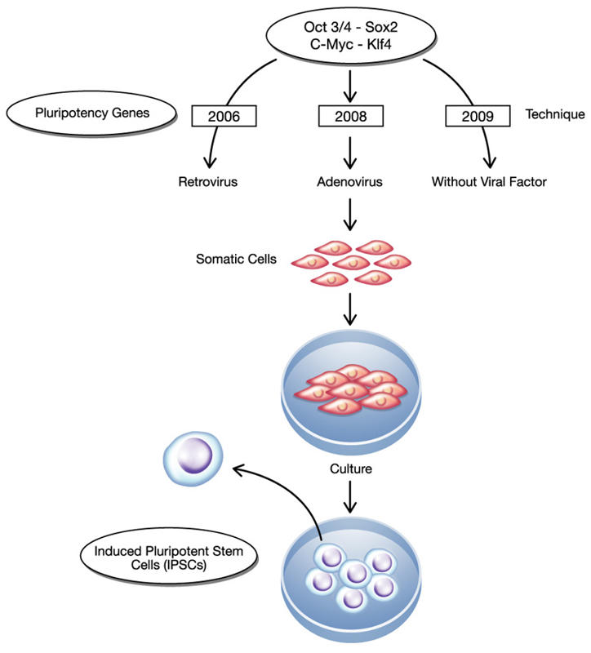
Induced Pluripotent Stem Cell
(iPS) cells
The method was described by Yamanaka and Takahashi in which the skin cells of laboratory mice were genetically manipulated and returned back to their embryonic state.
iPS are somatic cells that have been reprogrammed to a pluripotent state (embryonic stem cell like state).
Several difficulties are to be overcome before iPS cells can be considered as a potential patient-specific cell therapy. It will be crucial to characterize the development potential of human iPS cell line in the future.

Slide 25
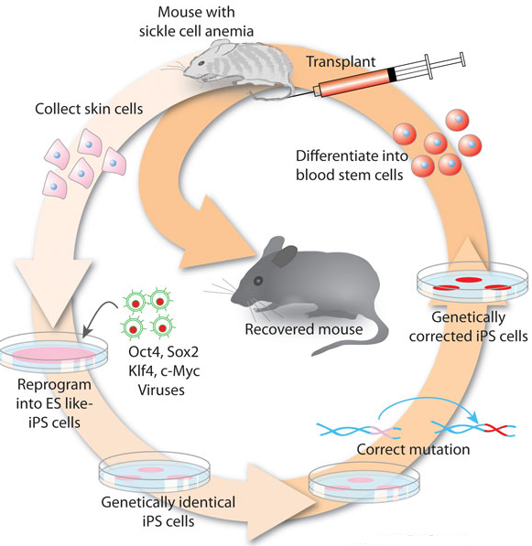
Induced Pluripotent Stem Cell
(iPS) cells
Skin cells were taken from the tail tip of a sickle-cell model mouse.
The cells were differentiated into hematopoietic cells.
The produced cells were transfused back into the sick mouse
Hanna J. et.al., 2007

Slide 26
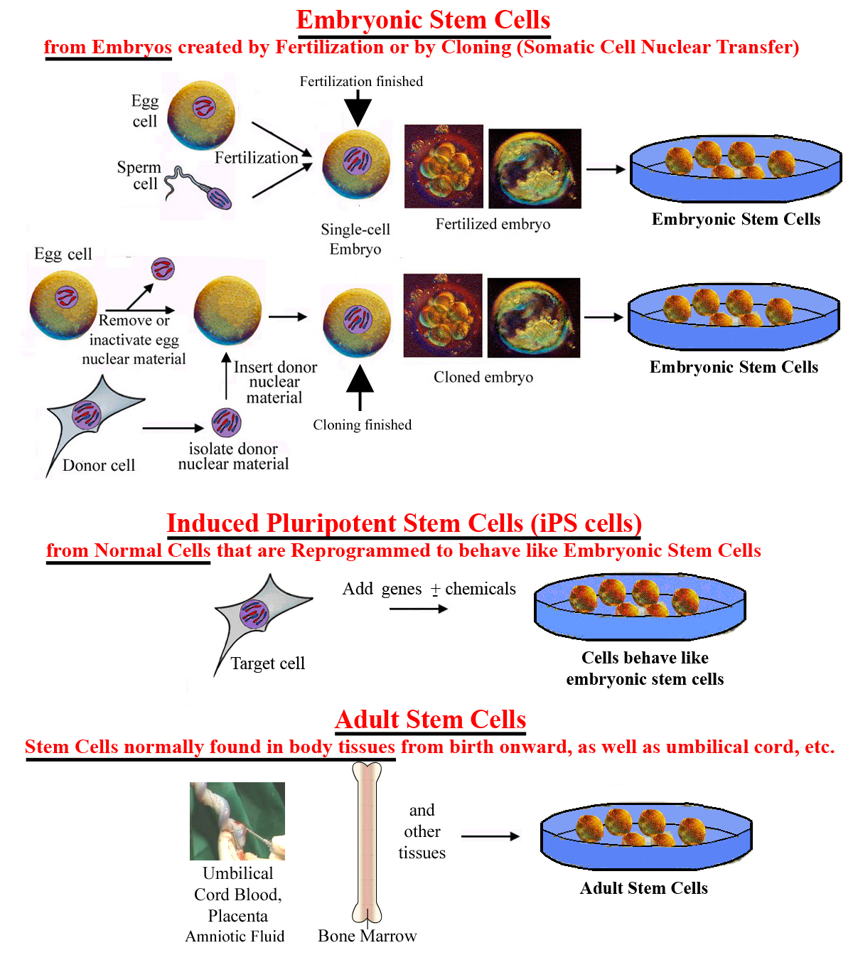

Slide 27
Goal of Stem Cell Therapies
The goal of stem cell therapies is to promote cell replacement in organs that are damaged and do not have the ability for self repair

Slide 28
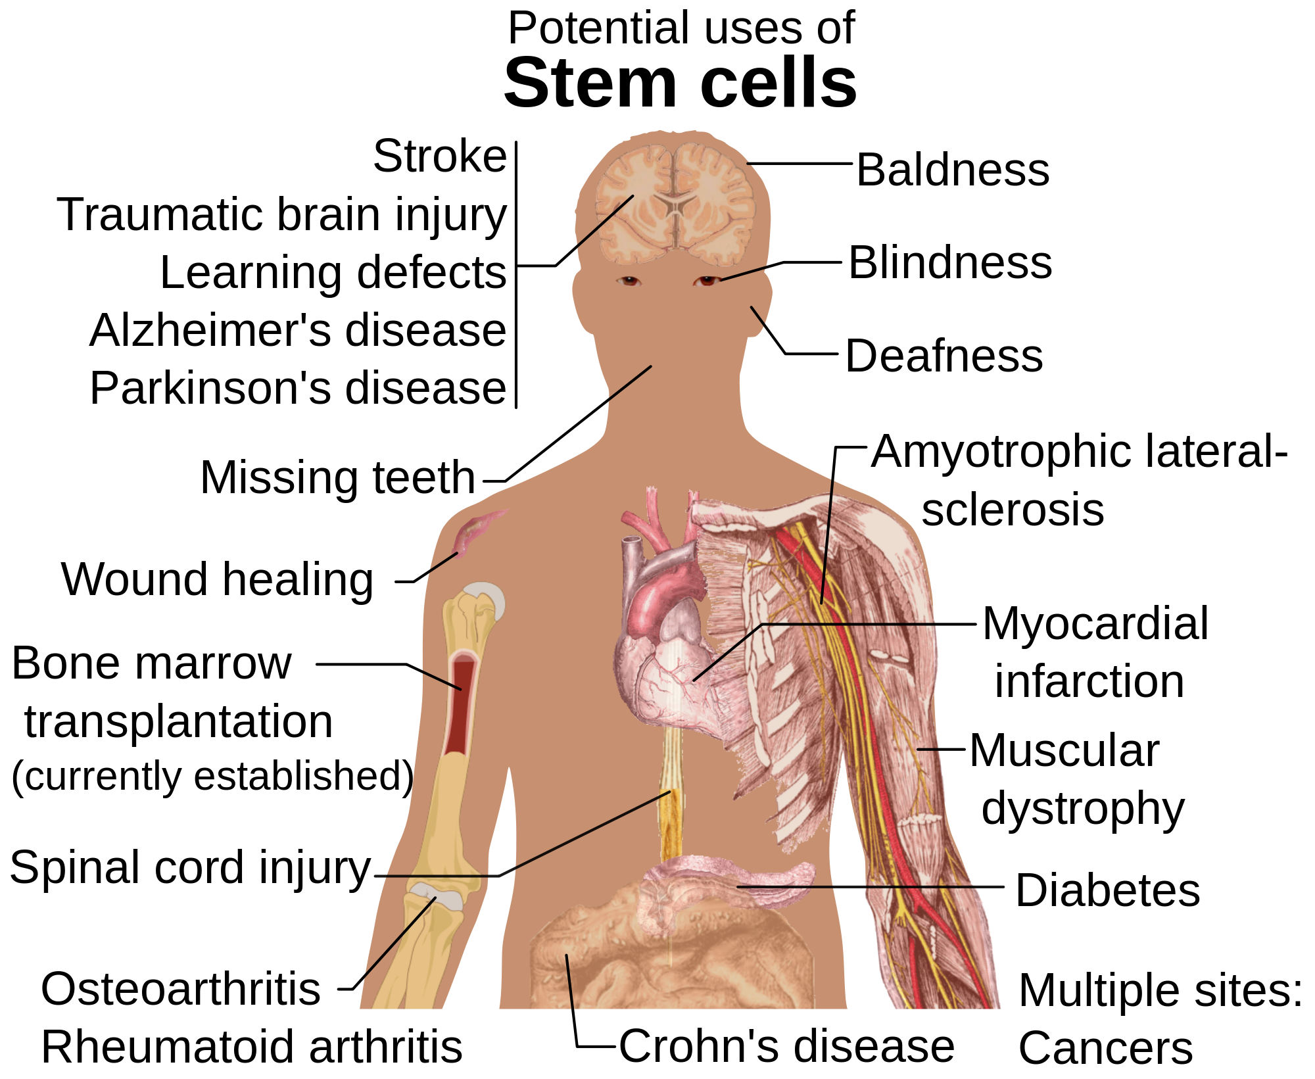

Slide 29
People in the US affected by diseases that may be helped by stem cell research
Condition Number of Persons Affected
Cardiovascular diseases 58 Million
Autoimmune diseases 30 Million
Diabetes 16 Million
Osteoporosis 10 Million
Cancer 8.2 Million
Alzheimer's disease 4 Million
Parkinson's disease 1.5 Million
Burns (severe) 0.3 Million
Spinal cord injuries 0.25 Million
Birth defects 150,000 (per year)
Total 128.4 Million
--------------------------------------------------------------------------------------
Data from the Patients' Coalition for Urgent Research, Washington, DC (according to Perry, Ref. 267).

Slide 30
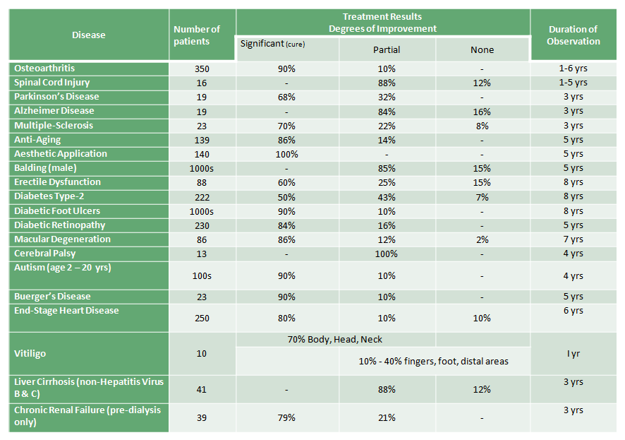
Stem Cells Treatments - Success Rate

Slide 31
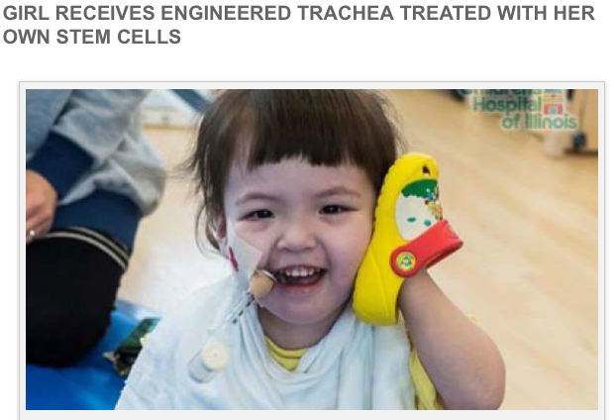
Notes:
It was first built with non-absorbable nanofibers then coated with stem cells taken from Hannah’s bone marrow.

Slide 32
Obstacles of Stem Cell Research
How to find the right type of stem cells?
How to completely differentiate Stem Cells to desired cell type?
How to put the stem cells into the right place?
Will the stem cells perform the desired function in the body?
Differentiation protocols for many cell types have not been developed.

Slide 33
Question 1
Which of the following are pluripotent stem cells?
  Cells has the Potential to form all differentiated cell types except placenta
  Cells that has limited potential to form only multiple adult cell types
  Cells that don’t have the ability for self renewal
  Cells has the potential to differentiate into any adult cell type Pluripotent (Plural)

Slide 34
Question 2
Some of the Important limitations of using cloned ESCs (SCNT-ESCs) clinically
  Immune rejection
  Produce limited number of cell types
  Destruction of human embryos
  Difficult to grow and culture in the laboratory

Slide 35
Question 3
What are Yamanaka factors?
  OCT3/4, SOX2, KLF4, c-Myc
  Growth factors
  Cytokines
  OCT3/4, SOX2, Nanog

Slide 36
Question 4
Mesenchymal stem cells are examples of:
  Pluripotent stem cells
  Multipotent stem cells
  Totipotent stem cells
  Induced pluripotent stem cells (iPS cells)

Slide 37

Thank You

