Slide 1
Biochemical Aspects of Digestion of Lipids
Dr. Amr S. Moustafa

Slide 2
OBJECTIVES
By the end of this lecture, the student should be able to understand:
the process of digestion of dietary lipids including, the organs involved, the enzymes required, and the end products.
the assembly (synthesis), metabolism and fate of chylomicrons.
the clinical manifestations of diseases that involve defective lipid digestion and/or absorption (maldigestion and malabsorption syndromes).

Slide 3
Dietary Lipids
Dietary lipids intake is ~81 g/day
Triacylglycerol is ~ 90%
The remainder includes (10%):
Cholesterol
Cholesterol ester
Phospholipids
Glycolipids
Free fatty acids

Slide 4
Lipid Digestion: Sites and Enzymes
Sites:
The stomach
The small intestine
Enzymes:
1. Act in stomach:
Mouth: Lingual lipase
Stomach: Gastric lipase
2. Act in small intestine:
Pancreatic enzymes
Lipase and co-lipase
Cholesterol esterase
Phospholipase A2
Lysophospholipase

Slide 5
1- Digestion of Lipids Begins in the Stomach
The effects of lingual and gastric lipases on TAG:
Little significance in adults (Why?)
Important for digestion of milk fat in neonates and infants (Explain)

Slide 6
2- Digestion of Lipids in Small Intestine
Digestion of lipids is preceded by emulsification
Digestion in small intestine is hormonally controlled:
Cholecystokinin (CCK)
Secretin

Slide 7
Emulsification of Dietary Lipids in duodenum
Emulsification increases the surface area of lipid droplets, therefore the digestive enzymes can effectively act.
Mechanisms:
1. Mechanical mixing by peristalsis
2. Detergent effect of bile salts:
Bile salts interact with lipid particles and aqueous duodenal contents, stabilizing the particles as they become smaller, and preventing them from coalescing

Slide 8
Hormonal Control of Digestion in Small Intestine:
The digestion in small intestine is hormonally controlled.
Two small peptide hormones are released from cells of the upper part of small intestine:
Cholecystokinin (CCK)
Secretin

Slide 9
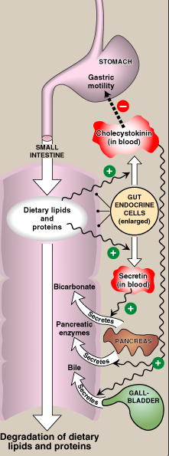
Hormonal Control of Digestion in Small Intestine:
CONT’D
Cholecystokinin (CCK):
Secretion of pancreatic enzymes
Bile secretion
Slow release of gastric contents
Secretin:
Release of watery solution
rich in bicarbonate by pancreas

Slide 10
The gut hormones:
The gut hormone | Stimulus for secretion | Effects
1- Cholecystokinin (CCK) | The presence of partially digested proteins (& lipids) in the upper small intestine | Stimulates the release of pancreatic digestive enzymes Stimulates the contraction of the gall bladder & release of bile Decreases gastric motility → slower release of gastric contents into the small intestine

Slide 11
The gut hormones: continued…
The gut hormone | Stimulus for secretion | Effects
2- Secretin | Low pH of the chyme entering the intestine | Stimulates the pancreas to release a watery solution rich in bicarbonate to neutralize the pH of the intestinal contents (to reach the optimum pH for digestive activity by pancreatic enzymes)

Slide 12
Pancreatic Enzymes for Digestion of Lipids
Pancreatic Lipase and co-lipase
Cholesterol esterase
Phospholipase A2
Lysophospholipase

Slide 13
Digestion of TAG by Pancreatic Lipase
& Colipase
Pancreatic lipase :
Found in high conc. in pancreatic secretion (2-3% of total proteins)
Inhibited by Orlistat, an antiobesity drug

Slide 14
Digestion of Cholesterol Ester by Cholesterol Esterase

Slide 15
Digestion of Phospholipids (PL)by Phospholipase A2 & Lysophospholipase
H₂O
Fatty acid
PL
Lysophospholipid
Phosphophlipase A2
H₂O
Fatty acid
Lysophospholipid
Glycerolphosphoryl
base
Lysophosphophlipase

Slide 16
Main End Products of Lipid Digestion
2-Monoacylglycerol
Cholesterol
Free fatty acids

Slide 17
Absorption of Lipids by Intestinal Mucosal Cells
Mixed micelles:
Disc-shaped clusters of amphipathic lipids.
Arranged with their hydrophobic groups on the inside and their hydrophilic groups on the outside.
Mixed micelle includes end products of lipid digestion, bile salts and fat-soluble vitamins
Short- and medium-chain fatty acids do not require mixed micelle for absorption by intestinal cells

Slide 18
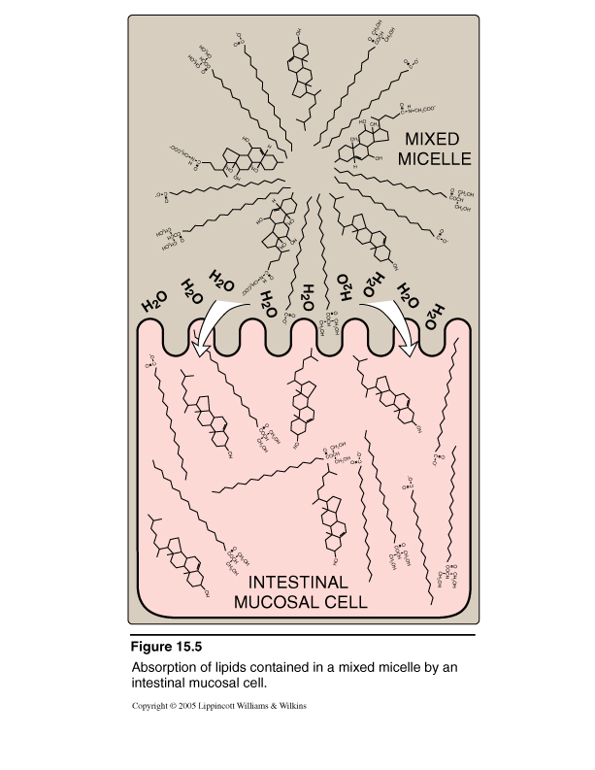
Absorption of Lipids by Intestinal Mucosal Cells
Mixed Micelle:
2-Monoacylglycerol
Cholesterol
Free fatty acids
Bile salts
Fat-soluble vitamins

Slide 19
Re-synthesis of Lipids by Intestinal Mucosal Cells
Activation of long chain fatty acids into acyl CoA
Synthesis of
TAG from monoacylglycerol
Cholesterol ester from cholesterol
Phospholipids from glycerolphosphoryl base
Short- and medium-chain fatty acids are not
converted into their CoA derivatives. Instead, they
are released into portal circulation, carried by
serum albumin

Slide 20
Re-synthesis of Lipids and Assembly of Chylomicrons by Intestinal Mucosal Cells

Slide 21
Assembly of Chylomicrons by Intestinal Mucosal Cells
Assembly of chylomicrons:
Newly synthesized TAG and cholesterol ester
are packaged as lipid droplets surrounded by
thin layer of:
Apolipoprotein B-48 (apo B-48)
Phospholipids
Free cholesterol

Slide 22
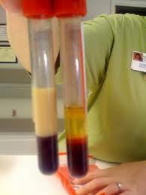
Secretion of Chylomicrons by Intestinal Mucosal Cells
Secretion of chylomicrons:
By exocytosis into lymphatic vessels around villi
of small intestine (lacteals) then enter into
systemic circulation
Milky-appearance of serum after lipid-rich meal

Slide 23
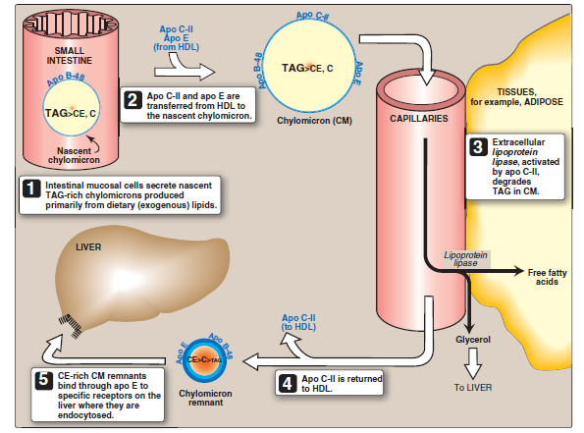
Metabolism and Fate of Chylomicrons

Slide 24
Chylomicrons Vs VLDLs
 | Chylomicrons | VLDLs
Site of synthesis | Small intestinal cells | Hepatocytes
Structure | Apoproteins B-48 | Apoproteins B-100
Function | Blood transport of dietary TAG (exogenous origin) | Blood transport of synthesized TAG in the liver (endogenous origin)
Metabolic fate | Uptake by the liver as chylomicron reminant via apoE receptor | Uptake by the liver & peripheral tissue mainly as LDL via apoE/B100 receptor

Slide 25
Apoproteins B-48 Vs B-100
Apo- B-100 is the full-length protein encoded by
Apo-B gene.
It is found both in VLDLs and its derivative LDLs.
Apo-B-48 constitutes N-terminal 48% of the protein
that is encoded by the same gene apo-B gene (How?).
It is found in chylomicrons.
Post-transcriptional editing of cytosine into uracil in
the intestinal apo-B mRNA creates a stop codon
allowing translation of only 48% of the protein
(apo-B-48)
Only apo-B-100 (and not apo-B-48) can be recognized
by apo-B receptor on hepatocytes.

Slide 26
Abnormalities in Lipid Digestion/Absorption
Liver and gall bladder diseases
Pancreatic insufficiency
e.g., chronic pancreatitis, cystic fibrosis, surgical removal of the pancreas
Intestinal diseases:
e.g., Intestinal resection (shortened bowl)
→ incomplete digestion & absorption of fat & protein → abnormal appearance of lipids (steatorrhea) & undigested protein in the feces (Malabsorption syndrome)

Slide 27
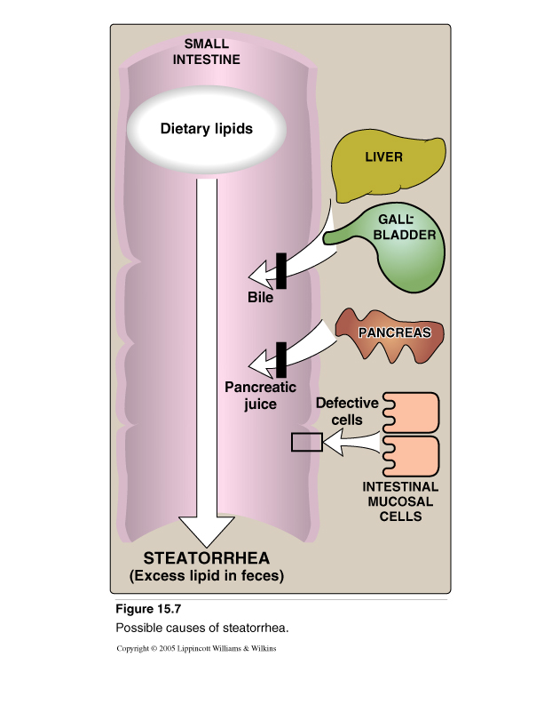
Maldigestion/Malabsorption of Lipids

Slide 28
Take home message
Dietary lipids are relatively hydrophobic
Lipid digestion begins in stomach
Emulsification of lipids occurs in duodenum, helped by peristalsis and bile salts
Intestinal digestion of lipids by pancreatic enzymes
Lipid absorption by formation of mixed micelles

Slide 29
Take home message
CONT’D
Re-synthesis of TAGs, cholesterol ester and PLs inside the intestinal mucosal cells
Assembly and secretion of chylomicrons into lymphatic lacteals and then into systemic circulation
Short- and medium-chain fatty acids:
Do not require micelle for absorption
Do not participate in re-synthesis of TAGs & PLs
Released directly from intestinal cells into portal circulation

Slide 30
Take home message
CONT’D
Liver diseases, pancreatic insufficiency, or intestinal diseases → incomplete digestion and absorption of fat & protein → steatorrhea & appearance of undigested proteins in the feces (Malabsorpton syndrome)

Slide 31
THANK YOU

