Slide 1
8 LECTURES
Gastro-esophageal reflux disease
Peptic Ulcer Disease
Diarrhea
Malabsorption
Inflammatory bowel disease-1
Inflammatory bowel disease-2
Colonic polyps and carcinoma-1
Colonic polyps and carcinoma-2

Slide 2
8 LECTURES
Inflammatory bowel disease-1
Inflammatory bowel disease-2

Slide 3
Objectives
Upon completion of this lecture the students will :
Know the two forms of idiopathic inflammatory bowel disease (IBD).
Describe the pathogenesis of IBD.
Compare and contrast Crohn disease and ulcerative colitis with respect to:
clinical features and extraintestinal manifestations
pathology (gross and microscopic features) of IBD.
complications of IBD.(especially adenocarcinoma preceded by dysplasia)

Slide 4
Inflammatory Bowel Diseases
Crohn's disease and ulcerative colitis.
Although their causes are still not clear, the two diseases probably have an immunologic hypersensitivity basis.

Slide 5
Pathophysiology
Nucleotide-binding oligomerization domain-containing protein 1
Genetics: mutation in
NOD2……. susceptibility gene in Crohn disease.
…………. Abnormal recognition and response to intracellular pathogens
THEORY
Less effective at recognizing and combating luminal microbes
Mucosal immune responses.
Abnormal intestinal epithelial tight junction barrier function
Immunosuppression is the mainstay of IBD therapy.
Transepithelial flux of luminal bacterial components activates immune responses
Inflammation
NOD2 encodes a protein that binds to intracellular bacterial peptidoglycans

Slide 6
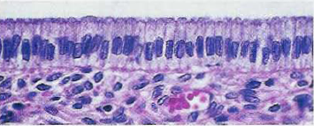
luminal bacteria

Slide 7
Mutations in NOD2 are seen in about 15% of Crohn's disease patients but are also seen in a smaller percentage of the general population,
so mutations in NOD2 are neither necessary nor sufficient for the development of Crohn's disease

Slide 8
Pathophysiology
An idiopathic disorder
The pathophysiology of IBD is under active investigation.
Persons with IBD have a genetic predisposition for the disease.
Most investigators believe that the two diseases result from a combination of
Defects in host interactions with intestinal microbes
Intestinal epithelial dysfunction
Aberrant mucosal immune responses.
For unclear reasons, research suggests that smoking increases the risk of Crohn disease but reduces the likelihood of ulcerative colitis.

Slide 9
Clinical
The manifestations of IBD generally depend on the area of the intestinal tract involved.
Colon
Small intestine
Extraintestinal manifestations
Bloody diarrhea,
Tenesmus
Abdominal pain
Intestinal obstruction.
Steatorrhea
Arthritis
Eye manifestation
Skin manifestation

Slide 10
Crohn's disease
is a chronic inflammatory disorder that most commonly affects the ileum and colon but has the potential to involve any part of the gastrointestinal tract from the mouth to the anus.

Slide 11
Crohn's disease
Clinical Features
Any age but has its highest incidence in young adults
Extremely variable clinical feature.
Acute phase: fever, diarrhea, and right lower quadrant pain may mimic acute appendicitis.
Chronic disease : remissions and relapses over a long period of time.
Thickening of the intestine may produce an ill-defined mass in the abdomen.

Slide 12
Crohn's disease
Sites of Involvement:
Any part of the GIT from the mouth to the anus.
ileum (30%) colon (20%).
most commonly terminal ileum
Commonly (75%) have perianal lesions such as abscesses, fistulas, and skin tags.

Slide 13
Crohn's disease
Gross Appearance:
Involvement is typically segmental, with skip areas of normal intestine between areas of involved bowel.
Marked fibrosis causing luminal narrowing with intestinal obstruction.
Fissures (deep and narrow ulcers that look like stabs with a knife that penetrate deeply into the wall of the affected intestine)
fistulas (communications with other viscera).

Slide 14
Mucosa: longitudinal serpiginous ulcers separated by irregular islands of edematous mucosa. This results in the typical cobblestone effect.
FAT : In involved ileal segments, the mesenteric fat creeps from the mesentery to surround the bowel wall (creeping fat)

Slide 15
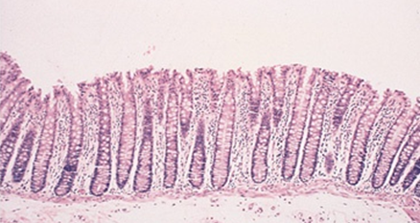
Crohn's disease
Microscopic Features
Distortion of mucosal crypt architecture,
Transmural inflammation,
Epithelioid granulomas [60%].
Fissure-ulcers and fistulas can be seen microscopically.
Normal

Slide 16
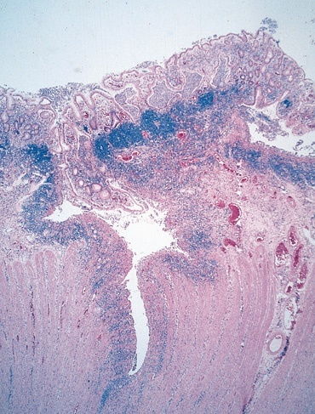
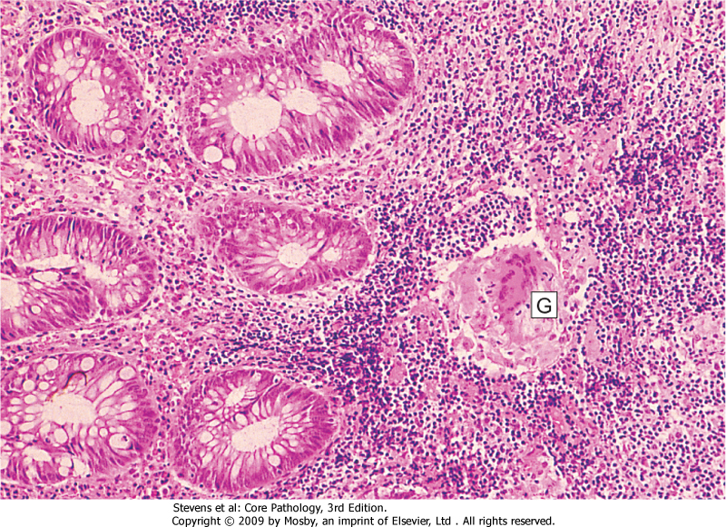
Crohn’s Disease
FISSURE
GRANULOMA

Slide 17
Crohn's disease
Complications
Intestinal obstruction
Fistula formation
between the ileum and the colon result in malabsorption
Enterovesical fistulas lead to urinary infections and passage of gas and feces with urine.
Enterovaginal fistulas produce a fecal vaginal discharge.
Extraintestinal manifestations (arthritis and uveitis)
Slight increased risk of development of carcinoma of the colon—much less than in ulcerative colitis.

Slide 18
Crohn's disease
Summary
Involvement of discontinuous segments of intestine (skip areas
Can involve any part of GIT.
Noncaseating epithelioid cell granulomas
Transmural (full-thickness) inflammation of the affected parts

Slide 19
Ulcerative Colitis
is an inflammatory disease of uncertain cause.
It has a chronic course characterized by remissions and relapses.
20- to 30-year age group but may occur at any age

Slide 20
Ulcerative Colitis
Etiology
The cause is unknown
Antibodies that cross-react with intestinal epithelial cells and certain serotypes of Escherichia coli have been demonstrated in the serum of some patients with ulcerative colitis.

Slide 21
Ulcerative Colitis
Clinical Features
In the acute phase and during relapse, the patient has fever, leukocytosis, lower abdominal pain, bloody diarrhea and mucus in the stool.
The disease usually has a chronic course, with remissions and exacerbations.

Slide 22
Ulcerative Colitis
Sites of Involvement
Ulcerative colitis is a disease of the rectum, and the colon.
Rectum is involved in almost all cases
The disease extends proximally from the rectum in a continuous manner without skip areas.
The ileum is not involved as a rule

Slide 23
Ulcerative Colitis
Gross Appearance
Involves mainly the mucosa (diffuse hyperemia with numerous superficial ulcerations in the acute phase.
The regenerated or nonulcerated mucosa may appear polypoid (inflammatory pseudopolyps) in contrast with the atrophic areas or ulcers.

Slide 24
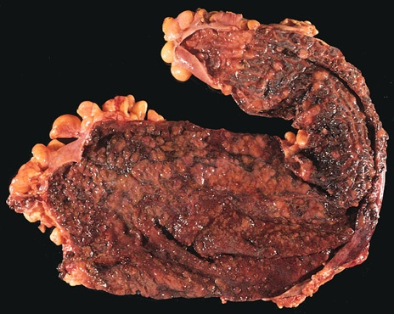
diffuse hyperemia with numerous superficial ulcerations
NO skip lesion

Slide 25
Ulcerative Colitis
Microscopic Appearance
The inflammation is usually restricted to the mucosa.
In the active phase….neutrophils (Cryptits, crypt abscess)
In the chronic phase…..crypt atrophy and distortion
Active inflammation correlates well with the severity of symptoms.

Slide 26
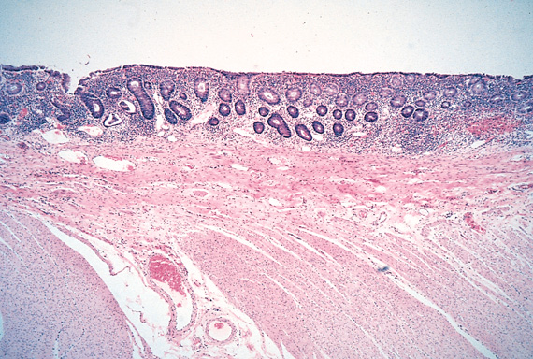
The inflammation is usually restricted only to the mucosa.
inflammation
No inflammation

Slide 27
Ulcerative Colitis
Complications
Acute phase
Severe bleeding
Toxic megacolon ( dilation of the colon, with functional obstruction)
Chronic ulcerative colitis
Increase risk of developing colon carcinoma.
The presence of high-grade dysplasia in a mucosal biopsy imposes a high risk of cancer and is an indication for colectomy.
Extraintestinal manifestations
occur more commonly in ulcerative colitis than in Crohn's disease.
Arthritis
Uveitis
skin lesions (pyoderma gangrenosum),
sclerosing pericholangitis (fibrosis around bile ducts), leading to obstructive jaundice.

Slide 28
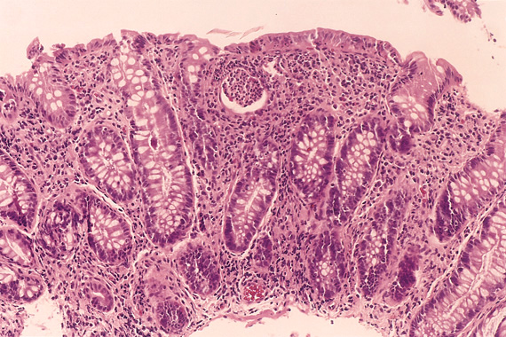
dysplasia

Slide 29
Objectives
Know the two forms of idiopathic inflammatory bowel disease (IBD).
Crhon disease and ulcerative colitis
2. Describe the pathogenesis of IBD.
Theories
Autoimmunity
3. Compare and contrast Crohn disease and ulcerative colitis with respect to:
clinical features and extraintestinal manifestations
pathology (gross and microscopic features) of IBD.
complications of IBD.(especially adenocarcinoma preceded by dysplasia)

Slide 30
Inflammatory bowel diseases summary
Crohn's disease
Ulcerative Colitis
Any part of the GIT
Skip areas of normal mucosa
Deep ulcers ( fissure )
Transmural inflammation
Fistula formation
Creeping mesenteric fat
Fibrous thickening of wall
Granulomas
Dysplasia is rare
Carcinoma is rare
Colon only
Diffuse involvement of mucosa
Superficial ulcers
Mucosal inflammation only
Not seen
Not seen
Not seen
Not seen
Dysplasia is common
Carcinoma is more common (10%)

Slide 31
Inflammatory bowel diseases
Colon only
Diffuse involvement of mucosa
Superficial ulcers
Any part of the GIT
Skip areas of normal mucosa
Mucosal inflammation only
Fistula formation
Transmural inflammation
Granulomas
Deep ulcers ( fissure )
Dysplasia is common
Carcinoma is more common (10%)
Crohn's disease
Ulcerative Colitis

Slide 32
8 LECTURES
Colonic polyps and carcinoma-1
Colonic polyps and carcinoma-2

Slide 33
Objectives
Upon completion of this lecture the students will
Know common types of intestinal polyps
Differentiate between the neoplastic and non-neoplastic polyps
Know the clinical presentation of left and right sided colon cancer, and the environmental factors that increase its risk
Understand the pathogenesis of colon cancer
Discribe the Pathological features of colon cancer

Slide 34
Tumors of the small and large intestines
Polyps
Carcinoma
Carcinoid tumor
Lymphoma

Slide 35
Polyps
Non-neoplastic polyps 90%
Hyperplastic polyps
Hamartomatous polyps (Juvenile & Peutz-Jeghers polyps)
Inflammatory polyps
Lymphoid polyps
Neoplastic polyps 10%
Adenoma

Slide 36
Polyps
Hyperplastic Polyp
Asymtomatic
> 50% are located in the rectosigmoid
Sawtooth surface
Star shaped crypts
Composed of well-formed glands and crypts lined by differentiated goblet or absorptive cells.

Slide 37
Hamartomatous polyps
Juvenile polyps Peutz-Jeghers polyps

Slide 38
Non-Neoplastic Polyp
Hamartomatous polyp
Juvenile Polyps (retention polyp)
Developmental malformations affecting the glands and lamina propria
Commonly occur in children under 5 years old in the rectum.
In adult called retention polyp.
Notes:
4

Slide 39
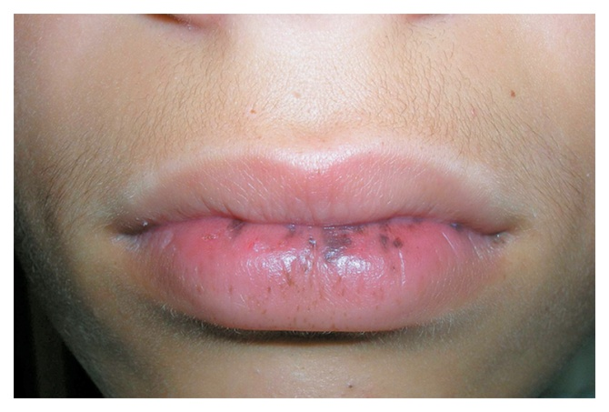
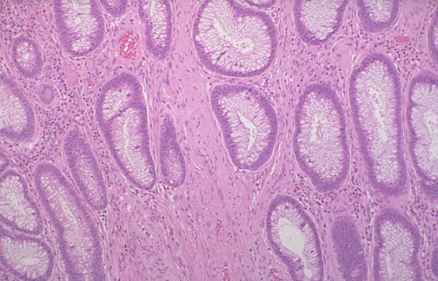
Non-Neoplatic Polyps
Hamartomatous Polyps
Peutz-Jehgers syndrome
Rare, autosomal dominant
hamartomatous polyps accompanied by mucosal and cutaneous pigmentation around the lips, oral mucosa, face and genitalia.
Polyps tend to be large and pedunculated.
Increased risk of developing carcinoma of the pancreas, breast, lung, ovary and uterus.
Notes:
5

Slide 40
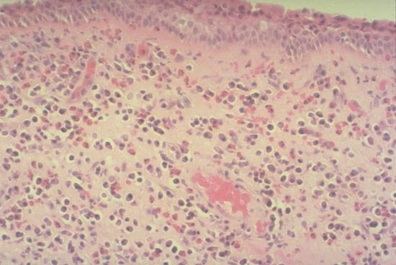
Non-Neoplastic Polyps
Inflammatory Polyps
longstanding IBD, especially in chronic ulcerative colitis.
Represent an exuberant reparative response to longstanding mucosal injury called pseudopolyps
Notes:
6

Slide 41
4] Lymphoid polyps

Slide 42
Neoplastic Polyps (Adenomas)
Adenomatous Polyp ( adenoma )
Occur mainly in large bowel.
Spordic and familial
Vary from small pedunculated to large sessile
Epithelium proliferation and dysplysia
Divided into:
Tubular adenoma: less than 25% villous architecture
Villous adenoma: villous architecture over 50%
Tubulovillous adenoma: villous architecture between 25 and 50%.
Notes:
7

Slide 43
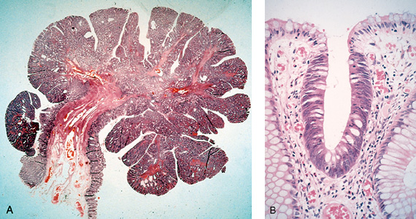
Neoplastic Polyps
1] Tubular adenoma
Represents 75% of all neoplastic polyps.
75 % occur in the distal colon and rectum.
Notes:
8

Slide 44
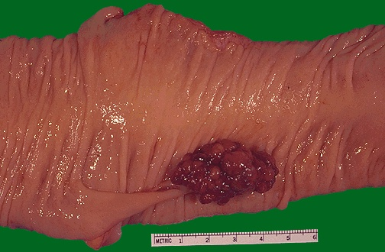
Neoplastic Polyps
Villous Adenoma
The least common, largest and most ominous of epithelial polyps.
Age: 60 to 65 years,
Present with rectal bleeding or anemia, large ones may secrete copious amounts of mucoid material rich in protein.
75% located in rectosigmoid area.
Notes:
10

Slide 45
3] Tubulovillous adenoma
Intermmediate in size, degree of dysplasia and malignant potential between tubular and villous adenomas.

Slide 46
Relationship of Neoplastic Polyps to Carcinoma
Adenoma to carcinoma sequence is documented by several genetic alterations.
The probability of carcinoma occuring in a neoplastic polyp is related to:
1. The size of the polyp.
2. The relative proportion of its villous features.
3. The presence of significant cytologic atypia (dysplasia) in the neoplastic cells.
Notes:
12

Slide 47
Adenoma to Carcinoma Pathway
Normal
Adenoma
Cancer
APC
loss
K-ras
mutation
Chrom 18
loss
p53
loss
Normal
Epithelium
Hyper-
proliferation
Early
Adenoma
Intermediate
Adenoma
Late
Adenoma
Cancer
Notes:
Polyp removal leads to CRC prevention
Polyp is surrogate marker

Slide 48
Familial Polyposis Syndrome
Patients have genetic tendencies to develop neoplastic polyps.
Familial polyposis coli (FPC)
Genetic defect of Adenomatous polyposis coli (APC).
APC gene located on the long arm of chromosome 5 (5q21).
APC gene is a tumor suppressor gene
Innumerable neoplastic polyps in the colon (500 to 2500)
Polyps are also found elsewhere in alimentary tract
The risk of colorectal cancer is 100% by midlife.
Gardener’s syndrome
Polyposis coli, multiple osteomas, epidermal cysts, and fibromatosis.
Turcot syndrome
Polyposis coli, glioma and fibromatosis
Notes:
13

Slide 49
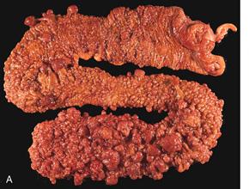
Familial polyposis coli (FPC)

Slide 50
Malignant Tumors of Large Intestine
Adenocarcinoma
Adenocarcinoma of the colon is the most common malignancy of the GI tract and is a major cause of morbidity and mortality worldwide.
Constitutes 98% of all cancers in the large intestine.
Predisposing factors:
IBD, adenomas , polyposis syndrome.
Diet appears to play an important role in the risk for colon cancer:
- Low fibre diet.
High fat content.
Alcohol
- Reduced intake of vit A, C & E.
Notes:
14

Slide 51
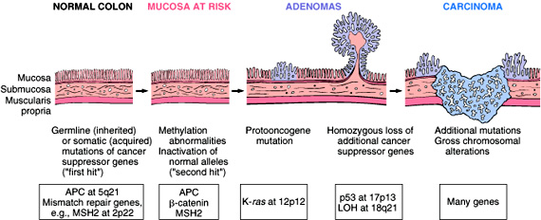
Adenocarcinoma of Large Intestine
Carcinogenesis
Two pathogenetically distinct pathways for the development of colon cancer, both seem to result from accumulation of multiple mutations:
1- The APC/B-catenin pathway ( 85 % )
chromosomal instability that results in stepwise accumulation of mutations in a series of oncogenes and tumor suppressor genes.
adenoma-carcinoma sequence

Slide 52
Malignant Tumors of Large Intestine Adenocarcinoma
Carcinogenesis
2- The DNA mismatch repair genes pathway:
10% to 15% of sporadic cases.
There is accumulation of mutations (as in the APC/B-catenin schema)
Five DNA mismatch repair genes (MSH2, MSH6, MLH1, PMS1, AND PMS2)
give rise to the hereditary non polyposis colon carcinoma (HNPCC)

Slide 53
Hereditary mutation of the APC gene is the cause of familial adenomatous polyposis (FAP), where affected individuals carry an almost 100% risk of developing colon cancer by age 40 years.

Slide 54
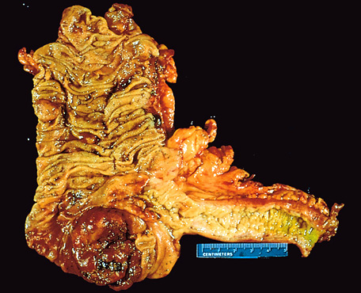
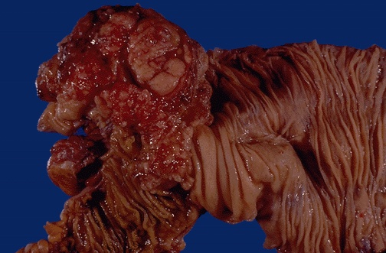
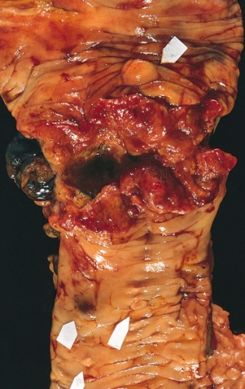
Colorectal Carcinoma
Morphology
70% are in the rectum, rectosigmoid and sigmoid colon.
Left-sided carcinomas tend to be annular, encircling lesions with early symptoms of obstruction.
Right-sided carcinomas tend to grow as polypoid, fungating masses, obstruction is uncommon.
Mucinous adenocarcinoma secret abundant mucin that may dissect through cleavage planes in the wall.
Left-sided
Right-sided
Notes:
16

Slide 55
Signs and symptoms
If located closer to the anus: change in bowel habit, feeling of incomplete defecation, PR bleeding
A tumor that is large enough to fill the entire lumen of the bowel may cause bowel obstruction

Slide 56
Tumor markers
A tumor marker is a substance found in the blood , urine or body tissues that can be elevated in cancer, among other tissue types.
Carcinoembryonic antigen (CEA)
Useful to assess disease recurrence (late stage )
Carbohydrate antigen (CA19-9 )
CEA levels may also be raised in some non-neoplastic conditions like ulcerative colitis pancreatitis, cirrhosis COPD, Crohn's disease as well as in smokers
CA19-9 are raised in in patients with colon cancer and pancreatic cancer, esophageal cancer and hepatocellular carcinoma. Apart from cancer, elevated levels may also occur in pancreatitis, cirrhosis.
Tissue inhibitor of metalloproteinases 1 (TIMP1 )
Early as well as late stage disease

Slide 57
Duke classification is used for staging

Slide 58
Malignant Small Intestinal Neoplasms
In descending order of frequency:
carcinoid, adenocarcinomas, lymphomas and leiomyosarcomas.
Notes:
20

Slide 59
Small Intestinal Neoplasms
Carcinoid Tumors
Neoplasms arising from endocrine cells found along the length of GIT mucosa.
60 to 80% appendix and terminal ileum: 10 to 20% rectum.
Ultrastructral features: neurosecretory electron dense bodies in the cytoplasm
Notes:
21

Slide 60
Small Intestinal Neoplasms
Carcinoid Tumor
Clinical features
Asymptomatic
May cause obstruction, intussusception or bleeding.
May elaborate hormones: Zollinger-Ellison, Cushing’s carcinoid or other syndromes.
Notes:
22

Slide 61
Small Intestinal Neoplasms
Carcinoid tumor
Carcinoid syndrome
1% of carcinoid tumor & in 20% of those of widespread metastasis
Paroxymal flushing, episodes of asthma-like wheezing, right-sided heart failure, attacks of watery diarrhea, abdominal pain,
The principal chemical mediator is serotonin
The syndrome is classically associated with ileal carcinoids with hepatic metastases.
Notes:
23

Slide 62
Small Intestinal Neoplasms
Lymphoma
Most often low-grade lymphomas arising in mucosal-associated lymphoid tissue (MALT) lymphoma or high-grade non-Hodgkin's lymphomas of B cell type.
May occur in any part of the intestine;
the ileocecal region is a favored site for Burkitt's lymphoma.

Slide 63
Objectives
Know common types of intestinal polyps
A- Non-neoplastic polyps no dysplasia
4 common types (hyperplastic, hamartomatous, inflammatory, lymphoid)
B- Neoplastic polyps there is dysplasia
3 types (tubular, tubulovilous, villous)
2. Know the clinical presentation of left and right sided colon cancer, and the environmental factors that increase its risk
Left colon…frank bleeding, obstruction
Right colon…iron diffecieny anaemia
Tumor markers ………………..CEA
3. Understand the pathogenesis of colon cancer
Adenoma to Carcinoma Pathway
Two genetic pathways APC/B-catenin and DNA mismatch repair genes
Familial Polyposis Syndrome
4. Discribe the Pathological features of colon cancer
Adenocarcinoma most common ………………carcinoid tumor { neurosecretory granules}
70% are in the rectum and/or sigmoid
Duke classification is used for staging

