Slide 1
Secretory Functions of the Alimentary Tract (Secretion of Saliva)
Chapter 64; page: 807-809
Chapter 65; page 817-821
Mohammed Alzoghaibi, PhD
Cell Phone #: 0506338400
zzoghaibi@gmail.com

Slide 2
Learning objectives
Mastication and Chewing reflex
The functions of secretory glands
Anatomical types of glands
Salivary glands
Secretion of saliva and its characteristics
Composition of saliva
Lubricating and protective properties of mucus
Secretory unit (salivon)
Saliva and its flow rate
Functions of saliva
Control of secretion by sympathetic and parasympathetic nervous systems

Slide 3
Mastication (Chewing)
Functions:
To lubricate the bolus with salivary secretion
To breakdown the bolus to small particles
To begin digestion of carbohydrate (α-amylase)

Slide 4
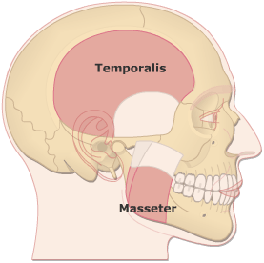
Mastication (Chewing)
Teeth organization
Anterior teeth (incisors) for cutting
Posterior teeth (molars) for grinding
Chewing muscles are innervated by CN-V (5th cranial nerve). Chewing process is controlled by nuclei in the brain stem.
Masseter
Temporalis
Lateral Pterygoid
Medial Pterygoid
Taste centers in the brain stem and Hypothalamus) rhythmical chewing movements
Much of the chewing process is caused by a chewing reflex & stretch reflex

Slide 5
Mastication (Chewing)
Chewing reflex & stretch reflex
The presence of a bolus of food in the mouth at first initiates reflex inhibition of the muscles of mastication, which allows the lower jaw to drop. The drop in turn initiates a stretch reflex of the jaw muscles that leads to rebound contraction. This automatically raises the jaw to cause closure of the teeth, but it also compresses the bolus again against the linings of the mouth, which inhibits the jaw muscles once again, allowing the jaw to drop and rebound another time; this is repeated again and again.

Slide 6
Secretory Functions of the Alimentary Tract
Chapter 64; page 773
The functions of Secretory Glands:
Secretion of digestive enzymes
Provide mucus for lubrication and protection
Most digestive secretions are formed only in response to the presence of food in the alimentary tract, and the quantity secreted in each segment of the tract is almost exactly the amount needed for proper digestion.

Slide 7
Anatomical Types of Glands
Single-cell mucous glands (goblet cells), they produce mucus.
Crypts of Lieberkühn at the mucosal pits in small intestine (they represent invaginations of the epithelium into the submucosa). They release several digestive enzymes.
Tubular glands that include an acid and pepsinogen-secreting gland (in the stomach).
Salivary glands, pancreas, and liver. They are located outside the walls of GI tract. They contain millions of acini lined with secreting glandular cells; these acini feed into a system of ducts that finally empty into the alimentary tract itself.

Slide 8
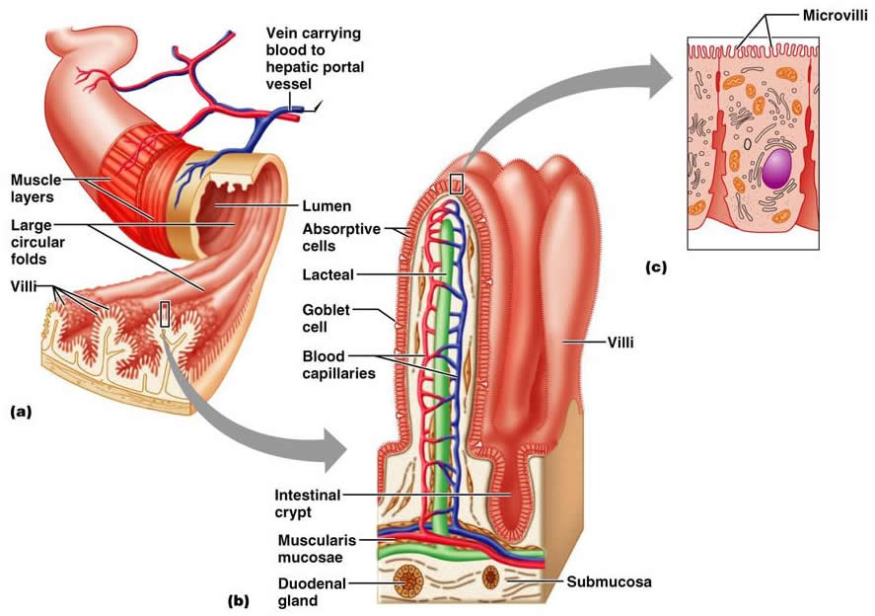
Anatomical Types of Glands (cont.)

Slide 9
Basic Mechanisms of Stimulation of the Alimentary Tract Glands
Effect of Contact of Food with the Epithelium: Function of Enteric Nervous Stimuli:
The mechanical presence of food in a particular segment of the GI tract usually causes the glands to secrete moderate to large quantities of juices. The types of stimuli that do this are:
(1) tactile stimulation.
(2) chemical irritation.
(3) distention of the gut wall.

Slide 10
Basic Mechanisms of Stimulation of the Alimentary Tract Glands (cont.)
Autonomic Stimulation of Secretion:
Parasympathetic Stimulation:
Stimulation of the parasympathetic nerves to the alimentary tract almost increases the rates of GI secretion, especially in the upper portion of the tract: salivary glands, esophageal glands, gastric glands, pancreas, Brunner’s glands in the duodenum and the distal portion of the large intestine.
Secretion in the remainder of the small intestine and in the first two thirds of the large intestine occurs mainly in response to local neural and hormonal stimuli in each segment of the gut.

Slide 11
Basic Mechanisms of Stimulation of the Alimentary Tract Glands (cont.)
Autonomic Stimulation of Secretion (cont.):
2. Sympathetic stimulation can have a dual effect: First, sympathetic stimulation alone usually slightly increases secretion. But, second, if parasympathetic or hormonal stimulation is already causing copious secretion by the glands, superimposed sympathetic stimulation usually reduces the secretion, sometimes significantly because of vasoconstrictive reduction of the blood supply.

Slide 12
Basic Mechanisms of Stimulation of the Alimentary Tract Glands (cont.)
Regulation of Glandular Secretion by Hormones:
In the stomach and intestine, several GI hormones help regulate the volume and character of the secretions. They are liberated from the GI mucosa in response to the presence of food in the lumen of the gut. The hormones then are absorbed into the blood and carried to the glands, where they stimulate secretion.

Slide 13
Basic Mechanism of Secretion by Glandular Cells
The nutrient material needed for formation of the secretion must first diffuse or be actively transported by the blood in the capillaries into the base of the glandular cell.
Mitochondria use oxidative energy to form ATP.
Energy from the ATP, along with appropriate substrates provided by the nutrients, is then used to synthesize the organic secretory substances in the endoplasmic reticulum and Golgi complex.
In the Golgi complex, the materials are modified, added to, concentrated, and discharged into the cytoplasm in the form of secretory vesicles.
These vesicles remain stored until nervous or hormonal control signals cause the cells to extrude the vesicular contents through the cell’s surface, exocytosis.

Slide 14
Lubricating and Protective Properties of Mucus:
Mucus is a thick secretion composed mainly of water, electrolytes, and glycoproteins
The mucus is an excellent lubricant and a protectant for the wall of the gut because of the following:
It has adherent qualities that make it adhere tightly to the food.
It has sufficient body that it coats the wall of the gut and prevents actual contact of most food particles with the mucosa.
It has a low resistance for slippage.
It causes fecal particles to adhere to one another.
It is strongly resistant to digestion by the GI enzymes.
The glycoproteins of mucus have amphoteric properties, (buffering small amounts of either acids or alkalies).

Slide 15
SALIVARY GLANDS

Slide 16
SALIVARY GLANDS
The principal glands of salivation are:
Parotid glands
Submandibular (Submaxillary) glands
Sublingual glands
Smaller glands in mucosa of tongue, palate, etc.
Daily secretion of saliva = 800-1500 mL (average value of 1000 mL) with pH = 6-7

Slide 17
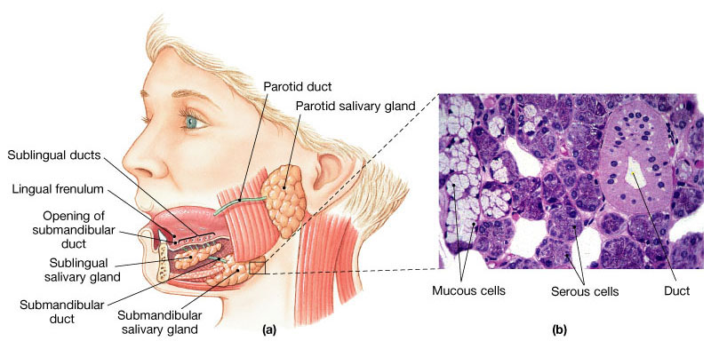
SALIVARY GLANDS

Slide 18
Secretion of Saliva and its Characteristics
Saliva contains two major types of secretion:
1. Aqueous fluids (a serous secretion)
Water, ions and enzymes such as ptyalin (an α-amylase)
Parotid, Submandibular and Sublingual glands
2. Mucus secretion (mucin)
Submandibular and Sublingual glands

Slide 19
Composition of Saliva
Aqueous Fluids
H₂O, K, HCO₃, Na, Cl, α-amylase, lingual lipase, IgA, kallikrein, muramidase (lyses muramic acid of Staphylococcus), lactoferrin and epithelial growth factor (EGF)
Hypotonic Solution
Ions Na, K, CI, HCO₃: (the concentrations of these ions are altered with altered flow rates), e.g., at low flow rate (under resting condition), the salivary secretions have:
High K (7 times as great as in plasma) and HCO₃ (2-3 times that of plasma).
Low Na⁺ and Cl⁻ (1/7 or 1/10 their concentrations in plasma)

Slide 20
Composition of Saliva (cont.)
Enzymes
α-amylase (from parotid glands)
cleaves α -1 ,4-glycosidic bonds
The optimal pH for this enzyme to work properly is 7
Inactivated at pH 4 but continues to work for sometime in unmixed food in Orad portion of stomach
Lingual lipase
hydrolyzes lipids
continues working in the duodenum
Kallikrein (a protease from acinar cells, which is not secreted into the salivary secretion):
Catalyzes production of bradykinin (good vasodilator) from α2-globulin
Bradykinin increases local blood flow
Water (0.5 L saliva/day)

Slide 21
Secretory Unit (salivon)
The basic unit “salivon” consists of:
Acinus -initial secretory process
Intercalated duct -initial portion of duct
Striated duct -modification of secretory product
Myoepithelial cells
surround acinus and intercalated duct
contraction moves saliva, prevents development of back pressure

Slide 22
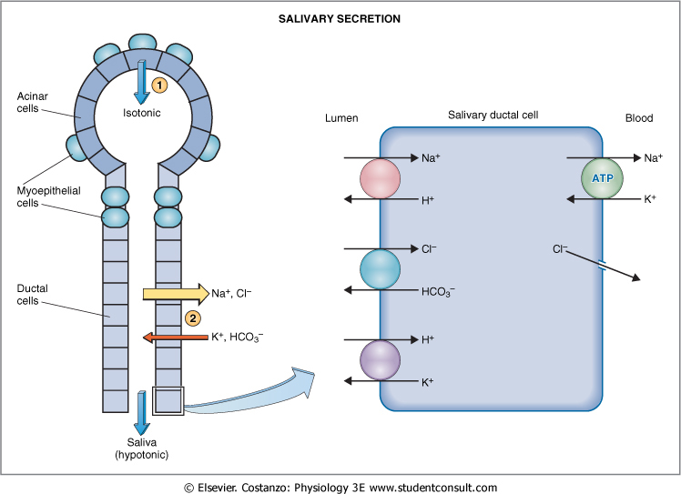

Slide 23
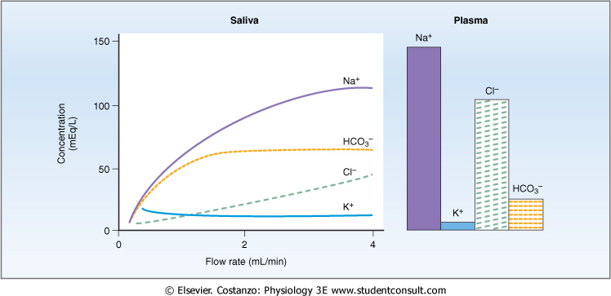
Characteristics of Saliva and Flow Rate

Slide 24
Functions of Saliva
Saliva helps prevent the deteriorative processes in the mouth in several ways:
It moistens food
It begins digestion
It adjusts salt appetite
The flow of saliva helps wash away pathogenic bacteria.
Saliva contains several factors that destroy bacteria such as thiocyanate ions, antibodies, lactoferrin which chelates iron necessary for bacterial growth and proteolytic enzymes such as lysozyme which is:
active against bacterial walls
helps thiocyanate ions in entering bacterial wall where they become bactericidal.

Slide 25
Control of Secretion
Unique aspect of control of salivary secretion
secretion rate depends entirely on neural control –autonomic nervous system (ANS)
both Parasympathetic and Sympathetic lead to increase secretion
Composition modified by Aldosterone:
increases Na⁺ and Cl⁻ reabsoption
increases K⁺ secretion

Slide 26
Parasympathetic
The origins of parasympathetic neurons are:
salivary nuclei in medulla and pons (brain stem).
Outflow
CN VII & IX
Transmitter
Ach
It is stimulated in response to:
conditioned reflexes (taste, smell, and tactile stimuli)
Its stimulation is reduced due to:
sleep, fear, dehydration

Slide 27
Parasympathetic
Stimulates
- the secretion (protein poor, high k and HCO₃)
- the contraction of myoepithelial cell
- the metabolic rate
- the blood flow
- the direct innervation of blood vessels
- the growth and development of different cells
Sectioning of parasympathetic markedly decreases flow & leads to atrophy

Slide 28
Sympathetic
The origin of sympathetic nerves are:
intermediolateral gray T1-T3
Transmitter
norepinephrine
Stimulates
- secretion (mostly enzymes)
- contraction of myoepithelial cell
- metabolic rate
- growth and development of different cells
Sectioning of sympathetic nerves has minimal impact on secretion

Slide 29
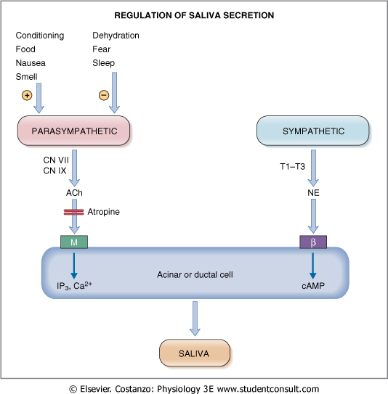

Slide 30
The End

