Slide 1
anemia
DON’T FORGET to check our editing file : haematology edit
Please don’t hesitate to contact us on:Haematology434@gmail.com
Notes:
شكرا لك منطوع في التيم جعله الله في ميزان حسناتك ان شاء الله

Slide 2
Just an extra to help you understand

Slide 3
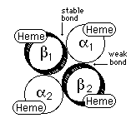
HEMATOPOIESIS
O2
O2
Identical cells
O2
O2
A) Hematopoiesis stem cells (HSC) characteristics:
1- self renewal
2- cell differentiation
Prophyrin ring
Globin chain
B) Transcriptional factor:
It’s effects permit HSC proliferation and nuclear regulation.
Hemoglobin:
is the protein molecule in RBC that carries O2 from the lungs to the body's tissues and returns CO2 from the tissues back to the lungs.
Hemoglobin maintains the shape of RBC.
Erythropoietin : hormone secreted by kidney binds onto membrane receptors of cells that will become Erythrocyte (RBCs).

Slide 4
Erythropoiesis “process of RBCs formation”
Intermediate
Normoblast
Late
Normoblast
Reticulocyte
Erythrocyte
Erythroblast
Basophilic
Normoblast
The “Bone Marrow” is the major site with the need of:
Folic acid – Iron “Ferrous” – Vit B12 – Erythropoietin -Amino acids
minerals - other regulatory factors
Hb synthesis begin with erythroblast and stop with reticulocyte, it is highly active at normoblast especially intermediate normoblast.
Erythroblast: the immediate precursor of a normal erythrocyte, reticulocyte & erythrocyte could be found in the circulation.

Slide 5
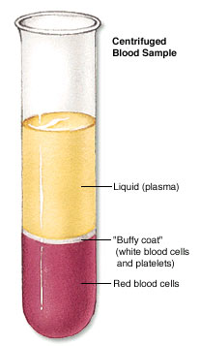
Normal range
This table is very important
Indices | Male | Female
Hemoglobin(g/dL) | 13.5-17.5 | 11.5-15.5
Hematocrit(PCV) % | 40-52 | 36-48
Red cell count (×10¹²) | 4.5-6.5 | 3.9-5.6
Mean cell volume (MCV)(fL) | 80-95
Mean cell hemoglobin(MCH)(pg) | 30-35
HCT
Hb
MCV
MCH
Microcytic
Hypochromic
Normocytic
Macrocytic
Normochromic

Slide 6
anemia
Clinical features
Reduction of Hb concentration below the normal range for the age and gender
Leading to decreased O2 carrying capacity of blood and thus O2 availability to tissues (hypoxia)
Clinical features: presence of absence of clinical features depends on :
general
Positive
Related to anemia :
Weakness, headache, pallor lethargy and dizziness
Related to compensatory mechanism: palpitation(tachycardia), angina cardiac failure
speed onset
severity
Age
Rapidly progressive anemia causes more symptoms than slow onset anemia due to lack of compensatory mechanisms
Mild anemia has no symptoms usually, symptoms appear if Hb less than 9g/dL
Practice a convincing appearance.
Personal speech and interaction with the audience.
specific
Negative
Spoon nail Iron deficiency
Leg ulcers Sickle cell anemia
Jaundice Hemolytic anemia
Bone deformities Thalassemia major

Slide 7
Classification of anemia
Very important
Reduction of DNA synthesis:
megaloblastic anemia:
B12 deficiency
Folate deficiency
Myelodysplastic syndrome(MDS)
Macrocytic anemia
Reduction of
prophyrin:
sidroblastic
anemia
Hypochromic microcytic anemia
Normocytic normochromic anemia
Blood loss:
acute bleeding
Reduction of
iron:
iron deficiency
anemia
Reduction of
globin chain:
thalassemia
Reduction of
RBCs production:
BM failure
Hemolysis:
Autoimmune
Enzymopathy
Membranopathy
Sickle cell anemia

Slide 8
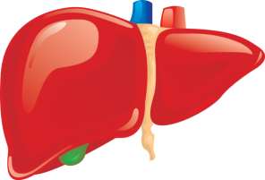
Iron deficiency anemia
Iron is among the abundant minerals on earth (6%).
Iron deficiency is the most common disorder( 24%).
Daily absorption ≈1 mg
Macrophage (1g)
Transferrin (4mg)
Liver and muscle myoglobin (650mg)
Storage forms:
Ferritin
Haemosiderin
Bone marrow erythroblast (150mg)
Limited absorption ability :
1-Only 5-10% of taken iron will be absorbed.
2- Inorganic iron can not be absorbed easily.
It could be due Excess loss due to hemorrhage
Circulating hemoglobin
(2.5g)
Urine faeces
Skin
nail
hair
Daily loss ≈1 mg
menstrual loss
(hemorrhage)

Slide 9
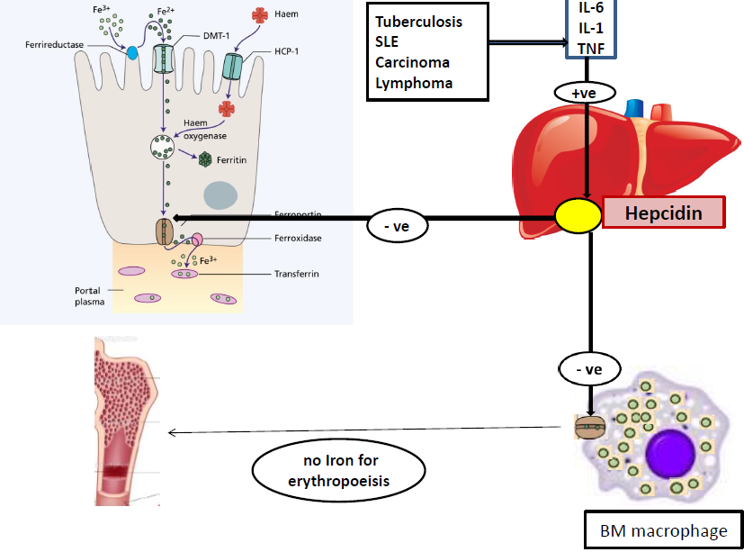
Iron absorption and regulation
Explanation:
In the duodenum(the site of absorption) dietry iron(fe3+) is converted to(fe2+) before absorption, and it enter throw DMT-1.
Dietry heam absorption controlled by HCP-1
Hepcidin produced in liver and it’s the major hormonal regulator of iron, it interfere with ferroportin either in intestine or macrophages so it inhibit iron absorption and release.
Ferroportin is the only protein which is responsible for iron exit.

Slide 10
Iron absorption
Causes of IDA
Factor reducing absorption | Factors favoring absorption
Inorganic iron | Haem iron
Ferric iron Fe+++ | Ferrous Iron (Fe++)
Alkalines | Acid vitamin C
Iron overload | Iron def
Tea | Pregnancy
Increased hepcidin | Hemochromatosis
Precipitating agent(phenol) | Solubilizing agent (Sugar)
Chronic
blood
loss
Poor diet
Increased
demands
Malabsorption

Slide 11
Iron absorption
Body status
Increased demands
Low iron stores
high absorption
Balance between dietary enhancers & Inhibitory factors
Iron overload
Full iron stores
Low absorption
More absorption
Enhancers:
Inhibitors:
More Iron
Content and form of dietary iron
Meat (haem iron)
Fruit (Vitamin C)
Sugar (Solubilizing agent )
Acids
Dairy foods (calcium)
High fiber foods (phytate)
Coffee &tea (polyphenoles)
Anti -Acids
Heam Iron
Ferrous Iron

Slide 12
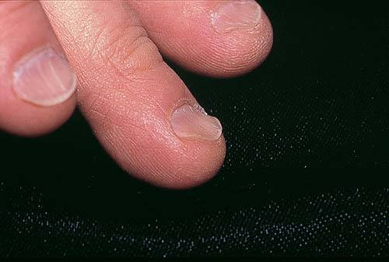
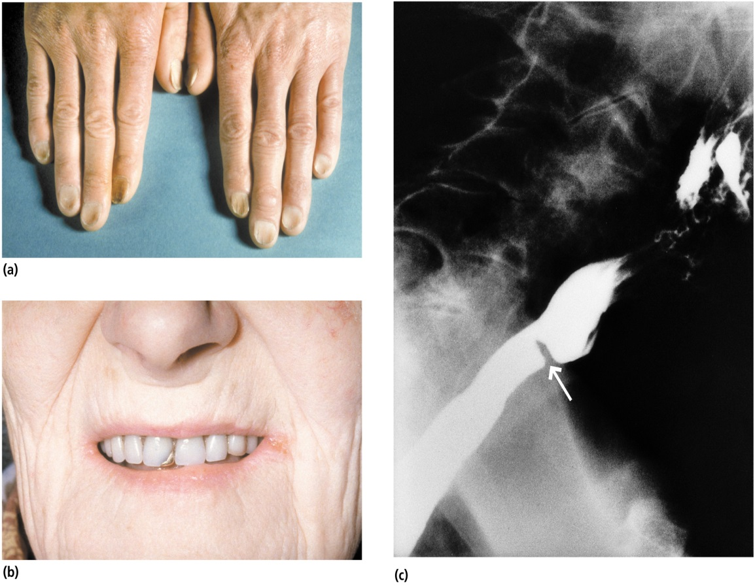
Development of IDA
 | 1 normal | 2 pre-latent | 3 Latent | 4 IDA
Stores | Normal | Low | Low | Low
MCV/MCH | Normal | Normal | Low | Low
Hemoglobin | Normal | Normal | Normal | low
May not appear normal
Signs and symptoms
Beside symptoms and signs of anaemia +/- bleeding patients present with:
(A): Koilonychia (spoon-shaped nails)
(B): Angular stomatitis and/or glossitis
(C): Dysphagia due to pharyngeal web (Plummer-Vinson syndrome) only found in very sever cases
a
b
c

Slide 13
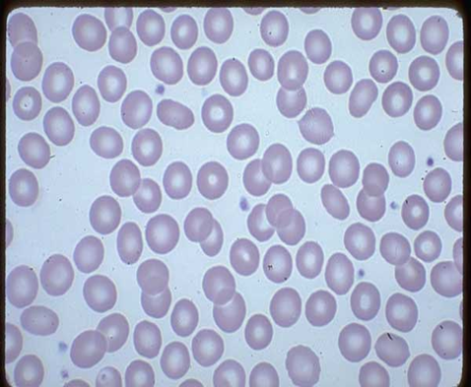
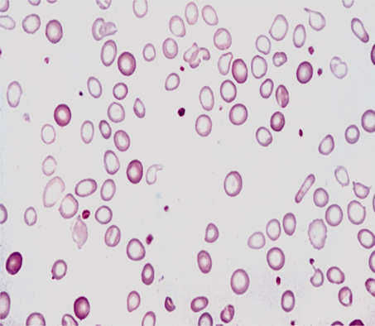
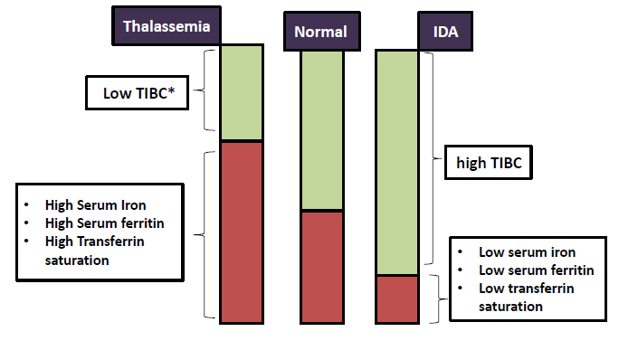
Investigation
Iron studies
A total iron-binding capacity (TIBC or transferrin) test is used to measure the amount of iron in the body.
IDA=LOW IRON+HIGH TIBC
Very important to note the difference between thalassemia and IDA
Cause both of them are microcytic hypochromic anemia
normal
IDA
Microcytic hypochromic anemia with:
•Anisocytosis( variation in size)
MCV Change in CBC
•Pokiliocytosis (variation in shape)
due to the differences in age of cells sense a RBC life span is 120 days making cells before anemia different than those after anemia.

Slide 14
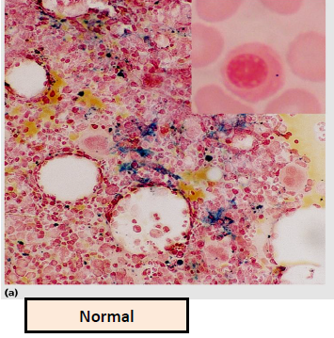
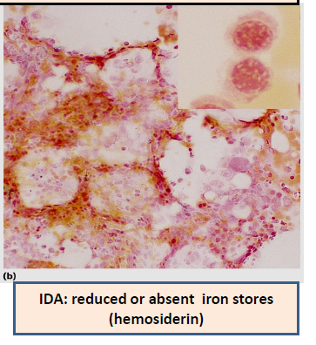
Investigation
prevention
Dietary modification
Meat is better source than vegetables.
Food fortification (with ferrous sulphate)
GIT disturbances ,staining of teeth & metallic taste.
Iron supplementation:
For high risk groups.
BM stands for bone marrow it’s biopsy procedure
treatment
•Treat the underlying cause (don’t play with the physiology of your body)
•Iron replacement therapy:
Oral :( Ferrous Sulphate OD for 6 months)
Intravenous:( Ferric sucrose OD for 6 months)
(Hb should rise 2g/dL every 3 weeks)

Slide 15
Anemia of chronic disease
Normochromic normocytic (usually) anemia caused by decreased release of iron from iron stores due to raised serum Hepcidin .
Associated with
- Chronic infection including HIV, malaria
- Chronic inflammations
-Tissue necrosis
-Malignancy

Slide 16
1) hemoglobin responsiple for:
a- carries O2 from body tissue to lung
b- carries CO2 from lung to body tissue
c- maintain the shape of RBCs
d- all of the above
4) which on is true regarding anemia:
a- mild anemia asymptomatic usually
b- symptoms diappear even if Hb less than 9g/dL
c- slow onset causes more symptoms than rapid progression
d- young patient tolerate anemia less than elderly
1- C
2- B
3- D
4- A
5- C
2) which one of these is responsible for producing an identical cells:
a- cell differentiation
b- self renewal
c- erythropoiesis
d- IDA
5) the specific clinical feature of anemia is:
a- lethargy
b- palpitation
c- spoon nail
d- angina
3) which one of these is the major factory of synthesizing hemoglobin:
a- basophilic normoblast
b- late normoblast
c- reticulocyte
d- intermediate normoblast

Slide 17
Q) what is the anemia that caused by reduction of prophyrin?
A) sidroblastic anemia
Q) why is the iron defeciency the most common disorder?
a-only 5-10% of taken iron will be absorbed.
b- inorganic iron can not be absorbed easily.
It could be due Excess loss due to hemorrhage.
Q) what are the iron studies that we find in IDA?
1- haigh total iron binding capacity 2- low serum iron
3- low serum ferritin 4- low transferrin saturation
Notes:
Here write at least 3-4 question

Slide 18
Done by:
Mohammed albadrani
Khalil alhindas
Saleh albnyan
Abdulrahman alnoeam
Reviewed by :
Hadeel B. Alsulami
Abdullah M. Albasha

