Slide 1
Thyroid Hormones and Thermogenesis
Endocrine Block
Reem Sallam, MD, MSc, PhD

Slide 2
Objectives:
By the end of this lecture, the students are expected to:
Describe types and steps of biosynthesis of thyroid hormones
Discuss the thyroid hormone actions
Determine different levels for the regulation of thyroid hormones
List the thyroid function tests
Define goiter
Differentiate between hypo and hyperthyroidism based on:
Causes
Diagnosis
Treatment
Discuss the concept of thermogenesis as it is linked to the thyroid hormone

Slide 3
Types & Biosynthesis of Thyroid Hormones
Thyroxine (T₄) and tri-iodothyronine (T₃)
Synthesized in the thyroid gland by:
Iodination
Coupling of two tyrosine molecules
Attaching to thyroglobulin protein
Thyroid gland mostly secretes T₄
Peripheral tissues (liver, kidney, etc.) de-iodinate T₄ to T₃
Deiodination is catalyzed by deiodinase enzymes
Notes:
3

Slide 4
Thyroxine (T₄), Tri-iodothyronine (T₃) & Reverse T₃ (rR₃)
Plasma [T₄]:
100 nmol/L
Plasma [T₃]:
2 nmol/L
Notes:
4

Slide 5
Types & Biosynthesis of Thyroid Hormones, continued..
T₃ is the more biologically active form
T₄ can be converted to rT₃ (reverse T₃) – inactive form
Most of T₄ is transported in plasma as protein-bound
Thyroxin Binding globulin (TBG)-bound (70%)
Albumin-bound (25%)
Transthyretin (prealbumin)-bound (5%)
The unbound (free) form of T₄ and T₃ are biologically active
Notes:
5

Slide 6
Thyroid hormone action
Plays an essential role in maturation of all body tissues, coordinating development and specific cell functions
Involved in thermogenesis and metabolic regulation
Increases cellular oxygen consumption and stimulates the metabolic rate.
Affects the rate of protein, carbohydrate and lipid metabolism
Notes:
6

Slide 7
Thyroid Hormone Action, continued..
Clinical evidence of the wide spectrum of thyroid hormone action:
Untreated congenital hypothyroidism →permanent brain damage
Hypothyroid children have:
delayed skeletal maturation →short stature
delayed puberty
Hypothyroid patients have high serum cholesterol due to:
Down regulation of LDL receptors on liver cells
Failure of sterol excretion via the gut
Notes:
7

Slide 8
Regulation of Thyroid Hormone Secretion
The hypothalamic-pituitary-thyroid axis regulates thyroid secretion
The hypothalamus senses low levels of T₃/T₄ and releases thyrotropin releasing hormone (TRH)
TRH stimulates the pituitary to produce thyroid stimulating hormone (TSH)
Notes:
8

Slide 9
Regulation of Thyroid Hormone Secretion, continued..
TSH stimulates the thyroid to produce T₃/T₄ until levels return to normal
T₃/T₄ exert negative feed back control on the hypothalamus and pituitary
Controlling the release of both TRH and TSH
Notes:
9

Slide 10
Regulation of Thyroid Hormone Secretion, continued..
High thyroid hormone levels
suppress TRH & TSH
Low thyroid hormone levels
stimulate TRH & TSH to produce
more hormone
Notes:
10

Slide 11
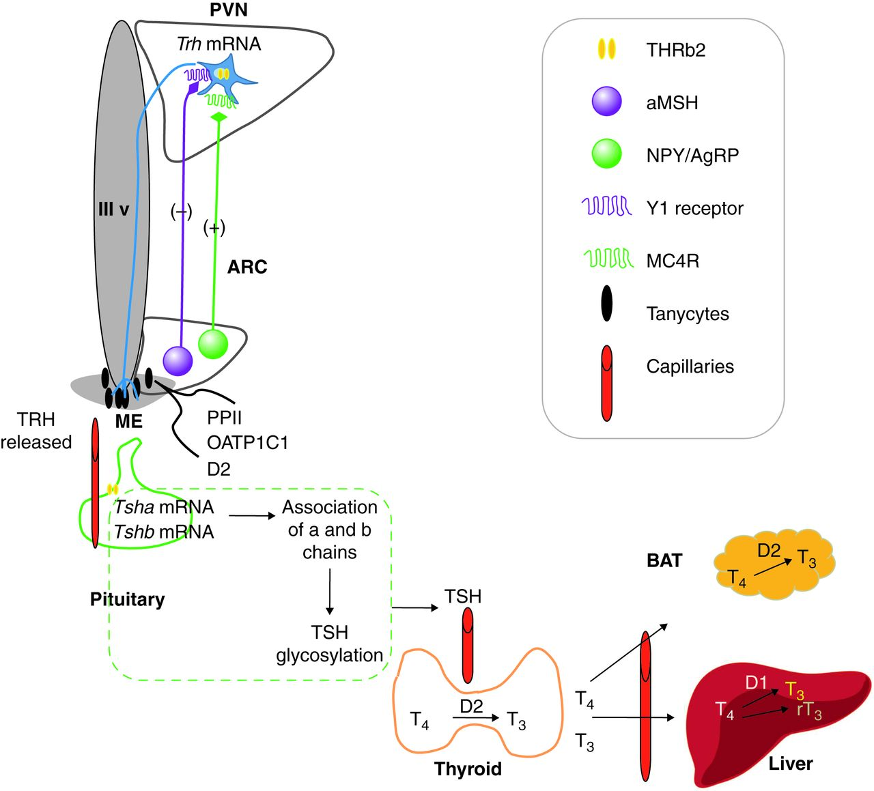
Elements involved in Hypothalamic-Pituitary-Thyroid regulation
Hypothalamus nuclei
Regulation of Trh gene transcription and processing
Regulation in response to nutrient status
Pituitary:
Regulation of TRH degradation
Regulation of TSH synthesis and activation
Thyroid:
Regulation of synthesis and release of T₄ and its conversion to T₃ by deiodinase 2 (D2) enzyme
Patricia Joseph-Bravo et al. J Endocrinol 2015;226:T85-T100 “60 Years Of Neuroendocrinology. TRH, the first hypophysiotropic releasing hormone isolated: control of the pituitary–thyroid axis”

Slide 12
Thyroid Function Tests (TFT)
TSH measurement:
Indicates thyroid status
Sensitive, first-line test
Total T₄ or free T₄:
Indicates thyroid status
Monitors thyroid treatment (both anti-thyroid and thyroid supplement treatment)
During the early treatment of hyperthyroidism, TSH may take up to 8 weeks to adjust to new level during treatment.
Notes:
12

Slide 13
Thyroid Function Tests (TFT), continued..
Total T₃ or free T₃:
Rise in T₃ is independent of T₄
In some patients only T₃ rises (T₄ is normal): T₃ toxicosis
For earlier identification of thyrotoxicosis
Antibodies:
Diagnosis and monitoring of autoimmune thyroid disease (Hashimoto’s thyroiditis); anti-thyroid peroxidase in hypothyroidism
Diagnosis of Grave’s disease: Antibodies against TSH receptors on thyroid cells
Notes:
13

Slide 14
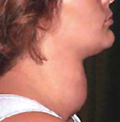
Goitre, Hypo and Hyperthyroidism
Enlarged thyroid gland
Functionally; Goitre may be associated with:
Hypofunction
Hyperfunction
Normal concentration of thyroid hormones (euthyroid)
Causes:
Iodine deficiency
Selenium deficiency
Hashimoto’s thyroiditis
Graves’ disease (hyperthyroidism)
Congenital hypothyroidism
Thyroid cancer
Notes:
14

Slide 15
Hypothyroidism
Deficiency of thyroid hormones
Primary hypothyroidism:
Failure of thyroid gland
Secondary hypothyroidism:
Failure of the pituitary to secrete TSH (rare)
Failure of the hypothalamic-pituitary-thyroid axis
Notes:
15

Slide 16
Hypothyroidism, continued..
Causes:
Hashimoto’s disease
Radioiodine or surgical treatment of hyperthyroidism
Drug effects
TSH deficiency
Congenital defects
Severe iodine deficiency
Clinical features
Tiredness
Cold intolerance
Weight gain
Dry skin
Notes:
16

Slide 17
Notes:
17

Slide 18
Hypothyroidism, continued..
Non-thyroidal illness
In some diseases, the normal regulation of TSH, T₃ and T₄ secretion and metabolism is disturbed
Most of T₄ is converted to rT₃ (inactive)
Causing thyroid hormone deficiency
Secretion of T₄ and T₃ is decreased
Notes:
18

Slide 19
Hyperthyroidism
Over-activity of the thyroid gland→ ↑secretion of thyroid hormones
Tissues are exposed to ↑ levels of thyroid hormones (thyrotoxicosis)
↑ pituitary stimulation of the thyroid gland
Causes:
Grave’s disease
Toxic multinodular goitre
Thyroid adenoma
Thyroiditis
Intake of iodine / iodine drugs
Excessive intake of T₄ and T₃
Notes:
19

Slide 20
Hyperthyroidism, continued..
Clinical features:
Weight loss with normal appetite
Sweating / heat intolerance
Fatigue
Palpitation / agitation, tremor
Angina, heart failure
Diarrhea
Eyelid retraction and lid lag
Notes:
20

Slide 21
Graves’ Disease
Most common cause of hyperthyroidism
An autoimmune disease
Antibodies against TSH receptors on thyroid cells mimic the action of pituitary hormone
Notes:
21

Slide 22
Hyperthyroidism, continued..
Diagnosis
Suppressed TSH level
Raised thyroid hormones level
Confirms primary hyperthyroidism
Problems in diagnosis
Total serum[T₄] changes due to changes in binding protein levels
In pregnancy, high estrogens → increase TBG synthesis
Total [T₄] will be high, free [T₄] will be normal
Notes:
22

Slide 23
Hyperthyroidism, continued..
Congenital TBG deficiency can also influence results
Free T₄ and TSH are first-line tests for thyroid dysfunction
Treatment
Antithyroid drugs: carbimazole, propylthiouracil
Radioiodine: sodium ¹³¹I inhibits T₄/T₃ synthesis
Surgery: thyroidectomy
Notes:
23

Slide 24
Notes:
24

Slide 25
Thermogenesis (Heat production)
Humans are homeothermic (keeping a constant body temperature, independent of the environment)
This is achieved by a tight control of our bodies’ temperature homeostasis
Heat production (Thermogenesis) is of 2 types:
Obligatory: Basic heat production due to basal metabolic rate
Facultative: On-demand extra heat production from metabolic activity in brown adipose tissue (BAT) and skeletal muscle.
In BAT, facultative thermogenesis is stimulated by sympathetic nervous system in response to cold temperature

Slide 26
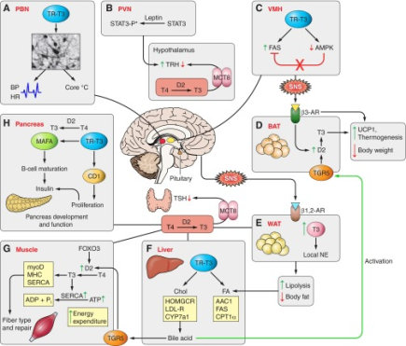
Sites of thyroid hormone regulation of metabolism
1
Hypothalamus-Pituitary-Thyroid Axis
In response to feedback regulation, nutrition status and stress level→ regulation of TRH, TSH, and T4 release and central conversion of T4 toT3
2
BAT
In response to sympathetic nervous system and bile acids → ↑ D2 → ↑local T3 → ↑UCP1 & thermogenesis and ↓body weight
6
Pancreas
In response T4 → ↑ local T3 → effect on β cell function & proliferation
4
5
Liver
In response to ↑ lipolysis in WAT → effect on cholesterol and lipid metabolism and synthesis and release of Bile acid
3
Muscle
In response T4 and to bile acid → ↑ D2 & ↑ local T3 → ↑ energy expenditure
WAT
In response to sympathetic nervous system → ↑ local T3 → ↑ lipolysis & ↓ body fat
Mullur et al, Physiol Rev. 2014 “Thyroid Hormone Regulation of Metabolism”

Slide 27
Thyroid Hormone and Thermogenesis in homeothermic species
Thyroid hormone has an essential role in thermogenesis:
1- Obligatory thermogenesis: ~ 30% of obligatory thermogenesis depends on thyroid hormone which is essential for temperature homeostasis
2- Facultative thermogenesis: in the absence of thyroid hormone, the thermogenic response of BAT is substantially reduced

Slide 28
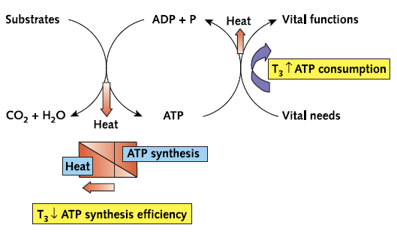
The Mechanisms by which Thyroid Hormone Regulates Thermogenesis
B
The energy is then transferred from ATP to provide energy for biological processes
A
The energy released from substrate oxidation is captured in ATP
A fraction of the energy involved both in the synthesis of ATP and in its consumption is lost as heat
Thyroid hormone increases heat production by:
increasing ATP utilization
reducing the thermodynamic efficiency of ATP synthesis
Silva, Ann Intern Med. 2003;139:205-213: “The Thermogenic Effect of Thyroid Hormone and Its Clinical Implications”

Slide 29
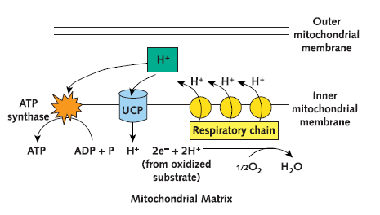
Mechanism of action of uncoupling proteins (UCPs):
Example: UCP1 is present in the inner mitochondrial membrane of BAT. Other UCPs are ubiquitous
The energy released in the oxidation of substrates in the mitochondria →proton gradient
The energy accumulated in this gradient is used the ATP Synthase to produce ATP i.e. oxidation is coupled to phosphorylation
UCPs reduce the proton gradient, bypassing the ATP synthase → exothermic movement of protons down the gradient→ heat (because oxidation is uncoupled to phosphorylation)
Silva, Ann Intern Med. 2003;139:205-213: “The Thermogenic Effect of Thyroid Hormone and Its Clinical Implications”
Notes:
29

Slide 30
Take home message
Thyroid hormones include T4 , T3, and rT3 (which is inactive), they are synthesized by iodination, coupling and attaching to thyroglobulin protein.
T3 is the active form of thyroid hormone and is synthesized by deiodinase in peripheral and central tissues.
Thyroid hormone has wide spectrum of actions, for instance maturation of all body tissues, coordinating development and specific cell functions, metabolic regulation, and thermogenesis.
Thyroid hormone is regulated by feed back mechanism. Several elements are involved in the regulation at the level of the hypothalamic nuclei, pituitary gland, thyroid, and peripheral tissues.
TFT include measurement of TSH, total and free T4, total and free T3, and thyroid antibodies.
Notes:
30

Slide 31
Take home message
Goiter is and enlarged thyroid gland, that can be associated with: Hypo-, Hyper, or Eu (normal) thyroid function
Hypo and hyperthyroidism are differentiated based on their clinical picture, causes, diagnostic criteria, and treatment
Thyroid hormone regulates both obligatory and facultative thermogenesis.
It increases obligatory thermogenesis, by accelerating ATP turnover and reducing the efficiency of ATP synthesis
It increases facultative thermogenesis as it is necessary for an efficient response of BAT to cold

