Slide 1
Pharmacology of corticosteroids
Dr. Saeed Ahmed

Slide 2
The Corticosteroids are steroid hormones produced by the adrenal cortex.
They consist of two major physiologic and pharmacologic groups
1. Glucocorticoids
2. Mineralocorticoids

Slide 3
1. Glucocorticoids:
Which have important effects on intermediary
metabolism, catabolism, immune responses and
inflammation.
2. Mineralocorticoids:
Which regulate sodium and potassium reabsorption
in the collecting tubules of the kidney

Slide 4
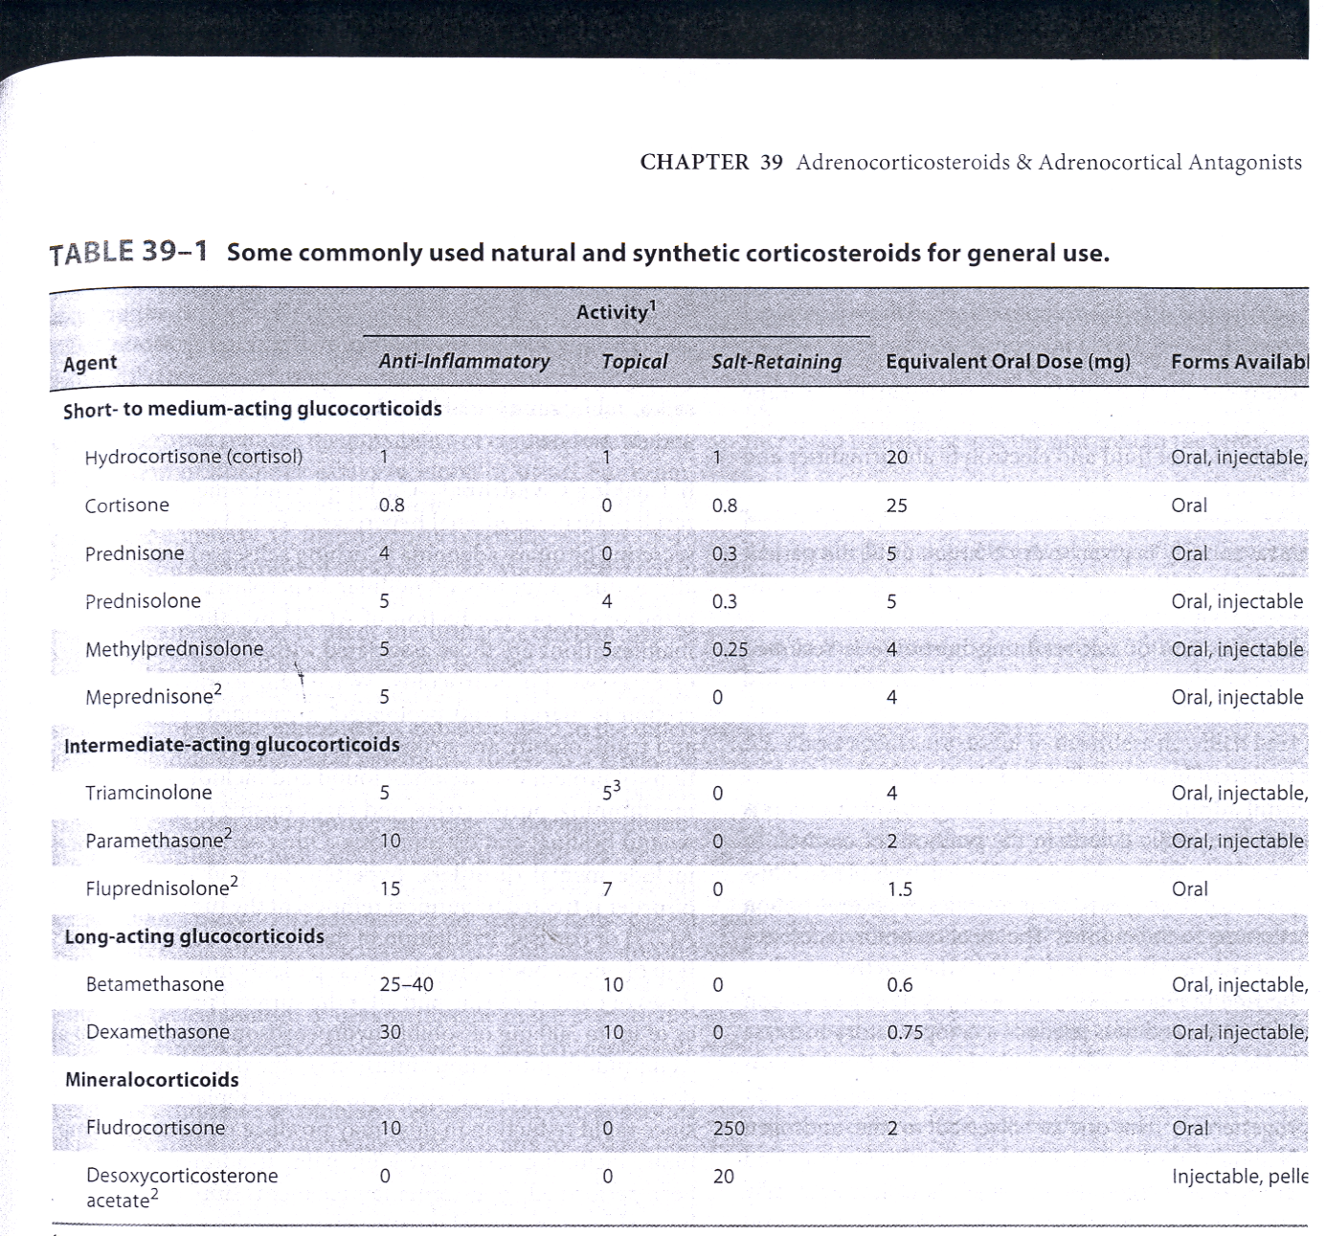

Slide 5
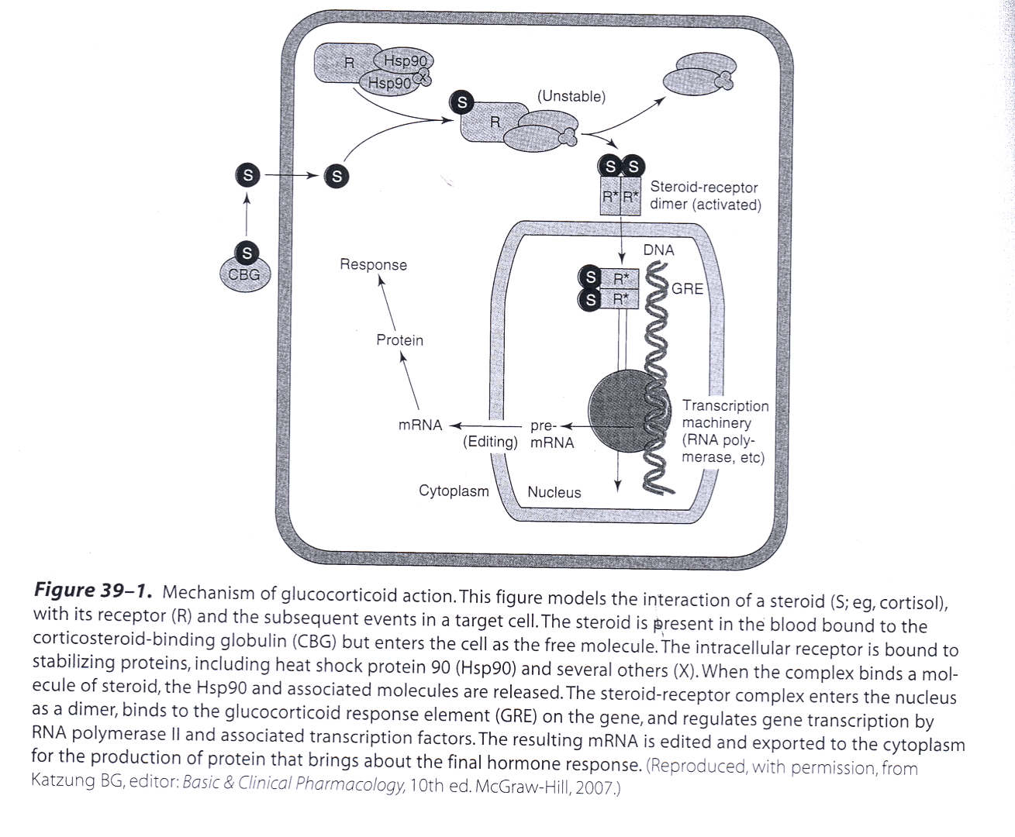

Slide 7
Pharmacodynamics:
A. Mechanism of Action:
Corticosteroid is present in the blood bound to the corticosteroid binding globulin(CBG) and enters the cell as the free molecule.
The intracellular receptor is bound to the stabilizing proteins, including heat shock protein 90(Hsp90) and several others(X). When the complex binds a molecule of steroid, the Hsp90 and associated molecules are released.

Slide 8
The Steroid – receptor complex enters the nucleus as a dimer, binds to the glucocorticoid response element(GRE) on the gene, and regulates gene transcription by RNA polymerase2 and associated transcription factors.
The resulting mRNA is edited and exported to the
cytoplasm for the production of protein that brings
about the final hormone response

Slide 9
B. Organs and tissue effects
Metabolic effects:
Glucocorticoids stimulate gluconeogenesis, as a result
Blood glucose rises
Insulin secretion is stimulated
Lipolysis and lipogenesis are stimulated
With a net increase of fat deposition in certain areas (e.g,
the face(moon facies) and shoulder and back(buffalo hump)

Slide 10
2. Catabolic effects:
Glucocorticoids cause muscle protein catabolism
Lymphoid and connective tissue fat and skin undergo
wasting.
Catabolic effects on bone lead to osteoporosis
In children growth is inhibited

Slide 11
3. Immunosuppressive effects:
Glucocorticoids inhibit cell mediated immunologic
functions, especially dependent on lymphocytes.
Glucocorticoids do not interfere with the development of
normal acquired immunity but delay rejection reactions in
patients with organ transplants.

Slide 12
4. Anti – inflammatory effects:
Glucocorticoids have important effects on the distribution and function of leukocytes
These drugs increase neutrophils and decrease lymphocytes,
eosinophils, basophils and monocytes.
The migration of leukocytes is also inhibited

Slide 13
5.Other effects:
Glucocorticoids such as cortisol are required for normal renal excretion of water loads.
CNS: When given in large doses these drugs may cause profound behavioral changes.
GIT: Large doses also stimulate gastric acid secretion and decrease resistance to ulcer formation

Slide 14
Important Glucocorticoids:
Cortisol:
The major natural glucocorticoid is cortisol(hydrocortisone).
The physiologic secretion of cortisol is regulated by adrenocorticotropin(ACTH) and varies during the day(circadian
rhythm).
The peak occurs in the morning and the trough occurs
about midnight

Slide 15
Pharmacokinetics:
Given orally ,cortisol is well absorbed from GIT
Cortisol in the plasma is 95% bound to CBG
It is metabolized by the liver and has short duration of
action compared with the synthetic congeners.
It diffuses poorly across normal skin and mucous membranes

Slide 16
The cortisol molecule also has a small but significant salt – retaining (mineralo corticoid) effect. This is an important cause of hypertension in patients with cortisol secreting adrenal tumor or a pituitary ACTH secreting tumor(cushing’s syndrome).

Slide 17
2. Synthetic Glucocorticoids
Large number are available for use;
prednisone and its active metabolite prednisolone, dexamethasone,triamcinolone, their properties(compared with cortisol) include longer half life and duration of action, reduce salt retaining effect and better penetration of lipid barriers for topical activity

Slide 18
Beclomethasone and budsonide have been developed for use in asthma and other condition in which good surface activity on mucous membrane or skin is needed and systemic effects are to be avoided
These drugs rapidly penetrate the airway mucosa but have very short half lives after they enter the blood, so that systemic effects and toxicity are greatly reduced.

Slide 19
Clinical uses:
A. Adrenal disorders
1. Addison’s disease(chronic adrenal cortical insufficiency)
2. Acute adrenal insufficiency associated with life threatening
shock, infections or trauma
3. Congenital adrenal hyperplasia (in which synthesis of
abnormal forms of corticosteroids are stimulated by ACTH.

Slide 20
B. Non adrenal disorders:
1. Allergic reactions(e.g; bronchial asthma, angioneurotic edema,
drug reactions, urticaria, allergic rhinitis)
2. Collagen vascular disorders (e.g; Rheumatoid arthritis,
systemic lupus erythematosus, giant cell arteritis, poly
myositis,mixed connective tissue syndrome).
3. Organ transplants (prevention and treatment of rejection –
immunosuppression)

Slide 21
4. Gastrointestinal disorders( inflammatory bowel disesase,
non tropical sprue).
5. Hematologic disorders( leukemia, multiplemyeloma,
acquired hemolytic anemia, acute allergic purpura)
6. Infections( acute respiratory distress syndrome, sepsis)
7. Neurologic disorders(cerebral edema after brain surgery to
minimize cerebral edema, multiple sclerosis

Slide 22
8. Pulmonary diseases( e.g.; aspiration pneumonia, bronchial
asthma, sarcoidosis
9. Thyroid diseases( malignant exophthalmos, subacute thyroiditis)
10. Renal disorders(nephrotic syndrome)
11. Miscellaneous ( hypercalcaemia, mountain sickness)

Slide 23
Toxicity (Adverse effects)
Cushing’s syndrome(iatrogenic, by higher doses more than 100mg hydrocortisone daily for more than 2 weeks characterized by moon shape face and buffalo hump)
Increased growth of fine hair on face ,thighs and trunk. Myopathy, muscle wasting, thinning of skin, Diabetes Mellitus

Slide 24
Osteoporosis and aseptic necrosis of the hip.
wound healing is impaired
In general patients treated with corticosteroids should be on high protein and potassium-enriched diets.
B. Other complications
Peptic ulcer
Acute psychosis, depression
Subcapsular cataracts

Slide 25
Growth suppression
Hypertension
C. Adrenal suppression
Methods for minimizing these toxicities include
Local application(e.g ,aerosol for asthma)
Alternate day therapy(to reduce pituitary suppression)
Tapering the dose soon after achieving a therapeutic response

Slide 26
To avoid adrenal insufficiency in patients who have had long term therapy, additional stress doses may need to be given during serious illness, or before major surgery

Slide 27
Mineralocorticoids:
A. Aldosterone:
The Major natural mineralocorticoid in human is
aldosterone.
The secretion of aldosterone is regulated by ACTH and by the renin-angiotensin system and is very important in the regulation of blood volume and blood pressure.
Aldosterone has short half life and little glucocorticoid activity.

Slide 28
Mechanism of action:
is same as that of glucocorticoids
Fludrocortisone:
it is a mineralocorticoid has a long duration of action and significant glucocorticoid activity
Fludrocortisone is favored for replacement therapy after adrenalectomy and in other conditions in which mineralocorticoid therapy is needed

Slide 29
Corticosteroid Antagonists:
A. Receptor Antagonists
Spironolactone and eplerenone, antagonists of
aldosterone at its receptor.
Mifepristone:
is a competitive inhibitor of glucocorticoid receptors as well as progesterone receptors and useful in the treatment of Cushing's syndrome

Slide 30
B. Synthesis inhibitors:
Aminogluthimide, Metyrapone and ketoconazole
Clinical uses:
Adrenal cancer, when surgical therapy is impractical or
unsuccessful because of metastasis.

Slide 31
Ketoconazole(anti fungal):
Mechanism of Action:
It inhibits the cytochrome p450 enzymes necessary for the synthesis of all steroids and is used in a no. of conditions in which reduced steroid level are desirable
1.Adrenal carcinoma
2. Hirsutism
3.Breast cancer
4. Prostate cancer

Slide 32
Aminogluthemide:
It blocks the conversion of cholesterol to pregnelone
Inhibits the synthesis of all hormonally active steroids.
Clinical uses:
Adrenocortical cancer(steroid producing tumor) in conjuction with other drugs.

