Slide 1
Diabetic Ketoacidosis (DKA)
Dr. Amr S. Moustafa, MD, PhD
Clinical Chemistry Unit, Pathology Dept.
College of Medicine, King Saud University

Slide 2
Diabetic emergencies
Diabetic Ketoacidosis (DKA)
Hyperosmolar hyperglycaemic state (HHS)= Hypperosmolar non-ketotic acidosis (HONK)
Hypoglycemia

Slide 3
Diabetic Ketoacidosis (DKA)

Slide 4
Diabetic Ketoacidosis (DKA):
Triad of hyperglycemia, high anion gap metabolic acidosis, and ketonemia
Characteristically associated with T1DM
It has become increasingly common in T2DM
DKA may be the first presentation of T1DM

Slide 5
Ketone Bodies
Acetoacetate
Acetone
β-Hydroxybutyrate
They are produced by the liver (ketogenesis) and utilized for energy production by peripheral tissues (Ketolysis)

Slide 6
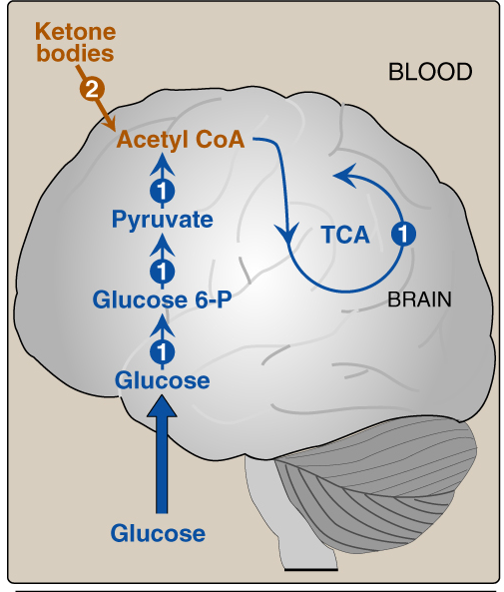
Normally, glucose is the primary fuel for the brain.
It can penetrate the blood brain barrier.
The brain’s GLUT is
insulin-independent.
If glucose is not available for the brain, the brain can utilize plasma ketone bodies, that can penetrate the blood brain barrier, and serve as fuel molecules.

Slide 7
Ketone bodies synthesis = Ketogenesis
Occurs in the hepatocyte mitochondria
In uncontrolled DM there is ↑lipolysis in adipose tissue → ↑ [FFA] mobilization to liver
→ ↑hepatic FA oxidation → ↑ acetyl CoA which will be channeled into KB synthesis
HMG CoA synthase is the rate limiting enzyme
The first KB to be synthesized is acetoacetate.
Acetoacetate can be:
reduced to β-Hydroxybutyrate, or
spontaneously decarboxylated to acetone.

Slide 8
Ketogenesis
↑hepatic FA oxidation → ↑ acetyl CoA which will be channeled into KB synthesis
Acetyl CoA + oxaloacetate (OAA) → Krebs cycle
↑ Acetyl CoA production activates pyruvate carboxylase
Pyruvate carboxylase converts pyruvic acid into OAA
OAA is used for gluconeogenesis (rather than Krebs cycle)
Acetyl CoA is channeled into KB synthesis

Slide 9
Ketone Bodies Utilization=Ketolysis
Takes place in extrahepatic tissues
Occurs in the mitochondria (so cannot occur in RBCs)
Does not occur in the liver (as the liver lacks the thiophorase enzyme required for ketolysis)
β-Hydroxybutyrate is oxidized to acetoacetate (by a dehydrogenase)
Acetoacetate is converted to acetoacetyl CoA (catalyzed by thiophorase)
Acetoacetyl CoA is converted to acetyl CoAs.

Slide 10
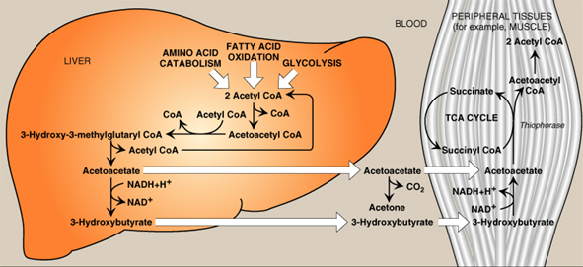
Ketone Bodies Utilization=Ketolysis

Slide 11
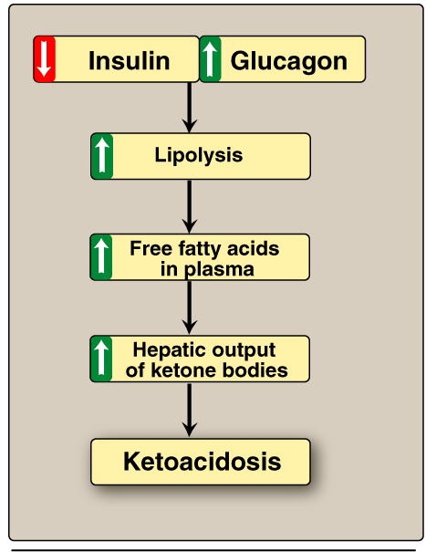
Mechanisms of DKA:
In uncontrolled DM there is ↑lipolysis in adipose tissue → ↑ [FFA] → ↑ mobilization of FFA to liver → ↑hepatic FA oxidation → ↑ hepatic acetyl CoA which will be utilized in KB synthesis (ketogenesis) → ketoacidosis

Slide 12
Mechanisms & Manifestations of DKA
In uncontrolled DM the rate of ketogenesis is > the rate of ketolysis → ketonemia (↑[KB] in blood)→ ketonuria (↑[KB] in urine).
Manifestations of DKA:
Fruity odor on the breath (acetone)
Acidosis (low pH of blood because KBs are acids)
Dehydration (due to glucosuria)

Slide 13
Precipitating factors for DKA
Infection (30-40%)
Inadequate insulin treatment or non-compliance (20%)
Severe illness e.g., Myocardial infarction
Trauma
Drugs: e.g., steroids

Slide 14
Hyperosmolar hyperglycaemic state (HHS)= Hypperosmolar non-ketotic acidosis (HONK)

Slide 15
Hyperosmolar hyperglycaemic state (HHS)= Hypperosmolar non-ketotic acidosis (HONK
Little or no accumulation of ketone bodies
Serum [glucose] is often >50 mmol/L
Plasma osmolality may reach 380 mosmol/Kg (normal 275-295)
Neurological abnormalities are frequently present
Insulin levels are insufficient to allow appropriate glucose utilization but are adequate to prevent lipolysis and subsequent ketogenesis
Usually occurs in elderly patients with T2DM
Has a substantially higher mortality than DKA (up to 15%)

Slide 16
Hypoglycemia

Slide 17
Hypoglycemia:
Common complication of treatment with insulin or oral hypoglycaemics
More common in patients with T1DM
Characterized by:
CNS Symptoms (confusion, aberrant behavior, or coma)
Low blood [Glucose]
Symptoms resolved within minutes following the administration of glucose

Slide 18
Hypoglycemia is a medical emergency, Why ?
The brain has absolute requirement for a continuous supply of glucose
Transient hypoglycemia → cerebral dysfunction
Severe, prolonged hypoglycemia → brain death

Slide 19
Hypoglycemia, continued..
Hypoglycemia occurs due to impaired protective responses to hypoglycemia:
Insulin is supplied exogenously and its release cannot be turned off
Glucagon & adrenaline response to hypoglycemia becomes impaired later in the course of DM
Clinical presentation:
Symptoms of sympathetic overactivity (plasma [glucose] <3.6 mmol/L, abrupt fall): anxiety, tremors, sweating & palpitation
Symptoms of neuroglycopenia (plasma [glucose] <2.6 mmol/L, gradual fall): headache, confusion, drowziness and ultimately loss of consciousness or seizures (at plasma [glucose] <1.5 mmol/L)

Slide 20
Hormonal mechanisms to prevent or correct hypoglycemia:
↓ Production of insulin
↑production of:
- Epinephrine & glucagon
- Growth hormone
- Cortisol

Slide 21
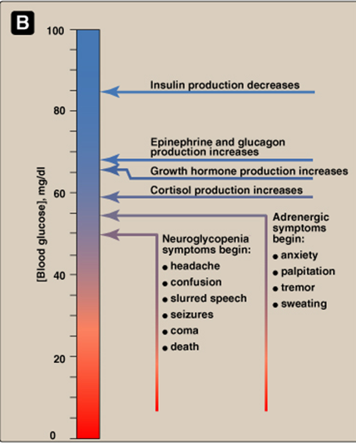
Glycemic thresholds for the various responses to hypoglycemia:

Slide 22
A CASE of DKA
A 14-year-old girl was admitted to a children’s hospital in coma. Her mother stated that the girl had been in good health until approximately 2 weeks previously, when she developed a sore throat and moderate fever. She subsequently lost her appetite and generally did not feel well.

Slide 23
A CASE of DKA …………Cont’d
Several days before admission she began to complain of undue thirst and also started to get up several times during the night to urinate. However, on the day of admission the girl had started to vomit, had become drowsy and difficult to arouse, and accordingly had been brought to the emergency department.

Slide 24
A CASE of KDA, continues..
On examination:
She was dehydrated
Her skin was cold
She was breathing in a deep sighing manner (Kussmaul respiration)
Her breath had a fruity odor
Her blood pressure was 90/60 mmHg (N: 120/80)
Her pulse rate 115/min.
She could not be aroused
A provisional diagnosis of T1DM with complicating ketoacidosis and coma (DKA) was made by the intern on duty

Slide 25
Laboratory findings: blood results
The admitting diagnosis was confirmed by the laboratory findings shown below:
Normal levels | Patient’s results | Plasma analytes
4.2-6.1 | 50 | Glucose (mmol/L)
(trace) | ++++ | Ketoacids
22-30 | 6 | Bicarbonate (mmol/L)
7.35-7.45 | 7.07 | Arterial blood pH
136-146 | 136 | Na⁺ (mmol/L)
102-109 | 100 | Cl⁻ (mmol/L)

Slide 26
Laboratory findings : blood results, continued..
Normal levels | Patient’s results | Plasma analytes
4.3-6.0 | 2.7 | PCO₂ (kPa)
7-16 | 35.5 | *Anion gap (mmol/L)
3.5-5.0 | 5.5 | K⁺ (mmol/L)
2.5-7.1 | 15 | Urea nitrogen (mmol/L)
44-80 | 200 | Creatinine (μmol/L)
41-53 | 50 | Albumin (g/L)
275-295 | 325 | Osmolality (mOsm/kg serum water)
0.354-0.444 | 0.500 | Hematocrit
*Anion gap (A⁻)= (Na⁺ + K⁺ )– (HCO₃⁻ + Cl⁻)

Slide 27
Laboratory findings: Urine results
Normal level | Patient’s results | Urine analyte
- | ++++ | Glucose
- | ++++ | Ketoacids

Slide 28
Interpretation of Laboratory findings
Interpretation | Results
Confirm the diagnosis of DKA | Hyperglycemia
 | Glucosuria
 | Ketonemia
 | Ketonuria
Severe metabolic acidosis due to ↑ production of ketone bodies | ↓ pH
Metabolic acidosis with partial respiratory compensation (the hyperventilation) | ↓ bicarbonate and PCO₂
Due to ↑ ketone bodies in the blood | ↑ anion gap
Renal impairment (dehydration → ↓ blood volume →↓ renal perfusion) Dehydration Degradation of protein (for urea) | ↑ urea & creatinine
↓ Uptake of potassium by cells in the absence of insulin | ↑K⁺
Due to hyperglycemia and fluid loss | ↑ Plasma osmolality

Slide 29
Metabolic Changes in DM and DKA
Multiple effects
CHO metabolism
↓glucose uptake by certain tissues (adipose tissue & muscle)
↑glycogenolysis
↑gluconeogenesis
Lipid metabolism
↑ lypolysis
↑ fatty acid oxidation
↑ production of Ketone bodies
Protein metabolism
↓ protein synthesis
↑ protein degradation
K⁺, Water & pH
↓ entry of K⁺ into the cells
Water loss secondary to glycosuria
Acidosis due to ↑ production of ketone bodies
DM
DKA

