Slide 1
Anterior Pituitary Disorders Dr.Aishah AlEkhzaimy, MBBS,FRCPC,FACE
Endocrine block 2015

Slide 2
Pituitary Disorders
Anterior pituitary disorders:
Non-functional pituitary tumor and mass-effect: hypopituitrism
Prolactin secreting cell disorder: prolactinoma
Growth hormone secreting cell disorder: acromegaly
ACTH secreting cell disorders: cushing’s
TSH secreting cell tumor: TSH-secreting adenoma
Gonadotropin secreting adenoma
Posterior Pituitary disorders:
Diabetes insipidus

Slide 3
Pituitary Development
Anterior pituitary is recognizable by 4- 5th wk of gestation
Full maturation by 20th wk
From Rathke’s pouch, Ectodermal evagination of oropharynx
Migrate to join neurohypophysis
Portion of Rathke’s pouch →→ Intermediate lobe
Remnant of Rathke’s pouch cell in oral cavity →→ pharyngeal pituitary
Lies at the base of the skull as sella turcica
Roof is formed by diaphragma sellae
Floor by the roof of sphenoid sinus
Notes:
Diaphragma sella is formed by a reflection of dura matter preventing CSF from entering the sella turcica by this diaphragm

Slide 4
Pituitary Development
Posterior pituitary from neural cells as an outpouching from the floor of 3rd ventricle
Pituitary stalk in midline joins the pituitary gland with hypothalamus that is below 3rd ventricle
Development of pituitary cells is controlled by a set of transcription growth factors like pit-1, Prop-1, Pitx2
Notes:
Normal pituitary stalk length 5- 7 mm , 2-3 mm in diameter

Slide 5
Pituitary Development
Pituitary stalk and its blood vessels pass through the diaphragm
Lateral wall by cavernous sinus containing III, IV, VI, V1, V2 cranial nerves and internal carotid artery with sympathetic fibers. Both adjacent to temporal lobes
Pituitary gland measures 15 X 10 X 6 mm, weighs 500 mg but about 1 g in women
Optic chiasm lies 10 mm above the gland and anterior to the stalk
Blood supply : superior, middle, inferior hypophysial arteries ( internal carotid artery) running in median eminence from hypothalamus
Venous drainage: to superior and inferior petrosal sinsuses to jugular vein
Notes:
Height is 5-7 mm and 10 mm lateral dimension, height is 10. superior, middle supply ant. Pituitary. Inferior supply stalk and post pituitary artery

Slide 6
Pituitary Development

Slide 7
Normal Pituitary Anatomy
Modified from Lechan RM. Neuroendocrinology of Pituitary Hormone Regulation. Endocrinology and Metabolism Clinics 16:475-501, 1987

Slide 8
Pituitary Development

Slide 9
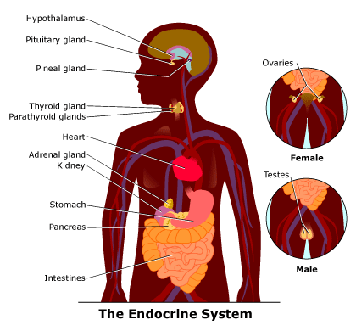
Endocrine system

Slide 10
Anterior Pituitary Function
 | Corticotroph | Gonadotroph | Thyrotroph | Lactotroph | Somatotroph
Hormone | POMC, ACTH | FSH, LH | TSH | Prolactin | GH
Stimulators | CRH, AVP, gp-130 cytokines | GnRH, Estrogen | TRH | Estrogen, TRH | GHRH, GHS
Inhibitors | Glucocorticoids | Sex steroids, inhibin | T3, T4, Dopamine, Somatostatin, GH | Dopamine | Somatostatin, IGF-1, Activins
Target Gland | Adrenals | Ovary, Testes | Thyroid | Breast and other tissues | Liver, bone and other tissues
Trophic Effects | Steroid production | Sex Steroid, Follicular growth, Germ Cell maturation | T4 synthesis and secretion | Milk Production | IGF-1 production, Growth induction, Insulin antagonism
Adapted from: William’s Textbook of Endocrinology, 10th ed., Figure 8-4, pg 180.

Slide 12
Etiology of Pituitary Masses

Slide 13
Etiology of Pituitary-Hypothalamic Lesions
Non-Functioning Pituitary Adenomas
Endocrine active pituitary adenomas
Prolactinoma
Somatotropinoma
Corticotropinoma
Thyrotropinoma
Other mixed endocrine active adenomas
Malignant pituitary tumors: Functional and non-functional pituitary carcinoma
Metastases in the pituitary (breast, lung, stomach, kidney)
Pituitary cysts: Rathke's cleft cyst, Mucocoeles, Others
Empty sella syndrome
Pituitary abscess
Lymphocytic hypophysitis
Carotid aneursym
\

Slide 14
Notes:
Left side microadenoma post contract

Slide 15
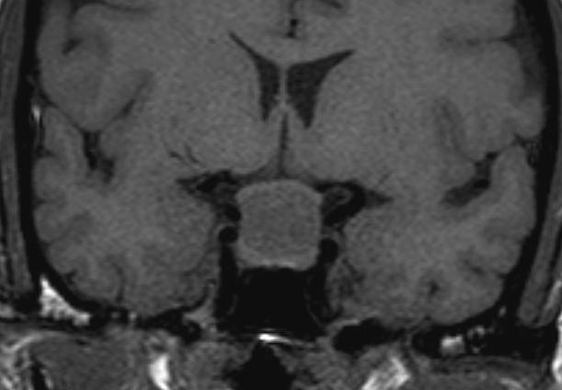
Notes:
Enhanced T1 MRI rathke’s cyst / non-enchanced T1 with large rathkes cyst compressing normal pituitary tissue and optic chiasm in the middle of stalk insertion sometimes go suprasellar

Slide 16
Disorders of Pituitary Function
Hypopituitarism
Central hypoadrenalism, hypogonadism, hypothyroidism or GH deficiency
Panhypopituitarism
Hypersecretion of Pituitary Hormones
Hyperprolactinemia
Acromegaly
Cushing’s Disease

Slide 17
Evaluation of Pituitary mass
Pituitary adenoma: 10 % of all pituitary lesions
Genetic-related
MEN-1, Gs-alpha mutation, PTTG gene, FGF receptor-4
Pituitary incidentaloma: 1.5 -31% in autopsy ( prevalence)
10 % by MRI most of them < 1 cm
Notes:
Guanine nucleatide stimulatory protein gene found in 40 % of somatotroph adenoma/ inactivation mutation in tumor supressing gene in men 1.

Slide 18
Evaluation of Pituitary lesion

Slide 19
Evaluation of Pituitary lesion
Non-Functional pituitary lesion:
Absence of signs and symptoms of hormonal hypersecretion
25 % of pituitary tumor
Needs evaluation either micro or macroadenoma
Average age 50 – 55 yrs old, more in male

Slide 20
Non- functional pituitary adenoma
Presentation of NFPA:
As incidentaloma by imaging
Symptoms of mass effects ( mechanical pressure)
Hypopituitarism ( mechanism)
Gonadal hypersecretion
Notes:
Mass effect tumour expansion lateral compressing cavernous sinus causing cranial nerve palsy like double vision, stretching meninges causing headache, or pushing temporal lobe causing seizure, pushing optic chiasm or headache from apoplexy. Hypopituitarism from suprasellar mass pushing stalk and cutting portal blood supply and hypothalamus signal to pituitary

Slide 21
Non- functional pituitary adenoma

Slide 22
Non- functional pituitary adenoma
Treatment:
Surgery if indicated
- recurrence rate 17 % if gross removal, 40 % with residual tumor
- predictors of recurrence: young male, cavernous sinus invasion, extent of suprasellar extention of residual tumor, duration of follow up, marker; Ki-67
Observation with annual follow up for 5 years and then as needed, visual field exam Q 6-12 month if close to optic chiasm. Slow growing tumour
Adjunctive therapy:
- Radiation therapy
- Dopamine agonist
- Somatostatin analogue
Notes:
Tumour greater than 2 cm, visual field defect, optic chiasm compression or touching by tumor with no visual field defect, headach, suprasellar/parasellar tumor extension

Slide 23
Functional pituitary mass

Slide 24
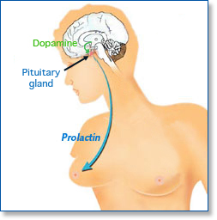
Prolactinoma

Slide 25
Prolactin
Human prolactin is a 198 amino acid polypeptide
Primary function is to enhance breast development during pregnancy and to induce lactation
Prolactin also binds to specific receptors in the gonads, lymphoid cells, and liver
Secretion is pulsatile; it increases with sleep, stress, pregnancy, and chest wall stimulation or trauma

Slide 26
Prolactin
Secretion of prolactin is under tonic inhibitory control by dopamine, which acts via D2-type receptors located on lactotrophs
Prolactin production can be stimulated by the hypothalamic peptides, thyrotropin-releasing hormone (TRH) and vasoactive intestinal peptide (VIP)

Slide 27
Clinical Features of Hyperprolactinemia/Prolactinoma
Women may present with oligomenorrhea, amenorrhea, galactorrhea or infertility
Men often have less symptoms than women (sexual dysfunction, visual problems, or headache) and are diagnosed later
In both sexes, tumor mass effects may cause visual-field defects or headache

Slide 28
Prolactin
Secretion of prolactin is under tonic inhibitory control by dopamine, which acts via D2-type receptors located on lactotrophs
Prolactin production can be stimulated by the hypothalamic peptides, thyrotropin-releasing hormone (TRH) and vasoactive intestinal peptide (VIP)

Slide 29
Causes of Hyperprolactinemia
Hypothalamic Dopamine Deficiency
Diseases of the hypothalamus( including tumors, arterio-venous malformations, and inflammatory processes
Drugs (e.g. alpha-methyldopa and reserpine)
Defective Transport Mechanisms
Section of the pituitary stalk
Pituitary or stalk tumors

Slide 30
Causes of Hyperprolactinemia (continued)
Lactotroph Insensitivity to Dopamine
Dopamine-receptor-blocking agents: phenothiazines (e.g. chlorpromazine), butyrophenones (haloperidol), and benzamides (metoclopramide, sulpiride, and domperidone)
Stimulation of Lactotrophs
Hypothyroidism- increased TRH production (acts as a PRF)
Estrogens: stimulate lactotrophs
Injury to the chest wall: abnormal stimulation of the reflex associated with the rise in prolactin that is seen normally in lactating women during suckling

Slide 31
REMEMBER: Not all hyperprolactinemia is due to a prolactinoma

Slide 32
Work up of Patient with Hyperprolactinemia
In females, pregnancy must always be ruled out
Get a TSH- hypothyroidism is another common cause of elevated prolactin:
Obtain detailed drug history- rule out medication effects
Rule out other common causes including:
Nonfasting sample
Nipple stimulation or sex
Excessive exercise
History of chest wall surgery or trauma
Renal failure
Cirrhosis
If no cause determined or tumor suspected, consider MRI, especially if high prolactin levels (> 100 ng/mL)
http://www.emedicine.com/Med/topic1915.htm

Slide 33
Prolactinomas
Most common of functional pituitary adenomas
25-30% of all pituitary adenomas
Some growth hormone (GH)–producing tumors also co-secrete PRL
Of women with prolactinomas- 90% present with microprolactinomas
Of men with prolactinomas- up to 60% present with macroprolactinomas
http://www.emedicine.com/Med/topic1915.htm

Slide 34
Management
Medical therapy: Dopamine agonist
Surgical resection
Radiation therapy

Slide 35
Growth hormone
Pituitary tumor as mass effect →→ Growth hormone deficiency
Hyperfunctioning mass →→ Acromegaly

Slide 36
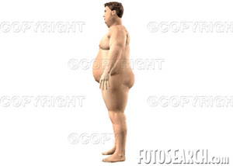
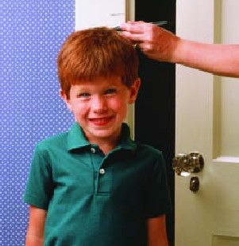
Growth hormone deficiency
Diagnosis in children and
adult

Slide 37
Diagnosis of GH-deficiency and management
GH, IGF-I level
Dynamic testing: clonidine stimulation test, glucagon stimulation, exercise testing, arginine-GHRH, insulin tolerance testing
X-ray of hands: delayed bone age
In Adult: Insulin tolerance testing, MRI pituitary to rule out pituitary adenoma
Management: GH replacement

Slide 38
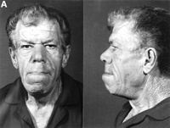
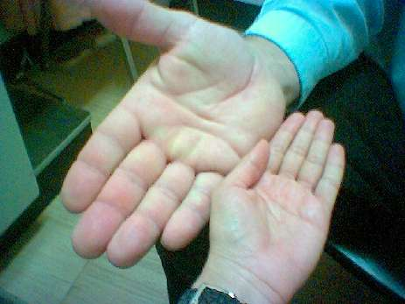
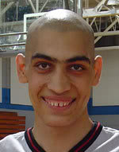
Acromegaly

Slide 39
Growth hormone disorder

Slide 41
Growth hormone disorder

Slide 42
Acromegaly
Clinical picture and presentation
GH level ( not-reliable, pulsatile)
IGF-I
75 g OGTT tolerance test for GH suppression
Fasting and random blood sugar, HbA1c
Lipid profile
Cardiac disease is a major cause of morbidity and mortality
50 % died before age of 50
HTN in 40%
LVH in 50%
Diastolic dysfunction as an early sign of cardiomyopathy

Slide 43
Growth hormone disorder-Acromegaly
Medical treatment:
Somatostatin analogue
Surgical resection of the tumor

Slide 44
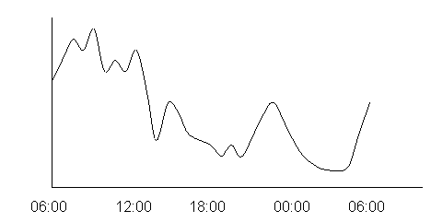
HPA-axis
2nd adrenal insufficiency
glucgocorticoid replacement
Circadian rhythm of cortisol secretion
Early morning cortisol between 8-9 am

Slide 45
ACTH-disorders

Slide 46
ACTH-disorders

Slide 47
Hypoadrenalism
Nausea
Vomiting
Abdominal pain
Diarrhoea
Muscle ache
Dizziness and weakness
Tiredness
Weight loss
Hypotension

Slide 48
Management of hypoadrenalism
Cortisol replacement

Slide 49
ACTH-Adenoma

Slide 54
HPA-axis ( excessive cortisol)

Slide 55
HPA-axis ( excessive cortisol)
80 % HTN
LVH
Diastolic dysfunction, intraventricular septal hypertrophy
ECG needed: high QRS voltage, inverted T-wave
Echocardiogram preop
OSA: 33% mild, 18% severe. Needs respiratory assessment and careful use of sedative during surgery
Glucose intolerance in 60%, control of hyperglycemia
Osteoporosis with vertebral fracture→→ positioning of patient in OR ( 50 %), 20 % with fracture
thin skin→→ difficult IV cannulation, poor wound healing

Slide 56
Cushing’s-Management
Surgical resection of pituitary
Medical Treatment

Slide 57
TSH-Hypothyroid

Slide 58
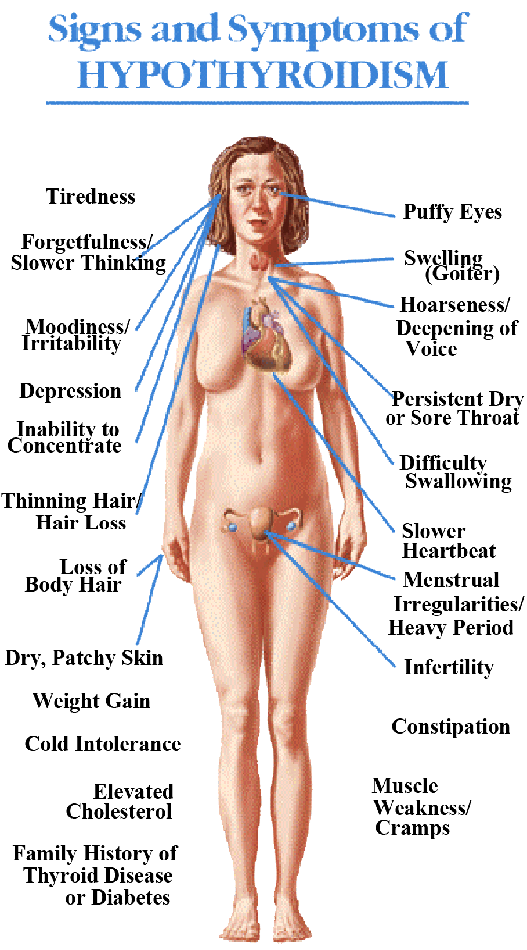
Central Hypothyroidism
Low TSH
Low free T4 and T3

Slide 59
Central Hypothyroidism
Thyroxine replacement
Surgical removal of pituitary adenoma if large

Slide 60
TSH-hyperthyroid

Slide 62
TSH-Producing adenoma
Very rare < 2.8 %
Signs of hyperthyroidism
High TSH, FT4, FT3
Treatment preop with anti-thyroid meds
Surgical resection of adenoma
Medical therapy: Somatostatin Analogue

Slide 64
Gonadotroph Adenoma
Surgical resection if large
Radiation therapy

Slide 65
assessment of pituitary function
Baseline: TSH, FT4, FT3, LH, FSH, Prolactin, GH, IGF-I,Testosterone, Estradiol
MRI brain
Neuropthalmic evaluation of visual field
Cardiac and respiratory assessment
Anesthesiologist for airway and perioperative monitoring
Neurosurgeon
ENT for Endonasal evaluation for surgical approach
Preop hormonal replacement: all pituitary adenoma should be covered with stress dose of HC

