Slide 1
Epidemiology of
Diabetes mellitus
Ashry Gad Mohamed
Prof. of Epidemiology
KSU

Slide 2
Learning Objectives
At the end of the presentation the participant will be able to :
  Discuss the Global prevalence of diabetes
  Discuss the state of diabetes in KSA.
  Know risk factors of diabetes.
  Discuss the magnitude of complications of diabetes.

Slide 3


Slide 4
Diabetes Mellitus
Definition
  A metabolic disorder of multiple aetiology characterized by chronic hyperglycaemia with disturbances of carbohydrate, fat and protein metabolism resulting from defects in insulin secretion, insulin action or both

Slide 5




Types of diabetes
Type 1 (5-10%) – sudden onset . Absolute deficiency in insulin. Usually affects younger age group (not always)
Type 2 (90 - 95%) – gradual onset of relative insulin insensitivity. Usually older age group (not always)
Gestational diabetes
Secondary diabetes
Pre-diabetes
Impaired glucose tolerance
  May remain undiagnosed for years; risk of complications same as for T2DM

Slide 6

Diagnosis of diabetes
Symptoms
    Thirst
    Passing lots of urine
    Malaise
    Infections (thrush)
    Weight loss
BUT – many years of pre-diabetes (type 2) before these symptoms appear!
Biochemical tests
  Random plasma glucose
  Fasting plasma glucose
  Oral glucose tolerance test – 2h glucose

Slide 7
Fasting Blood sugar
Non diabetic: FBS< 110 mg/dl (6.1m mol/dl).
Glucose Intolerance: FBS 110 -125 mg/dl (6.1-6.9 m mol/dl).
Diabetic: FBS >126 mg/dl (>7 m mol/dl)
OR Random BS >200 mg/dl (>11.1m mol/dl) .

Slide 8
Diagnosis based on:
Glucose Tolerance Test 2 hr post 75 gm glucose
If < 7.8 mmol/L = normal GTT
If ≥ 7.8 mmol/L and < 11.1 mmol/L = GTT
If ≥ 11.1 mmol/L = provisional diagnosis of Diabetes

Slide 9
Why is diabetes so important?
The burden to patients, carers, NHS
  Complications
    Cardiovascular
    Eyes
    Renal - Hypertension, renal failure
    Feet
    Skin, infections, sexual, psycho-sexual, depression
    Quality of life
    Premature mortality
  Cost

Slide 10
Epidemiology of diabetes
Prevalence worldwide is increasing
    2.8% in 2000;
    4.4% in 2030 worldwide.
    171 million in 2000; 366 million in 2030
    Greatest rise in developing world

Slide 11
Diabetes in the world
Millions

Slide 12
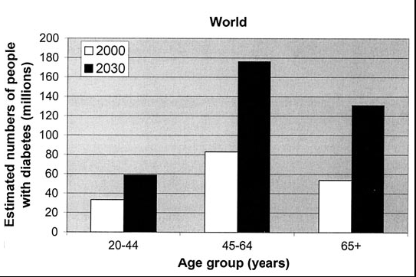

Slide 13
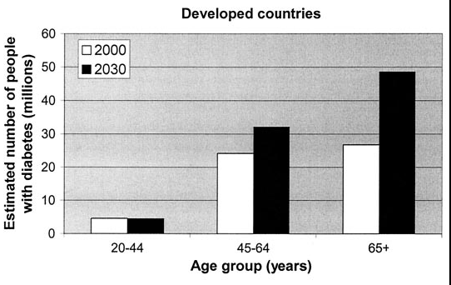

Slide 14
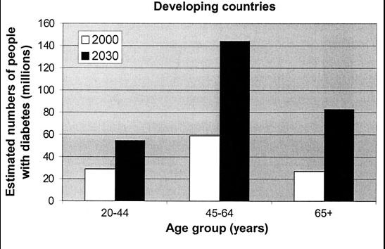

Slide 15
Diagnosed and Undiagnosed Prevalence of Diabetes by Age in the US (NHANES III)
Harris et al., Diabetes Care, 1998

Slide 16
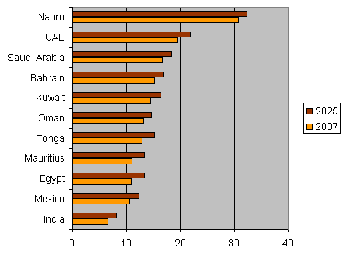
Top 10 Countries with the highest prevalence of diabetes in 2007 and 2025
(SA figure is based on FPG of 7 mmol and over)

Slide 17
Prevalence of diabetes based on stepwise surveys
Jordan: 12%
Iraq: 10.4%
Syria: 20.5%
Saudi Arabia: 17.9%
Iran: 10.3%

Slide 18
Prevalence of Diabetes in EMR
Notes:
Dr. Ossama AlKhatib (modified

Slide 19
Notes:
Dr. Ossama AlKhatib

Slide 20
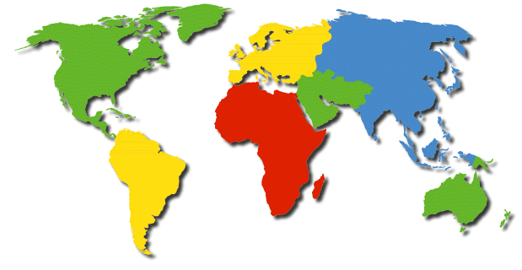
Global Projections for the Diabetes Epidemic: 2000-2030 (in millions)
EU
17.8
25.1
41%
NA
19.7
33.9
72%
China
20.8
42.3
204%
MEC
20.1
52.8
263%
LAC
13.3
33.0
248%
SSA
7.1
18.6
261%
India
31.7
79.4
251%
A+NZ
1.2
2.0
65%
World
2000 = 171 million
2030 = 366 million
Increase 213%
Wild, S et al.: Global prevalence of diabetes:
Estimates for 2000 and projections for 2030
Diabetes Care 2004 In press

Slide 21
Diabetes Mellitus Prevalence
Diabetes Mellitus
an Epidemic Disease in the
Gulf Countries
Kuwait
14.8
Bahrain
11.0
UAE
15.7
Qatar
15.0
Epidemiological
Data
Saudi Arabia
12.3
Oman
10.0

Slide 22
Impaired Glucose Tolerance Prevalence
Diabetes Mellitus
an Epidemic Disease in the
Gulf Countries
Kuwait
12.8
Bahrain
11.0
UAE
13.2
Qatar
11.0
Epidemiological
Data
Saudi Arabia
11.9
Oman
10.0

Slide 23
Diabetes mellitus and age distribution in KSA

Slide 24
Types of DM and age in KSA

Slide 25
Stepwise data from some EM countries
Country | Year of field work | Diabetes % | Hypertension % | Overweight & Obesity %
Iraq | 2006 | 10.4 | 40.4 | 66.9
Jordan | 2007 | 16 | 25.5 | 67.4
Saudi Arabia | 2005 | 17.9 | 26
Syrian Arab Republic | 2003 | 19.8 | 28.8 | 56.3
Kuwait | 2005 | 16.7 | 24.6 | 81.2
Egypt | 2005 | 16.5 | 33.4 | 76.4
Sudan | 2005 | 19.2 | 23.6 | 53.9

Slide 26
Stepwise data from some EM countries
Country | Year of field work | Hyper-cholestrolemia % | Smoking % | Low physical activity % | Low intake of fresh fruit & vegetables %
Iraq | 2006 | 37.5 | 21.6 | 56.7 | 92.3
Jordan | 2007 | 26.2 | 29 | 5.2 | 14.2
Saudi Arabia | 2005 | 19.3 | 12.9 | 33.8 | 91.6
Syrian Arab Republic | 2003 | 33.5 | 24.7 | 32.9 | 95.7
Kuwait | 2005 | 42 | 15.7 | 91.5 | 89
Egypt | 2005 | 24.2 | 21.8 | 50.4 | 79
Sudan | 2005 | 19.8 | 12 | 86.8 | 1.7/day

Slide 27
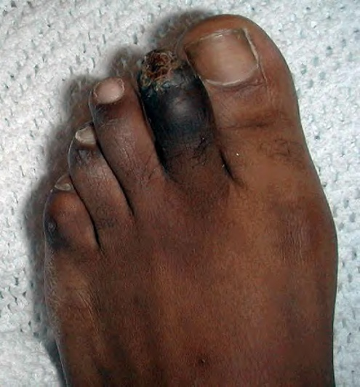
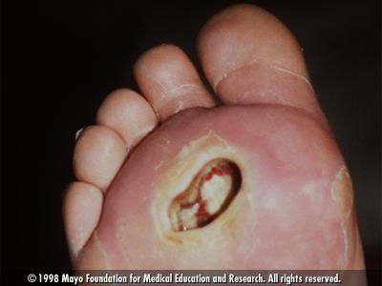
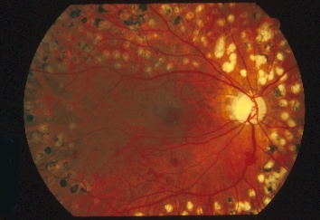
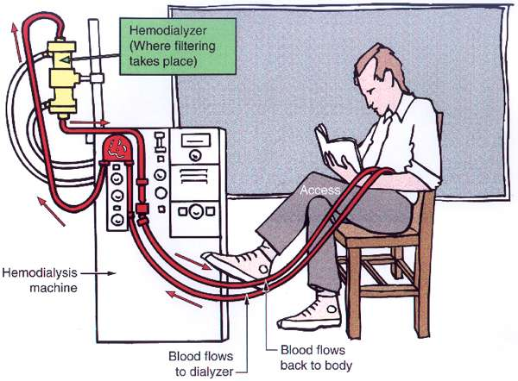

Diabetic complications

Slide 28
Diabetes accounts for more than 5% of the global deaths, which are mostly due to CVD.
Diabetes is responsible for over one third of end-stage renal disease requiring dialysis.
Amputations are at least 10 times more common in people with diabetes.
A leading cause of blindness and visual impairment. Diabetics are 20 times more likely to develop blindness than nondiabetics.

Slide 29
Diabetes Complications in the Gulf Countries
Prevalence of microvascular complications:
Comparing data from Arab
countries with data of the
highest & lowest prevalence
world wide in the year 2000.
The major complications will
be soon the highest in Arab
countries due to the lack of
prevention programs.
WHO report 2000.
Retinopathy
Neuropathy
Nephropathy

Slide 30
Diabetes Complications in the Gulf Countries
%
NIDDM
NEUROPATHY WITH DURATION
IDDM
Years
Diabetes Care 1, 168-188 1978

Slide 31
Diabetes Complications in the Gulf Countries
%
BLINDNESS BY DURATION OF DIABETES
Age at diagnosis 60 years old
Age at diagnosis 20 years old
Years
ADA 1993 Vital Statistic

Slide 32
Diabetes Complications in the Gulf Countries
Retinopathy
Retinopathy:
Number of persons with
diabetic retinopathy in different countries and according to the time.
WHO report 2000

Slide 33
Diabetes Complications in the Gulf Countries
Prevalence of Retinopathy in
Saudi diabetic patients
31.5%
IDDM 42.5%
NIDDM 25.3%
Risk factors for Retinopathy in
Saudi diabetic patients
✰ Duration > 10 years.
• Presence of nephropathy.
 Older than 60 years.
 Poor diabetes control.
 Use of insulin.

Slide 34
Diabetes Complications in the Gulf Countries
Diabetes in the Gulf countries
Diabetes is the leading cause for Blindness
Diabetes is the leading cause for ESRF
Diabetes is the leading cause for IHD
Diabetes is the leading cause for CVA
Diabetes is the leading cause for Amputation

Slide 35
Increasing mortality from diabetes mellitus
J. Olefsky, JAMA 2001:285:628-632
Notes:
Why is it interesting to do research in diabeets

Slide 36
Risk factors
Risk factors for Type 2 DM are complex including obesity, genetic and life style factors (overfeeding and sedentary life). There is patho- physiological changes (weight gain insulin resistance and reduction of insulin secretion) may lead to glucose intolerance and diabetes.

Slide 37
Genetic factors may play a part in development of all types; autoimmune disease and viral infections may be risk factors in Type I DM.
Physiologic or emotional stress: causes prolonged elevation of stress hormone levels (cortisol, epinephrine, glucagon and growth hormone), which raises blood glucose levels, placing increased demands on the pancreas.

Slide 38
Prevalence of DM in 60 years old Men
Decoda:Nakagami; Diabetologia 2003

Slide 39
Prevalence of DM in 60 years old Women
Decoda:Nakagami; Diabetologia 2003

Slide 40


Obesity
Contributes to the resistance to endogenous insulin.
  RR risk of DM in females (ref. BMI < 22)
    22-23 3.0
    24-25 5.0
    > 31 40
    (Colditz & al, Ann Int Med, 1995, 122; 481-6)

Slide 41

Physical inactivity.

Slide 42

Diet.

Slide 43
Infections

Slide 44
Pregnancy
Pregnancy causes weight gain and increases levels of estrogen and placental hormones, which antagonize insulin

Slide 45
Medications
Drugs that are known to antagonize the effects of insulin:
Thiazide diuretics,
Adrenal corticosteroids,
Oral contraceptives.

Slide 46
References
http://www.diabetesatlas.org/content/global-burden.
Al-Madani A. Diabetes Complications in the Gulf Countries. Presentation.
Ibtihal Fadhil. RA/ NCD/ Health promotion and Protection /EMRO/WHO Diabetes and Other Non-Communicable Diseases / EM Regional Perspective. First BA Regional Workshop on the Epidemiology of Diabetes and Other Non-Communicable Diseases , Bibliotheca Alexandrina. 5-13 January 2009.
WILD S, ROGLIC G, GREEN A, SICREE R, KING R. Global Prevalence of Diabetes. Estimates for the year 2000 and projections for 2030. DIABETES CARE 2004; 27 (5):1047-53.

Slide 47
Thank You

