Slide 1
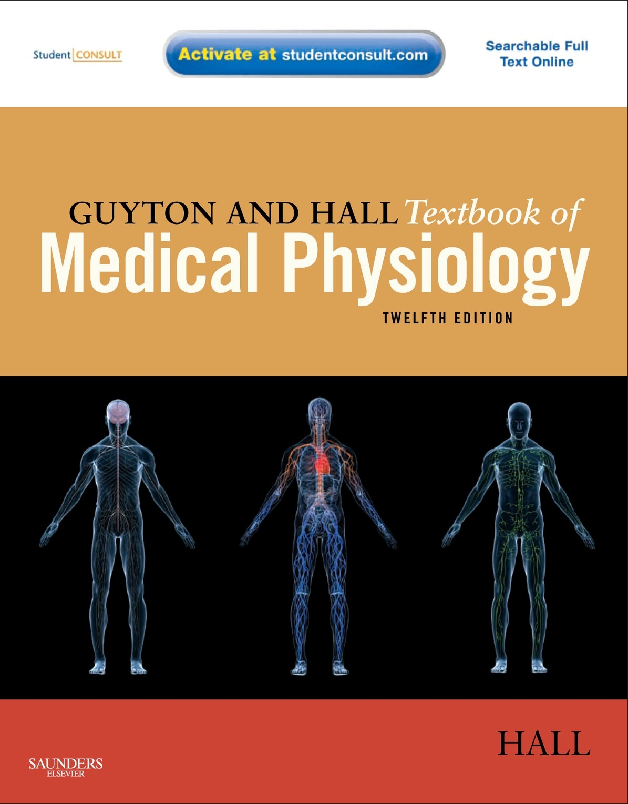

Slide 2
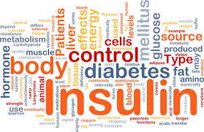
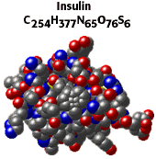
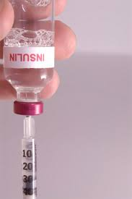
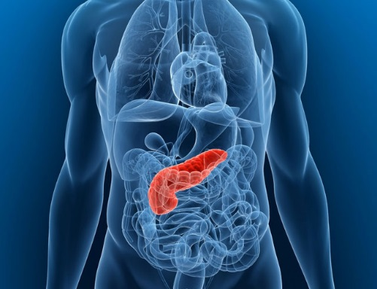
Physiology of the Pancreas
Dr Mouaadh Abdelkarim
mabdelkarim@ksu.edu.sa

Slide 3
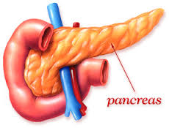
Pancreas
A triangular gland, which has both exocrine and endocrine cells, located behind the stomach
Strategic location
Acinar cells produce an enzyme-rich juice used for digestion (exocrine product)
Pancreatic islets (islets of Langerhans) produce hormones involved in regulating glucose, lipids, and protein metabolism

Slide 4
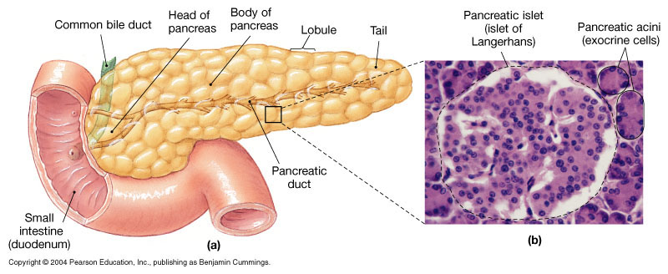
The Endocrine Pancreas

Slide 5
Islets of Langerhans
1-2 million islets
Beta (β) cells produce insulin (60%)
Alpha (α) cells produce glucagon (25%)
Delta (δ) cells produce somatostatin (10%) (GHIH (growth hormone-inhibiting hormone))
PP cells produce pancreatic polypeptide (5%)

Slide 6
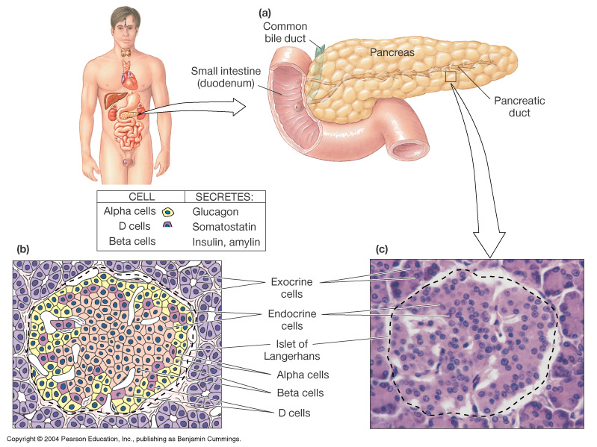
Islets of Langerhans

Slide 7
Insulin
Hormone of nutrient abundance
A protein hormone consisting of two amino acid chains linked by disulfide bonds
Synthesized as part of proinsulin and then excised by enzymes, releasing functional insulin (51 AA) and C- peptide
Has a plasma half-life of 6 minutes.

Slide 8
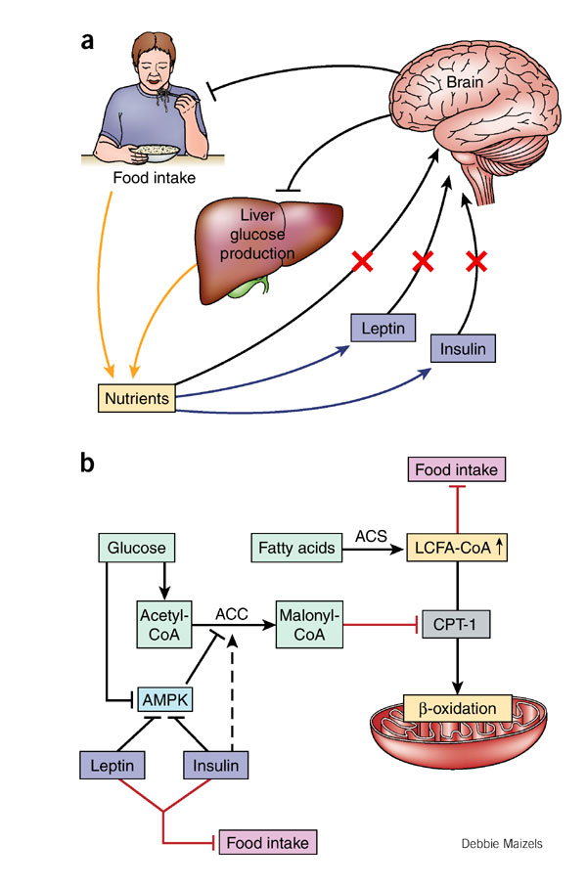

Slide 9
Mechanism of Insulin Secretion
Insulin secretion is stimulated by an increase in blood glucose and decreased by fasting and decrease in blood glucose

Slide 10
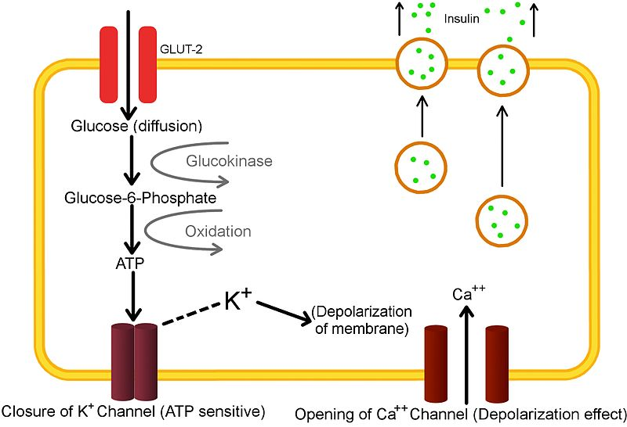
Glucose is the primary stimulator of insulin secretion

Slide 11
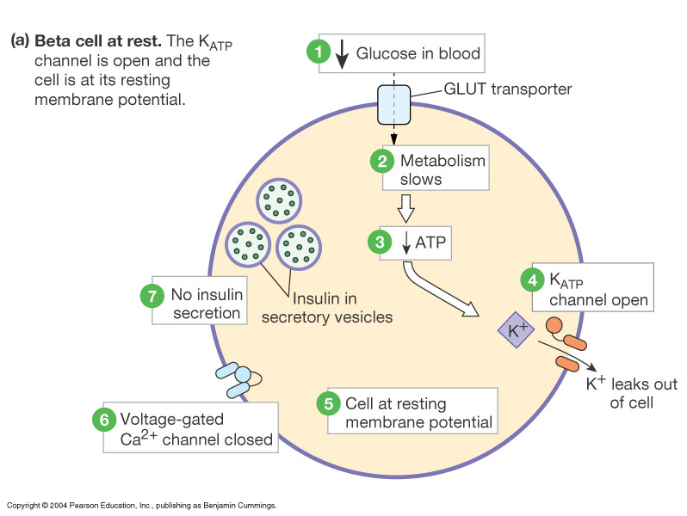

Slide 12
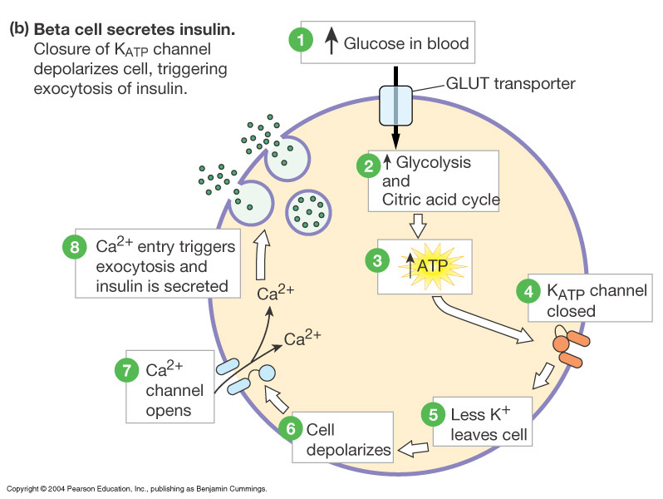

Slide 13
↑ Blood glucose concentration
↑ Gastrointestinal hormones
↓
↑ Blood amino acid conc.
↑
Major control
Food intake
↓
Parasympathetic stimulation
Islet β cells
Sympathetic stimulation
(and epinephrine)
↓
Insulin secretion
↓
Factors controlling insulin secretion
↓ Blood glucose
↓ Blood fatty acids
↓ Blood amino acid
↑ Protein synthesis
↑ Fuel storage

Slide 14
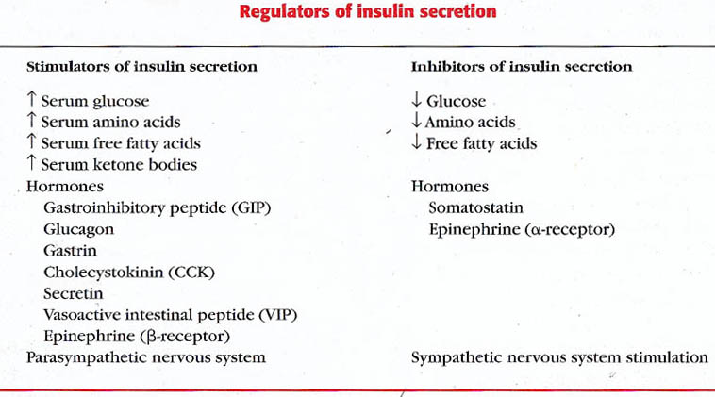

Slide 15
Insulin Receptor
The insulin receptor is a transmembrane receptor
Belongs to the large class of tyrosine kinase receptors
Made of two alpha subunits and two beta subunits

Slide 17
Glucose regulation and metabolism terms
- Gluconeogenesis - Synthesis of glucose from noncarbohydrate precursors, Lactic acid, glycerol, amino acids, liver cells synthesis glucose when carbohydrates are depleted.
- Glycogenesis - Formation of glycogen, glucose stored in liver and skeletal muscle as glycogen, important energy reserve.
- Glycogenolysis – breakdown of glycogen (polysaccharide) into glucose molecules (monosaccharide)
- Glycolysis - the breakdown of glucose into pyruvate by cells for the production of ATP

Slide 18
Actions of insulin

Slide 19
Actions of insulin
Main action of insulin:
Increase transport of glucose, amino acids, K+ into insulin-sensitive cells
- Liver
- Muscles
- Adipose tissue

Slide 20
Actions of insulin
Rapid (seconds)
(+) transport of glucose, amino acids, K⁺ into insulin-sensitive cells
Intermediate (minutes)
(+) protein synthesis
(-) protein degradation
(+) of glycolytic enzymes and glycogen synthase
(-) phosphorylase and gluconeogenic enzymes
Delayed (hours)
(+) mRNAs for lipogenic and other enzymes

Slide 21
Action of insulin on Liver:
(-) ketogenesis
(+) protein synthesis
(+) lipid synthesis
(-) gluconeogenesis
(+) glycogen synthesis
(-) glycogenolysis.
(+) glycolysis
+ GLUT2 transporters
↑ Glucokinase

Slide 22
Action of insulin on Muscle:
(+) glucose entry
(+) glycogen synthesis
(+) amino acid uptake
(+) protein synthesis in ribosomes
(-) protein catabolism
(+) potassium uptake

Slide 23
Action of insulin on Adipose tissue
(+) glucose entry
(+) fatty acid synthesis and deposition
(-) lipolysis
(+) potassium uptake

Slide 25
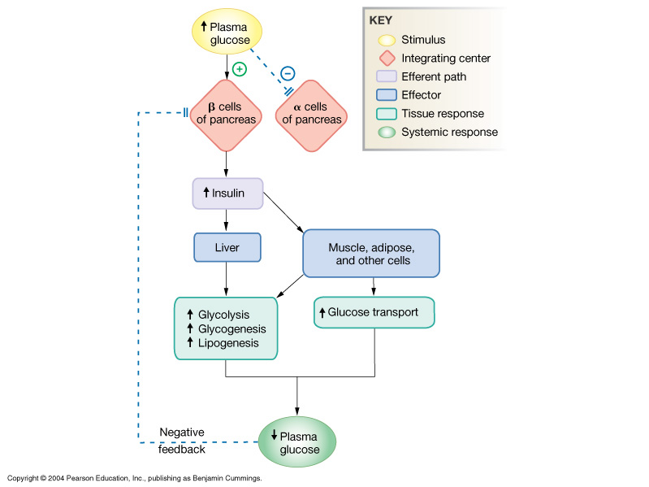
Insulin: Summary

Slide 26
Hormonal Effects on FFA Production in Adipose Tissue
Growth hormone
Cortisol
T₃
Epinephrine
Insulin
+
Triglycerides
Fatty Acids
+
Hormone
Sensitive
Lipase
+
α-Glycerol-P
_
glucose
Insulin
_
Glycerol
Growth hormone
Cortisol
+
Glycerol
Insulin
FA

Slide 27
Glucose Transport
GLUT1 (erythrocytes, brain)
GLUT2 (liver, pancreas, small intestines)
GLUT3 (brain)
GLUT4, insulin sensitive transporter (muscle, adipose tissue)

Slide 28
Glucagon
A 29-amino-acid polypeptide hormone that is a potent hyperglycemic agent
Produced by α cells in the pancreas

Slide 29
Synthesis of Glucagon
DNA in α cells (chromosome 2)
mRNA
Preproglucagon
proglucagon
glucagon

Slide 31
Actions of Glucagon
Its major target is liver
Glycogenolysis
Gluconeogenesis
Lipid oxidation (to produce keto acids “ketone bodies”).
Release of glucose to the blood from liver cells

Slide 32
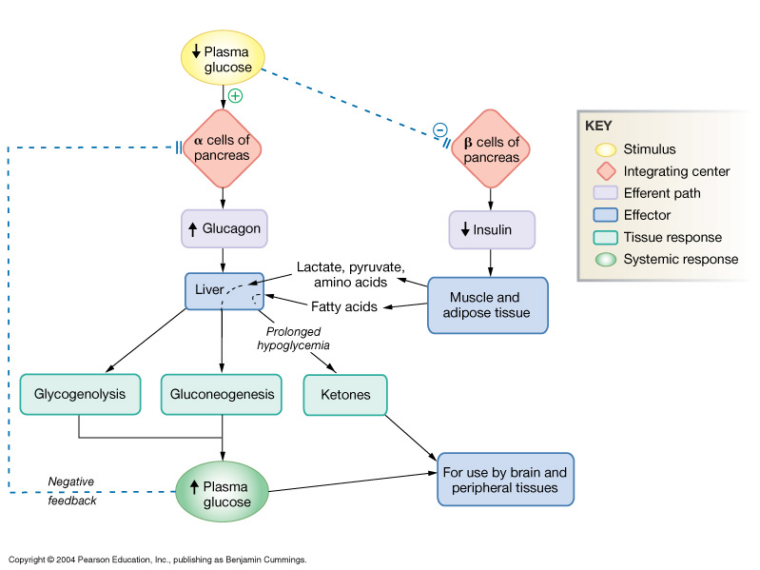
Glucagon Action on Cells:

Slide 33
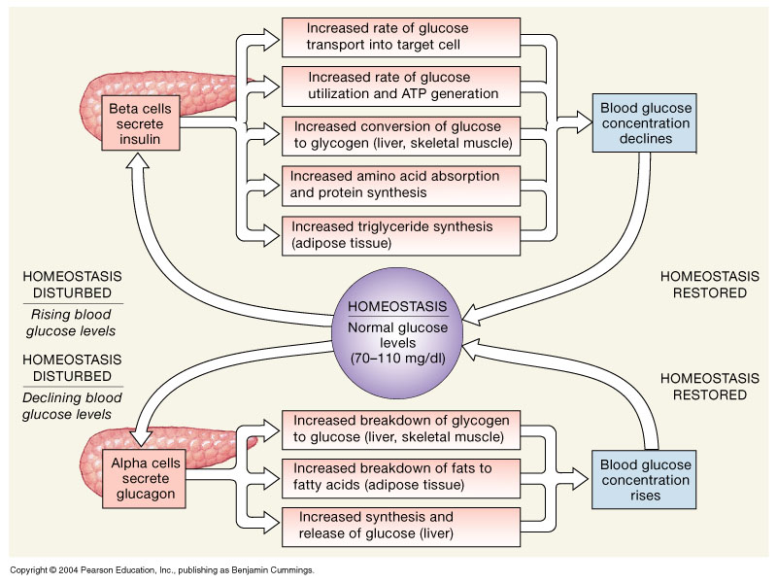
The Regulation of Blood Glucose Concentrations

Slide 34
Diabetes Mellitus
Diabetes mellitus is probably the most important metabolic disease.
Affects ~2% of population: a major health problem.
It affects every cell in the body and affects carbohydrate, lipid, and protein metabolism.
characterized by the following:
Polyuria (excessive urination)
Polydypsia (excessive thirst)
Polyphagia (excessive hunger and food consumption).

Slide 35
Types of Diabetes

Slide 36
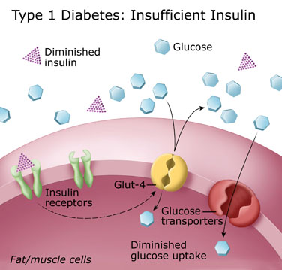
Type 1 Diabetes
Type 1 Diabetes
Affects children
Cause: inadequate insulin secretion
(insulin-dependent diabetes mellitus)
Caused by an immune-mediated selective destruction of β cells
β cells are destroyed while α cells are preserved:
No insulin >> high glucagon>>> high production of glucose and ketones by liver
glucose & ketones >>> osmotic diuresis
keto acids >>> diabetic ketoacidosis

Slide 37
Treatment : insulin injection
In future, Type 1 diabetes might
be treated with oral insulin sprays;
or transplantation of b cells.

Slide 38
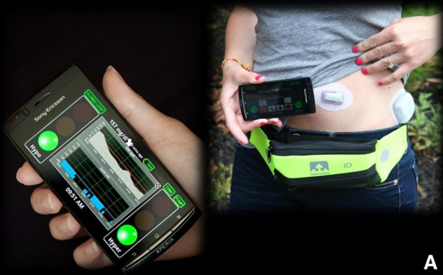
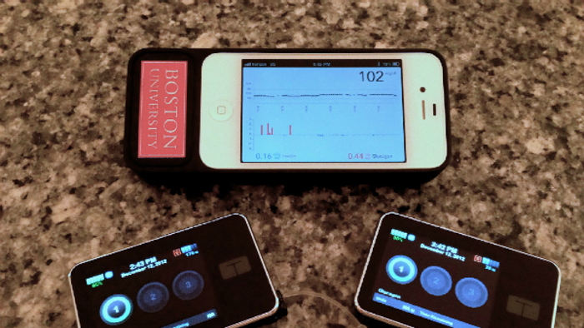
Artificial pancreas system aimed at type 1 diabetes mellitus
Harvard university January 2016
The artificial pancreas is not a replica organ; it is an automated insulin delivery system designed to mimic a healthy person’s glucose-regulating function. The closed-loop system consists of an insulin pump, a continuous glucose monitor placed under the user’s skin, and advanced control algorithm software embedded in a smartphone that provides the engineering brains, signaling how much insulin the pump should deliver to the patient based on a range of variables, including meals consumed, physical activity, sleep, stress, and metabolism.

Slide 39
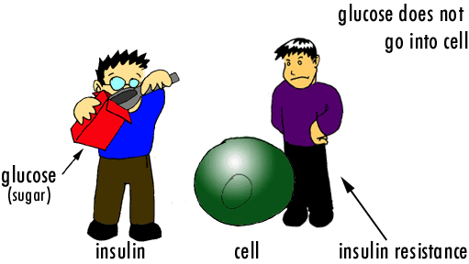
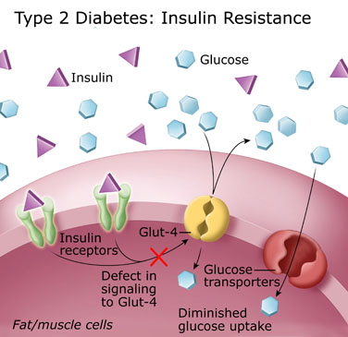
Type 2 Diabetes
Type 2 Diabetes
Affects adults
Cause defect in insulin action (insulin resistance)
(non-insulin-dependent diabetes mellitus)
Treatment :
diet and change life style
can develop into Type 1 diabetes if uncontrolled.

Slide 40
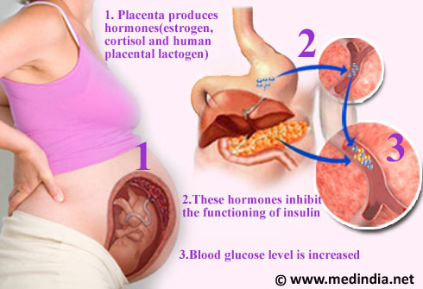
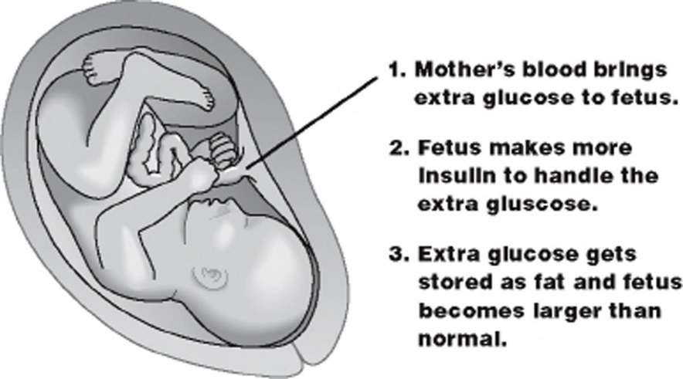
Type 3 gestational diabetes

Slide 41
Type 3 gestational diabetes
Occurs in 2-5% of pregnancies. Associated with decreased insulin levels and/or insulin resistance.
Resembles Type 2 Diabetes.
Usually transient: symptoms improve following delivery.
If untreated → macrosomia (high birth weight)

Slide 42
Diabetes Mellitus
Cause
Inadequate secretion
of insulin
Defects in the action
of insulin
Metabolic disturbances (hyperglycemia and glycosuria)

Slide 43
Long Term Complications of Uncontrolled Diabetes
MICROVASCULAR DISEASE
Hyperglycemia damages small blood vessels:
diabetic retinopathy → vision loss.
diabetic neuropathy → damage to nerves → most common cause of amputation in Western world.
diabetic nephropathy → kidney damage → chronic renal failure.

Slide 44
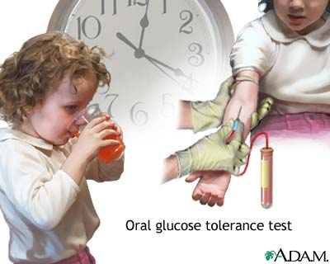

Slide 45
Glucose Tolerance Test
OGTT: is a test that can be used to help diagnose diabetes or pre-diabetes.
Both the fasting plasma glucose test (FPG) and OGTT tests require that the patient fast for at least 8 hours (ideally 12 hr) prior to the test.
The oral glucose tolerance test (OGTT):
FPG test
Blood is then taken 2 hours after drinking a special glucose solution

Slide 46
Glucose Tolerance Test (GTT)
Following the oral administration of a standard dose of glucose, the plasma glucose concentration normally rises but returns to the fasting level within 2 hours.
If insulin activity is reduced, the plasma glucose concentration takes longer than 2 hours to return to normal and often rises above 200 mg/dl.
Measurement of urine glucose allows determination of the renal threshold for glucose.

Slide 47
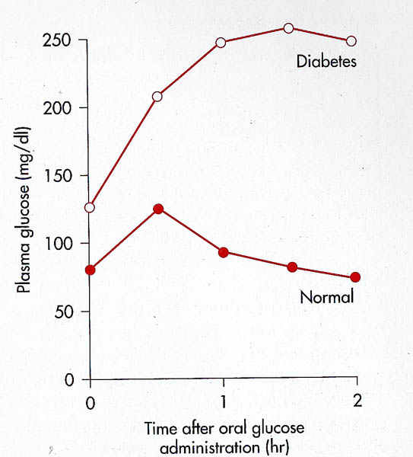
GTT

Slide 48
Glucose Tolerance Test
The following results suggest different conditions:
Normal values:
FPG <100 mg/dl
2hr PPG (postprandial glucose) < 140 mg/dL
Impaired glucose tolerance
2hr PPG = 140 - 199 mg/dL
Diabetes
FPG ≥ 126 mg/dl
2hr PPG levels ≥200 mg/dL

Slide 49
Glucose Homeostasis & Diabetes
Normal glucose tolerance
Impaired glucose tolerance (prediabetes)
Diabetes
FPG <110 110-125 ≥126
2-h PG <140 140-199 ≥200
(OGTT)

Slide 50
The End
Thank You

