Slide 1
Calcium homeostasis
and bone metabolism

Slide 2
Regulation of Calcium Metabolism
Minerals; serum concentration
– Calcium (Ca²⁺) = 2.2-2.6 mmol/L (total)
– Phosphate (HPO₄²⁻) = 0.7-1.4mmol/L
•
•
Organ systems that play
metabolism
an
import
role
in
Ca²⁺
–
–
–
Skeleton
GI tract
Kidney
•
Calcitropic Hormones
–
–
–
–
Parathyroid hormone (PT)
Calcitonin (CT)
Vitamin D (1,25 dihydroxycholecalciferol) Parathyroid hormone related peptide (PTHrP),
is
markedly
elevated in humoral hypercalcemia of malignancy ( sq. cell
carcinoma of the lung).

Slide 3
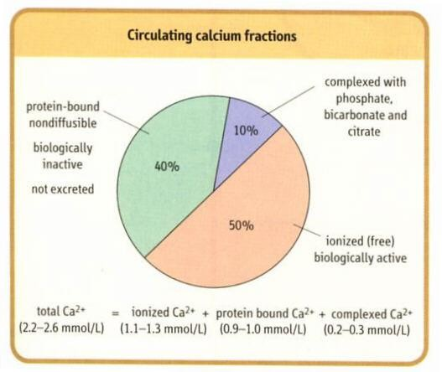

Slide 4
•
Increase in protein con. → ↑ in total
Ca²⁺
conc.
•
Decrease in protein con. → ↓ in total
Ca²⁺
conc.
•
The effects on ionized
Ca²⁺
conc. are insignificant.
•
Changes in anion con. alter the ionized
Ca²⁺
con. e.g.
•
↑ plasma phosphate con. → ↑ in the conc. of Ca²⁺ complexd
to phosphate → ↓ ionized
Ca²⁺
con.
Ca²⁺
affects the Na⁺ permeability of nerve membranes.
↓ plasma
Ca²⁺
→ Generation of spontaneous action
potentials in nerves → tetany

Slide 5
•
Acid-base abnormalities alter the ionized
Ca²⁺
con. by
changing the fraction of
Albumin has negatively
Ca²⁺
bound to plasma albumin.
•
charged
sites,
which can bind either
H⁺
ions or
Ca²⁺
ions.
•
Acidosis
Alkalosis
^{H}_{Ca}++
^{H}H
H
Ca⁺⁺
Albumin
Ca⁺⁺
Albumin
Ca⁺⁺
Ca⁺⁺
Ca⁺⁺
•
Ionized
Ca²⁺
Ionized Ca²⁺
Hyperventilation
→ Respiratory alkalosis
Tetany.
→
↓ ionized
Ca²⁺
→

Slide 6
Calcium Homeostasis
Parathyroid gland
Skeleton
Intestine
Vitamin D
Ca⁺⁺
Kidneys

Slide 7
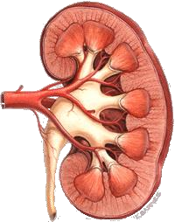
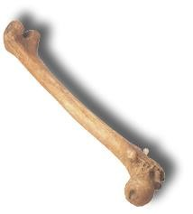
Calcium homeostasis
storage
bone
calcium deposition
kidney
Blood
Ca++
calcium resorption
1000 g Ca++
stored in bone
intake
Ca++ absorbed
into blood
Ca++
lost in urine
excretion
Calcium in
the diet
calcium lost in feces
small intestine

Slide 8
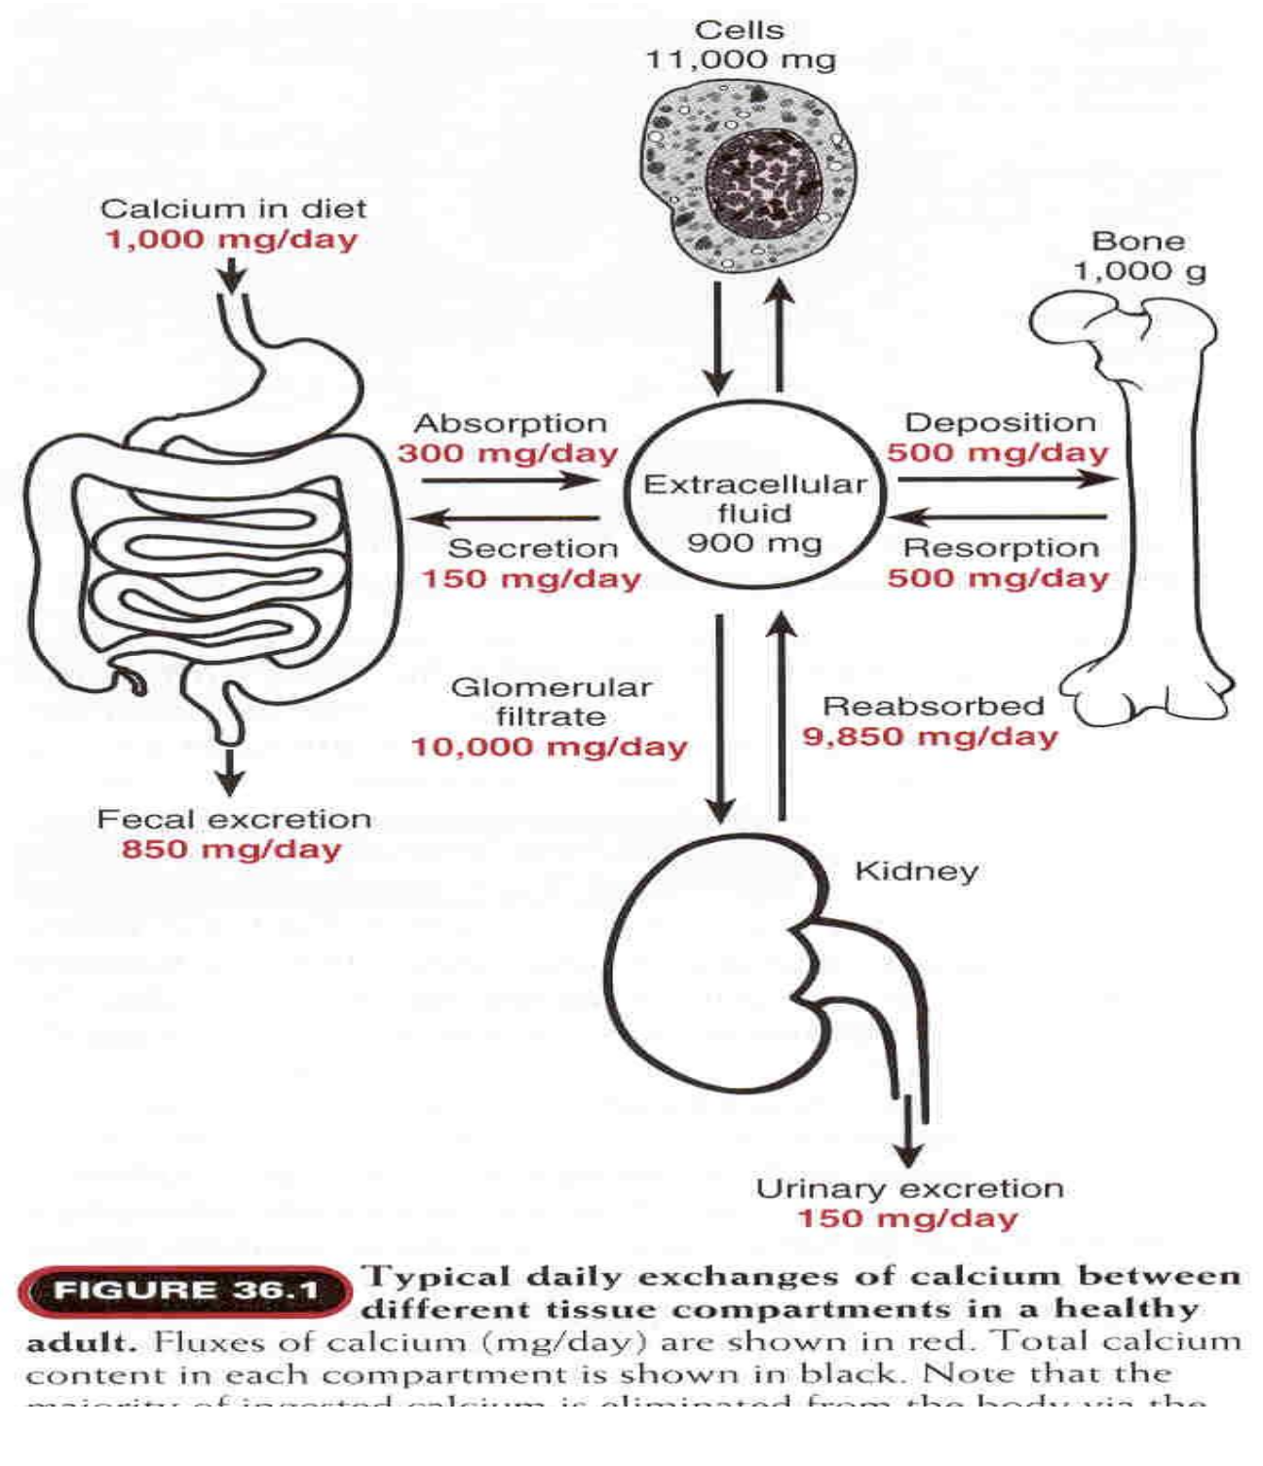

Slide 9
Bone
•
Inorganic 67%))
– Hydroxyapatite 3 Ca₁₀(PO₄)₆(OH)₂
– There is some amorphous calcium phosphate
•
Organic (33%) component is called osteoid
–
–
–
Type I collagen (28 %)
Non-collagen structural proteins (5%) Growth factors and cytokines (Trace)
•
Bone undergoes continuous turnover or
remodeling throughout life
– About 20% of bone is undergoing remodeling at any
one time.

Slide 10
Calcium cycling in bone tissue
Bone formation
Osteoblasts (bone builders)
Synthesize a collagen matrix that
holds Calcium Phosphate in crystallized form.
Once surrounded by bone, become osteocyte.
Bone resoption
Osteoclasts (bone breakers) Change local pH, causing Ca++ and phosphate to dissolve
from crystals into extracellular fluids.
•

Slide 11
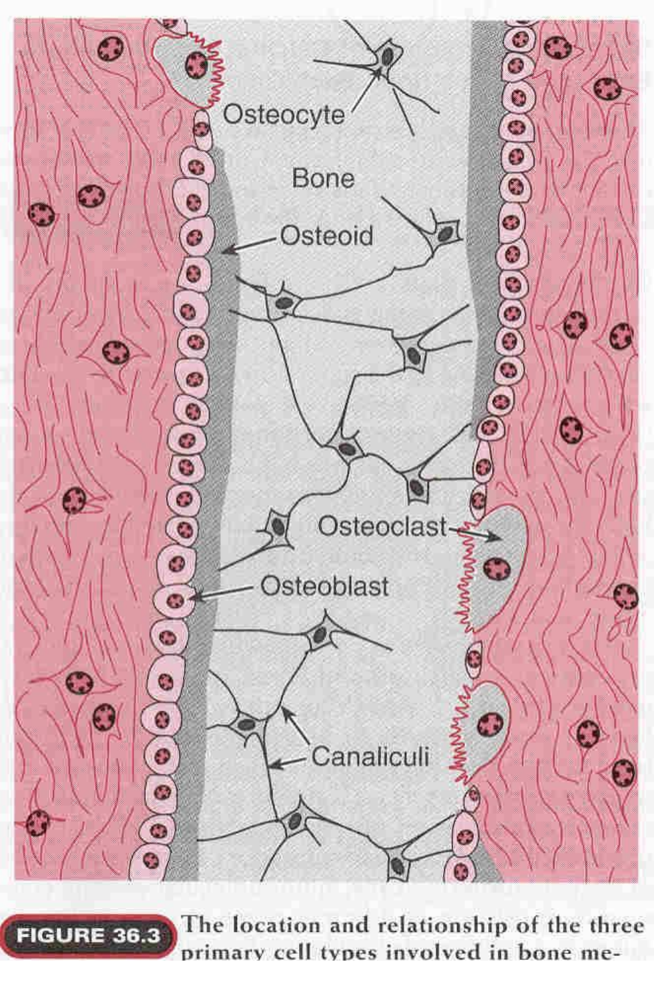

Slide 12
Functions of Calcium
Total serum calcium 2.15 - 2.6 mmol/L
•
•
•
•
•
•
•
•
Regulate
neuromuscular excitability
Blood coagulation
Secretory processes
Membrane integrity
Plasma membrane transport
Enzyme reactions
Release of hormones and neurotransmitters
Bone mineralization
•

Slide 13
Phosphorus
•
Important role in cellular metabolism
•
Source of energy in cellular reactions
•
Component of phospholipids in
membranes

Slide 14
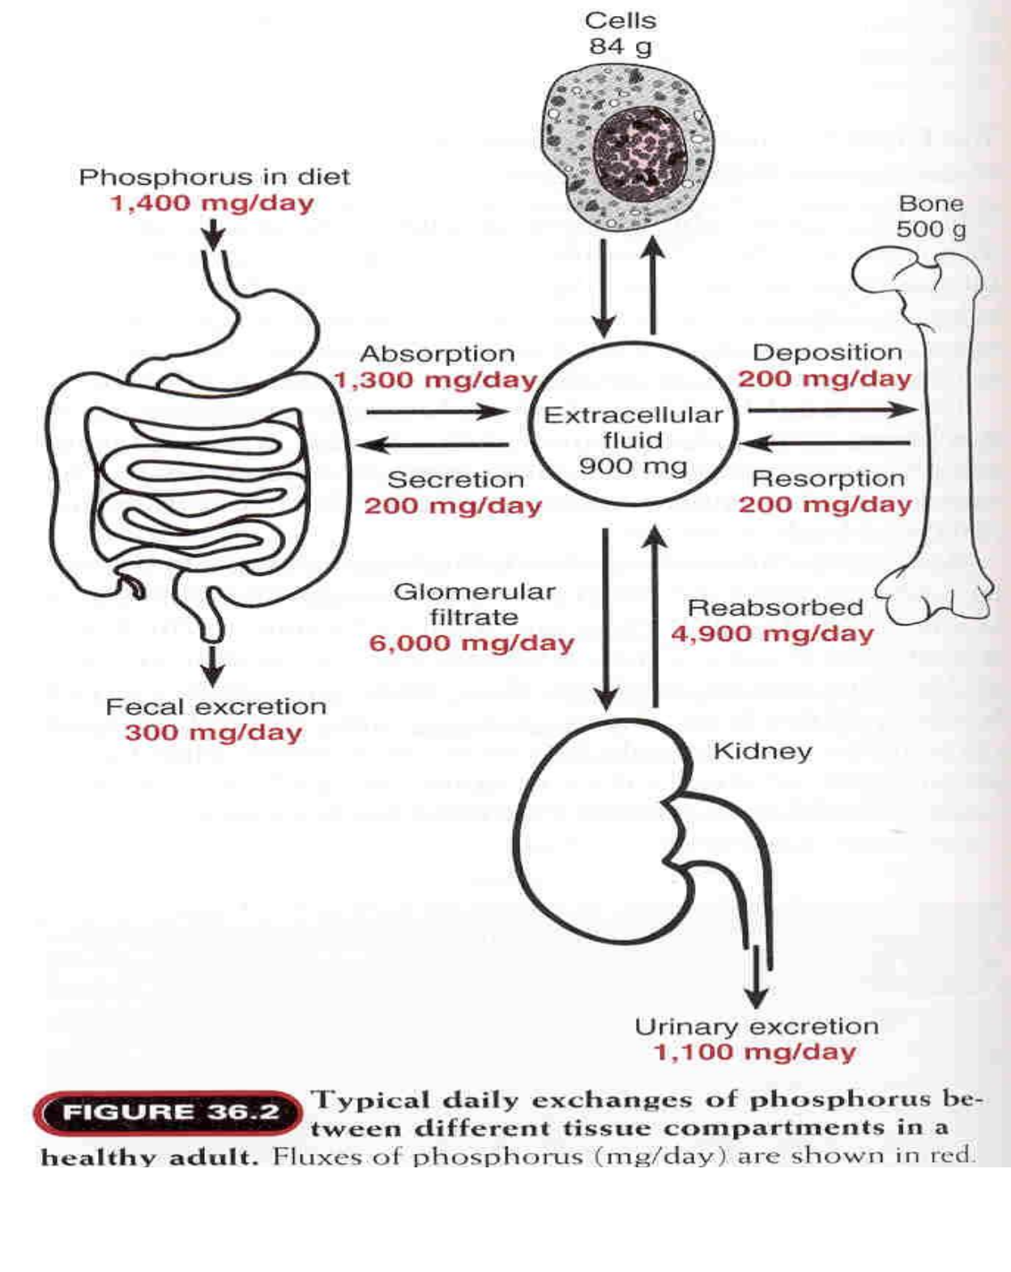

Slide 15
Inorganic constituents of bone
%age of total body content
constituent
Present in bone
Calcium
Phosphate
Carbonate
Magnesium
Sodium
Water
99
86
80
50
35
9

Slide 16
The Parathyroid Hormone
Secreted by the parathyroid glands.
Stimulated by hypocalcaemia.

Slide 17
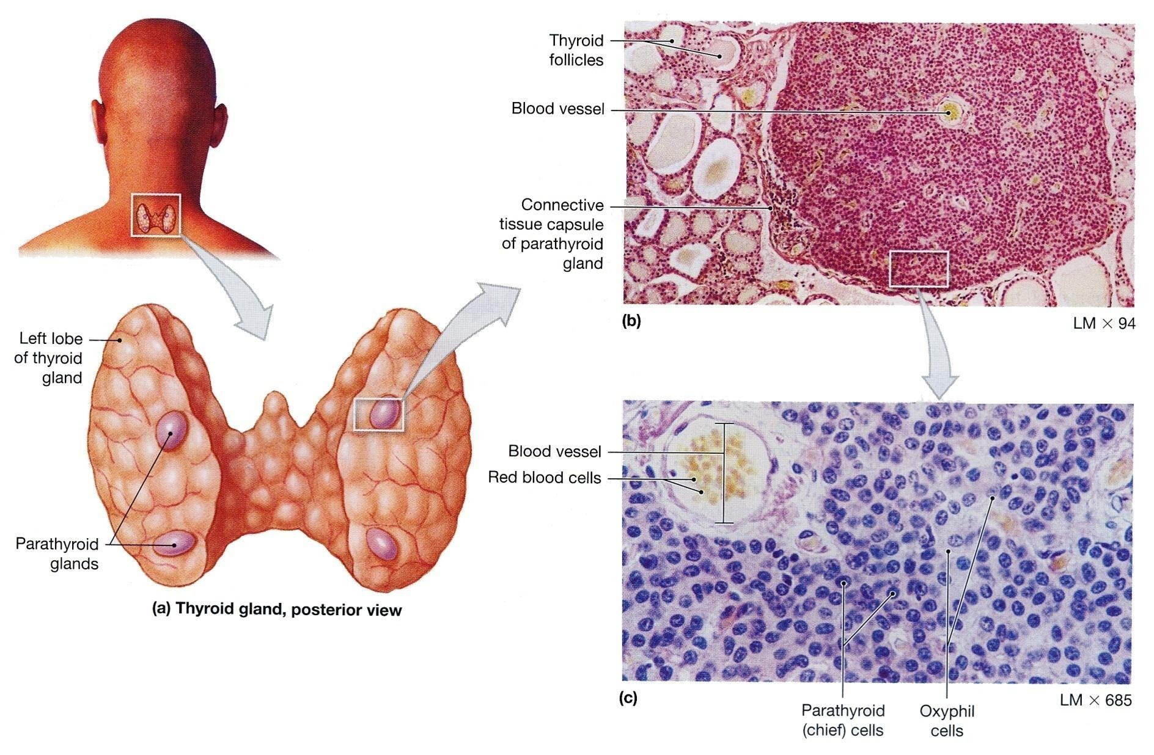


Slide 18
Actions of Parathyroid Hormone
Necessary for fine control of ionized serum levels.
– It increases
Ca²⁺
–It decreases Pi
•
Parathyroid hormone acts directly on bone to
Ca²⁺
stimulate resorption and release of
extracellular space (slow)
into the
•
Two effects in kidney
– Parathyroid hormone acts directly on kidney to increase calcium reabsorption and phosphate excretion (rapid)
– Stimulates transcription of 1-alpha hydroxylase enzyme
for Vitamin D activation in kidney
• Vitamin D increases calcium and phosphate absorption from intestine.

Slide 19






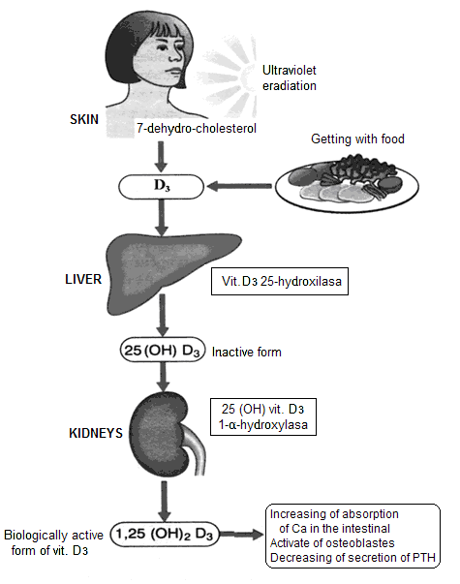
Hormone regulation of calcium metabolism
Parathyroid hormone (PTH)
Target organ: bones,kidneys
Function of PTH:
Increase of Ca++
concentration in plasma
Mechanisms:
1- Releasing of Са++ by
bones (activation of osteoclasts) → ↑ resorption of bones.
2- Increase of Са++
reabsorption by kidneys
3- Activation of vit. Dз
Synthesis and increase of
Са++ absorption in the
intestine
Vitamin D
Thyroid calcitonin
Target organ: bones
Function:
Decrease Ca++
concentration in
plasma

Slide 20
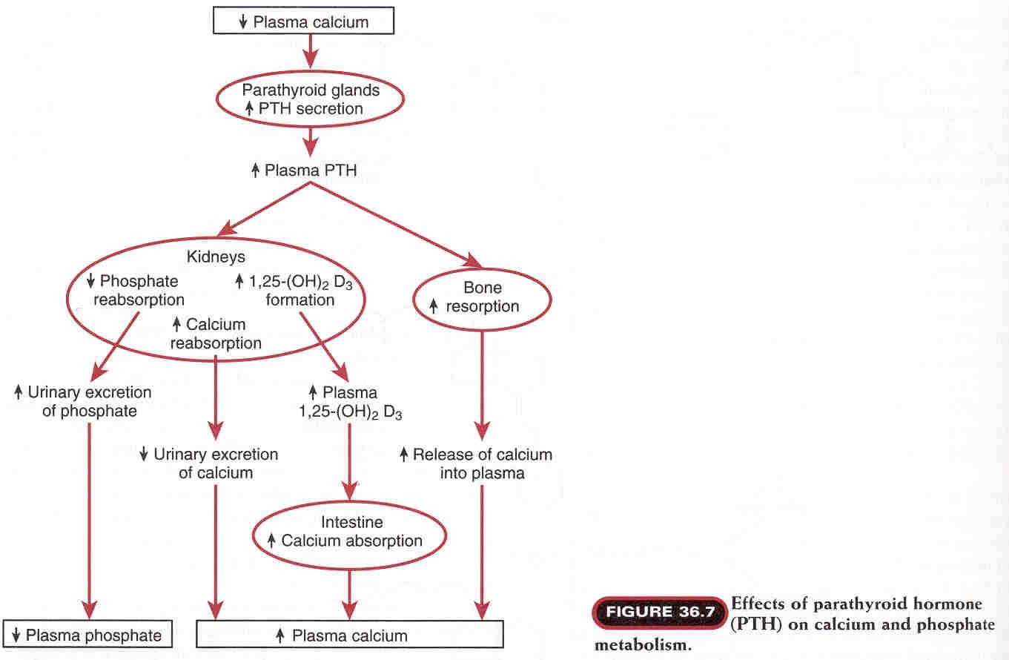

Slide 21
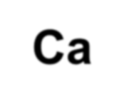


Calcitonin
Secreted by the parafollicular or thyroid gland.
C-cells
of
the
Stimulated by hypercalcaemia.
Lowers
Ca²⁺
in blood
Ca²⁺
Promotes deposition of
(inhibits osteoclasts)
into
bone
Promotes renal excretion of
Ca²⁺

Slide 22
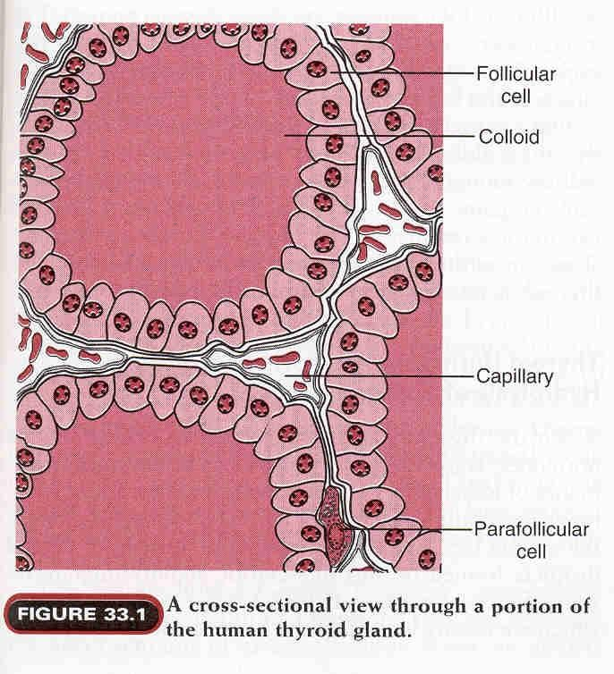

Slide 23
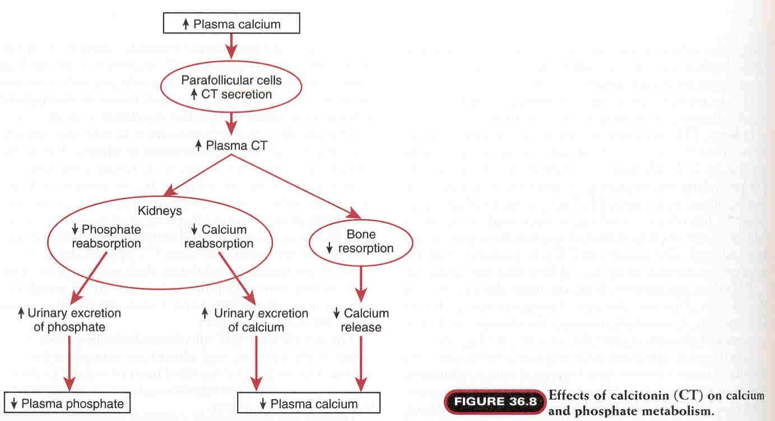

Slide 24
Vitamin D
➢
Synthesized by the body or taken in food.
➢
7- Dehydrocholestrol (in skin) + Ultraviolet light
→ Vit. D₃ (inactive form).
➢
^{Hydroxylation of Vit.D} ^{first in the liver to}
25,hydroxycholicalciferol (inactive form).
➢
^{Second hydroxylation of Vit.D} ^{in the kidneys to}
→ 1,25 dihydroxycholicalciferol (active form).

Slide 25
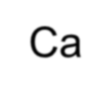


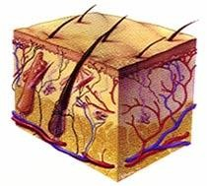
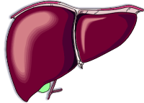
1,25 Vitamin D3
uptake from the gut
•
•
•
•
•
Increases
Ca²⁺
Increase transcription and translation of
gut epithelium
Minor roll: also stimulates osteoclasts
Ca²⁺
transport
proteins
in
UV
Increase
Ca++ resorption from bone
Cholesterol precursor
7-dehydrocholesterol
Vitamin D3
25 Vitamin D3
1,25 Vitamin D3
Low plasma Ca²⁺ increase kidney enzymes

Slide 26
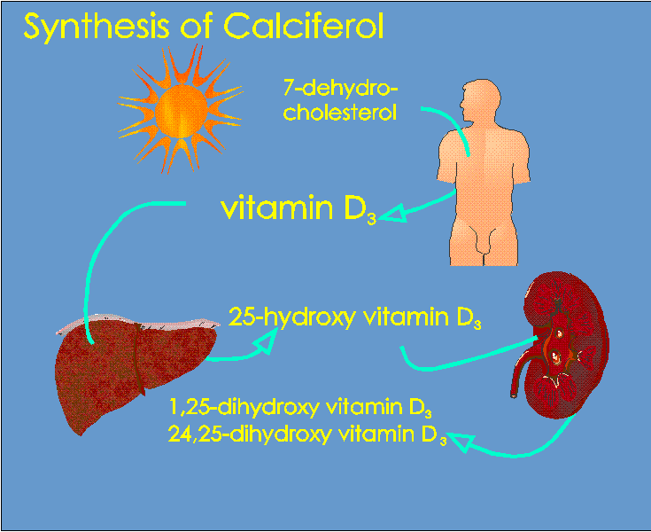
Synthesis of active vitamin D
vitamin D2
(10%)
(diet)
Bile
Salts
(90%)
calcidiol
25-hydroxylase
1,25 (OH)₂D₃
calcitriol
1a-hydroxylase
Tightly regulated

Slide 27
Other regulator of
Ca²⁺
homeostasis
Estrogens:
Stimulate osteoblast activity , limits
osteoclast activity, and enhance PTH
secretion.
Estrogens changes the set point of PTH cells
in the parathyroid so a greater reduction of
Ca²⁺
is needed to increase PTH secretion so:
Estrogen decreases
Ca²⁺
loss from bones.

Slide 28
Ca²⁺
homeostasis in pregnancy and lactation
The daily required dose of Ca²⁺ is greatly increased during
pregnancy.
30 grams of Ca²⁺ are transferred to the fetus and lost in urine
during pregnancy.
Bone turn over is increased during pregnancy → osteoporosis
especially hip bone.
280 - 800 mg of
lactation.
Ca²⁺
is lost in breast milk per day during
The mother compensate by:
1-
2-
3-
↑
↓
↑
intestinal absorption
renal excretion
bone resorption

Slide 29
