Slide 1
Causes of Hypocalcaemia
Hypoparathyroid
Nonparathyroid
PTH Resistance
Postoperative
Vitamin D
deficiency
Pseudo- hypoparathyroidism
Idiopathic
Malabsorption
Hyperproduction of
calcitonin (medullary
thyroid cancer).
Post radiation
Liver disease
Kidney disease
Vitamin D
resistance

Slide 2
Hypoparathyroidism
Commonly occur accidentally after surgical removal of
the thyroid gland → Latent or overt tetany.
Characterized by hypersensitivity (Low threshold)
nerves and muscles.
of
Can be demonstrated by two signs:
Chvostek’s sign:
Tapping the facial nerve as it emerge from the parotid gland In front of the ear → Contraction of the facial muscles.
Trousseau’s sign:
Arresting blood flow to the forearm for few minutes → Flexion of the wrist, thumb and metacarpophalangeal joints.

Slide 3
Hypocalcaemia
Symptoms:
•
Chvosteks and Trousseau’s
signs
•
Neuromuscular
excitability
•
Tetany
•
Paresthesia
•
Seizures

Slide 4
Tetnus → ↑ influx of Na++ ions at motor neurons
and interneurons → ↑ conduction of
reflex muscle contraction causing:
Impulses →
1-
Spasm of larynx
death.
and bronchus →
asphyxia and
2-
Muscle cramps.
3-
Coronarospasm
infarction
(cardiotetanus) → angina →

Slide 5
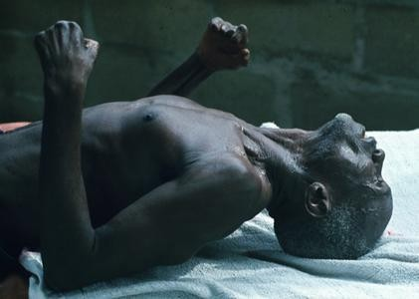
Hyperfunction
Hypofunction
hypercalciemia
- hypophosphatemia
- hyperphosphaturia
- osteoporosis
- Accumulation of
Саlcium in tissues
- hypocalciemia
- hyperphosphatemia
- hypophosphaturia
- tetanus

Slide 6
Pseudohypoparathyroidism
Symptoms and signs
•
–
–
–
Hypocalcemia
Hyperphosphatemia
Characteristic physical appearance: short stature, round face,
short thick neck, obesity, shortening of the metacarpals
Autosomal dominant
–
•
•
Resistance to parathyroid hormone
The patients have normal parathyroid glands, but they fail to respond to parathyroid hormone or PTH injections
•
Symptoms begin in children of about 8 years
– Tetany and seizures
– Hypoplasia of dentin or enamel and delay or absence eruption occurs in 50% of people with the disorder
of
•
Treatment: vitamin D and calcium

Slide 7
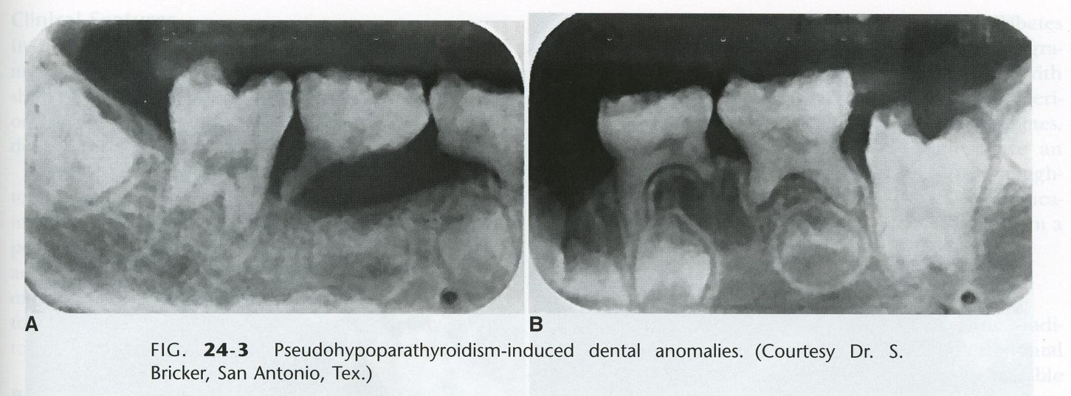
Pseudohypoparathyroidism
Short stature,
enamel hypoplasia

Slide 8
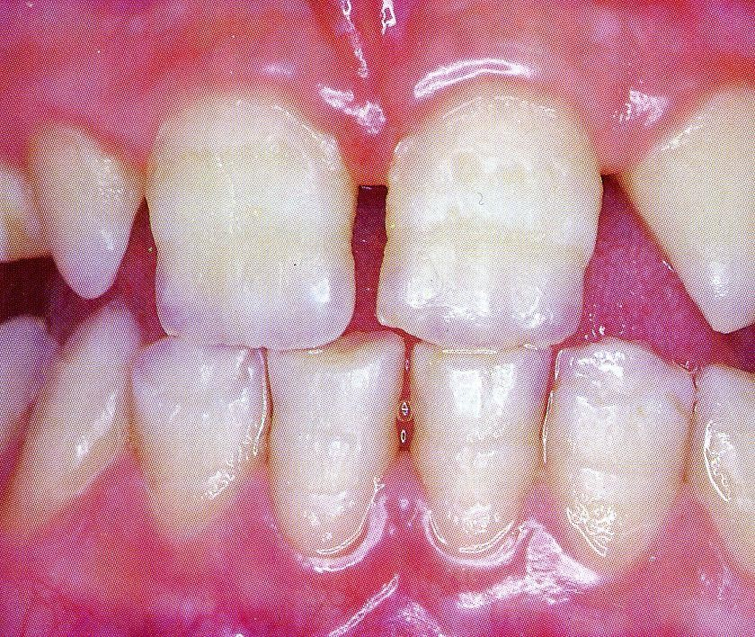
Congenital
Hypoparathyroidism
•
Hypoplasia of the teeth, shortened roots, and
retarded eruption

Slide 9

Case Study
A 27 years old man presents to his physician 3 weeks after his thyroid surgically removed for a thyroid cancer.
However, since he went home from the hospital, he noticed painful, involuntary muscular cramping.
He also felt numbness and tingling around his mouth & in his hands and feet. His parents said that he was irritable for the last 2 weeks.
He is on levothyroxine medication.
•
•
•
•
On
▪
•
examination
He has a well-healing thyroidectomy scar & no palpable masses in the thyroid bed.
Blood pressure cuff inflated above the systolic pressure induces involuntary
muscular contracture in the ipsilateral hand after 60 seconds (Trousseau`s sign)
Tapping on the face interior to the ears cause twitching in the ipsilateral corner of the mouth (Chevostek`s sign)
•
•
Lab Investigations:
Calcium: 5.6 mg/dl (N: 8.5 – 10.2)
Albumin: 4.1 g/dl (N: 3.5) – 4.8)
PTH: < 1 pg/ml (N:11 - 54)

Slide 10


DIAGNOSIS
The
parathyroid glands were removed
thyroidectomy
↓
PTH undetectable
↓
Hypocalcemia
↓
during
Clinical Manifestations of hypocalcemia
(increased reflexes & muscular cramping)

Slide 11
Causes of Hypercalcemia
Common | Uncommon
Malignant disease, e.g. some lung cancers | Renal failure
Hyperparathyroidism | Sarcoidosis
Vitamin D toxicity (excessive intake) | Multiple myeloma

Slide 12
Hypercalciemia
The quantity of cаlcium in blood more than 2.6 mmol/L
Causes:
•
Hyperparathyroidism and Malignant neoplasms
account
for majority of hypercalcemia
•
Neoplasms most frequently associated with
hypercalcemia:
Breast cancer, lung cancer and multiple myeloma
•
Most hypercalcemias in malignancy are caused
by
humoral hypercalcemia of malignancy (↑PTHrP).
•
Single adenomas of the parathyroid gland account for
75% of primary hyperparathyroidism associated with
hypercalcemia.

Slide 13
Parathyroid Hormone related Peptide (PTHrP)
➢
Can activate the PTH receptor
➢
Plays a physiological role in lactation, possibly as a
hormone for the mobilization and/or transfer of calcium to the milk
➢
May be important in fetal development
➢
May play a role in the development of hypercalcemia of
malignancy
- Some lung cancers are associated with
hypercalcemia
- Other cancers can be associated with hypercalcemia

Slide 14
Clinical Manifestations
of
Hypercalcemia
•
“Stones”
•
“Bones”
•
“Abdominal moans”
•
“Psychic groans”
•
Neuromuscular
•
Cardiovascular
•
Other

Slide 15
Clinical Manifestations of Hypercalcemia
•
Renal “stones”
–
Nephrolithiasis
–
Nephrogenic DI:
polydipsia and polyuria
–
Dehydration
–
Nephrocalcinosis

Slide 16
Clinical Manifestations of Hypercalcemia
•
Skeleton “bones”
–
Bone pain, arthralgias
–
Osteoporosis of cortical bone such as wrist
–
In primary hyperparathyroidism:
Subperiosteal resorption, leading to osteitis fibrosa cystica with bone cysts and brown tumors of the long bones

Slide 17
Clinical Manifestations of Hypercalcemia
•
Gastrointestinal “abdominal
moans”
–
Nausea, vomiting
–
Anorexia
–
weight loss
–
Constipation
–
Abdominal pain
–
Pancreatitis
–
Peptic ulcer disease

Slide 18
Clinical Manifestations of Hypercalcemia
•
“Psychic groans”
–
Impaired concentration and memory
–
Confusion, stupor, coma
–
Lethargy and Fatigue

Slide 19
Clinical Manifestations of Hypercalcemia
•
Neuromuscular
– Reduced neuromuscular excitability and muscle
weakness
– Easy fatigability and muscle weakness more common in hyperparathyroidism than other hypercalcemic conditions
•
Clinical features of hyperparathyroid
myopathy:
– Proximal muscle weakness, wasting and mild
nonspecific myopathic features on electromyogram
and muscle biopsy

Slide 20
Clinical Manifestations of Hypercalcemia
•
Cardiovascular
–
Shortened QT interval on electrocardiogram
–
Cardiac arrhythmias
–
Vascular calcification

Slide 21
Clinical
Manifestations
of
Hypercalcemia
•
Other
–
Itching
–
Keratitis
–
Conjunctivitis
–
Corneal calcification,
band keratopathy
–
Carpal tunnel syndrome has occasionally been
associated with hyperparathyroidism

Slide 22






















Metabolic Diseases of Bones
RICKETS
Normal formation of the collagen matrix
BUT
Incomplete mineralization (poor calcification)
↓
Soft Bones
↓
CLINICALLY: Bone Deformity (Rickets)
OSTEOMALACIA
Demineralization (poor calcification) of preexisting
↓
bones
CLINICALLY: More Susceptibility to Fracture

Slide 23
Vitamin D deficiency:
Rickets
•
Inadequate intake and absence of sunlight
•
The most prominent clinical effect of Vitamin D
deficiency in adults is osteomalacia, or the defective
mineralization of bone matrix.
•
Vitamin D deficiency in children produces rickets
leading to (bow-legged) due to weight bearing on the legs.
•
A deficiency of renal 1α-hydroxylase produces vitamin
D-resistant rickets
– Sex linked gene on the X chromosome
– Teeth may be hypoplastic and eruption may be
retarded

Slide 24


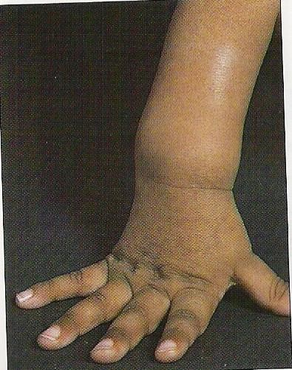

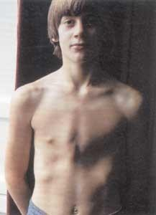

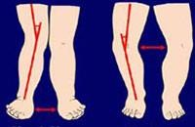
Images of Rickets
Wrist expansion: cupping and
fraying of hypertrophied
metaphyseal
plate
Rachitic Rosary
Bone demineralization and
deformity

Slide 25



























nal R
ste
In Chronic Renal Failure
Low activity of Renal 1α-hydroxylase
Decreased ability to form the
active form of vitamin D
(1, 25 DHCC will be low) Treatment: 1,25 DHCC (Calcitriol)

Slide 26




Laboratory Investigations for the Diagnosis of Rickets & Osteomalacia
Investigations to confirm the diagnosis of rickets:
↓ Blood levels of 25-hydroxycholecalciferol (25 HCC)
↓ Blood calcium, (hypocalcemia )
↑ Blood Alkaline phosphatase (ALP )

Slide 27










Osteoporosis
Most prevalent metabolic bone disease in adults
•
•
It means reduction in bone mass.
i.e. bone matrix composition is normal, but it is reduced.
•
Typically silent (without symptoms) until it leads to fracture
at a minimal trauma.
Most affected: vertebral compression (may be
asymptomatic) & hip fractures (requires surgery in most cases).
•
Post-menopausal women lose more bone mass than men
(primary osteoporosis)

Slide 28
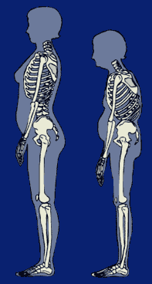
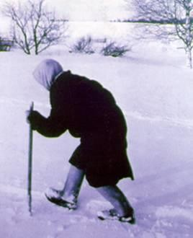
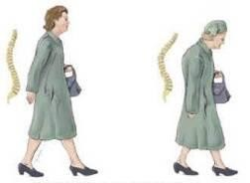
How
does look osteoporotic patient

Slide 29


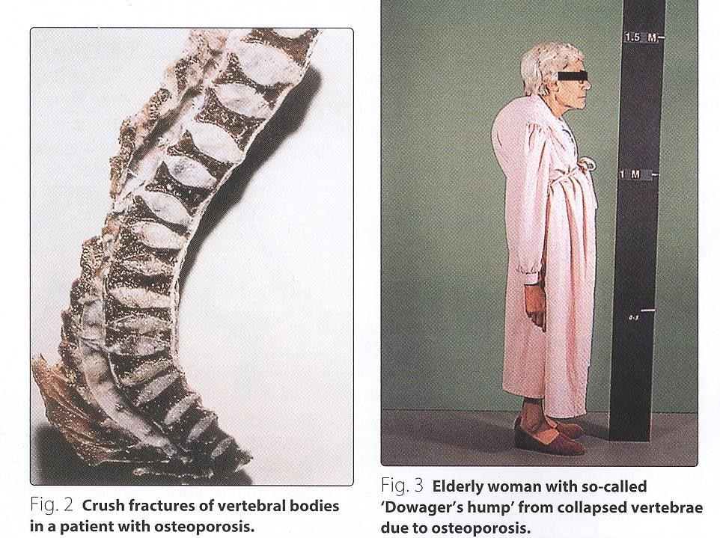
Osteoporosis

Slide 30
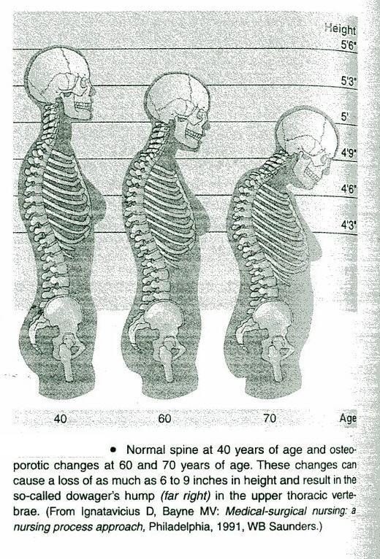
Sequelae of
Osteoporosis

Slide 31




Secondary Osteoporosis
Risk Factors
Risk Factors for osteoporosis:
▪
▪
▪
▪
▪
▪
▪
▪
▪
▪
▪
▪
Advanced age (esp. in females)
Certain Drugs
Family history of osteoporosis or
Immobilization
Smoking
Excess alcohol intake
Cushing’s syndrome
fractures
Long term glucocorticoids therapy
Hyperparathyroidism
Hyperthyroidism
Vitamin D disorders
Certain malignancies

