Slide 1
Adrenal (Suprarenal ) لب الغدة الكظرية Medulla
Dr Taha Sadig Ahmed
Medicine Bachelor and Bachelor
of Surgery

Slide 2
الغدة فوق الكلوية

Slide 3
The adrenal medulla constitutes the inner part of the suprarenal gland , and comprises 20% of the gland..
The adrenal medulla is actually a modified sympathetic ganglion , since its origin is the embryonic neural crest ( i.e. its cells are actually neurons )
It is made of Chromaffin cells that secrete s catecholamines →
(1) epinephrine (adrenaline) ( around 80% of its secretion ) ,
(2) norepinephrine (noradrenaline) ( around 20% of its secretion ), and
(3) a small amount of dopamine in response to stimulation by preganglionic sympathetic nerves .

Slide 5
It is made of Chromaffin cells that secrete s catecholamines →
(1) epinephrine (adrenaline) ( around 80% of its secretion ) ,
(2) norepinephrine (noradrenaline) ( around 20% of its secretion ), and
(3) a small amount of dopamine
in response to stimulation by preganglionic sympathetic nerves

Slide 6
secretions are derived from tyrosine :
Tyrosine Dopamine Norepinephrine Epinephrine
Phenylethanolamine N-methyltransferase (PNMT) is an enzyme that converts norepinephrine (noradrenaline) to epinephrine (adrenaline ).
It is present in the adrenal medulla, but NOT present in postganglionic sympathetic nerves ,
Therefore , ALL blood adrenaline comes ONLY from adrenal medaulla ,
BUT blood noradreanaline comes from both adrenal medulla AND postganglionic sympathetic fibers .

Slide 7
Epinephrine is the more potent stimulator of the heart and metabolic activities
Norepinephrine is more influential on peripheral vasoconstriction and blood pressure
Norepinephrine ( Noradrenaline) is metabolised into normetanephrine and Vanillyl mandelic acid (VMA ) .
High urine VMA is one of the diagnostic tests for Pheochromocytoma .

Slide 8
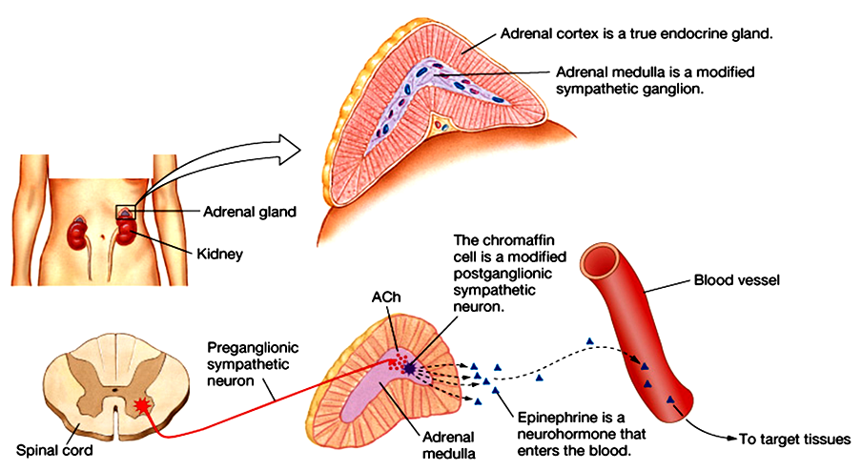
Its secretions are derived from tyrosine :
Tyrosine Dopamine Norepinephrine Epinephrine
Phenylethanolamine N-methyltransferase (PNMT) is an enzyme found in the adrenal medulla that converts norepinephrine (noradrenaline) to epinephrine (adrenaline).

Slide 9
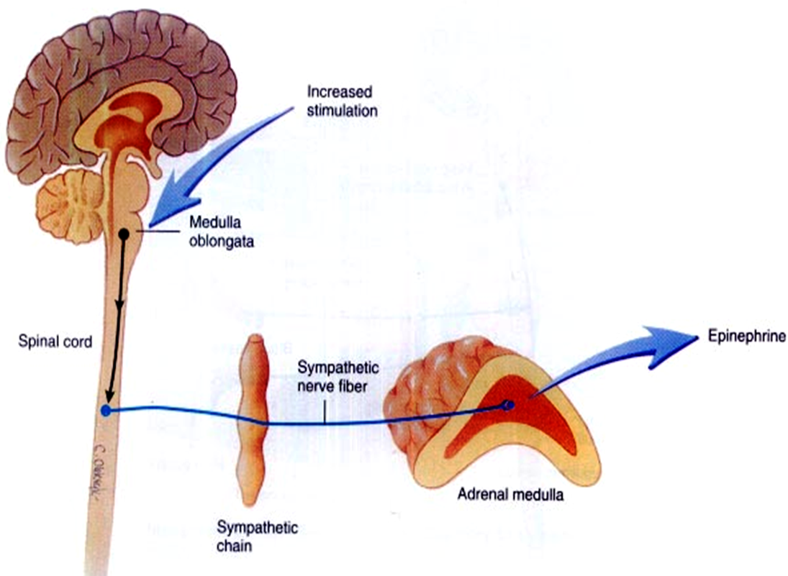
The adrenal medulla is, functionally , integral part تعتبر جزء لا يتجزof the sympathetic system .
80% of its secretion is Epinephrine ( EP) and
20% of its secretion is Norepinephrine (NE ).
EP in the bloodstream , on the other hand , comes solely from the adrenal medulla .
BUT → NE in blood comes from BOTH adrenal medulla and postganglionic sympathetic nerves
This is because postganglionic sympathetic nerves can not synthesize EP from its precursor NE , because they lack the enzyme ( PNMT) needed for conversion of NE into EP .

Slide 10
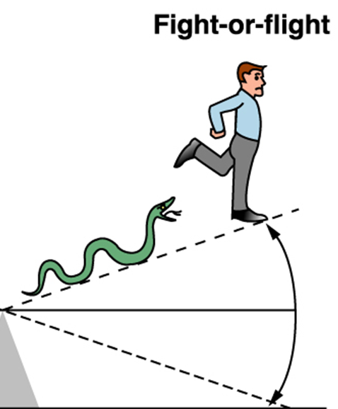
NE & Epinephrine Effects
Stimulates the “fight or fight” reaction
Eye : pupil dilation
Heart : increased heart rate & force of contraction → increased cardiac
output & BP (blood pressure)
TPR ( Total Peripheral Resistance )
Arteriolar constriction (→ raised BP.
norepinephrene is causing more effect )
Bronchioles → Bronchiolar dilation
Liver : glycogenolysis, gluconeogenesis ;
Skeletal muscle → glycogenolysis
Increased blood glucose
Metabolic Rate →Increased ,
epinephrene is causing more effect than NE (5-10 times)

Slide 11
NE & Epinephrine Effects (Contd)
skin: Increase sweating
GIT and Bladder:
Sphincter contraction
Wall relaxation
GIT :Decreased gastrointestinal secretion and motility
Kidney : Renin secretion

Slide 12
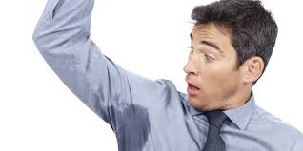
Pheochromocytoma
Pheochromocytoma is a tumor of adrenal medulla .
It can be life threatening if not recognized & not treated.
Most often occurs in middle age.
Symptoms & signs →
Sudden bouts of headache ( most common symptom ) نوبات مفاجئة من الصداع,
Pallor و الشحوب ,
Excessive sweating عرق كثير
Palpitations خفقان ( the patient is conscious of his heart beats, and feeling that his heart is beating more strongly & rapidly than used to be )
Sense of extreme fear and anxiety شعور بالقلق الشديد كأنما هناك خطر محدق
Tachycardia and high blood pressure تزايد معدل ضربات القلب
Episodic hypertensionارتفاعات عابرة في ضغط الدم تأتي و تختفي

Slide 13
Abdominal pains مغص في البطن
Weight loss نقص في الوزن
Orthostatic hypotension (a fall in systolic BP greater than 20 mmHg or a fall in diastolic BP greater than 10 mmHg upon standing)
Elevated blood glucose level ارتفاع السكر في الدم(due primarily to catecholamine stimulation of lipolysis (breakdown of stored fat) leading to high levels of free fatty acids and the subsequent inhibition of glucose uptake by muscle cells.
Further more , stimulation of beta-adrenergic receptors leads to glycogenolysis and gluconeogenesis and thus elevation of blood glucose levels).

Slide 14
Thanks

