Slide 1
OSPE Revision

Slide 2
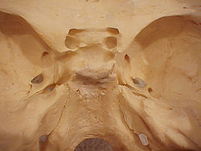
*Anatomy Of Pituitary Gland *
2
*Identify the Pointed area ;.
1- hypophyseal fossa.
2- Sella turcica
1

Slide 3
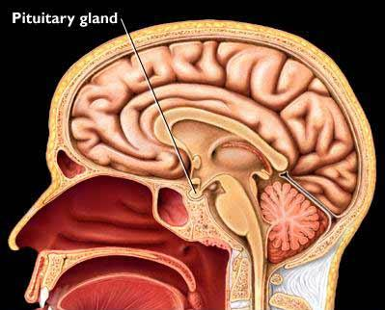
*Relations Of Pituitary Gland *
*Identify the Pointed area ;.
1- optic chiasma (anteriorly).
.2- mamillary bodies
(posteriorly).
3-Sphenoidal air sinuses (inferior) .
2
1
3

Slide 4
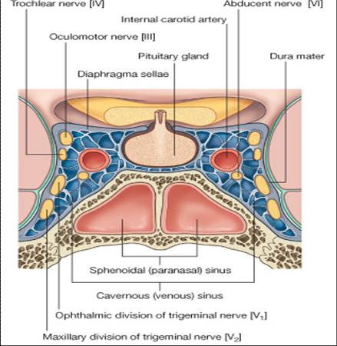
*Relations Of Pituitary Gland *
1
2
*Identify the Pointed area ;.
1- Pituitary gland.
.2- Diaphragma sellae (superior)
3-Sphenoidal air sinuses
(inferior) .
4-Cavernous sinuses (lateral) .
3
4

Slide 5
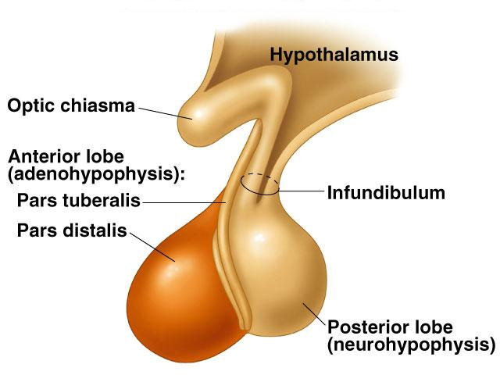
2
*Identify the Pointed area ;.
1- Anterior lobe (Adenohypophysis)
.2- optic chiasma
3- infundibulum .
4- Posterior lobe (Neurohypophysis)
3
1
4

Slide 6
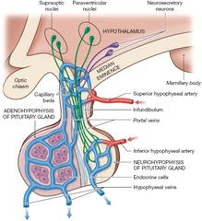
*blood supply of pituitary gland*
*Identify the Pointed area ;.
1- Superior hypophyseal artery.
2-inferior hypophyseal artery.
branches of internal carotid artery
3- Hypophyseal veins drain into Cavernous Sinuses
1
2
3

Slide 7
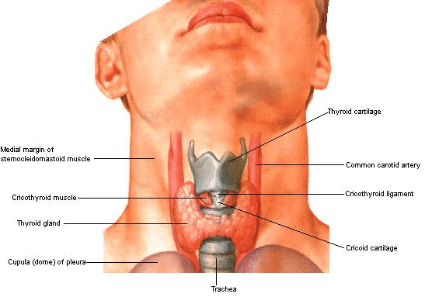
Thyroid gland
-Consists of right & left lobes.
Extend from oblique line to 4th or 5th tracheal rings
-The 2 lobes are connected to each other by a narrow isthmus, which overlies the 2nd 3rd & 4th tracheal rings.
-It is surrounded by a sheath derived from the pretracheal layer of cervical fascia.

Slide 8
*Each lobe is pear shaped, with its apex reaches up to the oblique line of the thyroid cartilage (2) .
*Its base lies at the level of 4th or 5th tracheal rings.
-Identify the pointed
areas :-
1-sternohyoid muscle
2-thyroid cartilage
3-sternothyroid muscle
4-cricoid cartilage
5- thyroid gland
6-isthmus
7-trachea
8-esophagus
1
2
3
4
5
6
7
8

Slide 9
A small pyramidal lobe is often present which projects from the upper border of the isthmus usually to left of middle line.
Pyramidal lobe is connected to hyoid bone by a fibrous or muscular band called levator glandulae thyroideae.
This represents the fibrosed & obliterated thyroglossal duct.
Levator glandulae thyroideae

Slide 10
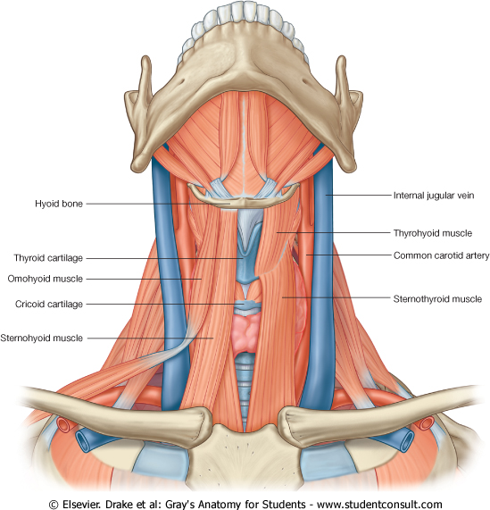
RELATION
OF
THE THYROID
Anterolaterally: (4 S).
1. Sternothyroid.
2. Sternohyoid.
3. Superior belly of omohyoid
4. Sternomastoid.
Posteriorly:
Carotid sheath & its contents.
Medially:
Above:
Larynx & pharynx .
Below:
Trachea & esophagus.
(Recurrent laryngeal nerve in between).
-Cricothyroid muscle & external laryngeal nerve

Slide 11
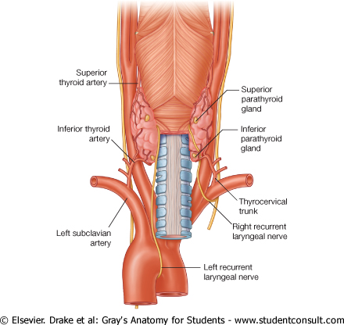
The rounded posterior border is related to the superior & inferior Parathyroid glands.

Slide 12
ARTERIAL SUPPLY
1-Superior thyroid artery:
From the external carotid artery
-It descends to the upper pole of the lobe, with the external laryngeal nerve.
2- Thyroidea ima artery:
If present, it arises from aortic arch or from brachiocephalic artery.
-It ascends in front of the trachea to reach the isthmus.

Slide 13
3-Inferior thyroid :artery
From the thyrocervical trunk of 1st part of subclavian artery.
-The recurrent laryngeal nerve crosses either in front or behind it.

Slide 14
Veins of Thyroid Gland
1-Superior thyroid vein & Middle thyroid vein :-
internal jugular vein
3- Inferior thyroid vein :-
left brachiocephalic vein .

Slide 15
PARATHYROID GLAND
-They are supplied by superior & inferior thyroid arteries.
-Their veins are drained to superior, middle and inferior thyroid veins.

Slide 16
Clinical points :-
*Superior thyroid artery on each side is related to the external laryngeal nerve, which supplies the cricothyroid muscle. Damage to external laryngeal nerve results in an inability to tense the vocal folds and hoarseness.
*Inferior thyroid artery is closely associated with the recurrent laryngeal nerve . Damage to recurrent laryngeal nerve results in impaired breathing & speech.

Slide 17
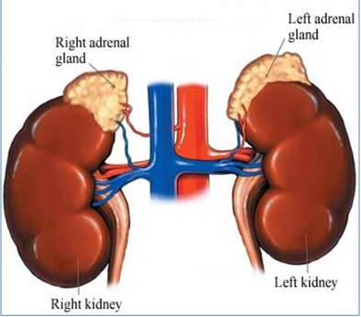
*Anatomy Of Adrenal Gland *
*The two suprarenal glands are yellowish retroperitoneal organs that lie on the upper poles of the kidneys , just above the level of T12.
*They are surrounded by renal fascia (but are separated from the kidneys by the perirenal fat).
*Each gland has an outer cortex and an inner medulla.

Slide 18
*Relation Of Adrenal Gland *
The right gland is pyramid shaped and caps the upper pole of the right kidney.
Relations:
Anterior:
1.right lobe of the liver.
2.inferior vena cava.
Posterior: diaphragm.
Medial :
Celiac plexus and ganglia
The left gland is crescentic in shape and extends along the medial border of the left kidney from the upper pole to the hilus.
Relations:
Anterior:
1.pancreas
2.lesser sac
3.stomach
Posterior: diaphragm.
Medial :
Celiac plexus and ganglia

Slide 19
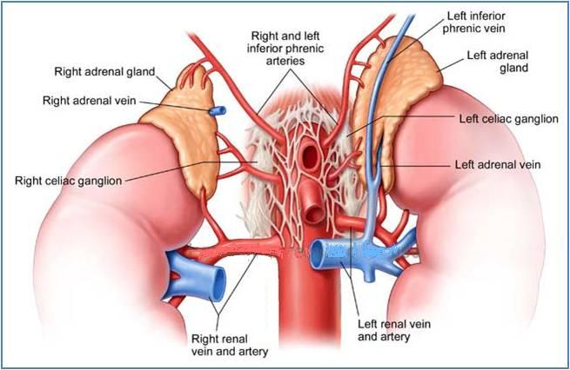
Adrenal gland
Each gland receives branches from three main arteries: Inferior phrenic Aorta Renal artery. | Arteries
A single vein emerges from the hilum of each gland and drains into the Inferior vena cava on the right & Renal vein on the left. | Veins
Preganglionic sympathetic fibers derived from the splanchnic nerves. Most of the nerves end in the medulla of the gland. | Nerve Supply
The lymph drains into the lateral aortic nodes. | Lymph Drainage

